Slide 1
VMCS
SG5208:
Object Oriented Design Patterns – Team PT01

Slide 2
Team PT01
METRANI NIKHIL DILIP – A0135935
BARLA MARUTHI DATTATREYA – A0120530
JING DONG – A0135901
SITHIVINAYAGAM KOKULAKUMARAN – A0120490
SIVANANTHAMOORTHY JANAHAN – A0120591

Slide 3
Implemented Patterns
Simplification of complex user interface update mechanisms (by Metrani Nikhil Dilip – A0135935)
Multiple Store controller instance causes inconsistent of store data (by BARLA MARUTHI DATTATREYA – A0120530)
Unexpected error causes inconsistency of data (by BARLA MARUTHI DATTATREYA – A0120530)
Create a general purpose GUI component (by JING DONG – A0135901)
Enabling multiple persistence mechanisms (by SITHIVINAYAGAM KOKULAKUMARAN - A0120490U)
Decoupling UI subsystem and controller (by SIVANANTHAMOORTHY JANAHAN – A0120591)

Slide 4
Design Problem
Simplification of complex user interface update mechanisms

Slide 5
Design Problem
Multiple UI elements showing the same content (quantity)
Change of quantity done in one screen must reflect in all other screens
Explicit methods implemented to refresh UI elements

Slide 6
Design Pattern Selection

Slide 7
Candidate Design Patterns
Command Pattern
Encapsulate a request as an object.
Parameterize clients with different requests, queue or log requests.
Support undoable operations.

Slide 8
Candidate Design Patterns
Mediator Pattern
Define an object that encapsulates how a set of objects interact.
Promote loose coupling by keeping objects from referring to each other explicitly.
Vary the interaction independently.

Slide 9
Candidate Design Patterns
Observer Pattern
Define one-to-many dependency between objects.
Notify all dependents when object state changes.

Slide 10
Observer
Motivation
Change in store item quantity needs to be reflected on multiple screens
The tight coupling of UI elements

Slide 11
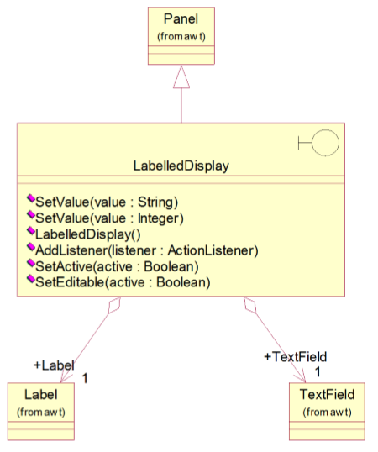
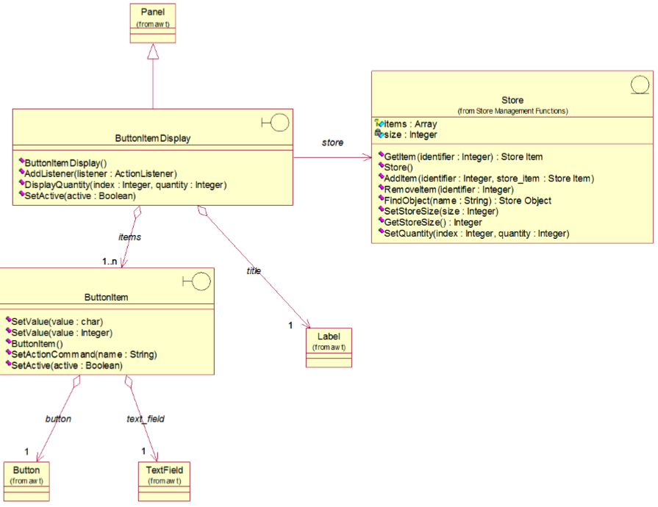
Initial Design

Slide 12
Modified Design

Slide 13
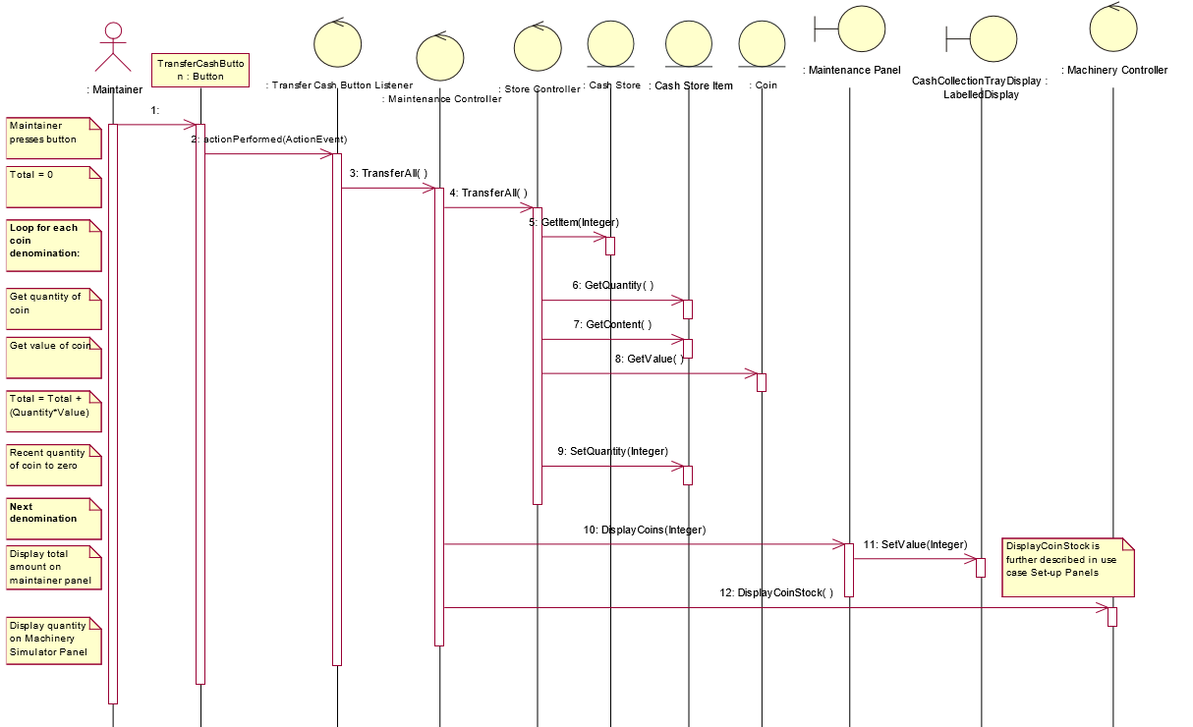
Initial Sequence Diagram

Slide 14
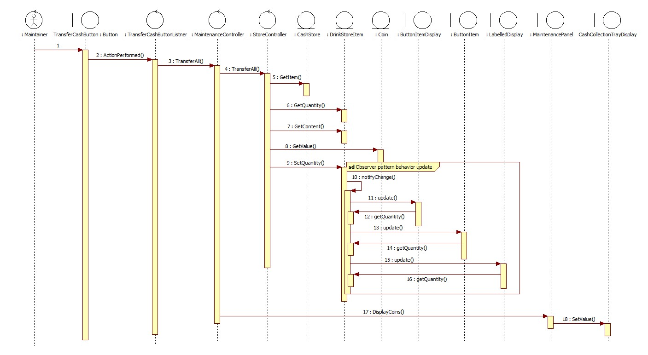
Modified sequence diagram

Slide 15
Implementation
Mapping of Subjects to their Observers
Who triggers the update?
Avoid Observer specific update protocol using pull model
Ensure subject state is changed before sending notification
Notes:
Mapping of Subjects to their Observers: By making LabelledDisplay, ButtonItem, and ButtonItemDisplay the concrete observer, VMCS can be freed of the complex methods required to refresh the display. Example – DisplayDrinkStock, and DisplayCoinStock. The StoreViewer attached appropriate LabelledDisplay to necessary StoreItem, thus handing over the responsibility of update.
Who triggers the update: The StoreItem, who is the concrete subject, triggers the notifyChange() method whenever there is a change in quantity. This can be seen in property accessor – setQuantity(in quantity) and methods increment(), decrement(), and store().

Slide 16
Participants
Subject
- Subject - abstract class
Concrete Subject
- StoreItem (CashStoreItem, and DrinkStoreItem inherit this role)
Observer
- Observer - interface
Concrete Observer
- LabelledDisplay, ButtonItem, and ButtonItemDisplay
Notes:
Subject
- Subject - abstract class
- Knows its Observers. Any number of observers can observe the subject.
- Provides a mechanism to attach and detach observers and to notify changes.
Concrete Subject
- StoreItem (CashStoreItem, and DrinkStoreItem inherit this role)
- Stores state of interest to ConcreteObserver objects.
- Notifies observers when state changes.
Observer
- Observer - interface
- Defines an updating interface for objects that should be notified of changes in a subject.
Concrete Observer
- LabelledDisplay, ButtonItem, and ButtonItemDisplay
- Maintains a consistent reference to a ConcreteSubjects state.
- Implements the Observer updating interface to keep its state consistent with the Subject’s.

Slide 17
Q&A

Slide 18
Thank you!

