Slide 1
IBM University Engagement Project Submission
“Exploring the Power of Agentic AI with IBM Granite and LangFlow”

Slide 2

Project Tile – AI-Powered DBMS Teaching Assistant using IBM Granite and LangFlow
Domain of Project – Education
Faculty Name | Recent Passport Photo | Email ID | Mobile number [WhatsApp]
Dr. Nikhil Mhala |  | ncmhala@prpotepatilengg.ac.in | 7588751166

Slide 3
Problem Statement -
Problem Statement : AI-Powered DBMS Teaching Assistant using IBM watsonx, LangFlow and Agentic AI
The Challenge
Database Management Systems (DBMS) is one of the most important subjects in Computer Science and Engineering. Students often face difficulties in understanding complex concepts such as normalization, SQL queries, transaction management, indexing, concurrency control, database design, and query optimization.
Traditional learning resources are scattered across books, notes, websites, and videos, making it difficult for students to obtain personalized guidance and instant doubt resolution.
Faculty members also spend significant time answering repetitive questions and providing learning support outside classroom hours.
The Objective
Develop an AI-powered DBMS Teaching Assistant that provides:
Instant doubt solving for DBMS concepts
Personalized learning support
Query explanation and SQL assistance
Retrieval of DBMS notes and educational resources
Interactive learning experience using conversational AI
24×7 academic assistance for students

Slide 4
Technology Used
IBM watsonx.ai
IBM Granite-4.0-8B-Instruct Model
LangFlow
IBM BoB VS Code Extension
Retrieval-Augmented Generation (RAG)
Flask
ngrok
Tiiny Host
GitHub
HTML, CSS, JavaScript

Slide 5
Proposed Solution -
Proposed Solution: AI-Powered Nutrition Agent
The proposed solution is a multi-agent AI-powered DBMS Teaching Assistant built using IBM watsonx.ai, IBM Granite Models, and LangFlow.
The system retrieves educational information from DBMS notes and learning resources using RAG and generates context-aware responses using Granite models.
The assistant acts as a virtual tutor that:
Explains DBMS concepts
Solves student doubts
Assists with SQL queries
Provides personalized learning support
Maintains conversational context
The chatbot is deployed through LangFlow workflows, Flask API services, ngrok tunneling, and a Tiiny Host frontend interface.

Slide 6
Langflow component Used -
Chat Input
Accepts student queries and DBMS-related questions.
IBM watsonx AI Agent
Processes educational queries using IBM Granite Models.
Granite-4.0-8B-Instruct
Generates intelligent educational responses.
File Component
Stores and retrieves DBMS notes and learning materials.
Chat Output
Displays responses generated by the AI assistant.
Memory Component
Maintains conversational context.
Agent Component
Coordinates reasoning and response generation.

Slide 7
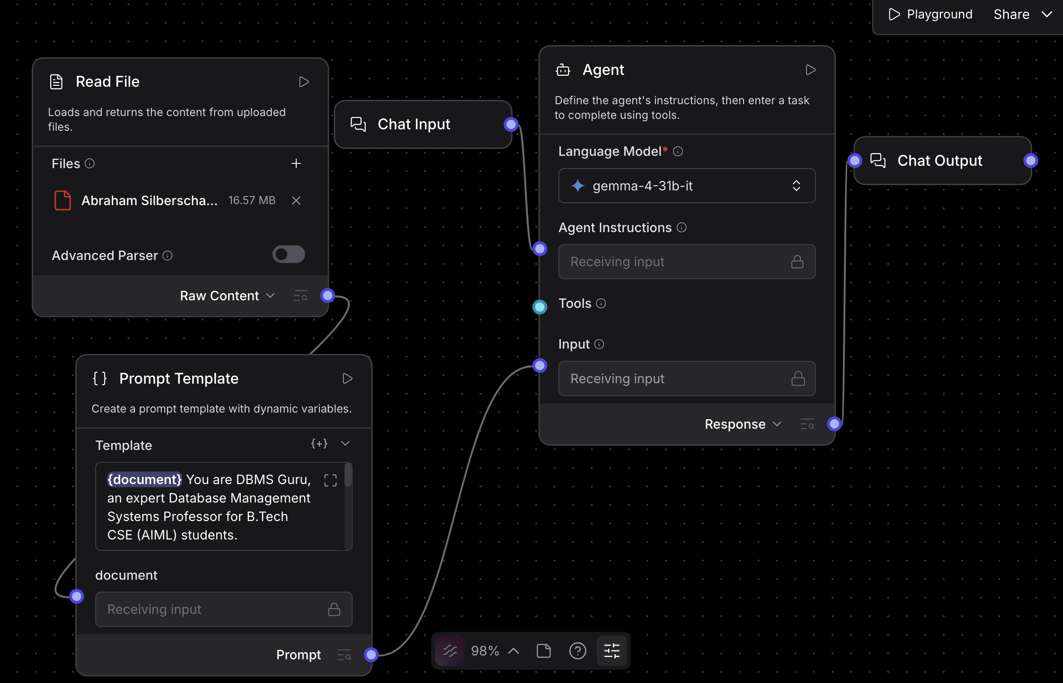
Langflow workflow -

Slide 8
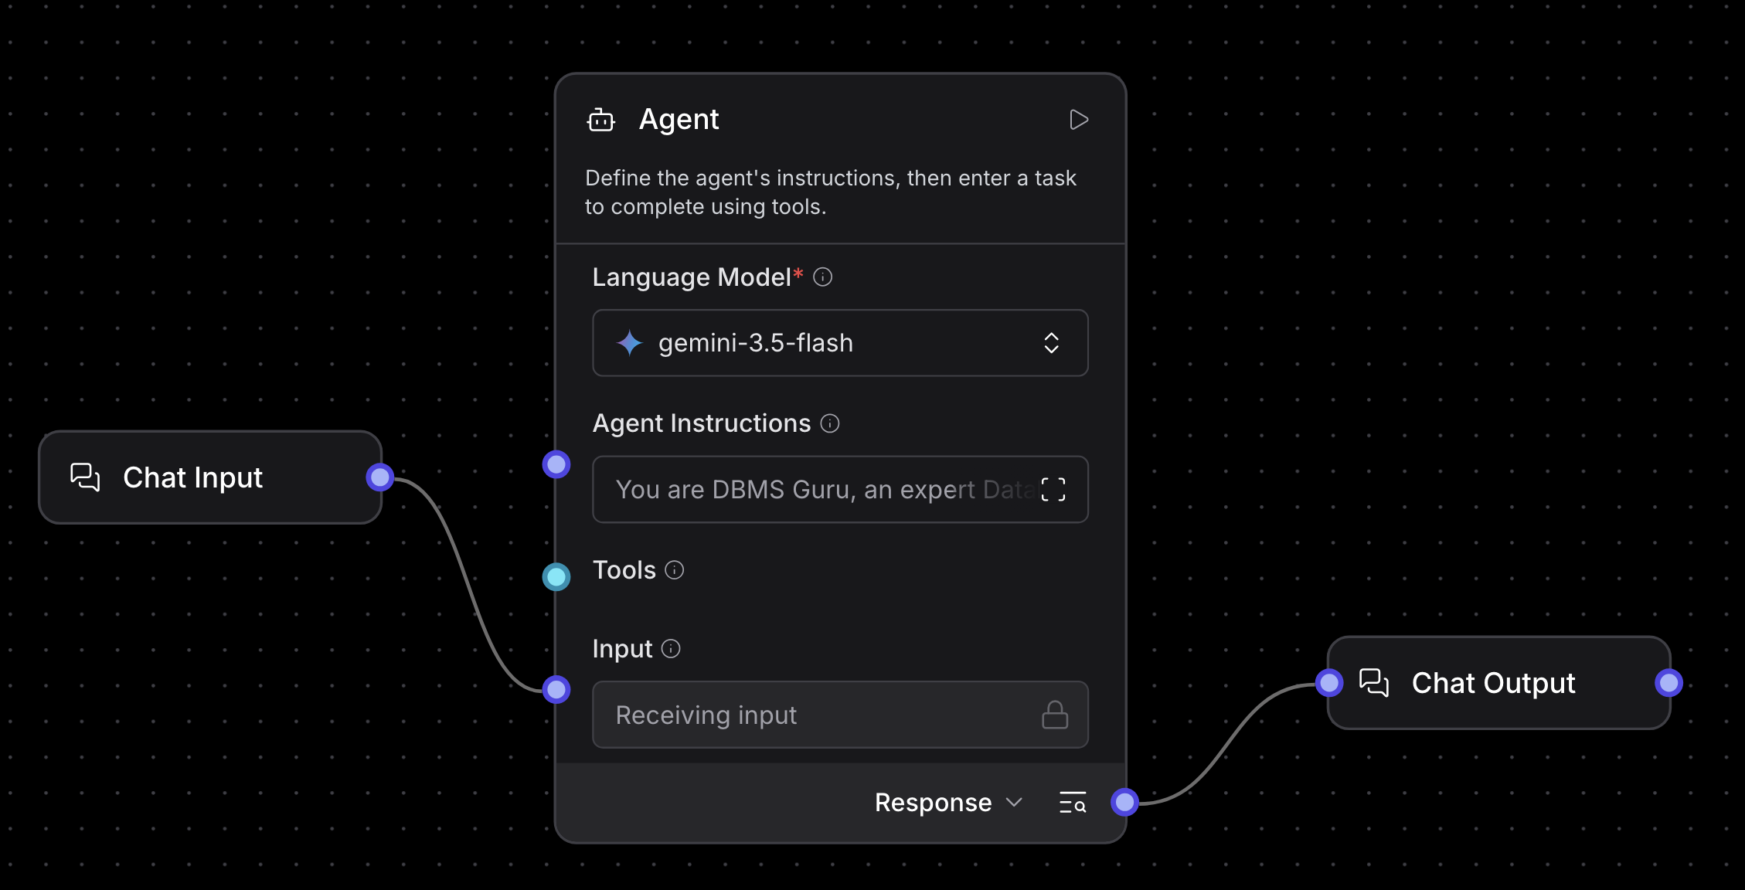
Langflow workflow -

Slide 9
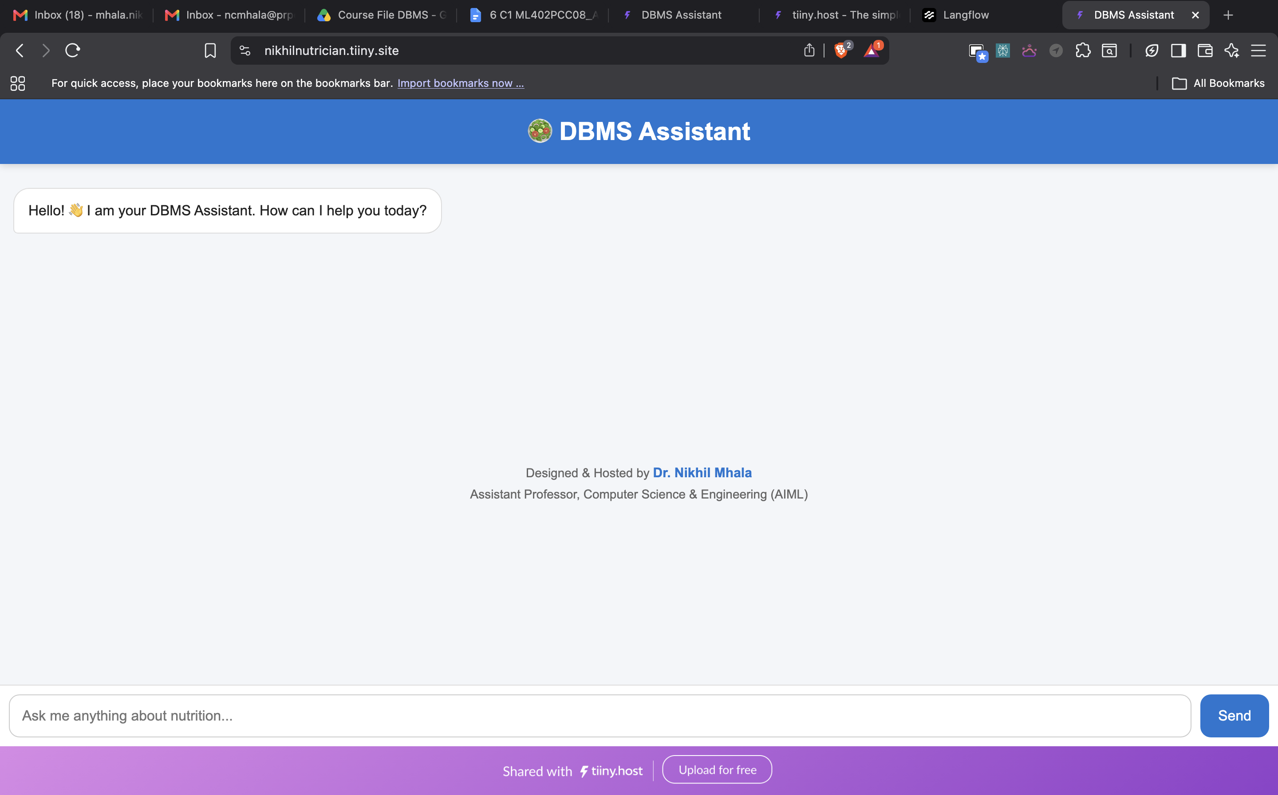
O/p:-

Slide 10
Architecture blueprint
Student
↓
Web Interface
↓
Flask + ngrok
↓
LangFlow
↓
Knowledge Base
↓
IBM watsonx.ai + Granite
↓
AI Response

Slide 11

Role of Agentic AI in the solution
Role of Agentic AI in the Solution:
Understands student intent and DBMS-related queries.
Retrieves relevant educational content using RAG.
Generates personalized explanations using IBM Granite Models.
Maintains conversational context for better interactions.
Assists students with SQL queries and DBMS concepts.
Provides 24×7 academic support.
Improves learning outcomes through personalized guidance.
Acts as an intelligent virtual DBMS tutor rather than a traditional chatbot.

Slide 12
Technology Used
LangFlow
Used for workflow design and orchestration.
IBM Granite Model
Used for reasoning, educational explanations, and response generation.
IBM watsonx.ai
Used for model access and deployment.
IBM BoB VS Code Extension
Used for rapid development, code generation, workflow enhancement, and website improvements.
RAG
Used for accurate retrieval of DBMS educational content.
Flask :Used as middleware API layer.
Ngrok :Used to securely expose local deployment.
Tiiny Host :Used for frontend deployment.

Slide 13
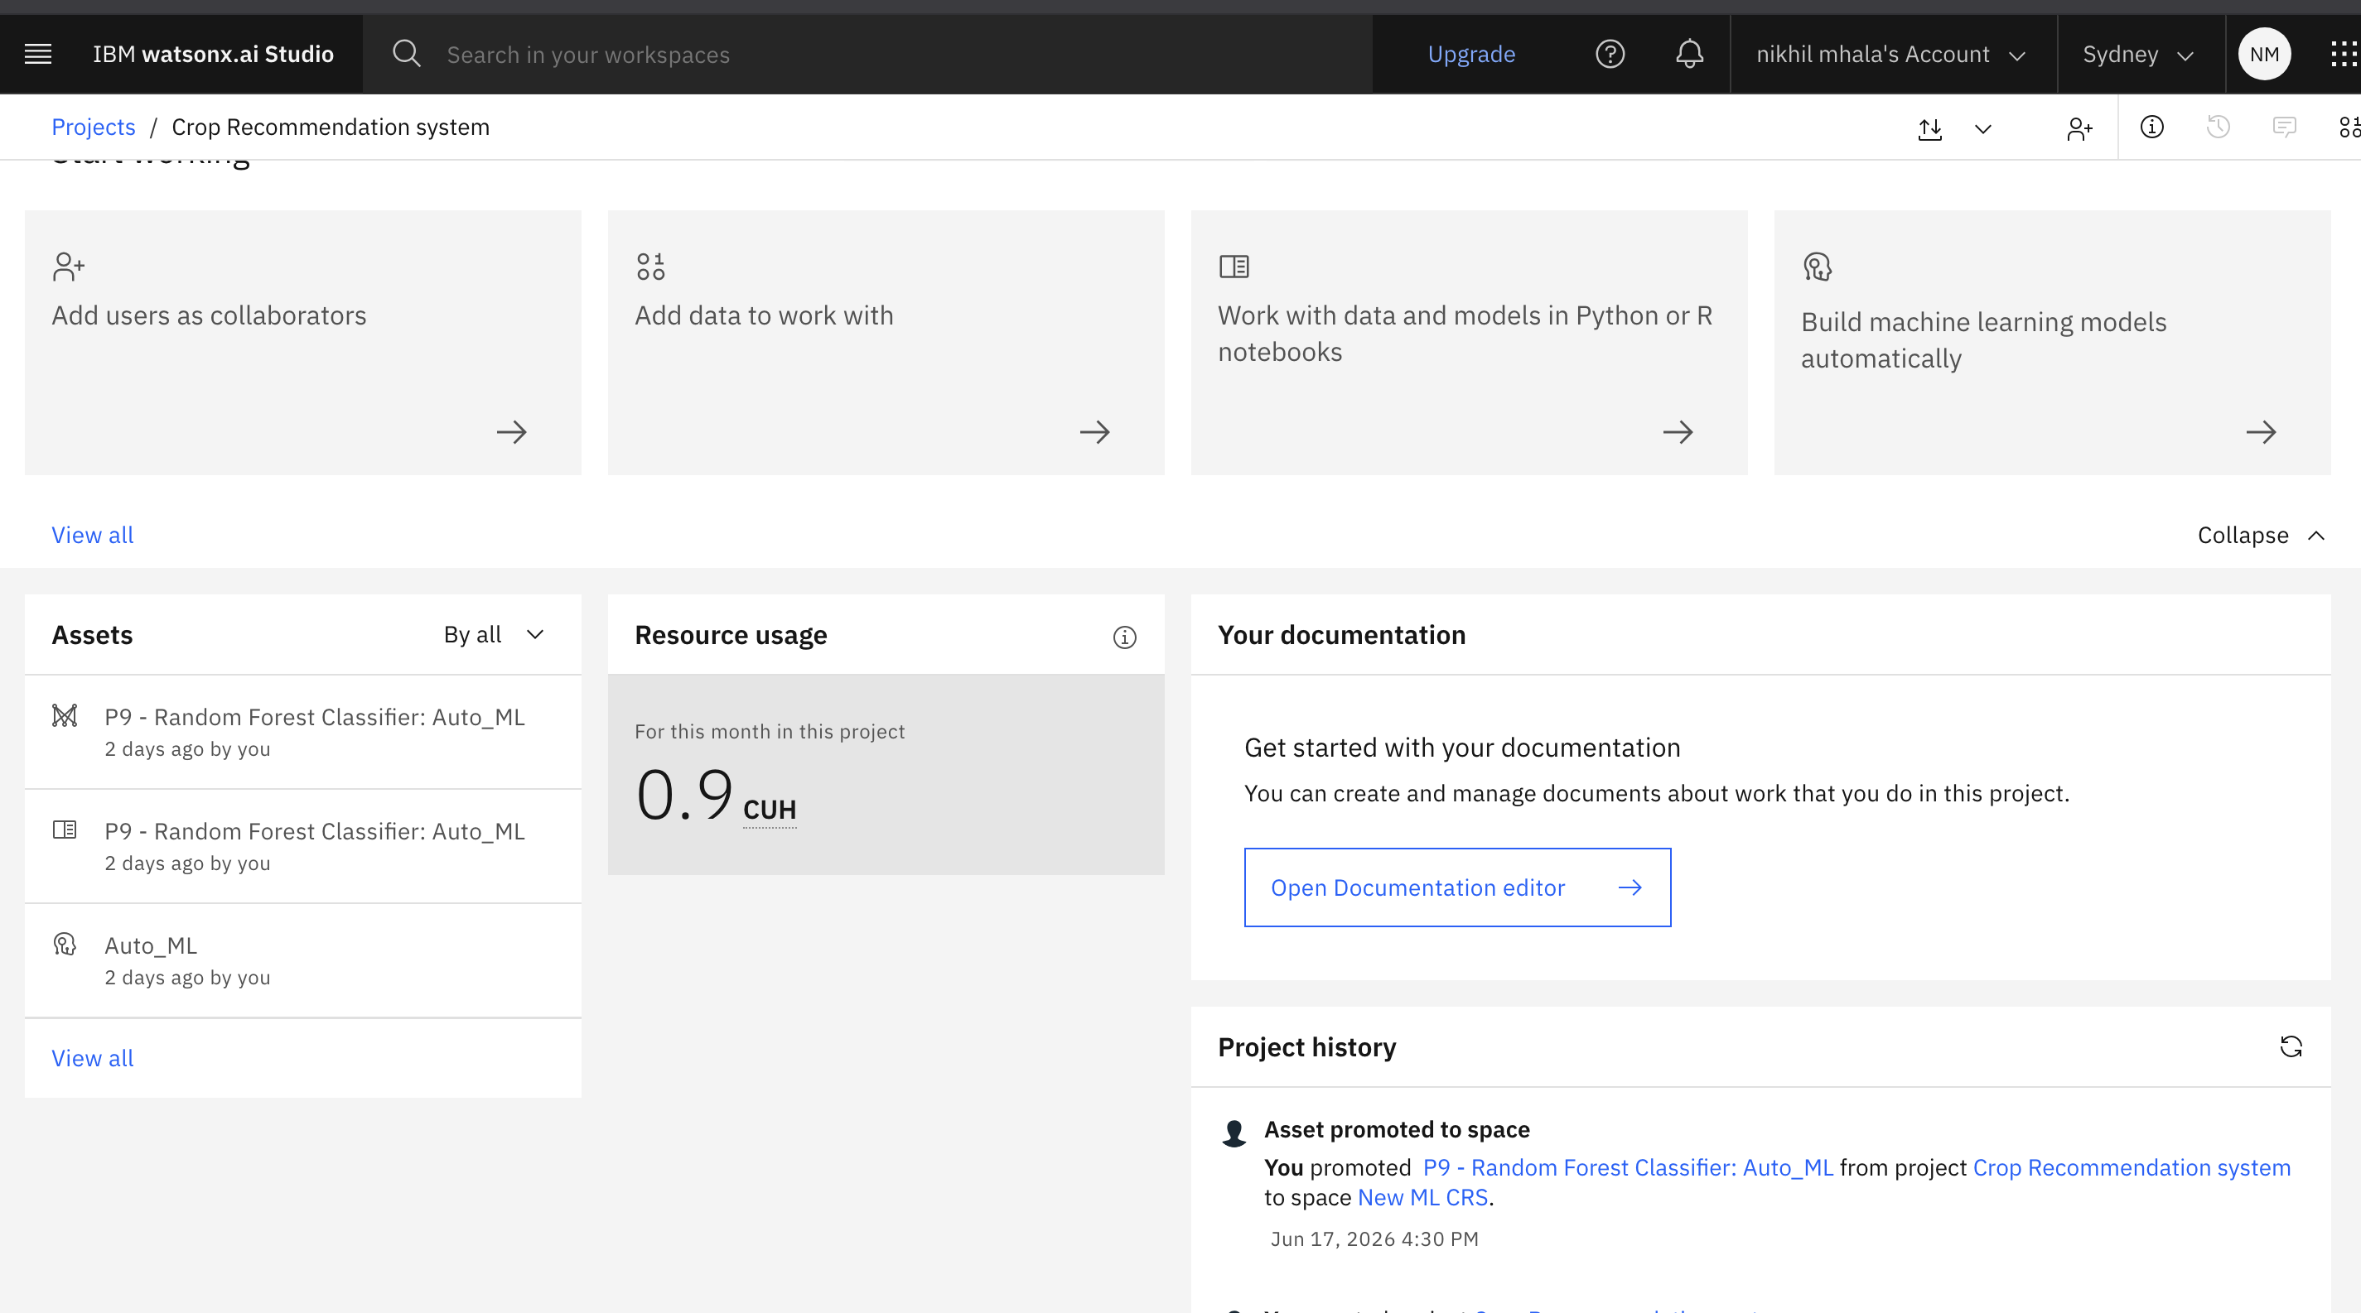
Token Usage
token are used :- 0.9 CUH
·
·
·

Slide 14
Novelty and Uniqueness
The proposed DBMS Agent stands out by combining Agentic AI, RAG, and personalization into a single intelligent system.
Agentic AI based educational assistant
Personalized DBMS learning support
IBM Granite powered responses
Retrieval-Augmented Generation
Website integration with academic portal
24×7 availability
Context-aware learning experience
Fast deployment using LangFlow and IBM technologies

Slide 15
Git Hub Link
Hosted Model URL for testing :- https://nikhilnutrician.tiiny.site/
Github Link:- Click Here
·
·
·

Slide 16
Future Scope
Future Scope
Voice-Based Learning Assistant
Support speech-based DBMS question answering.
Multilingual Learning
Support English, Hindi, Marathi, and other languages.
Student Analytics Dashboard
Track learning progress and identify weak areas.
LMS Integration
Integrate with Moodle and Google Classroom.
Multi-Subject Expansion
Extend to Data Structures, Algorithms, Operating Systems, Machine Learning, and Deep Learning.
·
·
·

Slide 17
BoB Certificate
·
·
·

Slide 18
Credly Certificates: Getting Started with AI
·
·
·

Slide 19
Credly Certificates: Generative AI in Action
·
·
·

Slide 20
Credly Certificates: Exploring Quantum Computing
·
·
·

Slide 21


