Slide 1
Malverde
Nikhil Muneshwar

Slide 2
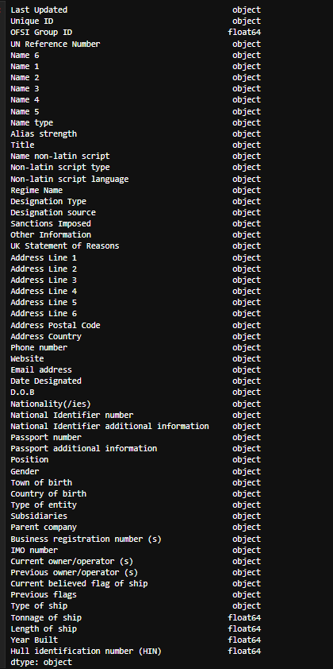
Data Types given
Non-Ideal data types

Slide 3
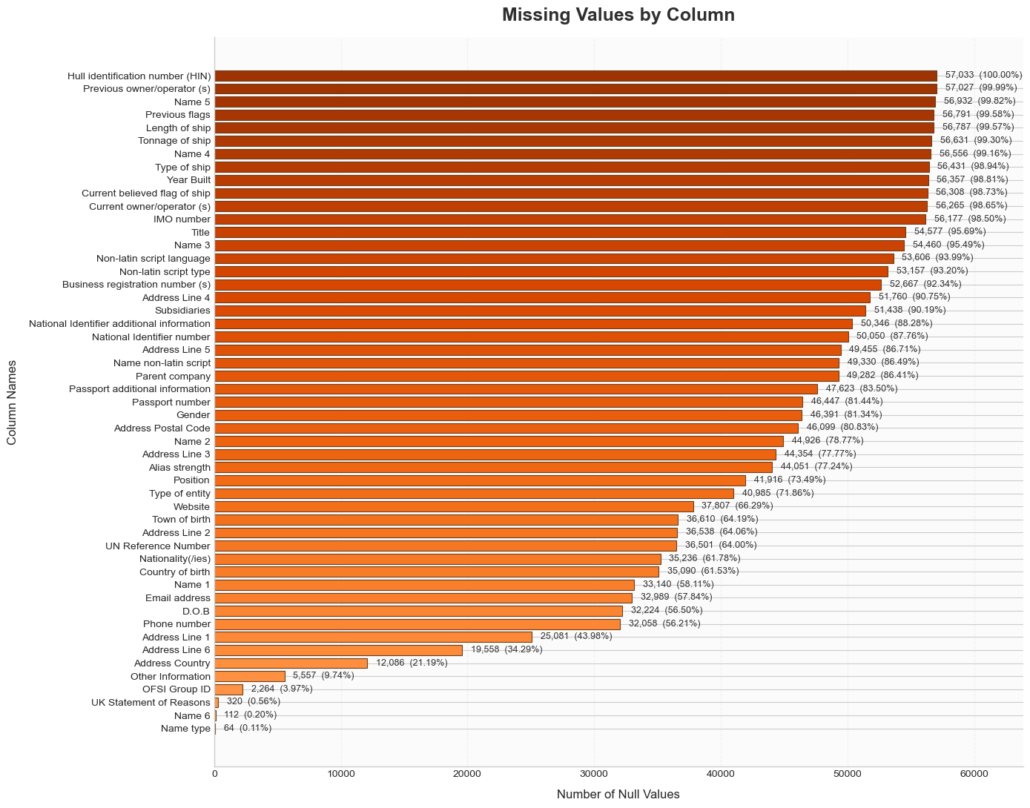
HIN, whole column is empty
Many Missing values

Slide 4
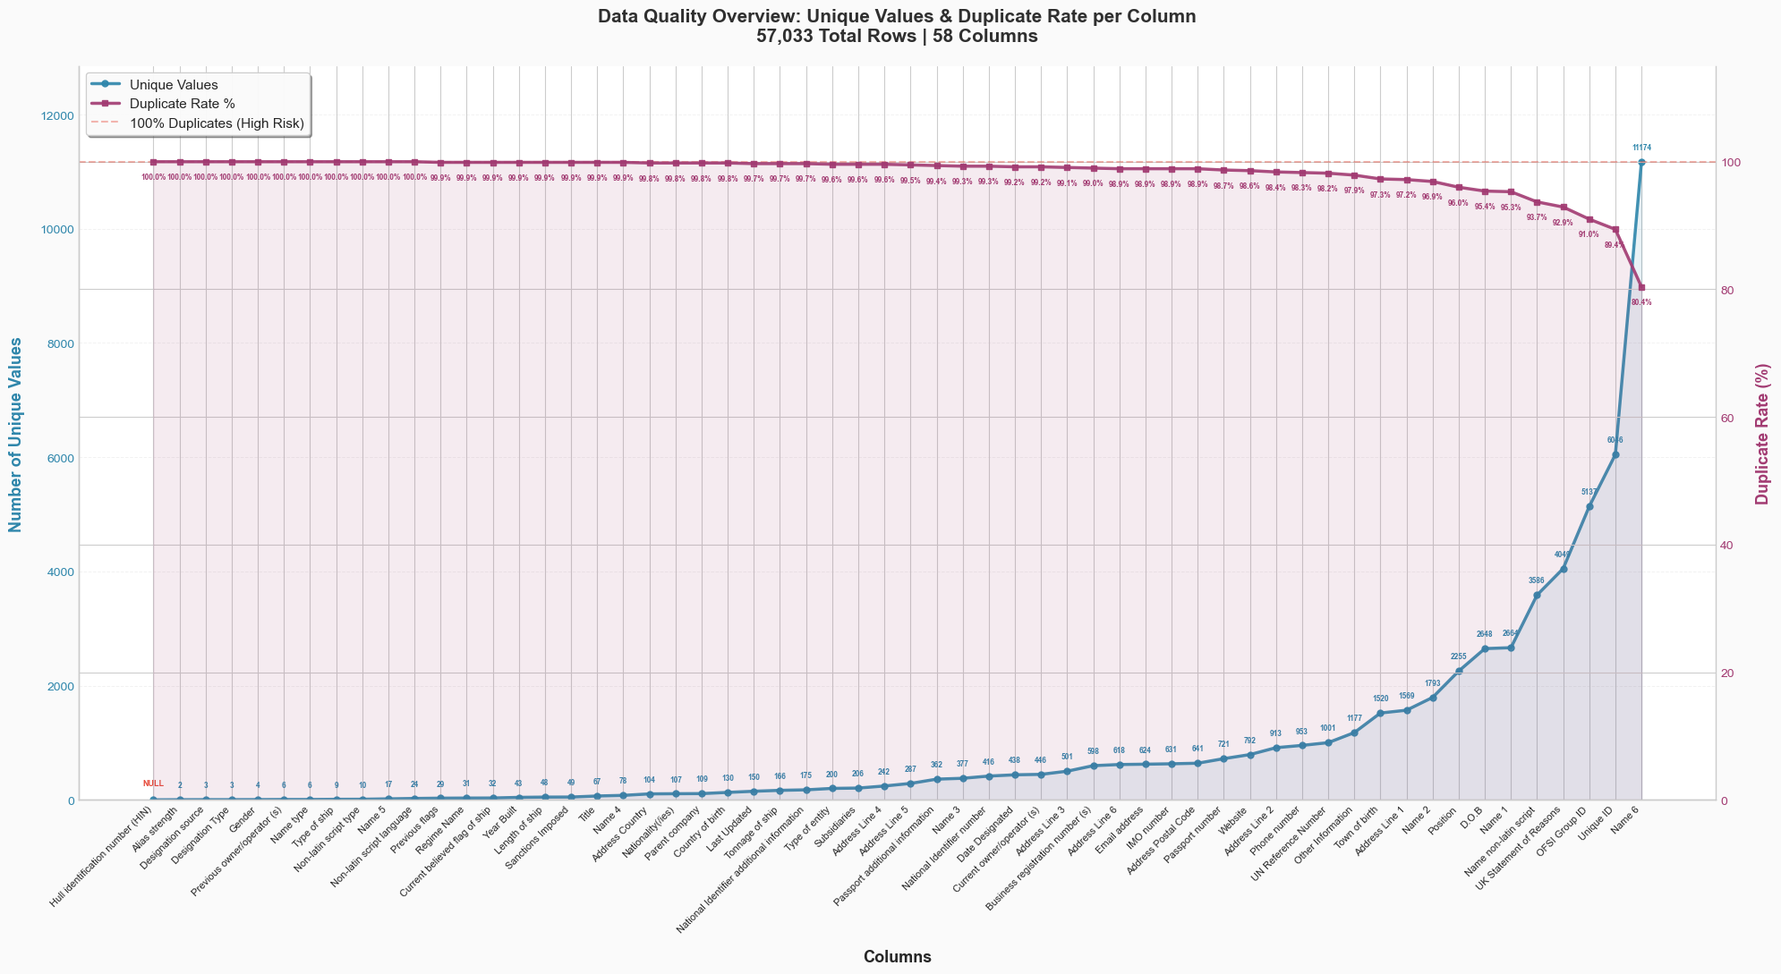
The Duplication rate is high.
Multiple values in cols like Name type, gender, etc. Further Investigation needed.

Slide 5
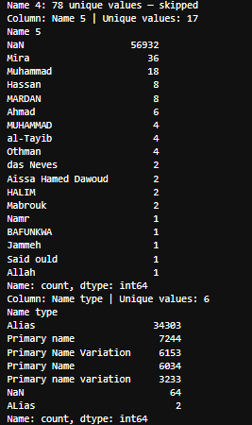
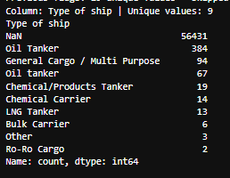
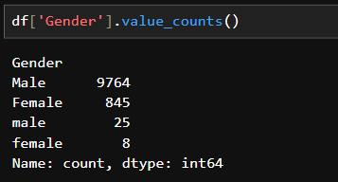
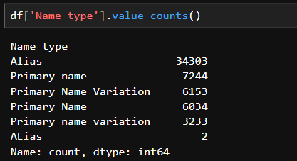
After Investigation.
In names, same names are repeated multiple times.
The same goes for Name type, gender, Type of ship, etc.

Slide 6
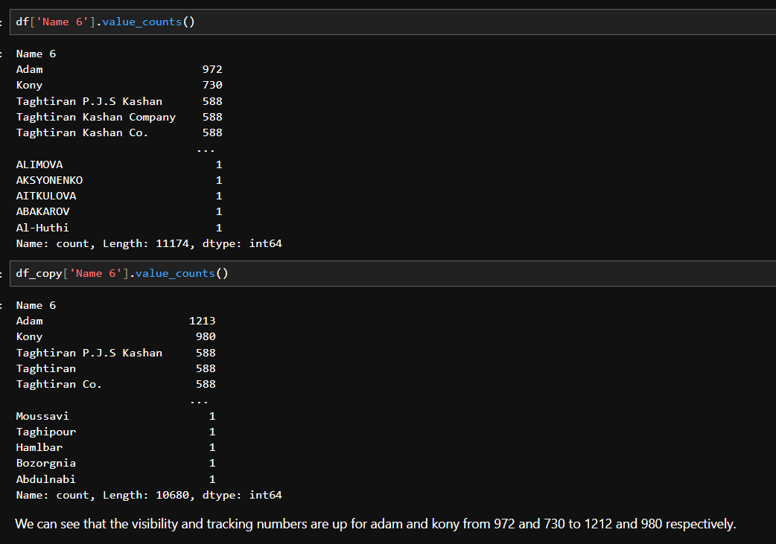
After normalizing and striping names, Gender Etc,
We are able to get Good results for visibility and tracking.

Slide 7
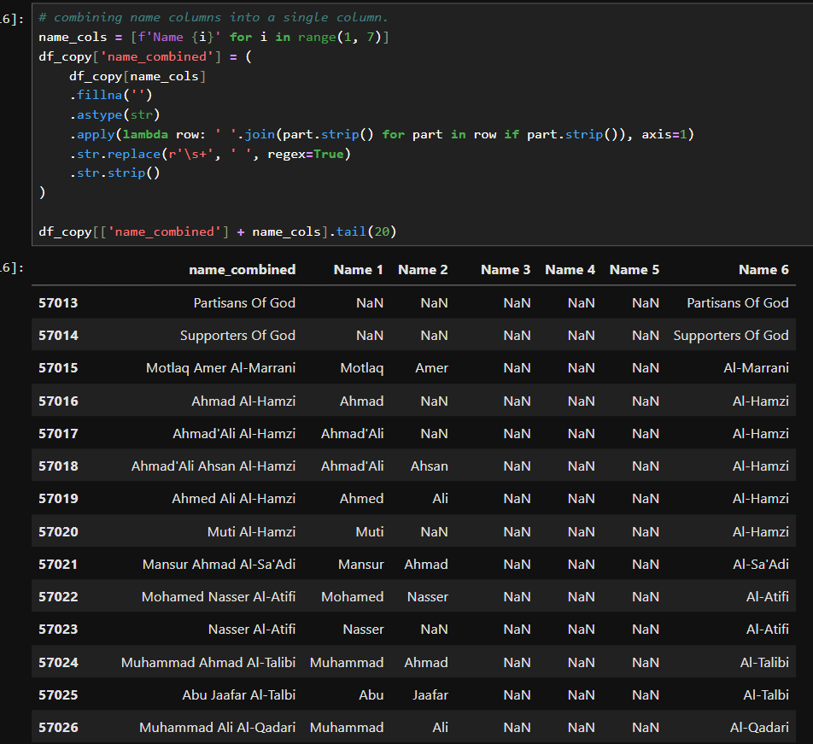
Combined name column as a quality-of-life measure.
Can check the full name in one cell instead of scrolling.

Slide 8
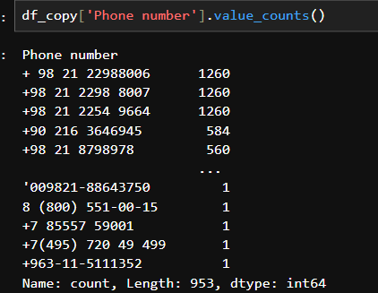
The same problem as other string columns
This also needs the same treatment.

Slide 9
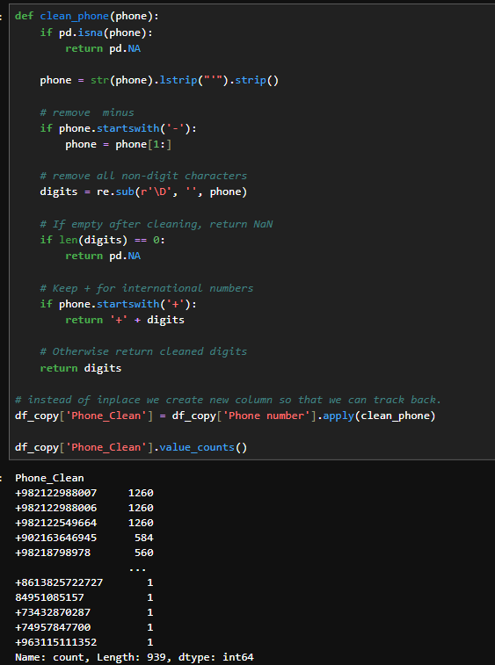
Small function that strips, removes – signs
Removes non digital character
Keeps + sign.

Slide 10
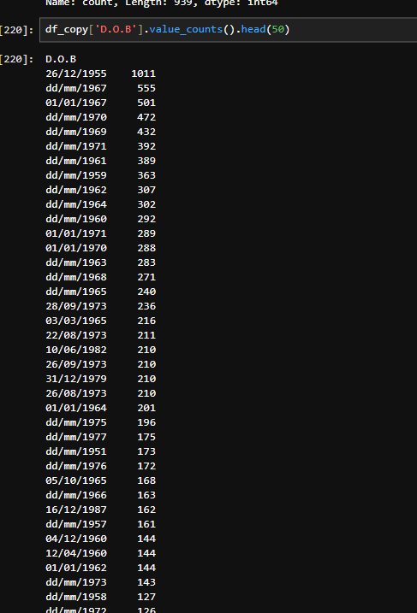
DOB col is saved as object (string) data type.
Problem for downstream pipelines

Slide 11
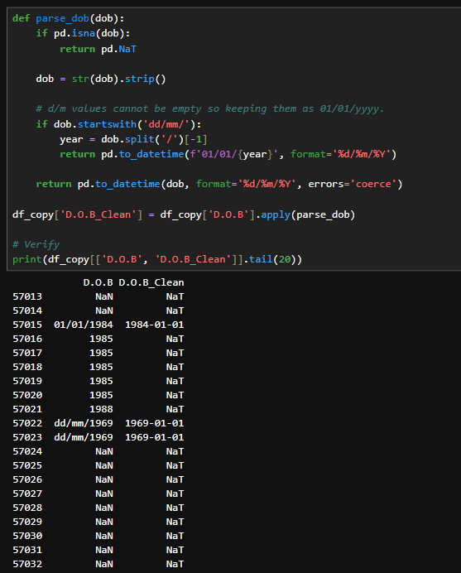
Where dd/mm infor is not available we can keep them as 01/01/yyyy to convert them.

Slide 12
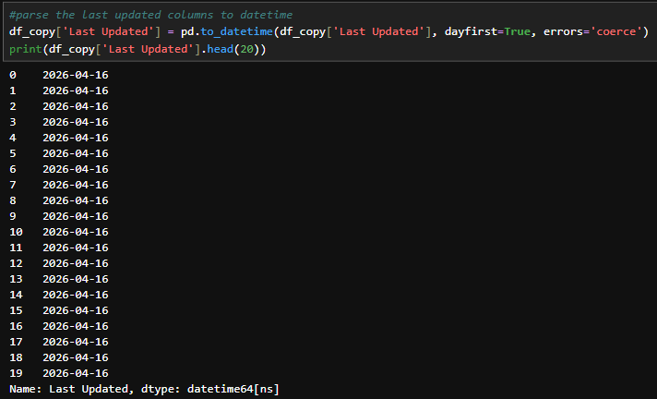
Parsing other date object (string) data types to datetime.

Slide 13
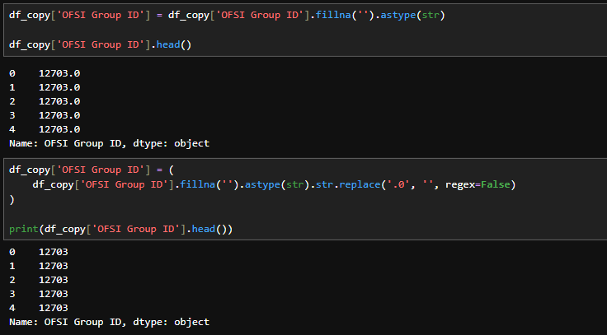
They are saved as floats
Convert them to strings as it is an ID.

Slide 14
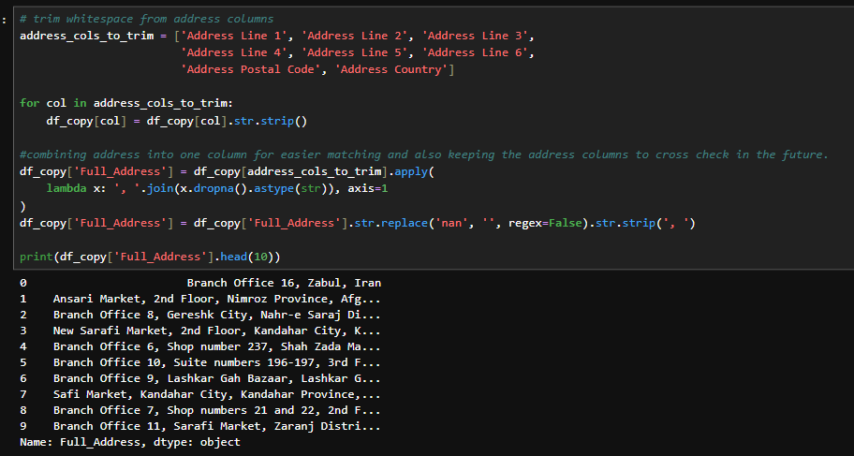
Again, quality of life measure with address columns, we combine them into one column for easier tracking.

Slide 15
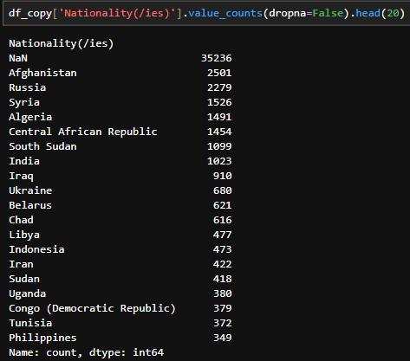
Getting Nationalities for further analysis.

Slide 16
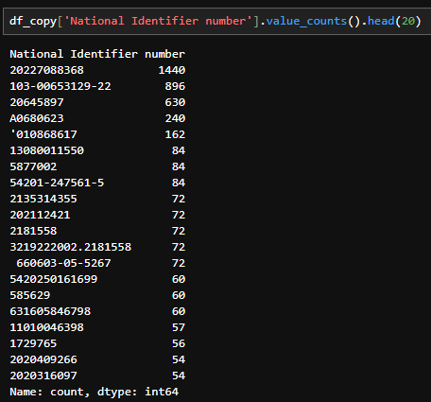
Cleaning the NIN

Slide 17
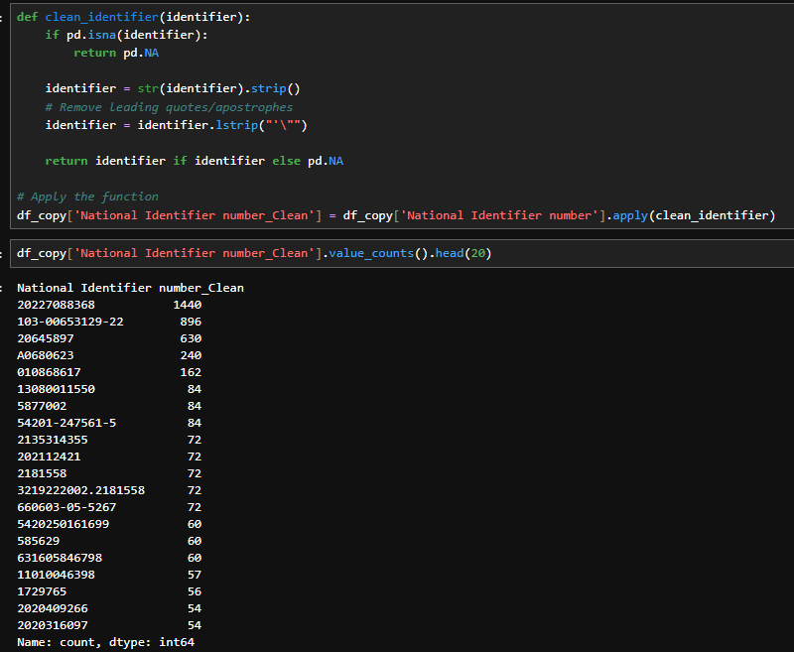
Storing them in a new column, to not dirty the original data.

Slide 18
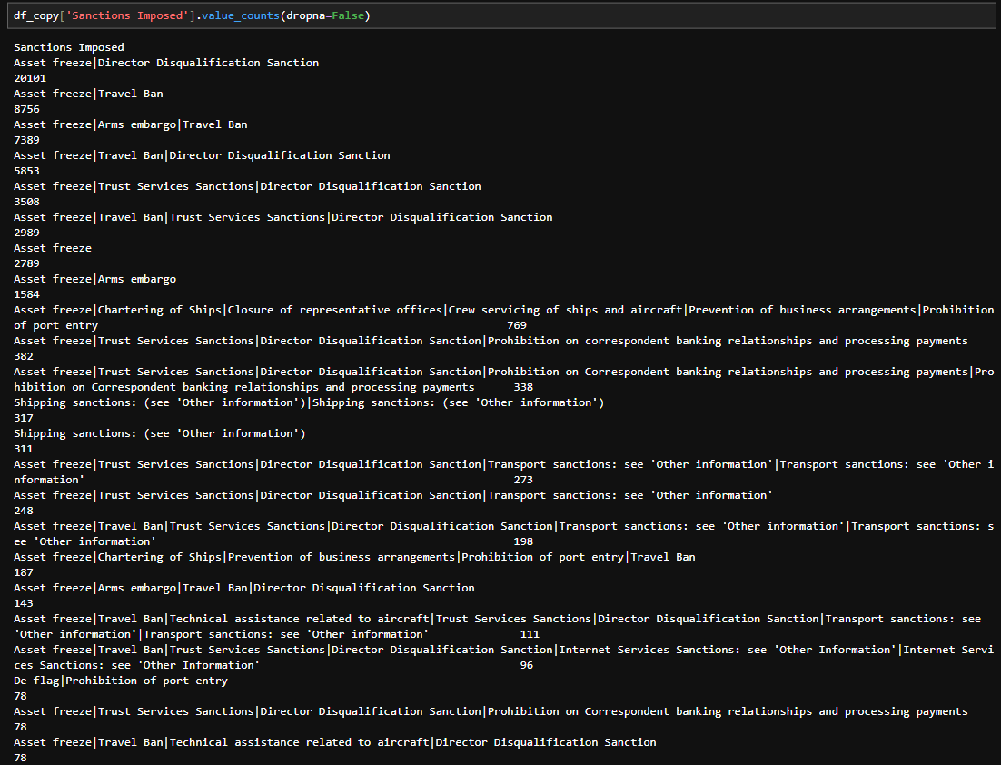
Multiple sanctions
Pipe separator used
Could be useful for analysis downstream.

Slide 19
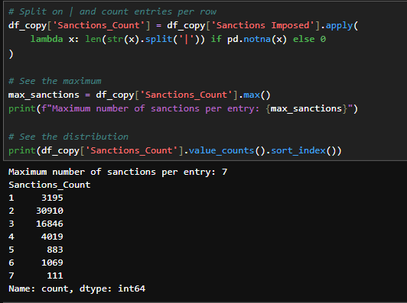
Sanction count be row.
Most of them have 2 sanctions.

Slide 20
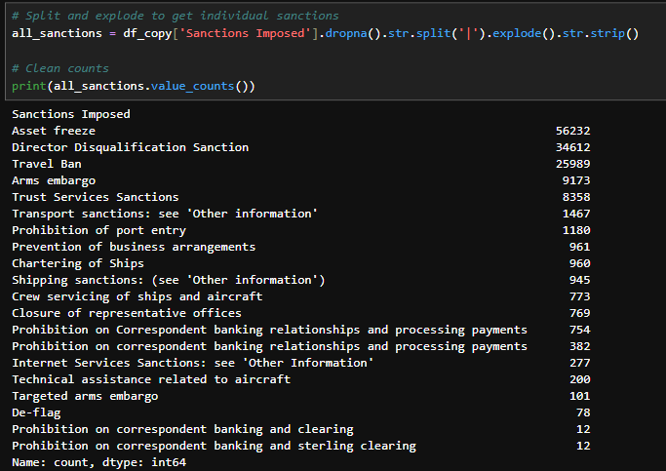
All the sanctions and their counts.

Slide 21
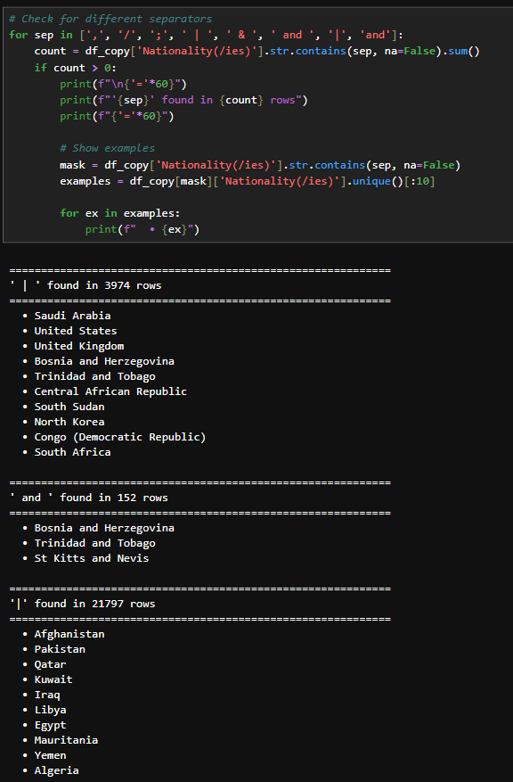
Digging deeper into Nationality column for Multi-nationality.
All False positives.

Slide 22
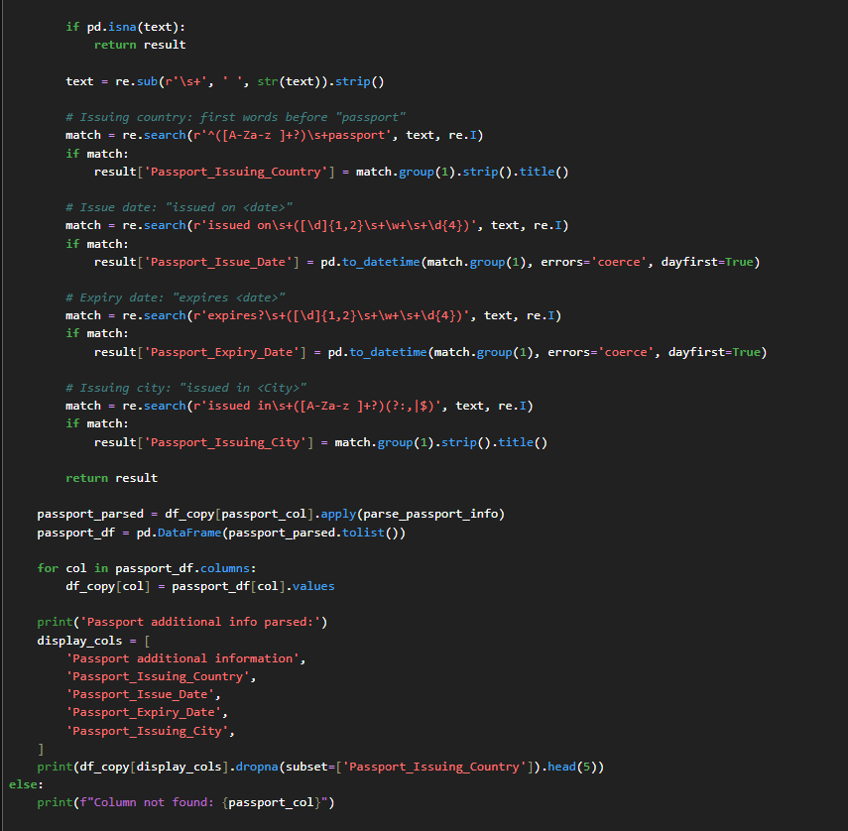
Dissecting Passport info.
Mange to extract Issuing country.
Issue dates.
Expiry dates.
Issuing cities.

Slide 23
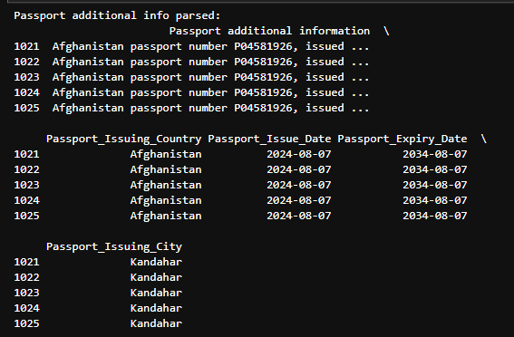
Separate columns created with passport info, based on previous slides.

Slide 24
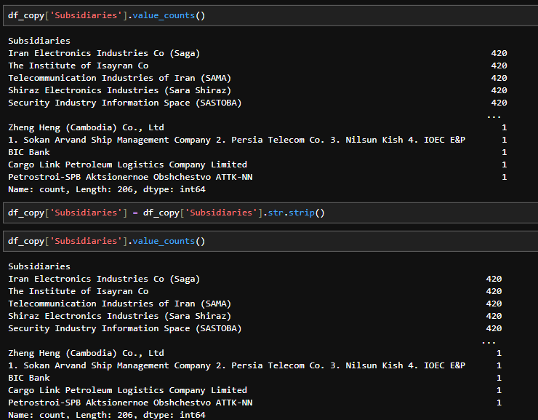
Subsidiaries investigation.

Slide 25
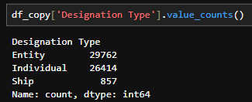
Designation type counts.

Slide 26
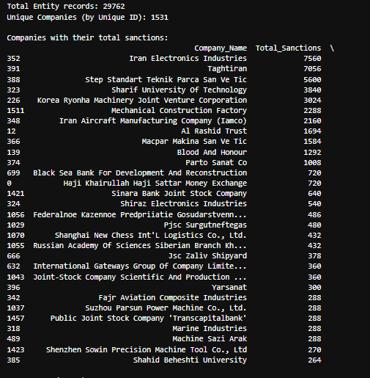
Total sanctions of every entity is extracted.

Slide 27
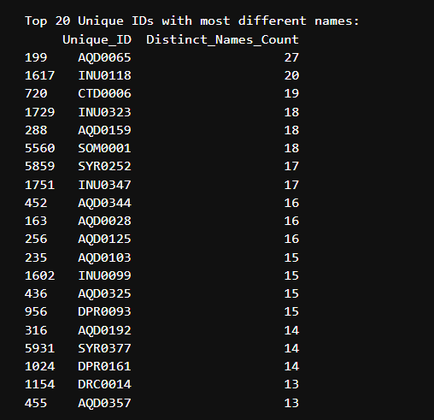
Unique names for every Unique ID’s and their count.

Slide 28
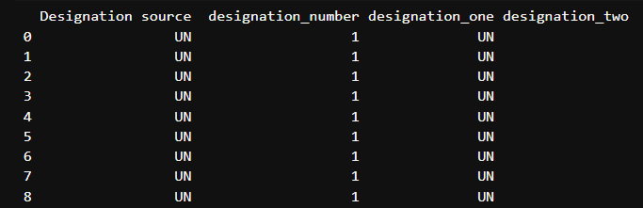
There are multiple designations for one sanction with pipe separator.
Extracted number of designation for every sanction and their values with are stored in separate columns.

Slide 29
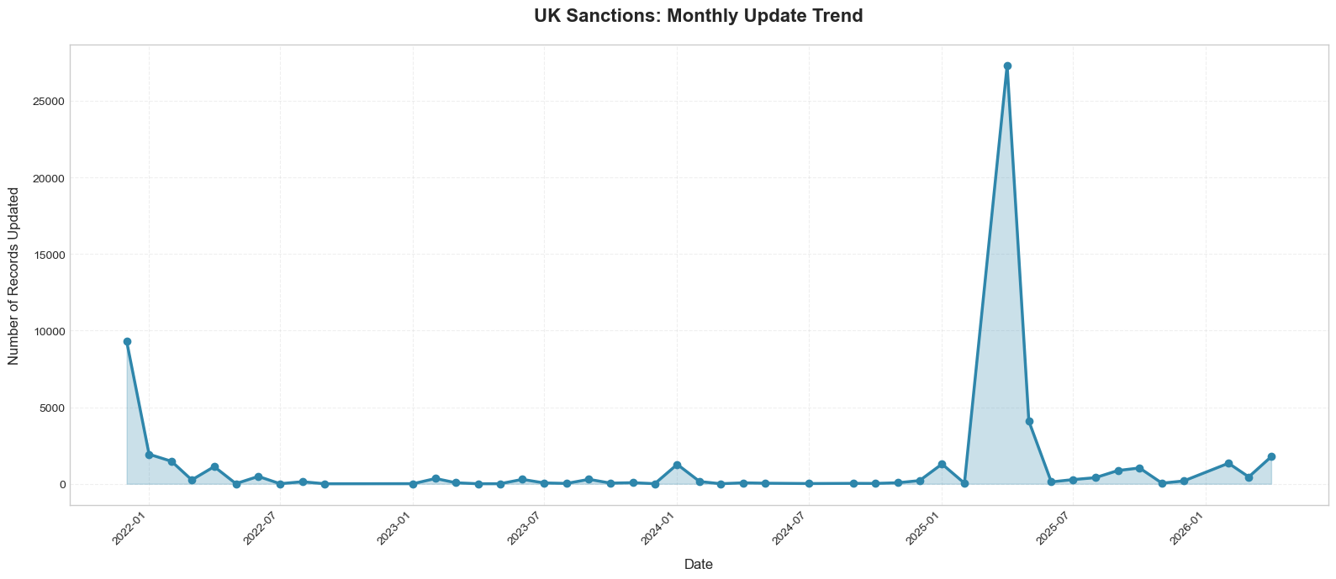
Information from Last Updated Column

Slide 30
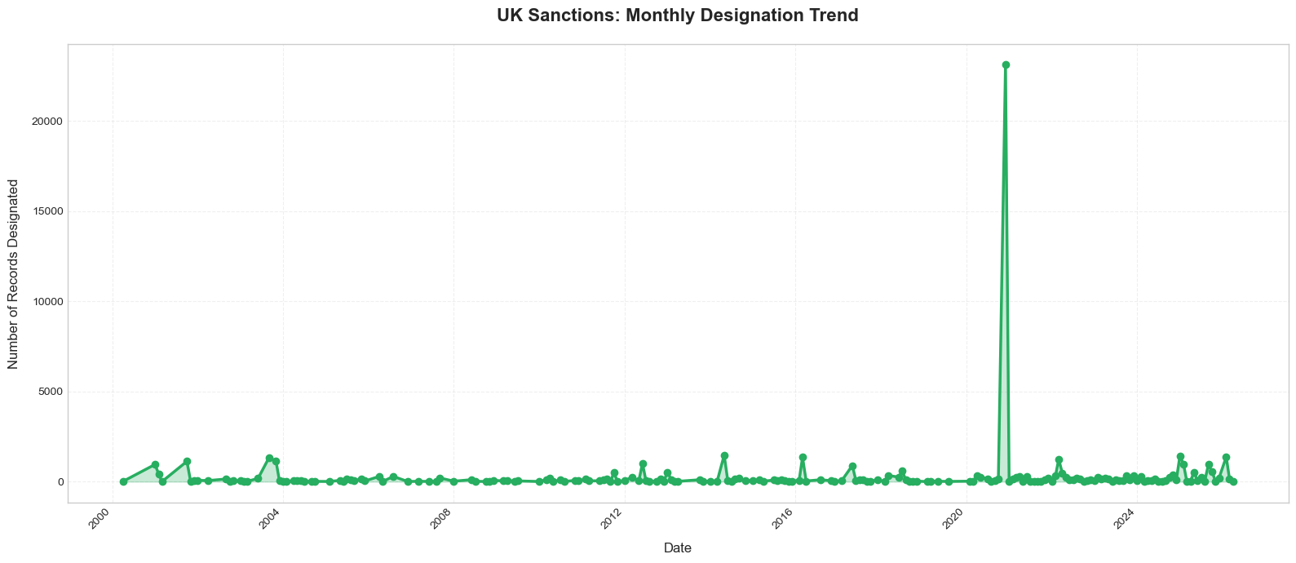
Information from Date Designated column.

Slide 31
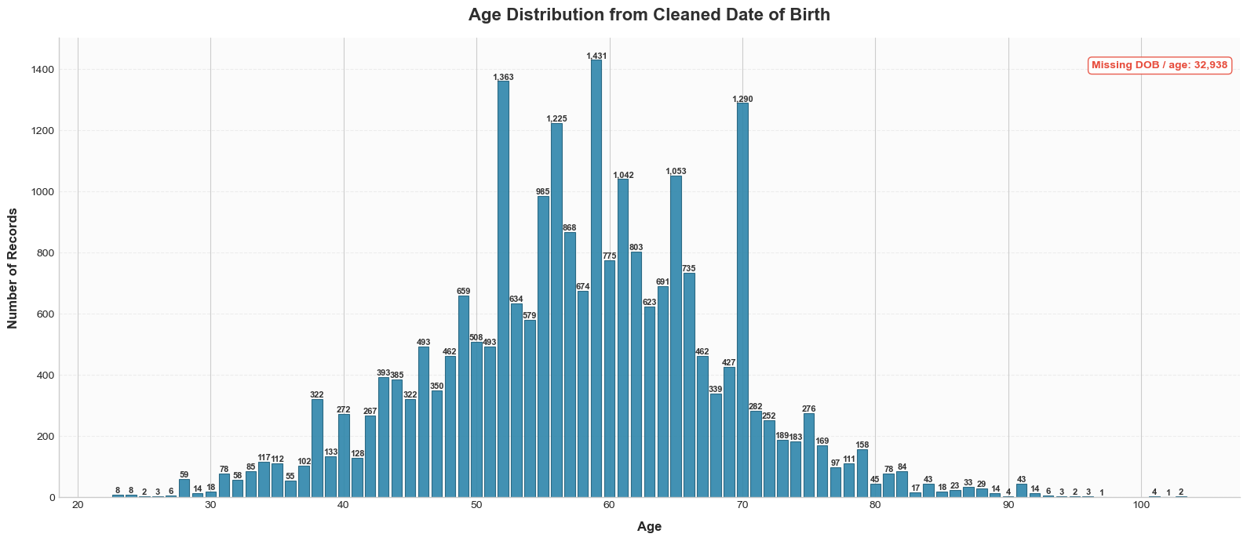
Age distribution

Slide 32
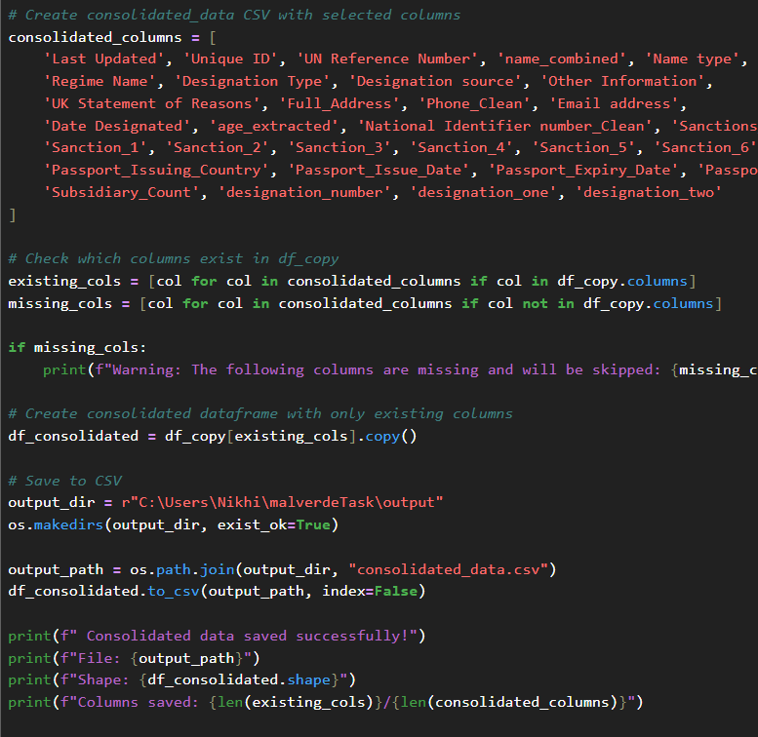
Final Consolidated Data

Slide 33
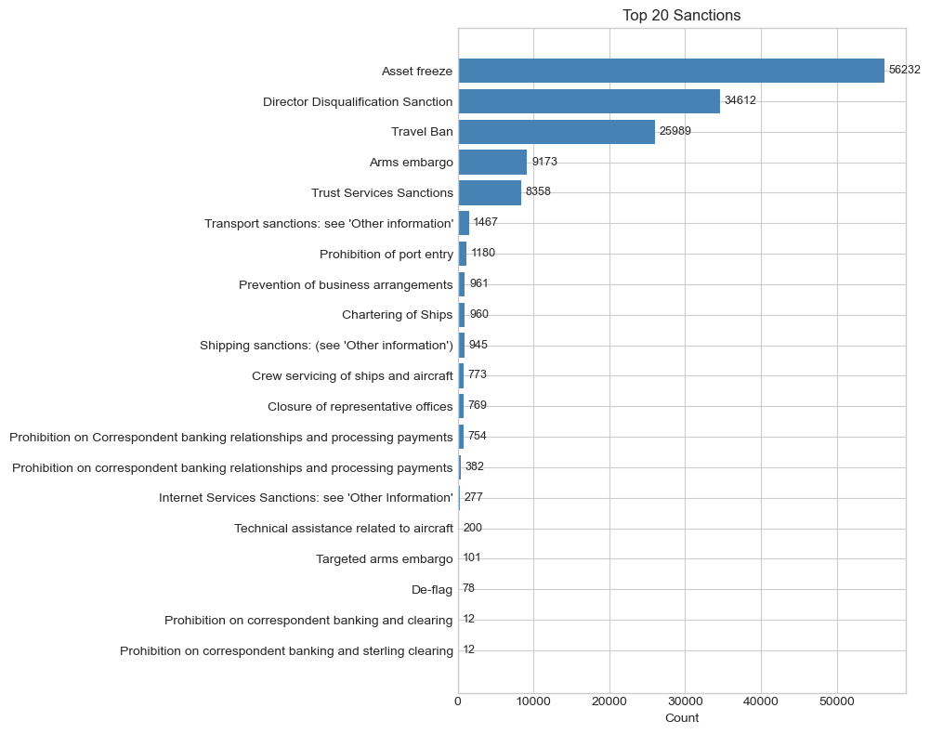
Sanctions and their counts.

Slide 34
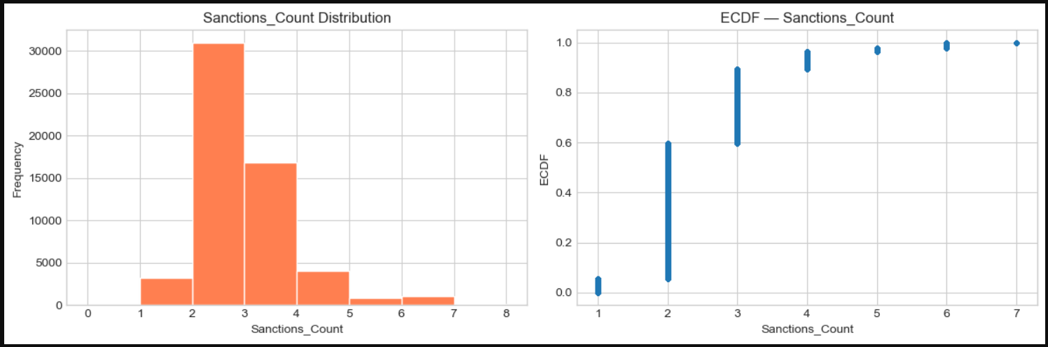
Distributions of sanctions for each row.
ECDF graph showing % change of sacntions.

Slide 35
Thank you

