Slide 1
Predicting Student Growth Through Education and Study Habits

Slide 2
Overview
Introduction
Business Understanding Objectives
Data Preparation
Data Understanding CRISP-DM
Conclusions

Slide 3



Team 06
Veera Swamy Gattupalli
ML Engineer
Satya Sai Sri Nikhil N
Data Engineer
Revanth Myneni
Cloud Engineer

Slide 4
Business Understanding
This project understands how the student's performance (test scores) is affected by other variables such as Gender, Ethnicity, Parental level of education, Lunch and Test preparation course

Slide 5
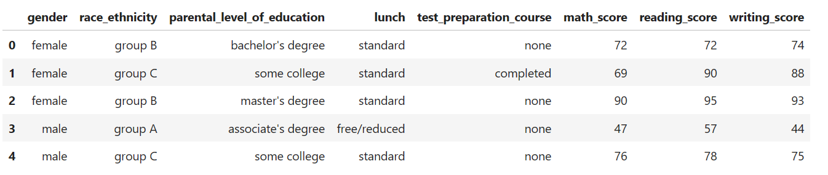
Data Understanding
This dataset consists of 1000 student’s information about academics of students.
Attributes such as Student’s gender, parental_level_of_education, lunch,Student’s reading & writing_scores etc.
Student’s math_score attribute is target feature.

Slide 6
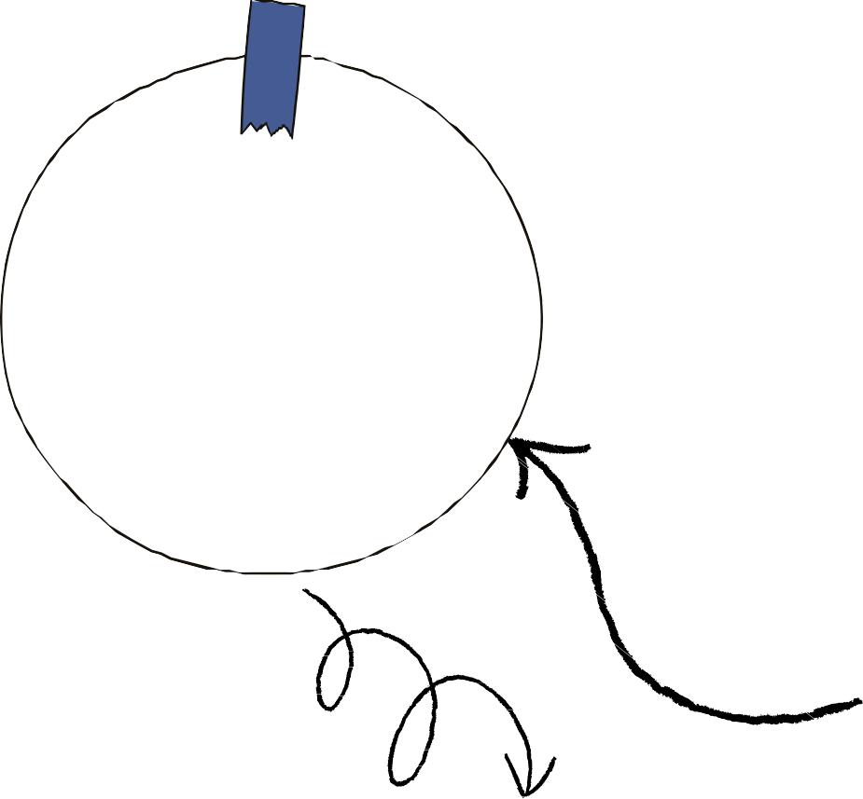











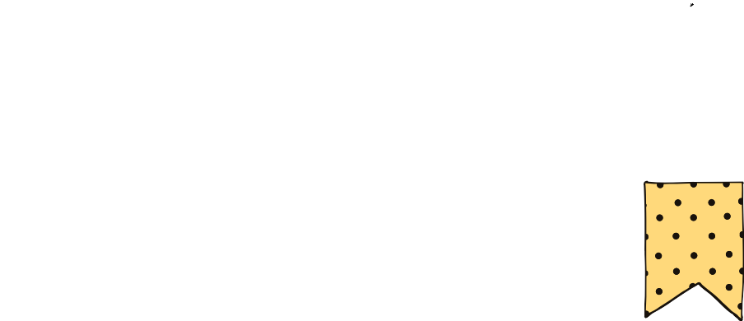


CRISP-DM
Data Preparation
Business Understanding
Data Understanding
MODELLING
Evaluation
Deployment

Slide 7
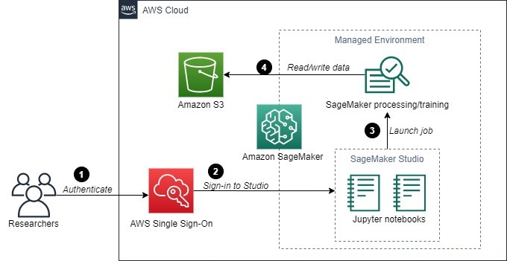
Architecture diagram of the solution

Slide 8
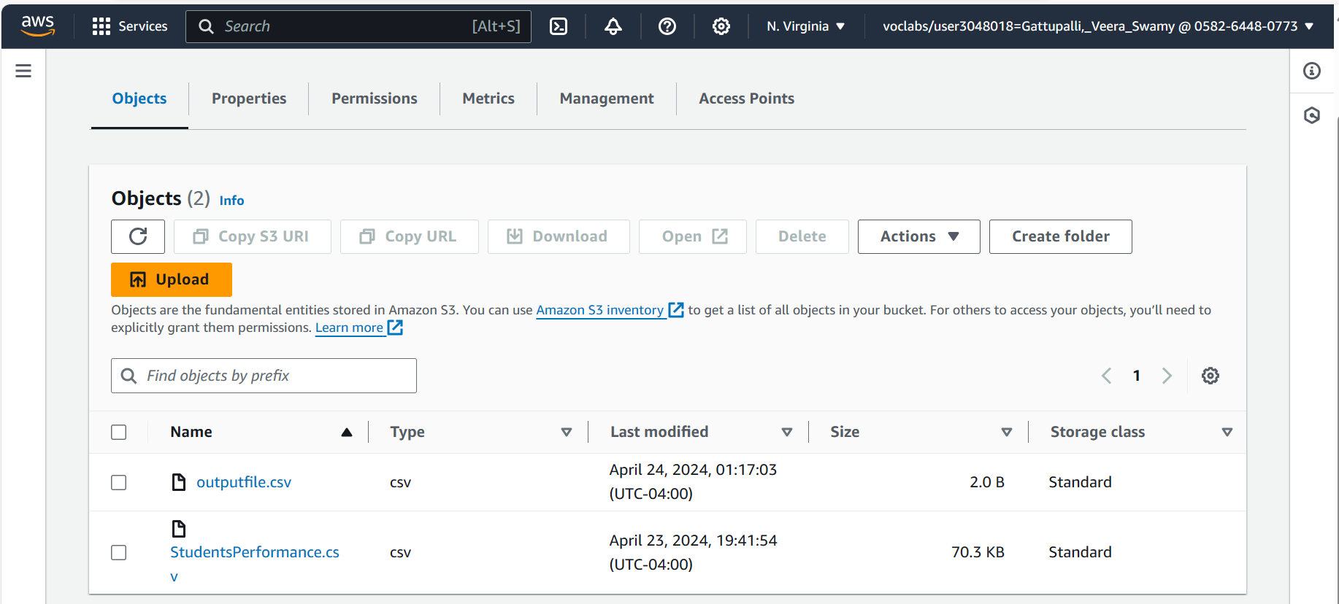
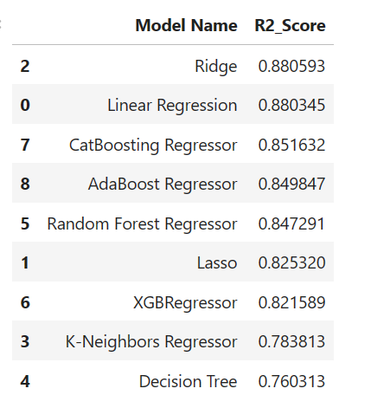
Output
Here is the output of the model accuracies where linear and Ridge model give the best accuracy.
We use linear Regression and predict the output and uploaded and save the file in the S3 bucket.

Slide 9
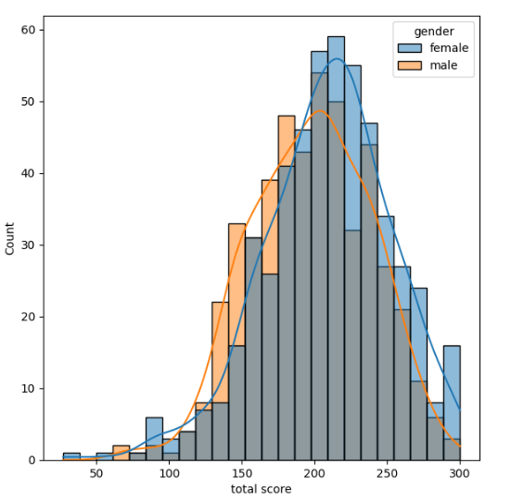
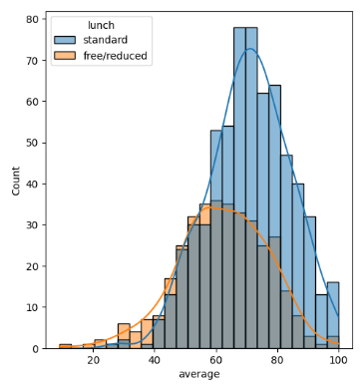
Insights
Found few insights like:
Female students tend to perform well then male students
Standard lunch helps perform well in exams.

Slide 10


Conclusion and Lessons Learned
1
By leveraging machine learning tools, we aimed to predict student performance and provide targeted interventions for those facing educational challenges, particularly in marginalized communities.
03
3
Through meticulous data processing, visualization, and algorithm comparison, we identified impactful factors for student academic success, paving the way for personalized interventions and improved educational outcomes
2
By doing this project we came to know how we can leverage the AWS/cloud platform to make the decision and deploy the model and the input output data.

Slide 11
Thank You

