Slide 1
Customer Segmentation and Churn Analysis for ISPs
Midterm Project: GROUP 6
Distributed and Scalable Data Engineering

Slide 2
OUR TEAM MEMBERS
1.VEERA SWAMY G-TEAM LEADER
2.SATYA SAI SRI NIKHIL N-Team member
3.SAI REVANTH M-Team member

Slide 3
PROBLEM
At-Risk Customer Groups
Which consumer groups are most vulnerable to attrition?
Competitor Comparison
How do our turnover rates stack up against those of the industry's rivals?
Churn Rate Evaluation
Can we spot any trends or patterns in the client attrition from the previous months or years?

Slide 4
SOLUTION
Enhanced Customer Service
Strategic Pricing Strategies
Modernized Technology Solutions
Improved Customer Interaction

Slide 5
WHAT IS CUSTOMER SEGMENTATION ?
Separating individuals into different categories according to their preferences, purchasing habits, usage trends and demographics.

Slide 6
EVERY MINUTE..
231.4 M Emails are sent 16 M texts are sent
5.9 M searches are conducted on Google
$400K is spent on Amazon
350K tweets are shared on Twitter

Slide 7
Factors Influencing Consumers Decision to Switch to Better Service Providers
Outdated technology
HIGHER PRICES
LIMITED AVALABILITY OR COVERAGE
POOR QUALITY OF SERVICE
Cheaper alternatives

Slide 8
WHAT IS CHURN
Customer churn rate is a metric that measures the rate at which customers stop doing business with a company over a certain period. It is typically expressed as a percentage of the total number of customers at the beginning of that period.
Churn rate is an important metric for businesses as it can indicate customer satisfaction, product/service quality, and the overall health of the customer base. High churn rates can be costly for businesses, as acquiring new customers is generally more expensive than retaining existing ones

Slide 9
WHY SEGEMENTATION AND CHURN ANALYSIS
Understand customers needs better
Provide tailored services
Increase customer satisfaction and loyalty
Better resource allocation

Slide 10
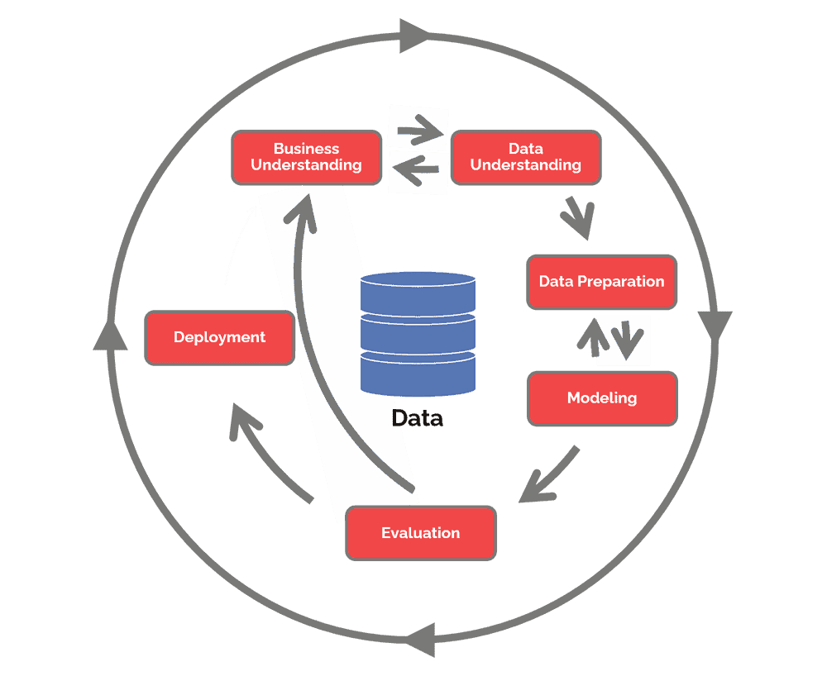
OUR PLAN
GAIN BUSINESS UNDERSTANDING
DATA COLLECTION AND INTEGRATION
DATA CLEANING AND PREPARATION
DATA MODELING AND ANALYSIS
DEPLOYMENT

Slide 11

DATA SOURCES
Internet Service Provider speeds and prices
Internet Service Provider churn data
Source: https://www.kaggle.com/datasets/mehmetsabrikunt/internet-service-churn https://www.kaggle.com/datasets/michaelbryantds/internet-speeds-and-prices

Slide 12
DATA SOURCES
id
is_tv_subscriber is_movie_package_subscriber subscription_age
bill_avg remaining_contract service_failure_count download_avg upload_avg download_over_limit
Internet Service Provider speeds and prices
Internet Service Provider churn data
Source: https://www.kaggle.com/datasets/mehmetsabrikunt/internet-service-churn https://www.kaggle.com/datasets/michaelbryantds/internet-speeds-and-prices

Slide 13

DATA SOURCES
major_city
state lat, long
block_group collection_datetime provider speed_down speed_up speed_unit
price technology package
fastest_speed_down fastest_speed_price income_lmi n_providers income_dollars
internet_perc_broadband median_household_income
Internet Service Provider speeds and prices
Internet Service Provider churn data
Source: https://www.kaggle.com/datasets/mehmetsabrikunt/internet-service-churn https://www.kaggle.com/datasets/michaelbryantds/internet-speeds-and-prices

Slide 14







WORKFLOW
Data Collection and Integration
Load
Analysis/Modeling
Deploy
Extract
Transform
(Data sources)

Slide 15

ACHIEVABLE MILESTONES
Visualization dashboard
Examine consumer behavior
Track customer satisfaction
Customer Segmentation Report
Determine which customers are most valued
Divide up your client base to launch marketing initiatives.

Slide 16
THANK YOU

