Slide 1


Time Series Analysis and Forecasting Using ARIMA
By:NIKHIL CHEKKATTU NANDAN

Slide 2
CONTENTS
Introduction
Dataset
Introduction
Visualizing Dataset
Stationarizing the series
ACF/PACF charts and optimal parameters
Stationarizing the series
Plot ACF/PACF charts and optimal parameters
ARIMA Model
Predictions
Building ARIMA Model
Making Predictions

Slide 3
INTRODUCTION
In this project, we are using ARIMA(AutoRegressive Integrated Moving Average) Model. The code provides a workflow for applying the ARIMA model to weather data. It includes:
Loading and visualizing the data.
Checking for stationarity and differencing if necessary.
Decomposing the time series to understand its components.
Fitting an ARIMA model.
Forecasting future values and visualizing the forecast with confidence intervals.
To tailor the model to specific data, the parameters p, d, q, P, D, Q, and s need to be selected based on model selection criteria and the nature of the data.

Slide 4
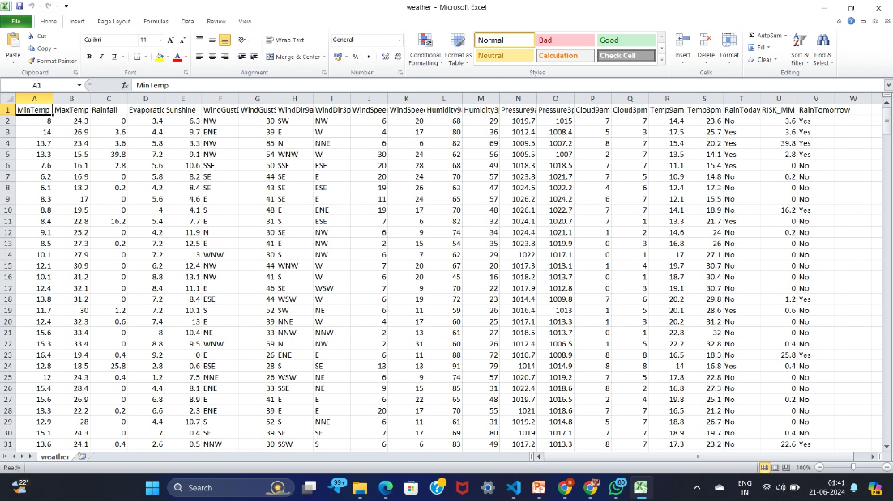
DATASET
The dataset used in this project is a time series of daily average temperature data from a specific location. The data spans several years, providing a comprehensive view of temperature fluctuations over time. This dataset is ideal for demonstrating the capabilities of ARIMA models in forecasting future temperature trends.

Slide 5
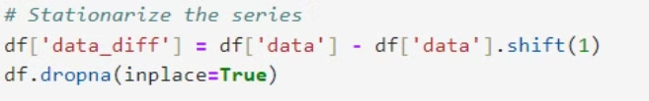
STATIONARIZING THE SERIES
To stationarize a time series, you typically remove trends and seasonality.
This can be done by differencing the series or applying transformations like logarithms.
In time series analysis, it is crucial to work with stationary data, where statistical properties such as mean and variance are constant over time.
Non-stationary data can lead to misleading or inaccurate modeling results. The process of transforming a non-stationary series into a stationary one is called stationarizing.

Slide 6
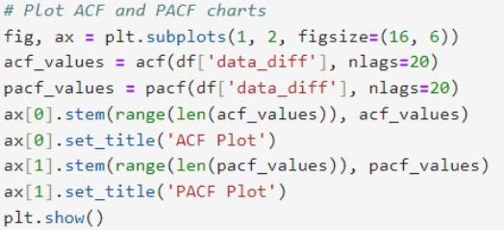
ACF/PACF charts and Optimal Parameters
Autocorrelation Function (ACF) and Partial Autocorrelation Function (PACF) plots are used to identify the order of ARIMA models.
1. Autocorrelation Function (ACF)
The ACF measures the correlation between the time series and its lagged values. It helps in determining the number of Moving Average (MA) terms in an ARIMA model.
ACF Plot: Shows how the correlation between the series and its lagged values changes as the lag increases.
2. Partial Autocorrelation Function (PACF)
The PACF measures the correlation between the time series and its lagged values after removing the effects of intermediate lags.

Slide 7
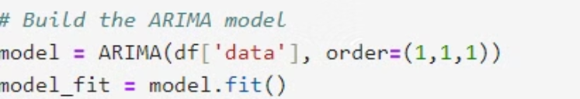
ARIMA model
The ARIMA (AutoRegressive Integrated Moving Average) model is a popular time series forecasting method that combines three components: Autoregressive (AR), Integrated (I), and Moving Average (MA).
The ARIMA model is denoted as ARIMA(p, d, q), where:
p: The number of lag observations included in the model (AR terms).
d: The number of times that the raw observations are differenced (I terms).
q: The size of the moving average window (MA terms).

Slide 8
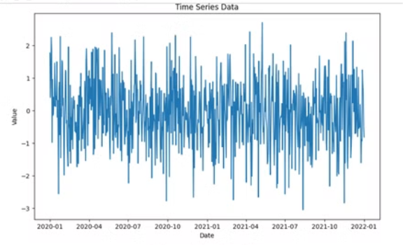
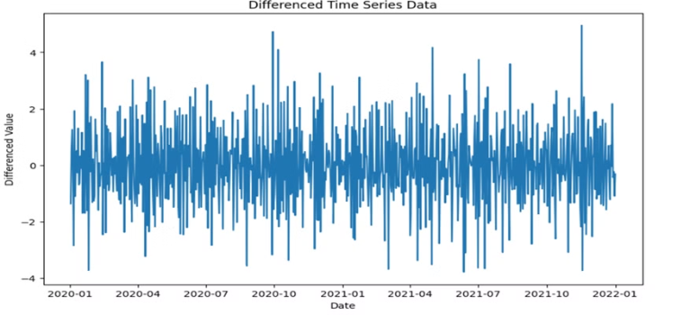
PREDICTIONS

Slide 9
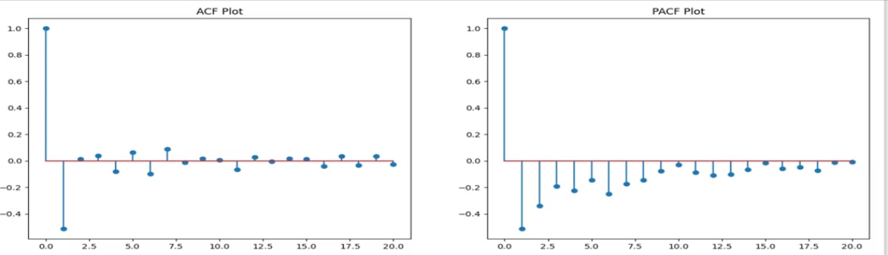
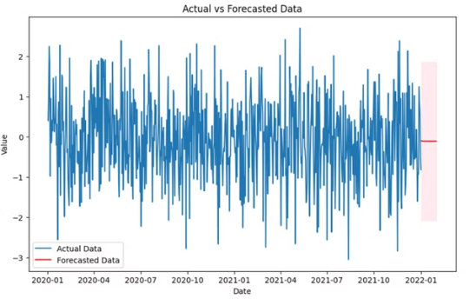
PREDICTIONS

Slide 10
THANK YOU
BY: NIKHIL CHEKKATTU NANDAN

