Slide 1

ERP SYTEM OF A SOLAR COMPANY

Slide 2
SIKSHA ‘O’ ANUSANDHAN (DEEMED TO BE UNIVERSITY)
WEB DESIGN
Prepared By :-
AMAN KUMAR DAS 1641012072
JYOTI RANJAN MOHAPATRA 1641012112
NIKHIL RANJAN NAYAK 1641012040
MUDDANA ADITYA 1641012318

Slide 3
PROBLEM DEFINITION
This project entitled “ERP System of a Solar Company” aims to develop some of the promising new ERP evolutionary design and models that could affect the future of ERP systems and open new market for next generation customers. We have developed a integrated application system which helps the organization to manager their business activities and many back office functions.

Slide 4
PROJECT OVERVIEW
The main idea behind the ERP (Enterprise resource planning) is creating a central system while in traditional approach is to do a manual work in paper. So for that it’s very difficult to manage all the record and also difficult to analyse all the record in any departments. A manual work are to lengthy and its very time consuming for the entire department. So for that needs of central system is arising which gives the effective and efficient result within a few time. All departments can access the data with the system and also they can perform a desire task. With that all the data can easily manipulate and get easily whenever anybody wants.

Slide 5
MOTIVATION
New innovations in technology trends have forced ERP designers to go with the new development. Earlier the company was facing problems such as maintaining their stocks, keeping track of their employee’s attendance, managing inventories by which they were facing difficulties in tracking their business profit and loss. Moreover, one of the biggest challenges for ERP is to keep speed with a manufacturing sector that has been rapidly moving from product-centric to customer-centric focus. This change required most ERP vendors to add a variety of functions and modules on their core systems, while the basic design of most ERP systems remained product-centric.

Slide 6
HARDWARE REQUIREMENTS
Since neither the web application nor the web portal have any designated hardware, it does not have any direct hardware interfaces. The hardware connection to the database server is managed by the underlying operating system on the device and the web server. This website can be accessed by any device which has network connectivity with a browser and display such as mobile phones, tablets and PCs with a minimum of 256 MB RAM.

Slide 7
SOFTWARE REQUIREMENTS
The use of other required software products and interfaces with other application systems include PHP, HTML 5, CSS 3. JQuery 1.1.2, JavaScript and Bootstrap for smooth and sound rum of website. Browsers such as World Wide Web, Mosaic, Netscape Navigator, Netscape Communicator, Internet Explorer, Opera, Mozilla Navigator, Safari, Mozilla Firefox, Google Chrome, Microsoft Edge and UC Browser can be used to access the website.

Slide 8
EXISTING SYSTEM
The current ERP System deals with maintaining a physical contact with the management for filling all the details and the documentation work.
According to the current system, the management has to fill in the forms manually, go to the account management dept., and submit the form. The applicant needs to visit the portal now and then in order to get his work accomplished. The admin also has to manage all the users. He needs to maintain records of all the users, their activity status, submission methods and installation details on paper. The Manual process is more error prone and also slow. Thus a simulation of this entire process can be a boon to the applicants as well as the admin

Slide 9
PROPOSED SYSTEM
To automate selection process for the company, facilitating high graphical user interface to the user, providing attendance management system for the employees, showing an updated chart of the company’s monthly, quarterly and annual profit and loss, better functioning and accurate information in time, providing data maintenance features such as updating inventory or stocks and to store and manage new items in the inventory which gradually improves the efficiency and reduces the overload of work.

Slide 10
FEASIBILITY STUDY
Technical Feasibility
The following technical feasibility areas were probed during the feasibility study phase:
The necessary technology i.e. front-end development tools, back-end database technology for developing the system are already available within the organization.
The front-end tool proposed in easily compatible with the current hardware configuration in the organization.
The back-end tool proposed has the capacity to hold the data required for using the new system.
The System is expandable in many dimensions with respect to addition of more functionality, featured, etc.
The front-end and back-end technologies provide a way to preserve the accuracy, reliability and ease of access and data security.

Slide 11
FEASIBILITY STUDY
Implementation Feasibility
This project can easily be made available online without much consideration of the hardware and software. The only required thing at the applicant’s side is the Internet connection and a web browser, which are a no difficult issue these days. A database server and application server are required to set up at the admin side. After setting up the project online, even the administrator can access the system from anywhere.

Slide 12
FEASIBILITY STUDY
Operational Feasibility
The system has been developed for any user who wants to use this system. I have given a demo of my project and the users found the system friendly and easy to use. The interoperability with the existing system is also checked. So they may face certain problems in using the user interface. So keeping this consideration in mind we have provided field for each and every field on the forms. The administrator also may be non-technical, so the user interface is designed in such a way that it gets comfortable for the non-technical person to operate easily

Slide 13
FEASIBILITY STUDY
Economical Feasibility
The company being a well-to-do company didn’t have any problem in buying our software that was required in developing the application. The softwares we used were readily available. So as such we didn’t face any economical constrains.

Slide 14
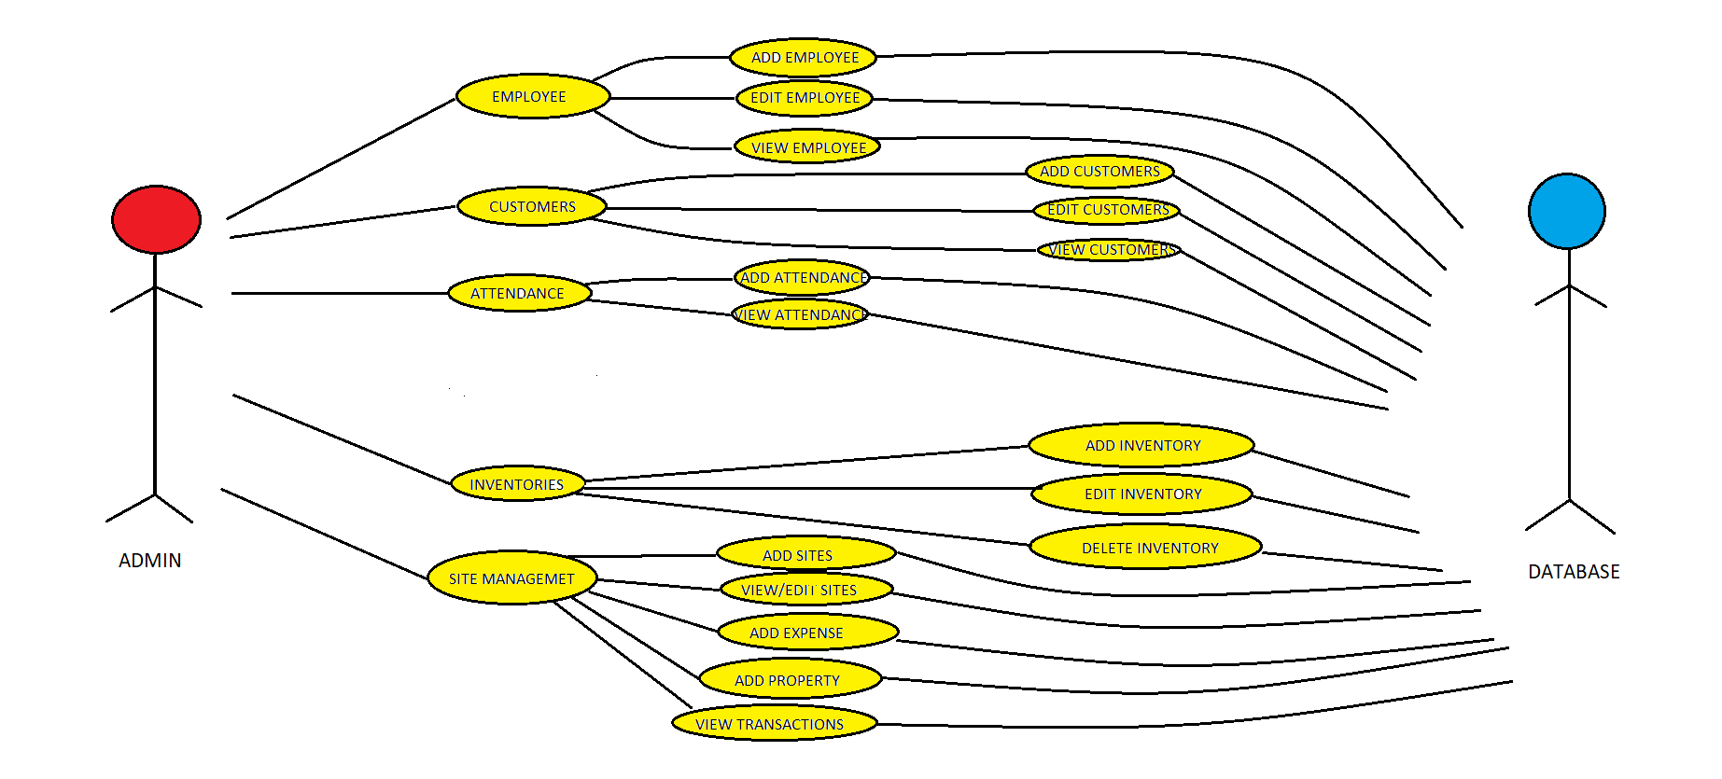
USE CASE DIAGRAM

Slide 15
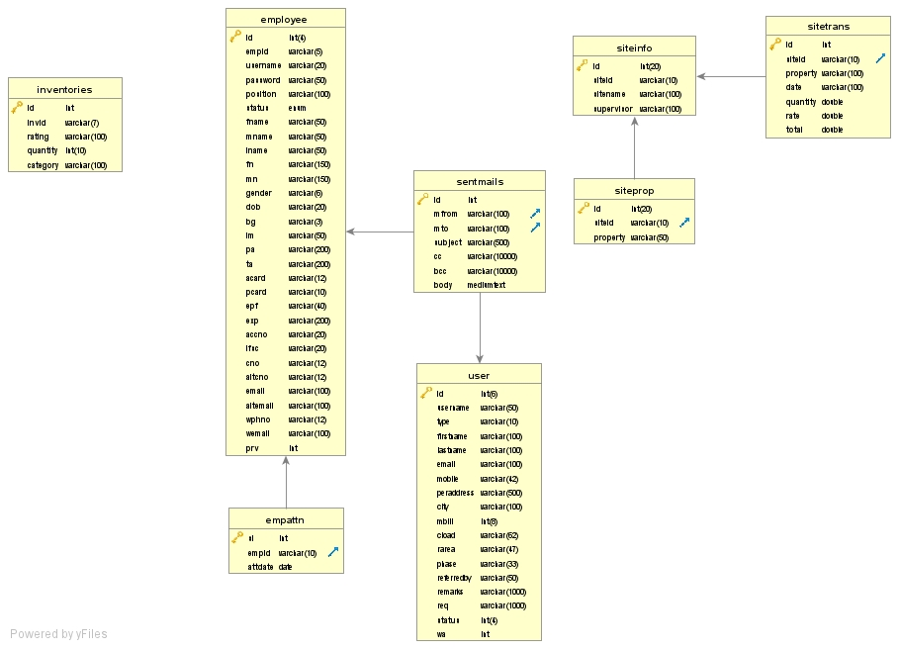
CLASS DIAGRAM

Slide 16
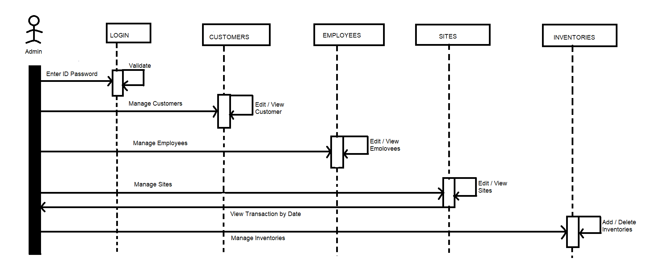
SEQUENCE DIAGRAM
Modification ACK
Change ACK

Slide 17
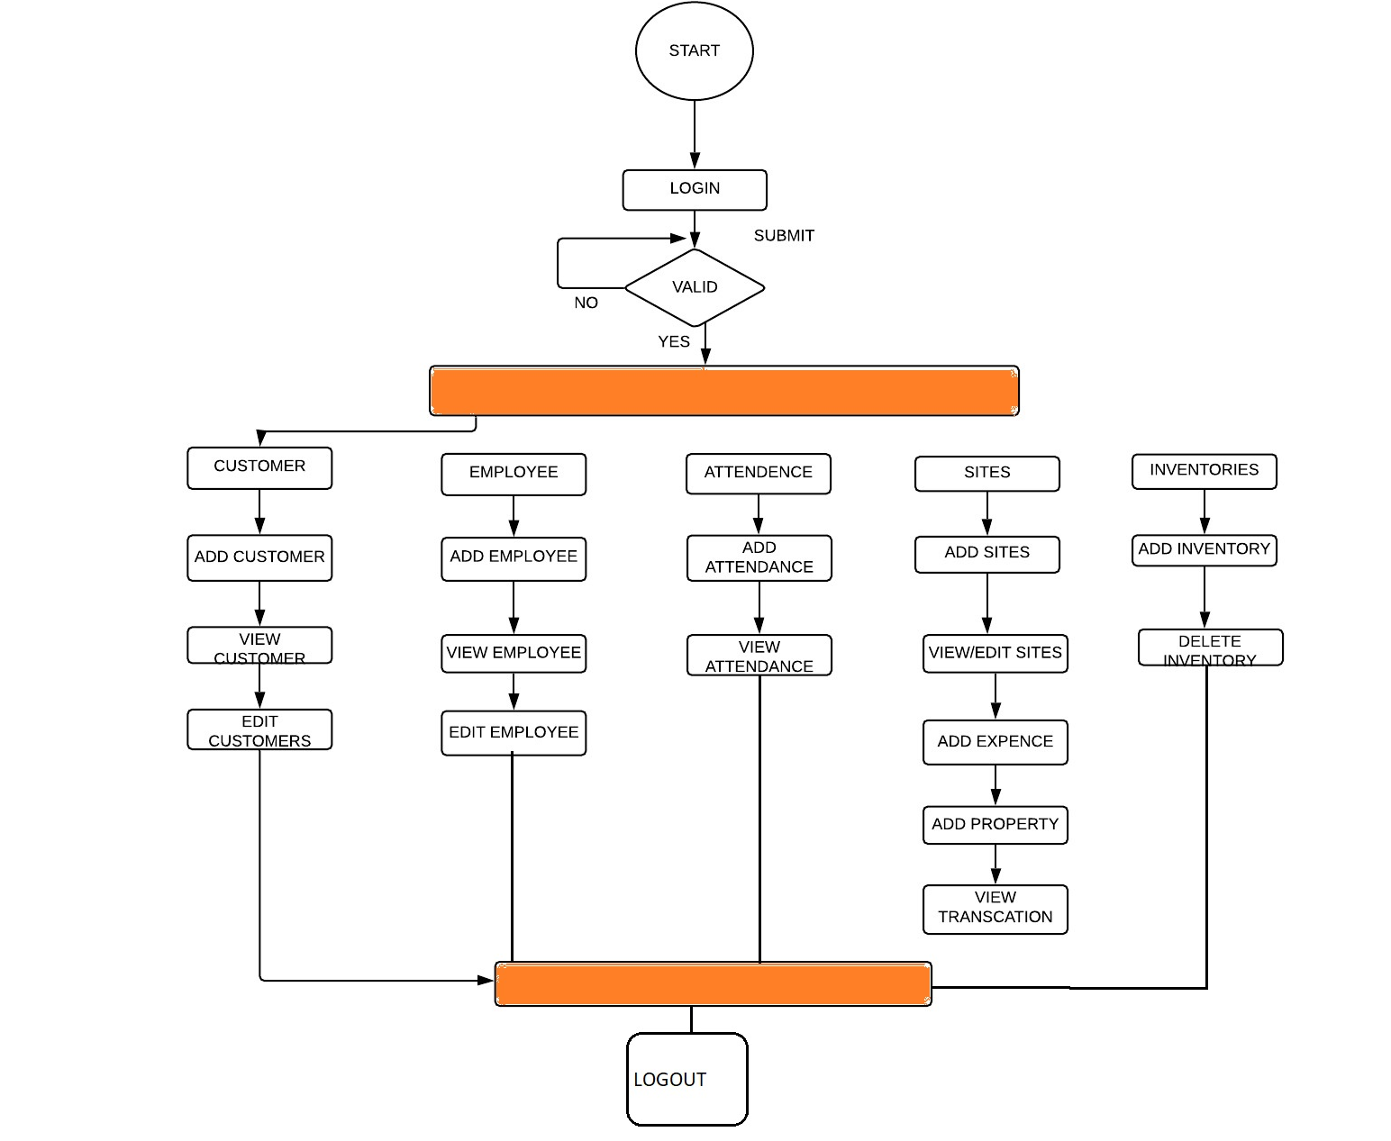
STATE CHART

Slide 18
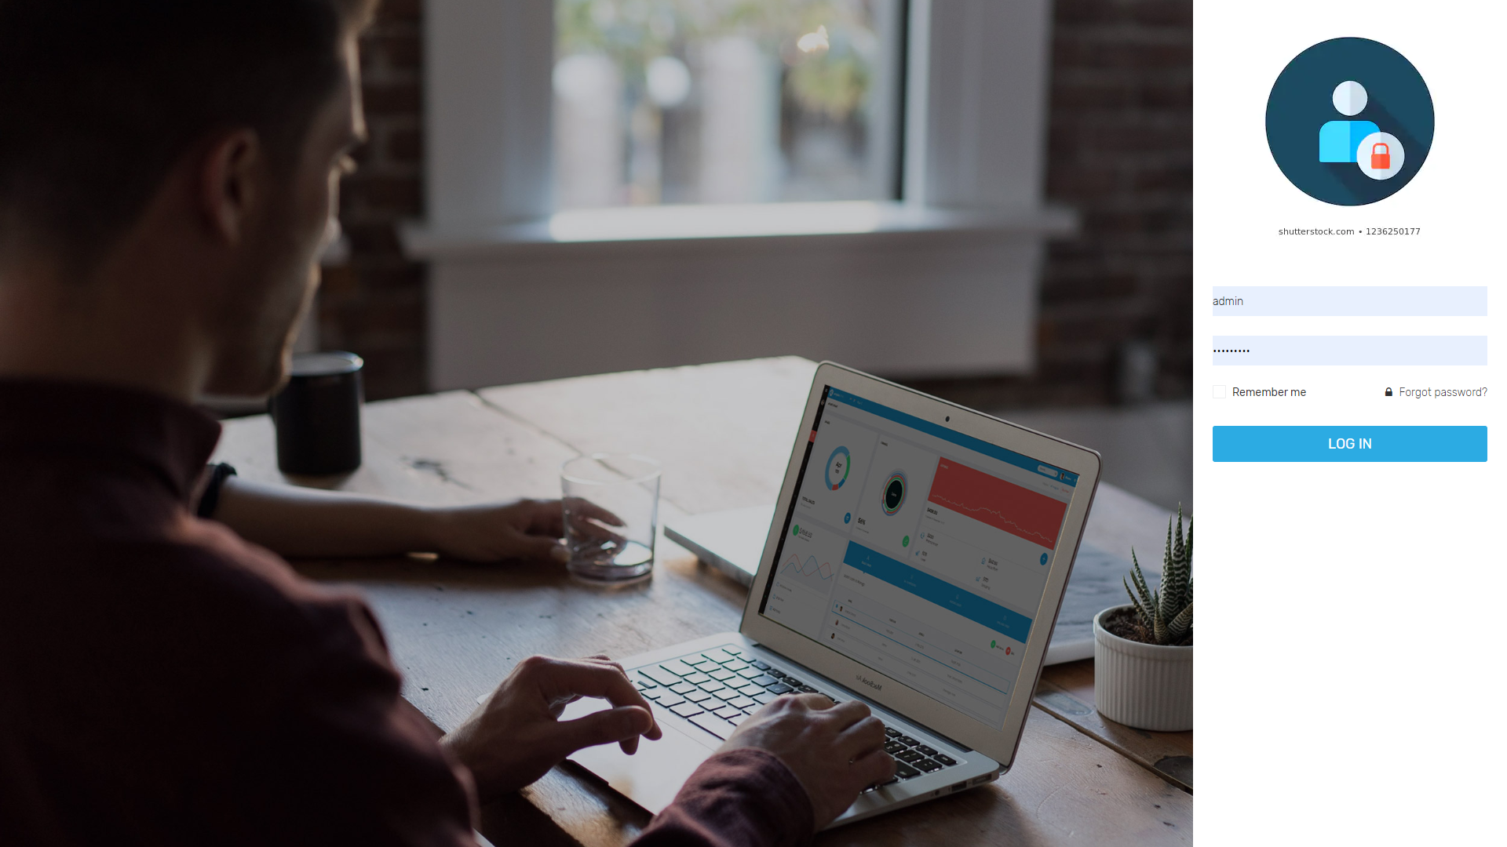
LOGIN PAGE

Slide 19
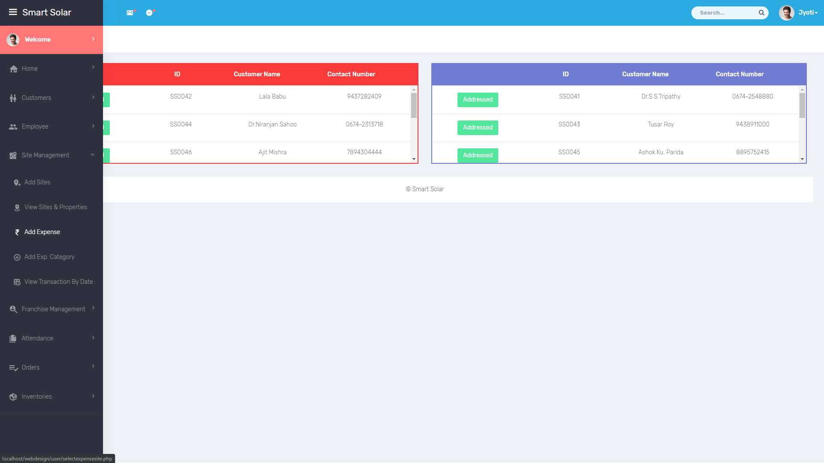
DASHBOARD

Slide 20
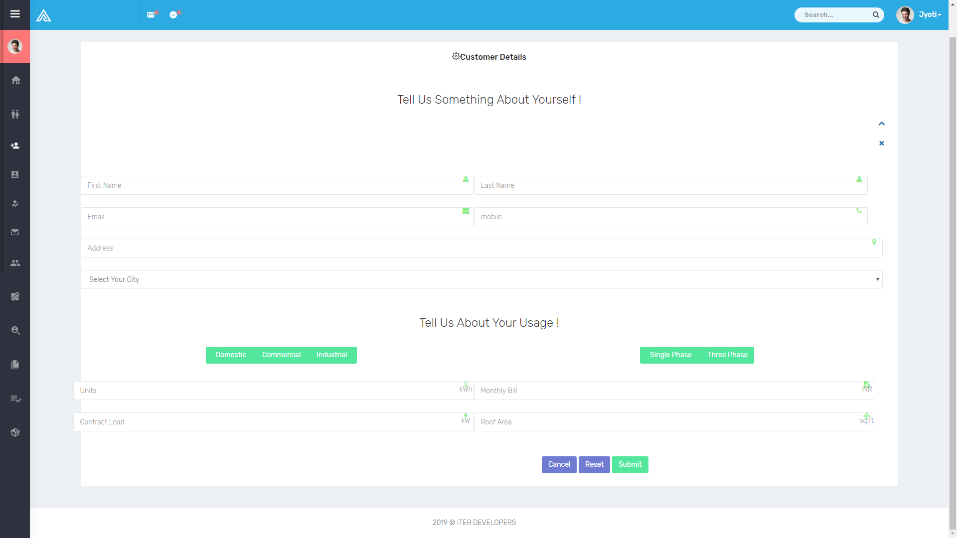
CUSTOMER MANAGEMENT PAGE

Slide 21
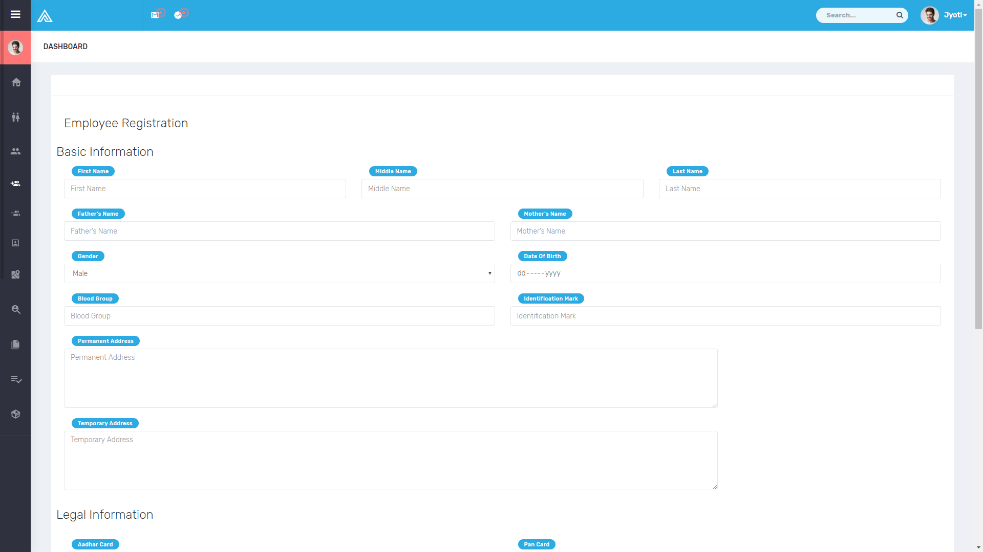
EMPLOYEE MANAGEMENT PAGE

Slide 22
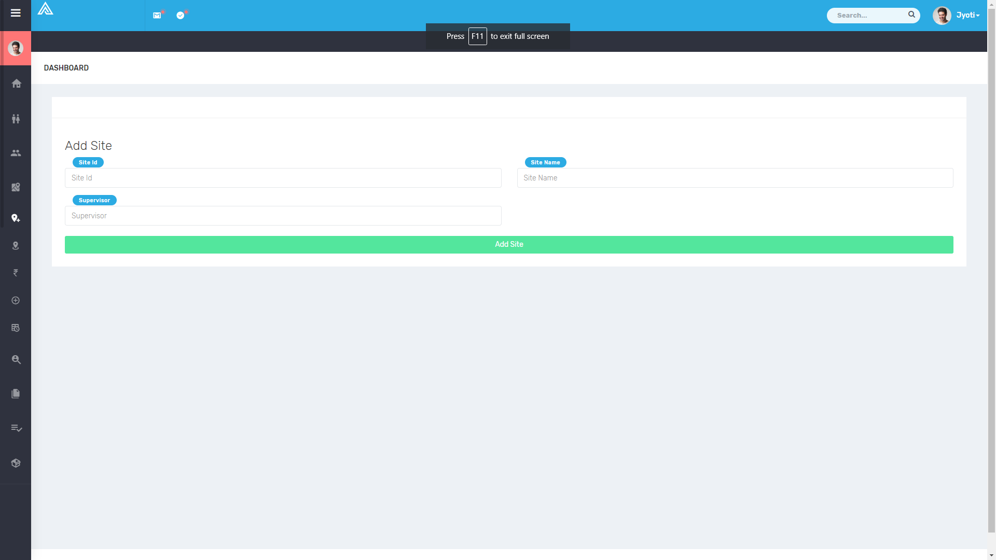
SITE MANAGEMENT PAGE

Slide 23
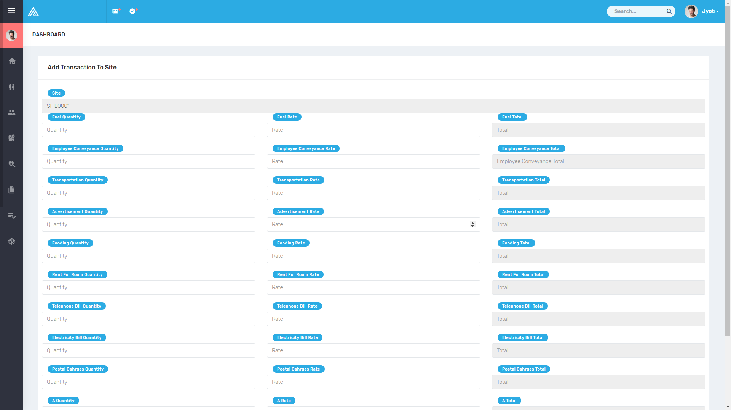
SITE EXPENSE PAGE

Slide 24
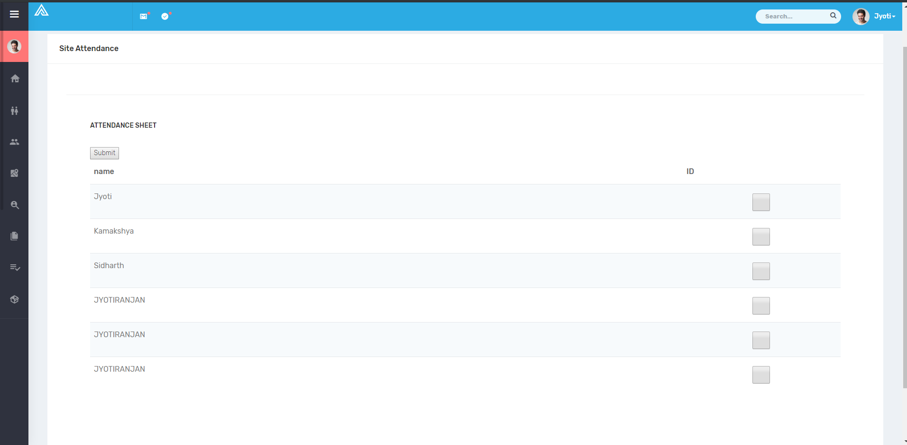
ATTENDANCE MANAGEMENT PAGE

Slide 25
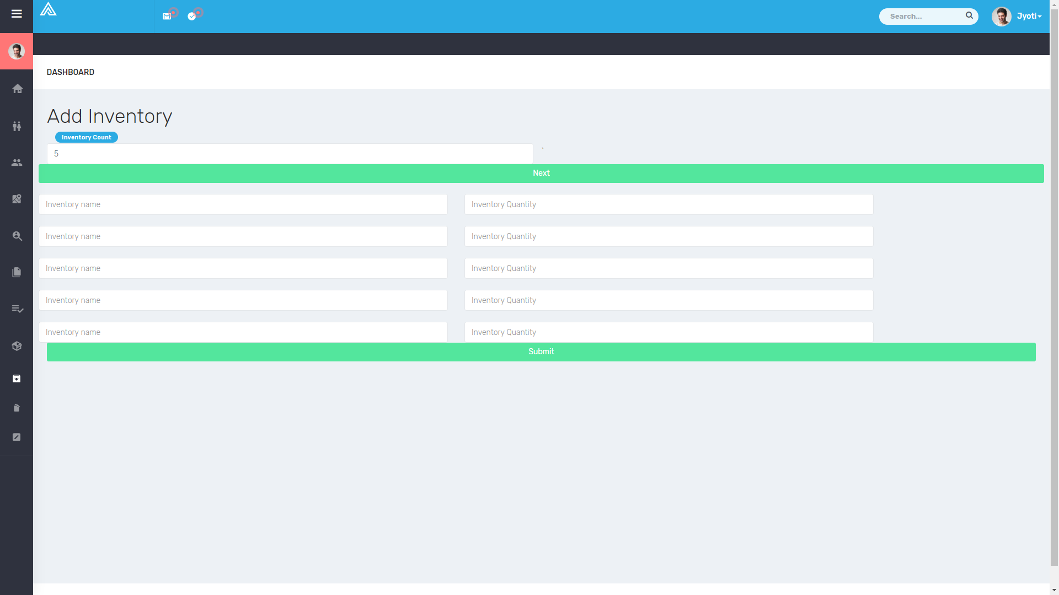
INVENTORY MANAGEMENT PAGE

Slide 26
CONCLUSION
No project can be termed as ‘perfect’ in real sense and there always remains scope for future improvement and so that helps to develop a new version of the software. We are always eager to know some new points and validation related to projects which give us more knowledge and help us to create new version.
The “ERP” system has been developed by us and also done enhancement in application through applying our knowledge gained in class room, referring to certain books, browsing some sites and through the help of external and internal faculties and using our knowledge related to subject it.
We are very thankful to the project guide and college staffs that extended all their support and helped us complete this project successfully.

Slide 27
THANK YOU

