Slide 1

SOFTWARE ENGINEERING PRINCIPLES
USING ANDROID
(CSE 4141)
Dept. Of COMPUTER SCIENCE AND ENGINEERING
Institute of Technical Education and Research
SIKSHA ‘O’ ANUSANDHAN UNIVERSITY
Bhubaneswar, Odisha, India
(2016-2020)

Slide 2
ShareNotes
AN ANDROID APPLICATION FOR SHARING NOTES

Slide 3
A Project Submitted by
Mudana Aditya Nikhil Ranjan Nayak
(1641012318) (161012040)
Jyoti Ranjan Mohapatra Baibhab Swain
(1641012112) (1641012206)

Slide 4
INTRODUCTION
Problem Definition
At present the notes are only maintained by some particular students those who are serious. Later on during exam time every student are in need of notes and it gets difficult for them even on daily basis.

Slide 5

v
v
EXISTING SOLUTION
At the end moment instead of concentrating on studies, students waste their time on collecting notes from different sources by
Physically visiting students
asking friends to take pictures or scan
v

Slide 6
SURVEY REPORT
90% OF THE STUDENTS ARE FACING THIS PROBLEM
8% OF THEM MAINTAINED THE NOTES REGULARLY
2% OF THEM DENIED TO GIVE THEIR OPINION

Slide 7

PROPOSED SOLUTION
To resolve this issue an android application is developed and this application is mainly for our college students to get the notes of all branches.
The application offers various operations like viewing note, downloading and uploading notes which can be accessed by others.

Slide 8
PROJECT OVERVIEW
ShareNotes is an application for our university. The application offers various operations like viewing notes, downloading and uploading notes which can be accessed by others. These specifications are conveniently grouped and developed specifically for use on your device. All the operations can be performed when an internet connection is available. Admin of the application can register prospective university students to fully experience all services provided.

Slide 9


REQUIREMENTS
HARDWARE REQUIREMENT
ANDROID PHONE
Since the application doesn’t have any designated hardware, it does not have any direct hardware interfaces. The hardware connection to the database server is managed by the underlying operating system on the device and the web server.
SOFTWARE REQUIREMENT
ANDROID 9.0 +
Having an device with Android OS and internet connectivity is enough to run this app.

Slide 10



FEASIBILITY
The project is economically feasible as it only requires daily usable android phone.
To develop this application, an internet connection, a database server, a web server and software are required that is available for free as Firebase Service.
The application is behaviorally feasible since it requires no technical guidance, all the modules are user friendly and execute in a manner they were designed to.
ECONOMIC
FEASIBILITY
TECHNICAL
FEASIBILITY
BEHAVIORAL
FEASIBILITY

Slide 11




FUNCTIONAL FEATURES
REGISTRATION
LOGIN
SHARE
UPLOAD & DOWNLOAD
The app has a registration feature where the user is required to enter name, email id, password, branch, section, semester and pass-out year.
,
After registration the app allows students to login after verifying email id and password from firebase.
The app shares notes and assignments among the students(sharing of assignments or notes take place among students belonging to same branch) through listing
The app allows its users to download and upload their notes and assignments.

Slide 12
NON FUNCTIONAL FEATURES
Availability
This app is available for all android devices. Soon it will be available on Play Store
Maintainability
This app doesn’t require any maintenance as the server is hosted on Firebase provided for free by Google.
Usability
It is easy to use the UI/UX as it is extremely responsive interpretable.
Optimization
The storage is optimized and the notes gets deleted after 18 months automatically.

Slide 13
TECHNICAL DETAILS
USE CASE DIAGRAM
CLASS DIAGRAM
FLOW MODEL

Slide 14
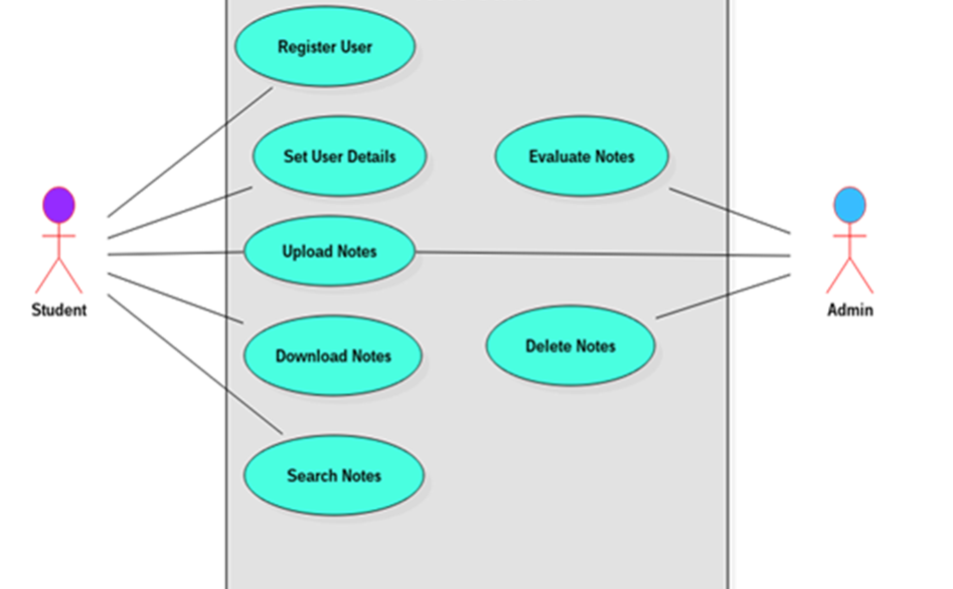
USE CASE DIAGRAM

Slide 15
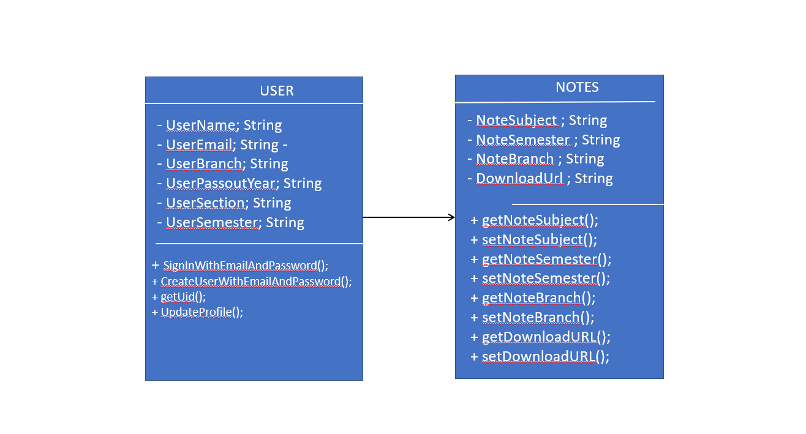
CLASS DIAGRAM

Slide 16
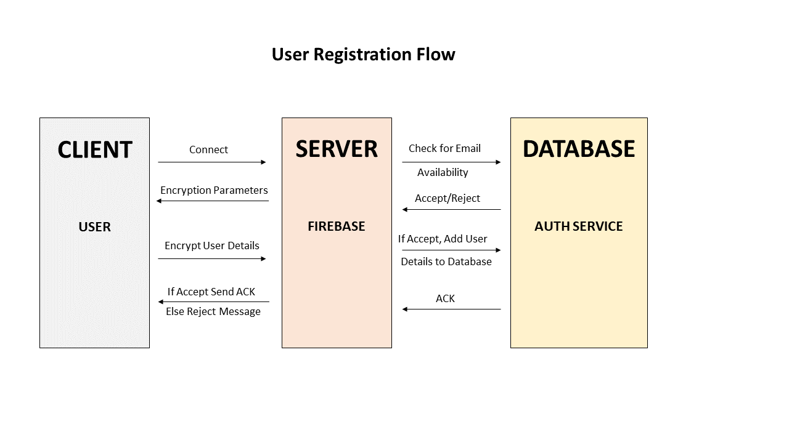
USER REGISTRATION

Slide 17
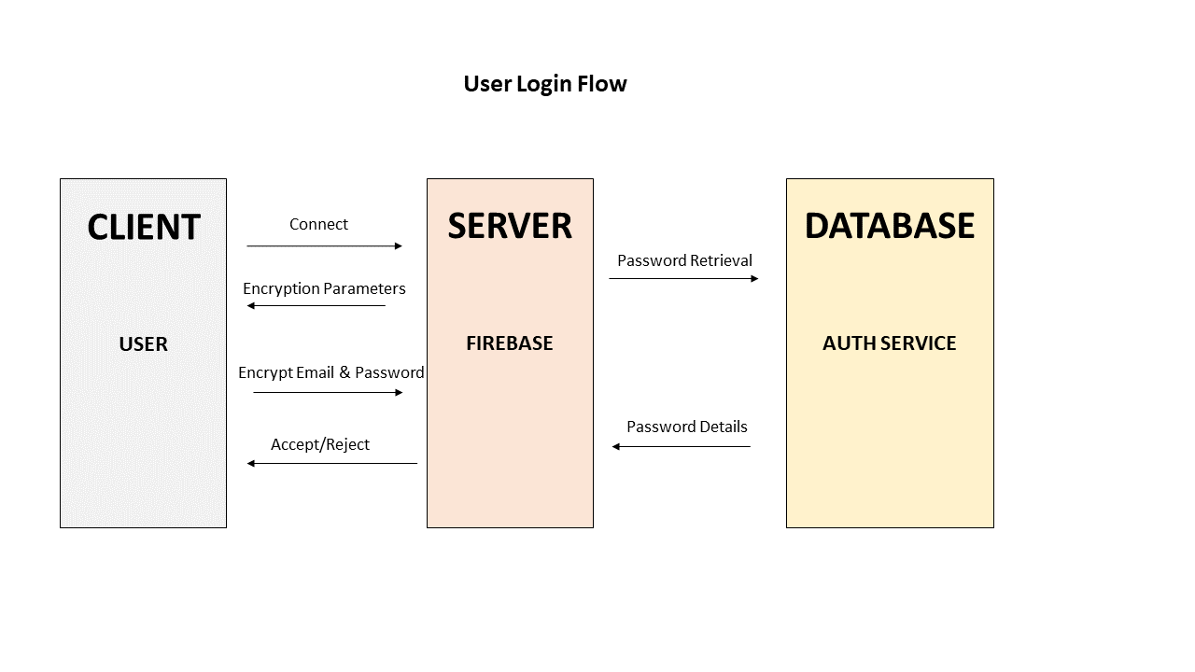
USER LOGIN

Slide 18
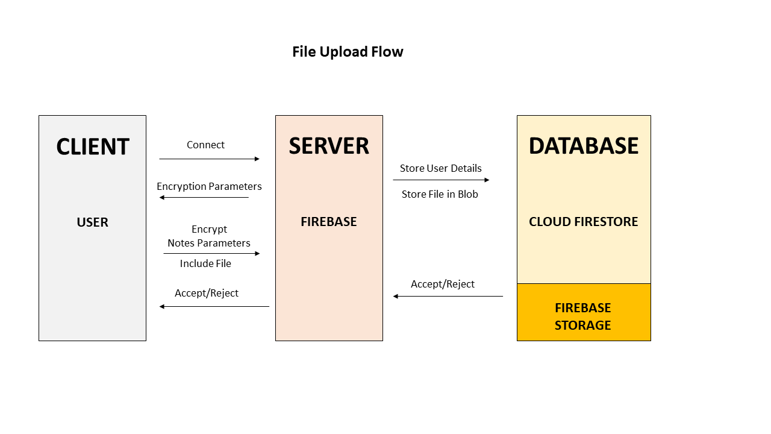
FILE UPLOAD

Slide 19
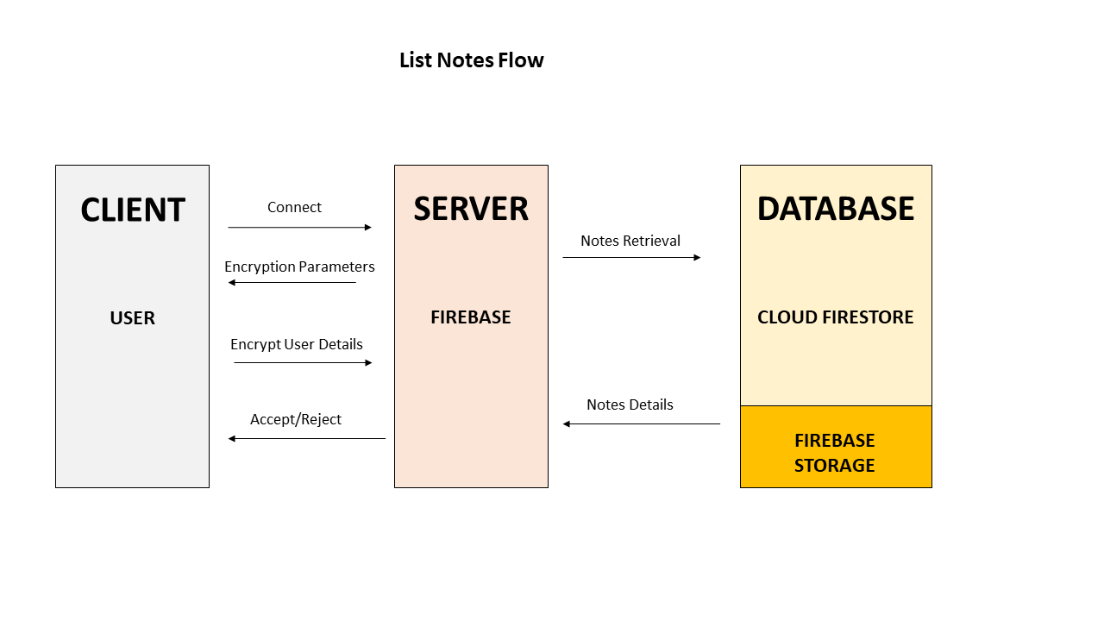
LIST NOTES

Slide 20
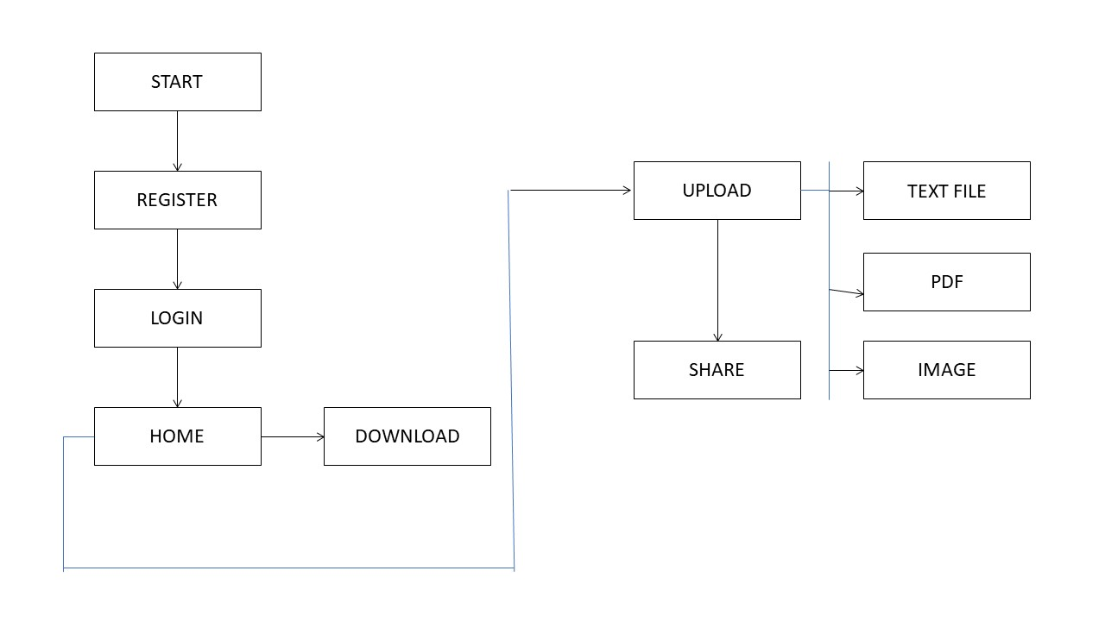
ACTIVITY DIAGRAM

Slide 21
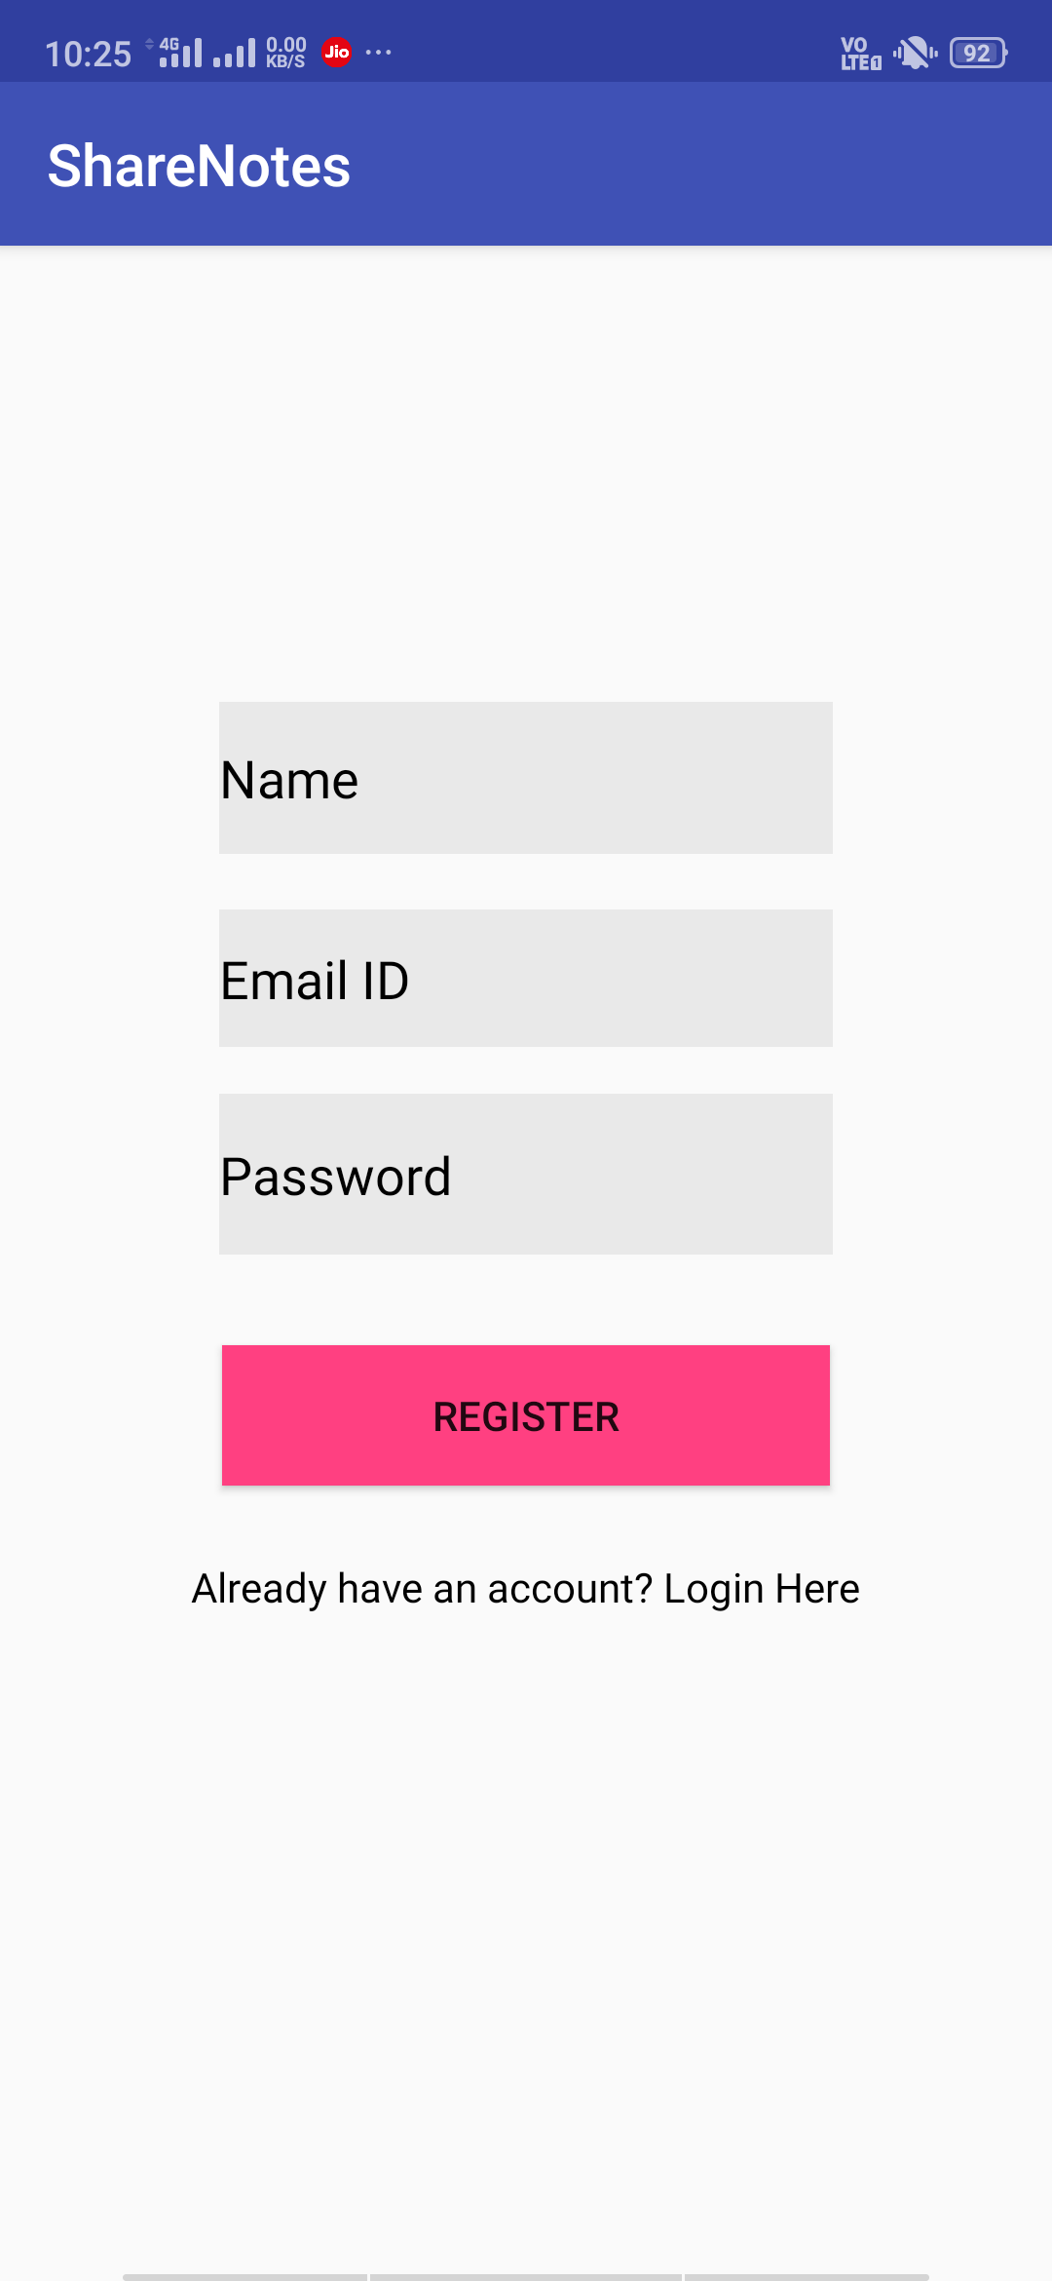
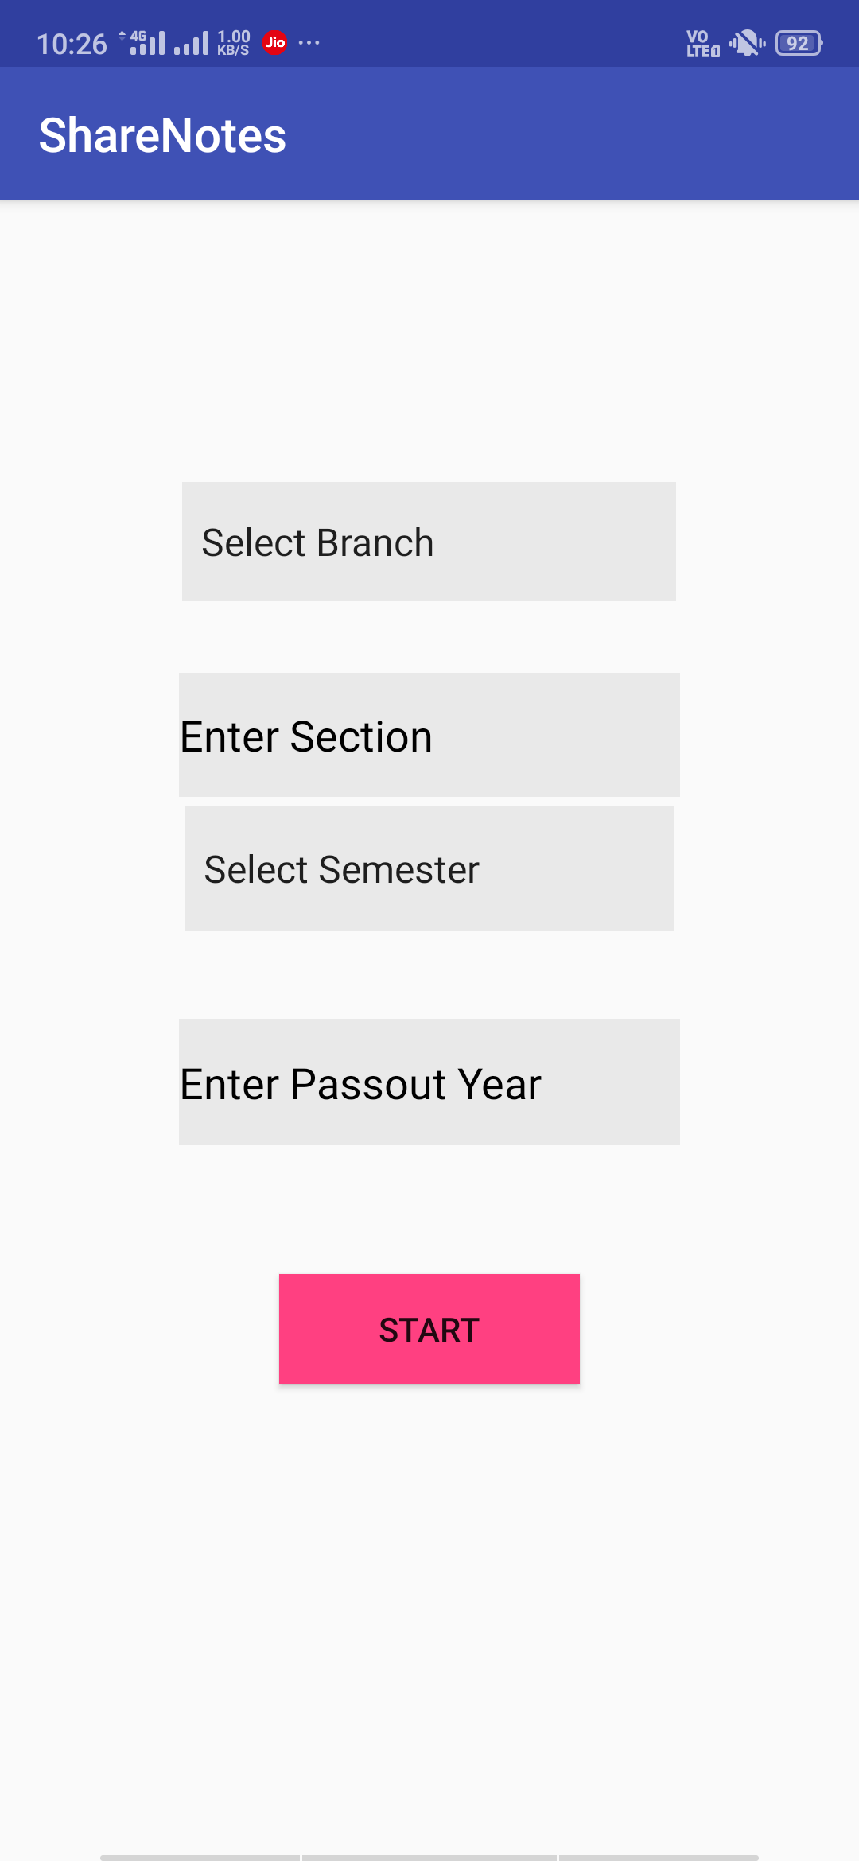
UI DESIGN

Slide 22
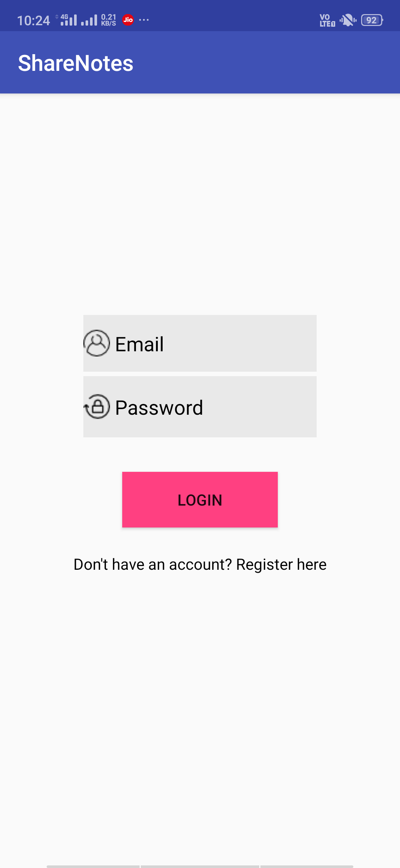
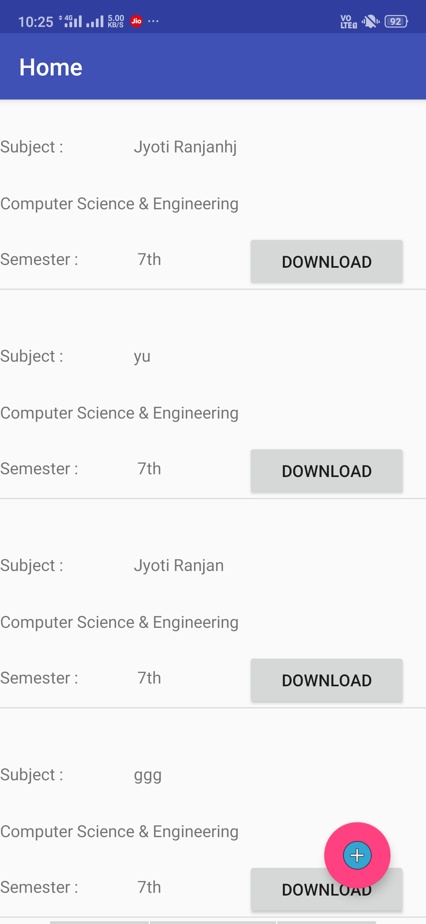
UI DESIGN

Slide 23
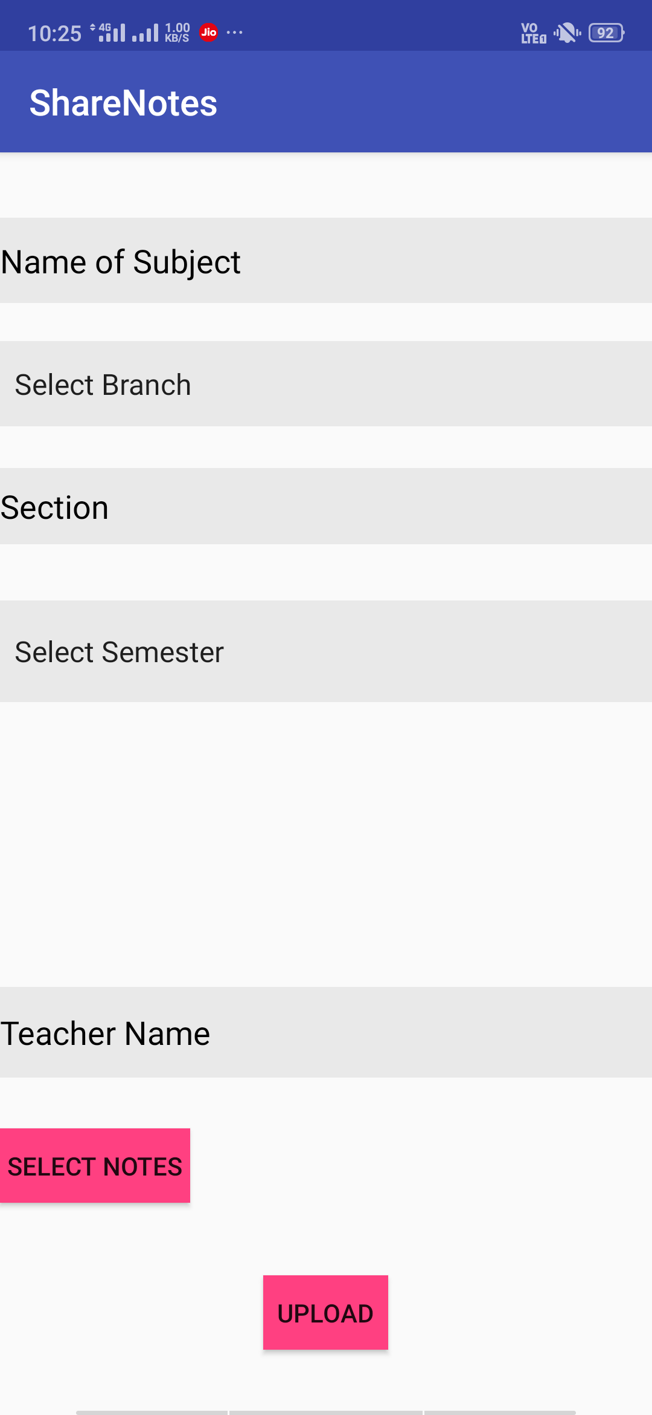
UI DESIGN

Slide 24
CONCLUSION
Students often face problem while collecting notes and it interrupts their learning process.
Our application will provide a platform for the students where they can come together for collaborative learning.
It is an easy to host application that can be swiftly implemented using firebase.
This app can be easily scaled with very less cost to promote collaborative learning

Slide 25
FUTURE SCOPE
We aim to extend this app beyond Note Sharing to promote collaborations not only between students but also between teachers and management by adding different features such as notice board, reviews, feedbacks etc.

Slide 26
THANK YOU

