Slide 1
Introduction
Hotel Management System is a Java-based desktop application developed using Object-Oriented Programming (OOP) concepts and Swing GUI.
The system helps hotel staff efficiently manage room bookings, customer details, food orders, billing, and reports through a user-friendly graphical interface.
It automates reservations, check-in/check-out, invoice generation, and room status tracking, making hotel management faster and more accurate.

Slide 2
Problem Statement
Traditional hotel management systems rely on manual record keeping, leading to:
• Time-consuming booking processes
• Human errors in billing and customer data
• Difficulty in tracking room availability
• Inefficient handling of food orders and reports
Problem: Automate hotel operations with accuracy and ease.
Solution: A Java-based system managing rooms, customers, food, billing, and reports efficiently.

Slide 3
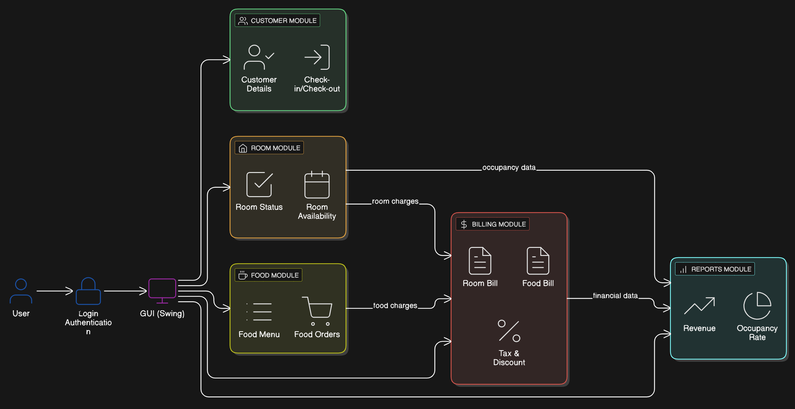
Project Overview (Block Diagram)
User (Admin) → Login Authentication → Hotel Management GUI (Swing)
Customer Module: Details, Check-in / Check-out
Room Module: Availability, Status tracking
Food Module: Menu management, Food orders
Billing Module: Room bill, Food bill, Tax & Discount
Reports Module: Revenue, Occupancy rate
Modular architecture improves maintainability and scalability.

Slide 4
Tools & Technologies Used
Programming Language: Java
GUI Framework: Java Swing
OOP Concepts: Encapsulation, Abstraction, Inheritance, Polymorphism
Data Structures: ArrayList
Date Handling: java.time.LocalDate
IDE: Eclipse / IntelliJ IDEA / NetBeans
File Handling: FileWriter (Invoice generation)

Slide 5
Features of the System
Secure Admin Login
Room reservation, cancellation, check-in and check-out
Real-time room availability tracking
Food ordering with quantity selection
Automatic bill calculation with tax and discount
Invoice generation and booking history
Search functionality, maintenance handling, reports, and notifications

Slide 6
OOP Concepts Used – Overview
The project follows Object-Oriented Programming principles
Modular, scalable, and easy to maintain system design
Key concepts used:
• Encapsulation
• Abstraction
• Inheritance
• Polymorphism

Slide 7
Encapsulation
Class variables are declared private
Controlled access provided using getters and setters
Example classes: Customer, Room, Food
Benefits:
• Protects data from unauthorized access
• Improves security and maintainability

Slide 8
Abstraction
Achieved using well-defined classes (Customer, Room, Food)
Internal logic is hidden from the GUI layer
GUI interacts only with methods like getRoomBill(), getFoodBill()
Benefits:
• Simplifies complex logic
• Improves code readability

Slide 9
Inheritance
Used through Java’s built-in Swing classes
HotelManagementGUI extends JFrame behavior
Benefits:
• Code reuse
• Reduced redundancy
• Enhanced functionality

Slide 10
Polymorphism
Implemented using method overriding
toString() overridden in Customer, Room, and Food classes
Same method behaves differently for different objects
Benefits:
• Flexible and dynamic behavior
• Cleaner and reusable code

Slide 11
Conclusion
The Hotel Management System successfully automates hotel operations using Java and OOP principles.
It reduces manual effort, improves efficiency, and ensures accurate billing.
The project demonstrates strong knowledge of Java, Swing, OOP, and real-world software development.

