Slide 1
SYSTEM DESIGN — INTERNAL
AI JIRA Story Generator
A conversational pipeline that turns raw meeting notes into validated,
INVEST-scored JIRA stories using Claude, then pushes them to a JIRA
Cloud project on request.
Status Working draft Updated 2026-07-14 Owner Nikhil Patil Runtime FastAPI + React (Vite) + Claude

Slide 2
01
Overview
The app is a single chat surface backed by a small FastAPI service. A user pastes unstructured text — meeting notes, a feature idea — and an orchestrator agent decides, turn by turn, whether to ask a clarifying question, run the generation pipeline, revise a draft, or push approved stories to JIRA.
Session state (conversation history, drafted stories, stage) lives in a single in-memory store keyed by session_id, so the whole system is one process with no database. Story quality is enforced by a second loop inside generation: each requirement is drafted, scored by a validator agent against INVEST criteria, and refined automatically until it passes or a retry budget runs out — before the user ever sees it.
3 agents
orchestrator, drafter/validator, extractor
2 state machine stages
gathering → reviewing (→ done)
1 retry loop
draft → validate → refine per requirement
app/main.py · app/pipeline.py · app/agents/

Slide 3
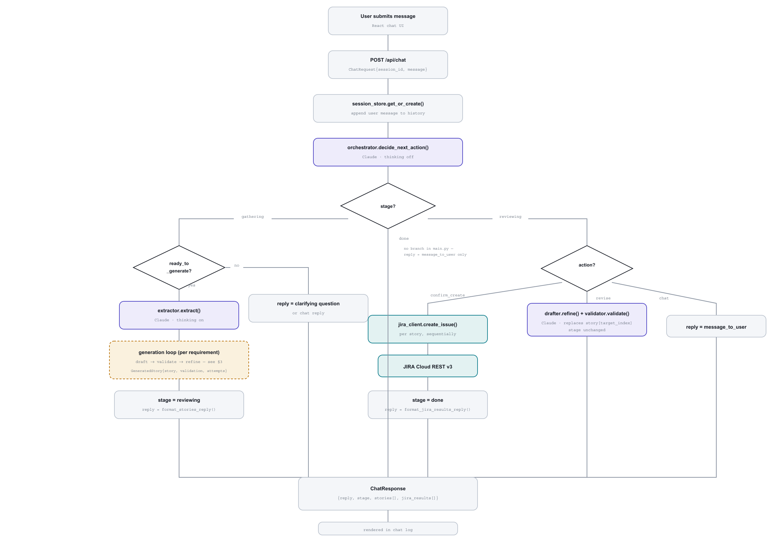
02
Request lifecycle
Every message passes through POST /api/chat, which reads the session's stage and dispatches accordingly.
API / control flow
Claude call
external system (JIRA)
expands in §3

Slide 4
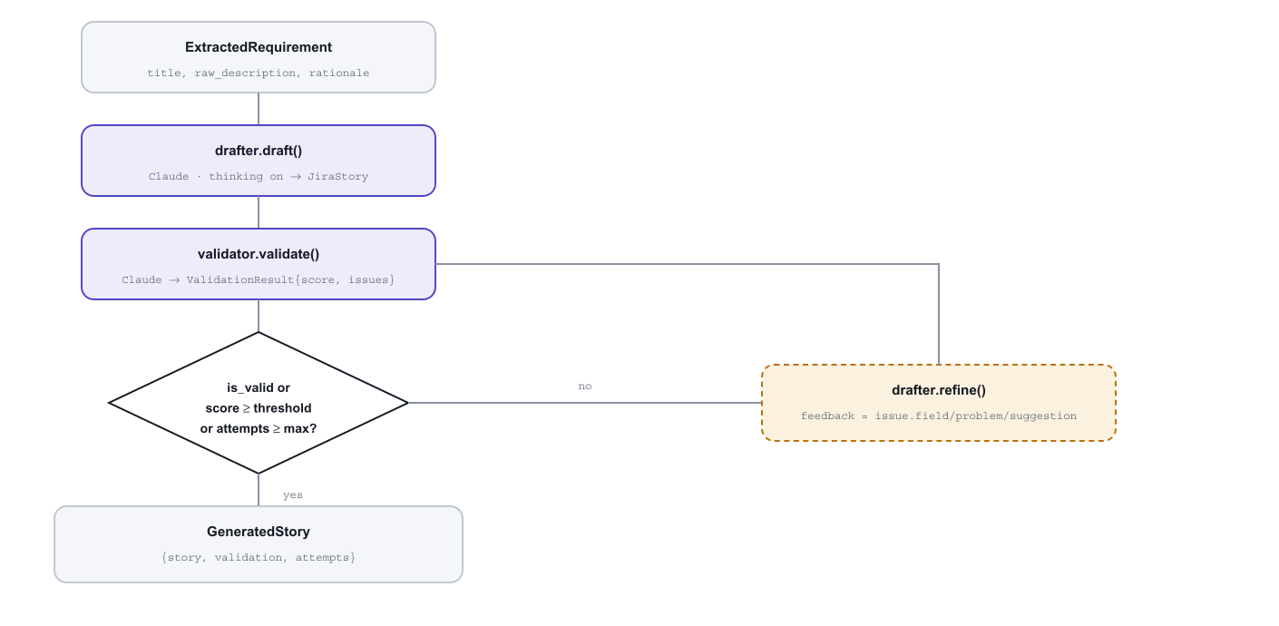
03
Generation sub-flow
generate_stories() runs once per requirement — the only automatic retry loop in the system.
MAX_REFINEMENT_ATTEMPTS default 2
VALIDATION_PASS_SCORE default 75

Slide 5
04
Components
app/main.py
FastAPI app; /api/chat, /api/reset, /health; stage dispatch
app/agents/base.py
Shared structured_call() — wraps AsyncAnthropic().messages.parse()
app/agents/orchestrator.py
Classifies the user's latest message into an action per stage
app/agents/extractor.py
Splits raw text into independent requirements + open questions
app/agents/drafter.py
Writes (draft) or revises (refine) a JIRA story
app/agents/validator.py
Scores a story 0–100 against INVEST criteria
app/pipeline.py
Runs extract → draft → validate → refine across requirements
app/services/jira_client.py
Builds ADF description, posts to JIRA Cloud REST v3
app/services/session_store.py
In-memory dict[session_id, SessionState]

Slide 6
05
Data model
Pydantic schemas in app/models/schemas.py, used directly as Claude's structured output format.
JiraStory
summary: string ≤100c
user_story: As a / I want / so that
acceptance_criteria: string[3–6]
story_points: int | null
priority · labels · issue_type
ExtractionResult
requirements: ExtractedRequirement[]
open_questions: string[]
ValidationResult
is_valid: bool
score: int 0–100
issues: {field, problem, suggestion}[]
GeneratedStory
story: JiraStory
validation: ValidationResult
attempts: int
OrchestratorDecision
action: ask_clarification | ready_to_generate |
confirm_create | revise | chat
target_story_index · revision_instructions
SessionState
stage: gathering | reviewing | done
history · raw_text_parts · stories
jira_results: dict[]

Slide 7
06
Known constraints
Single-process state. session_store is a module-level dict — sessions are lost on restart, not shared across workers.
No auth on the API. /api/chat and /api/reset take a bare session_id with no ownership check.
No explicit “done” handling. After JIRA creation, later messages still reach the orchestrator but nothing acts on them — needs /api/reset.
One JIRA project, one issue mapping. No epic linking; story points only set if JIRA_STORY_POINTS_FIELD is configured.
Secrets via .env. ANTHROPIC_API_KEY and JIRA_API_TOKEN load through dotenv — keep real values out of any checked-in example file.
Regenerate after material changes to app/main.py, app/pipeline.py, or app/models/schemas.py.

