Slide 1


Articles

Slide 2
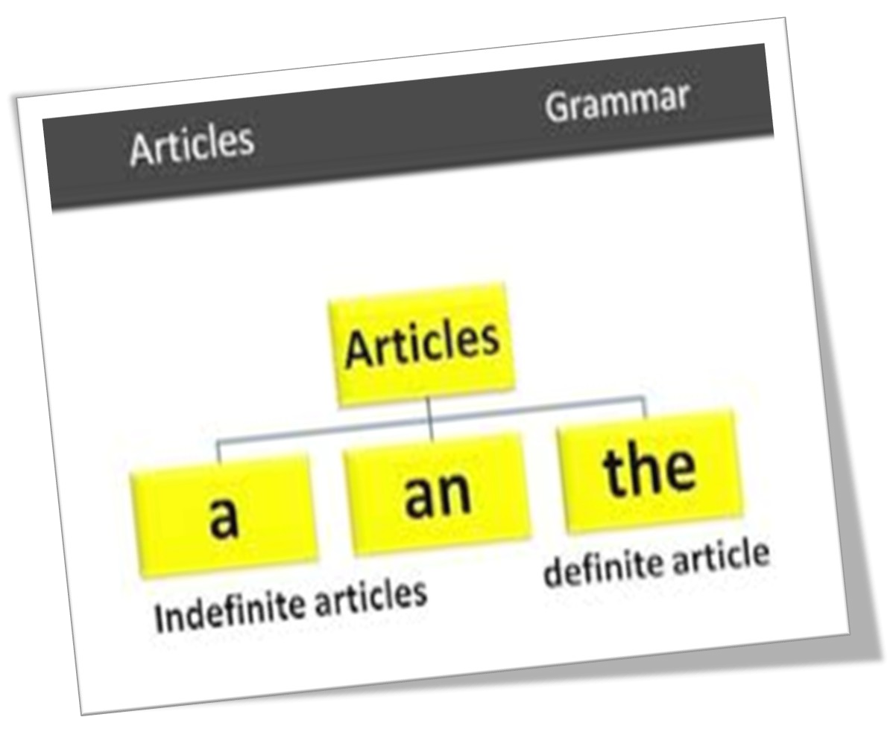

Slide 3
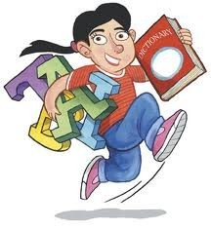
An article is an adjective. Like adjectives, articles modify nouns.
A, an and the are called articles A, an are called indefinite articles The is called definite article

Slide 4
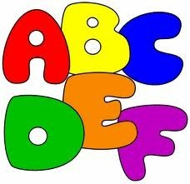
A AN THE
The is used to refer to specific or particular nouns.
A / an is used to modify non-specific or non- particular nouns.

Slide 5

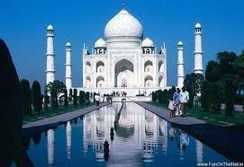
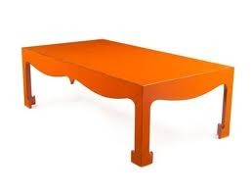
We use a, an, or the before nouns that we want to introduce.
Nouns are names of people, places, animals or things.
A Person
A Place
A thing

Slide 6
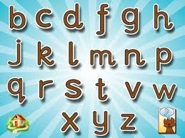

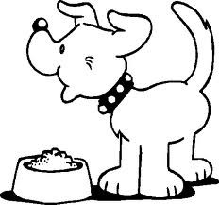
‘A’ is used
Before beginning with a consonant sound.
(Eg) a boy, a bird
Before a singular noun beginning (Eg) a book, a school, a dog.
Even before vowel letters which don’t have vowel sound.
(Eg) a European, a unit, a union.

Slide 7
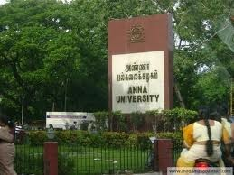
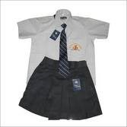
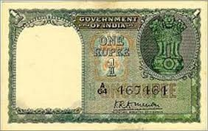
Some words start with a vowel letter but begin with a consonant sound, so we use a before these words too.
a university
a uniform
a one-rupee note

Slide 8
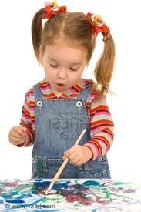
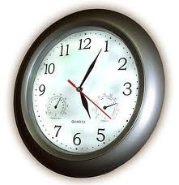
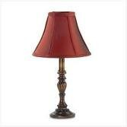
a girl
We use a before words that begin with a consonant.
a clock
a lamp

Slide 9
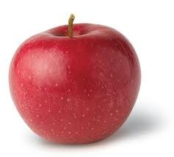
‘An’ is used
Before a word beginning with a vowel (Eg) an idiot, an apple
Before a word beginning with ' h' sounded
(Eg) an honour, an hour, an honest man
but not

Slide 10
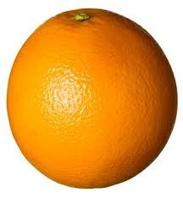
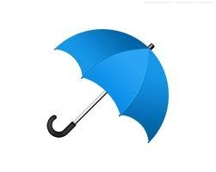
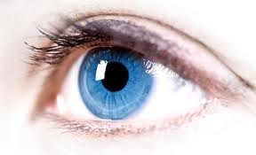
We use an before words that begin with a vowel sound .
a,e,i,o,u are vowels
an orange
an umbrella an eye

Slide 11

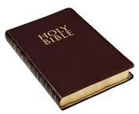
'The’ is used
Before unique objects
(Eg) the sun, the sky, the moon
Before the names of mountains, rivers, oceans, deserts etc.
(Eg) the Ganges, the Sahara, the Pacific
Before the names of books
(Eg) the Bible, the Ramayana, the Quran

Slide 12
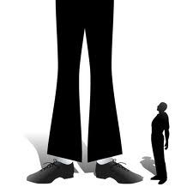
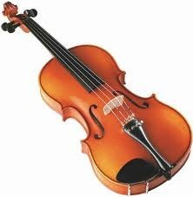
4. Before the superlative degree (Eg) the best, the tallest
Before musical instruments (Eg) the flute, the violin
Before an adjective to denote a whole class (Eg) the old, the rich, the poor

Slide 13


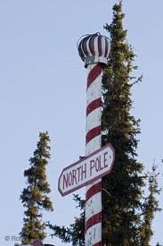
We use the when we know that there is only one of a particular thing.
the sky
the world
the North Pole

Slide 14
Omission of article
Before the names of relations (father, uncle,sister )
Before the names of material (gold, silver, diamond ) 3.Before proper noun ( Lotus, Chennai, Priya ) 4.Before abstract noun (honesty, wisdom, truth ) 5.Before language ( Tamil, Hindi, English )
6.Before certain phrases ( at noon, by train, on foot )

Slide 15
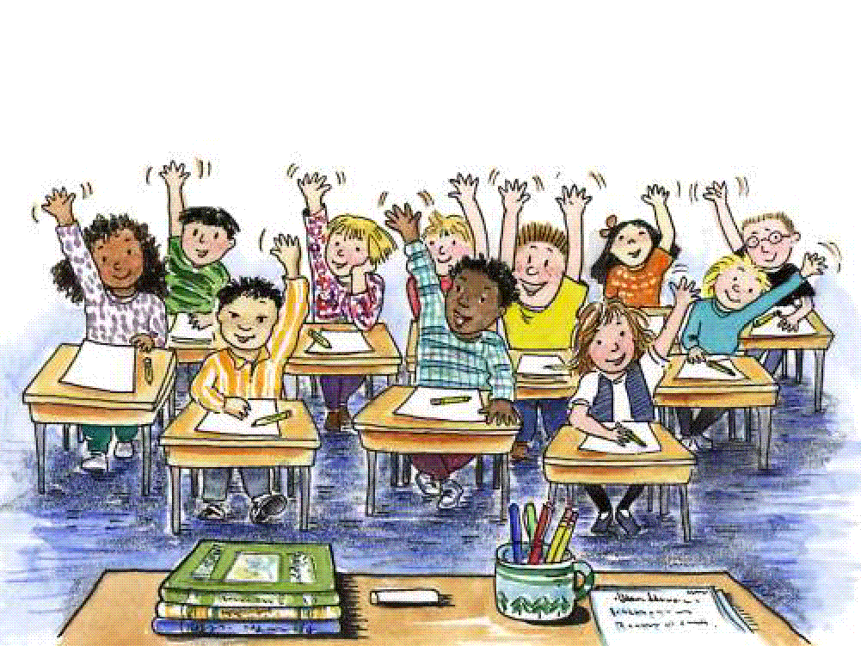
THE END!!!

