Slide 1
SELF-SOVEREIGN IDENTITY FOR CONNECTED VEHICLES
Every V2V message signed, every receiver verifying: the identity layer, shown
Nikhil Prakash · MASc, Electrical and Computer Engineering, UBC
blue = SSI / MOBI VID ochre = PKI
Notes:
Title. The road at the bottom is the deck's motif: blue vehicles carry an SSI / MOBI VID identity (W3C credential, secp256k1), ochre ones a PKI pseudonym certificate (X.509, ECDSA P-256).

Slide 2
FOUR QUESTIONS
RQ1
Cost
RQ2
Security
What does a vehicle identity cost on chain, standard by standard?
Which architecture rejects the V2X attacks of the threat model?
RQ3
Compliance
RQ4
Real time
Can a blockchain identity layer meet W3C DID and VC and MOBI VID?
Does credential verification fit the 100 ms V2V safety budget?
Notes:
RQ4 is highlighted: the rest of the deck shows the V2V message path that answers it, plus the attacks (RQ2) and the gas costs (RQ1).

Slide 3
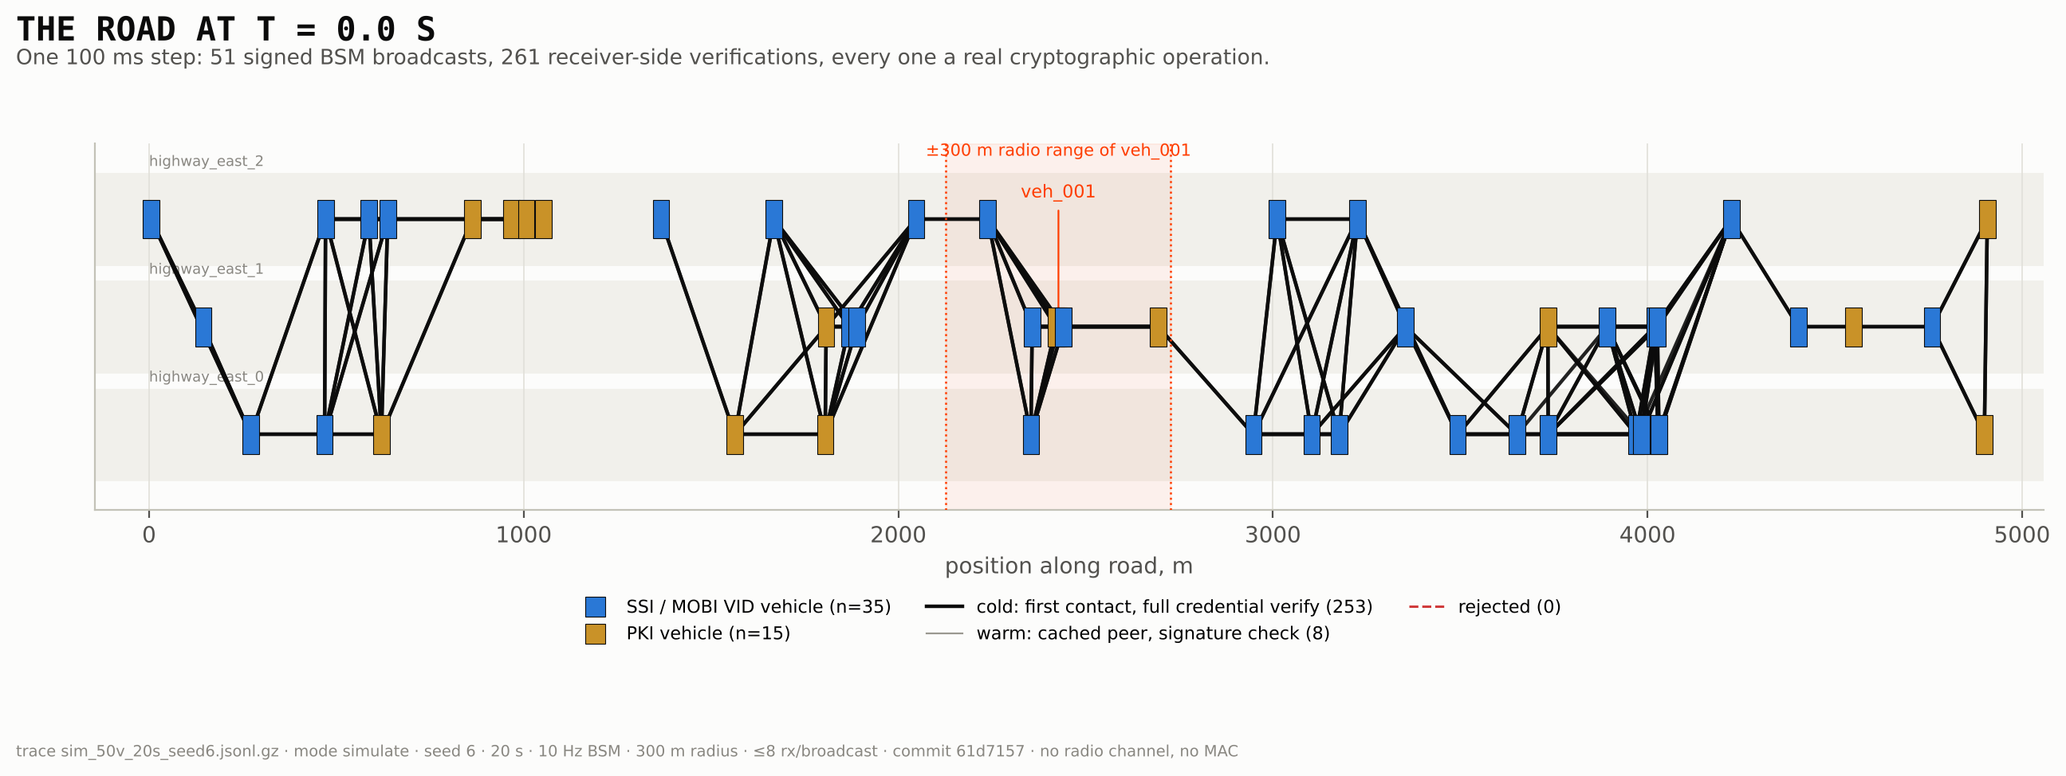
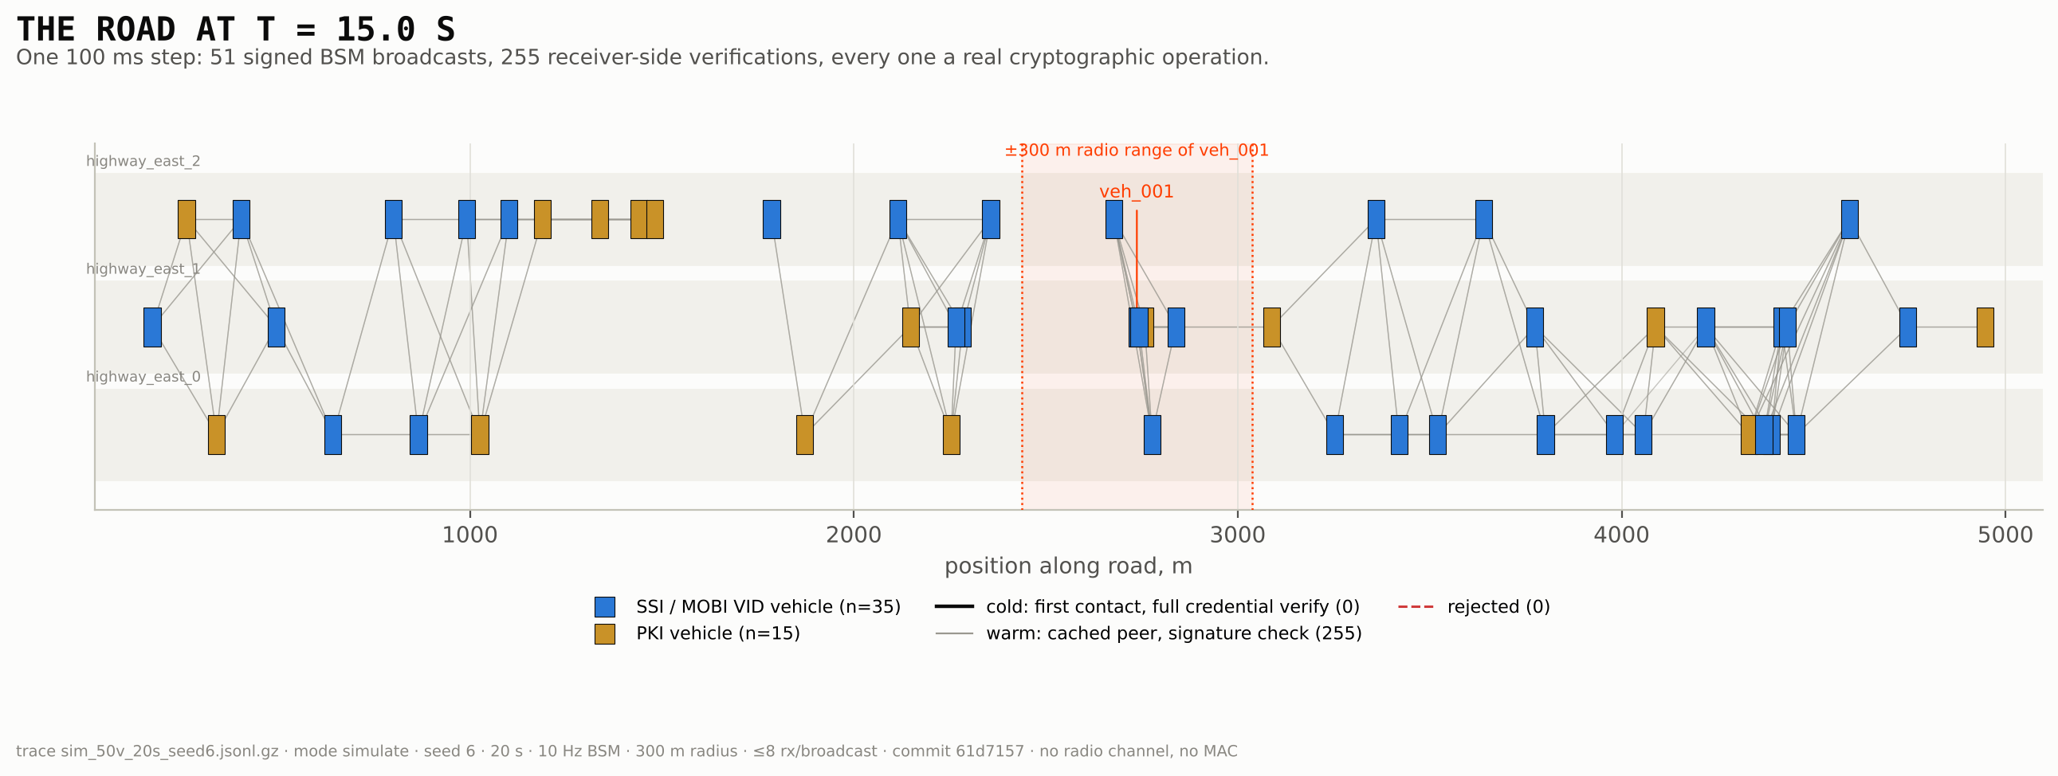
THE ROAD, 100 MS AT A TIME
t = 0 s
Every neighbour is a first contact: links are cold, full credential verification.
t = 15 s
Steady state: one signature check against a cached key per message.
50 vehicles, 10 Hz, seed 6 of the registered N = 30 set; mock mobility, no radio channel.
Notes:
Figures V-1 and V-2 (docs/visual/FIGURES.md). Each link is a verification that ran. Command: thesis_figures.py traces/sim_50v_20s_seed6.jsonl.gz --t 0 15.

Slide 4
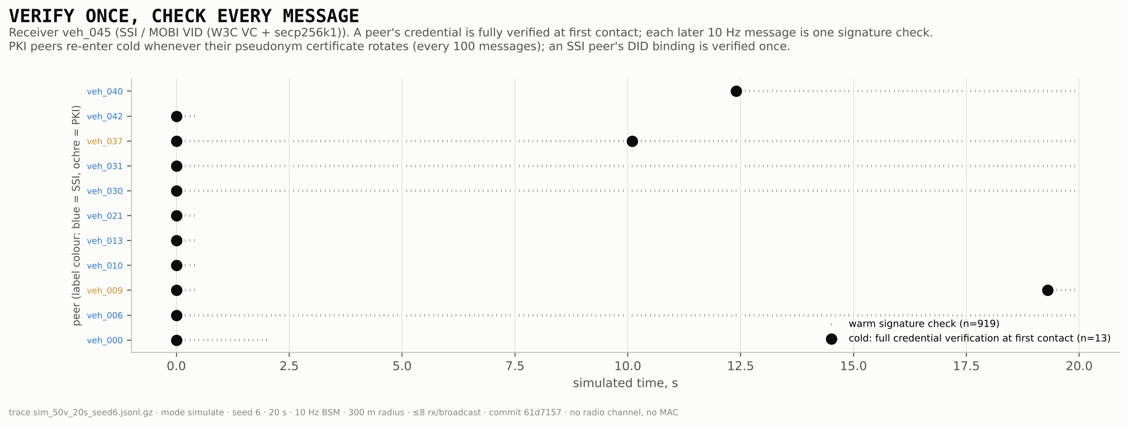
VERIFY ONCE, CHECK EVERY MESSAGE
PKI peers re-enter cold at every pseudonym-certificate rotation (every 100 messages); an SSI peer's DID binding is verified once per encounter.
Notes:
Figure V-5. A finding the tables did not show: the PKI design pays the full chain check again at each rotation.

Slide 5
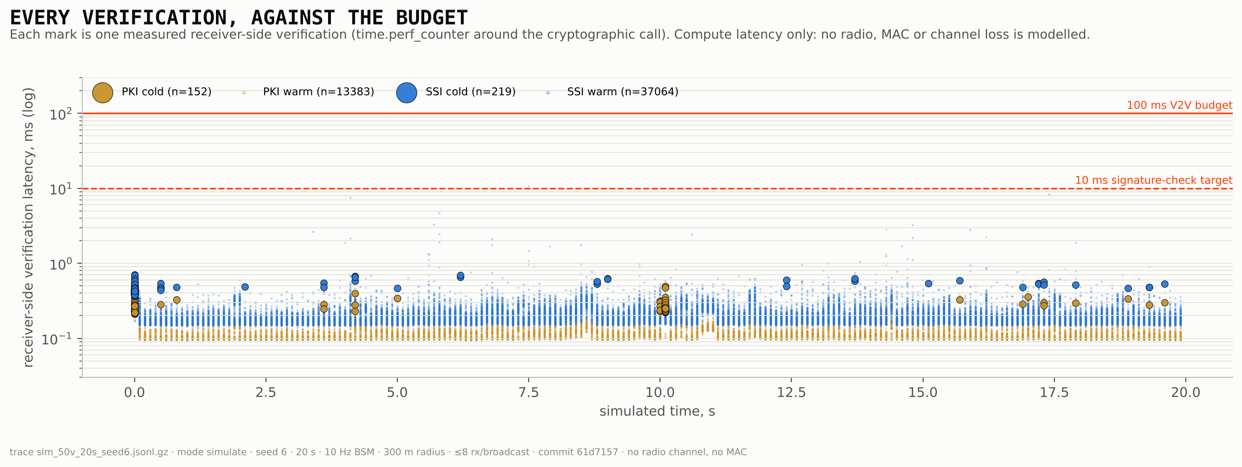
EVERY VERIFICATION, AGAINST THE BUDGET
0.142 ms
SSI warm verify, median of 30 run-medians (register #27)
100 ms
SAE J2945/1-derived V2V budget
Compute latency only: no radio, MAC or channel loss is modelled.
Notes:
Figure V-6. The headline number is the result of record (#27, 0.142 ms [0.141, 0.143]); the figure illustrates one seed.

Slide 6
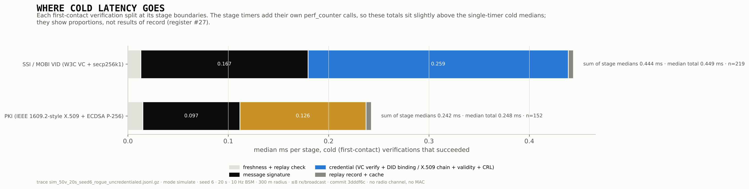
WHERE COLD LATENCY GOES
0.259 ms
0.126 ms
Measured with stage timers on, so these are proportions; results of record stay #27.
SSI credential step: W3C VC verify + DID binding
PKI credential step: X.509 chain + validity + CRL
Notes:
Figure V-15 (F8), from the uncredentialed-rogue trace with --stage-timers.

Slide 7
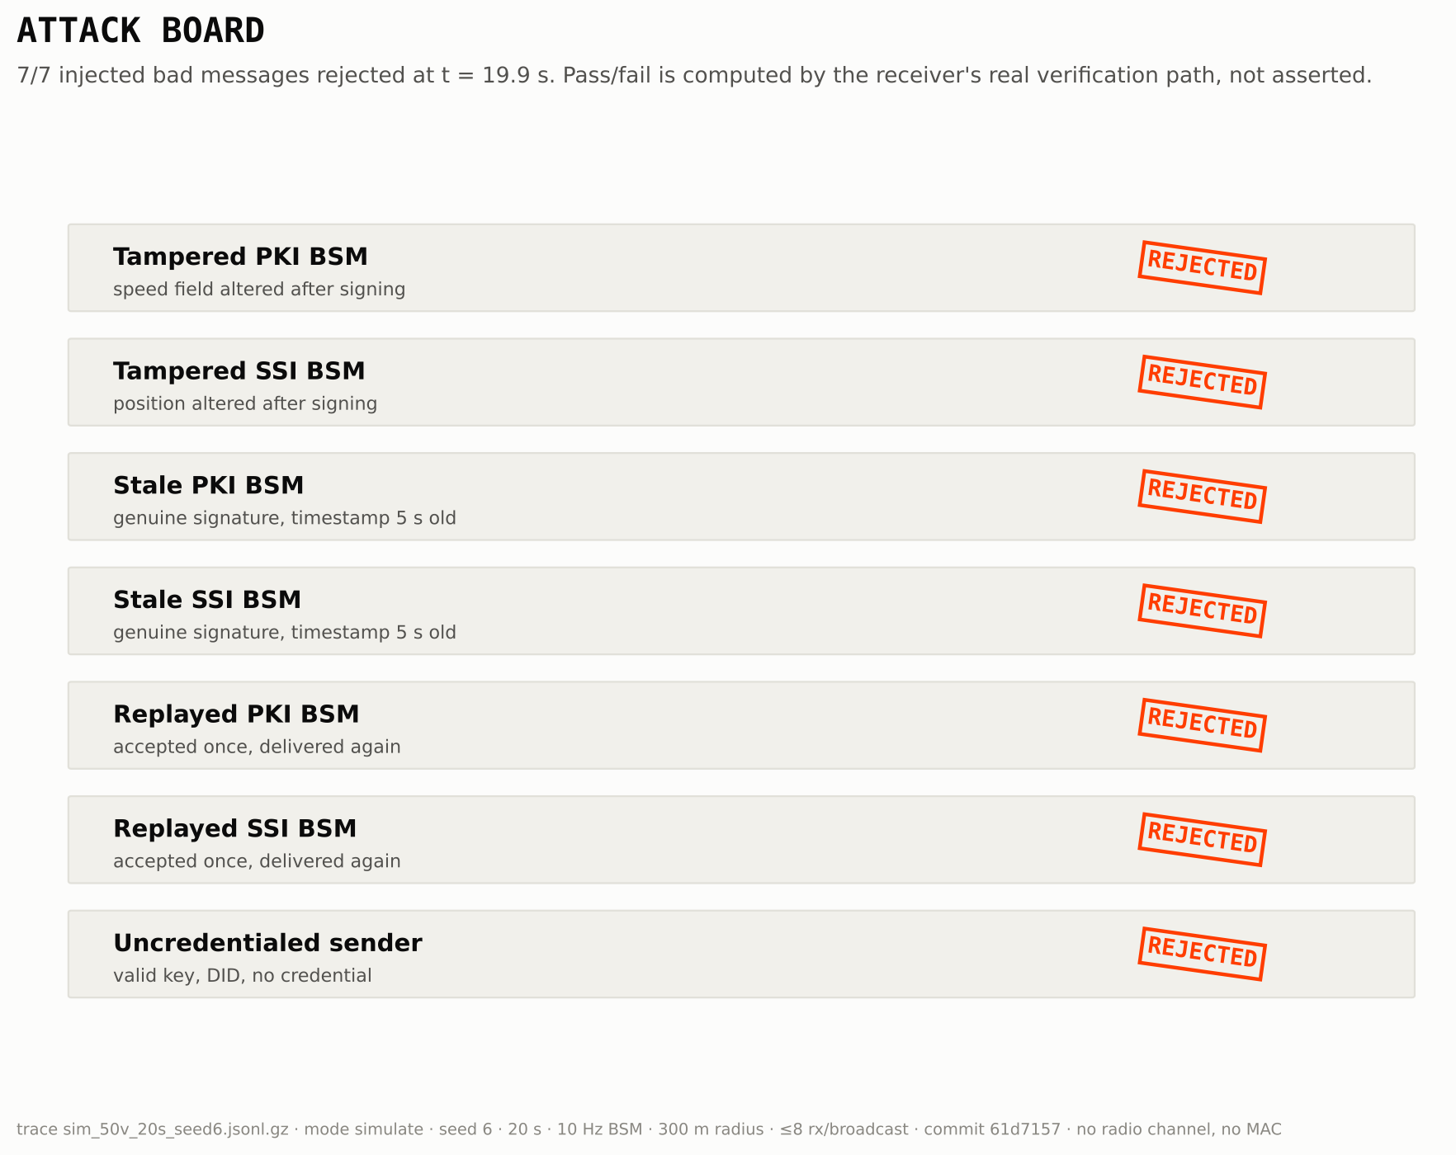
SEVEN ATTACKS, SEVEN REJECTIONS
Injected after every run, in both populations:
tampered, stale and replayed BSMs, and a sender with a key and a DID but no credential.
Pass or fail is computed by the receiver's real verification path, not asserted.
30 / 30 runs in the register.
REJECTED
Notes:
Figure V-8. The infrastructure attacks (I2, register #45) are drawn by the trunk renderer.

Slide 8
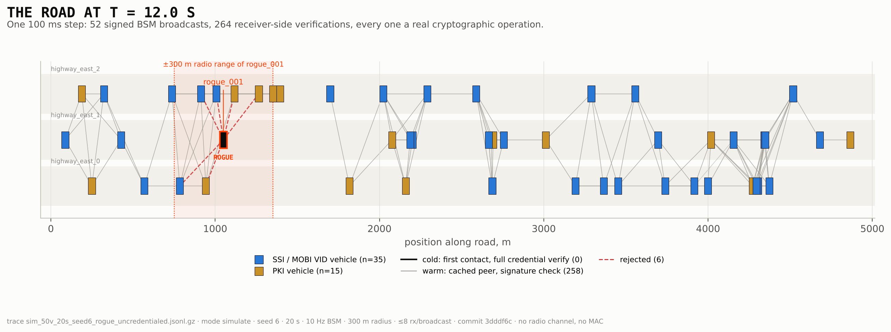
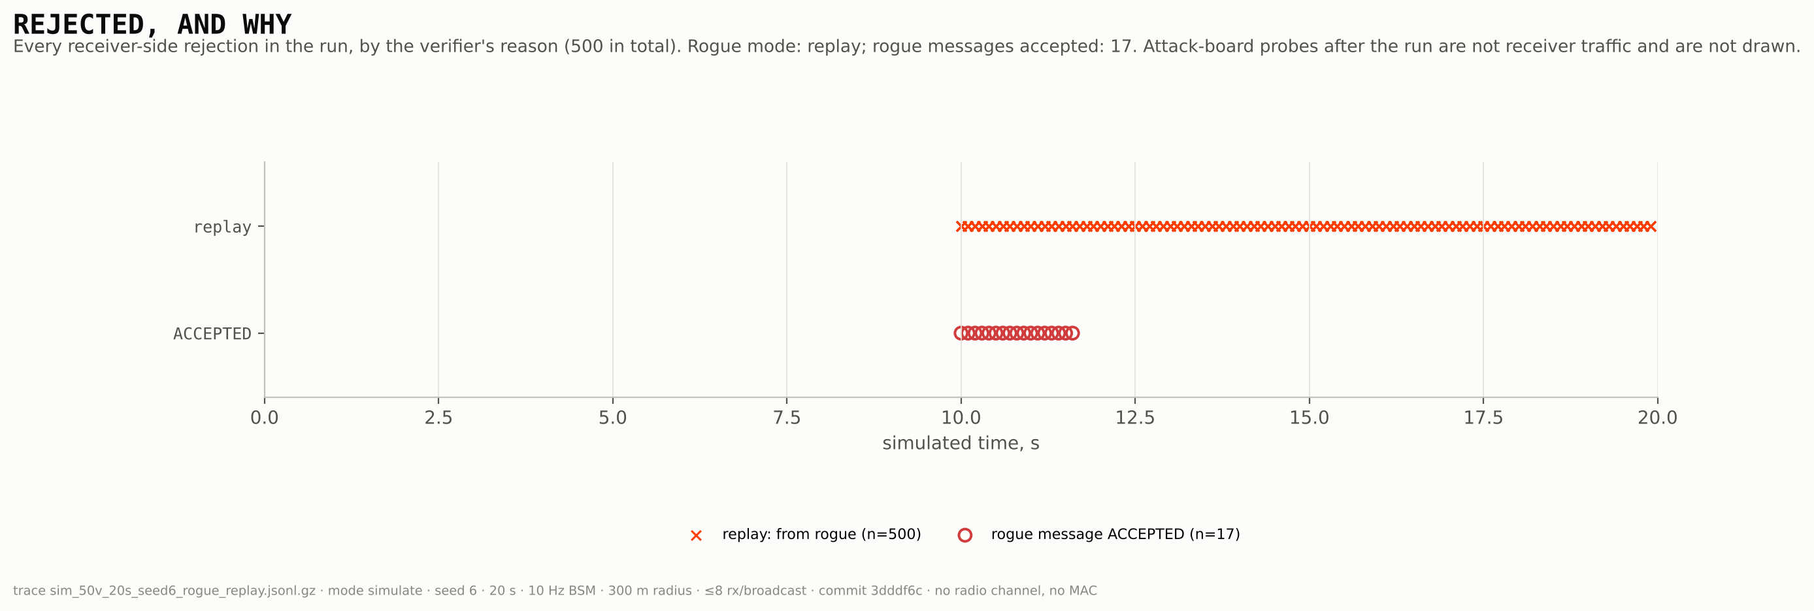
AN ATTACKER ON THE ROAD
617
of 617 uncredentialed rogue messages rejected
17
replays accepted: fresh genuine messages relayed to receivers that missed the original
Authenticity holds; reach is extended. A position-plausibility check would close it.
Notes:
Figures V-13 and V-14. Seed 6, rogue from t = 10 s. Tamper mode: 517 / 517 rejected (signature, binding). The relay limit applies to SSI and PKI alike and is proposed for docs/THREAT_MODEL.md.

Slide 9
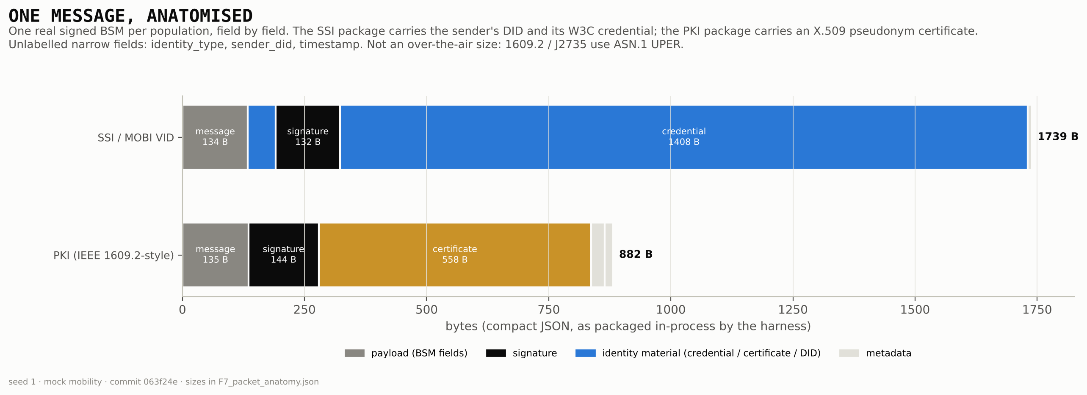
ONE MESSAGE, ANATOMISED
The 1,408 B credential rides on every SSI message as the harness packages it, though a receiver needs it only at first contact. Compact-JSON sizes, not over-the-air ASN.1.
Notes:
Figure V-11 (F7), packet_anatomy.py --seed 1. A bandwidth point for chapter 6.

Slide 10
WHAT AN IDENTITY COSTS ON CHAIN
33.7×
spread, ERC-735 against CVIN-Combined
Source: 4_comparison-framework/results/gas_benchmark.json (register #25, commit 7a59058). MOBI-VID-V2 is an application profile, not a base standard.
Notes:
Native chart from the results of record (gas_benchmark.json, register #25); the README key-results table carries the same values.

Slide 11
WHAT THE PICTURES MAY CLAIM
In the pictures | Real or mock | A caption may say
Signing of each BSM | Real: ECDSA P-256 (PKI), secp256k1 EIP-191 (SSI) | each message is actually signed
Cold and warm verification | Real: X.509 chain and CRL; W3C VC and signature recovery | every link drawn is a verification that ran
Latency on any axis | Real: time.perf_counter around the cryptographic call | compute latency of identity verification only
Vehicle motion | Mock kinematic model, or SUMO 1.28 over TraCI | the mobility source, always
Radio channel | Mock: in-process delivery to the 8 nearest within 300 m | no radio, MAC or channel loss
The blockchain | Not in the V2V loop: credentials verified off chain | never a chain read per message
Notes:
docs/visual/VISUAL_PLAN.md §1. Every figure footer carries the mobility source, seed, commit and the radio caveat.

Slide 12
WHAT IS NEXT
Decide N-4: SUMO for illustrations only, or S1–S3 at N = 30 in TraCI mode
State the relay limit in the threat model, with a position-plausibility check as the remedy
Send the credential on first contact, not on every message, and measure the bandwidth
Notes:
Decisions for the author: N-4 / P2-D4 on the decision sheet; the relay finding (Phase 5); the packet-size finding (F7).

