Slide 1
SQL-Capstone Project
Analysis of Amazon sales to understand the different factors that affect sales of the branches.
Nikhil Karaka

Slide 2
Agenda
1
2
3
4
5
Introduction
Data Wrangling
And Feature Engineering
Business questions
Analysis
Insights and Summary

Slide 3
Introduction
This dataset contains sales transactions from three different branches of Amazon, respectively located in Mandalay, Yangon and Naypyitaw. The data contains 20 columns and 1000 rows.

Slide 4
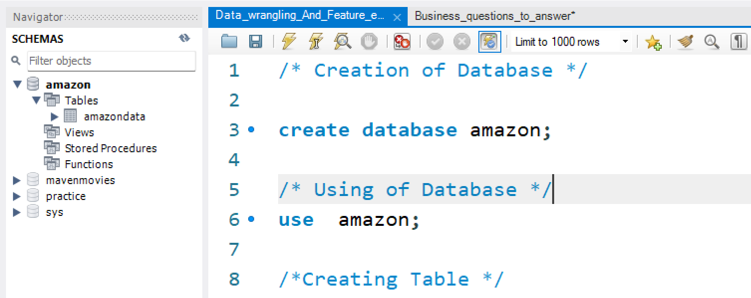
Data Wrangling
Building a database

Slide 5
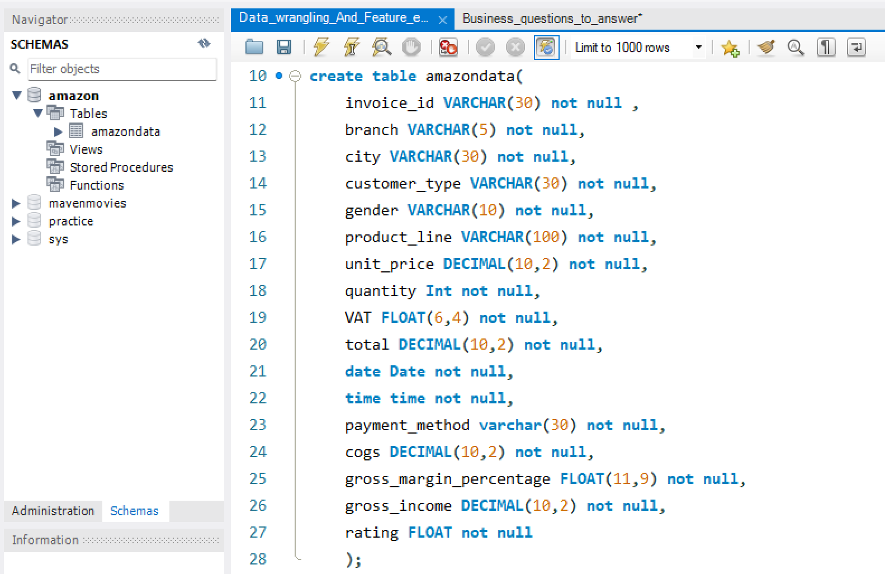
Creating a table and Insert the data

Slide 6
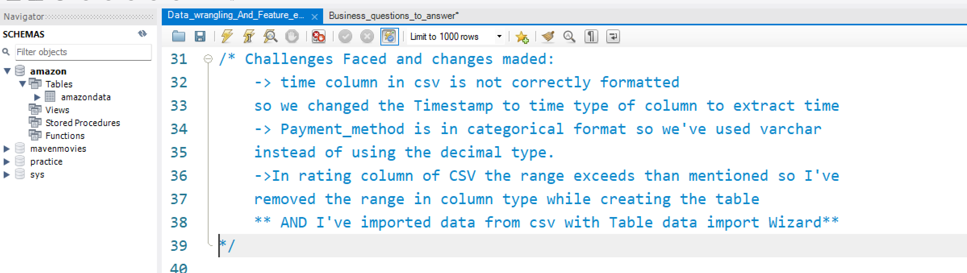
There are no null values in our database as in creating the tables, we set NOT NULL for each field, hence null values are filtered out.

Slide 7
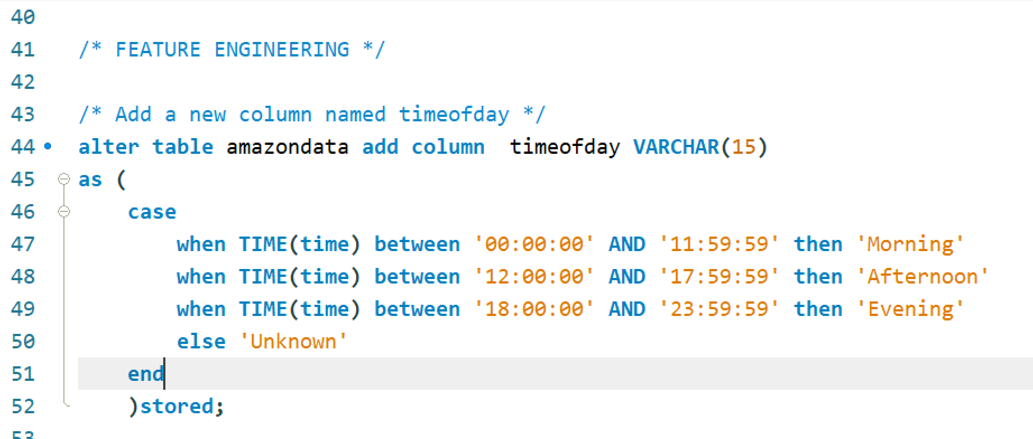
Feature Engineering

Slide 8
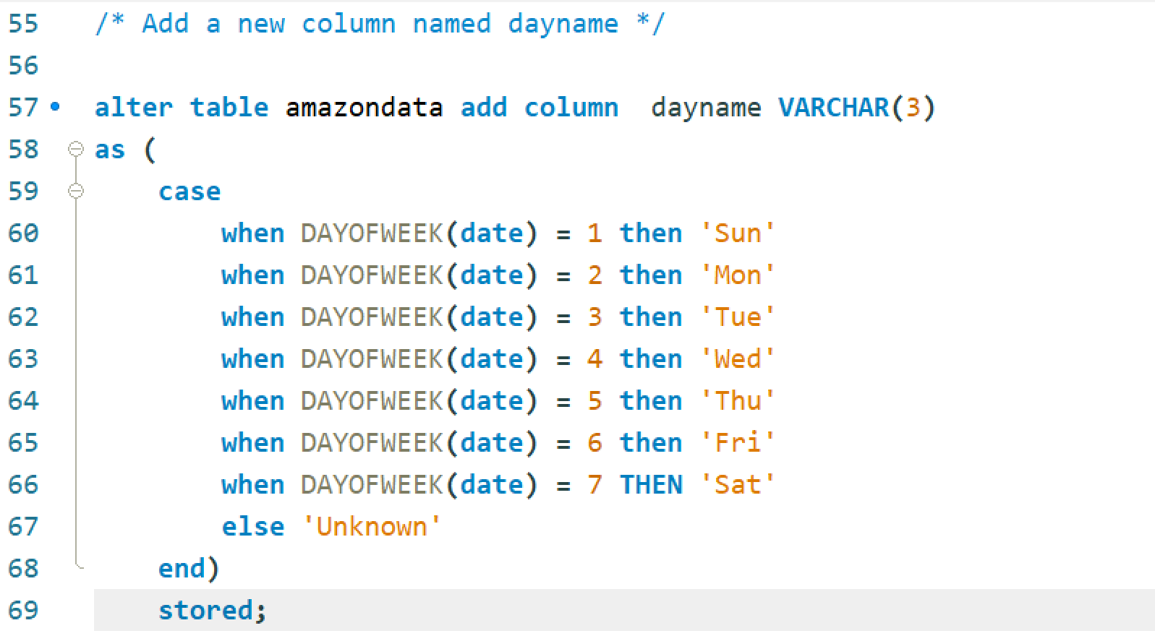

Slide 9
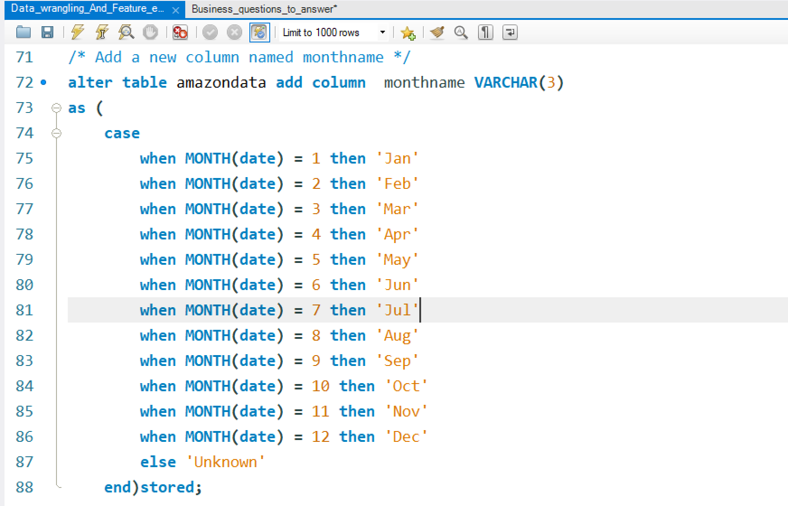

Slide 10
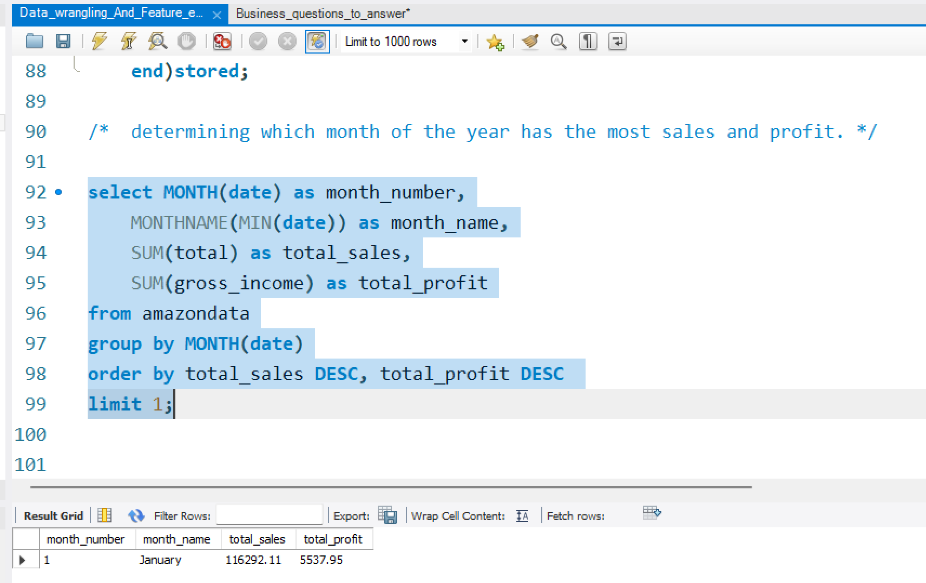

Slide 11
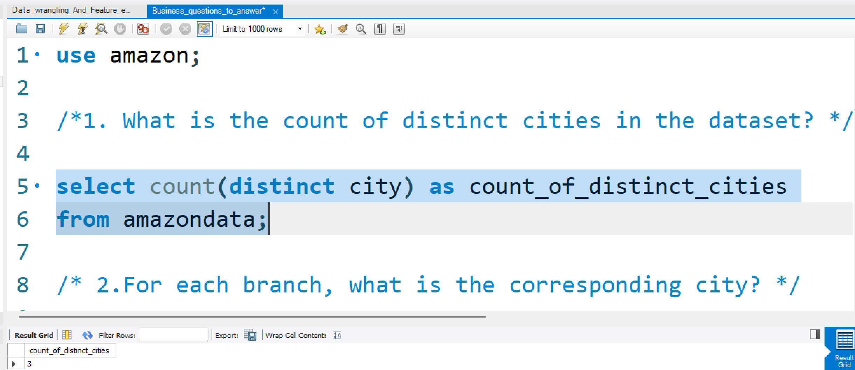
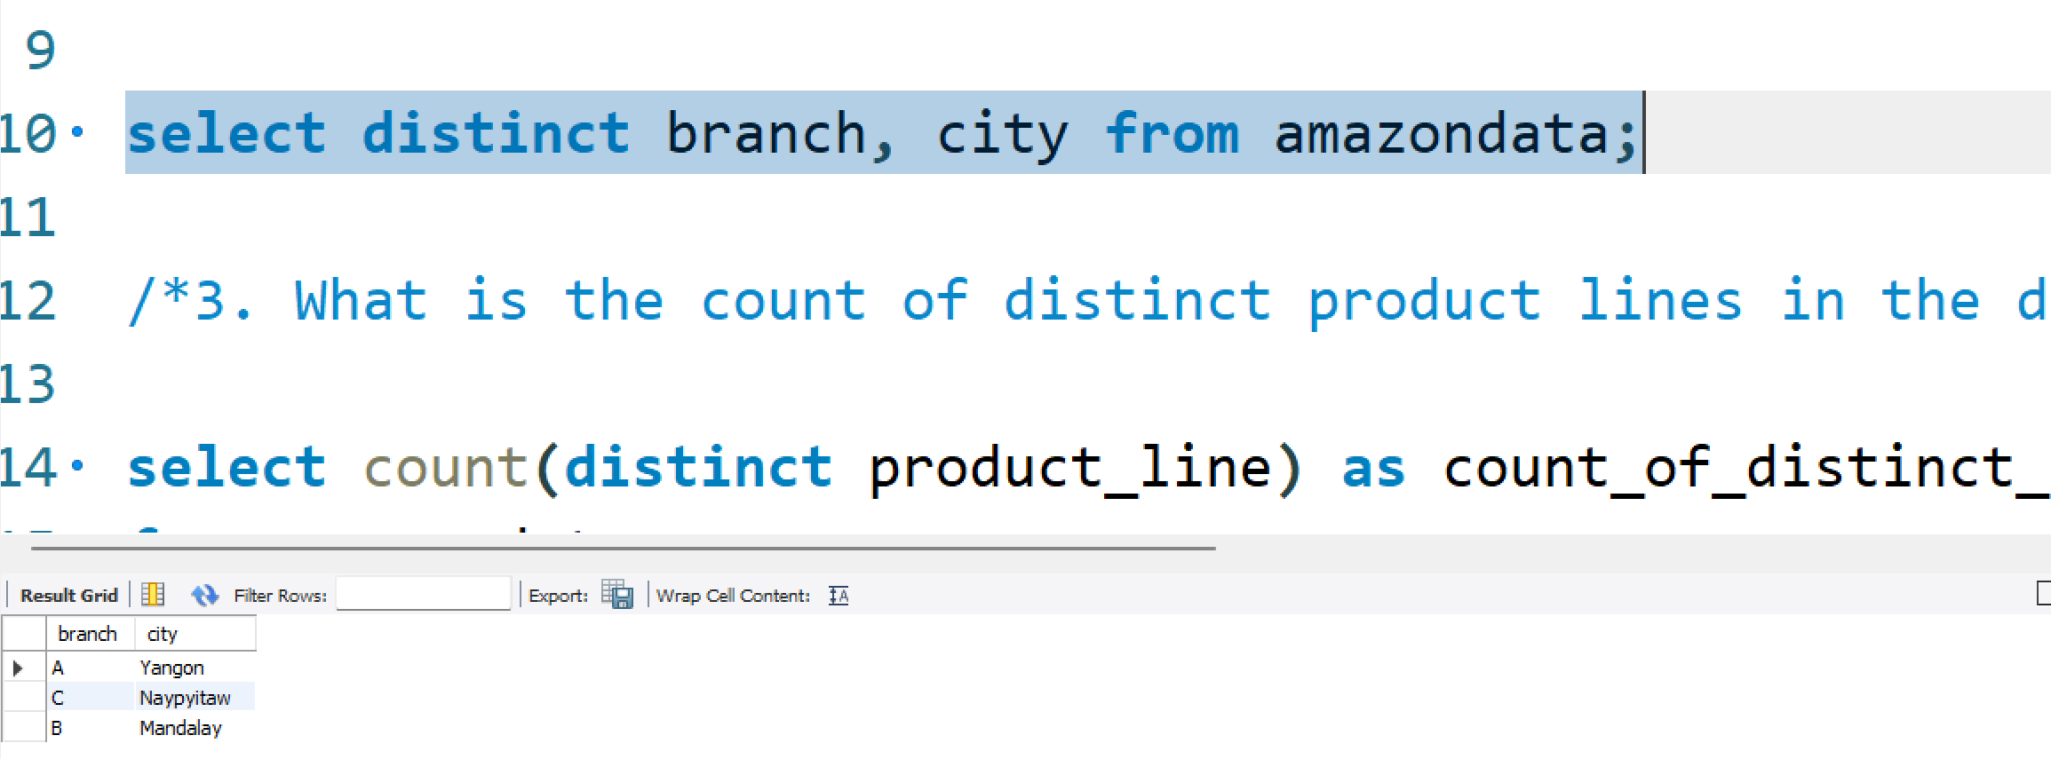
Business Questions to answer:

Slide 12
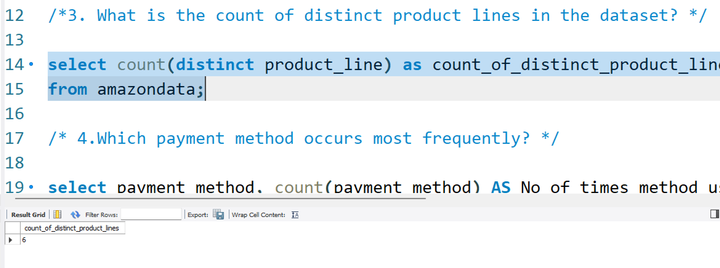
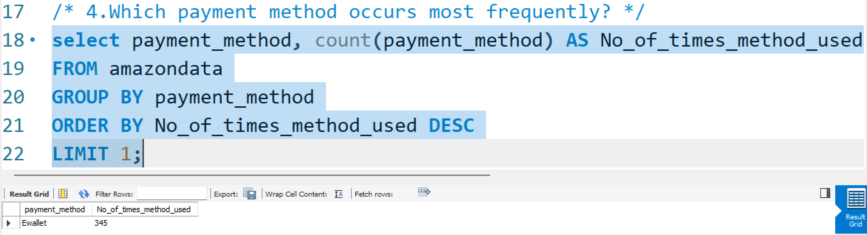

Slide 13
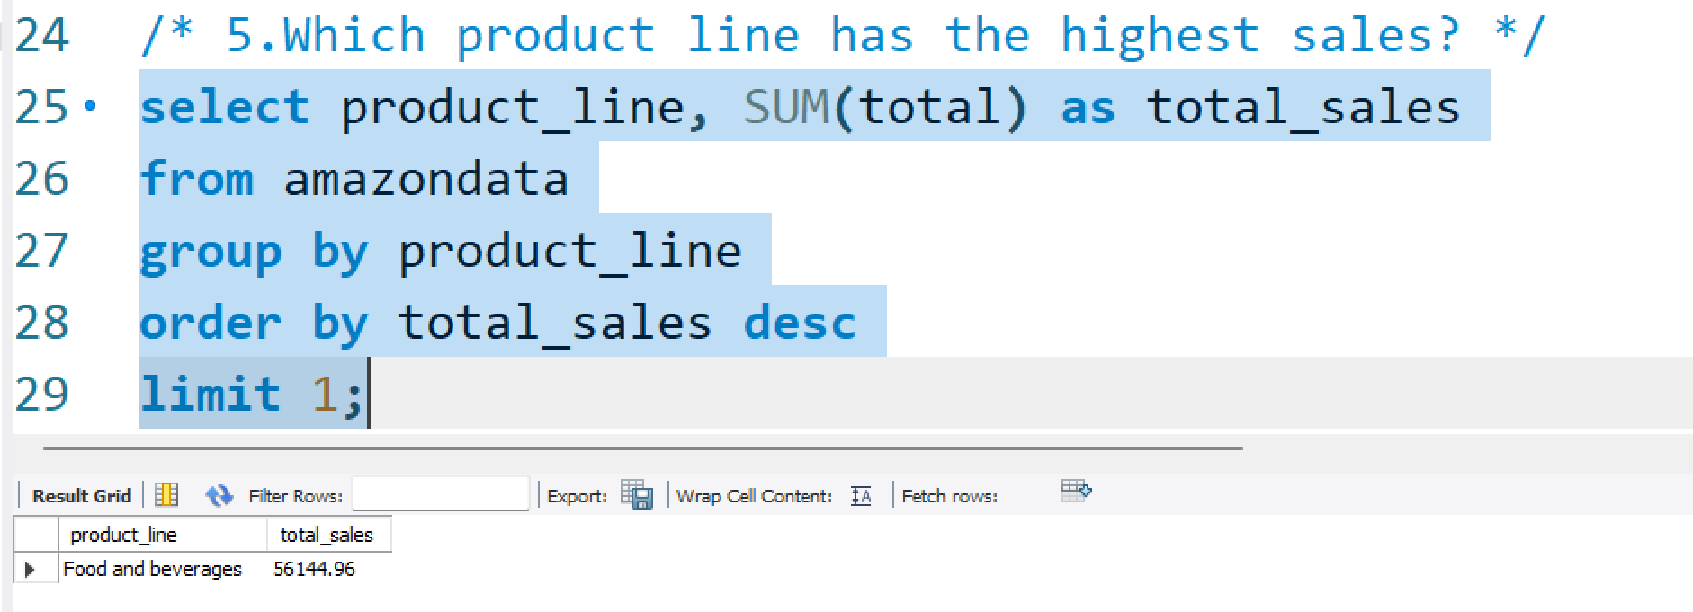
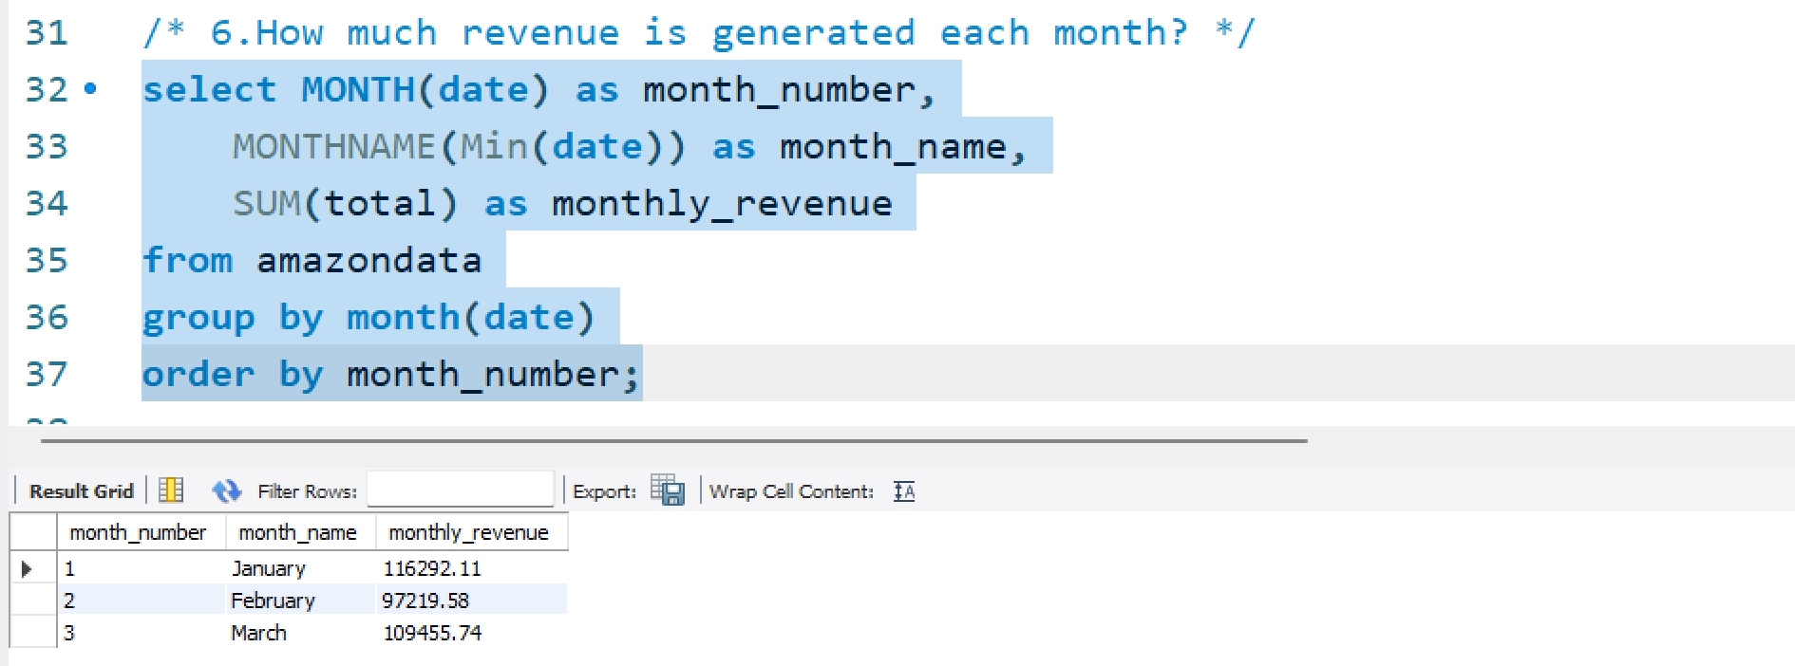

Slide 14
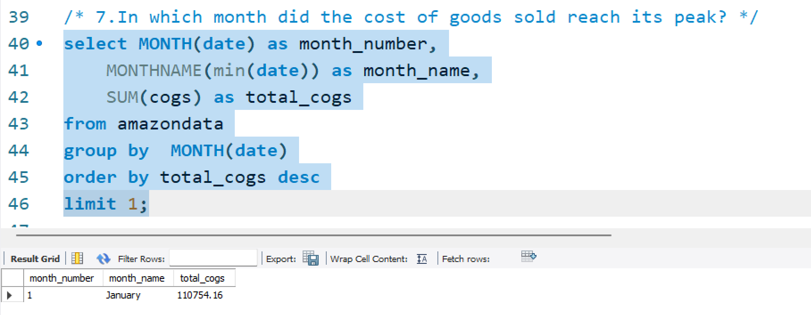
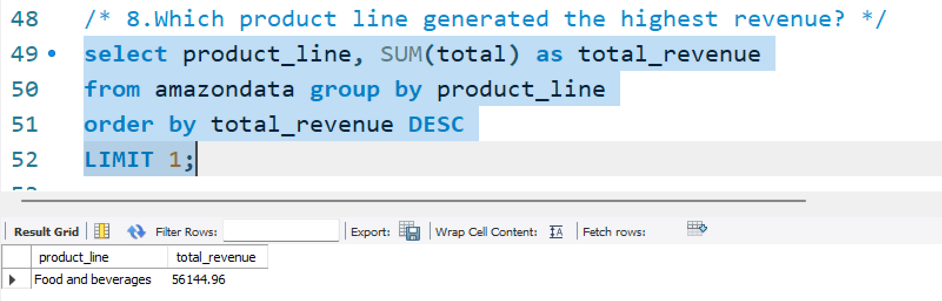

Slide 15
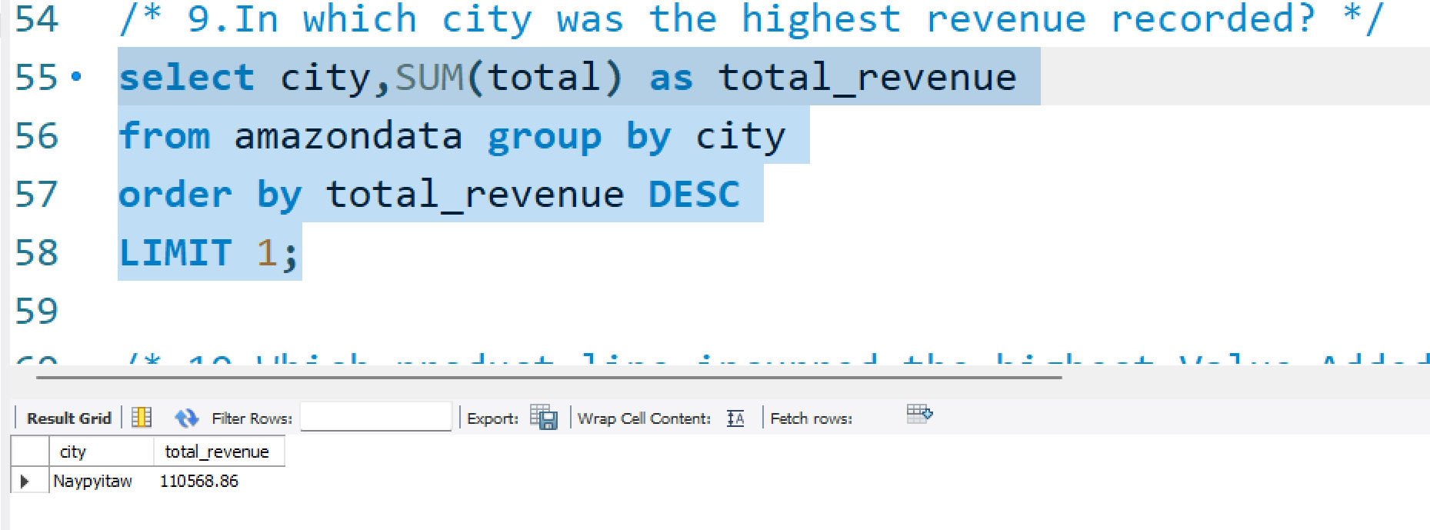
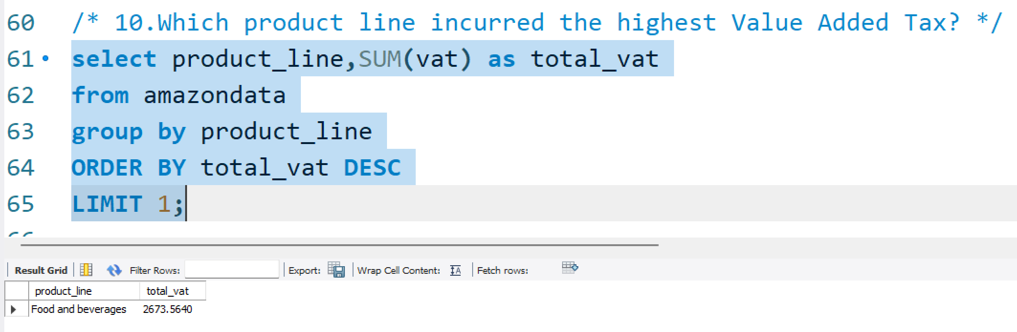

Slide 16
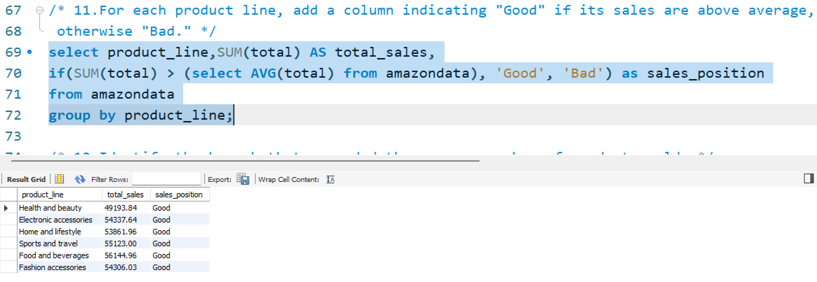
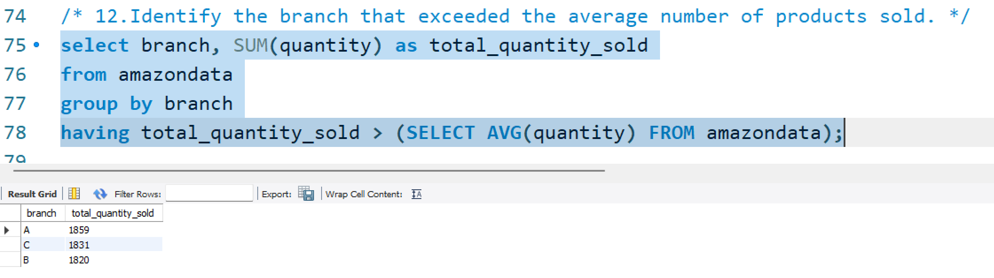

Slide 17
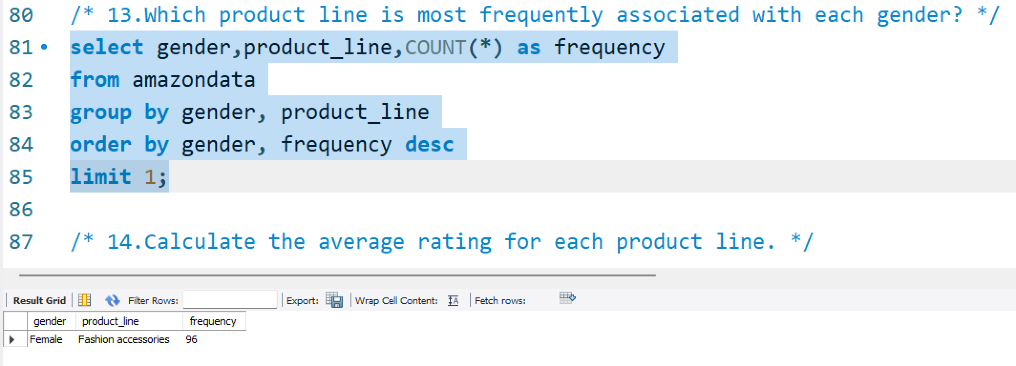
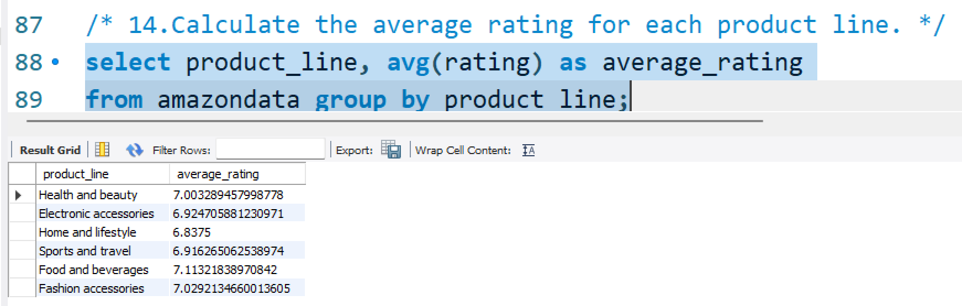

Slide 18
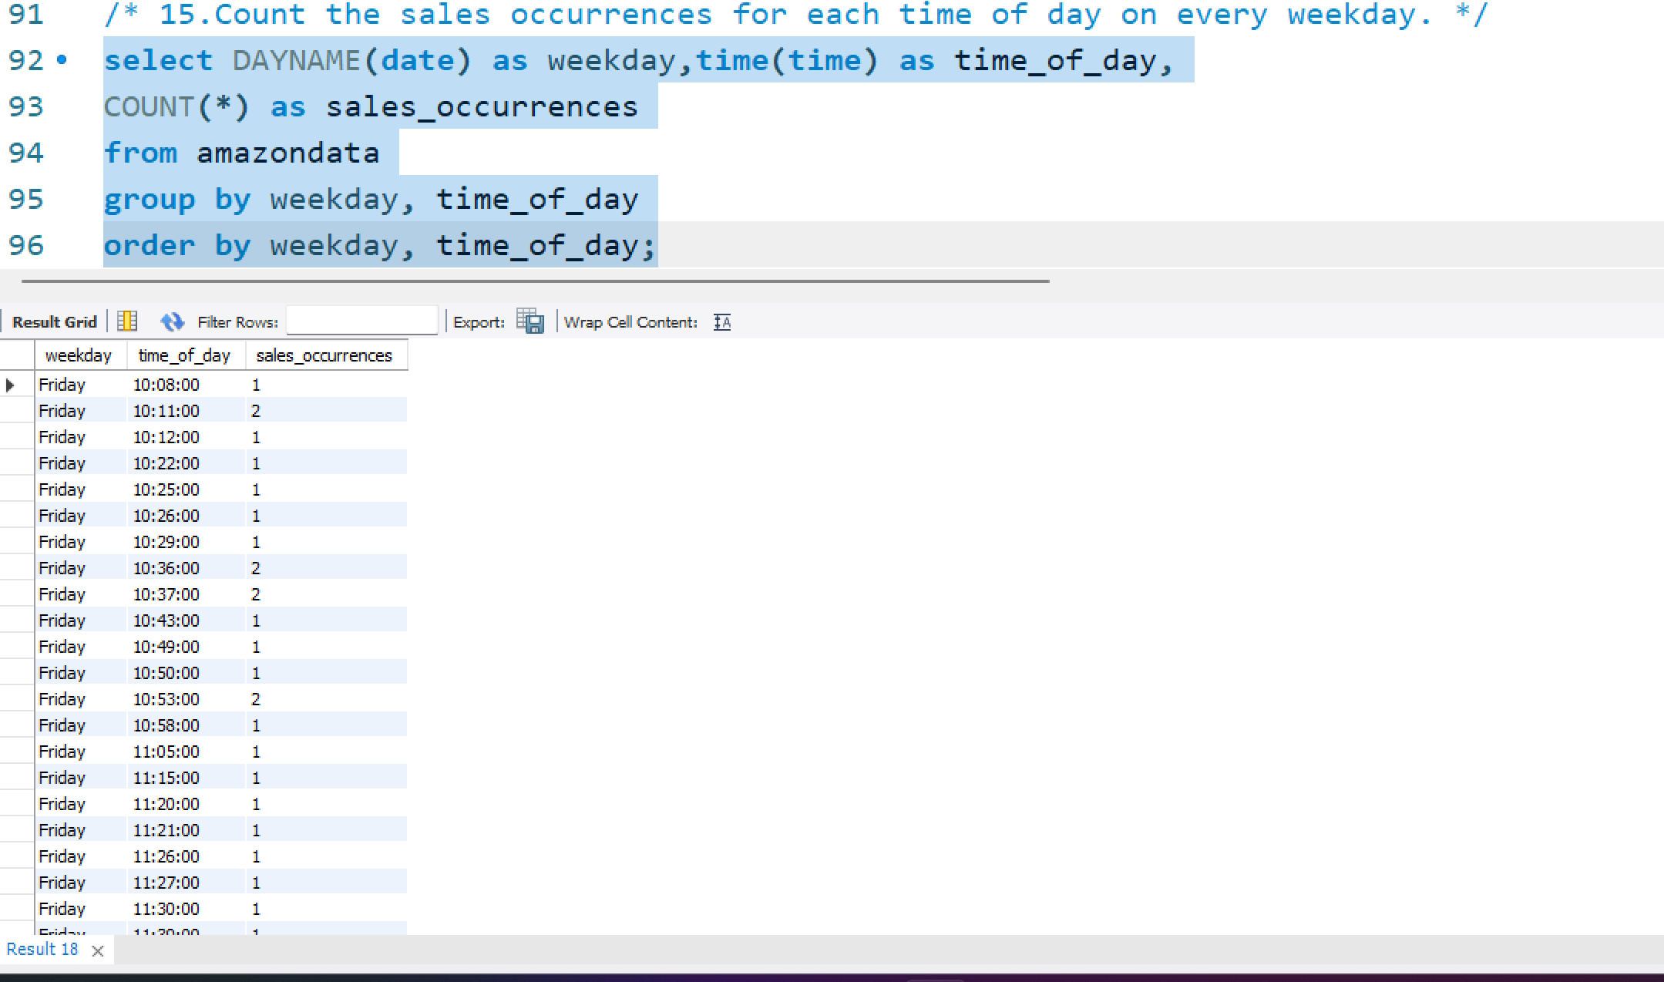

Slide 19
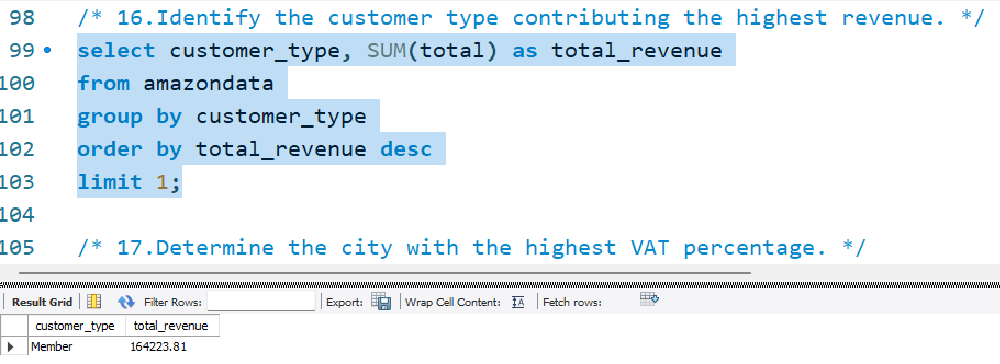
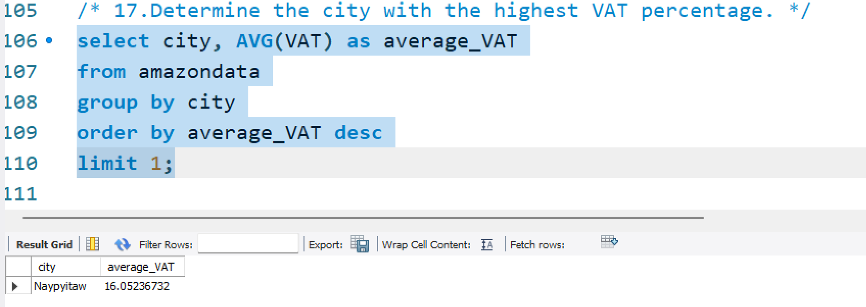

Slide 20
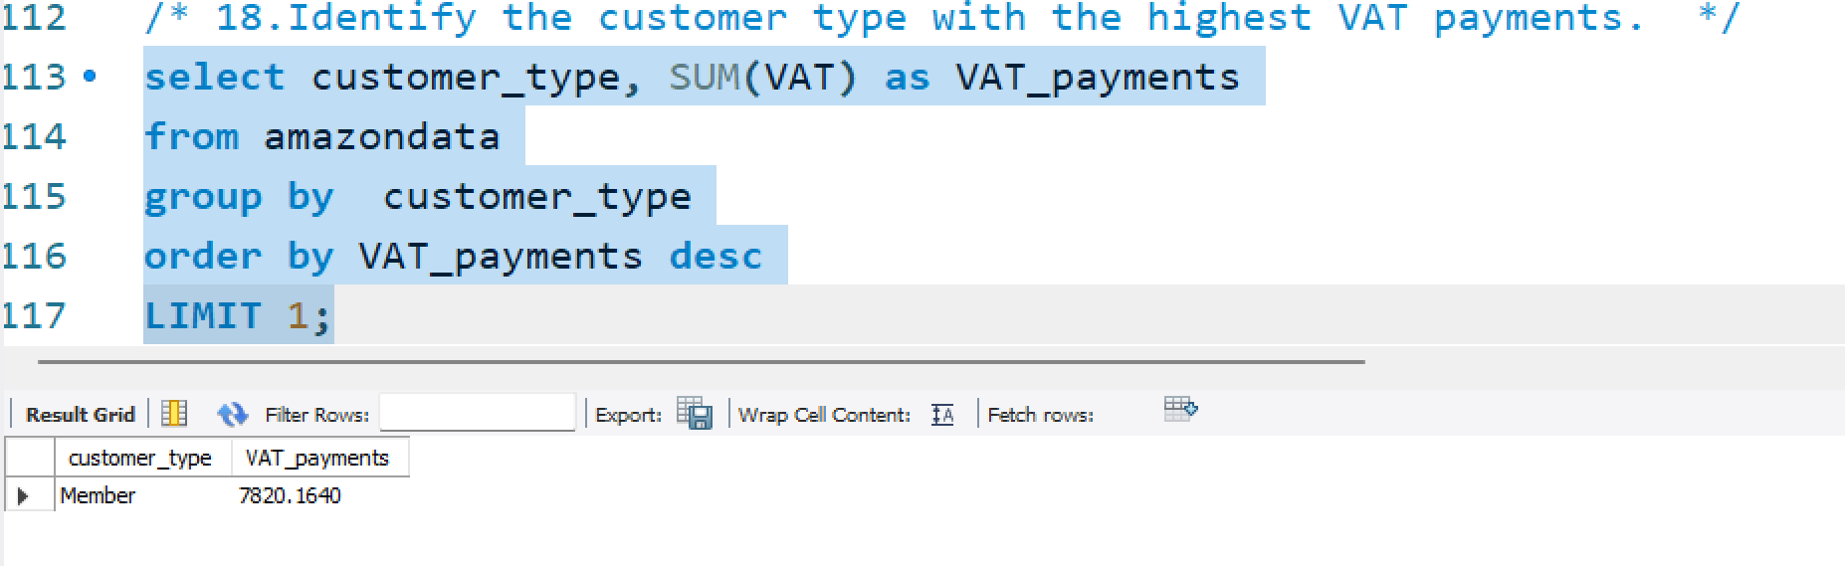
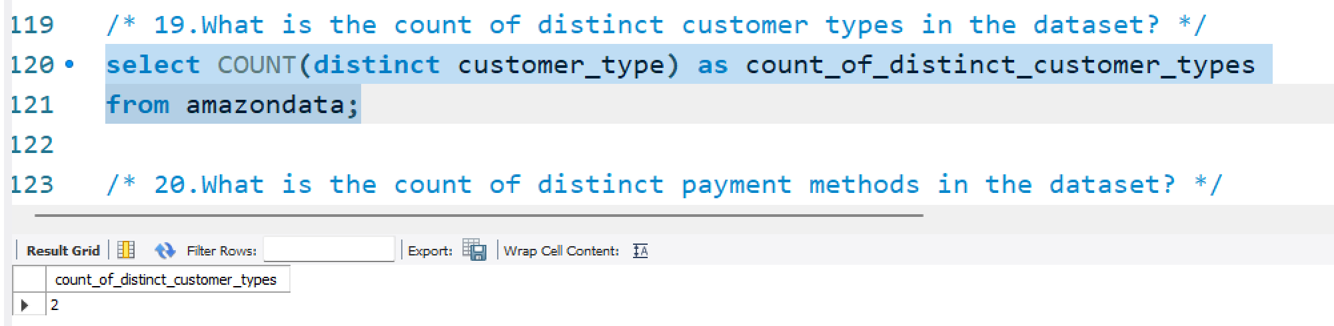

Slide 21
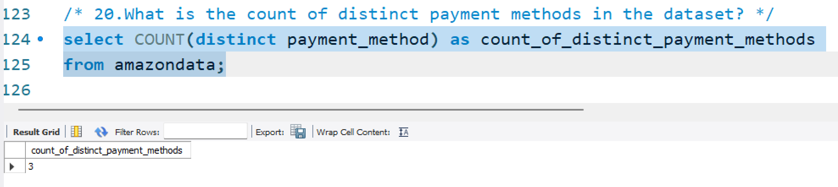
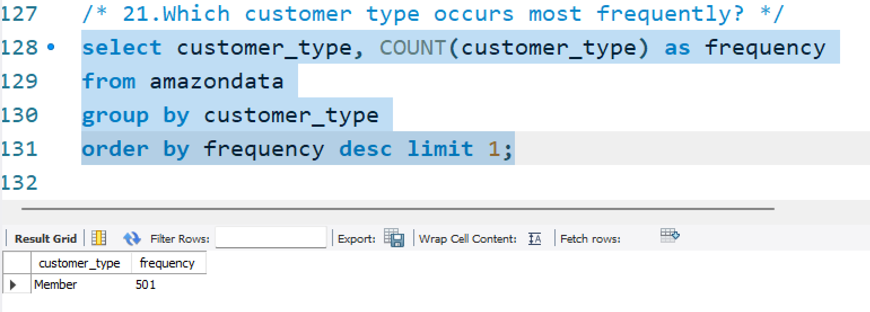

Slide 22
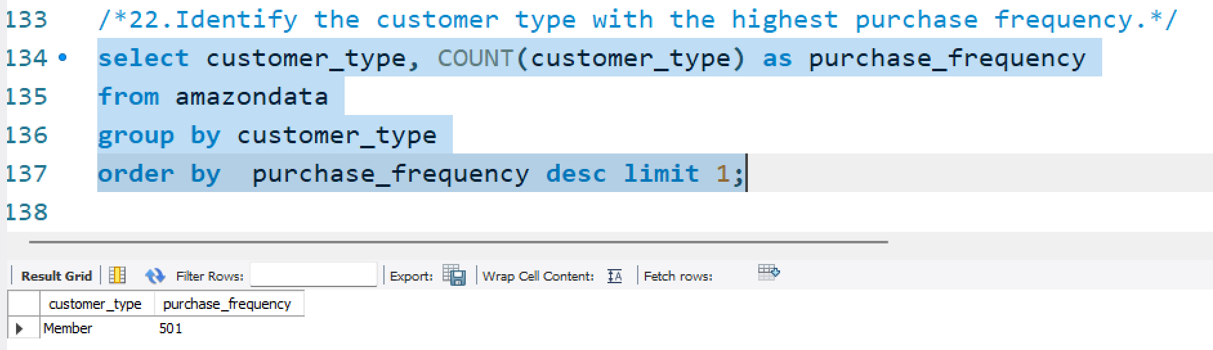
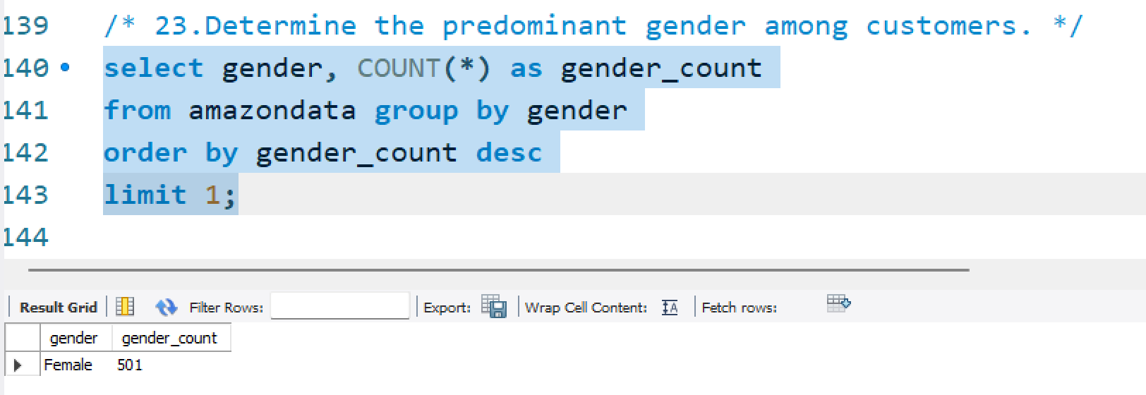

Slide 23
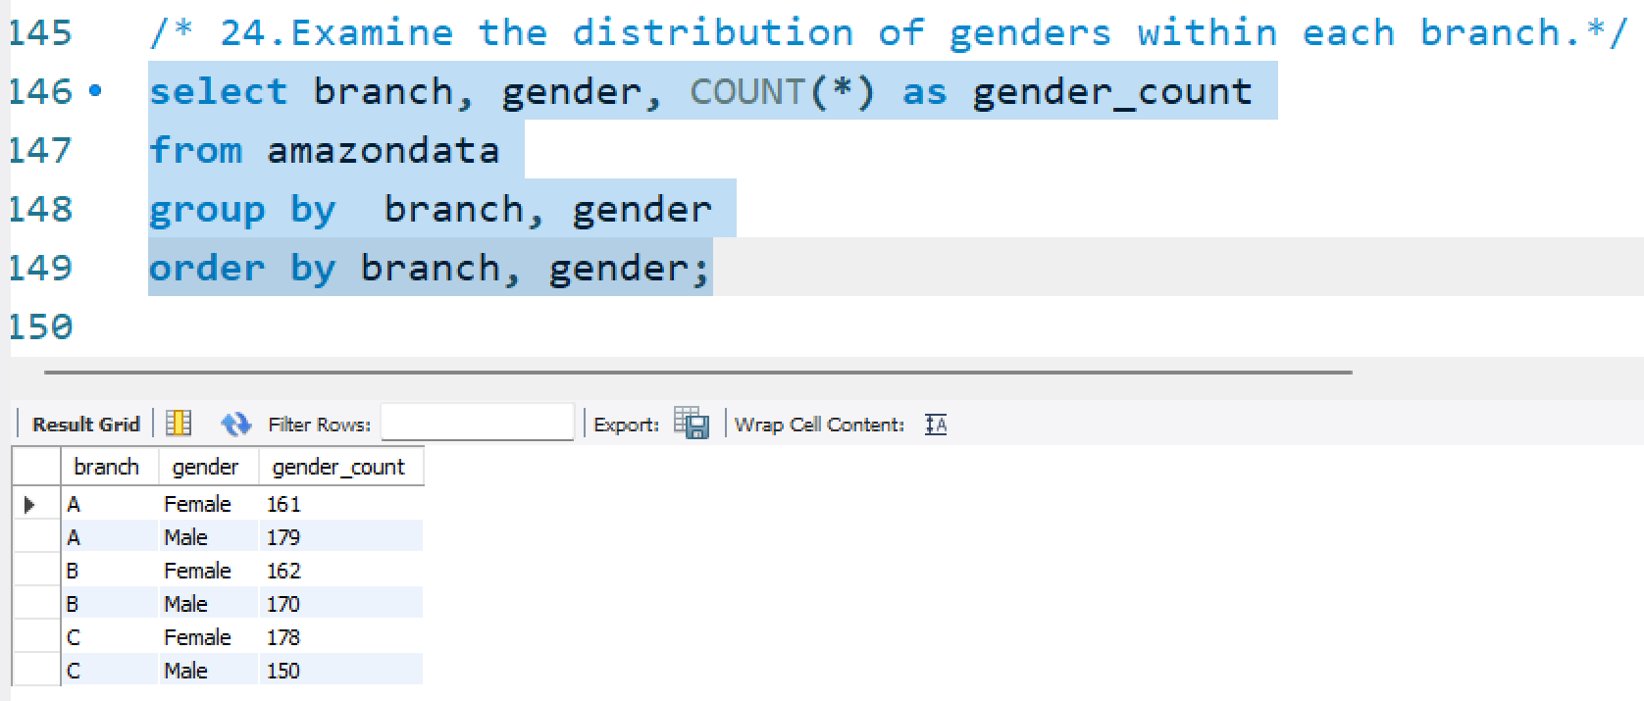
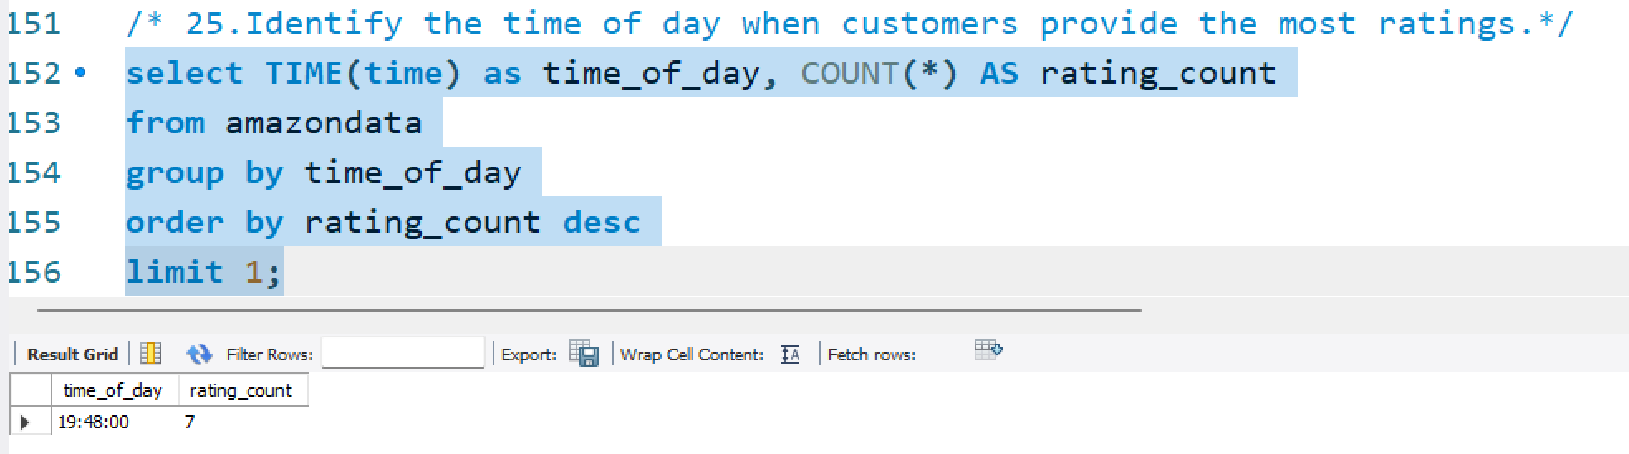

Slide 24
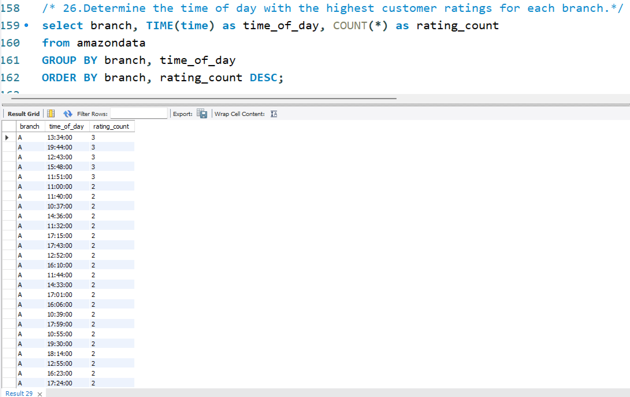

Slide 25
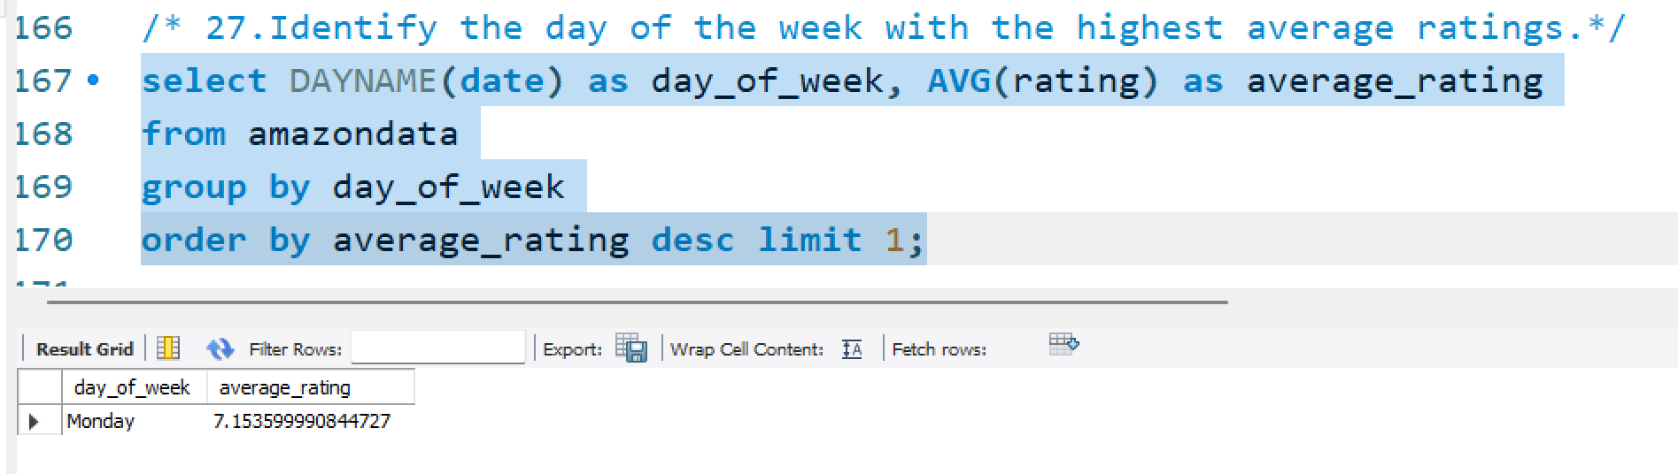

Slide 26
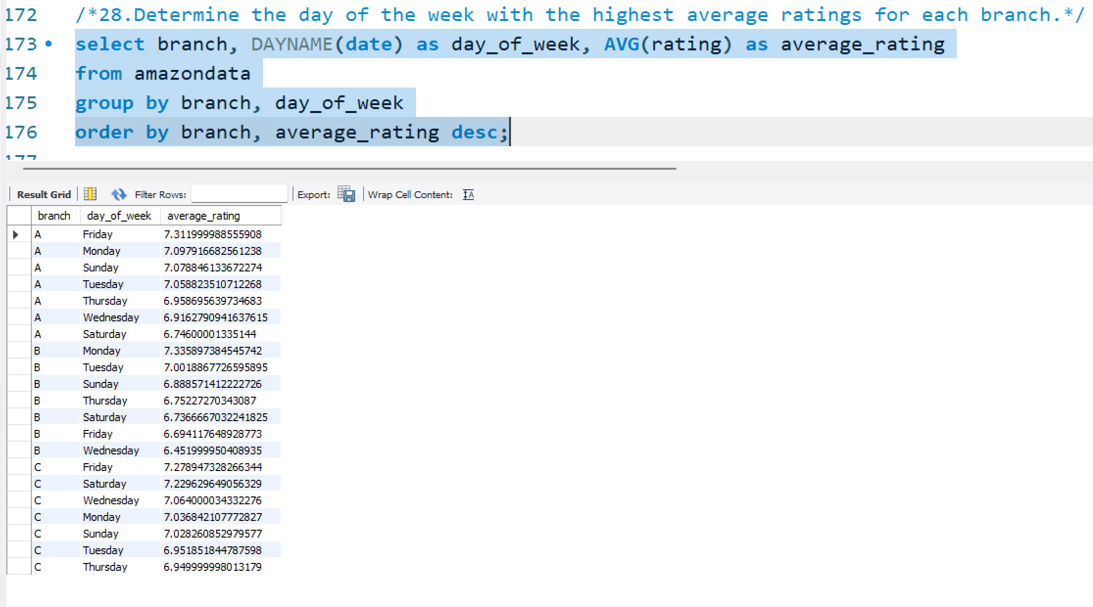

Slide 27
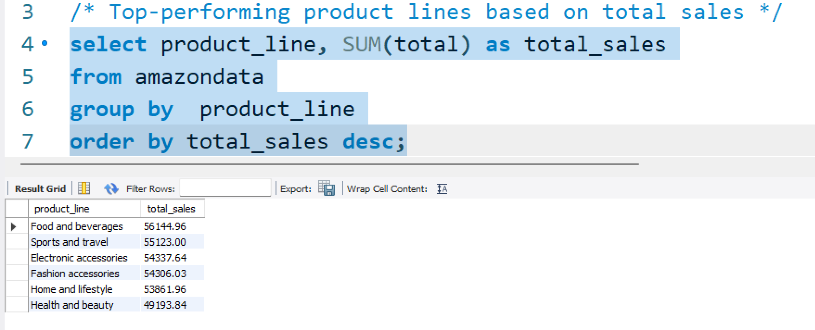
Analysis
Product Analysis: performance of different product lines, determine which product lines are performing well, and least.

Slide 28
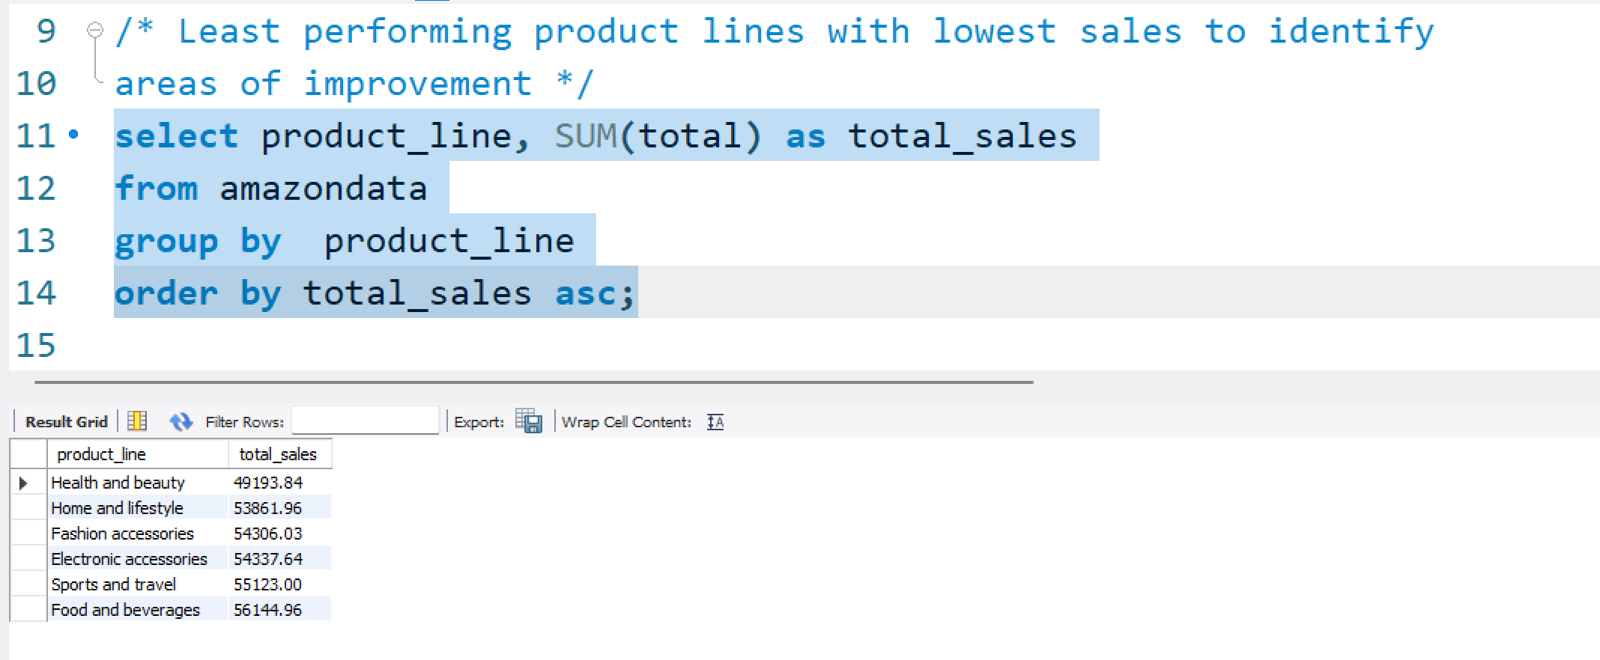

Slide 29
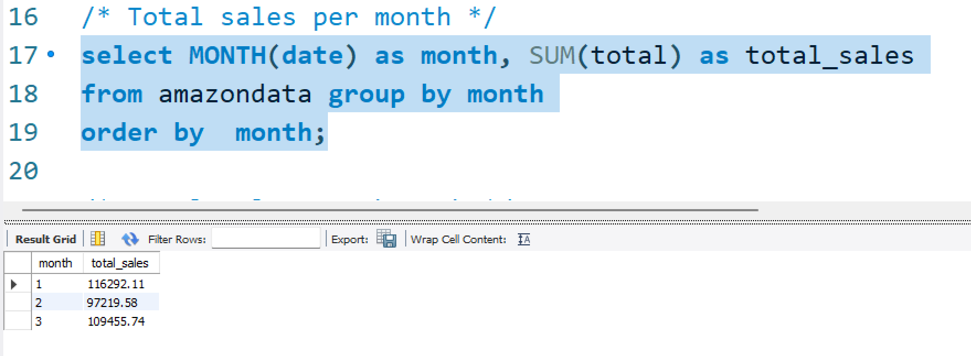
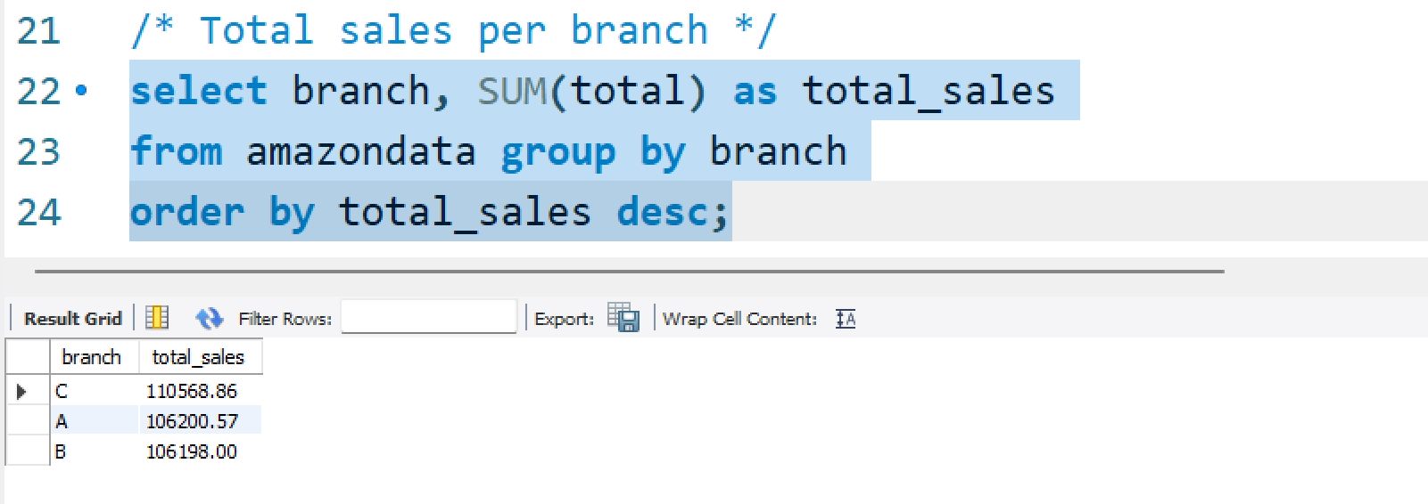
Sales Analysis:

Slide 30
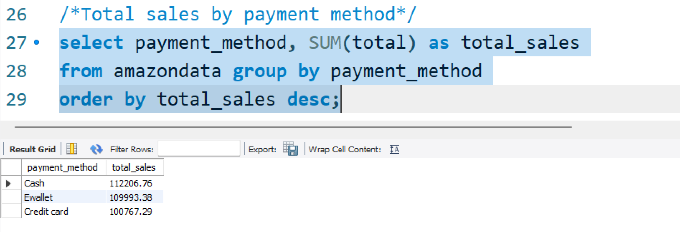

Slide 31
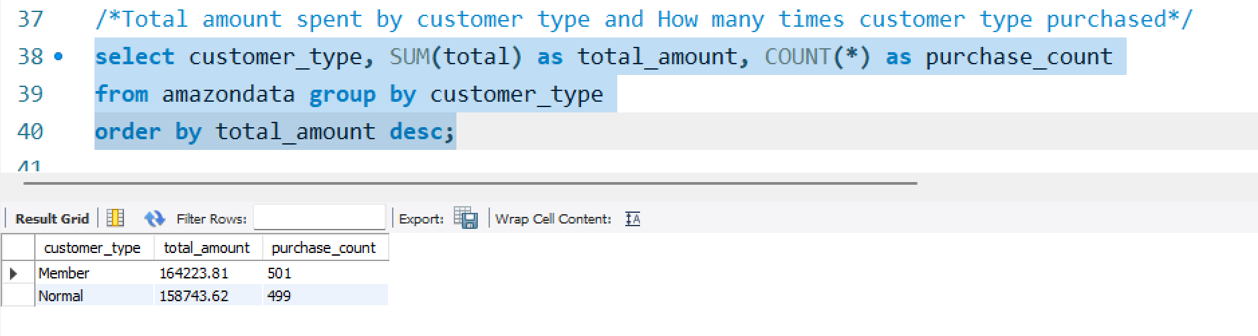
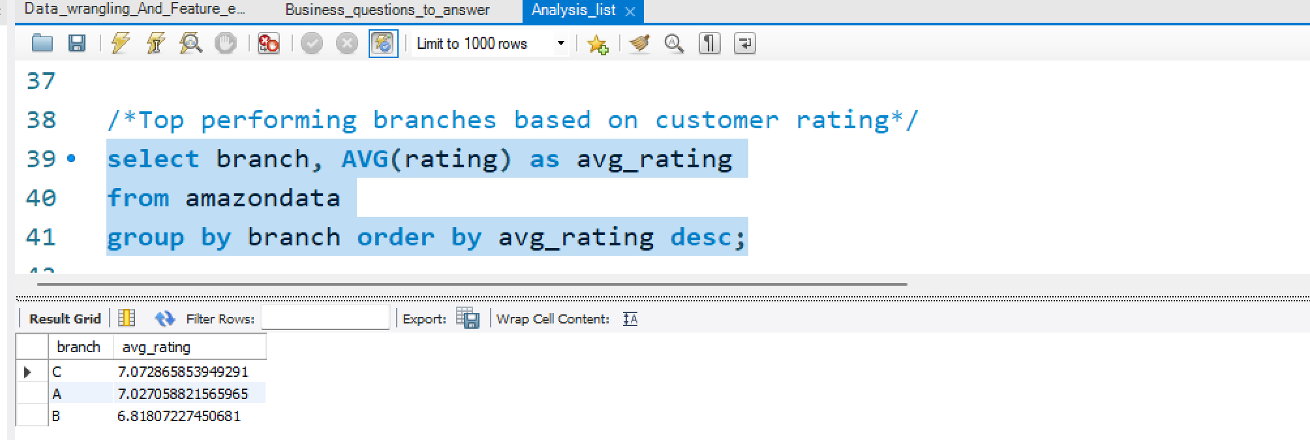
Customer Analysis:

Slide 32
Insights and Summary
Product analysis:
The top-performing product lines are dominated by the “Food and Beverages”, with total sales of 56,122.96, respectively On the other hand, the least performing product lines include Health and beauty, Home and lifestyle, and Fashion accessories, with total sales ranging from 49,193.84 to 56,144.96. These product lines may require attention and improvement strategies to boost sales.
Sales Analysis:
Monthly sales are relatively consistent, with the highest sales in January (116,292.11) and the lowest in February (97,219.58).- Branch C leads in terms of total sales (110,568.86), followed closely by Branch A and Branch B.- Cash payments account for the largest share of total sales (112,206.76), followed by E-wallet payments (109,993.38) and Credit Card payments (100,767.29).
Customer Analysis:
Members are the top-spending customer type, with a total spend of 164,223.81 and 501 purchases, closely followed by Normal customers with a total spend of 158,743.62 and 499 purchases.- Branch C is the top-performing branch based on customer ratings, with an average rating of 7.07, followed by Branch A (7.03) and Branch B (6.82).

Slide 33

Nikhil Karaka

