Slide 1

A Skeptics view of using the BPM tool
Notes:
A very good morning everyone.
Today I would be presenting on Camunda BPM as a workflow automation platform.
So you all might me wondering why “Skeptic”. It all started with a business requirement involving complex workflows and we were short on time and resources.
After some analysis we realised that Camunda BPM solution fits the bill but were a bit doubtful since it was our first time using a BPM tool.
A little more on the business problem

Slide 2
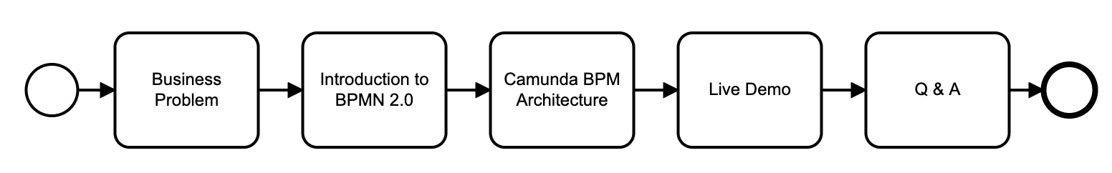
Agenda
Notes:
Business Problem
Explore the most commonly used BPMN 2.0 elements
Camunda BPM architecture. Overview of the components provided by Camunda
Live Demo on how to model, start and monitor processes using Camunda. Entire BPM lifecycle (Design, Implement, Operate, Analyze)
Q&A session

Slide 3
Business Problem

Slide 4
Business Problem?
Scenario :
Complex processes
Routing scenarios across multiple entities
Long lived processes
Pain Points/Challenges:
Multiple developers for building the portals
Authorization and Admin module
Resilience
Testing multiple complex workflows
Workflow as code not transparent/visible
Notes:
Business owners apply for “General Exemptions” to be able to remain open

Slide 5
If not Camunda then what ?
Build bespoke workflows
Notes:
Build bespoke workflows using custom code in whatever language/framework

Slide 6
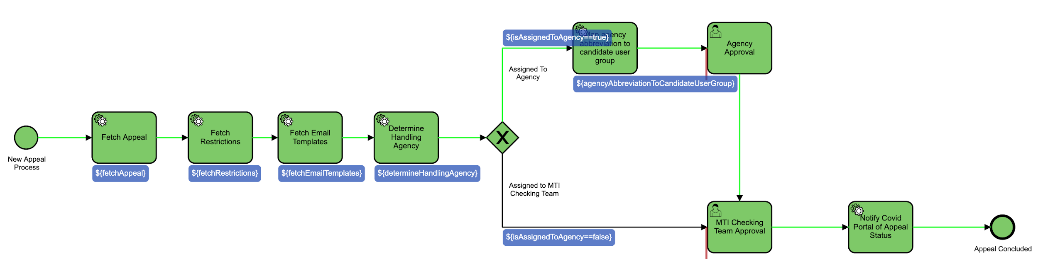
Why Camunda ?
Easy integration with Spring Boot
Scalability
Open source, lightweight
Processes are testable
Process transparency. Allows visual representation of business processes
Developer friendly
Notes:
Behind the scenes an application might have a lot of process. Camunda enables the processes to be visible which in turn helps businesses identify any remove redundant steps easily
Developer friendly, Java and Rest API’s are well documented
Process is not hidden in the code.
Process model can be used for monitoring and operations

Slide 7
Introduction to BPMN 2.0

Slide 8
What is BPM,BPMN and BPMS?
BPM
Business Process Management is the discipline in which people use various methods to discover, model, analyze, measure, improve, optimize, and automate business processes.
BPMN
Business Process Model and Notation.
BPMS
Business Process Management Suite.
Notes:
A combination of methods used to manage a company’s business processes is BPM In its most simplest form, BPM is a way of looking at and then controlling the processes that are present in an organization.
Provides businesses with the capability to understand their internal business procedures in graphical notations. Before BPMN was introduced there was no common language to represent a business process.
BPMS is the software tool used to improve an organization's business processes, through the definition, automation, and analysis of business processes

Slide 9
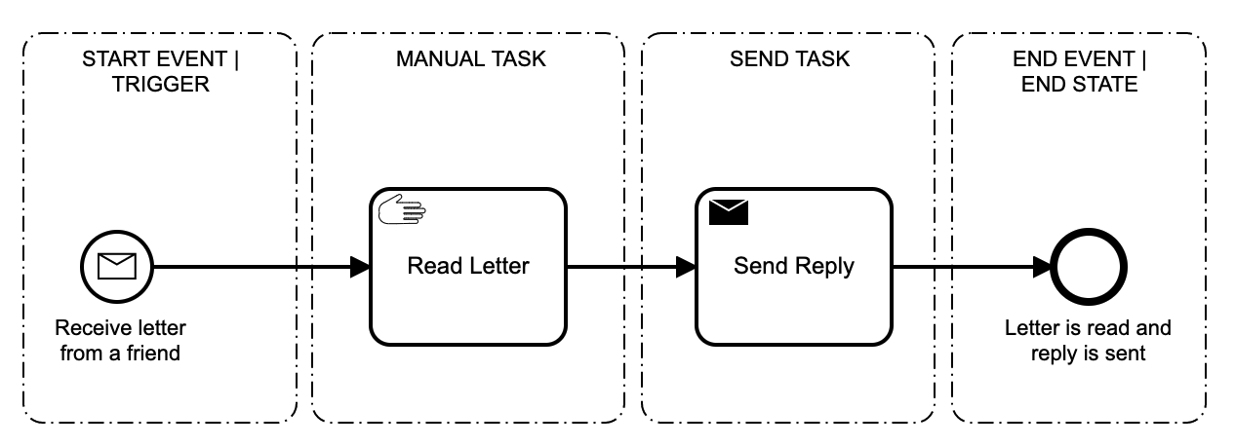
What is a Business Process ?
An Independent Trigger
Collection of Interrelated Activities
A specific result
Notes:
A business process is a collection of interrelated activities performed in response to an independent trigger to deliver a specific result.
BPMN 2.0 is now an ISO standard and not vendor specific

Slide 10
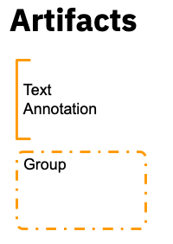
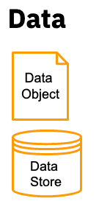
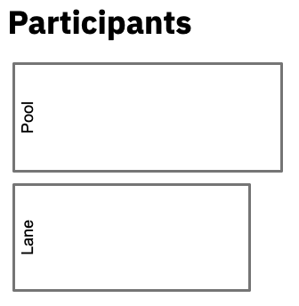
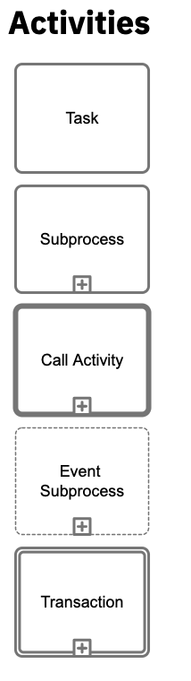
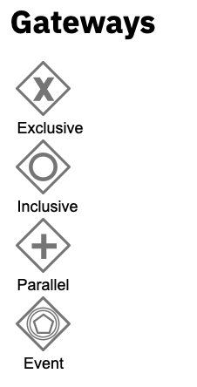
BPMN 2.0 Building Blocks
Notes:
Artifacts: Artifacts do not affect the execution semantics
Text Annotations are used to supplement the diagrams. They are connected to other elements using associations
Data:
A data object represents data flowing through a process
A data store is a place where a process can read or write data. i.e. database. It persists beyond the lifetime of a process instance.

Slide 11
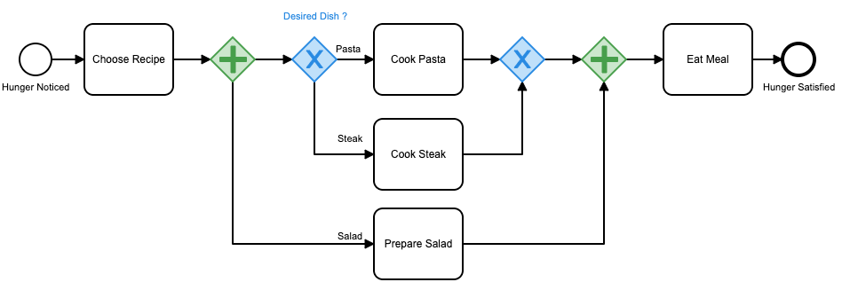
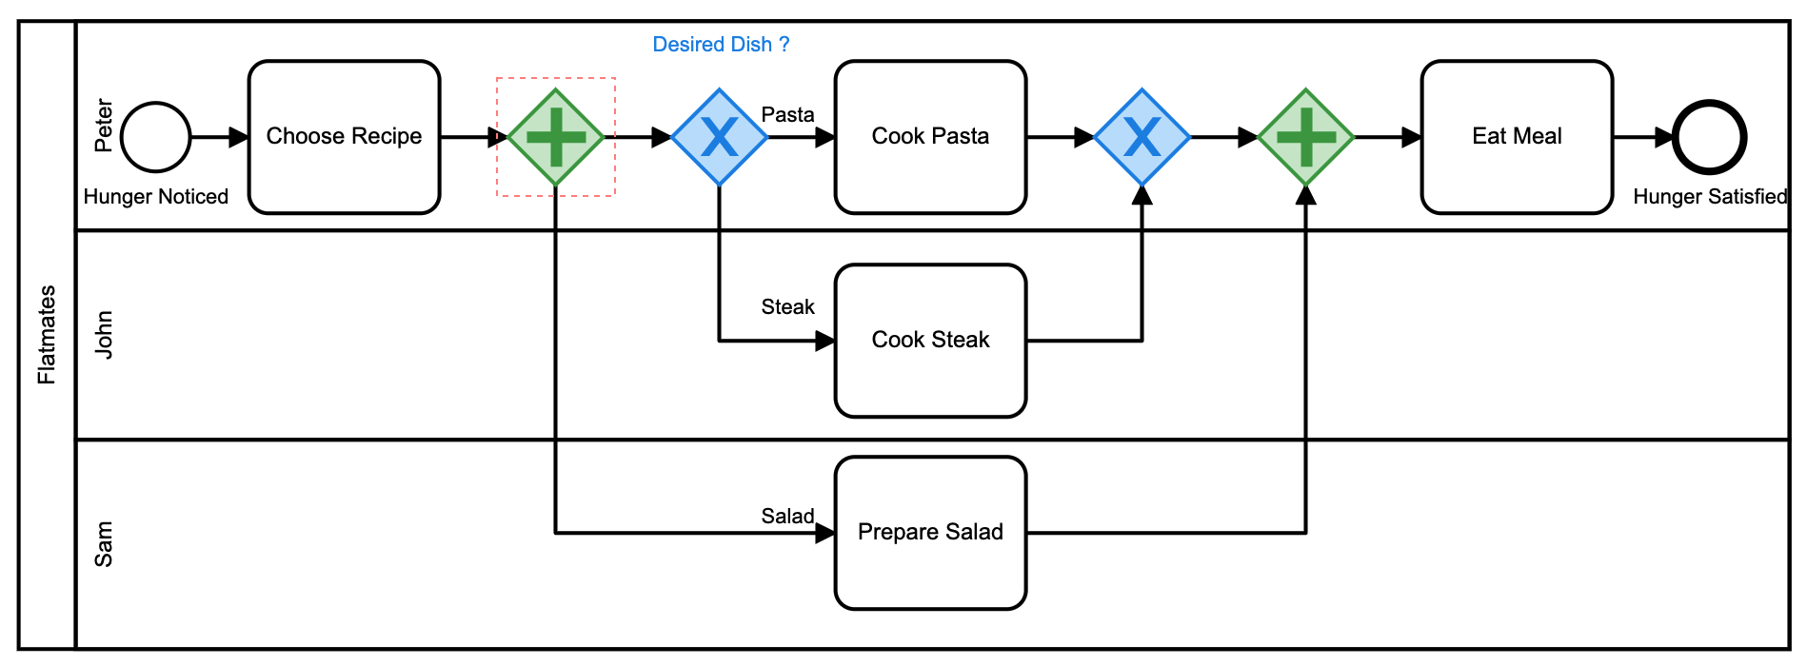
Participants - Pools and Lanes
Notes:
Pools and Lanes :
Pools and lanes help us to assign tasks in a process.
WIthout pools and lanes we are focusing on what needs to be done in a process but not whose responsible for executing the tasks.
Pools represent participant in the process (Business entity or Role) or represent a business process.
Pool is a container for sequence flow between activities
Sequence flow cannot continue beyond the boundaries of a pool

Slide 12
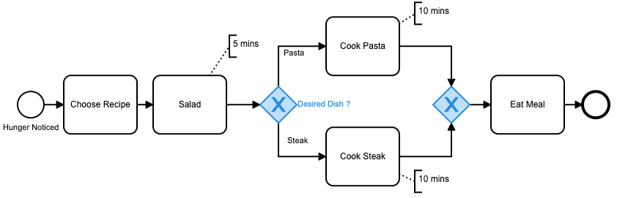
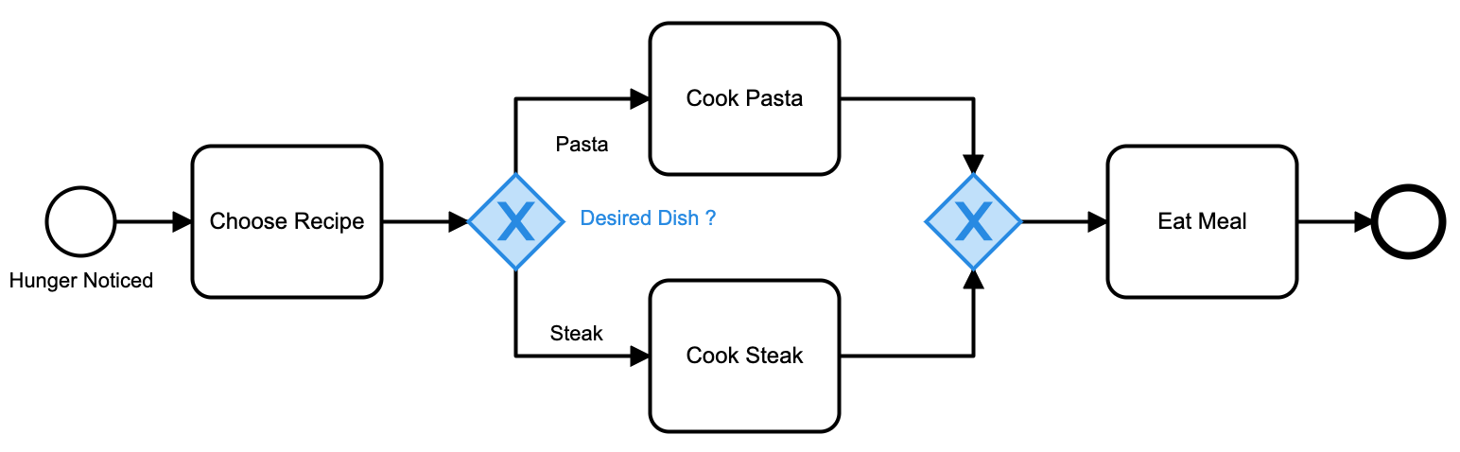
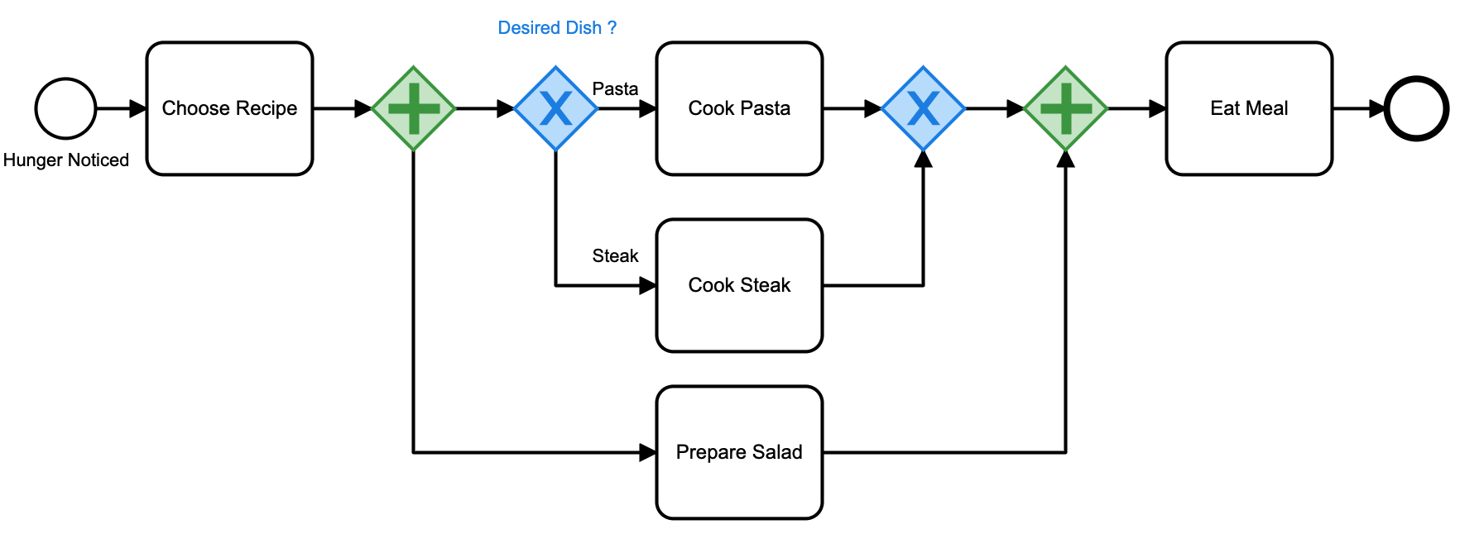
Gateways
Data-based Exclusive Gateways
Parallel Gateways
Notes:
Gateways control token flow in a process.
The point of decision on what to do next is called a gateway.
We decide based on the available data.
Data Based Exclusive Gateways(XOR): Default gateway
When execution arrives at this gateway all sequence flows are evaluated. The sequence flow that evaluates to true is selected for continuing the process.
One important thing to note when working with Exclusive gateways is that only one sequence flow is selected.
Parallel Gateway:
How do you model concurrency in a process ?
Allows you to fork multiple paths of execution or join multiple incoming paths of execution.
Create one concurrent execution for each sequence flow
All concurrent executions wait at the joining gateway until an execution arrives for each of the incoming sequence flows. Then the process continues.
https://docs.camunda.org/manual/7.13/reference/bpmn20/gateways/parallel-gateway/

Slide 13
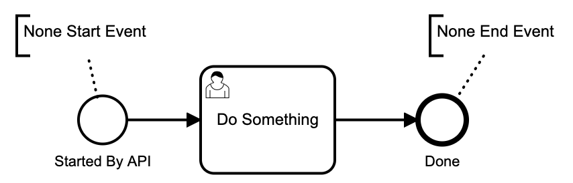
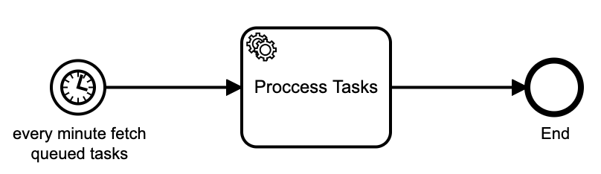
Events
None Events
Timer Events
Notes:
None Event : Also referred as blank or unspecified events.
None Start Event : What it means is that the trigger to start the process instance is unspecified. It needs an external trigger to kick start a process instance. It could be triggered via Rest/Java API.
None End Event : Result thrown when the event is reached is unspecified. The engine ends the current path of execution
Timer Events : Timer events are events that are triggered by a predefined timer

Slide 14
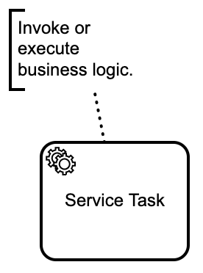
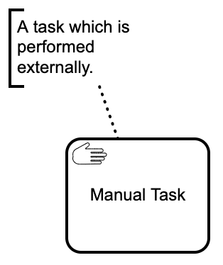
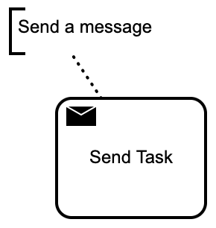
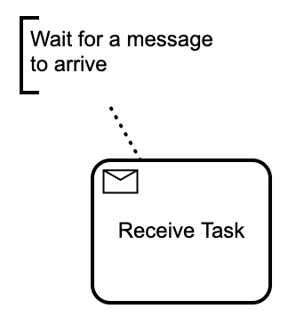
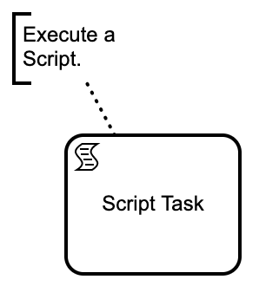
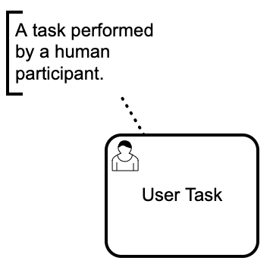
Tasks
Notes:
Tasks allow to model the actual work being done/performed in the process.

Slide 15
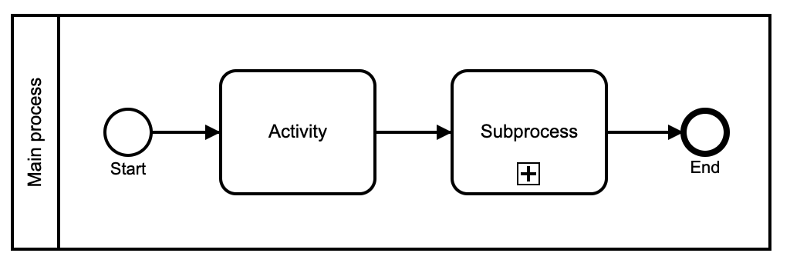
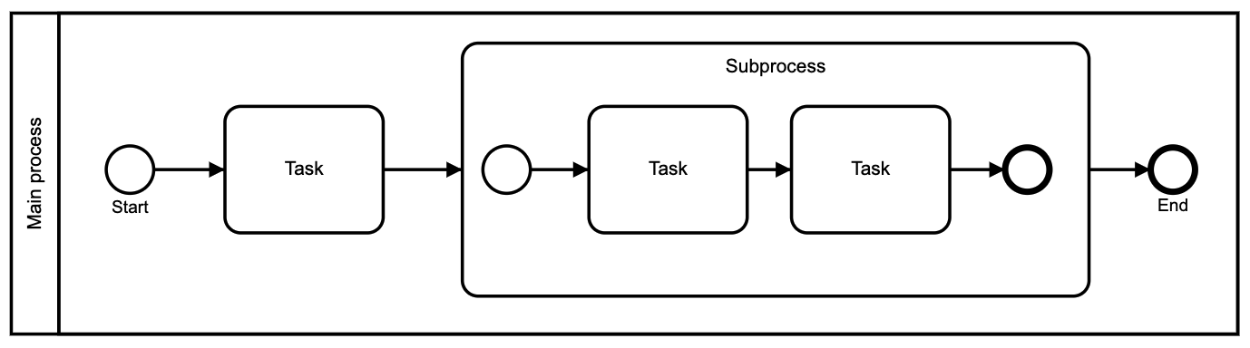
Sub Processes
Sub Process with external process definition
Expanded Sub Process

Slide 16
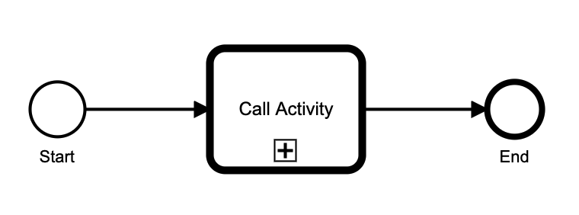
Call Activity
Notes:
The main difference between a sub-process and a call activity is that the call activity does not share context with the process instance. Process variables are explicitly mapped between the process instance and the call activity.

Slide 17
Camunda BPM Architecture

Slide 18
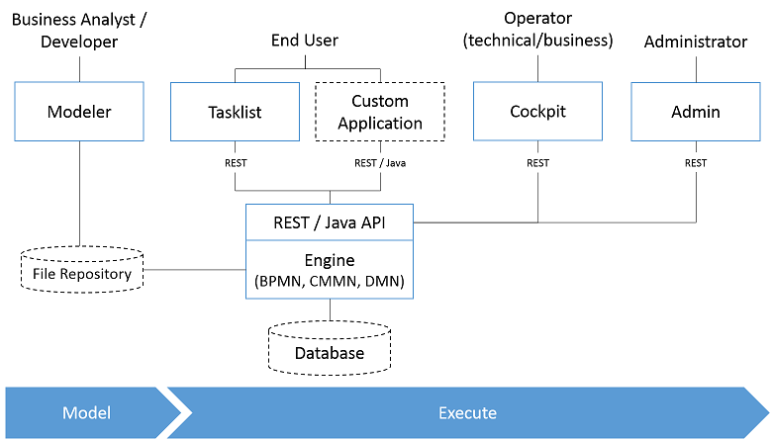
Camunda BPM Components
Notes:
Camunda Tasklist A web application for human workflow management and user tasks that allows process participants to inspect their workflow tasks and navigate to task forms in order to work on the tasks and provide data input. Used by the end users to work on tasks and complete them
Camunda Cockpit A web application for process monitoring and operations that allows you to search for process instances, inspect their state and fix broken instances.
Camunda Admin A web application for user management that allows you to manage users, groups and authorizations.
Camunda Cycle A web application for synchronizing BPMN 2.0 process models between different modeling tools and modelers.
Camunda Modeler: Application to model business processs
https://docs.camunda.org/manual/7.3/guides/user-guide/

Slide 19
Live Demo
Design a process
Implement & Deploy
Operate
Analyze
Notes:
Executable vs Startable tasks
Model the business process using Camunda Modeller
Deploy the process to the engine
Start a process instance using Tasklist
Monitor it using cockpit
A business key is unique identifier for a process instance. Compare this to the process instance id, which is a Camunda-generated UUID.
Querying by business key is more efficient that querying by variables.
Business keys is prominently displayed in Cockpit
Credit card application businessKey could be the reference number
Logistics application businesskey could be reference number

Slide 20
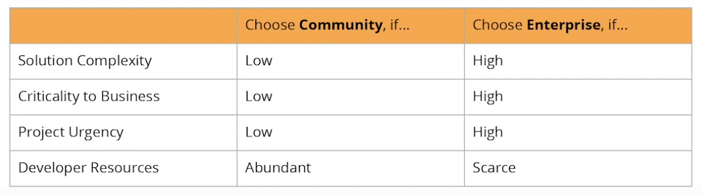
Do all projects need BPM ?
NO - for example for CRUD, mobile app, simple state
YES - Lots of processes, multiple roles and integrations
YES - Long lived processes
Community or Enterprise ?
Notes:
To implement a class that can be called during process execution, this class needs to implement the org.camunda.bpm.engine.delegate.JavaDelegate interface and provide the required logic in the execute method.

Slide 21
Questions ?

