Slide 1
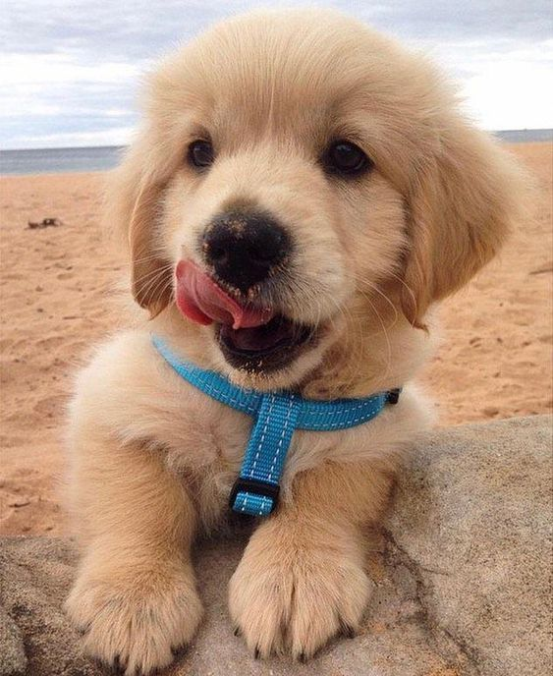
PetGoHome
WHAT IF YOUR DOG GOES MISSING
Yuche Lin
Sai Teja Yeniganti
Nikhil Raj

Slide 2
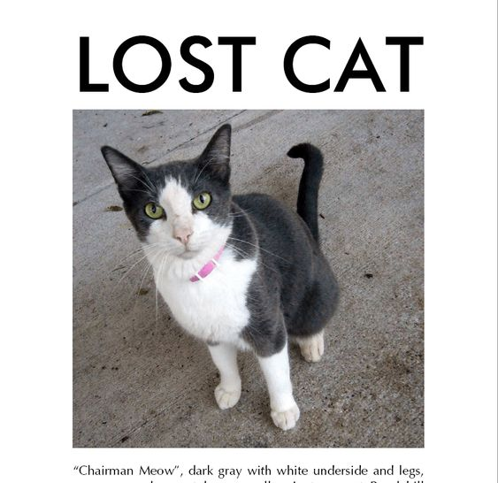
Have you ever seen a missing cat poster before?

Slide 3
Have you ever seen a missing cat poster before?
Did you know what you could do to try to help reunite the lost dog with his or her family?

Slide 4
Have you ever seen a missing cat poster before?
Did you know what you could do to try to help reunite the lost dog with his or her family?
Are you prepared for if one of your very own pets go missing?

Slide 5
Have you ever seen a missing cat poster before?
Did you know what you could do to try to help reunite the lost dog with his or her family?
Are you prepared for if one of your very own pets go missing?
Better yet, do you know what steps you can take to prevent losing your pet altogether?

Slide 6
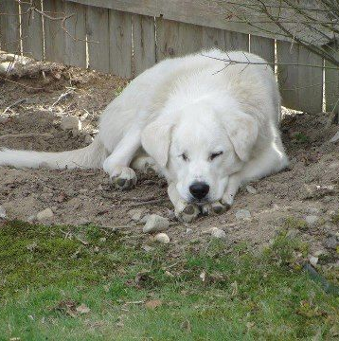
Pet-go-Home
PetGoHome aims to help answer all of these questions and more

Slide 7
Pet-go-Home
According to the national council of pet population study, a family pet is lost every two seconds in North America.
That equates to more than 10 million pets getting lost each year
One out of three pets getting lost during his or her lifetime.

Slide 8
Pet-go-Home
Research has confirmed that for most people, the loss of a pet is comparable to the loss of a loved one.
Pets become a very significant part for many in today’s life.

Slide 9
What is Pet-go-Home
The free information center for lost and found dogs, cats and all other pets
Search for your pets
Post your own report
Learn what to do and whom to contact
Sign up to help lost pets in your area

Slide 10
Persona
Pet’s Owner
Search for their pets
Residents/Other people
Provide the information

Slide 11
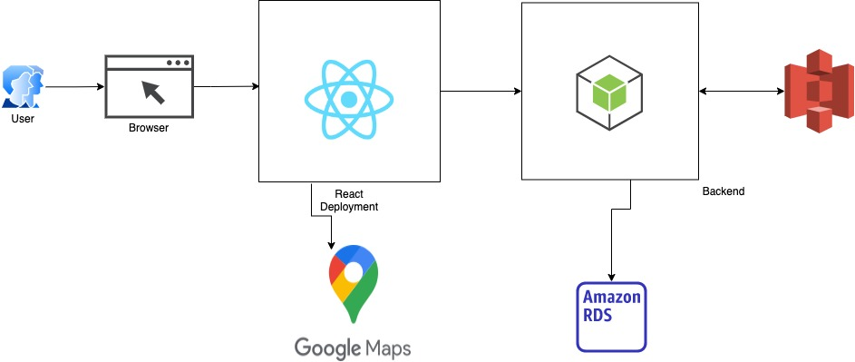
Architecture Diagram

Slide 12
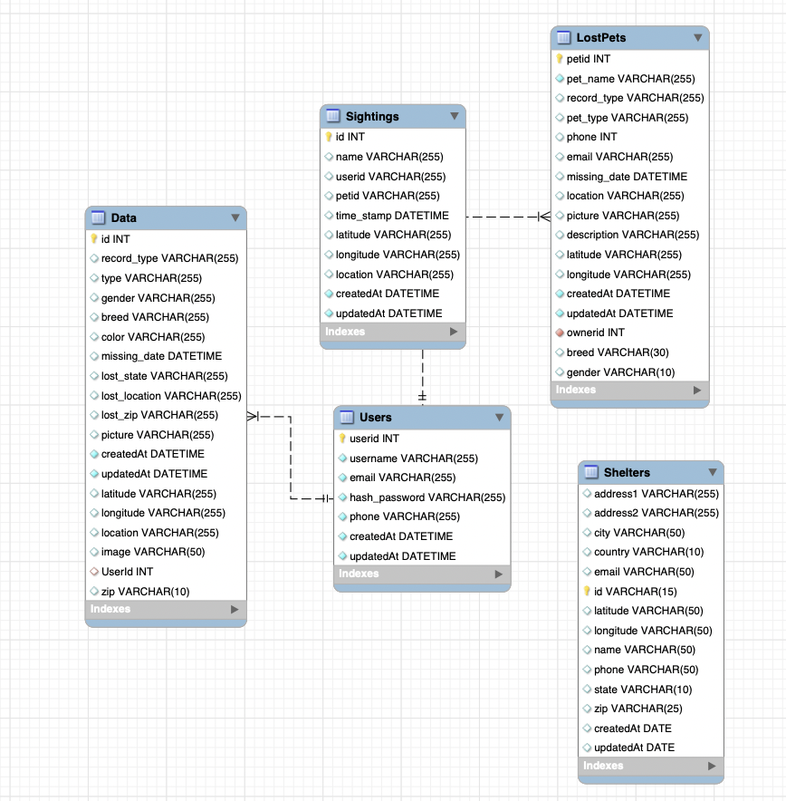
Database Design

Slide 13
Open-source dataset
We use two datasets
Lost, found and adoptable dataset from data.world, which contains 1,019 rows of data
Shelter Animal dataset, which contains 10,316 rows of data

Slide 14
Demo

Slide 15
Future scope
•We can implement user to user chat feature.
•We can send live text alerts to the owner whenever a pet is sighted.
•We can work with nearby shelters and veterinary clinics incase a pet is injured, or owner is not identified.

Slide 16
THANK YOU

