Slide 1
Project Title
Anomaly-Based Network Intrusion Detection System through Feature Selection and Hybrid Machine Learning Technique
Paper Link

Slide 2
Table of contents:
Introduction
Dataset Description
Data pre-processing
Models and Algorithms used
Results

Slide 3
Introduction:
An intrusion detection system (IDS) is a device or software application that monitors a network or systems for malicious activity or policy violations.
In this paper, we focus on NID’s binary classification problem where the system differentiates between normal or attack activities. We propose an anomaly-based network intrusion detection system based on a combination of feature selection, K-Means clustering and XGBoost classification model.
We test the performance of our proposed system over NSL-KDD dataset using KDDTest+ dataset.
Moreover, due to feature selection, our proposed model employs only 75 out of 122 features (61.47%) to achieve this level of performance comparable to those using full number of features to train the model.

Slide 4
DATASET DESCRIPTION:
Here we have used the NSL-KDD Train+ dataset for training purpose and for testing purpose we have used NSL-KDD Test+ dataset. NSL-KDD dataset contains 41 features categorizing into 3 types consisting of 3 nominal features, 6 binary features and 32 numeric features. The NSL-KDD categorizes attacks into 4 types consisting of Denial-of-Service, Probe, Root to Local and Unauthorized to Root as presented in Table 1. Each type of attack is mentioned below:
1) Denial-of-Service (DoS)
2) Probe
3) Root to Local (R2L)
4) Unauthorized to Root (U2R

Slide 5
Table 1 . Type of Attacks
Category | Attacks
DoS (Denial of Service) | Neptune, pod, smurf, teardrop, process table, warezmaster, apache2, mail bomb, back
Probe | multihop, http tunnel, ftp_write, root kit, ps buffer overflow, xterm
R2L (Root to Local) | named, snmpgetattack,xlock, send mail, guess_passwd
U2R (Unauthorized to Root) | ipsweep, nmap, port sweep, satan, mscan, saint

Slide 6
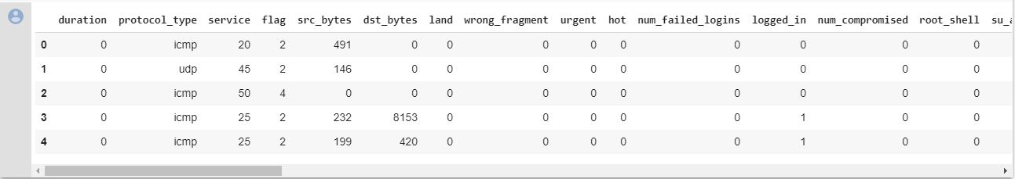
One of the glimpse of the train dataset is given below:

Slide 7
DATASET PRE-PROCESSING
One Hot Encoding and Scaling: We exercise One-Hot Encoding to transform 3 nominal features listed as protocol_type, service and flag into 84 binary features (protocol has 3 features, service has 70 features and flag has 11 features). In summary, after One-Hot Encoding process, there are 122 features entering Normalization process.
Feature Selection: We implement feature selection based on calculating the average AR

Slide 8
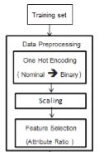
The block diagram of data pre-processing is given below:

Slide 9
Algorithms used in this project:
K-Means Clustering
XGBoostClassifier
Decision-Tree
SVM
Using the above algorithms we made following models and then recorded the results for each case:
CLUSTERING+XGBOOST
CLUSTERING+DECISION TREE
CLUSTERING+SVM
XGBOOST WITHOUT CLUSTERING

Slide 10
Result Table
MODEL | WEIGHTED F1-SCORE | MACRO F1-SCORE | ACCURACY
CLUSTERING+XGBOOST | 0.69 | 0.46 | 0.71
CLUSTERING+DECISION TREE | 0.23 | 0.21 | 0.34
CLUSTERING+SVM | 0.02 | 0.04 | 0.11
XGBOOST WITHOUT CLUSTERING | 0.66 | 0.45 | 0.70

