Slide 1

Team Name: NOVA-AgenticIQ
Team Leader Name: Nikhilraj SV
Team Size: 1
Problem Statement: Supply Chain Ontology and Governed Conversational Analytics

Slide 2
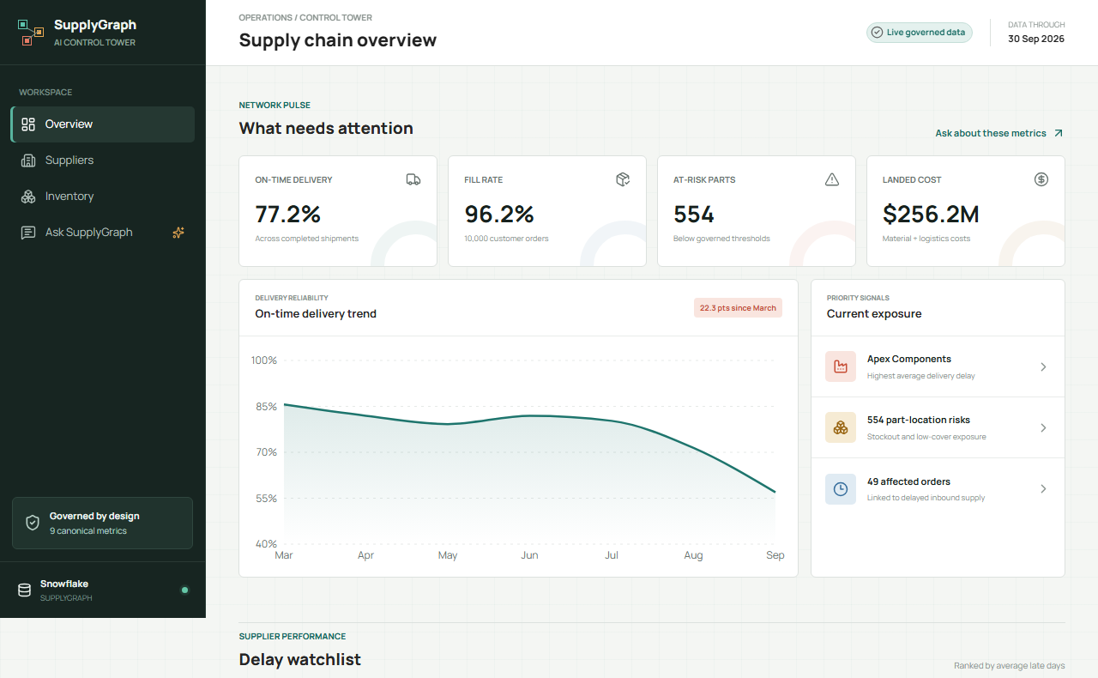

NOVA-AgenticIQ | SupplyGraph AI
CoCo CLI HACKATHON • GCC Edition
1 | Problem Brief
One governed answer across planning, procurement, and logistics
THE PAIN
• Supply-chain data is fragmented across suppliers, plants, shipments, orders, inventory, and quality.
• Teams calculate the same KPI differently, creating slow and low-trust decisions.
• Generic text-to-SQL can return plausible answers without an auditable definition or source.
TARGET USERS
Planning • Procurement • Logistics

Slide 3
NOVA-AgenticIQ | SupplyGraph AI
CoCo CLI HACKATHON • GCC Edition
2 | Supply-chain Ontology
A canonical model connects operational cause to customer impact
Supplier
Part
Inventory
Plant
Supplier
Shipment
Order
Customer
Quality Event
ONE MODEL
THREE PERSONAS
ONE METRIC DEFINITION
Supplier + Part

Slide 4
NOVA-AgenticIQ | SupplyGraph AI
CoCo CLI HACKATHON • GCC Edition
3 | Live Control Tower
A live operational surface for network risk and performance
77.17%
ON-TIME DELIVERY
Completed shipments
96.15%
FILL RATE
10,000 orders
554
AT-RISK LOCATIONS
Part-plant exposure

Slide 5
NOVA-AgenticIQ | SupplyGraph AI
CoCo CLI HACKATHON • GCC Edition
4 | Governed AI: Snowflake Cortex Architecture
AI interprets the question; governance controls the answer
Business
User
React
UI
FastAPI
Contract
Cortex
Intent
Approved
SQL
Snowflake
Metrics
WHAT CORTEX MAY RETURN
WHAT CORTEX CAN NEVER DO
{"metric_name": "ON_TIME_DELIVERY_RATE",
"period_mode": "LATEST_MONTH"}
Generate SQL • Change data • Bypass metric definitions
Invalid or unavailable AI output falls back to deterministic intent matching.

Slide 6
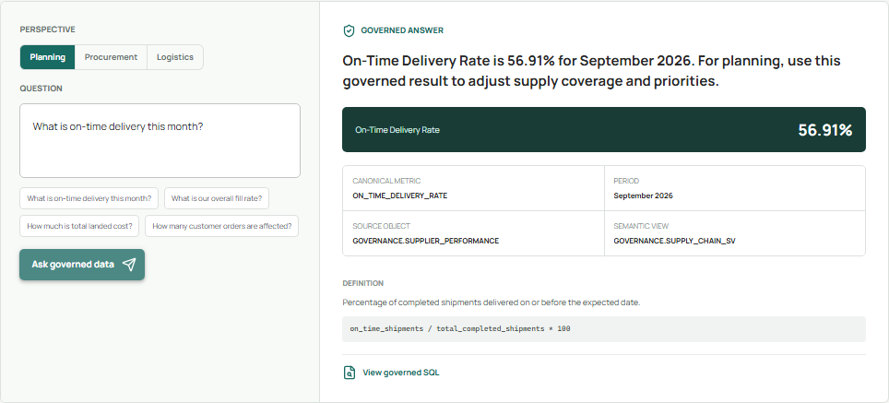

NOVA-AgenticIQ | SupplyGraph AI
CoCo CLI HACKATHON • GCC Edition
5 | Evidence, Not Just an Answer
Every answer carries its definition, formula, source, period, and SQL

Slide 7
NOVA-AgenticIQ | SupplyGraph AI
CoCo CLI HACKATHON • GCC Edition
6 | Persona Consistency
Recommendations adapt by role; metric truth never changes
PLANNING
PROCUREMENT
LOGISTICS
56.91%
56.91%
56.91%
Adjust supply coverage and priorities.
Focus supplier and cost discussions.
Prioritize delivery-flow investigation.
IDENTICAL ACROSS ALL PERSONAS: metric • definition • evidence • SQL • result rows

Slide 8
NOVA-AgenticIQ | SupplyGraph AI
CoCo CLI HACKATHON • GCC Edition
7 | Impact and Scale
A realistic governed network with measurable operational signals
50
10
10,000
SUPPLIERS
PLANTS
ORDERS
GCC network
Distribution footprint
Customer demand
554
49
$256.2M
RISK LOCATIONS
AFFECTED ORDERS
LANDED COST
Part-plant exposure
Delayed inbound supply
Material + logistics
All values returned from live governed Snowflake objects and cross-checked through the API.

Slide 9
NOVA-AgenticIQ | SupplyGraph AI
CoCo CLI HACKATHON • GCC Edition
8 | Engineering Readiness
Trust is enforced in code, Snowflake, tests, and deployment
12
1
3
0
BACKEND TESTS
LIVE BROWSER FLOW
PERSONAS
GENERATED SQL
Guardrails + contracts
API-to-UI proof
Canonical consistency
Allowlisted queries only
SNOWFLAKE SECURITY
DEPLOYMENT
• Read-only SUPPLYGRAPH_APP role
• Query tag: SUPPLYGRAPH_AI
• Credentials only in runtime secrets
• FastAPI + Vite on Vercel
• Public health and dashboard checks
• GitHub Actions deployment path

Slide 10
NOVA-AgenticIQ | SupplyGraph AI
CoCo CLI HACKATHON • GCC Edition
9 | Thank You
Why SupplyGraph AI wins: one network, one metric truth, every answer evidenced
GOVERNED
OPERATIONAL
EXTENSIBLE
Definitions, formulas, source objects, SQL, and rows travel with the answer.
Supplier, part, plant, shipment, order, and customer impact connect in one workflow.
New metrics plug into the catalog without weakening the trust boundary.
NOVA-AgenticIQ | Nikhilraj SV | CoCo CLI Hackathon 2026
One network. One metric truth. Every answer evidenced.
LIVE supplygraph-ai-web.vercel.app | CODE github.com/nikhilrajsv054/supplygraph-ai

