Slide 1


AIRLINE MANAGEMENT SYSTEM
Airline Reservation and Passenger Management System
Arya College of Engineering & IT, Jaipur · Department of Computer Science and Engineering · Project Mentor: Er. Ram Babu Buri · Team SkyTech · Academic Session: 2026–2027

Slide 2
Manual reservation processes create fragmented records
02
SkyTech Airlines is proposed as a centralized Java-based web application for flight search, passenger information, bookings, tickets, cancellations, and administrative operations
Problems addressed: manual booking and passenger records; duplicate or inconsistent data; difficult flight and schedule searches; booking and cancellation errors; limited administrative visibility

Slide 3
Five modules turn reservation tasks into one connected system
03
Connected responsibilities across the reservation journey
Passenger registration, authentication, profile management, and role-based access
Flight search by origin, destination, and date with schedules, fares, and database-derived availability
Passenger details, booking confirmation, unique PNR generation, ticket retrieval, booking history, and cancellation
Protected administrator dashboard for flights, routes, schedules, fares, bookings, and reports

Slide 4
The proposed stack separates presentation, logic, and data access
04
All technologies are proposed; local installation and implementation status remain to be verified.
01
Java 21 · JSP · HTML · CSS · JavaScript · Jakarta Servlets · JDBC · MySQL
02
Apache Tomcat 10.1 · Apache Maven · Git and GitHub
03
Browser → JSP Presentation Layer → Servlet Controller Layer → Service Layer → DAO/JDBC Layer → MySQL Database
04
Entities: Users, Flights, Bookings, Passengers, and Tickets

Slide 5
Five owners, one integrated project
05
Module dependencies connect authentication, flight data, booking, ticketing, cancellation, and administration.
Authentication and User Management
Mohammed Sahil
Flight Search and Availability
Nikhil Ranjan Choubey
Booking and Passenger Management
Mukesh Sah
Ticketing and Cancellation
Muskan Raj
Admin Dashboard and Flight Management
Prashant Chaudhary

Slide 6
Booking is validated before it is committed
06
Controls before commit
Server-side validation and availability rechecking
Unique PNR generation with a database uniqueness constraint Database transactions and
duplicate-submission prevention
The baseline excludes verified payment processing and live airline inventory.
Login → Search Flights → Select Flight → Enter Passenger Details
Validate availability → Generate unique PNR → Save booking
Booking confirmation → View ticket

Slide 7
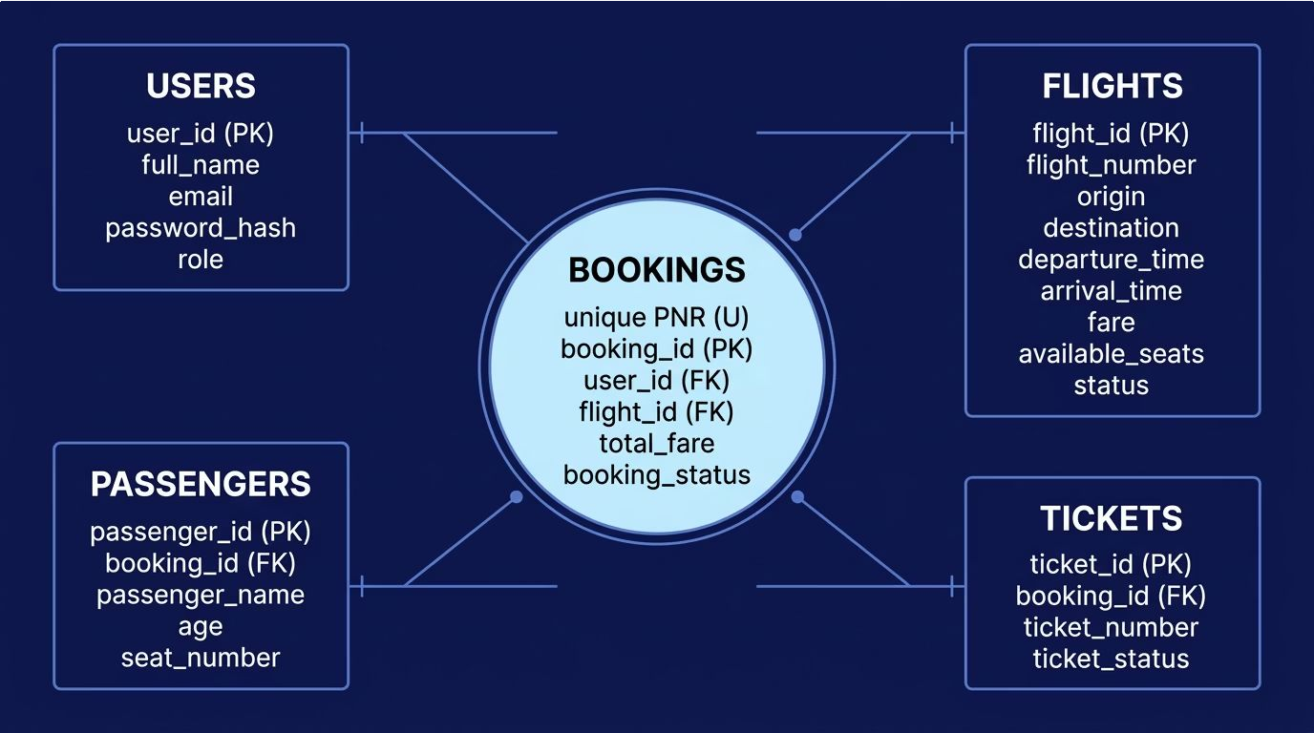
The proposed database preserves traceability
07
Show primary keys, foreign keys, unique PNR, and relationships between users, flights, bookings, passengers, and tickets. Label this proposed conceptual database design.

Slide 8
Security and reliability are requirements to verify
08
Salted password hashing, role-based access control, server-side validation, prepared SQL statements, database constraints, and transactions
Booking ownership checks, controlled error messages, session security, output encoding, and CSRF protection
Testing scope: unit, integration, functional, regression, security, and acceptance testing
Examples: invalid login, duplicate booking submission, PNR uniqueness, unauthorized admin access, and transaction rollback
The SRS defines 22 functional and 7 security test cases; none has been executed, so no pass/fail result is claimed.

Slide 9
09
Collaboration supports the five-module build
Feature Branch → Development → Commit and Push
Limitations: no live airline inventory integration; payment processing and refunds outside the baseline; email/SMS delivery and production deployment not verified
Future enhancements: payment gateway integration; PDF tickets and notifications; graphical seat selection; external airline APIs; automated regression and load testing
Pull Request → Merge into Main → Integration Testing

Slide 10

AIRLINE MANAGEMENT SYSTEM
SkyTech Airlines proposes a modular Java web application for reservation activities, supported by database integrity, maintainable layers, team collaboration, and explicit verification of implementation and testing.
THANK YOU Questions & Answers
Team SkyTech — Arya College of Engineering & IT

