Slide 1
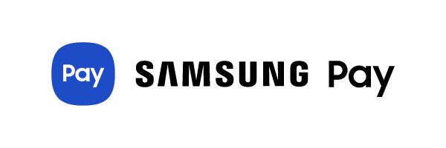
INTERNSHIP PROJECT
Under Guidance
By: Nikhil Kumar
Venkata Kiran Chegu
Job Profile: Associate Intern
Senior Technical Manager Security Software
Samsung Electronics SRI Bangalore
Payment SRIB Samsung Electronics

Slide 2
PROFILE
Name NIKHIL KUMAR
Job Title Associate Payment ,Intern
Company Samsung Electronics SRI Bangalore
Internship Duration 8 Weeks
Start date 18 May 2020
End Date 13 July 2020

Slide 3
Contents
Objective
Project Worked On
Task Assigned
My Key Contribution
Technologies Used
Challenges
Accomplishment
Lesson Learnt
Q&A

Slide 4
OBJECTIVE
To develop skills for the application of theory to practical work situations
To gain Corporate world experiences with some Real time applications experiences too.
To contribute to Organisation with my technical skills.
To gain Work culture at organisation.

Slide 5
Project WORKED ON
In current payment industry, if Issuer bank is DOWN, users are not aware of availability in
Advance , only when they have initiated the transaction they are getting to know about this,
Post this retries , switching to alternate mode of Payment.
Build an engine to learn which flows are working and between which nodes , based on service APIs Logs.
Build a proactive engine to send alerts proactively to end application Users about current health of service .so that users can choose alternate services before making payment.

Slide 6
Task Assigned
To build a proactive engine part to send alerts to end application users about current health of service API’s
To create Servers WA,WA PARTNER,WA DB,DOWNTIME_SVC
Performance Testing using jmeter to generate .jmx script file
Report as and when bugs arise
Push all the code with all docs on github.

Slide 7
MY KEY CONTRIBUTIONS
Started engine part by creating servers named WA,WA PARTNER ,WA DB
SVC_DOWNTIME.
WA
Exposed three different API’s named (Transaction , Transaction History & Registration) in WA ,which in turn making Rest calls to WA PARTNER SERVICE
Created Filters to intercept requests/response in between WA and WA PARTNER SVC

Slide 8
Continue…..
WA PARTNER
Created WA PARTNER SVC, exposing three API , which serves the request coming from WA and return responses back.
Filter
Created three filters for three different URL , which are intercepting request/responses and writes the response status with timestamp in corresponding log file using logger.

Slide 9
Continue…..
SVC_DOWNTIME
Created services named downtime , Reducer and Alert service.
Downtime service fetch the logs and read responses from log files using file observer and passes to Reducer SVC. It also exposes health APIs to Client which is external svc.
Reducer service counts all success/fail events and passes counts to alert service.

Slide 10
Continue….
Build an Alert service which take counts from reducer svc and based on threshold percentage/acceptable counts ,it decides status UP/DOWN in a particular time window and stored it in a local map/db .
Alert svc also send status/health of last some t time, of API for which Client service made a transaction call.
Alert service update thresholds value at successive t interval of time, from its local db.
Tested performance of services API, using Jmeter and generated .jmx script file.

Slide 11
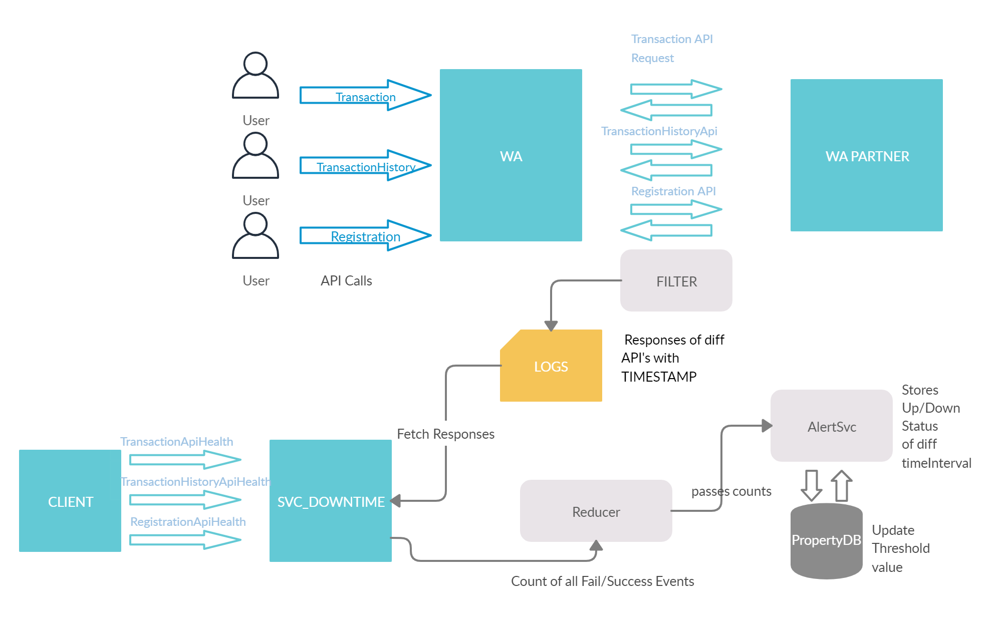

Slide 12
Technologies used
Language JAVA,SQL
Framework Spring Boot
Tools Apcahe Jmeter CLI, Git CLI
UI Github , jmeter UI
Front end tools HTML,CSS

Slide 13
Challenges faced
New Technology.
Professional environment
Bugs Fixing

Slide 14
accomplishment
Technical
Spring boot , REST MVC .
JAVA
Jmeter
Git Commands
Non-Technical
Confidence
Self Responsibility
How to implement Business problems

Slide 15
Lesson Learnt
Class vs real time application of knowledge
To behave in a professional environment

Slide 16
Q& A

