Slide 1
NUTRITIONAL MEAL DROP
Presented by:
H Nikhil Reddy (9919004106)
S Likhil Srinivas (9919004269)
M Jaipal (9919004177)
Y Pawan Kumar Reddy(9919004305)
Guided by :
DR.R Murugeswari
Assistant Professor
Computer Science and Engineering
Kalasalingam Academy of Research and Education
02/05/2022
Community Service Project(CSE18R399)

Slide 2
OBJECTIVE
Most people are very busy with their jobs. which doesn't leave much time for cooking and might lead to a poor diet.
We want to solve this problem by using an web approach that create a custom and individual weekly meal plan.
We partner with cooking partners to actually cook and deliver all meals from the generated meal plans, in selected cities.
All this will be packed up in a monthly subscription, where users can choose between receiving one or two meals per day of every month.
01

Slide 3
NEED ANALYSIS & SURVEY
By this analysis we understood
Working procedure of restaurants.
Steps to maintain food quality.
How we can accommodate restaurant based on dietary plans.
This helped us to
Generate personalized weekly plan for each client.
Know how to provide all nutrients, no matter what diet they follow.
Know how packaging plays a major rule for maintain food quality.
02

Slide 4
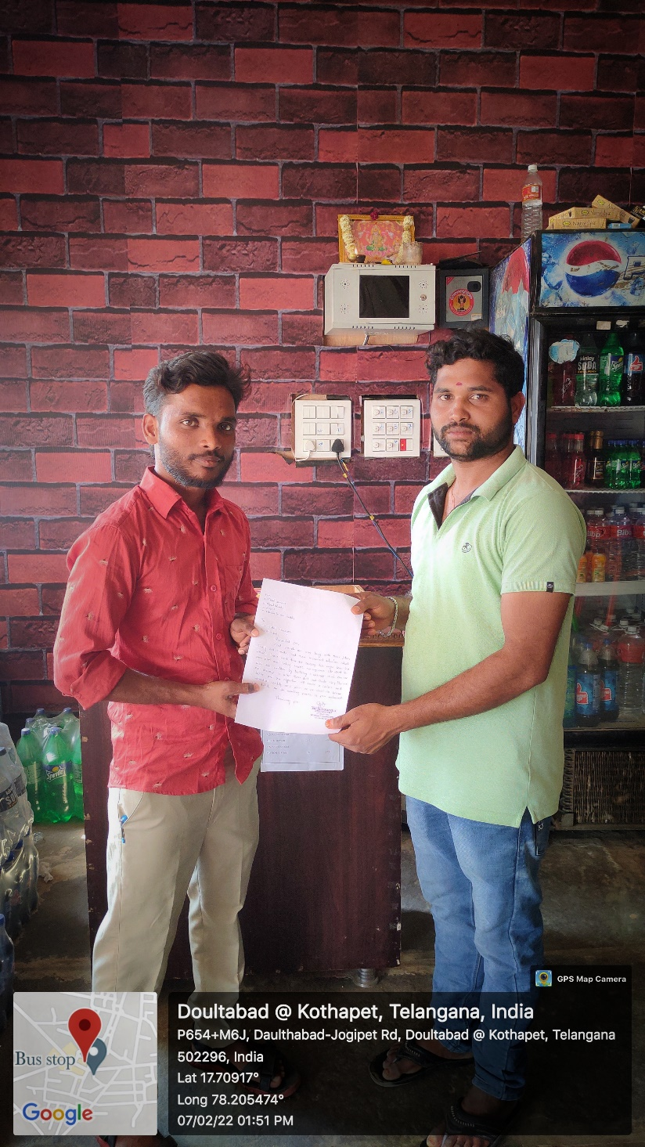
NEED ANALYSIS & SURVEY
03

Slide 5
THE PROBLEM
Searching food items daily to eat is a time consuming process.
They don’t get option to change ingredients.
They may not get all required nutrients and might lead to poor diet
04

Slide 6
THE SOLUTION
We will generate personalized weekly plan for each clients.
In our web page client can change ingredients, swap entire meals.
We make sure clients get their favorite food with enough nutrients
05

Slide 7
TECHNOLOGIES USED
HTML
CSS
JAVASCRIPT
PYTHON
VS CODE
NETLIFY
06

Slide 8
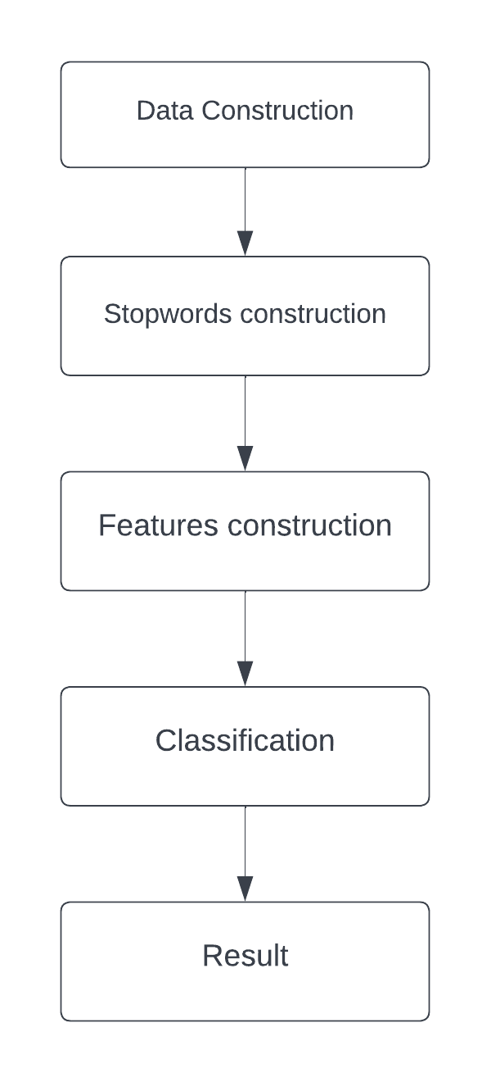
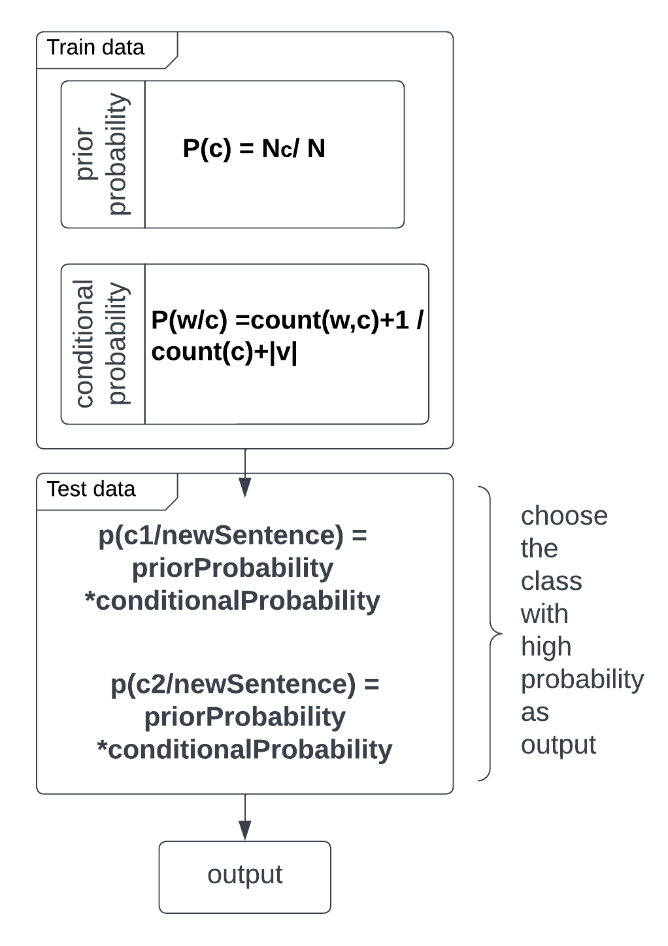
METHODOLOGY
07

Slide 9
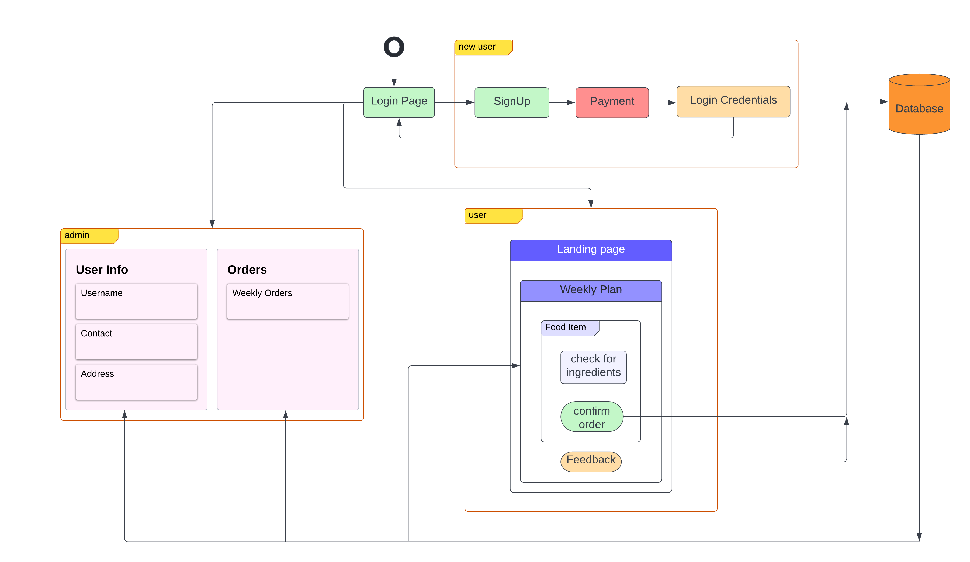
PROPOSED PROJECT BLOCK DIAGRAM
08

Slide 10
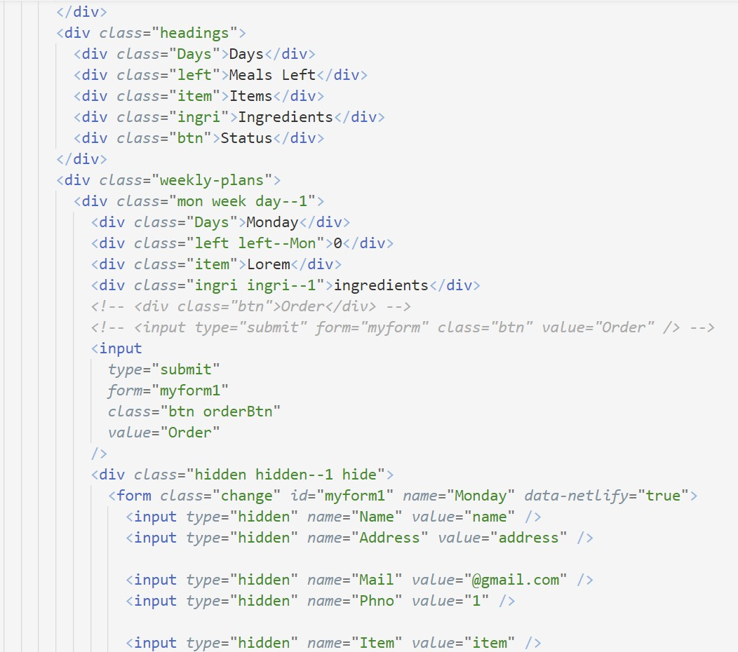
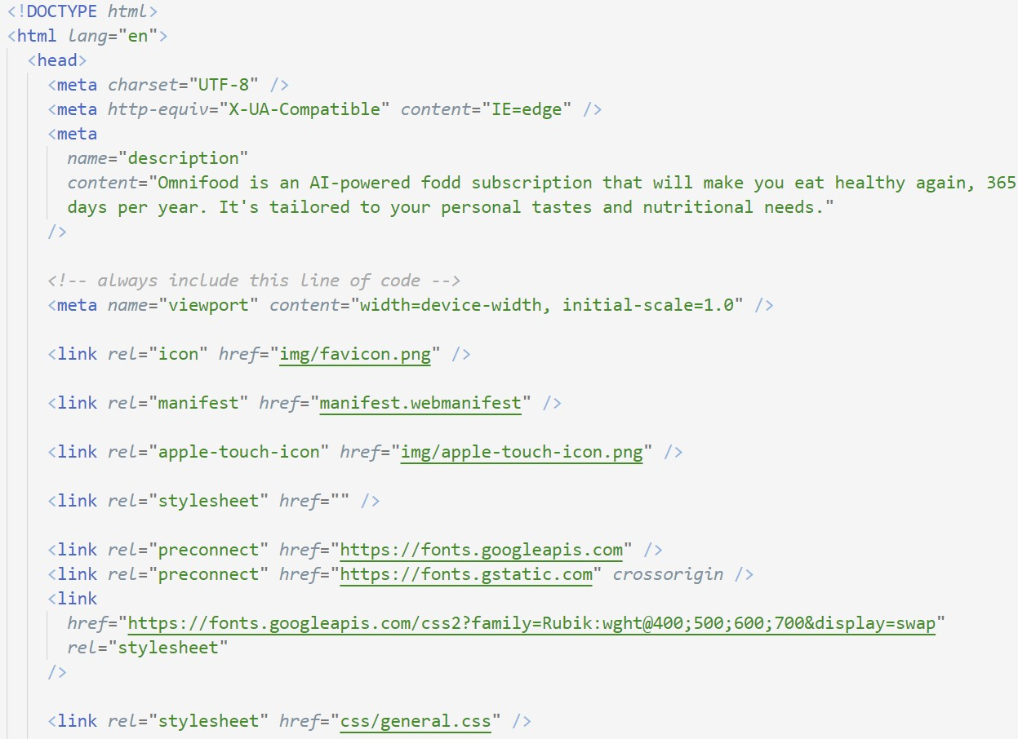
SOFTWARE IMPLEMENTATION
09

Slide 11
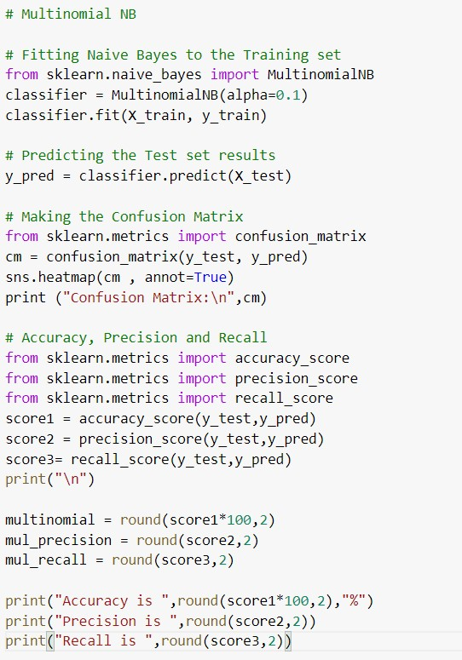
SOFTWARE IMPLEMENTATION
10

Slide 12
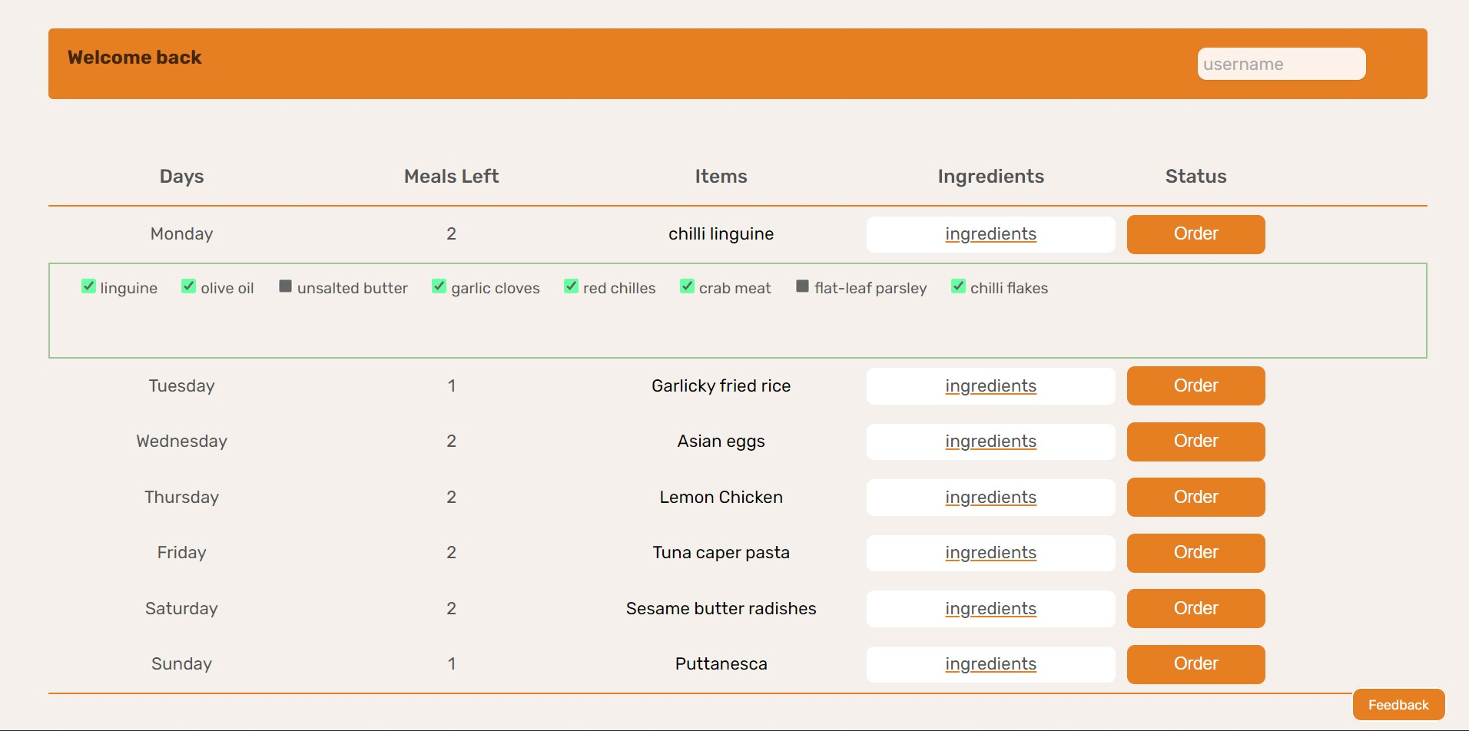
RESULTS
11

Slide 13
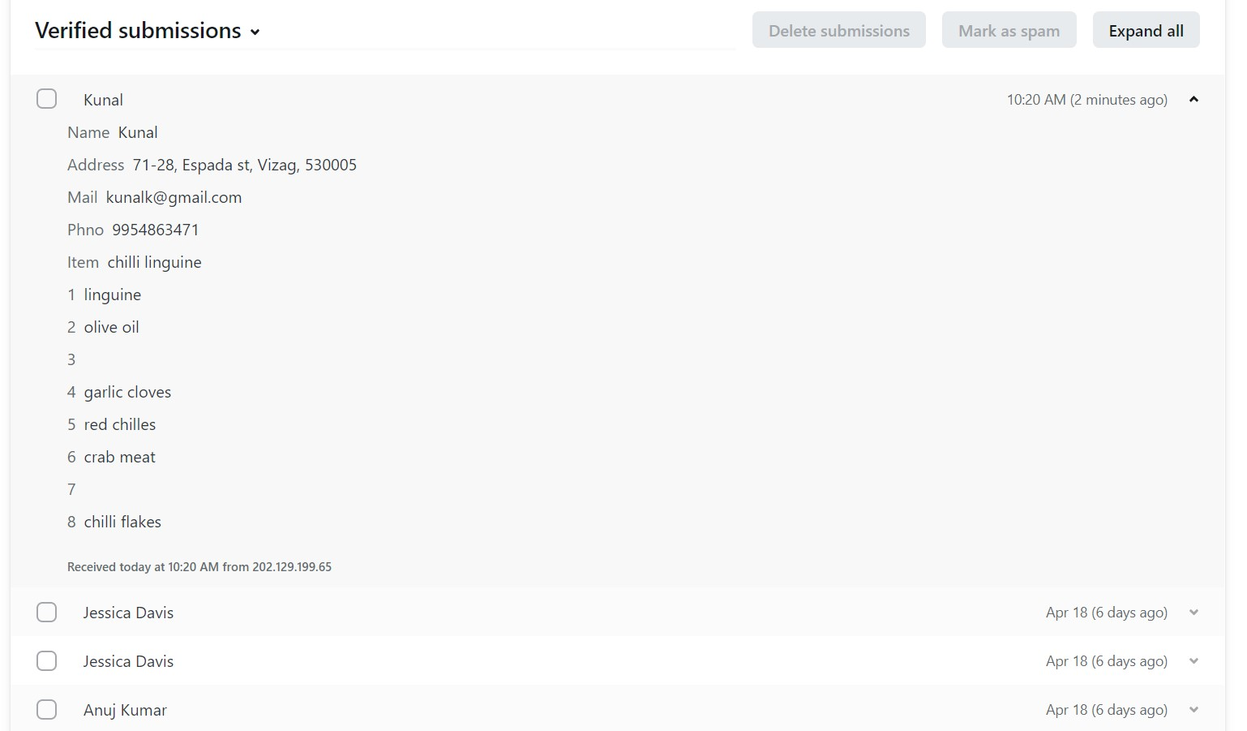
RESULTS
12

Slide 14
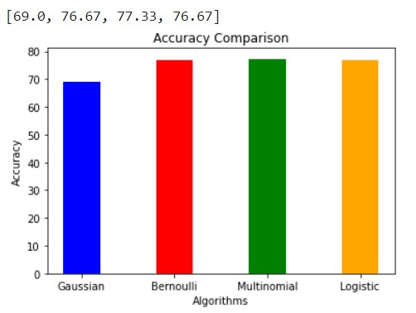
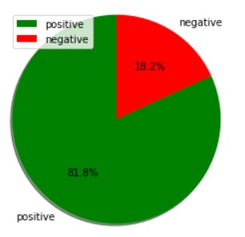
RESULTS
13

Slide 15
REFERENCES
Manuel B. Garcia. "Plan-Cook-Eat: A Meal Planner App with Optimal Macronutrient Distribution of Calories Based on Personal Total Daily Energy Expenditure " IEEE Access (2020)
Agapito G., “DIETOS: a recommender system for adaptive diet monitoring and personalized food suggestion,” Fourth International IEEE Workshop on e-Health Pervasive Wireless Applications and Services 2016.
Cristina-Edina Domokos., "Netfood: A Software for Food Ordering and Delivering" SISY 2018 • IEEE 16th International Symposium on Intelligent Systems and Informatics • September 13-15, 2018, Subotica, Serbia
XU Hongzhen., "Wireless Food Ordering System Based on Web Services." IEEE 2009 Second International Conference on Intelligent Computation Technology and Automation.
Rachmawan, Kelly, et al. "Sentiment Analysis of Restaurant Customer Reviews on TripAdvisor using Naïve Bayes." 12th International Conference on Information & Communication Technology and System (lCTS) IEEE 2019.
Unggul Widod Wijayanto, et al. "An Experimental Study of Supervised Sentiment Analysis Using Gaussian Naïve Bayes." IEEE 2018 International Seminar on Application for Technology of Information and Communication (iSemantic).
Nourin Islam, Nasrin Akter. et al. " Sentiment Analysis on Food Review using Machine Learning
14

Slide 16
THANKS
15

