Slide 1
STORES TO DOOR
Guided by :
MR.M. Raja
Presented by:
M Jaipal (9919004177)
S Likhil Srinivas (9919004269)
S V Nagendra (9919004270)
H Nikhil Reddy (9919004106)
Computer Science and Engineering
Kalasalingam Academy of Research and Education
Project Work(CSE18R498)

Slide 2
OBJECTIVE
To create a platform on which a customer can launch their own online e-commerce site of any type, such as groceries, electronics, hotels, and so on.
Allow users to browse stores based on their location and buy items from their favourite stores.
We want to do sentiment analysis on shop reviews using Multinomial Naive Bayes.
01

Slide 3
LITERATURE SURVEY
Paper Details | Existing Work
“Smart Local Shopping System”, Rohan Padaya, IEEE(2018). | This paper's goal is to improve e-commerce marketing and push delivery using huge data from recent consumer search texts. In this work, the Word2vector technique is employed to analyze the big data.
“Design and implementation of e-commerce system based on the Web”, He JunHua , IEEE(2022). | The proposal is a platform for store owners to advertise their goods and services to regular customers. This is a middleware solution between store owners and customers that serves as a system of recommendations.
02

Slide 4
LITERATURE SURVEY
Paper Details | Existing Work
“Accurate delivery analysis of distributed e-commerce based on Word2vector”, Lin Long, IEEE(2019). | This paper's goal is to improve e-commerce marketing and push delivery using huge data from recent consumer search texts. In this work, the Word2vector technique is employed to analyze the big data.
“Customer Demanding Products In Online Shopping A Novel Framework ”, Yogananth, IEEE(2017). | The goal of the task is to develop an interface that will allow users to shop online by placing bids on the items they want to buy and then buying those items. Any seller that receives a sufficient bid rate may sell the item.
03

Slide 5
LITERATURE SURVEY
Paper Details | Existing Work
“Customer Satisfaction of E-Commerce Websites”, Xiang Jianchi, IEEE(2009). | This paper provides a hypothetical model of the elements that affect client satisfaction for e-commerce sites based on past research and empirical findings.
“Last mile delivery concepts in E-Commerce An empirical approach ”, Simon Holdorf, IEEE(2014). | This paper proposed an empirical study in which 250 potential online customers were asked about their preferences for last-mile delivery and online shopping, in order to demonstrate the significance of new shipping strategies.
04

Slide 6
EXISTING SYSTEMS
We can develop and manage e-commerce websites using open technologies such as WordPress, Wix, woo-commerce, and others.
We can list and sell our products on e-commerce sites like Flipkart, Amazon and can order food from Swiggy, Zomato etc.
05

Slide 7
ISSUES IN EXISTING SYSTEMS
We can build our website with open-source software, but getting clients is difficult.
We cannot place our trust in every seller on Flipkart or Amazon.
Shipping fees are expensive.
delivery delay.
06

Slide 8
PROPOSED SYSTEM
We develop a platform on which a customer may launch their own online e-commerce site.
Users may browse shops based on their location and purchase things from their favorite stores.
Sentiment analysis on shop reviews using Multinomial Naive Bayes.
07

Slide 9
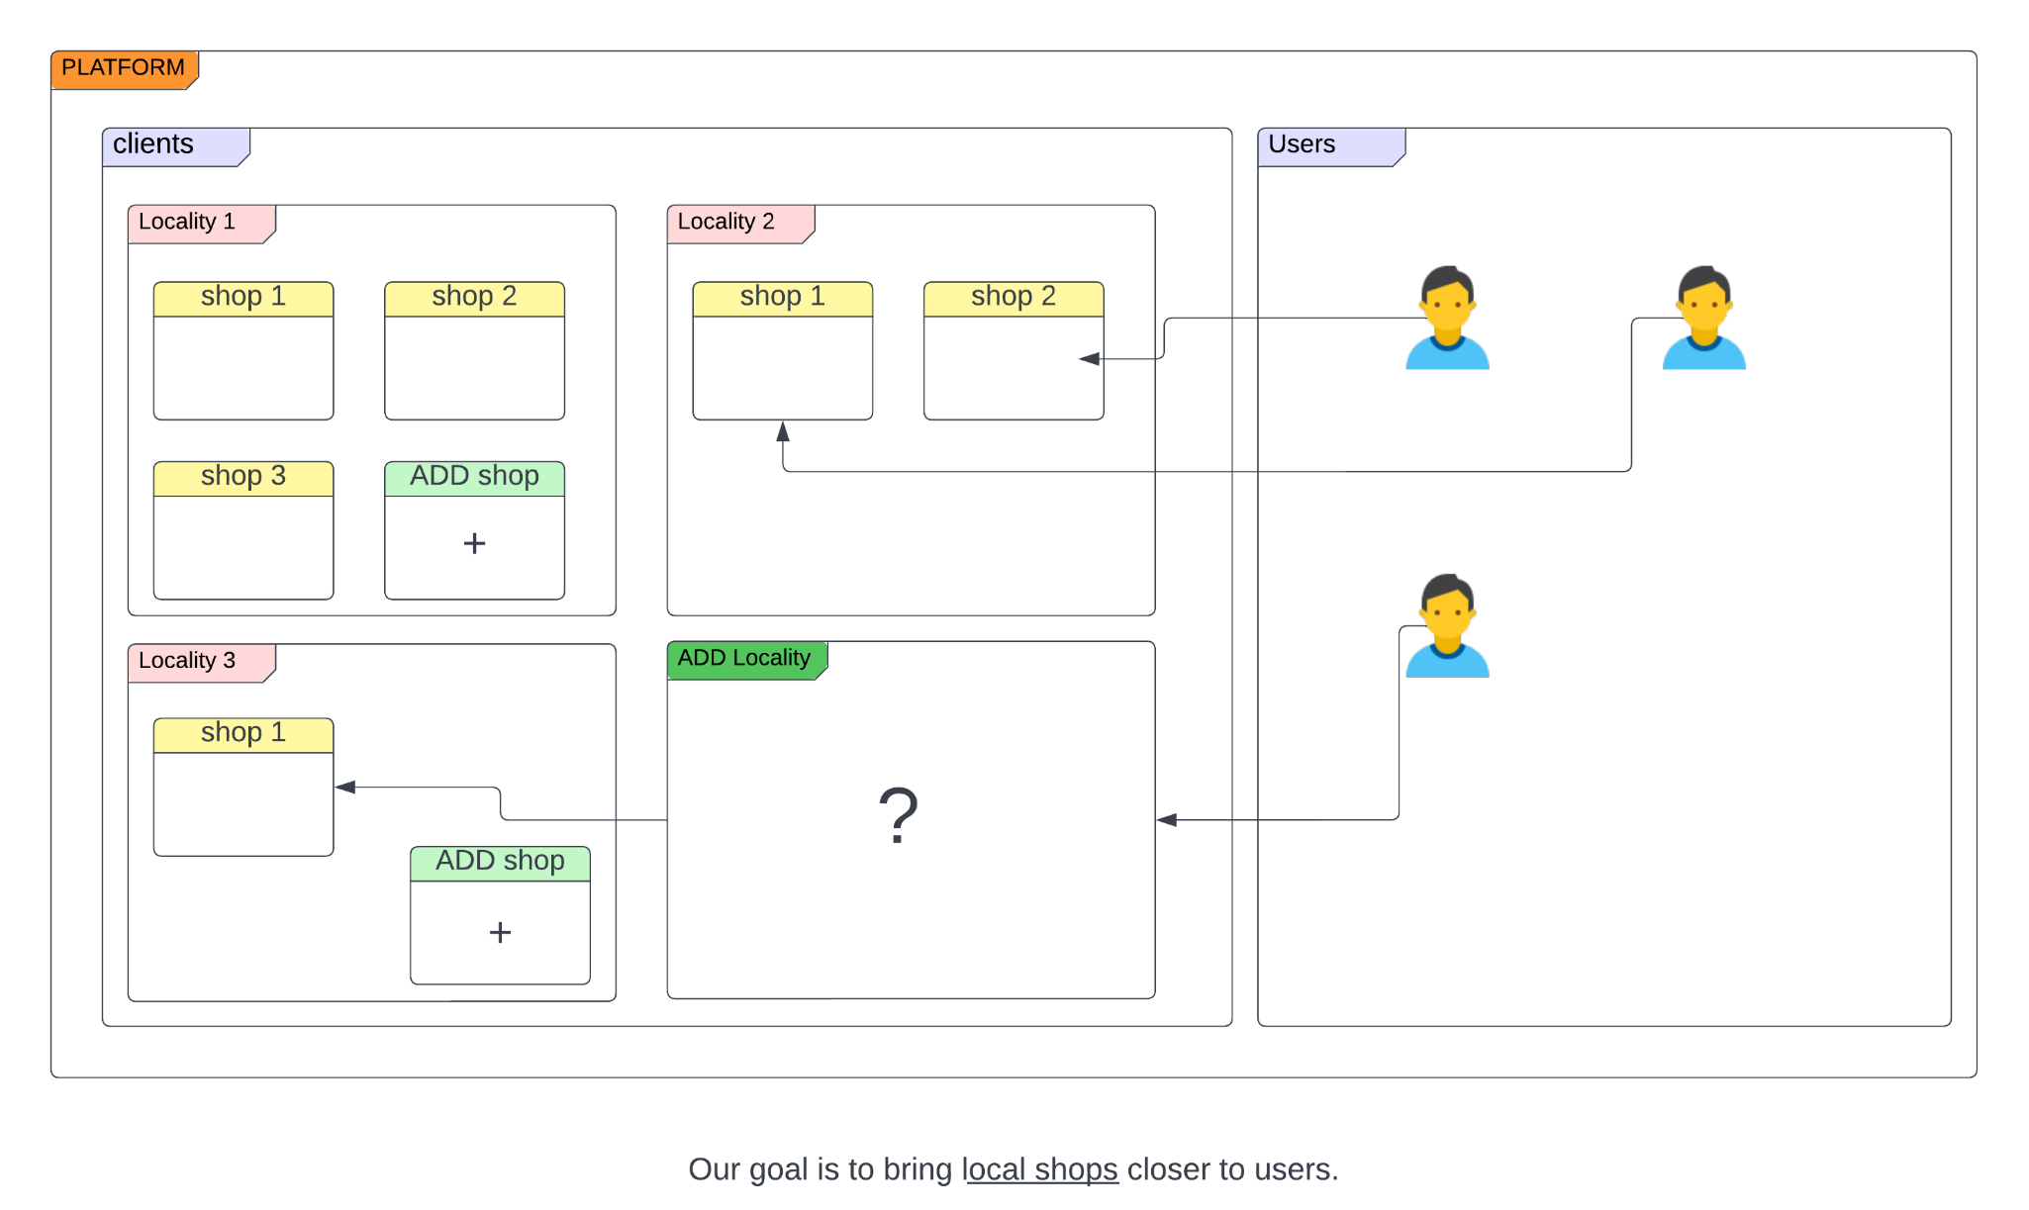
BLOCK DIAGRAM
08

Slide 10
ADVANTAGES
We can buy from trustworthy or well-known stores.
Because the business is close to our home, we can go there and question the owner if any of the products are of bad quality.
Shipping fees are low.
There is no delivery delay.
09

Slide 11
SOFTWARE REQUIREMENT
HTML
CSS
JavaScript
NodeJS
Express
VS Code
Netlify
Machine Learning
front end
back end
code editor
to deploy
sentiment analysis
10

Slide 12
PROJECT PLAN
September | Literature Survey & block diagram
October | landing page
November | User page, Admin page
December | Back-end
Phase-I
Phase- II
Front-end
January | Back-end
February | Paper work
March | Paper work
April | Paper work
May | Paper work
11

Slide 13
THANKS
12

