Slide 1
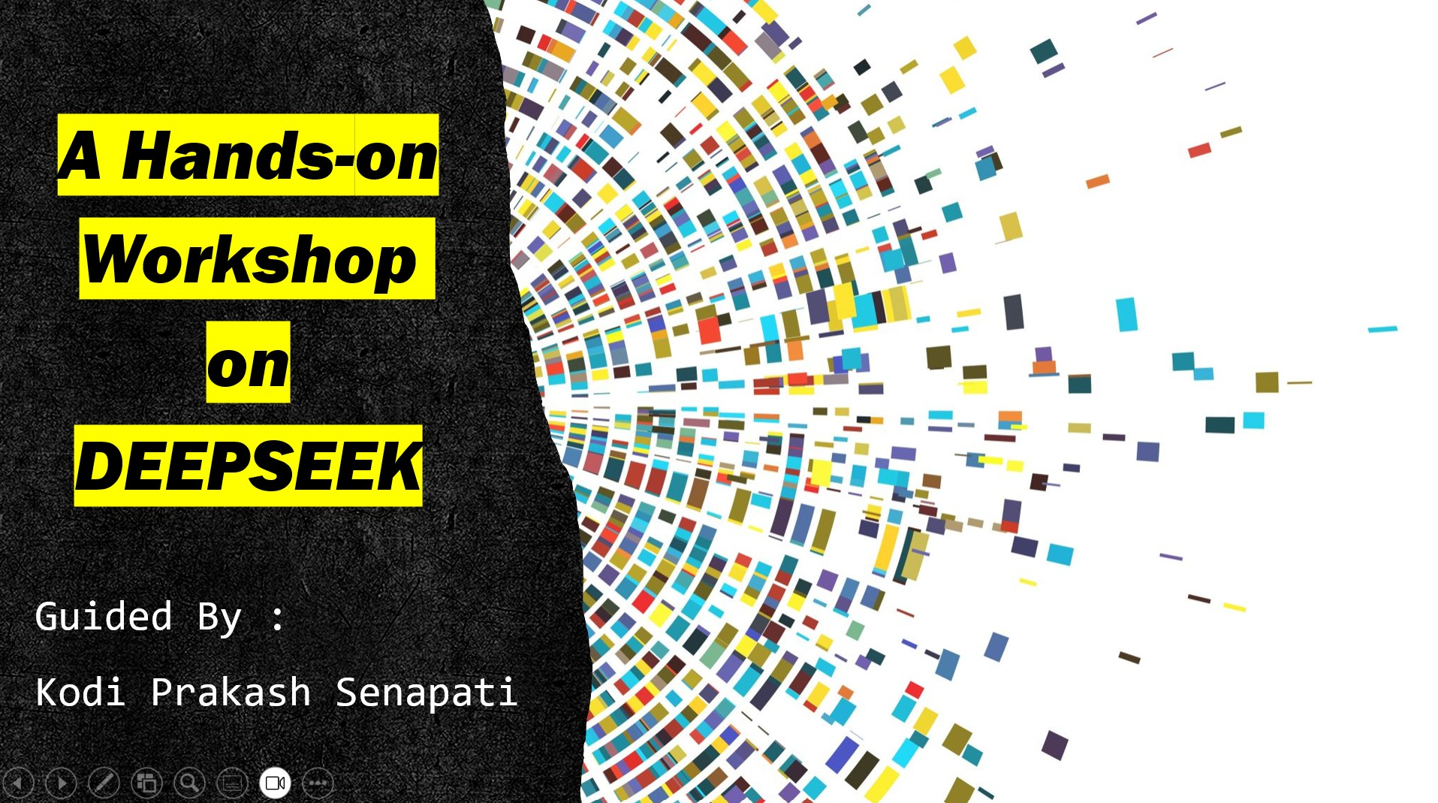

Slide 2
AGENDA
1- My Introduction
2- Introduction to DeepSeek
3- Deepseek Model
4- Project:1 → DeepSeek-R1 Bot Using Ollama
5- Practicle:2 → Deepseek integration using OpenRouter
6- Existing Generative AI video
7- Upcoming Training Programme
8- Q & A

Slide 3
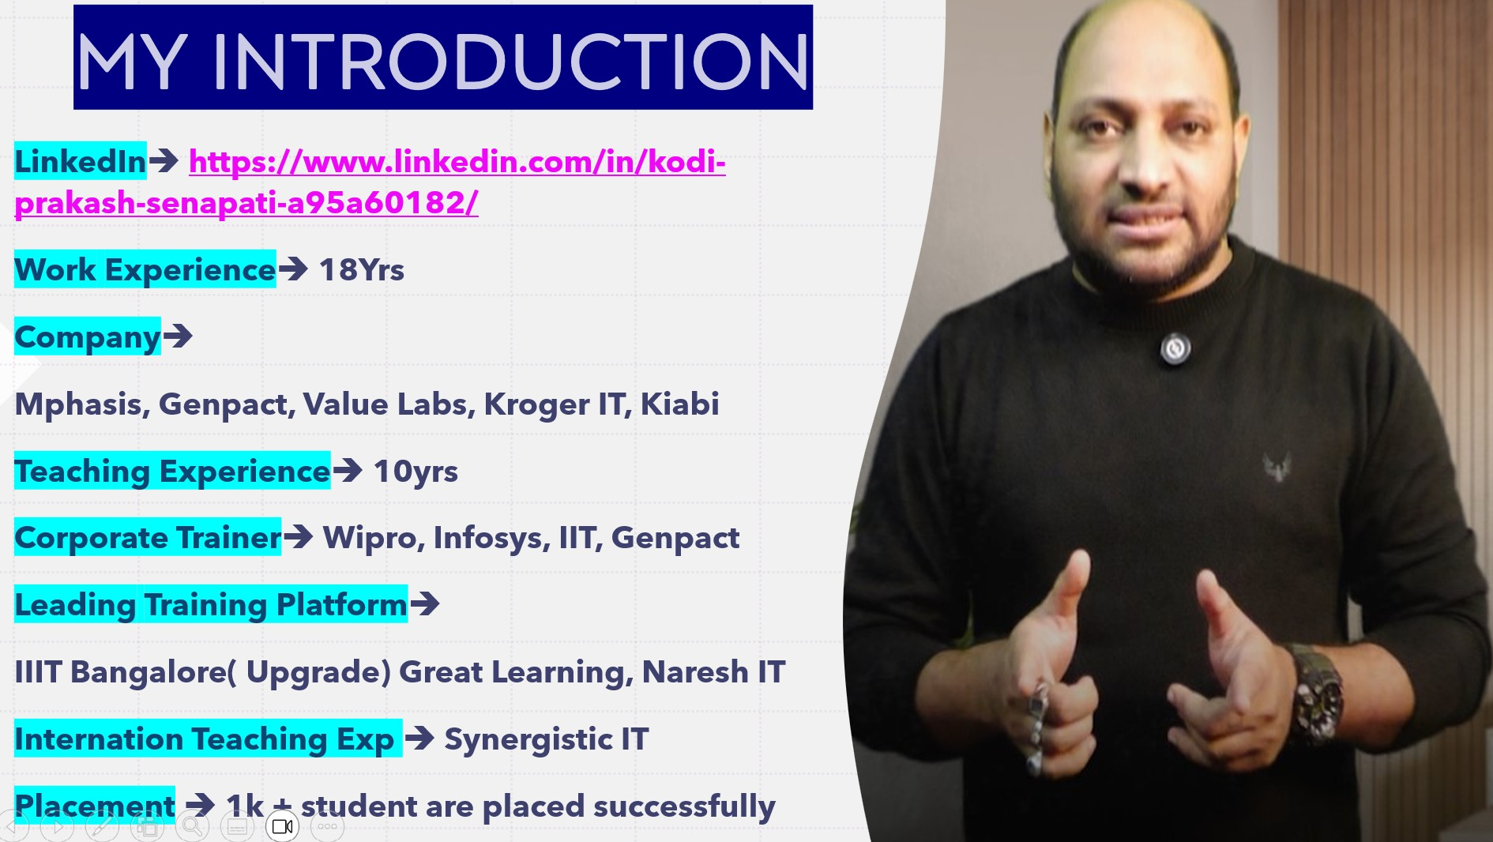

Slide 4
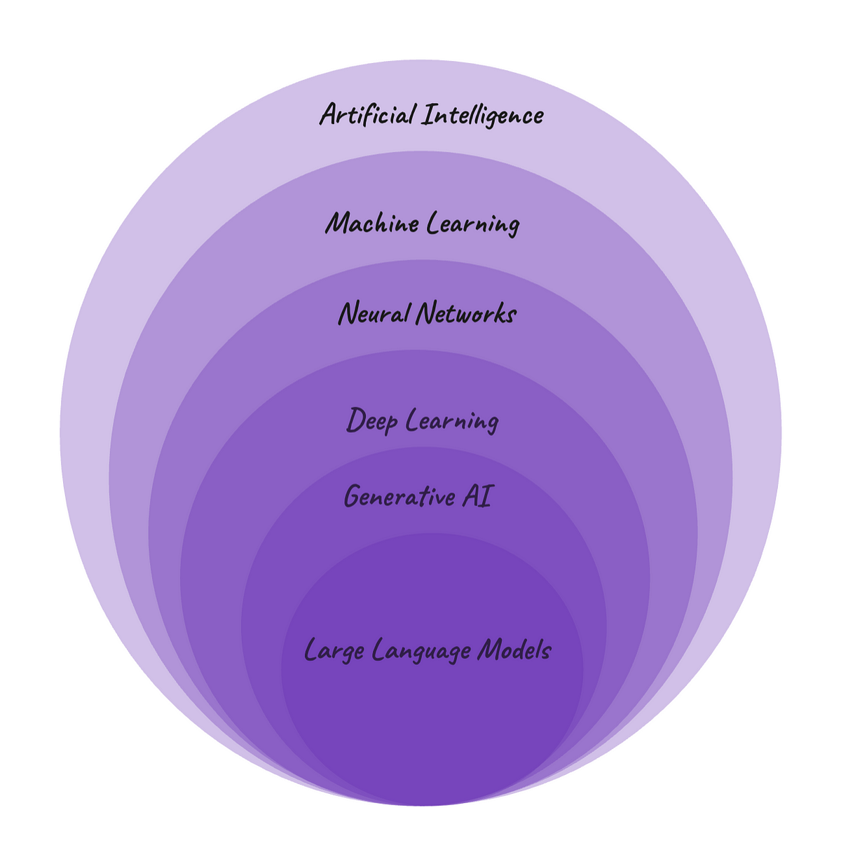
DATA SCIENCE , DATA ANALYTICS
SUPERVISED LEARNING
UNSUPERVISED LEARNING
REINFORCEMENT LEARNING
MACHINE LEARNING
ARTIFICIAL ITELLIGENCE
GENERATIVE
Artificial Intelligence
LLM MODELS
REGRESSION
NLP
CLASSIFICATION
DEEP LEARNING
NEURAL NETWORK
OPEN AI
CLUSTERING
CREW AI
GOOGLE
AI AGENTS
META
SUPER AGI
CLAUDE
Unfetch
DEEPSEEK

Slide 5

What is DeepSeek ?
DeepSeek is an artificial intelligence company that develops open-source large language models founded in 2023.
Deepseek is the part of High-Flyer’s AI research unit. High-Flyer created DeepSeek in 2023 to focus on artificial general intelligence (AGI)
Deepseek Implement Reinforcement learning technique which more focus to developing llms that achieve AGI(Artificial General Intelligence).
Chipmaker company Nvidia lost nearly $600 billion in market value after introduce deepseek.
Deepseek will more impactable on Trading ,stock market & other financial market.
Deepseek is work similar like chatgpt. Chatgpt is paid application but deepseek is opensource.
Refer the Below page link to more about founder →
https://www.upexciseportal.in/who-is-liang-wenfeng-deepseek/

Slide 6
DEEP SEEK MODEL
DeepSeek V2 →
https://github.com/deepseek-ai/DeepSeek-V2
DeepSeek V3 →
https://github.com/deepseek-ai/DeepSeek-V3
DeepSeek VL2 → (Deepseek Vision-Language Model)
https://github.com/deepseek-ai/DeepSeek-VL2
DeepSeek R1 →
https://github.com/deepseek-ai/DeepSeek-R1
DeepSeek's flagship reasoning model, which performs on several math, coding, and reasoning benchmarks which built on V3, Alibaba's Qwen model and Meta's Llama model.

Slide 7
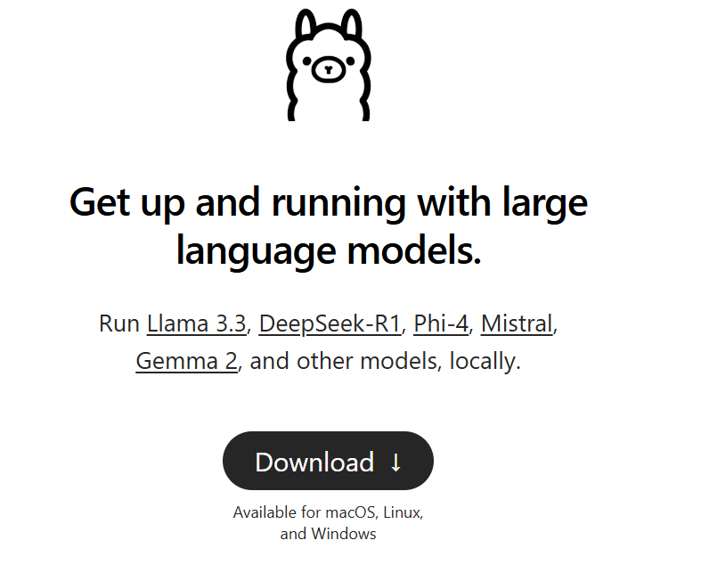
Project:1 → DeepSeek-R1 Bot Using Ollama
Software Tool → Vs Code
Programming Language → Python
Frontend UI → Streamlit
Frame Workd → LANGCHAIN
Steps to build Deepseek Bot →
Download Deepseek : https://ollama.com/
Verify installation : ollama version
Check if DeepSeek-R1 is Available : ollama models list
Pull the DeepSeek-R1 Model: ollama pull deepseek-r1
Test the prompt by writing sample query
Lets code together

Slide 8
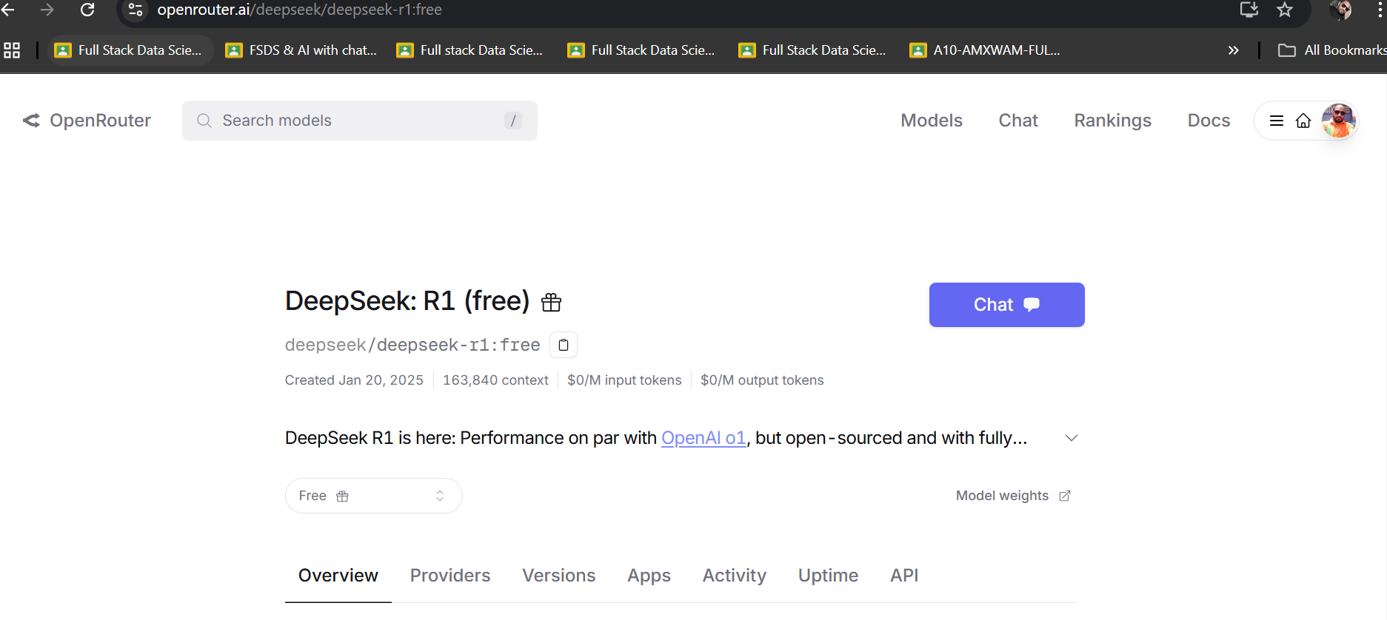
Project:2→ DeepSeek Integration using OpenRouter
Software → Google Colab
Signin to openrouter.ai → https://openrouter.ai/
Search with → deepseek: R1 (free)
Create Api KEY
Refer to OpenAi-python code Documentation

Slide 9
GENERATIVE AI PREVIOUS RECORDING SESSION
1- ChatGPT Tutorial for Developers | Introduction to ChatGPT → youtube.com/watch?v=SDStCnlITT8
2- Generative AI Workshop → youtube.com/watch?v=Xp1MnygECUs
3- LARGE LANGUAGE MODEL → youtube.com/watch?v=v0w9LXXrsys
4- COMPLETE DATA SCIENCE LIBRARY → youtube.com/watch?v=MsFhUjFL4vE&t=209s
5- Know About Data Science & Generative AI→ youtube.com/watch?v=TR_OCx5z-m8
6- Generative AI with Langchain, Langsmith, OpenAI & LLMops → youtube.com/watch?v=MAkXifYHnuw&t=1320s
7- Google Generative AI | Gemini AI→ youtube.com/watch?v=BDrXdvNh19Q&t=5684s
8- Gen AI for Build LLM Model Using Lama 3,Hugging Face & Ollama : youtube.com/watch?v=eDN6fAWLNNE&t=5425s
9- GEMMA-9B Integration with GROQ, HUGGINGFACE & LANGCHAIN: youtube.com/watch?v=Bp1XyvMvedg&t=7086s
10- NLP: youtube.com/watch?v=s-xhKH-e8ig&t=5844s
11- RAG: www.youtube.com/watch?v=8nWjvn8ZKtU&t=7553s
12- CREW AI: https://www.youtube.com/watch?v=0gqlrw-6I0s
13- STABLE DIFFUSION : https://www.youtube.com/watch?v=c1GqJ-VFLW0
14- STATISTIC : https://www.youtube.com/watch?v=baJi1276DcU&t=1288s
15- why to choose fsds with Genai ( llama 3.2 model) : https://www.youtube.com/watch?v=UgFerJcuICw
16- prompt engineer: https://www.youtube.com/watch?v=2n-RIgSNnwQ&t=8628s

Slide 10


