Slide 1
MOVIE ANALYTICS FOR BOX OFFICE AND OTT
PRESENTED BY
UNDER THE GUIDANCE OF
PavanKumar · Nikhil Saradhi · Srikanth · Pradnya
Babjee Reddy

Slide 2
ABSTRACT
The Movie Analytics Platform is an end-to-end data engineering and analytics solution designed to analyze Box Office and OTT performance using data from multiple sources such as TMDB, IMDB, OTT platforms, and Box Office datasets. The system utilizes technologies like Snowflake, PySpark, Apache Airflow, and Streamlit to ingest, process, and transform raw data into structured, analytics-ready formats. By implementing a layered architecture, the platform enables efficient data processing and supports the generation of insights related to revenue trends, genre performance, and OTT distribution. The final output is presented through an interactive dashboard, allowing users to explore and analyze key business metrics effectively.

Slide 3
OBJECTIVES
To design and implement a scalable end-to-end data pipeline.
To integrate and process multi-source movie datasets.
To perform data cleaning, transformation, and standardization.
To build a star schema data model for efficient analytics.
To generate meaningful business insights from movie data.
To develop an interactive dashboard for data visualization.

Slide 4






AGENDA
01
Project Overview
02
Medallion Architecture
03
Airflow Pipeline
Goals, scope & data sources
Bronze → Silver → Gold on AWS S3
Orchestration & task dependency flow
04
Star Schema
05
Snowflake Load
06
Dashboard
Dim & Fact tables design
Data warehouse ingestion
Streamlit OTT & Movies analytics

Slide 5
TECH STACK
PySpark
AWS S3
Airflow Orchestration
Medallion Architecture
Snowflake
Streamlit

Slide 6


MEDALLION ARCHITECTURE
AWS S3 · Bronze → Silver → Gold
BRONZE
SILVER
GOLD
Raw Ingestion
Cleaned, Standardized & Star Schema
Aggregated Analytics View
1
2
3
S3: movie-analytics-platform-data
Column standardization & null fills
vw_movie_analytics (Full View)
→
→
6 CSV files: raw1/ → bronze1/
OTT: Netflix, Amazon, Disney, Movies
Pre-aggregated for dashboard queries
boto3.copy_object() — zero transform
Separate: Film Locations, Theatres
Joined across all Silver tables
Preserves exact source fidelity
Star Schema: 1 Fact + 4 Dim tables
Loaded to Snowflake Gold layer
Each layer stored in AWS S3 as Parquet · Orchestrated by Apache Airflow · Final destination: Snowflake DWH

Slide 7
APACHE AIRFLOW PIPELINE
DAG: movie_analytics_pipeline
▶
1
→
2
→
3
→
4
bronze_layer
silver_layer
gold_layer
snowflake_load
bronze_reader.py
silver_transform.py
gold_transform.py
snowflake_load.py
boto3 S3
pyspark
Analytics View
COPY INTO
copy raw1/
std columns
SCD Type 2
6 tables
→ bronze1/
4 OTT + meta
vw_movie_analytics
Parquet
5 CSV files
locations
Aggregated Gold
→ Snowflake
No transform
→ Parquet
→ Parquet

Slide 8
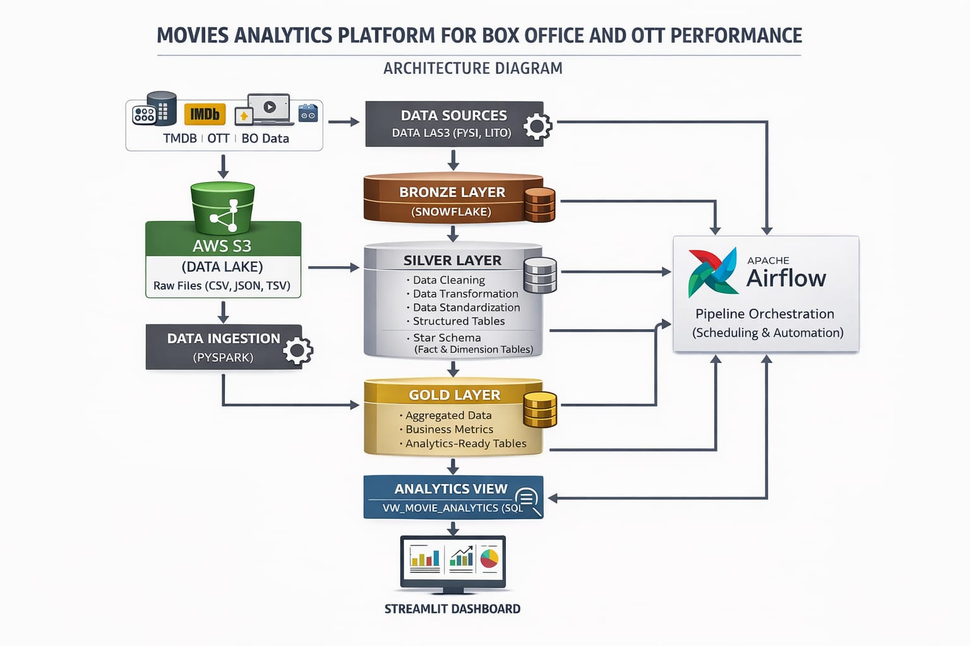
END-TO-END ARCHITECTURE

Slide 9
STAR SCHEMA — SILVER LAYER
dim_movies
dim_platform
★ fact_movie_analytics
PK movie_id
INT
PK platform_id
INT
title
VARCHAR
PK fact_id
INT
platform_name
VARCHAR
genre
VARCHAR
FK movie_id
INT
rating
VARCHAR
FK platform_id
INT
FK theatre_id
INT
FK location_id
INT
dim_theatre
release_year
INT
avg_ticket_price
FLOAT
PK theatre_id
INT
total_seats
INT
theatre_name
VARCHAR
dim_location
city
VARCHAR
SCD Type 2 on all dim tables
start_date
DATE
PK location_id
INT
is_current
BOOL
city
VARCHAR
title
VARCHAR
1 Combined Fact Table · 4 Dimension Tables · SCD Type 2: start_date / end_date / is_current on all dim tables

Slide 10
SNOWFLAKE DATA LOAD
CONNECTION CONFIG
TABLES LOADED VIA COPY INTO
Database
MOVIE_DB
DIM
dim_movies
DIM
dim_platform
@movie_stage/dim_movies/
@movie_stage/dim_platform/
Schema
MOVIE_SCHEMA
DIM
dim_location
DIM
dim_theatre
Warehouse
COMPUTE_WH
@movie_stage/dim_location/
@movie_stage/dim_theatre/
File Format
PARQUET
FACT
fact_streaming
FACT
fact_theatre
@movie_stage/fact_streaming/
@movie_stage/fact_theatre/
Method
COPY INTO
COPY INTO SYNTAX
COPY INTO dim_movies FROM @movie_stage/dim_movies/ FILE_FORMAT = (TYPE = PARQUET) MATCH_BY_COLUMN_NAME = CASE_INSENSITIVE;

Slide 11
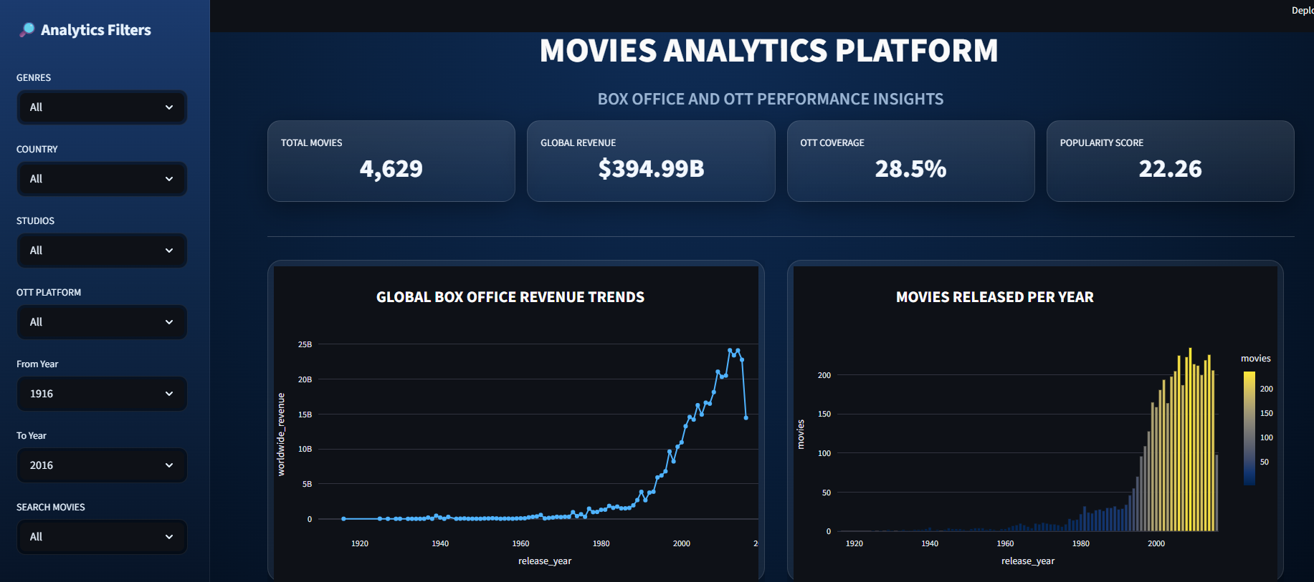
DASHBOARD SNAPSHOTS
Movies Analytics Platform · Box Office Revenue Trends · KPI: 4,629 Movies · $394.99B Revenue · 28.5% OTT Coverage

Slide 12
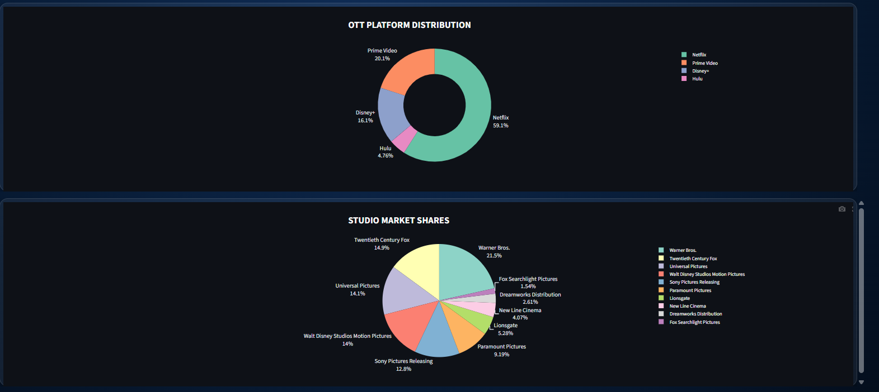
OTT Platform Distribution & Studio Market Shares
Netflix 59.1% · Prime Video 20.1% · Disney+ 16.1% · Hulu 4.78% · Warner Bros. leads studio share at 21.5%

Slide 13
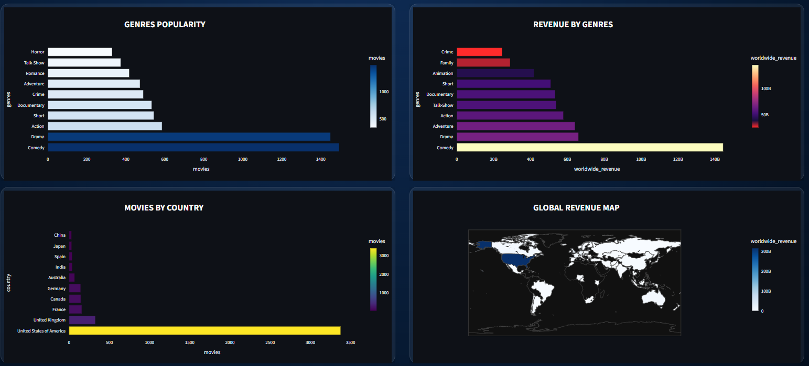
Genre Popularity, Revenue by Genre & Global Revenue Map
Comedy leads revenue · Drama highest movie count · US dominates count · Global revenue heat map by country

Slide 14
CONCLUSION
The Movie Analytics Platform demonstrates a complete end-to-end data engineering pipeline that transforms raw movie datasets into structured, analytics-ready insights. By integrating multiple data sources and applying Bronze, Silver, and Gold layer architecture, the system ensures efficient data processing, scalability, and reliability. The use of star schema modeling enhances query performance, while the Streamlit dashboard enables interactive visualization of key metrics such as revenue trends, OTT distribution, and genre performance. Overall, this project highlights the significance of data-driven decision-making in improving business strategies and optimizing movie performance in the entertainment industry.

Slide 15
THANK YOU

