Slide 1
10 November 2021
Selling CI/CD
UdaPeople

Slide 2


Introduction
Introduction
Selling CI/CD
UdaPeople

Slide 3
Slalom is a modern consulting firm focused on strategy, technology, and business transformation.
STRATEGY
TECHNOLOGY
TRANSFORMATION
Redefine what’s possible
Go beyond the expected. We help you move confidently through ambiguity and risk, focus on your customer needs, and deliver sustainable business value.
We analyze, architect, and co-create
Learn from your data, create incredible digital experiences, or make the most of new tech. We blend design, engineering, and analytics expertise to help you build the future.
Enact lasting change
New technologies. Shifting customers. Industry disruption. Business moves fast, and we specialize in working through change with you.

Slide 4
Slalom is a modern consulting firm focused on strategy, technology, and business transformation.
STRATEGY
TECHNOLOGY
TRANSFORMATION
Redefine what’s possible
Go beyond the expected. We help you move confidently through ambiguity and risk, focus on your customer needs, and deliver lasting business value.
Build the future
Learn from your data, create incredible digital experiences, and make the most of new technology through our design, engineering, analytics, and cloud expertise.
Enact lasting change
New technologies. Shifting customers. Industry disruption. We can help you redefine the way your company does business now and into the future.

Slide 5
Personal connection at global scale
NORTH AMERICA
United States
Atlanta
Austin
Boston
Charlotte
Chicago
Columbus
Dallas
Denver
Detroit
East Bay
Fort Worth
Hartford
Houston
Los Angeles
Minneapolis
New York
New Jersey
Orange County
Philadelphia
Phoenix
Portland
Salt Lake City
San Diego
San Francisco
Seattle
Silicon Valley
South Florida
St. Louis
Washington DC
Westchester/
Southern CT
NORTH AMERICA
Canada
Montréal
Toronto
Vancouver
ASIA PACIFIC
Australia
Melbourne
Sydney
Japan
Tokyo
EUROPE
United Kingdom
London
Manchester
= Build Center

Slide 6
Personal connection at global scale
NORTH AMERICA
United States
Atlanta
Austin
Boston
Charlotte
Chicago
Columbus
Dallas
Denver
Detroit
East Bay
Fort Worth
Hartford
Houston
Los Angeles
Minneapolis
New York
New Jersey
Orange County
Philadelphia
Phoenix
Portland
Salt Lake City
San Diego
San Francisco
Seattle
Silicon Valley
South Florida
St. Louis
Washington DC
Westchester/
Southern CT
NORTH AMERICA
Canada
Montréal
Toronto
Vancouver
ASIA PACIFIC
Australia
Melbourne
Sydney
Japan
Tokyo
EUROPE
United Kingdom
London
Manchester
= Build Center

Slide 7

OUR VISION
To enable a world in which each person has the opportunity to love their work and life.
OUR PURPOSE
To help our clients reach for and realize their vision.

Slide 8










CORE VALUES
Our company culture is what sets us apart. These values guide how we work with our clients, our teams, and our communities.
Do what is right, always.
Inspire passion and adventure.
Take ownership. Get it done.
Celebrate authenticity.
Focus on outcomes.
Drive connection and teamwork.
Fuel growth and innovation.
Stay humble and curious.
Build and shape a better future.
Smile.

Slide 9
Setting the standard for partnership
1,730+
engagements
550+
customers
1,600+
consultants
3,030+
engagements
750+
customers
950+
consultants
We partner with over 400 of the world’s leading solution providers to create extraordinary results for your business.
315+
engagements
115+
customers
175+
consultants
190+
engagements
90+
customers
600+
consultants
2,920+
engagements
820+
customers
850+
consultants
1,300+
engagements
380+
customers
900+
consultants

Slide 10

Our clients range from leading global brands to ambitious startups.

Slide 11
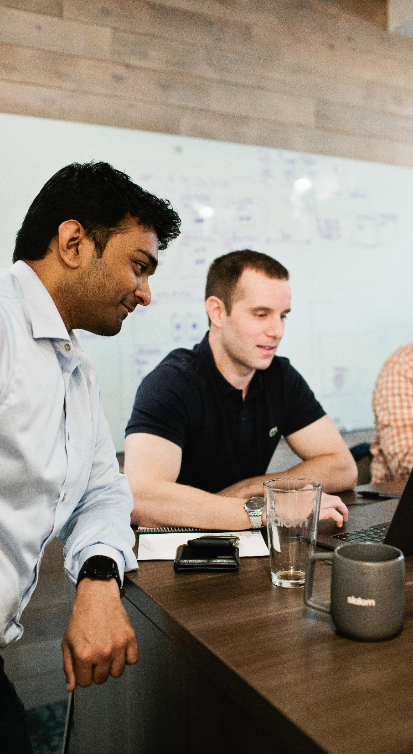
AWARDS
We believe in a world in which every person loves their work and life.
Fortune 100 Best Companies to Work For
Fortune Best Workplaces for Women
Human Rights Campaign Best Places to Work 2015-2021
Glassdoor Best Places to Work 2016-2021

Slide 12
We believe in a world in which every person loves their work and life.
Fortune 100 Best Companies to Work For
[Space here for your local award]
Human Rights Campaign Best Places to Work 2015-2021
[Space here for your local award]

Slide 13
What is CI/CD?
Continuous Integration (CI)
Beremod maximusaesto dunt labo. Et laborum que parit invere nullit et, simporiatium et exceatibus sim laborro to doluptiati optatincid ut ma simint.
Fuga. Nem necupta ius consequ osseritem quis eium faceperibus re lab il idi reratem ipsum.
Continuous Deployment (CD)
Beremod maximusaesto dunt labo. Et laborum que parit invere nullit et, simporiatium et exceatibus sim laborro to doluptiati optatincid ut ma simint.
Fuga. Nem necupta ius consequ osseritem quis eium faceperibus re lab il idi reratem ipsum.

Slide 14
Benefits In Practice?
Continuous Integration (CI)
Beremod maximusaesto dunt labo. Et laborum que parit invere nullit et, simporiatium et exceatibus sim laborro to doluptiati optatincid ut ma simint.
Fuga. Nem necupta ius consequ osseritem quis eium faceperibus re lab il idi reratem ipsum.
Continuous Deployment (CD)
Beremod maximusaesto dunt labo. Et laborum que parit invere nullit et, simporiatium et exceatibus sim laborro to doluptiati optatincid ut ma simint.
Fuga. Nem necupta ius consequ osseritem quis eium faceperibus re lab il idi reratem ipsum.

Slide 15
Benefits vs Cost Analysis
Continuous Integration (CI)
Beremod maximusaesto dunt labo. Et laborum que parit invere nullit et, simporiatium et exceatibus sim laborro to doluptiati optatincid ut ma simint.
Fuga. Nem necupta ius consequ osseritem quis eium faceperibus re lab il idi reratem ipsum.
Continuous Deployment (CD)
Beremod maximusaesto dunt labo. Et laborum que parit invere nullit et, simporiatium et exceatibus sim laborro to doluptiati optatincid ut ma simint.
Fuga. Nem necupta ius consequ osseritem quis eium faceperibus re lab il idi reratem ipsum.

Slide 16

Introduction
Introduction
Introduction

