Slide 1
DriverlessAI on Power
Nikhil Shekhar
Machine Learning Engineer, H2O.ai

Slide 2
Major products from H2O.ai
H2O
Sparkling water
H2O4GPU
Datatable (Python variant of R data.table)
DriverlessAI

Slide 3
What is DAI
It is automatic machine learning platform that delivers advanced functionality for data visualization, feature engineering, model interpretability and low-latency deployment.

Slide 4
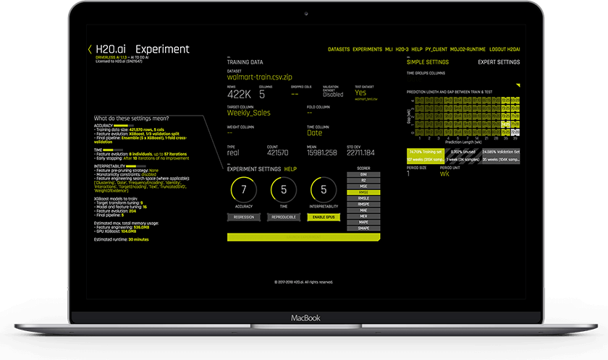
Driverless AI - Key Features
Automatic visualization
Automatic feature engineering
Automatic model tuning
Machine learning interpretability
Automatic scoring pipeline
GPU acceleration
Time series support
NLP support

Slide 5
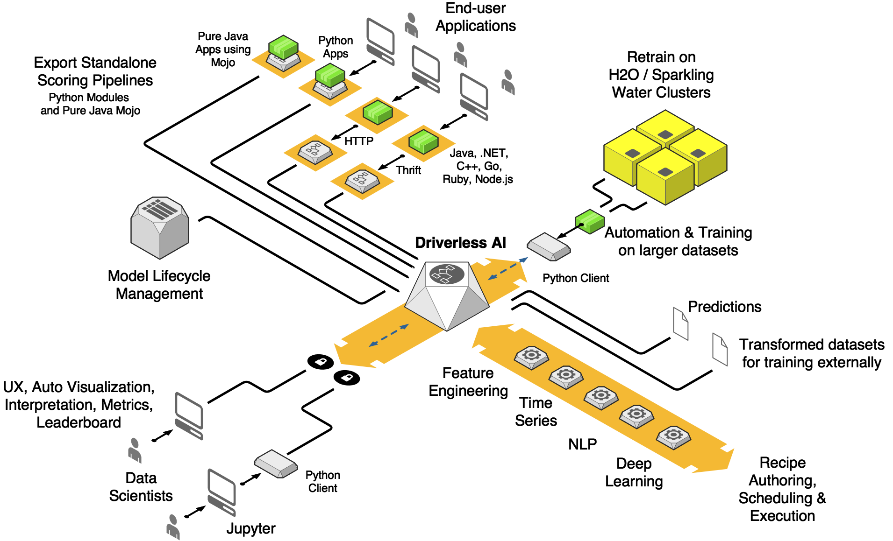
DAI Architecture

Slide 6
The Start of DAI + Power install
One year ago
Limited distribution of dependencies
Compiler differences

Slide 7
Distribution on Power + DAI
RPM and DEB packages
Docker image
IBM Cloud Private

Slide 8
TensorFlow on Power
One of our developers, Patrick Rice worked on compiling Tensorflow for Power Machines
Worked with IBM to update Community build of TF
Built on Ubuntu 14
Supported on RHEL and Ubuntu
Incorporated IBM’s community build of TensorFlow
TF 1.11.0 for CUDA 9.0
GPU support
Works out of the box

Slide 9
DriverlessAI Demo

Slide 10
Q&A

Slide 11
Thank You.!

