Slide 1

Rhyme Detection in Poetry: Indian Languages
Presented by:
Aman Garg (185036)
Prashant Kumar (185045)
Atul Thakur (185050)
Rohit Kaushal (185037)
Nikhil Sharma (185068)
Azhan Ali (185096)
Under the guidance of: Dr. Kamlesh Dutta
DEPARTMENT OF COMPUTER SCIENCE & ENGINEERING
NATIONAL INSTITUTE OF TECHNOLOGY HAMIRPUR (H.P.)

Slide 2
CONTENTS
1
Introduction
2
Related Work
3
Dataset Generation
4
Classification Algorithms
5
Architecture
6
Conclusions

Slide 3
Introduction
Rhyme Detection

Slide 4
Rhyme in Poetry
Rhyme, also spelled rime, the correspondence of two or more words with similar-sounding final syllables placed so as to echo one another.
Rhyme is used by poets and occasionally by prose writers to produce sounds appealing to the reader's senses and to unify and establish a poem's stanzaic form.

Slide 5
Examples
Hey, diddle, diddle, The cat and the fiddle, The cow jumped over the moon; The little dog laughed To see such sport, And the dish ran away with the spoon.
कभी तिराहे पर, कभी आँगन में टाँगा, कभी किसी खटिया तो खूँटी से बाँधा, कभी मतलब से तो कभी युहीं नकारा

Slide 6
Types of Rhyme
Full rhyme – cat/hat/, dog/log.
Half or para-rhyme – cat/hit, lover/river.
Internal rhyme – rhyme that does not occur at the end of the line (the usual place rhyme is found) – Today, as I walked, the large black cat, tipped his hat at me and smiled.

Slide 7
Objectives
Development of annotated corpora of poems in Indian Languages, along with Meta Data and Rhythmic features.
Development of Deep Learning models for Rhyme detection for Poetry in an Indian Language.
.

Slide 8
Steps to achieve the Objective
Collection of about 3000 poems written in Indian languages.
Dataset pre-processing.
Manually annotating the rhymes in the poems collected.
Evaluation of various DL models to solve the purpose.
Selection of two DL algorithms by two groups.
Training the selected DL model with the dataset created.
Evaluation of trained model.
Lexical features (no. of words and stanzas, no. of characters, no. of sentences, vowel and cononants, frequency of character), statistical features (avg. no. of characters in a poem, avg. word in a line, avg. word length, ratio of consonants and vowels), SYNTATIC (occurrence of conjunction words in each poem (nouns, pronouns, verbs, adjactives and adverbs)), POETIC (internal rhyming, end rhyming (perfect, slant and identity), meter)
.

Slide 9
RELATED WORK

Slide 10
RELATED WORK
2018
2020
2021
Thomas et al., 2018
They used Siamese RNN for Supervised Rhyme Detection. The language they used was: German and English.
Priyanka et al., 2020
They used DL algorithms for language Identification of Devanagari poems.
Thomas et al., 2021
They built a poetry corpora with rhythmic features.

Slide 11
DATASET GENERATION

Slide 12
Dataset Generation
No dataset for Hindi or any other Indian language.
To collect poems written in Indian languages, we wrote a web scrapping script in Python language.
The poems were scrapped from www.kavitakosh.org
Dataset contains poems in Hindi, Maithili, Rajasthani, Avadhi, Harayanvi and Bhojpuri.
We scrapped ~3000 poems.
The script that we wrote can be found at https://codeshare.io/vwNvm4

Slide 13
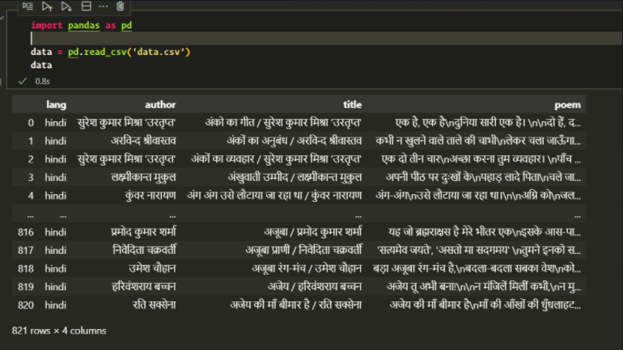
Screenshot of Data Scrapped

Slide 14
Dataset Annotations
To annotate the dataset, we manually find out the rhyming words.
We collect the rhyme pair tokens.
We are also creating false tokens that don’t rhyme for training and testing purpose.
Pattern | Token
A | टाँगा
B | नकारा
B | पुकारा
A | बाँधा

Slide 15
Deep Learning Models

Slide 16
Siamese Recurrent Neural Networks
Siamese networks train a similarity measure between labelled points.
Two input points (e.g. two rhyming tokens) are run simultaneously through a neural network and are both mapped to a vector of shape Nx1.
Then a standard numerical function can measure the distance between the vectors (e.g. cosine distance).

Slide 17
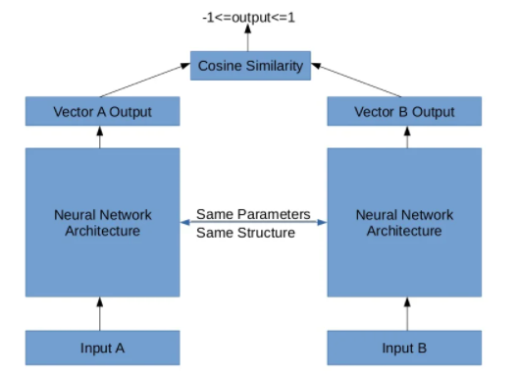
Structural Definition

Slide 18
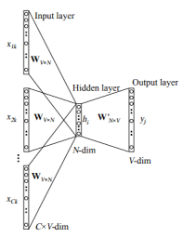
Word2Vec
A word vectorization technique.
Creates n-dimensional embeddings for a word.
Low dimensional vector representation of each word in the corpora.

Slide 19
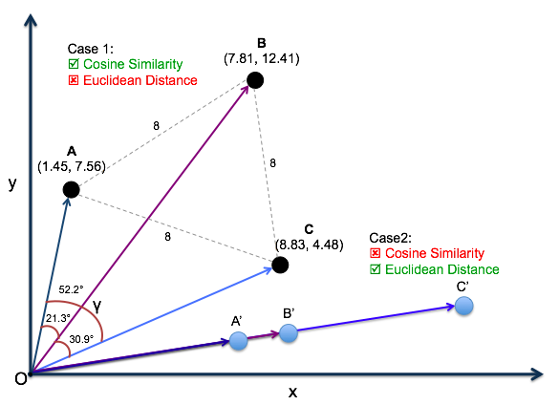
Similarity of two embeddings
The similarity of two word embeddings can be found via:
Euclidian Distance
Cosine Similarity

Slide 20
Architecture

Slide 21
The Rhyme Detection Model Architecture:
Data Set Creation
Scrap various Indian poems from kavitakosh.org
Data Set Pre-processing and Annotation
Filter out the stopwords and remove incomplete poems.
Then manually annotate the rhymes in the Poems.
Create train-test set
The rhyming tokens are then spit into train-test set.
Wrong pairs of rhyming tokens are also added for better training
Training
The features are then passed to either Siamese Network or word2vec algorithm.

Slide 22
Conclusions:
No previous work in field of rhyme detection for poems in Indian languages.
No previous dataset for Indian poems.
The dataset we created will help future research on poetic features and rhyming characteristics of poems written in Indian languages.
A reliable system for the detection of rhyme would allow large scale analyses, opening several directions for research.

Slide 23
Thank You

