Slide 1

Data Base Management System
Student Record Management

Slide 2

Why DBMS:
In Student Database, we have many records and contain large data which cannot be efficiently managed with File Processing System
DBMS serves as a critical tool for efficiently managing and manipulating large volumes of data in various applications and industries.

Slide 3
Introduction
This is the project that is based on mySQL language and with DBMS tools.
This project enhances the efficiency, transparency, and effectiveness of student record management within educational institutions.
Educational Institutions have different entities like student, grade, course, instructor, department.
We use some steps to make database to work efficiently.

Slide 4
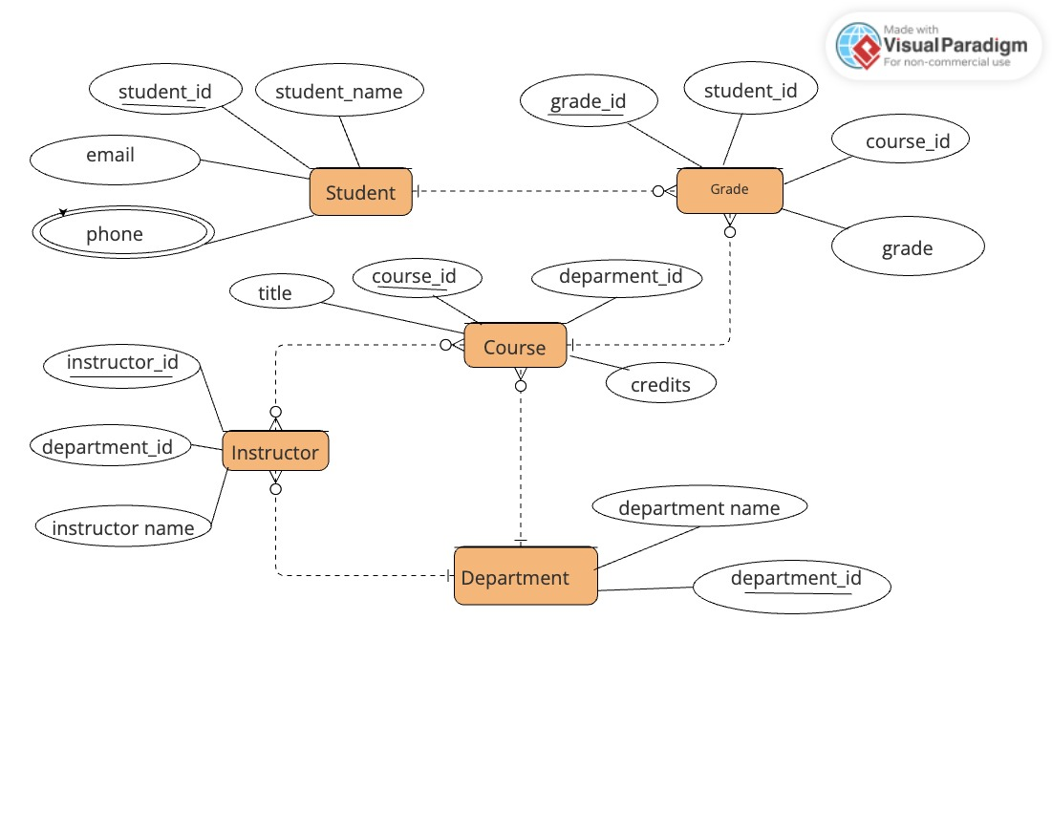
Entity Relation Diagram

Slide 5
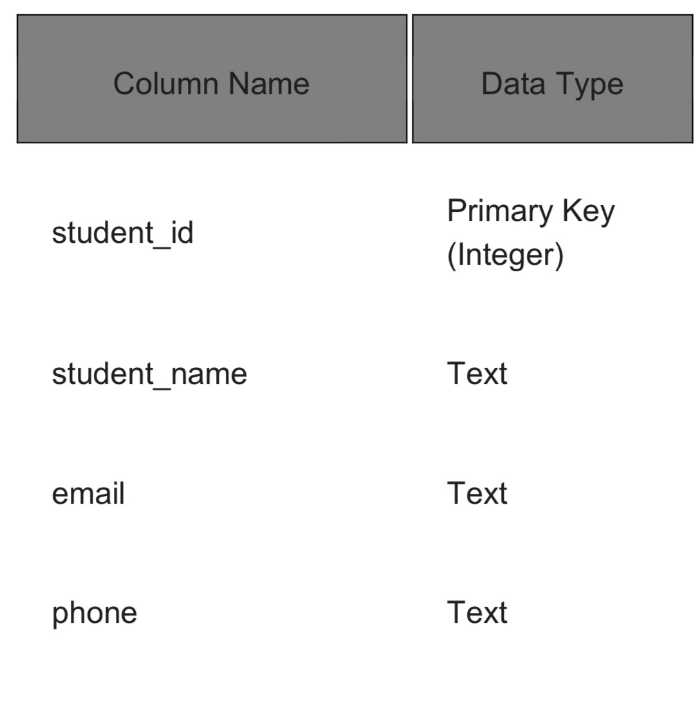
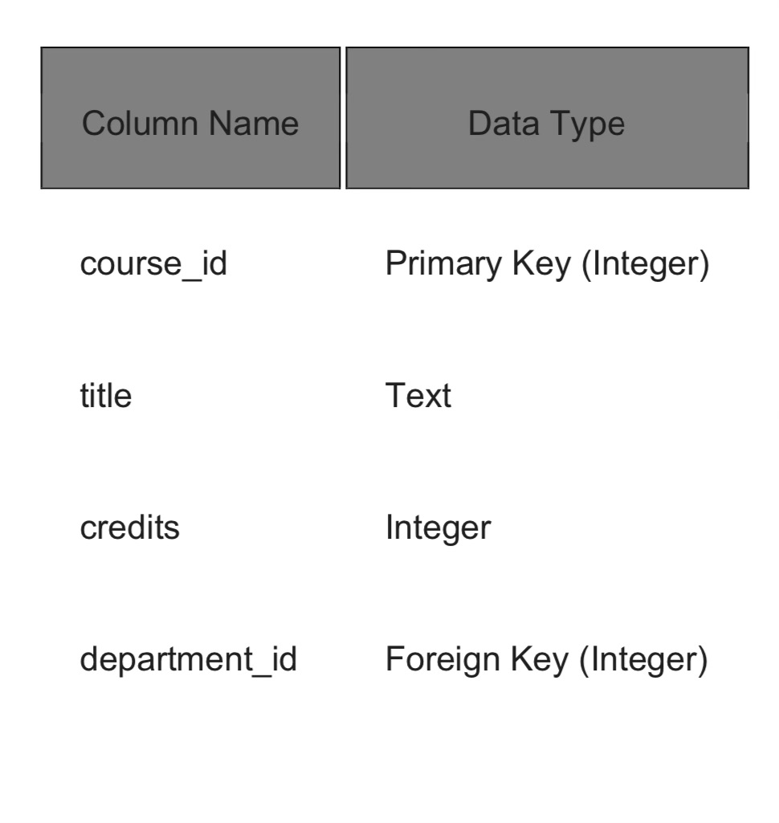
Tables
Student Table:
Course Table:

Slide 6
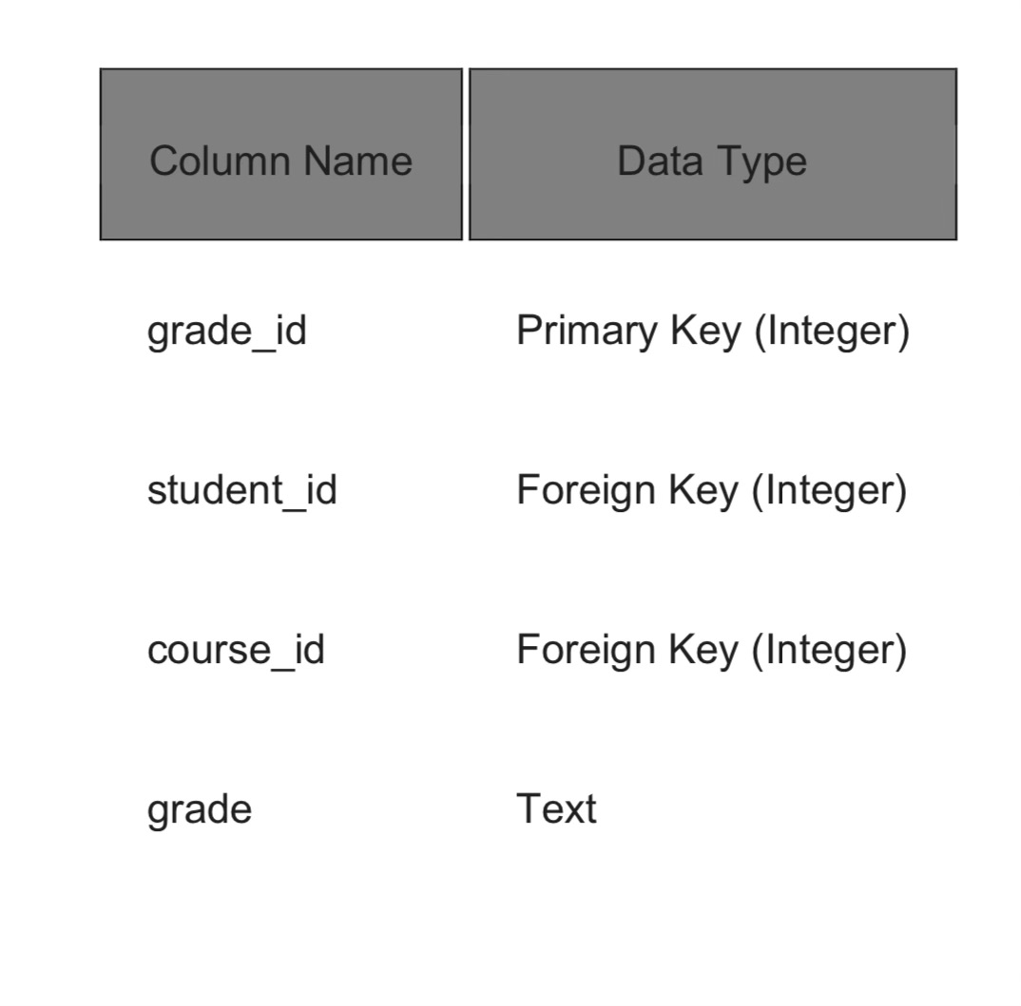
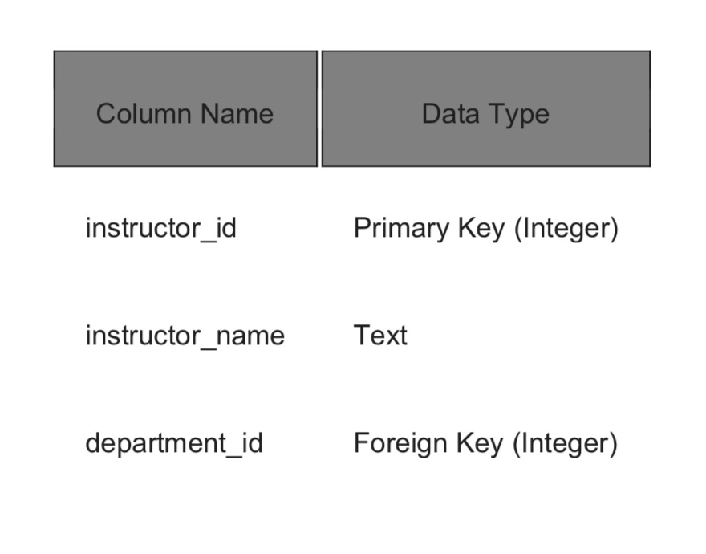
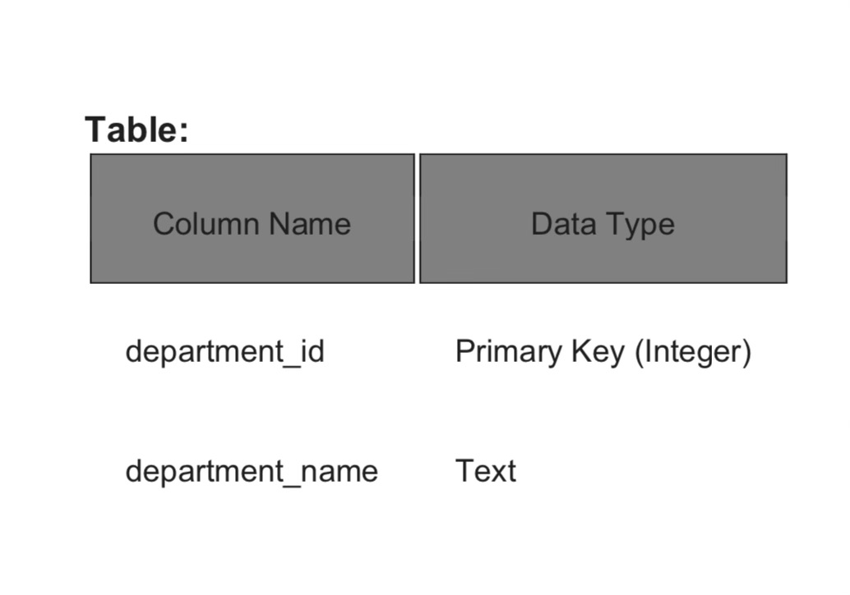
Instructor Table:
Department Table:
Grade Table:

Slide 7
Normalizing Tables
The main objective of database normalization is to eliminate redundant data, minimize data modification errors, and simplify the query process.
3NF: Each table has a unique primary key, Each non-key attribute is fully functionally dependent on the entire primary key, There are no transitive dependencies.
Student Table : Already in 3NF
Course Table : Already in 3NF
Department Table : Already in 3NF
Instructor Table : Already in 3NF
Grade Table : Not in 3NF

Slide 8
Normalizing Grade Table
In this table we have transitive dependancy which can lead to data redundancy.
Here's the breakdown of Grade table normalization to 3NF, along with the corresponding table structures:
CREATE TABLE Enrollment (
enrollment_id INT PRIMARY KEY AUTO_INCREMENT,
student_id INT NOT NULL,
course_id INT NOT NULL,
-- Optional attributes (semester, term, etc.)
FOREIGN KEY (student_id) REFERENCES Student(student_id),
FOREIGN KEY (course_id) REFERENCES Course(course_id)
);

Slide 9
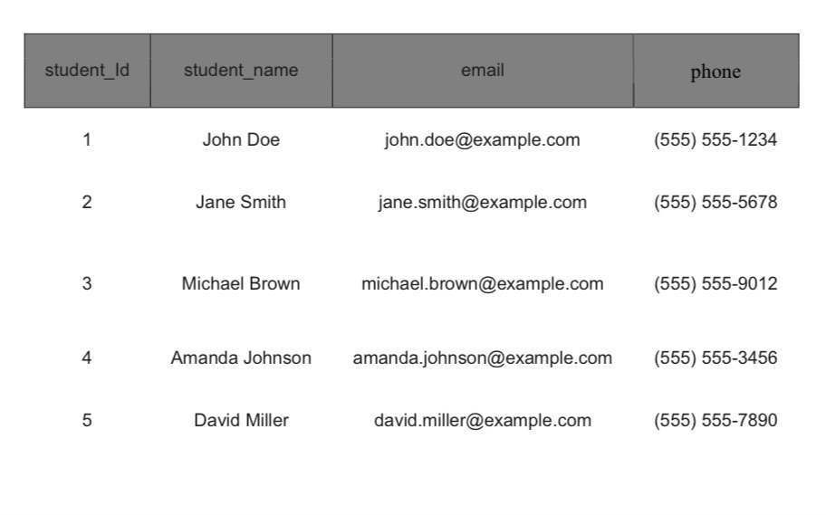
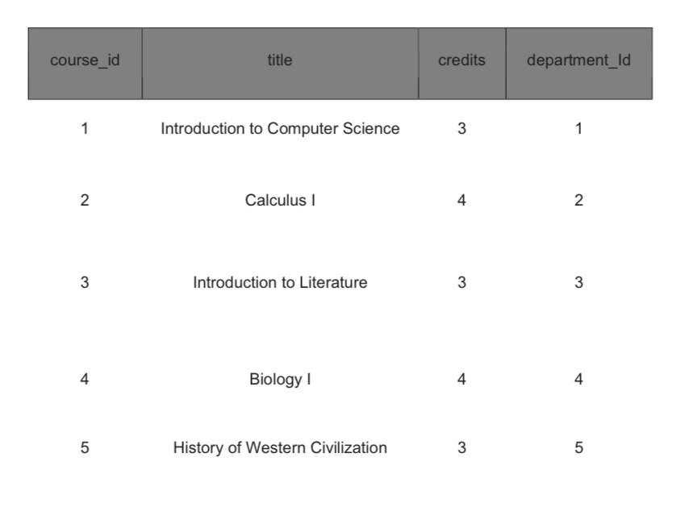
Tables with some Data
Student Table:
Course Table:

Slide 10
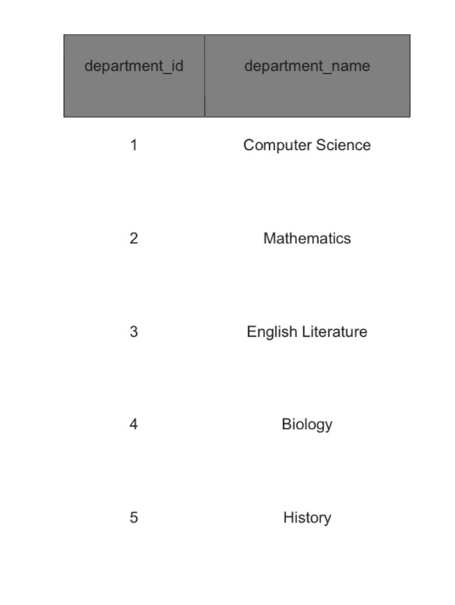
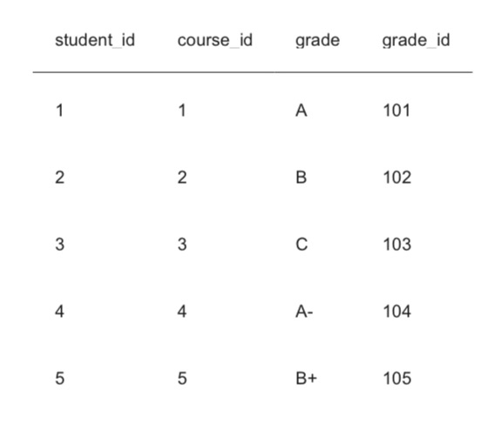
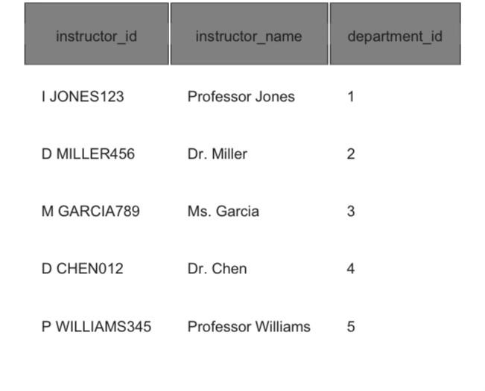
Department Table:
Instructor Table:
Grade Table:

Slide 11
1. List all instructors and their departments:
SELECT i.instructor_name, d.department_name
FROM Instructor i
INNER JOIN Department d ON i.department_id = d.department_id;
2. Find all students enrolled in a specific course (course ID = 101):
SELECT s.student_name
FROM Student s
INNER JOIN Enrollment e ON s.student_id = e.student_id
WHERE e.course_id = 101;
3. Get the average grade for a particular course (course ID = 101):
SELECT AVG(g.grade) AS average_grade
FROM Grade g
INNER JOIN Enrollment e ON g.student_id = e.student_id
WHERE e.course_id = 101;
Few SQL queries:

Slide 12
4. List all students with a grade of 'A' and their instructors:
SELECT s.student_name, i.instructor
_
name
FROM Student s
INNER JOIN Enrollment e ON s.student_id = e.student_id
INNER JOIN Grade g ON e.student_id = g.student_id AND e.course_id =
g.course_id
INNER JOIN Instructor i ON e.course_id = i.course_id -- Assuming
instructors teach courses they are enrolled in
WHERE g.grade = 'A';

Slide 13
3. View for StEnrollmentes with Course Information:
CREATE VIEW StudentGrades AS
SELECT s.student_name, c.title, g.grade
FROM Student s
INNER JOIN Enrollment e ON s.student_id = e.student_id
INNER JOIN Grade g ON e.student_id = g.student_id AND e.course_id =
g.course_id
INNER JOIN Course c ON e.course_id = c.course_id;
Views:
1. View for Instructor Information with Department Details:
CREATE VIEW InstructorDetails AS
SELECT i.instructor_name, d.department_name
FROM Instructor i
INNER JOIN Department d ON i.department_id = d.department_id;
4. View for Average Grades per Course:
CREATE VIEW AverageGradesPerCourse AS
SELECT c.title, AVG(g.grade) AS average_grade
FROM Course c
INNER JOIN Enrollment e ON c.course_id = e.course_id
INNER JOIN Grade g ON e.student_id = g.student_id AND e.course_id =
g.course_id
GROUP BY c.course_id;
2. View for Enrolled Students with Course Details:
CREATE VIEW EnrolledStudents AS
SELECT s.student_name, c.title, c.credits
FROM Student s
INNER JOIN Enrollment e ON s.student_id = e.student_id
INNER JOIN Course c ON e.course_id = c.course_id;

Slide 14
6. View for Students with Specific Grade in a Department:
CREATE VIEW StudentsByGradeInDept AS
SELECT s.student_name, i.department_name, g.grade
FROM Student s
INNER JOIN Enrollment e ON s.student_id = e.student_id
INNER JOIN Grade g ON e.student_id = g.student_id AND e.course_id =
g.course_id
INNER JOIN Instructor, i ON e.course_id = i.course_
INNER JOIN Department d ON i.department_id = d.department_id
WHERE g.grade = 'A';

Slide 15
Thank you

