Slide 1
SPRINTD ZÜRICH · EQUANS CASE · FROM TENDER TO PRICED OFFER
BidGenius AI
Every number. Backed by evidence.
From a 202-page tender to a price an estimator can defend — line by line.
Team BidGenius · October 2026
Notes:
[0:00–0:15] Speaker faces the jury, driver has the app ready on My workspace.
"BidGenius turns a 202-page tender into a price you can defend, line by line — and tells you exactly what it doesn't know yet."

Slide 2
THE PROBLEM
One tender. 202 pages. One shot at the price.
202
679
0
pages of German tender text
line items to quantify, match and price
price negotiations after submission
Schulhaus Oberglatt · BKP 244 ventilation
today: read and priced by hand
„1.17 Preisverhandlungen ausgeschlossen.“ — tender p. 9
In a low-margin business, one missed line is the margin.
BidGenius AI · Equans case · 2
Notes:
[0:15–0:35] "This is the Oberglatt school ventilation tender: 202 pages of German, 679 line items. Page 9 says it plainly: no price negotiations. The first price is final. Today an estimator builds that price by hand — and one missed line can be the whole margin."

Slide 3
OUR ANSWER
Read. Match. Price. Defend.
1
2
3
4
Read
Match
Price
Defend
›
›
›
All 202/202 pages parsed on a laptop — a reviewable, priced draft in 55 seconds.
Every line linked to your catalogue and labour rules, with a visible confidence band.
Exact CHF maths: quantity × net price × waste, plus hours × site factors × rate.
Every number opens its PDF page. Every change needs a reason and creates a revision.
FEASIBILITY
TRACEABILITY
IMPACT
TRACEABILITY
AI proposes. Deterministic maths prices. The estimator decides — every number.
BidGenius AI · Equans case · 3
Notes:
[0:35–0:50] "BidGenius does four things: it reads the whole tender, matches every line to your catalogue and labour rules, prices it with exact maths — the AI never sets a price — and lets the estimator defend every number. Let me show you." → SWITCH TO DEMO

Slide 4
LIVE DEMO
Watch for three moments
1
The honest number
what is priced and proven — and what is not, yet
2
The page that says „Nicht Bestandteil dieser Submission“
and why BidGenius stops instead of pricing it
3
The assumption that moves the price most
previewed live, applied with a reason, reversible
Notes:
Optional — show for 3 seconds while the driver switches windows, or skip straight to the app.
Demo path (≈3:20): My workspace → open draft → Overview honest number → Estimate: LA02 p.113 insulation (Calculation, then Source) → LA02 p.110 scope ambiguity (choose "Install only" with a reason) → Scenarios: sensitivity + slider + apply with reason → Export package.

Slide 5
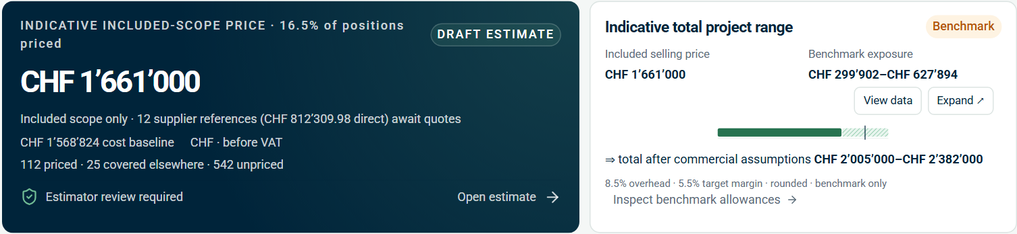
IMPACT & RELEVANCE · 30%
A price an estimator would trust
CHF 1’661’000
included-scope offer · 82.1% of estimated value priced · 5.5% margin · before VAT
Priced & proven
Full scope CHF 2.01M–CHF 2.38M
Unpriced scope: CHF 300k–CHF 628k benchmark range — shown, never hidden inside the bid.
Most tools hand you a number. BidGenius hands you a number and its gaps.
385 review items ranked by cause, 205 supplier quote requests drafted.
BidGenius AI · Equans case · 5
Notes:
Backup / handout for the "honest number" demo beat.
"CHF 1’661’000 is priced and proven — 82% of the value. The rest is not hidden: a benchmark range of CHF 300k to CHF 628k, so the realistic full scope is CHF 2.01M to CHF 2.38M. And here is the to-do list, ranked by cause."

Slide 6
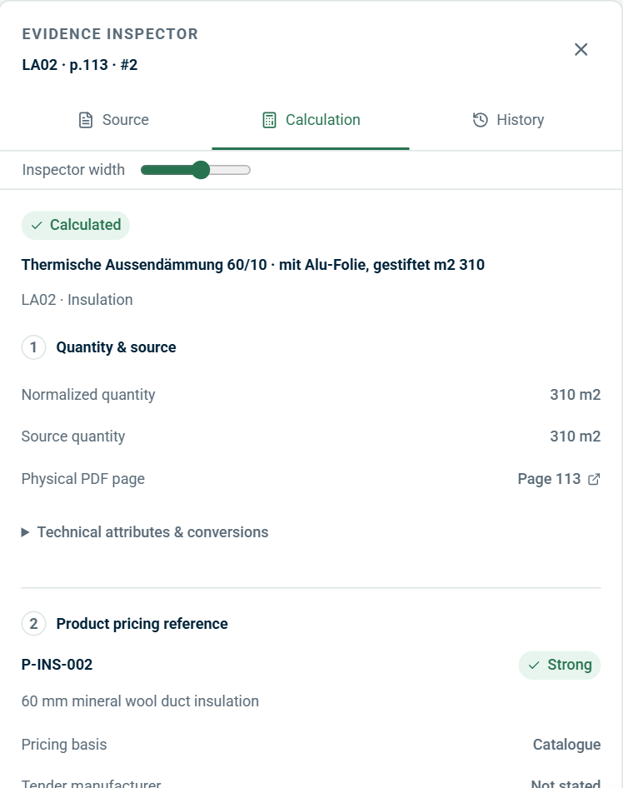
TRACEABILITY · 20%
Every number links back to the tender
1
Quantity → tender page
310 m² read from PDF page 113. One click opens the page with the source line highlighted.
2
Price → your catalogue
P-INS-002 from catalog.csv, match band “Strong”. A pricing reference — technical equivalence stays a separate decision.
1
3
Labour → your productivity rules
2
Base hours × site factors × role rate, unrounded hours, written out as a formula with its source rows.
The same for all 679 positions — and every change records owner, reason and CHF effect, reversible.
BidGenius AI · Equans case · 6
Notes:
Backup / handout for the inspector demo beat.
"Take any line. 310 square metres of insulation: quantity from page 113, net price from your catalogue, labour from your productivity sheet — and the original page, highlighted. Nothing is a black box."

Slide 7
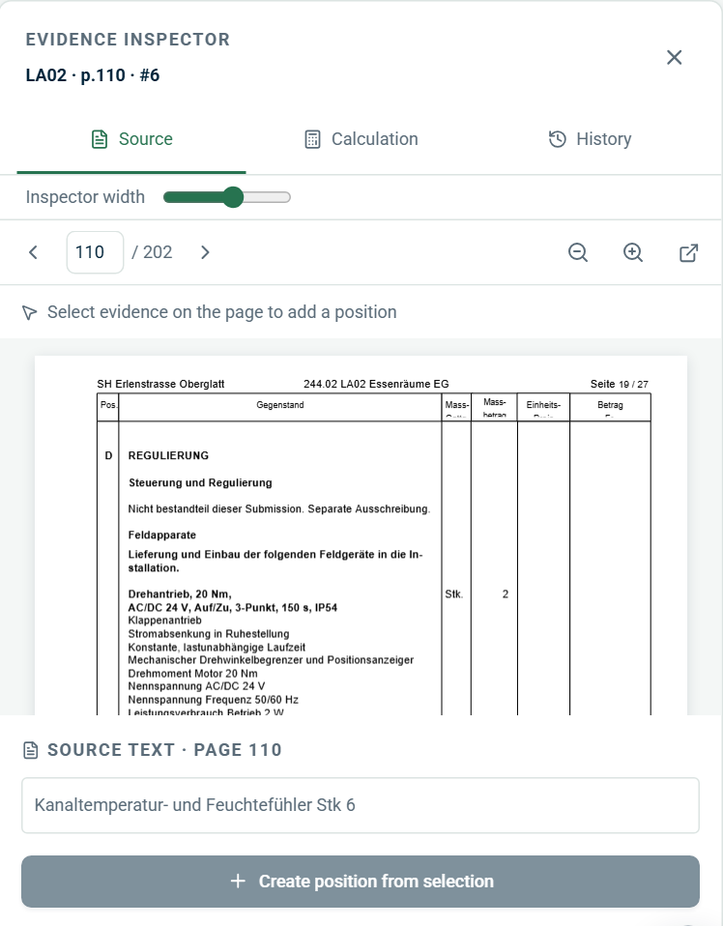
TRACEABILITY · IMPACT
It knows when to stop
„Nicht Bestandteil dieser Submission. Separate Ausschreibung.“
“Not part of this tender — tendered separately.” Tender p. 110, repeated in every ventilation system.
A product matcher would price it anyway. BidGenius holds 37 positions for the estimator’s decision:
Include
Install only
Exclude
— each with a reason, a new revision and a visible CHF effect.
That decision is what protects the margin.
BidGenius AI · Equans case · 7
Notes:
THE KEY DEMO MOMENT — slow down, pause after the quote.
"Page 110 says: Nicht Bestandteil dieser Submission — not part of this tender. A product matcher would price it anyway. BidGenius stops and asks: include, install only, or exclude? That's the decision that protects your margin."

Slide 8
IMPACT · FEASIBILITY
Measured, not claimed
22/22
80/83
202/202
55 s
verified example positions
hand-checked hold-out rows
tender pages processed
to a priced, reviewable draft
quantity, unit, catalogue item and system all correct
100% of detected quantities correct
one partial page flagged for visual review
local parser, no AI calls, single laptop
Sources: artifacts/evaluation.json · artifacts/live-holdout-evaluation.json · docs/VALIDATION.md. Sampled evidence — not a claim of whole-tender completeness.
Every claim on this slide can be re-run from the repository.
BidGenius AI · Equans case · 8
Notes:
Q&A anchor: "How accurate is it?" → "On your 22 verified examples, 22 of 22. On 83 rows we transcribed by hand, it found 80 — and every quantity it found was right. Measured, and in the repo."

Slide 9
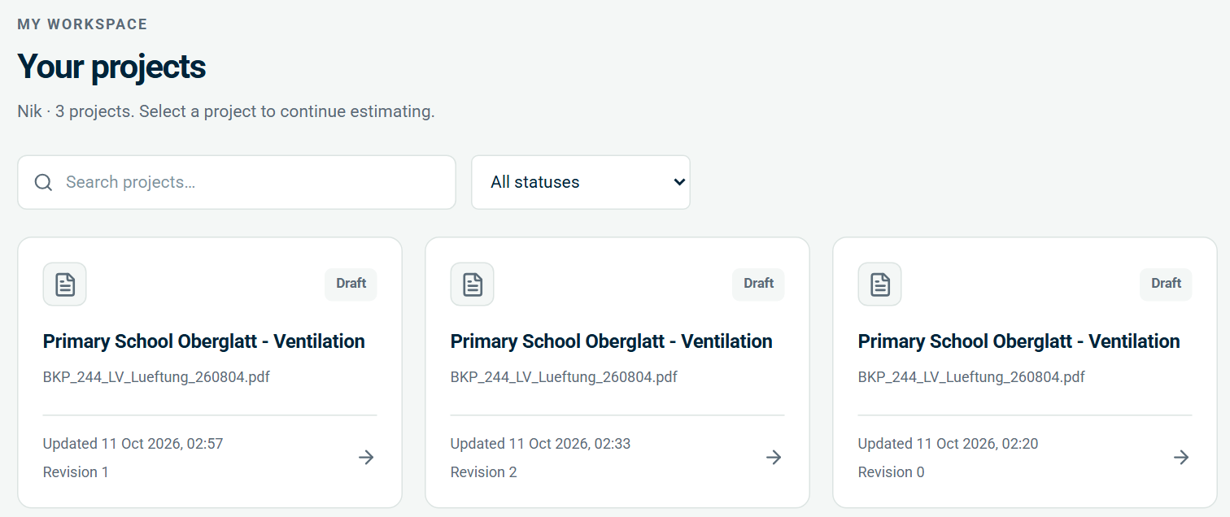
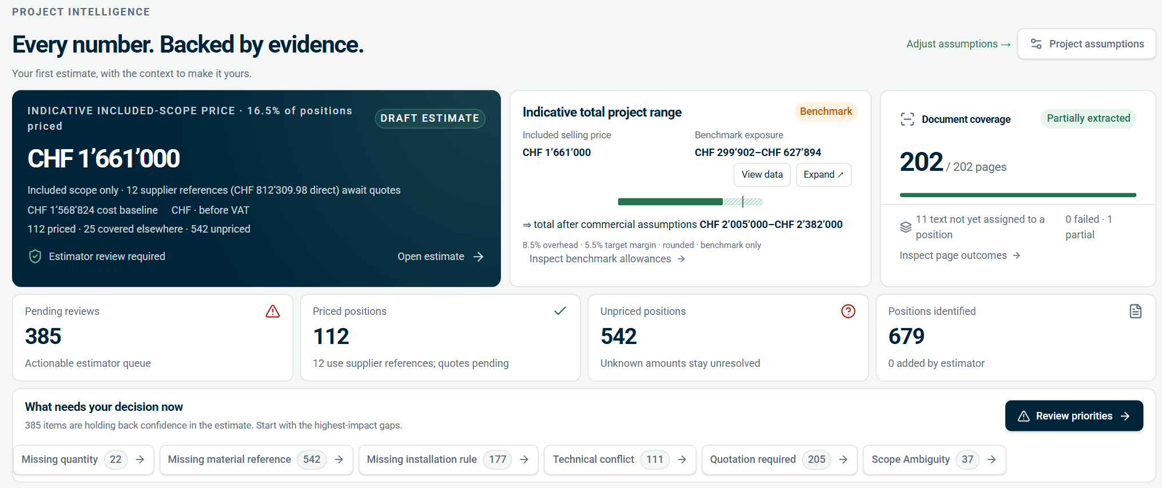
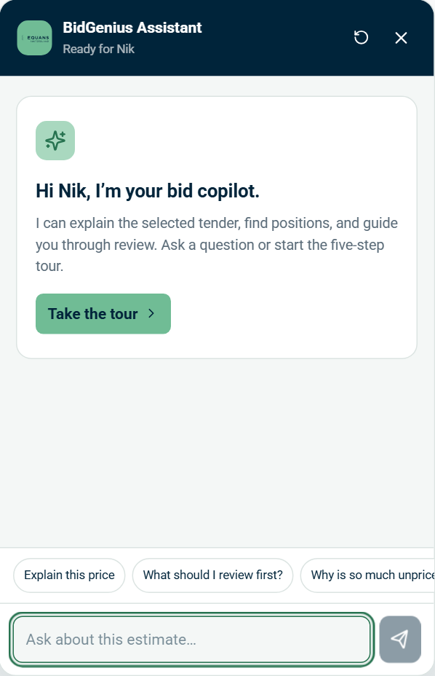
DESIGN & USABILITY · 15%
Usable without training
My workspace: every bid and its state
Overview: price, gaps, next decision
One question per page Overview · Estimate · Scenarios · Export
Review queues by cause missing quantity, quote needed, scope ambiguity…
Keyboard-first table j/k to move · Enter to inspect · a to accept
Built-in copilot + 5-step tour answers cite positions and pages
Equans look and feel. German source text where estimators expect it. No manual needed.
BidGenius AI · Equans case · 9
Notes:
"An estimator opens BidGenius and sees their bids, the price, the gaps and the next decision — no training. If they're unsure, the copilot explains any number and links to the page it came from."

Slide 10
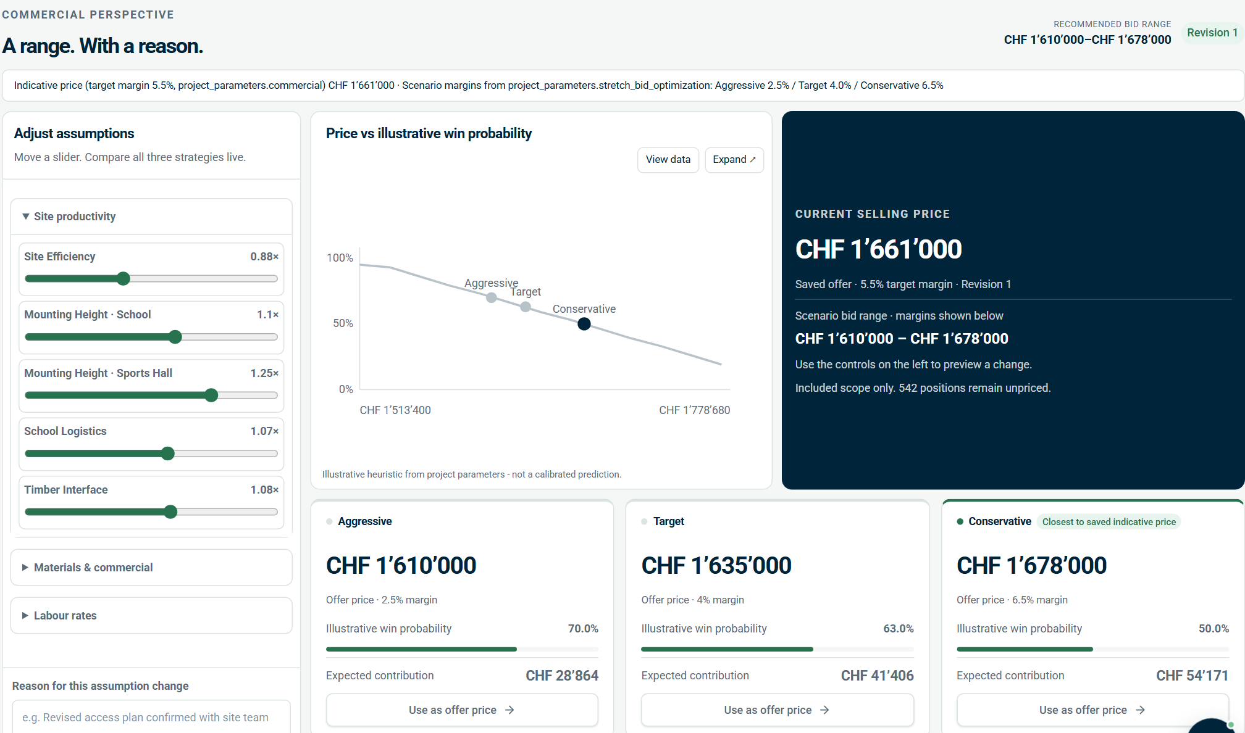
CREATIVITY & INNOVATION · 10%
Three ideas we haven’t seen in estimating tools
1
An honest range, not a hidden gap
Unpriced scope becomes a benchmark band of CHF 300k–628k next to the bid — never inside it.
2
“Which assumption moves the price?”
Sensitivity across site efficiency, overhead, margin and rates — check the right thing before signing.
3
Every change is a revision
Preview live, apply with a reason, reverse anytime. The bid file explains itself.
Scenarios from your parameters: CHF 1’610’000 · 1’635’000 · 1’678’000 — odds labelled illustrative.
BidGenius AI · Equans case · 10
Notes:
Backup / handout for the Scenarios demo beat.
"Before you sign, BidGenius tells you which assumption moves the price most. Change it, see all three bids move, give a reason — new revision."

Slide 11
FEASIBILITY · 25%
Runs on Azure. Fits your bid process.
YOUR BID PROCESS
Tender in
Estimator review
Bid manager sign-off
Offer + RFQs out
PDF from the tender platform, original kept unchanged
queues, evidence, reasons, revisions
Management view: every bid, status, margin
German draft offer, CSV/JSON, supplier requests
ON AZURE — SAME CONTAINER AS TODAY
Azure Container Apps
Azure Files at /data
Azure OpenAI
Entra ID + PostgreSQL
the existing Docker image, single replica
SQLite, originals, revisions, exports
optional · store=false · bounded excerpts
estimator & management roles, multi-user
Runs offline on a laptop today. No integration needed — CSV/JSON into your calculation tool.
BidGenius AI · Equans case · 11
Notes:
[4:15–4:35] "It runs on a laptop today — and the same container runs on Azure Container Apps. The AI is optional and maps directly to Azure OpenAI in your own tenant. It fits the process you already have: estimator prepares, bid manager signs off, the offer and supplier requests go out."

Slide 12
PATH TO PRODUCTION
From prototype to pilot in 90 days
30 DAYS
60 DAYS
90 DAYS
Prove the value
Connect your data
Run it as a team
› Pilot on 5–10 past Equans tenders
› Live catalogue and net prices
› Entra ID roles and four-eyes sign-off
› Measure time-to-draft vs. today
› Supplier quotes back into the bid
› Azure deployment with backups
› Estimators score trust per position
› Historical bids to calibrate win odds
› Hand-over into the calculation system
Same pipeline — coverage grows with your catalogue (prototype: 56 products, 22 labour rules).
BidGenius AI · Equans case · 12
Notes:
[4:35–4:45] "Next: prove it on your past tenders and measure the time saved, connect your live catalogue and supplier quotes, then roll it out with Entra ID and a four-eyes sign-off."

Slide 13
BidGenius turns a 202-page tender into a price you can defend — line by line — and tells you exactly what it doesn’t know yet.
IMPACT 30%
FEASIBILITY 25%
TRACEABILITY 20%
DESIGN 15%
CREATIVITY 10%
A price with an honest range
Same container → Azure
Every CHF → its PDF page
Four pages, no training
Knows when to stop
Thank you.
Notes:
[4:45–5:00] Say the line slowly, then stop talking.
"Equans doesn't need a faster way to produce a wrong number. It needs a price every estimator can defend. BidGenius turns a 202-page tender into a price you can defend, line by line — and tells you exactly what it doesn't know yet. Thank you."

Slide 14
BACKUP · FOR Q&A
What we deliberately did not build — yet
No OCR or drawing take-off
Drawings and the Excel take-off are not in the package; missing quantities go to a queue instead of being guessed.
No automatic technical approval
“Fabrikat z.B. … oder gleichwertig” stays an explicit estimator decision, separate from the pricing match.
Nothing is sent
Supplier RFQs and the German offer are drafts; formal submission stays with the bid team.
Illustrative win odds
Heuristic from your project parameters until historical bids are imported and explicitly adopted.
Demo login
Role switch for the demo; production uses Entra ID.
BidGenius AI · Equans case · 14
Notes:
Use only if asked "What did you not build?" — each item is a deliberate safety boundary.

Slide 15
BACKUP · FOR Q&A
Every number in this deck — and where it comes from
Number | Value | Source
Included-scope offer | CHF 1’661’000 | summary.totals.selling_price_chf (revision 1)
Cost baseline · margin | CHF 1’568’824 · 5.5% | summary.totals · project_parameters.json
Value priced | 82.1% | summary.completeness.pct_value_priced
Positions · priced · unpriced | 679 · 112 · 542 | summary.coverage
Unpriced benchmark range | CHF 299’902 – CHF 627’894 | summary.completeness.allowance_*
Full-scope range | CHF 2’005’000 – CHF 2’382’000 | summary.likely_total_low/high
Scope-ambiguity positions | 37 | summary.coverage.unresolved_by_cause
Scenarios A / T / C | CHF 1’610’000 / CHF 1’635’000 / CHF 1’678’000 | summary.scenarios (2.5 / 4.0 / 6.5% margins)
Verified examples · hold-out | 22/22 · 80/83 | artifacts/evaluation.json · live-holdout-evaluation.json
Time to priced draft | 55 s (parse 44 s) | docs/VALIDATION.md · evaluation.json
BidGenius AI · Equans case · 15
Notes:
Generated from project project_f1acfeec34bc4fa4 at 2026-10-11T01:24:20.506Z. Re-run node pitch/build_deck.mjs after resetting the demo so these match the live app.

