Slide 1
EQUANS CHALLENGE / WORKING PROTOTYPE
BidGenius
AI
A first price.
You can explain.
TENDER
202
pages of source evidence
From a 202-page tender to a reviewable estimate.
REVIEW → EXPLAIN → DECIDE
BidGenius AI / Equans challenge
01 / 10
Notes:
A first price you can explain
0:00–0:25
CUE: Explain the price
Imagine being asked to defend a tender price, line by line. Could you show where every number came from? We built BidGenius AI to help estimators reach a first price they can explain, with the source, the calculation, and the open questions together.
Start looking at the judges. Pause after the question, then say the product name slowly.
EVIDENCE / PRESENTER REFERENCE
Challenge: Schulhaus_Oberglatt_Hackathon_Starter_Package_v2/README.md. This is a prototype and first estimate, not a complete procurement submission.

Slide 2
THE PROBLEM
202 pages. One pricing decision.
202
01
Find the scope
What is included, missing or unclear?
02
Price the work
Connect quantities, products and labour.
pages in the Oberglatt
ventilation tender
03
Explain the gaps
Show which decisions still need a person.
This tender excludes price negotiations. The first estimate matters.
BidGenius AI / Equans challenge
02 / 10
Notes:
202 pages, one pricing decision
0:25–0:50
CUE: Three jobs
Our case is a two-hundred-and-two-page ventilation tender for a school in Oberglatt, Switzerland. An estimator must understand the scope, connect it to catalogue references, and calculate installation labour. Those jobs are connected. Miss a quantity or misunderstand an exclusion, and the price can look precise while the underlying decision is wrong.
Point once to each of the three jobs. Do not read every label.
EVIDENCE / PRESENTER REFERENCE
Original tender, physical PDF page 9, section 1.17: Preisverhandlungen Ausgeschlossen. Source PDF has 202 pages. No claimed estimate of manual time or financial loss.

Slide 3
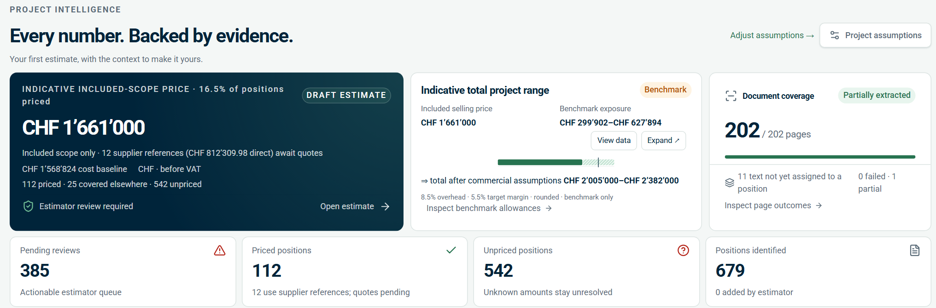
THE WORKSPACE
Read. Match. Calculate. Review.
Prepared demo snapshot · included scope · estimator review required
01
AI proposes
02
Code calculates
03
Estimator decides
Interpretation + candidate matches
Material + labour + assumptions
Review + reasons + revisions
BidGenius AI / Equans challenge
03 / 10
Notes:
Read, match, calculate, review
0:50–1:20
CUE: People decide
This is a prepared snapshot of the working application. It reads the documents, proposes matches, calculates costs, and brings unresolved items into review. AI can help interpret the text and suggest references. The maths follows explicit rules. The estimator makes the decision. This overview shows the draft price and what still needs attention.
Point to the overview screenshot, then look back at the judges for the final two sentences.
EVIDENCE / PRESENTER REFERENCE
Screenshot: pitch/shots/overview.png, prepared demo revision 1. Indicative included-scope CHF 1,661,000; 542 unpriced positions remain in this snapshot. Snapshot is not live workspace state. Optional AI may propose; authoritative Decimal arithmetic is in backend/tenderproof/pricing.py. AI does not approve prices.

Slide 4
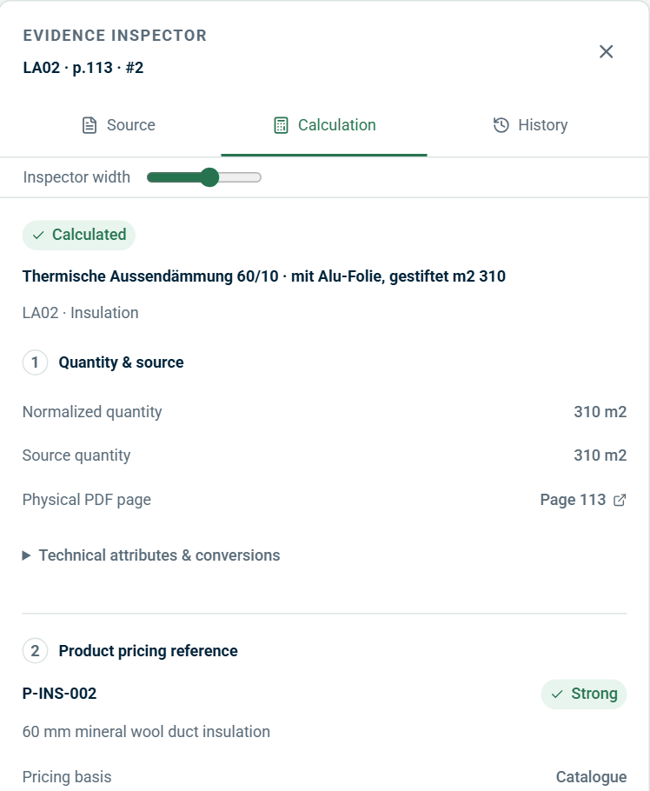
TRACEABILITY
Open the price. See the proof.
310 m²
Quantity from PDF page 113
LA02 · thermal insulation
P-INS-002
Catalogue pricing reference
60 mm mineral wool insulation
Labour rule
Hours, site factors and rate
Calculation inputs stay inspectable
A price reference still needs technical review.
BidGenius AI / Equans challenge
04 / 10
Notes:
Open the price, see the proof
1:20–1:55
CUE: Follow one line
Take this insulation line from system L A zero two. Page one hundred and thirteen specifies three hundred and ten square metres. We can open that evidence, inspect catalogue reference P INS zero zero two, and follow the labour rule. That makes the cost explainable. The reference still needs review; it does not prove technical equivalence.
Move your pointer from source evidence to catalogue reference to labour. Say the quantities slowly.
EVIDENCE / PRESENTER REFERENCE
Source screenshot pitch/shots/inspector-calc.png: LA02 physical p.113 #2, 310 m², P-INS-002. Catalogue confirms 60 mm mineral wool duct insulation. Pricing confidence is not technical equivalence. Project factors and labour rules have their own source data, not necessarily the PDF.

Slide 5
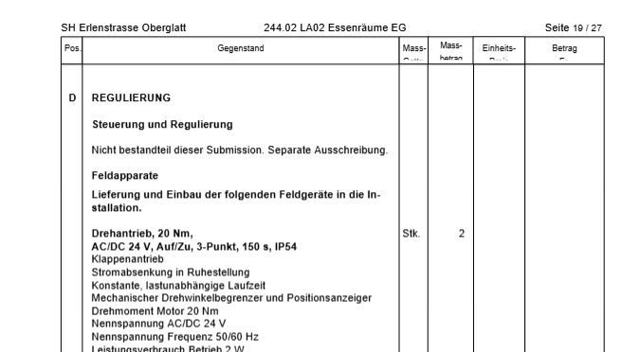
THE MOMENT THAT MATTERS
“This needs your decision.”
SCOPE AMBIGUITY
“Not part of this tender.
Tendered separately.”
The page also lists field devices.
The estimator resolves the scope.
Include
Install only
Exclude
Original tender · page 110
Record a reason. Create a revision.
Unknown scope stays visible until it is reviewed.
BidGenius AI / Equans challenge
05 / 10
Notes:
Needs your decision
1:55–2:25
CUE: Read the exclusion
Now look at page one hundred and ten. A note flags scope for a separate tender, while nearby items can still carry installation obligations. The estimator must check which instruction applies. They can include a position, keep installation only, or exclude it. A reason and a new revision preserve how that decision changed the estimate.
Point to the German note, then to the three scope choices. Explain the ambiguity without implying everything on page 110 is excluded.
EVIDENCE / PRESENTER REFERENCE
Original PDF page 110: controls/regulation exclusion followed by field-device installation wording. This is ambiguous scope, not a claim that everything on the page must be excluded. Screenshot is a saved prototype view. Choices require estimator rationale and create a revision.

Slide 6
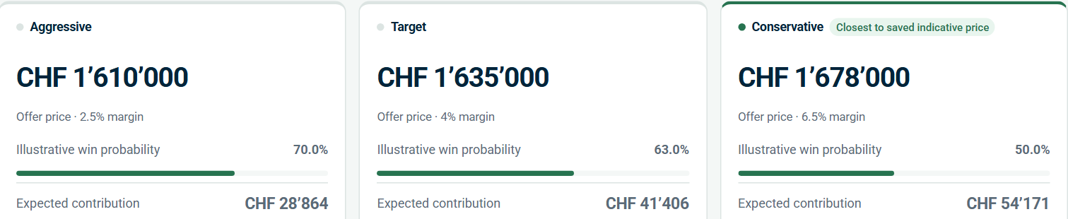
BID SCENARIOS
Compare the bid before committing.
THREE STRATEGIES / SAME INCLUDED SCOPE
Preview → Compare → Apply with a reason
Prepared demo snapshot. Win probabilities are illustrative; included scope only.
BidGenius AI / Equans challenge
06 / 10
Notes:
Compare the bid before committing
2:25–2:50
CUE: Compare assumptions
Next, we compare aggressive, target, and conservative bids. The estimator can preview changes and see the effect on price, margin, and contribution before accepting them. The displayed win probabilities are illustrative assumptions. They help explore a decision, but they are not reliable predictions of winning.
Trace the three scenario cards with one gesture. Emphasize the word 'illustrative'.
EVIDENCE / PRESENTER REFERENCE
Prepared screenshot: bid scenarios CHF 1,610,000 / CHF 1,635,000 / CHF 1,678,000, requested margins 2.5% / 4.0% / 6.5%. Source project_parameters.json stretch_bid_optimization and pitch/shots/scenarios.png. Scenario margins differ from saved offer target margin of 5.5%. Win probabilities are heuristics, not calibrated predictions or a statistical optimum.

Slide 7
MEASURED EVIDENCE
Fast to a draft. Clear about the limits.
PREPARED LOCAL RUN
SEPARATE AI + LOCAL RUN
55 s
80/83
to a reviewable first draft
sample rows detected with
correct quantity and unit
202 pages attempted · one partial page
Single laptop · no AI call in this run
Purposive sample; does not establish
complete extraction or pricing accuracy.
22/22 supplied examples reproduced
Quantity · unit · reference · system
Sources: prepared-demo.json · evaluation.json · live-holdout-evaluation.json (10 Oct 2026)
BidGenius AI / Equans challenge
07 / 10
Notes:
What we measured
2:50–3:40
CUE: Three separate checks
Here is the evidence, with the tests kept separate. One prepared local run produced a draft in about fifty-five seconds. It attempted all two hundred and two pages, with one partial page. A separate live run, combining AI and local fallbacks, found eighty of eighty-three sampled rows and their explicit quantities and units. That measures extraction on a selected sample, not pricing accuracy. The local checks also passed all twenty-two supplied examples. These results support a prototype; they do not prove a complete tender.
Slow down. Pause between the local run, live sample, and supplied examples. Do not read the decimal seconds aloud.
EVIDENCE / PRESENTER REFERENCE
55.035 s = artifacts/prepared-demo.json, local end-to-end import/draft. 22/22 = artifacts/evaluation.json supplied examples. 80/83 = artifacts/live-holdout-evaluation.json; frozen purposive sample from separate live mixed AI/local run. Latest live artifact records 38 successful AI batches and 15 fallbacks. Do not describe 55 seconds as live AI latency or 80/83 as price accuracy. No manual-review time saving was measured.

Slide 8
HANDOVER
The estimate travels with its evidence.
01
Draft offer
ONE REVISION
German printable estimate
Estimate
+ evidence
+ open questions
02
Structured data
CSV, JSON and calculation inputs
03
Review package
A draft package the next
reviewer can inspect.
Source PDF, assumptions and issues
Exports stay tied to the saved revision.
BidGenius AI / Equans challenge
08 / 10
Notes:
Complete the handover
3:40–4:05
CUE: Carry the evidence
The output is a reviewable handover. It includes source evidence, the cost build-up, unresolved scope, and draft exports tied to a specific revision. Another estimator can see what was included, what was assumed, and what still needs a decision.
Point to the handover items, then say the last sentence to the judges.
EVIDENCE / PRESENTER REFERENCE
README and backend/tenderproof/exports.py: pinned-revision CSV, JSON, German printable HTML and offline ZIP containing source PDF and review data. Supplier RFQs are unsent drafts. No automatic procurement submission. The review package is not a completed approved tender.

Slide 9
PROPOSED NEXT STEP
Prove the value with estimators.
5–10
Test
Compare against reviewed estimates.
Measure
historical tenders
for a proposed pilot
Review time, corrections and coverage.
Connect
Current supplier data and team controls.
Pilot success = less review effort, with errors and gaps still visible.
Pilot proposal; time savings and commercial impact have not yet been measured.
BidGenius AI / Equans challenge
09 / 10
Notes:
Prove value with estimators
4:05–4:35
CUE: Pilot, then measure
Our next step is a pilot with estimators using five to ten historical tenders. We would measure review time, corrections, and pricing coverage against their existing process. We also need real supplier quotes, authentication, and team collaboration. We have not measured return on investment yet. The pilot should tell us where the product creates value.
Present the pilot as a proposal. Keep your voice steady when naming the remaining work.
EVIDENCE / PRESENTER REFERENCE
Proposed pilot, not an agreed deployment or evidence of customer adoption. Current prototype is local/single estimator; organizational login, multiuser workflow and supplier integrations require further engineering and validation. 5–10 is an illustrative pilot scope chosen for the pitch.

Slide 10
BIDGENIUS AI
Read the tender.
See the gaps.
Defend the price.
Next: a measured pilot with Equans estimators.
Thank you.
BidGenius AI / Equans challenge
10 / 10
Notes:
Read the tender. See the gaps. Defend the price.
4:35–5:00
CUE: Make the ask
BidGenius AI brings the tender, the estimate, and the reasons behind it into one workspace. Read the tender. See the gaps. Defend the price. We are asking for an estimator partner and historical tenders to run that pilot. Thank you.
Look at the judges. Pause between the three short lines, make the ask, and stop after 'Thank you'.
EVIDENCE / PRESENTER REFERENCE
Stop here for the main presentation. Backup slides 11–13 are hidden and can be opened by slide number during Q&A. No guarantee of winning the hackathon or measured ROI is claimed.

Slide 11
BACKUP / HOW IT WORKS
AI interprets. Code prices. People approve.
01
02
03
04
Source inputs
→
Interpretation
→
Calculation
→
Review + export
PDF + catalogue
+ productivity rules
Local parsing
+ optional AI proposals
Validated inputs
+ Decimal arithmetic
Reasons + revisions
+ pinned snapshots
React + TypeScript → FastAPI → SQLite + local files
LangGraph checkpoints preserve completed processing batches.
Local review works offline. Optional AI sends selected excerpts to an external API.
BidGenius AI / Equans challenge
Q&A / 01
Notes:
Use the matching slide in BidGenius_AI_Presenter_Guide. Main slides 1–10 total approximately five minutes.
EVIDENCE / PRESENTER REFERENCE
docs/ARCHITECTURE.md; backend modules. Current single-estimator local prototype. Optional OpenAI interpretation does not approve prices or technical equivalence. store=False is not a guarantee of zero retention. Azure deployment is not asserted.

Slide 12
BACKUP / SCOPE
What still needs validation?
Coverage
Page attempts do not prove complete extraction.
Page 201, drawings and missing quantities need review.
Pricing
Supplier references are provisional.
Catalogue match does not approve technical equivalence.
Bid probabilities
Scenario assumptions are illustrative.
Historical data is needed for calibration.
Team deployment
Authentication and multiuser collaboration remain future work.
Formal tender submission stays with the bid team.
BidGenius AI / Equans challenge
Q&A / 02
Notes:
Use the matching slide in BidGenius_AI_Presenter_Guide. Main slides 1–10 total approximately five minutes.
EVIDENCE / PRESENTER REFERENCE
README known scope limits and docs/ARCHITECTURE.md. The supplied reference set has 56 catalogue rows and 22 installation rules. No OCR or drawing takeoff. Existing screenshots are a prepared R1 snapshot, not current live state.

Slide 13
BACKUP / EVIDENCE REGISTER
The numbers and their sources.
MEASUREMENT
RESULT
LOCAL SOURCE
Prepared local draft
55.035 s · 202 pages attempted
artifacts/prepared-demo.json
Prepared extraction
679 records · 542 unpriced
artifacts/prepared-demo.json
Included-scope draft price
CHF 1,661,000 · revision 1
artifacts/prepared-demo.json
Supplied examples
22/22 across evaluated fields
artifacts/evaluation.json
Live run sample
80/83 detected + quantity/unit correct
artifacts/live-holdout-evaluation.json
Golden example LV0001
CHF 806.26 direct position cost
Starter package: expected_output_example.json
Prepared financial snapshot: 10 October 2026. Provisional prices; unresolved scope remains.
The 55-second local draft and the live AI sample are separate runs.
BidGenius AI / Equans challenge
Q&A / 03
Notes:
Use the matching slide in BidGenius_AI_Presenter_Guide. Main slides 1–10 total approximately five minutes.
EVIDENCE / PRESENTER REFERENCE
Use current JSON artifacts as the source of measurements. docs/VALIDATION.md contains older parser/live batch counts. Prepared-demo.json counted 137 priced before UI separated 112 priced and 25 included elsewhere; both correspond to 542 unpriced of 679 extracted. Deck avoids mixing these categories. Current running workspace has later revisions and can differ from screenshots.

