Slide 1


SIMATS ENGINEERING
SAVEETHA INSTITUTE OF MEDICAL AND TECHNICAL SCIENCES
Capstone project presentation
Electric Grid Load Control using Reinforcement Learning
MLA0310 –Reinforcement Learning for Real Life Application
Guided By:
Dr. Manimaran A
Dr. Amandeep singh
Presented by:
T. Deekshtith (192472253)
S. Nikhil (192472279)
B. Charan Kumar Reddy

Slide 2
INTRODUCTION
Electric power systems must maintain a balance between electricity demand and supply
Sudden changes in demand can cause power shortages or energy wastage
Traditional control methods are rule-based and not adaptive
Modern grids require intelligent and automated control systems
Reinforcement Learning (RL) enables systems to learn optimal control actions through experience
This project applies RL to automatically control electric grid load and maintain stability

Slide 3
OBJECTIVES
Objectives | Explanation
Design | Design a simple electric grid control system that represents power demand, supply levels, in a simulated environment.
Integrate | Integrate demand and supply data into the system using Python to simulate real-time grid conditions for learning and control.
Implement | Implement a Reinforcement Learning (Q-learning) algorithm to automatically adjust power supply based on changing demand.
Train & Test | Train the RL agent using multiple learning episodes.
Evaluate | Evaluate system performance by comparing demand and supply using visual graphs to measure grid stability and efficiency.

Slide 4
METHODOLOGY
Model grid load control as an MDP (states, actions, rewards).
Environment Modeling – Build a grid simulation incorporating demand patterns, renewable uncertainty, and operational limits.
RL Algorithm Selection – Apply suitable RL methods (e.g.Multi-Agent RL) based on action space and grid scale.
Training & Exploration – Train agents using historical and simulated data with safe exploration to avoid grid instability.
Evaluation & Deployment – Deploy with real-time monitoring and retraining.
Problem Formulation
Environment Modeling
RL Algorithm selection
Training & Exploration
Deployment & Evaluation

Slide 5
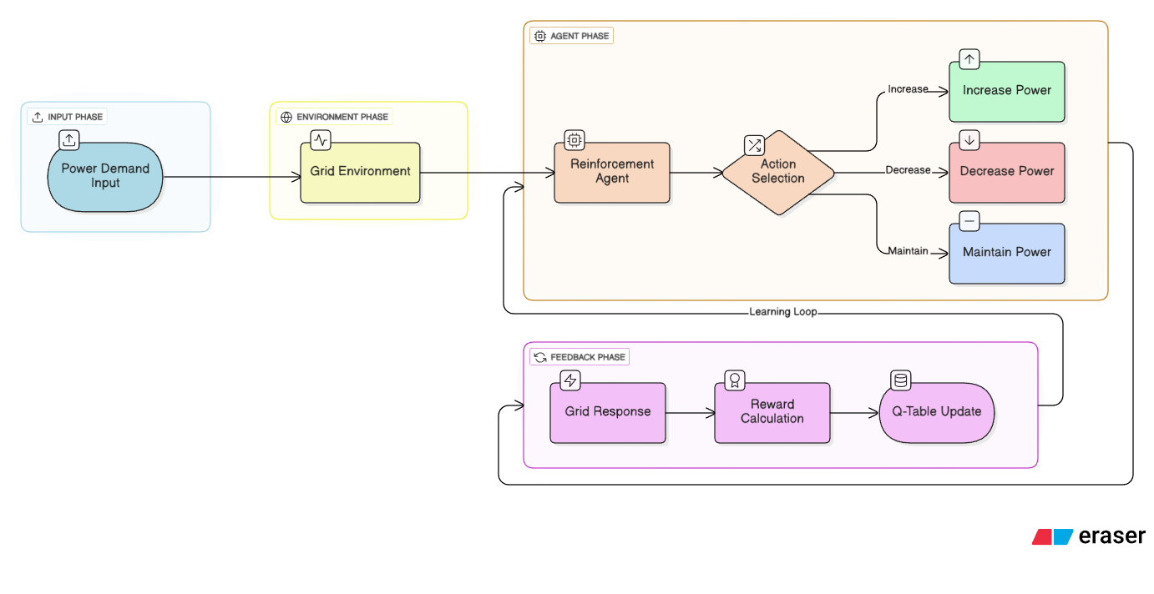
SYSTEM ARCHITECTURE

Slide 6
PROBLEM STATEMENT
Electric grids must continuously balance power generation and consumption
Sudden changes in electricity demand cause overloading or power shortages
Traditional grid control methods are rule-based and lack adaptability
Manual and static control leads to energy wastage and instability
Increasing use of renewable energy makes load management more complex
There is a need for an intelligent, automated system to control grid load efficiently

Slide 7
MODULE – 1
Grid Environment Simulation
Purpose:
To simulate the electric grid by representing power demand and supply conditions.
Key Features:
Generates electricity demand levels and maintains current power supply state
Calculates load imbalance
Responds to control actions (increase/decrease/hold)
Output:
Updated grid state (demand, supply, imbalance) Environment

Slide 8
MODULE – 2
Reinforcement Learning Controller
Purpose:
To learn optimal actions for adjusting power supply using Reinforcement Learning.
Key Features:
Q-learning algorithm & State–action mapping using Q-table
Reward calculation based on demand–supply difference
Exploration and exploitation strategy
Output:
Trained Q-table
Optimal control actions for different grid states

Slide 9
MODULE – 3
Performance Evaluation and Visualization
Purpose:
To evaluate and visualize the effectiveness of the RL-based grid control system.
Key Features:
Demand vs supply comparison
Graphical visualization of grid performance Stability and efficiency analysis
Output:
Demand vs supply graph
Performance summary showing reduced imbalance

Slide 10
RESULTS & DISCUSSION
Results
RL-based control reduced peak load and operating cost compared to rule-based methods.
Improved demand–supply balance under variable renewable generation.
Faster response to load fluctuations and fewer constraint violations.
Discussion
RL adapts better to uncertainty than static controllers.
Performance depends on accurate environment modeling and reward design.
Safe training and scalability remain key challenges for real-world deployment.

Slide 11
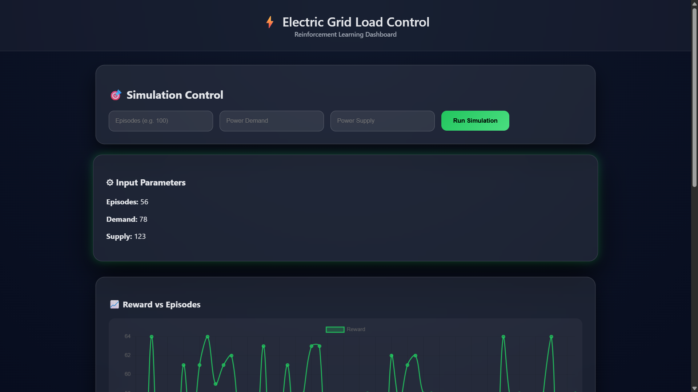
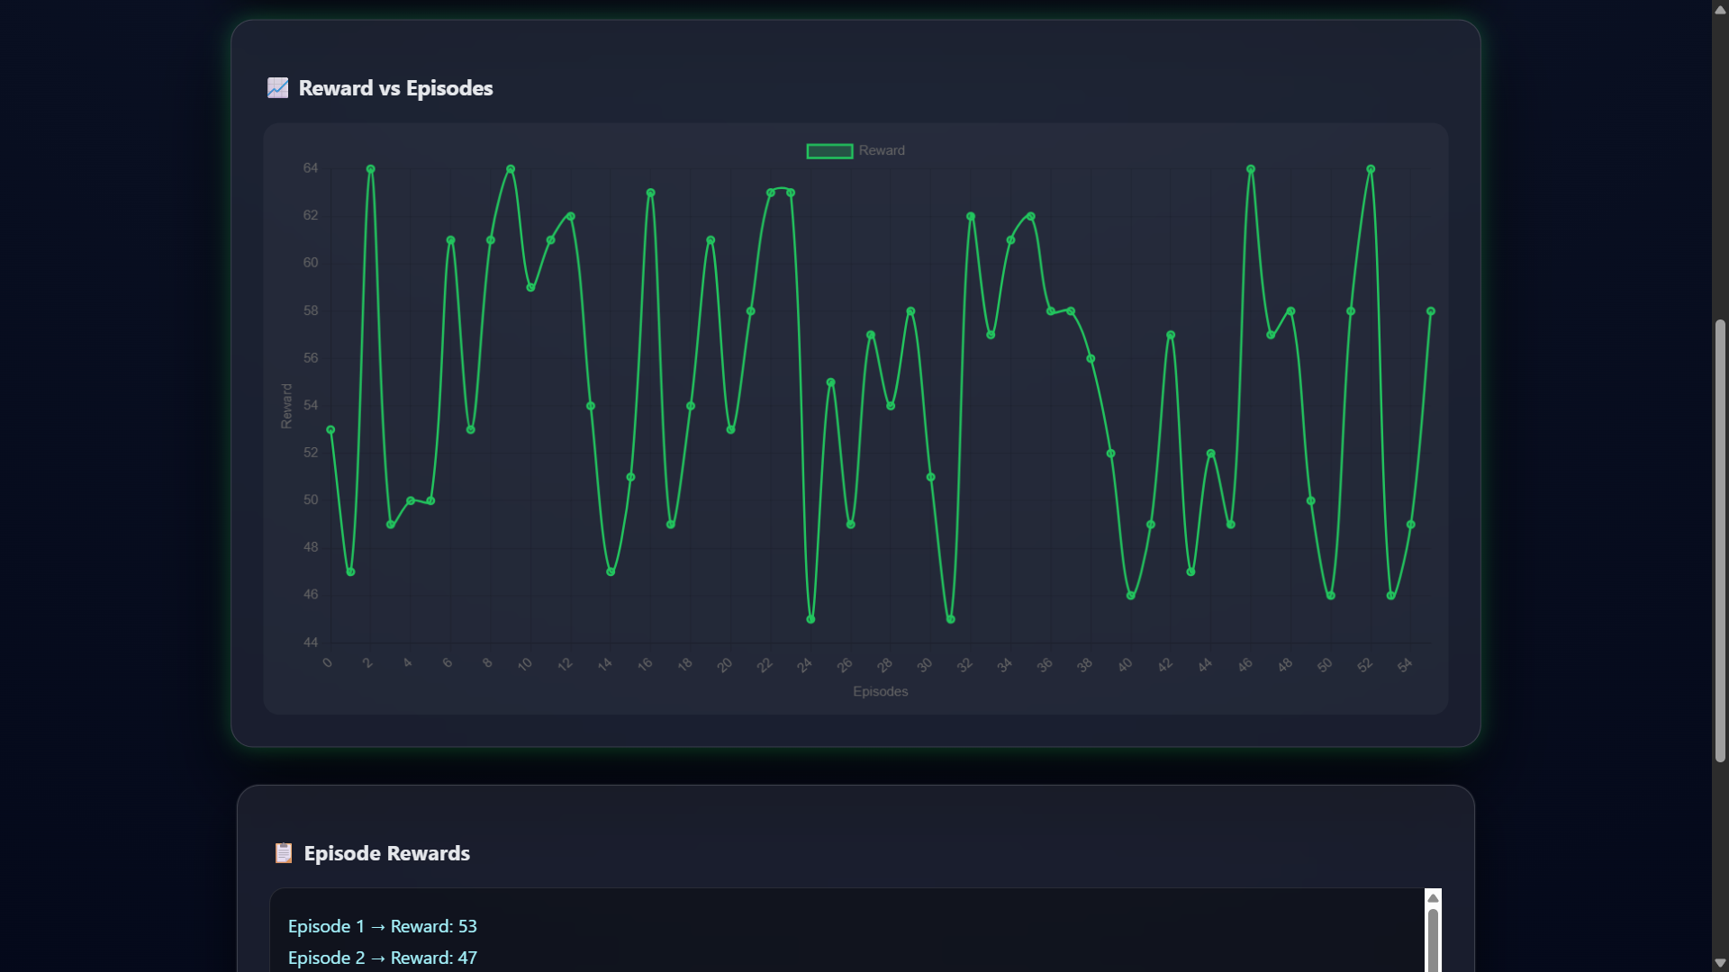
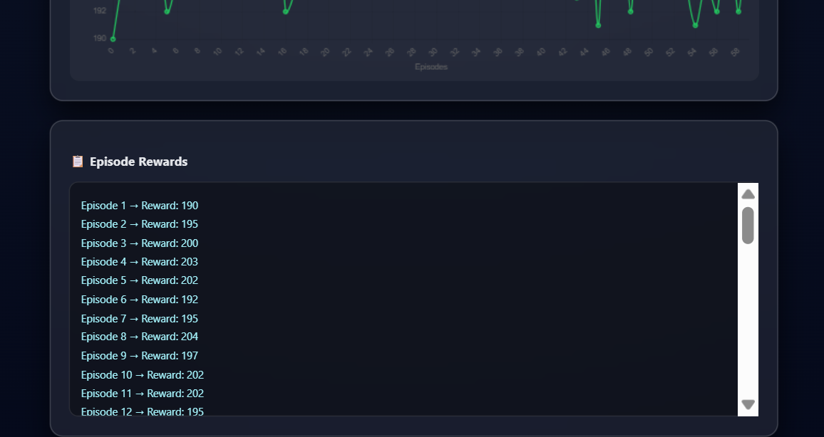
OUTPUTS

Slide 12
CHALLENGES & LIMITATIONS
Challenges
Accurate modeling of real-world grid dynamics and uncertainties is difficult.
Safe exploration is required to avoid instability during training.
High computational cost for training RL agents at large grid scales.
Limitations
Results are based on simulation, not real-time grid deployment.
Performance depends heavily on reward function design.
Scalability to multi-node or national grids is limited.

Slide 13
CONCLUSION
This project successfully demonstrates the use of Reinforcement Learning for electric grid load control.
The RL agent learns to adjust power supply dynamically based on changing demand.
The system helps in reducing power imbalance, improving grid stability and efficiency.
The project proves that RL-based control is more adaptive than traditional rule-based methods.
This approach can be extended to smart grids and renewable energy systems in the future.

Slide 14
REFERENCES
Zhang et al. (2025) – Model-free safe deep reinforcement learning for transformer/grid constraint management, demonstrating improved energy delivery and safety performance.
Bashyal et al. (2025) – Multi-agent reinforcement learning for demand response and energy management in industrial systems with decentralized coordination.
Ahmed et al. (2025) – Hybrid deep learning & reinforcement learning framework for real-time electrical load prediction and adaptive control.
Seyfi et al. (2025) – Deep reinforcement learning controller for real-time integrated energy control highlighting RL in coordinated grid decisions.

Slide 15


