Slide 1


SIMATS ENGINEERING
SAVEETHA INSTITUTE OF MEDICAL AND TECHNICAL SCIENCES
Capstone project presentation
Learning Management system(LMS)
CSA1022 – Software Engineering with Agile
Presented by:
Guided By:
Dr. S Ashok Kumar
Dr. Pandi Kumar
T. Deekshtith (192472253)
S. Nikhil (192472279)
V. Naga Nishchay(192472255)
M Supraja (192472301)

Slide 2
INTRODUCTION
A web-based Learning Management System (LMS) designed to help educational institutions manage courses and digital learning activities efficiently.
Enables instructors to create courses, upload learning materials, conduct quizzes, and assign tasks.
Provides assessment and reporting features to track student performance and learning outcomes.
Developed using the Iterative Model with emphasis on UI/UX design to enhance the overall digital learning experience.

Slide 3
OBJECTIVES
Objectives | Explanation
Design | Design a user-friendly LMS interface that supports course creation, content management, assessments, and reporting for institutions.
Integrate | Integrate different course types, assessment methods, and user roles (admin, instructor, student) into a single centralized system.
Implement | Implement the system using the Iterative Model with focus on UI/UX design.
Testing | Test the system for functionality, performance, and usability.
Secure Entry | Ensure secure login and role-based access to protect academic data.

Slide 4
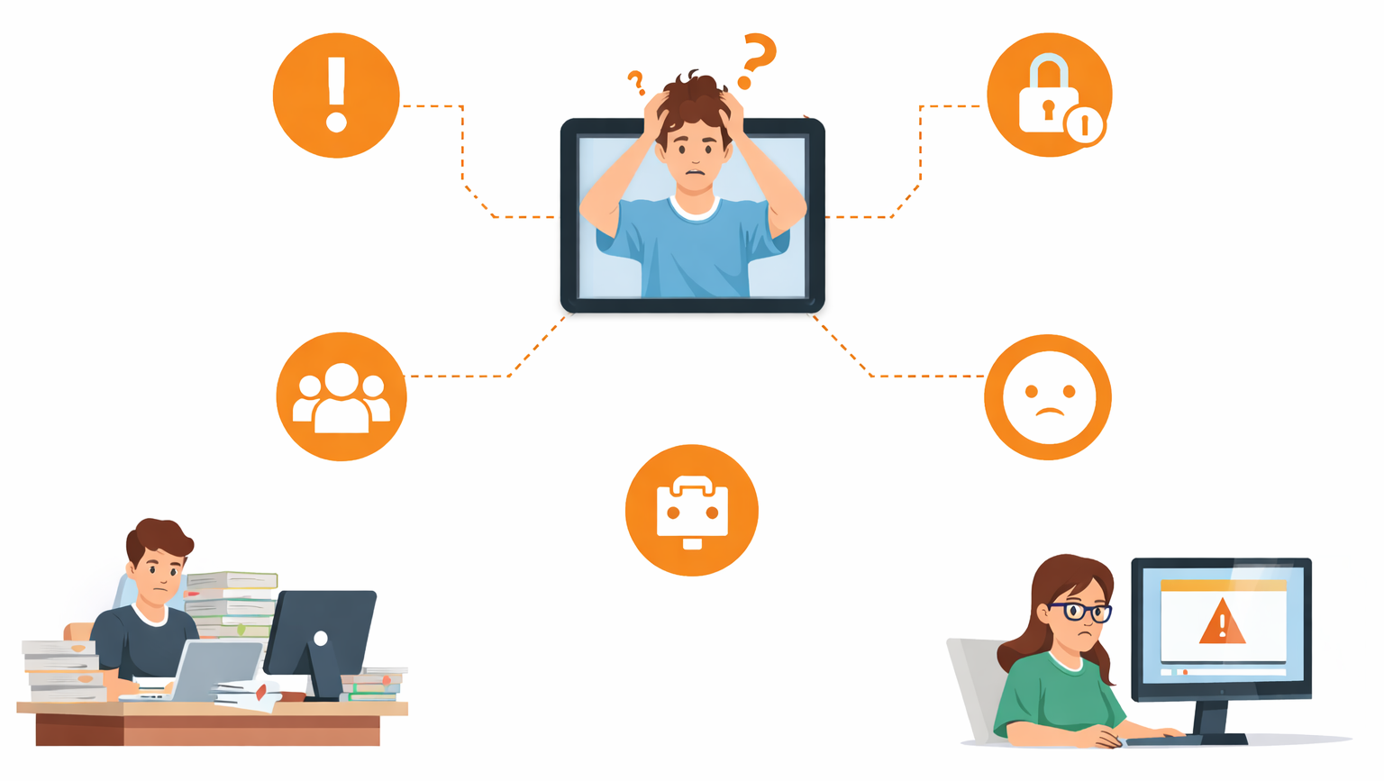
PROBLEM STATEMENT
  Lack of a centralized system for managing courses and learning activities.
  Difficulty in handling content, assessments, and student performance efficiently.
  High administrative effort due to manual or disconnected tools.
  Limited user-friendly and flexible digital learning platforms.
  Need for a secure and integrated LMS to improve digital education.

Slide 5
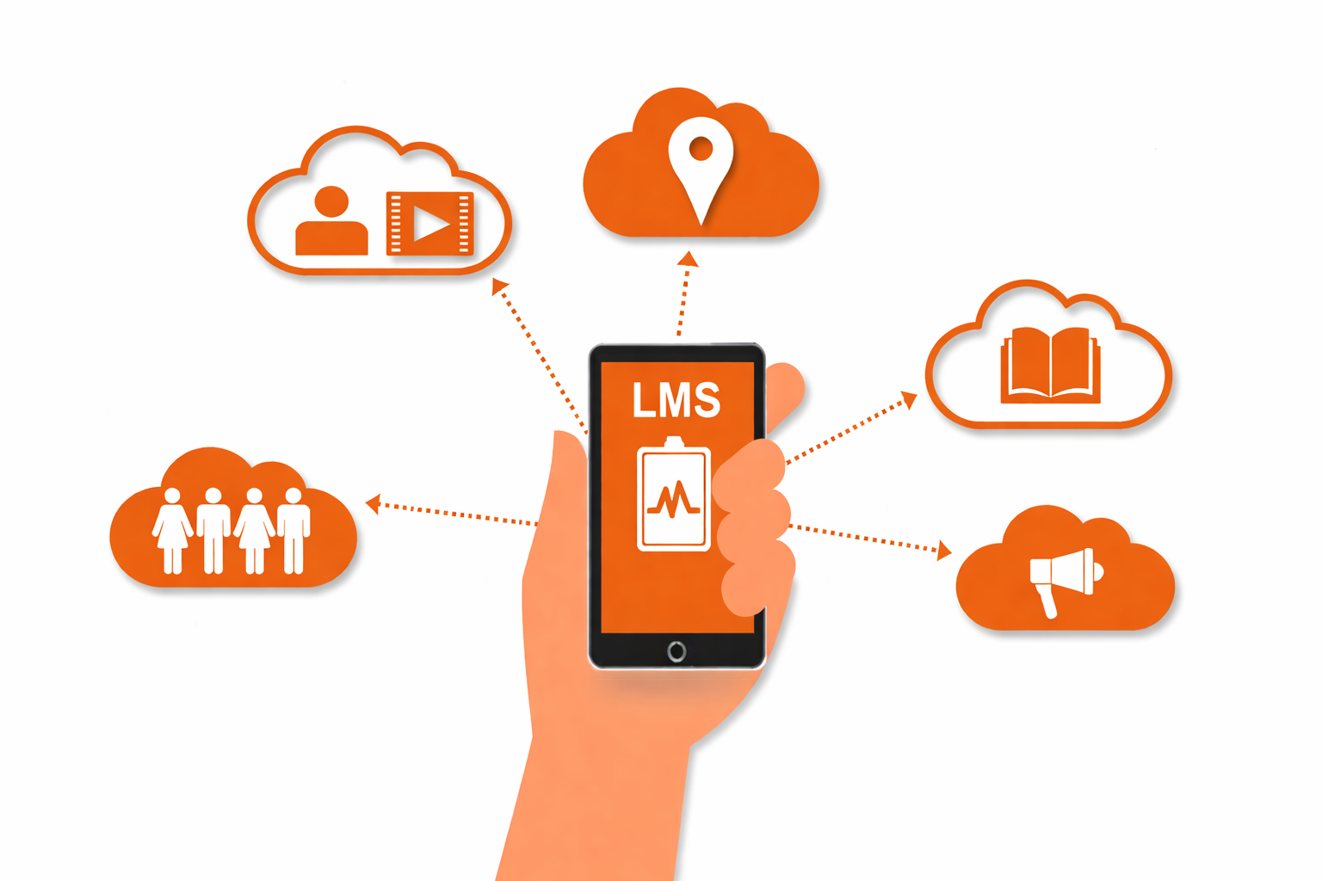
WHY WE NEED LMS?
Tracking student progress through all activities
Complete of partial replacement of frontal teaching
Management of course or subjects
Management of students
Exchange of information with students

Slide 6
METHODOLOGY
The project is developed using the Iterative Development Model to build the system in phases.
Each iteration includes analysis, design, implementation, and testing activities.
Core modules like course creation and content upload are developed first, followed by assessments and reports.
UI/UX improvements are incorporated in every iteration based on user feedback.
Continuous testing and integration ensure system reliability and performance.
Iterative Development
Phase wise implementation
Core Module Development
UI/UX Enhancements
Testing & Integration

Slide 7
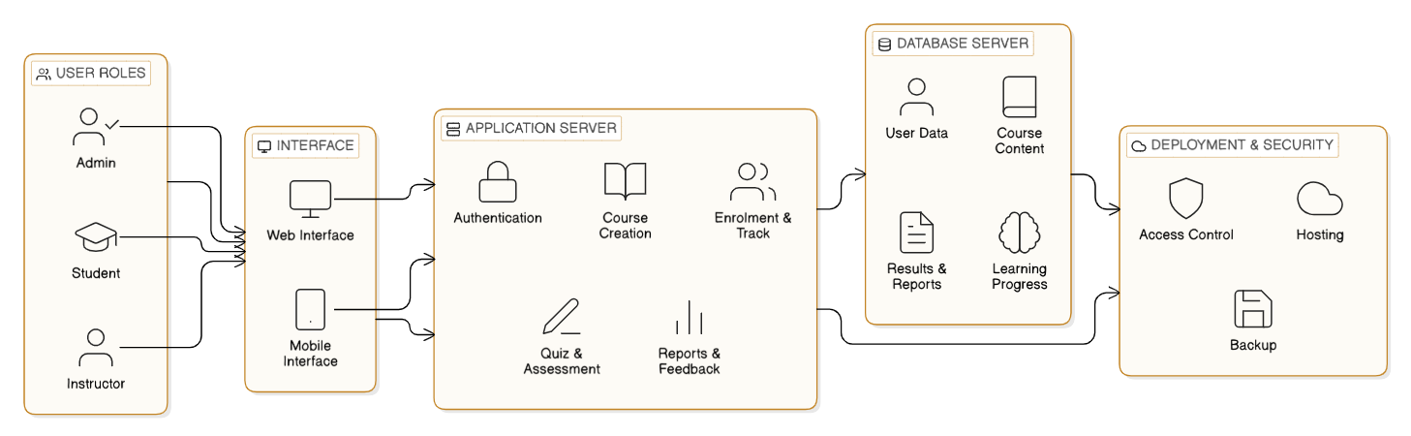
SYSTEM ARCHITECTURE

Slide 8
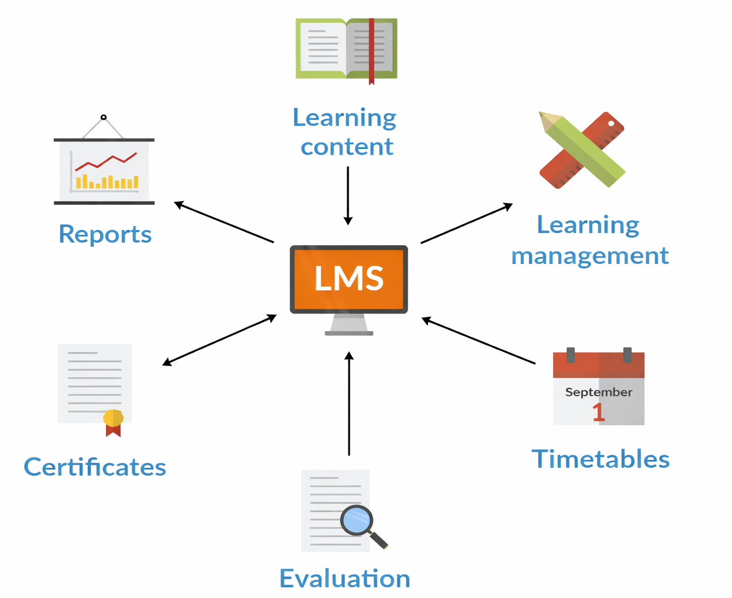
MODULE – 1
Course Creation & Content Management
Purpose:
To create and manage courses and learning content in a centralized LMS.
Key Features:
Allow instructors to Create and organize courses.
Upload and manage learning materials.
Structure content into modules or lessons.
Output:
A well-organized digital course ready for learning.

Slide 9
MODULE – 2
Student Enrolment & Learning Tracking
Purpose:
To manage student enrolment and monitor learning progress within the LMS.
Key Features:
Allows students to enroll in available courses through the LMS.
Maintains student profiles and course enrolment records.
Tracks learning progress, course completion status.
Output:
A detailed and accurate record of student enrolment, progress, and learning outcomes.

Slide 10
MODULE – 3
Assessment, Quiz & Feedback
Purpose:
To evaluate student learning through assessments and quizzes to improve performance.
Key Features:
Enables creation of quizzes, tests, and assessments.
Supports multiple question types such as MCQs, descriptive questions.
Automatically evaluates quizzes and calculates scores.
Helps students understand their strengths and areas for improvement.
Output:
Accurate assessment results with meaningful feedback to support continuous learning improvement.

Slide 11
MODULE – 4
Testing, Security & Deployment
Purpose:
To ensure the LMS is reliable, secure, and ready for real-world use through proper testing and deployment.
Key Features:
Performs functional and performance testing to detect and fix errors.
Implements authentication and role-based access control.
Ensures data security and protection of sensitive information.
Deploys the LMS for institutional use.
Output:
A secure, tested, and fully deployed LMS ready for users.

Slide 12
MODULE OUTPUTS

Slide 13
RESULTS & DISCUSSION
Results
The developed LMS successfully supports course creation, student enrolment, assessments, and learning tracking.
Automated quizzes, tasks, and reports and reduced manual workload.
User-friendly UI and secure access enhanced overall system usability and reliability.
Discussion
The LMS effectively addresses problems of traditional learning systems by providing a centralized platform.
Proper integration of security and assessment modules ensures safe and outcome-based digital learning.

Slide 14
CHALLENGES & LIMITATIONS
Challenges
Designing a user-friendly interface that suits both students and instructors.
Integrating multiple modules such as courses, assessments, and tracking into a single system.
Ensuring data security and role-based access control throughout the LMS.
Limitations
Limited scalability for handling a very large number of users simultaneously.
Dependence on internet connectivity for accessing LMS features.
Advanced analytics and AI-based recommendations are not included in the current version.

Slide 15
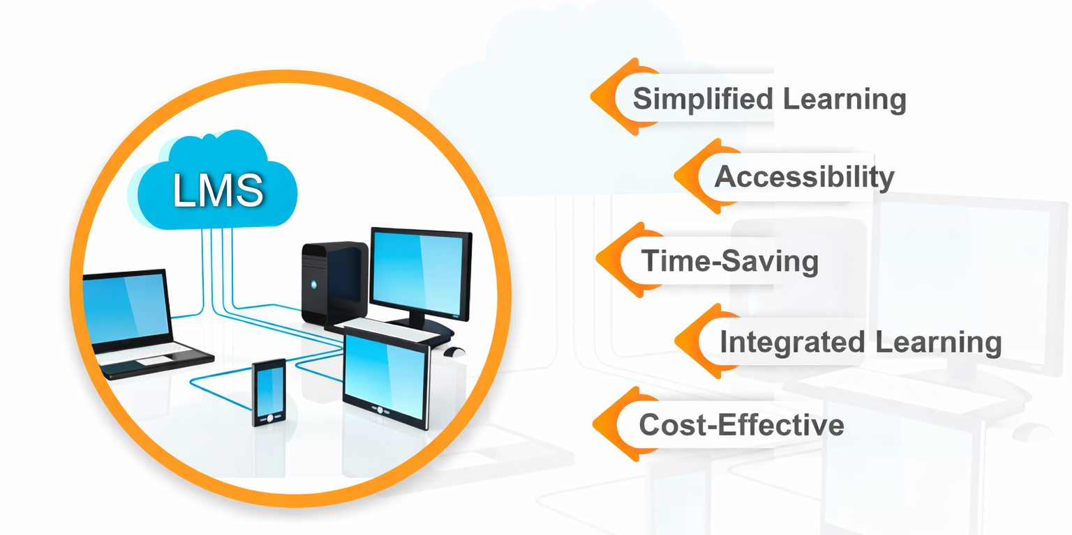
BENEFITS OF LMS

Slide 16
CONCLUSION
The Learning Management System successfully provides a centralized platform for digital learning.
It simplifies course management, student enrolment, assessments, and learning tracking.
The use of the Iterative Development Model improved system quality and usability.
Secure access and automated features reduce manual effort and errors.
Overall, the LMS enhances the effectiveness and accessibility of digital education.

Slide 17
REFERENCES
Ian Sommerville, Software Engineering, Pearson Education.
Roger S. Pressman, Software Engineering: A Practitioner’s Approach, McGraw-Hill.
Ellis, R. K., A Field Guide to Learning Management Systems, ASTD Learning Circuits.
Moodle Documentation – Learning Management System Concepts and Features.
IEEE Software Engineering Standards and Documentation Guidelines.

Slide 18


