Slide 1
Architecture Icons – Flat
Icons are a great way to increase the visual impact of your bullet points.
Bullet points are boring. Make them appealing with our icons.
Icons make it easy for your audience to visualize your point.
Select from over 10,000 icons on our site to complement your text.

Slide 2
Architecture Icons – Choose your own colors

Slide 3
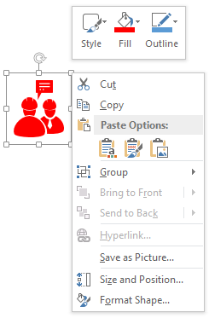
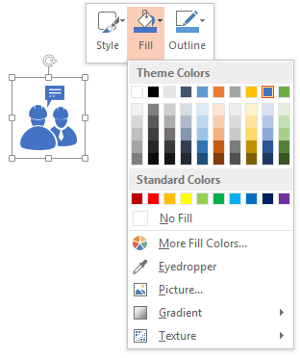
Edit Color
(The color of icon can be changed with two clicks)
1. Right-Click on the icon
2. Click on the Fill tab & select the color

Slide 4
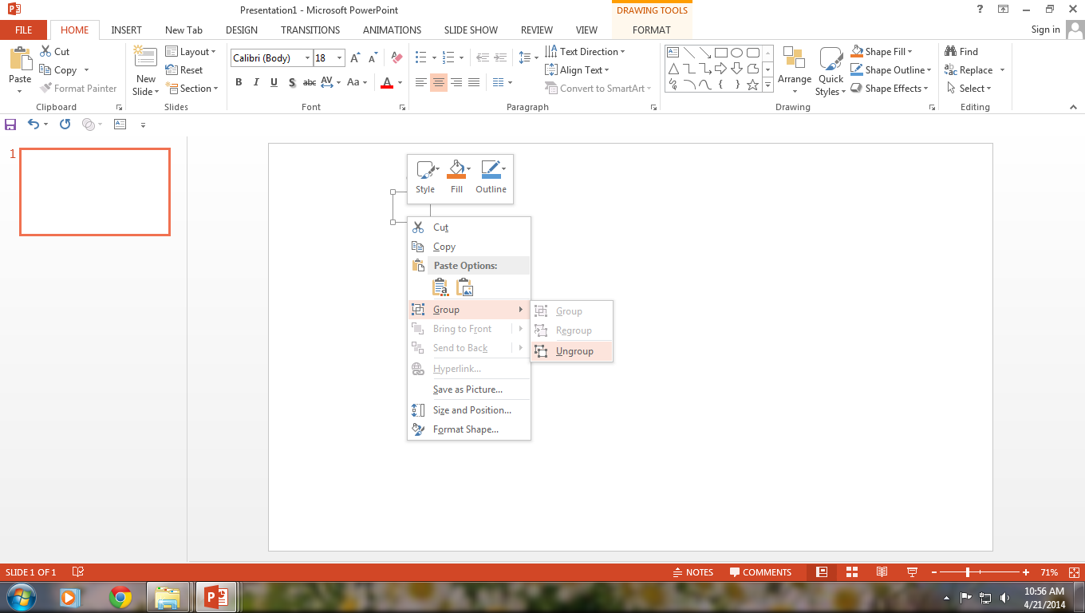
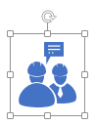
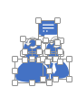
Ungrouping the object
2
1
3
Right click the object.
Choose Group and then Ungroup.
Click beside the object and drag the arrow over it.

