Slide 1
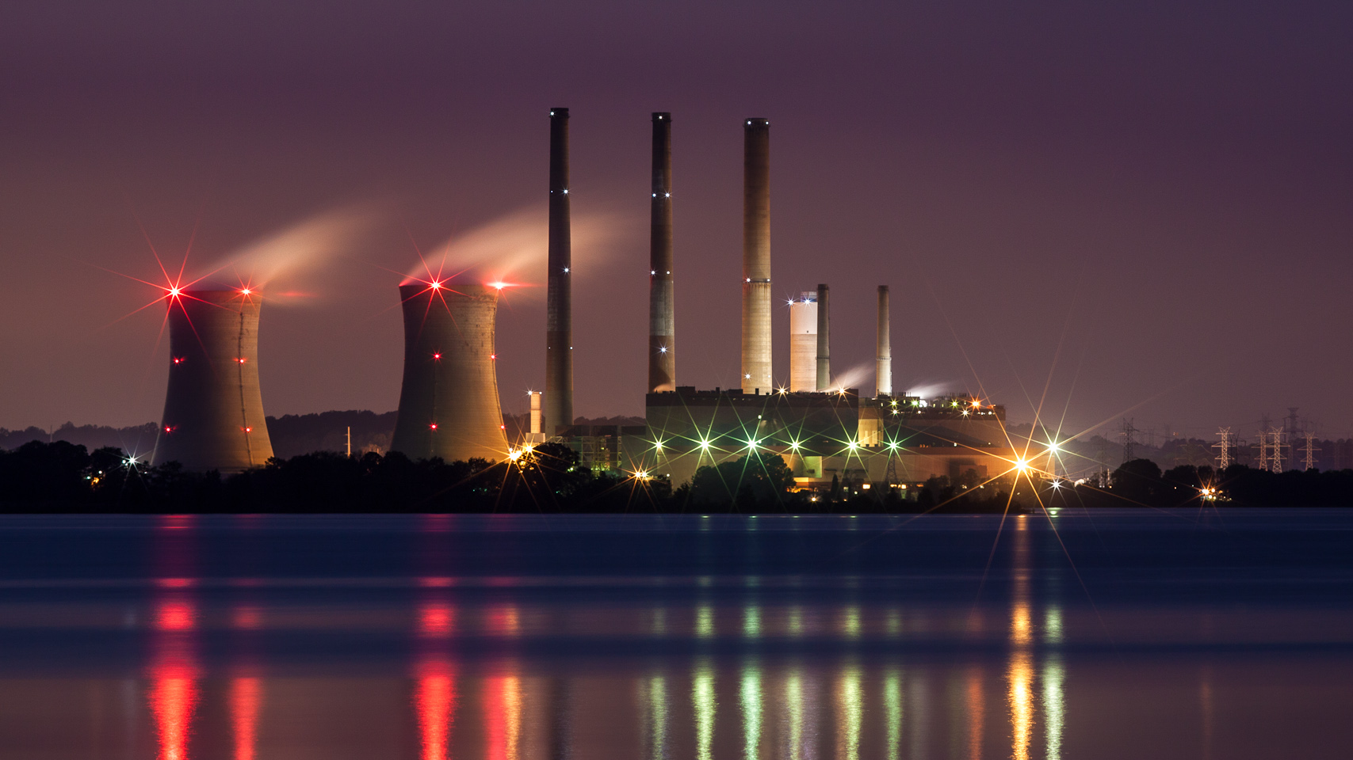

Indian Power Sector at a Glance
Indian Institute of Technology Guwahati
Data Visualization for Indian 'State-wise Installed Power Capacity Data' and 'Regional Grid-wise Power Generation Data' across different sources of energy.
Nikhil Thosar (224161020)
n.thosar@iitg.ac.in
Course: CS595
Course Instructor: Dr. Ashish Anand

Slide 2
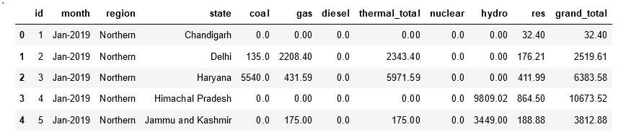
Data Description and Analysis:
Data File: Installed_Power_Capacity_State_wise_MW.csv
Details: The given data represents the monthly electricity generation and distribution statistics for the five regions of India from Jan-2019 to Jan-2022 The data is broken down by state and includes information on the amount of installed electricity generation capacity using different sources such as coal, gas, diesel, thermal, nuclear, hydro, and renewable energy (RES) and the total installed capacity by each state.

Slide 3
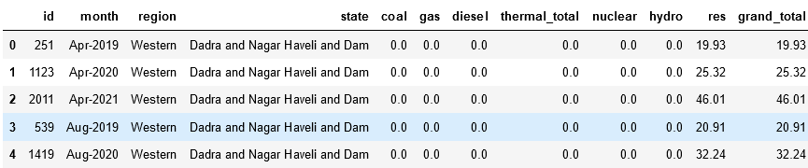
Data Anomalies:
In original data, for state 'Andhra Pradesh' , for certain data entries state-name was 'Andhra Pradesh.', during data cleaning, I replaced it appropriately.
From 26th January 2020, 'Dadra Nagar Haveli' and 'Daman-Diu' merged to a single Union Territory so data inconsistency and discontinuity was there, as data for same state was present with three different names and for different time periods. I removed this inconsistency and discontinuity that could have lead to complicate visualizations for user.

Slide 4
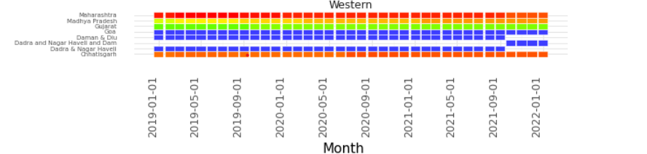
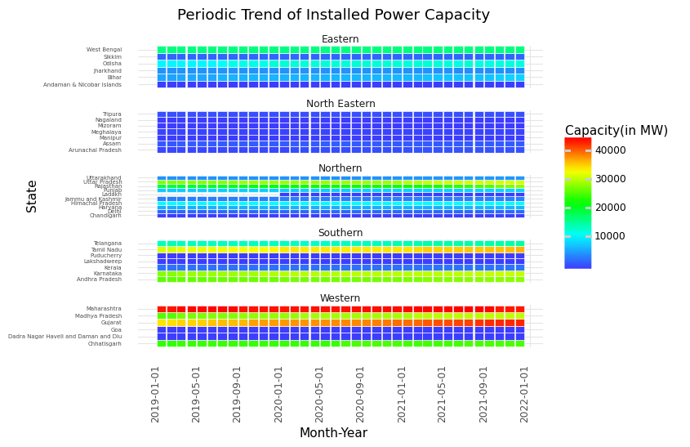
PLOT I: Periodic Faceted Heat-Map for different regions
Plot Description:
This Heatmap plotted here provides good insights about the overall periodic growth and development of Power Generation Infrastructure throughout country, region-wise and moreover state-wise.
Moreover, comparative study of different regional power grids of country can be done from this.
Observations:
It can be seen that, 'Western region' have highest power generation capacity overall and 'North-Eastern', the least.
Gujarat, Tamil Nadu and Rajasthan have made significant growth in installed capacity overall, this can be observed from gradient.

Slide 6
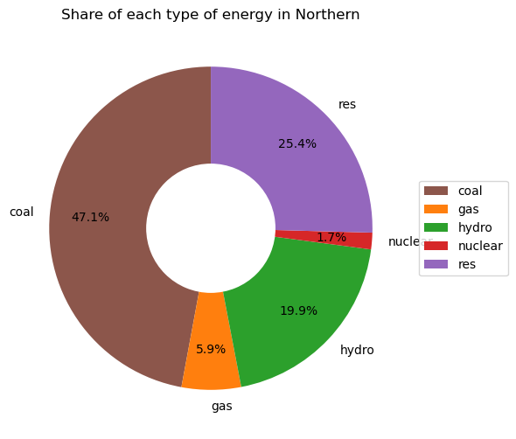
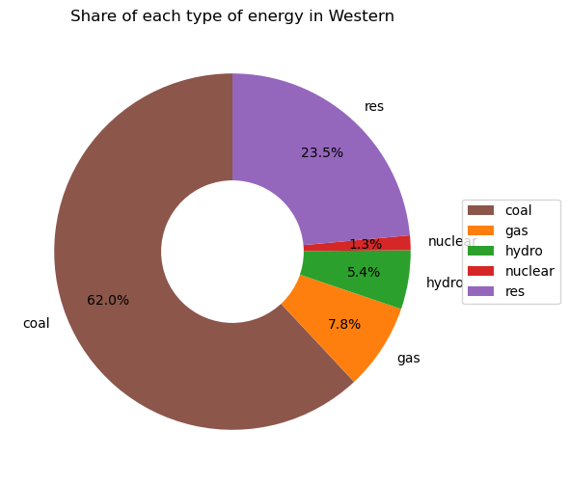
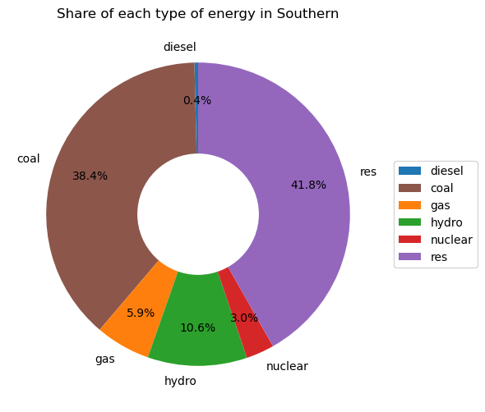
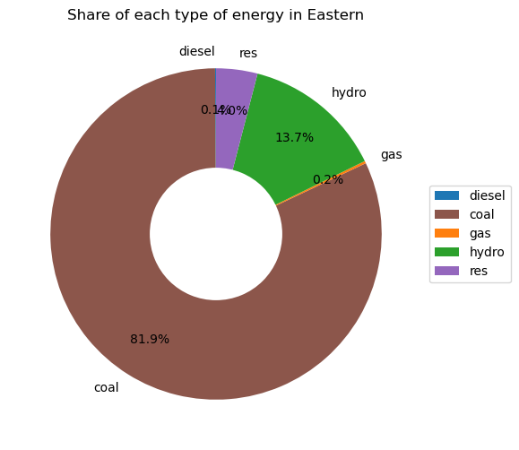
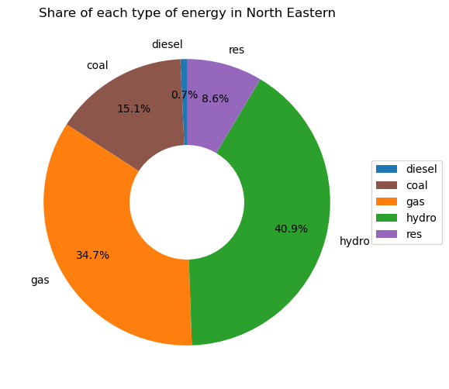
PLOT II: Different Energy Sources Distribution
Details: Capacity installed during the given period can be seen from below visualizations and the highest three states having maximum capacity installed during this period are highlighted with different color.

Slide 7
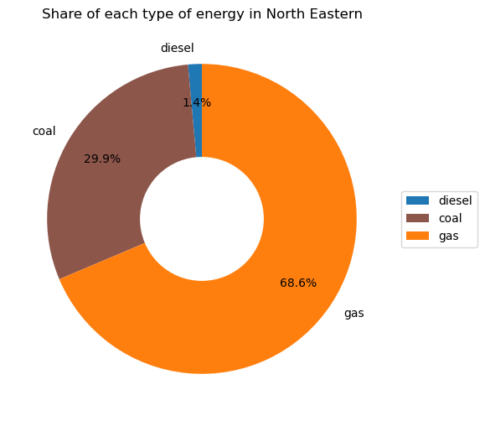
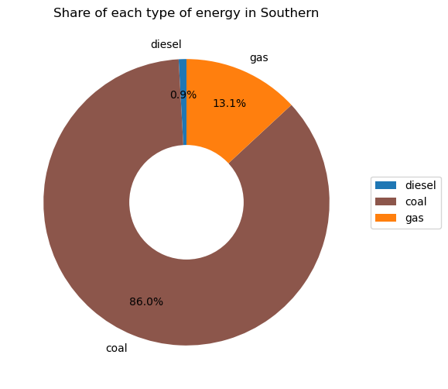
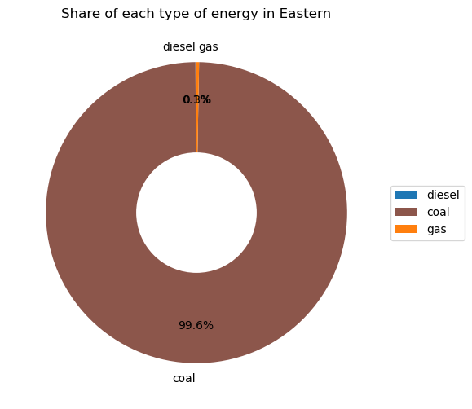
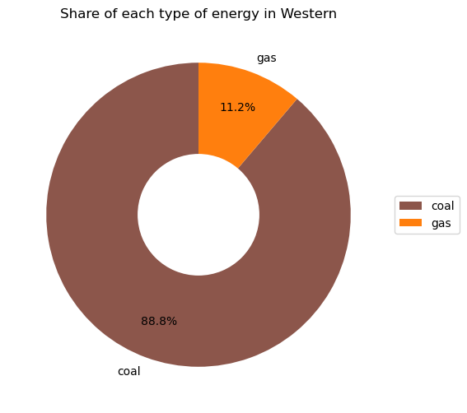

PLOT III: Different Thermal Energy Distribution
Details: Capacity installed during the given period can be seen from below visualizations and the highest three states having maximum capacity installed during this period are highlighted with different color.

Slide 8
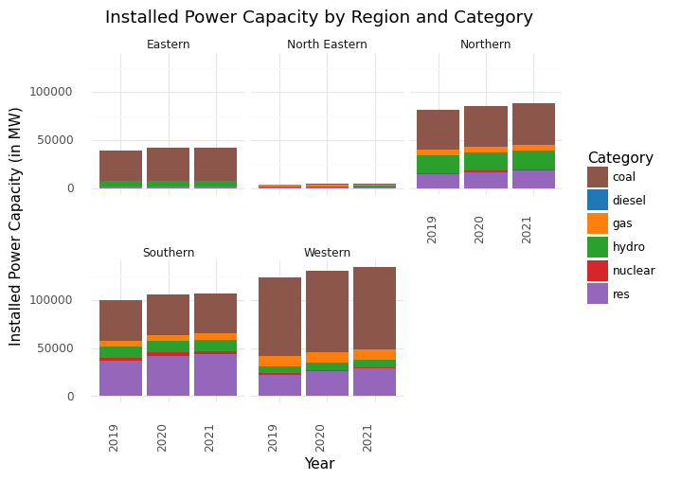
PLOT IV: Region-Wise Facetted Stacked Bar Plot for 2019-2022
Details: Five facets each of a particular region makes it easy to compare data of installed capacity for period, moreover for different sources of energy gives idea that coal plants are the most dominant source of power generation facility installed in most of the regions.

Slide 9
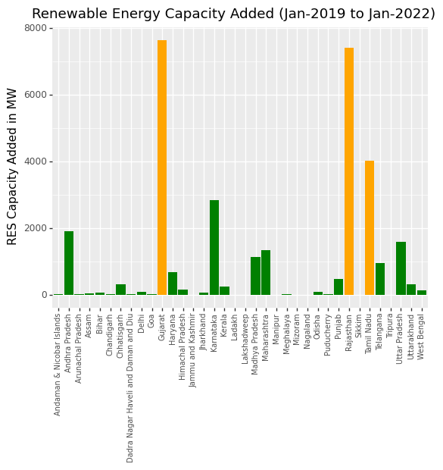
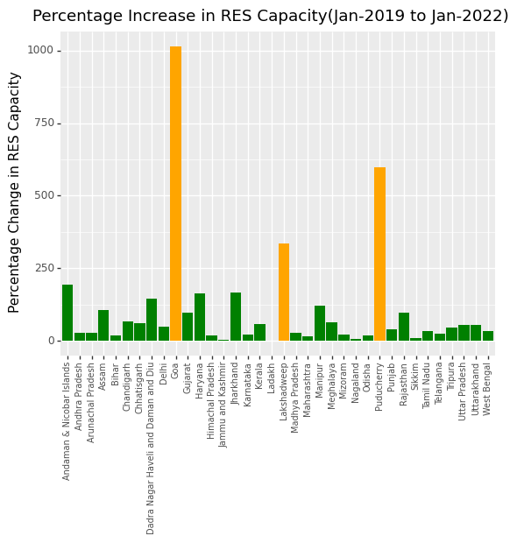
PLOT V: Renewable Energy Plots
Details: Capacity installed during the given period can be seen from below visualizations and the highest three states having maximum capacity installed during this period are highlighted with different color.

Slide 10
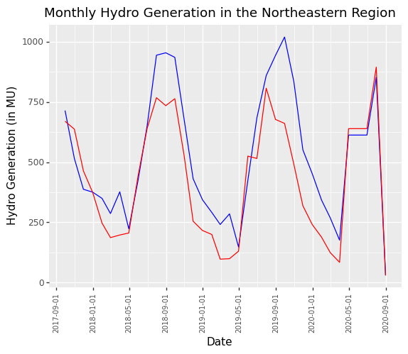
Work in Progress: Power Generation Plots, Data Structuring and Cleaning
Data File: Power_Generation.csv
Data Analysis: Generation Data for Thermal, Nuclear and Hydro (Estimated and Actual ) is present for period of Sept-2017 to Aug-2020.
There is no data for Eastern and North-Eastern region particularly for Nuclear Generation.
As this is day-wise data for long time of 3 years, I observed it's tough to get a smooth generalized trend out of it, so I grouped it month-wise and tried to visualize the monthly generation data.
Data Anomalies:
Missing values in periodic data for couple of months and particular regions.
Structuring and Cleaning Approach:
I separated out data for all five regions in different data frame to replace the missing values appropriately as per the regional trend.
Replaced 0.0 values firstly with 'NaN' and then used interpolation to fill up those values. This made data retain its general nature, instead of showing an unexpected dip in line plot.

