Slide 1
Creating Anti-Oppressive Spaces Online
MCN, November 2016
Sina Bahram @SinaBahram
Prime Access Consulting
Eric Gardner @ecgardner
Getty Museum
Sarita Hernandez @FwdMuseums
Fwd: Museums Journal
fari nzinga @fari_nzinga
Southern University at New Orleans, Createquity
Trish Oxford @TrishOxford
Trish Oxford Media
nikhil trivedi @nikhiltri
A museum in Chicago

Slide 2
Definitions
Anti-oppression: an approach to work that focuses on ending oppressions.
Creating Anti-Oppressive Spaces Online, MCN 2016

Slide 3
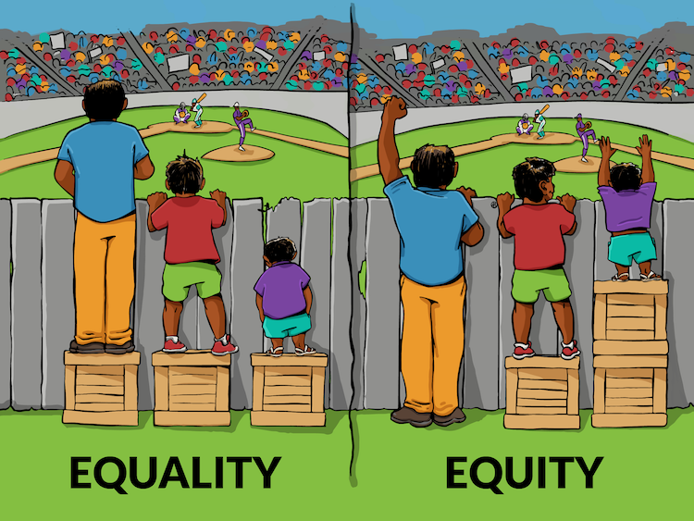
Equality vs. Equity
Creating Anti-Oppressive Spaces Online, MCN 2016

Slide 4
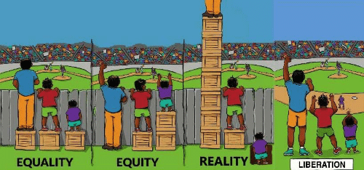
Equality vs. Equity vs. Reality vs. Liberation
Creating Anti-Oppressive Spaces Online, MCN 2016

Slide 5
Definitions
Intersectionality: a theory that examines how various categories of identity such as gender, race, class, ability, sexual orientation, religion, caste, age, nationality and others interact on multiple and often simultaneous levels.
Creating Anti-Oppressive Spaces Online, MCN 2016

Slide 6
Common Myths
“Those people” don't come to museums.
Creating Anti-Oppressive Spaces Online, MCN 2016

Slide 7
Common Myths
Everyone feels welcome at museums and is motivated to visit.
Creating Anti-Oppressive Spaces Online, MCN 2016

Slide 8
Common Myths
Museums are neutral authorities.
Creating Anti-Oppressive Spaces Online, MCN 2016

Slide 9
Common Myths
White people have the most to contribute, and have contributed the the most to the art world.
Creating Anti-Oppressive Spaces Online, MCN 2016

Slide 10
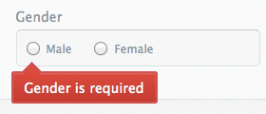

Checklist
Are your sign-up forms respectful of people outside the norms of names, gender, sexuality, relationships and ethnicity?
Collect all user data in changeable, free-form text fields
Creating Anti-Oppressive Spaces Online, MCN 2016

Slide 11
Checklist
What data are you collecting?
Why are you collecting each piece of data?
Is your intention conveyed to users?
Does the project respect the privacy of users?
Be clear on why you're collecting each piece of data and what you’re doing with it
Creating Anti-Oppressive Spaces Online, MCN 2016

Slide 12
Checklist
If you collect comments that will be made public, do you have guidelines for discourse in place?
Establish guidelines for discourse online
Creating Anti-Oppressive Spaces Online, MCN 2016

Slide 13





Checklist
Do icons, photos, etc. assume things about gender, race or ability of users?
Use non-gendered, raced, or abled user icons
Creating Anti-Oppressive Spaces Online, MCN 2016

Slide 14
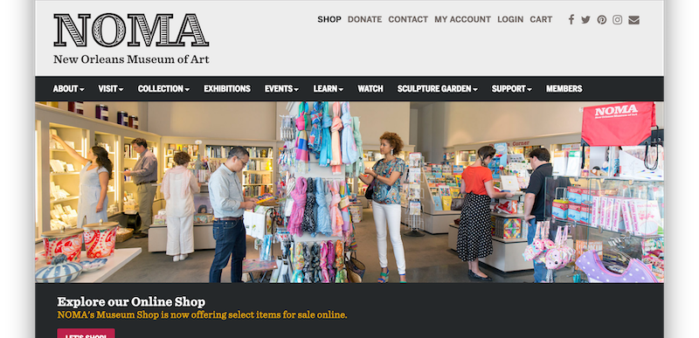
Checklist
Have you staged any photos that inaccurately reflect the diversity of your visitorship or staff?
Don't stage false diverse photographs
Creating Anti-Oppressive Spaces Online, MCN 2016

Slide 15
Checklist
Have you been sure not to make business decisions based solely on existing analytics? Do you have a clear plan on how to measure the business decisions you've made, through analytics or otherwise?
When using analytics: Decide, then act, then measure. Don’t measure, then decide, then act
Creating Anti-Oppressive Spaces Online, MCN 2016

Slide 16
Checklist
What modes of communication do your teams use? Is that working for everyone?
Consider and critique modes of communication: face-to-face, e-mail
Creating Anti-Oppressive Spaces Online, MCN 2016

Slide 17
Checklist
Is the project accessible to older people, younger people, people without disabilities, and people with disabilities?
Implement Universal Design and Learning
Creating Anti-Oppressive Spaces Online, MCN 2016

Slide 18
Checklist
Is all the writing, including curatorial content, at an accessible reading level?
Check the readability grade level of your text
Creating Anti-Oppressive Spaces Online, MCN 2016

Slide 19
Checklist
Who’s not part of your design process? Why?
Creating Anti-Oppressive Spaces Online, MCN 2016

Slide 20
Ideas
Create relationships and co-create with people of color
Creating Anti-Oppressive Spaces Online, MCN 2016

Slide 21
Ideas
Find out how to connect your work with movements
Creating Anti-Oppressive Spaces Online, MCN 2016

Slide 22
Ideas
Create work based on the needs of people
Creating Anti-Oppressive Spaces Online, MCN 2016

Slide 23
Ideas
Identify reusable wins
Creating Anti-Oppressive Spaces Online, MCN 2016

Slide 24
Ideas
Use money to subsidize programming
Creating Anti-Oppressive Spaces Online, MCN 2016

Slide 25
Ideas
Critique your organization’s inclusion work
Creating Anti-Oppressive Spaces Online, MCN 2016

Slide 26
Ideas
Share relevant articles about pressing issues
Creating Anti-Oppressive Spaces Online, MCN 2016

Slide 27
Thanks!
Sina Bahram @SinaBahram
Prime Access Consulting
Eric Gardner @ecgardner
Getty Museum
Sarita Hernandez @FwdMuseums
Fwd: Museums Journal
fari nzinga @fari_nzinga
Southern University at New Orleans, Createquity
Trish Oxford @TrishOxford
Trish Oxford Media
nikhil trivedi @nikhiltri
A museum in Chicago
Creating Anti-Oppressive Spaces Online, MCN 2016

