Slide 1
Capstone Project-1
EDA on Hotel Booking Analysis BY Nikhil G. Umare

Slide 2
Problem Statement:
Have you ever wondered when the best time of year to book a hotel room is? Or the optimal length of stay in order to get the best daily rate? This hotel booking dataset can help you explore those questions!
This data set contains booking information for a city hotel and a resort hotel, and includes information such as when the booking was made, length of stay, the number of adults, children, and/or babies, and the number of available parking spaces, among other things.
The main objective behind this project is to explore and analyze data to discover important factors that govern the bookings and give insights to hotel management ,which can perform various campaigns to boost the business and performance.

Slide 3
Steps Followed:
Data Collection and Exploration
Data cleaning and Manipulation
Exploratory Data Analysis(EDA)

Slide 4
Data Description:
hotel : Hotel(Resort Hotel or City Hotel)
is_canceled : Value indicating if the booking was canceled (1) or not (0)
lead_time : Number of days that elapsed between the entering date of the booking into the PMS and the arrival date
arrival_date_year : Year of arrival date
arrival_date_month : Month of arrival date
arrival_date_week_number : Week number of year for arrival date
arrival_date_day_of_month : Day of arrival date
stays_in_weekend_nights : Number of weekend nights (Saturday or Sunday) the guest stayed or booked hotel
stays_in_week_nights : Number of week nights (Monday to Friday) the guest stayed or booked to stay at the hotel
adults : Number of adults
children : Number of children
babies : Number of babies
meal : Type of meal booked. Categories are presented in standard hospitality meal packages:
country : Country of origin.`

Slide 5
Data Description(contd):
market_segment : Market segment designation.(TA/TO)
distribution_channel : Booking distribution channel.(TA/TO)
is_repeated_guest : a repeated guest (1) or not (0)
previous_cancellations : Number of previous bookings that were cancelled by the customer prior to the current booking
previous_bookings_not_canceled : Number of previous bookings not cancelled by the customer prior to the current booking
reserved_room_type : Code of room type reserved.
assigned_room_type : Code for the type of room assigned to the booking.
booking_changes : Number of changes/amendments made to the booking from the moment the booking was entered on the PMS until the moment of check-in or cancellation
deposit_type :No Deposit,Non Refund,Refundable
agent : ID of the travel agency that made the booking
company : ID of the company/entity that made the booking or responsible for paying the booking.
days_in_waiting_list : Number of days the booking was in the waiting list before it was confirmed to the customer
customer_type : Type of booking, assuming one of four categories
adr : Average Daily Rate
required_car_parking_spaces : Number of car parking spaces required by the customer
total_of_special_requests : Number of special requests made by the customer (e.g. twin bed or high floor)
reservation_status: Reservation last status

Slide 6
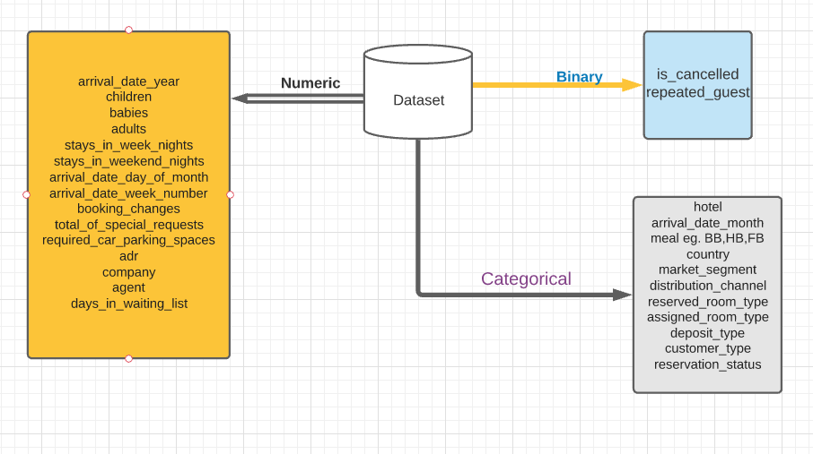
Data summary

Slide 7
Data Cleaning:
1)Missing values: There were 4 columns company, agent, country and children with missing values.
2)Handling Duplicates: Data had 31994 duplicates values.so we dropped it from data.
3) Removing Outliers:Removing an outlier from Average_daily_rate column
4) Feature Engineering:
We created 2 new columns
a) ‘Total _People’=from the childrens, adults, babies.
b) ‘Total_stay’=From weekend nights and weekdays nights.

Slide 8
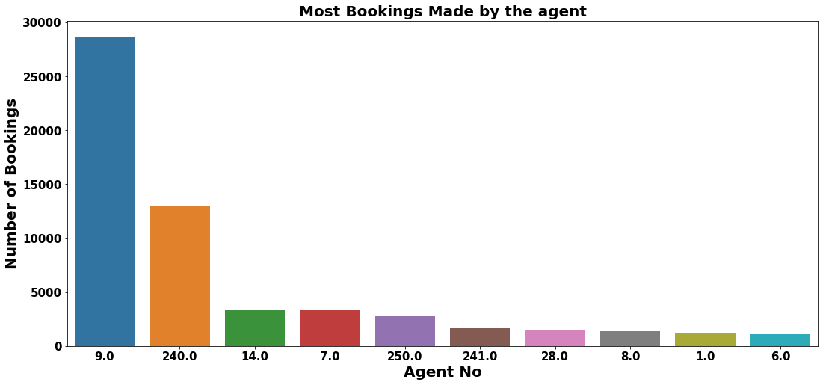
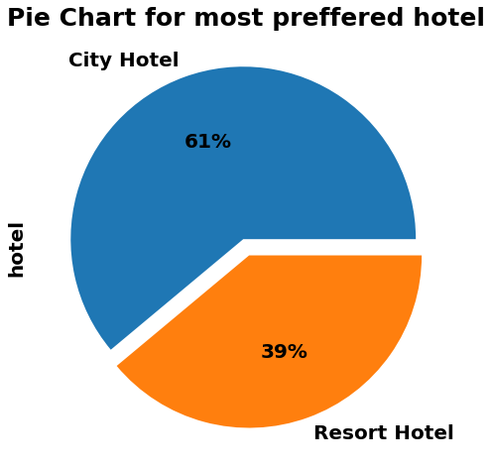
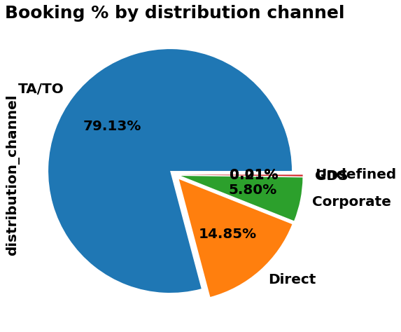
Exploratory Data Analysis:
CONCLUSIONS:
1. City Hotel is most preferred hotel by guests. Thus city hotels has maximum bookings.
2. Most 79% people prefer 'TA/TO' for booking.
3. Agent ID no: 9 made most of the bookings

Slide 9
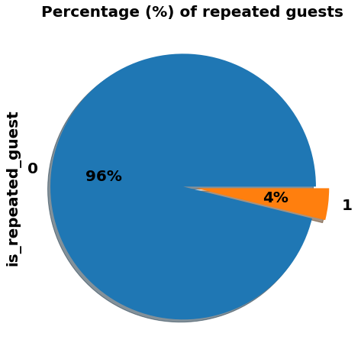
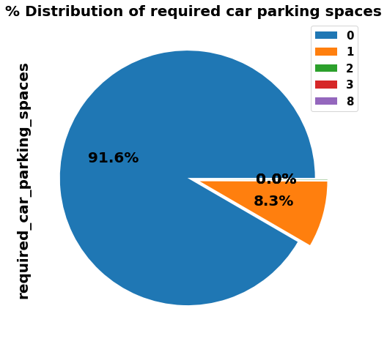
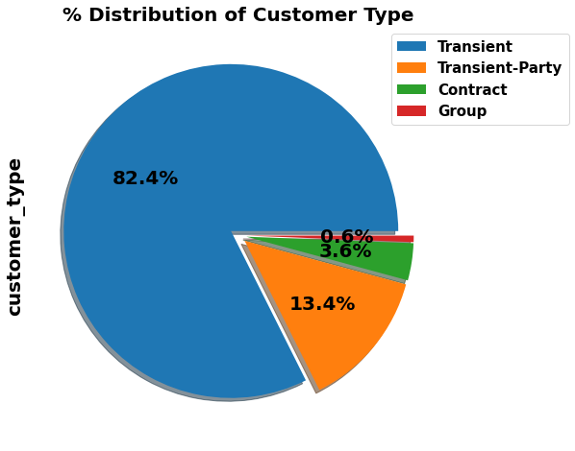
Exploratory Data Analysis:
CONCLUSIONS:
1. . Only 4 % people were revisited the hotels. Rest 96 % were new guests. Thus retention rate is low.
2. 91.6 % guests did not required the parking space. only 8.3 % guests required only 1 parking space.
3. Transient customer type is more which is 82.4 %. percentage of Booking associated by the Group is vey low.
Contract-when the booking has an allotment or other type of contract associated to it
Group -when the booking is associated to a group
Transient-when the booking is not part of a group or contract, and is not associated to other transient booking
Transient-party-when the booking is transient, but is associated to at least other transient booking

Slide 10
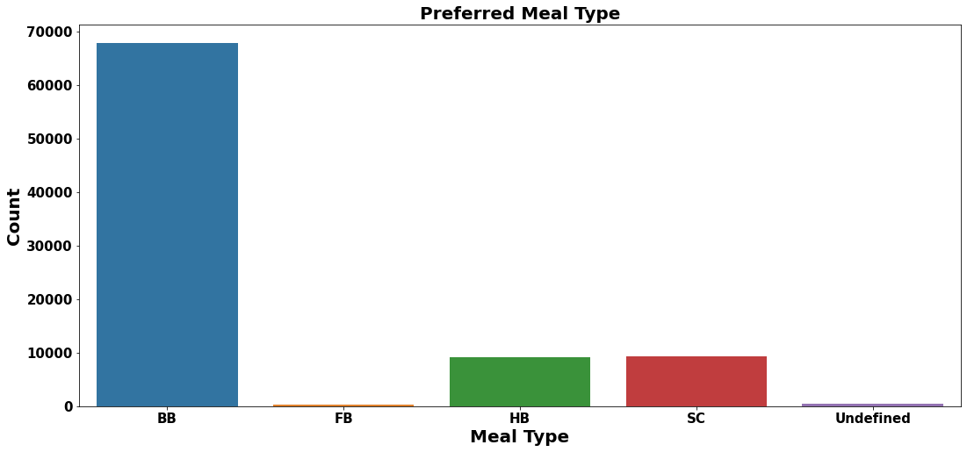
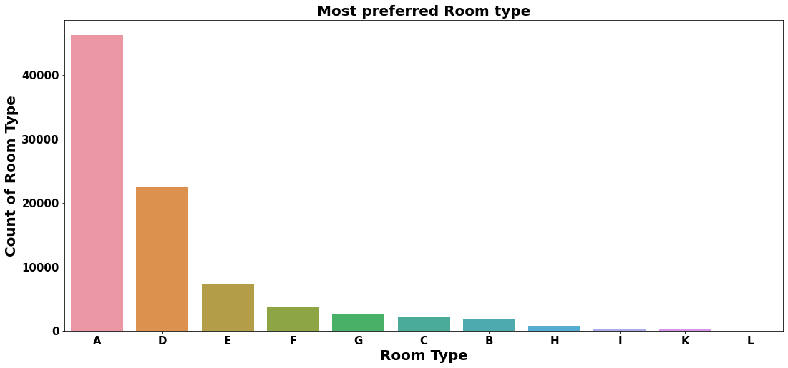
Exploratory Data Analysis:
CONCLUSION:
1. So the most preferred meal type by the guests is BB( Bed and Breakfast)
HB- (Half Board) and SC- (Self Catering) are equally preferred.
2. So the most preferred Room type is "A".

Slide 11
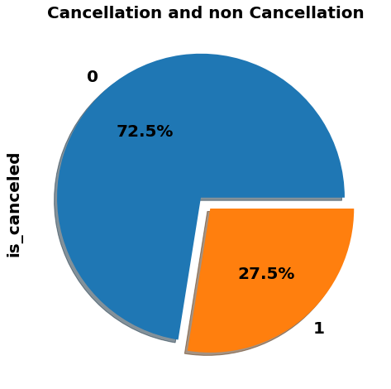
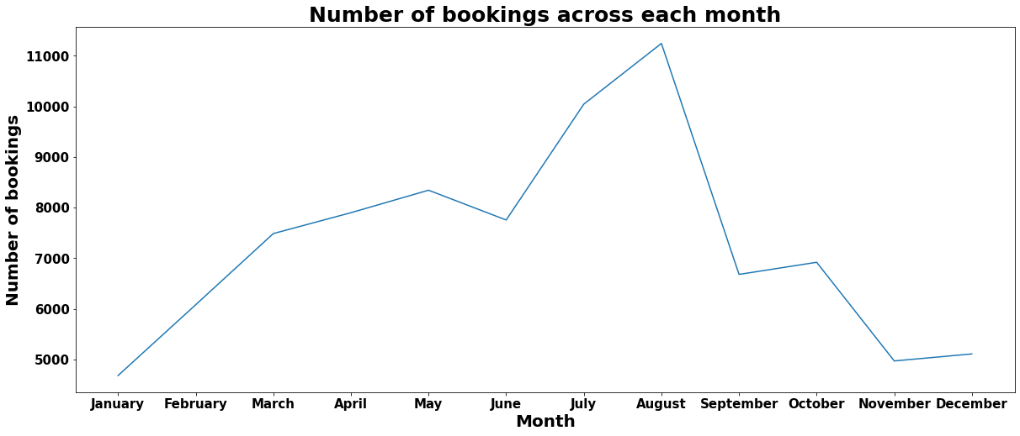
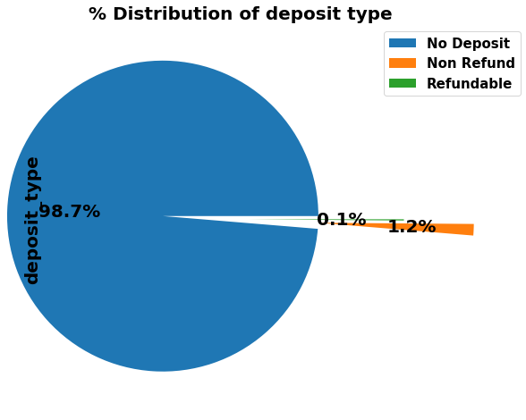
Exploratory Data Analysis:
CONCLUSIONS:
1. 27.5 % of the bookings were cancelled.
2. 98.7 % of the guests prefer "No deposit" type of deposit.
3. July and August months had the most Bookings. Summer vacation can be the reason for the bookings.

Slide 12
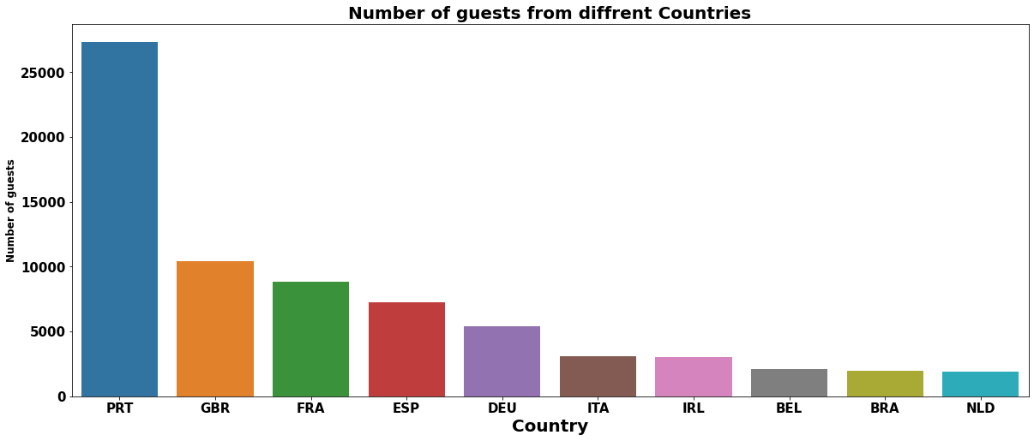
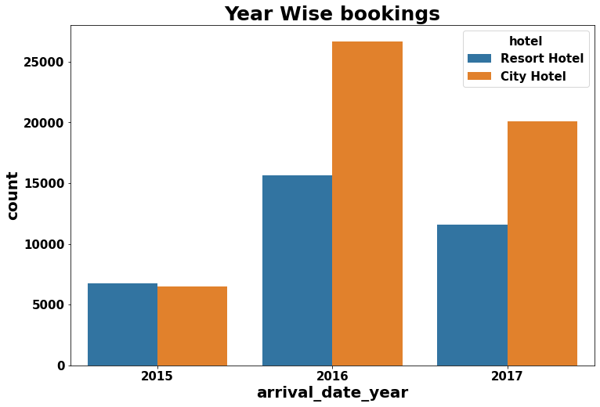
Exploratory Data Analysis:
CONCLUSIONS:
1.Most of the guests are coming from portugal i.e more 25000 guests are from Portugal.
2. 2016 had the higest bookings. 2015 had less 7000 bookings. overall City hotels had the most of the bookings.

Slide 13
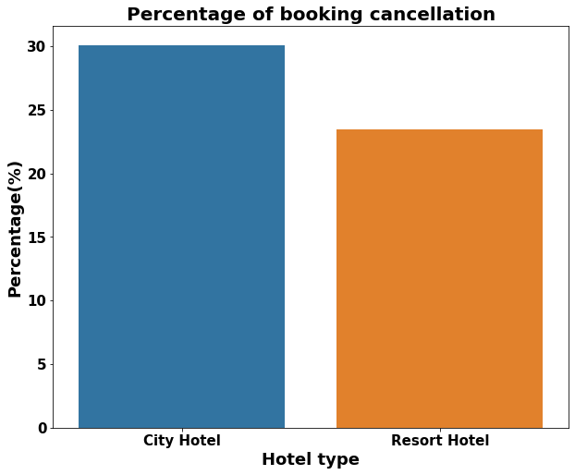
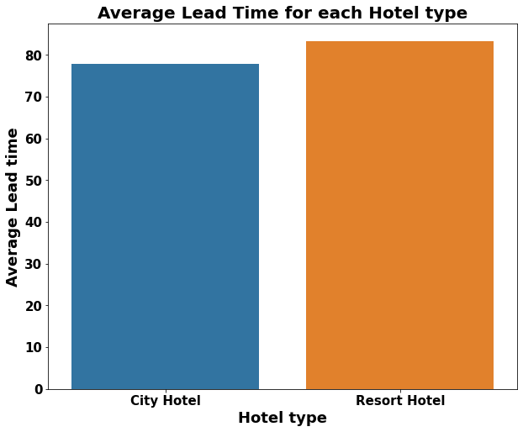
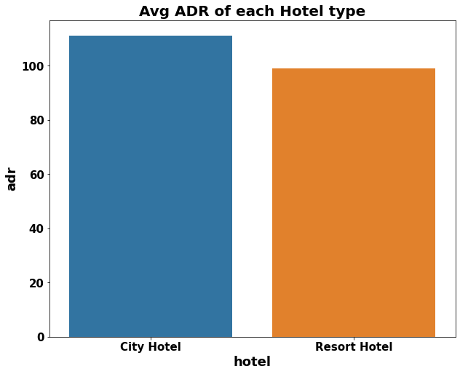
Exploratory Data Analysis:
CONCLUSION:
1. Booking cancellation rate is high for City hotels which almost 30 %.
2. Average lead time for resort hotel is high. It means people plan their trip too early. Usually people prefer resort hotels for
longer stays. That’s why people plan early.
3. Average ADR for city hotel is high as compared to resort hotels. These City hotels are generating more revenue than the
resort hotels.

Slide 14
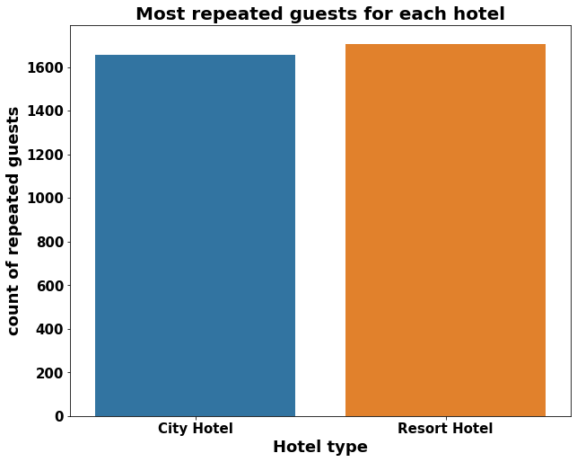
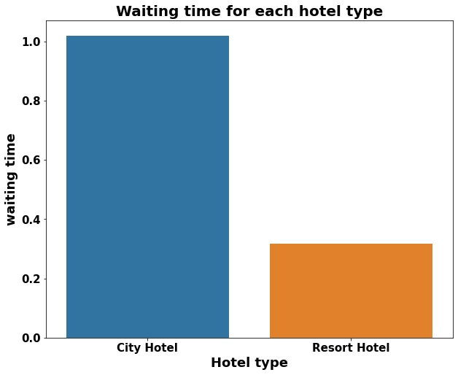
Exploratory Data Analysis:
CONCLUSION:
1.Resort hotels has the most repeated guests. In order to get increase the count of repeated guests hotel management need to take the valuable feedbacks from the guests and try to give good service.
2. Waiting time period for City hotel is high as compared to resort hotels. That means city hotels are much busier than Resort hotels.

Slide 15
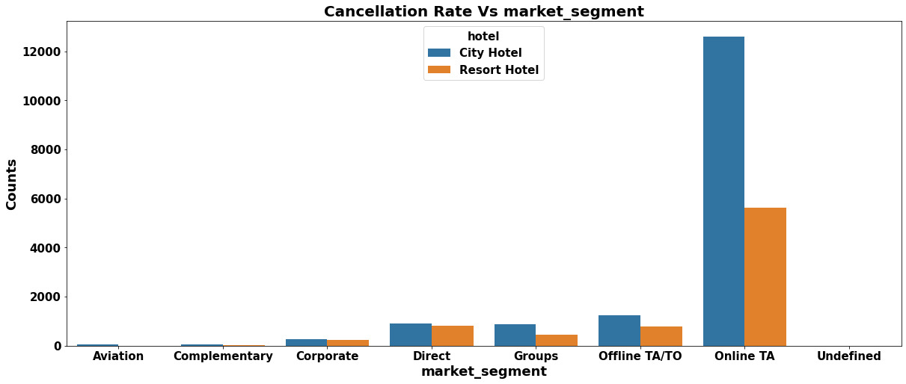
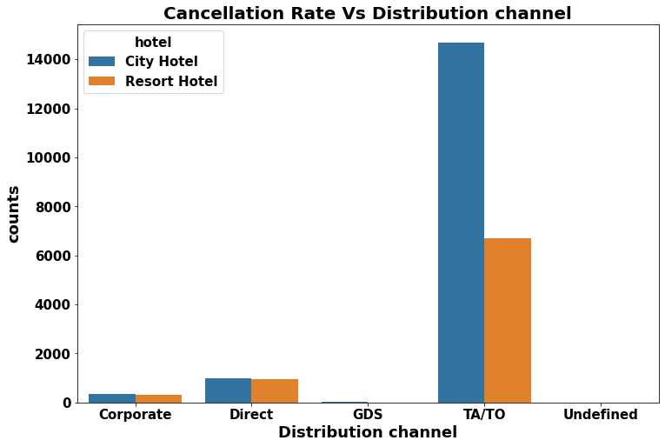
Exploratory Data Analysis:
CONCLUSIONS:A/TO’ market segment has highest cancellations for city hotels.
‘1.Market Segment: Online TA/TO’ market segment has highest cancellations for city hotels.
2. Distribution channel: TA/TO’ distribution channel has highest cancellations for city hotels and more than 6000
cancellations for resort hotels. In order to reduce the cancellations they should improve their cancellation policies and deposit policies.
et segment has highest cancellations for city hotels.
‘Online TA/TO’ market segment has highest cancellations for city hotels.

Slide 16
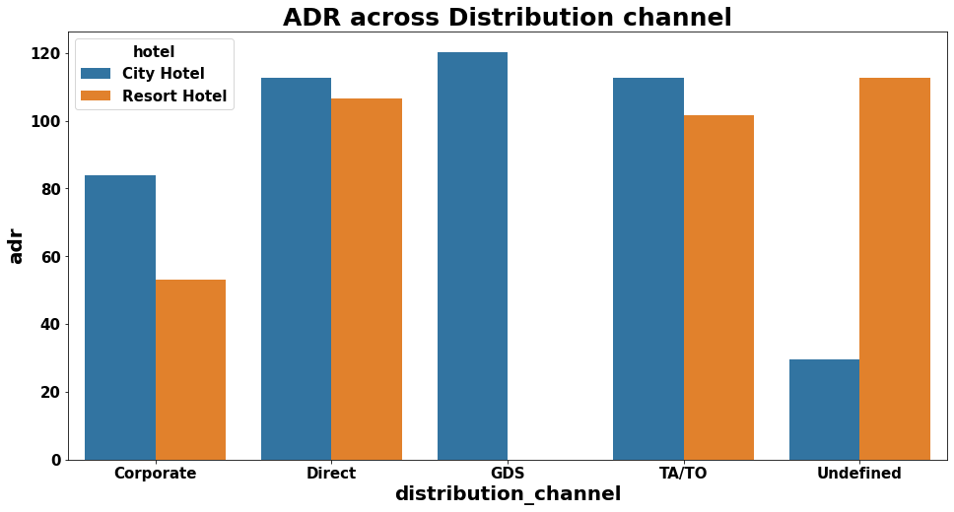
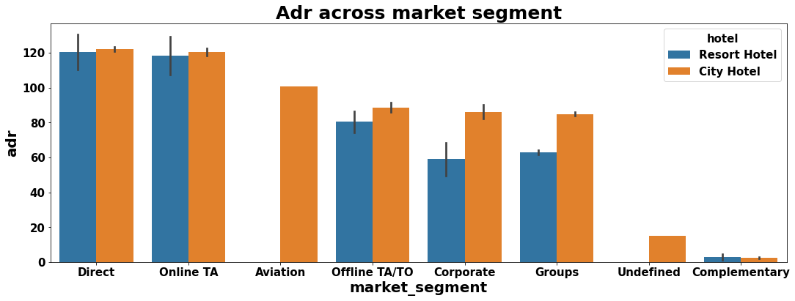
Exploratory Data Analysis:
CONCLUSION:
Distribution channel:
1.'Direct' and 'TA/TO' has almost equal adr in both type of hotels which is high among other channels.
2.GDS has high adr in 'City Hotel' type. GDS needs to increase Resort Hotel bookings. From this we can say that “Direct” and ‘TA/TO’ are generating more revenue than the other channels.
Market Segment:
1.Here “Direct” and ‘Online Travel Agency’ has high adr for both hotel types. Aviation segment needs to increase Resort hotel bookings.

Slide 17
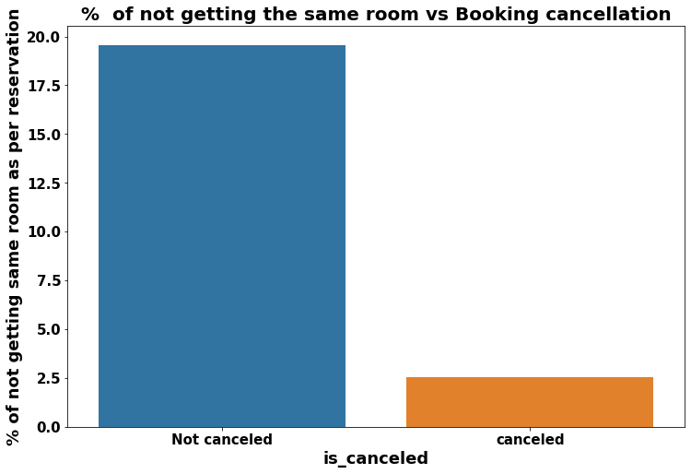
Exploratory Data Analysis:
CONCLUSION:
1.Almost 19 % people did not canceled their bookings even after not getting the same room which they reserved while booking hotel. Only 2.5 % people cancelled the booking.
2.Thus not getting the same room as per reserved room is not the reason for booking cancellations

Slide 18
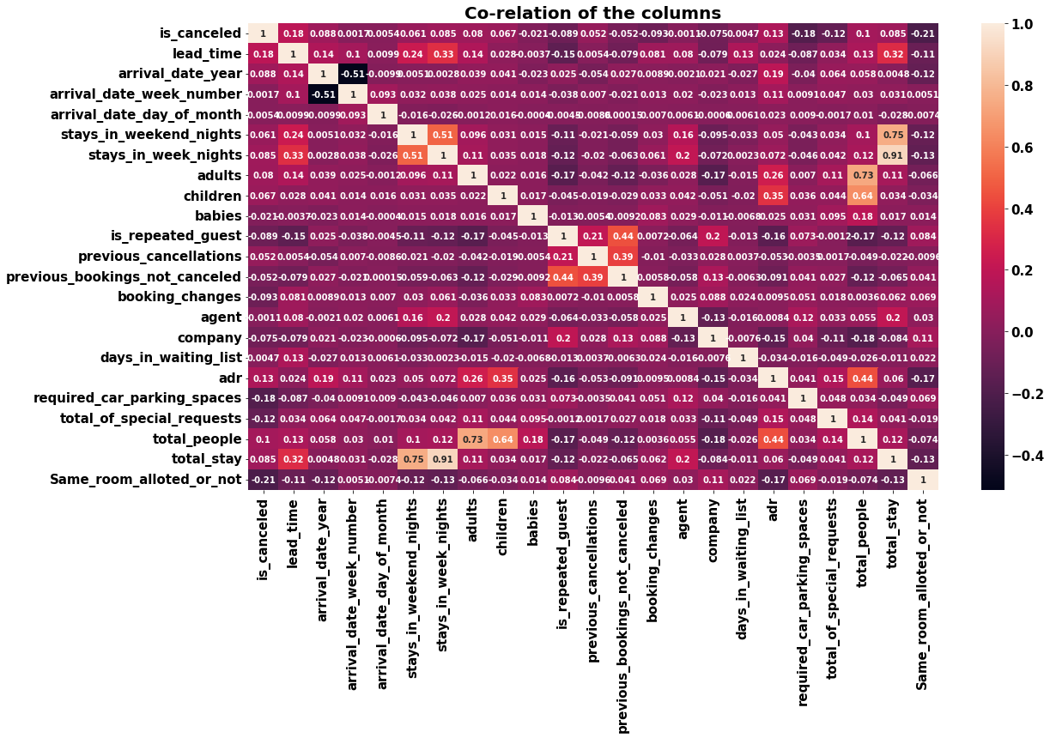
Exploratory Data Analysis:
CONCLUSION:
1.is canceled and same_room_alloted_or_not are negatively correlated. Not getting the same room as per reserved room is not the reason for booking cancellations.
2.lead-time and total stay is positively correlated means more is the stay of customer more will be the lead time.
3.ADR and total people are highly correlated. That means more the people
more will be adr. High adr means high revenue
4.is_repeated_guest and previous_bookings Not_canceled has strong correlation. May be repeated guests are not more likely to cancel their bookings.

Slide 19
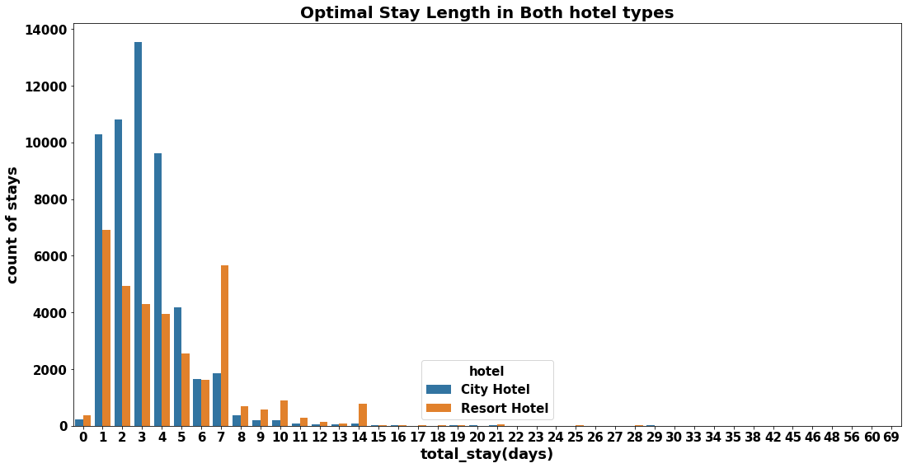
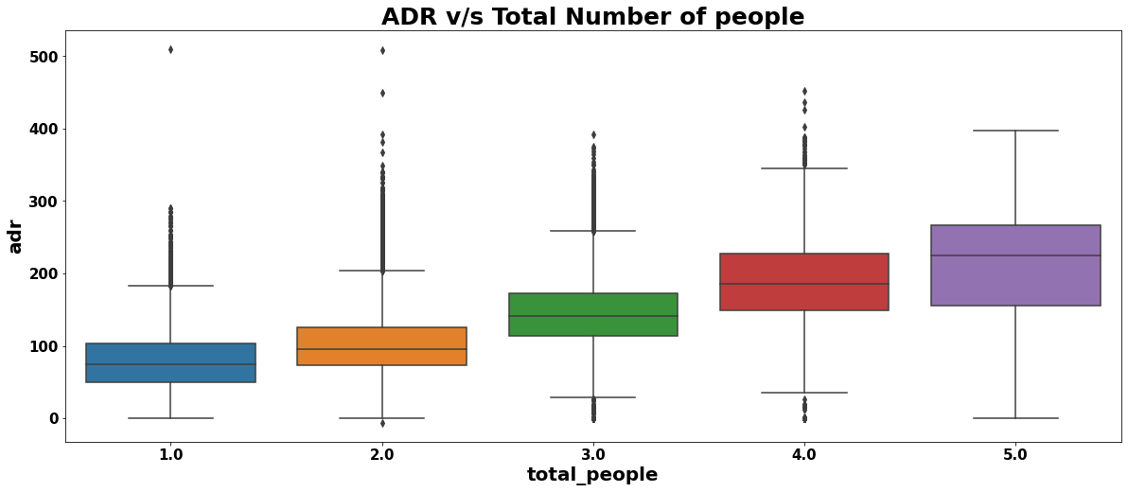
Exploratory Data Analysis:
CONCLUSION:
1.Optimal stay in both the type hotel is less than 7 days. Usually people stays for a week.
2.For stay more than 7 days people likes to stay in Resort hotels. As we can see after 7 days City Hotel Bookings are very less as compared to Resort hotels.
3.As we saw in Correlation heatmap, total people and adr are positively correlated. Thus for 2 people ,adr is almost 100 and for 5 people its more than 200.
4.Thus more the people more will revenue of the hotel

Slide 20
THANK YOU

