Slide 1
LENDING CLUB CASE STUDY
NIKHIL VALSARAJ
YASMIN N S

Slide 2
OBJECTIVE
To analyse the data of loan applicants who default
To derive meaningful pattern out of the data with the help of EDA
Derive observations from the pattern
Conclusion based on the observations which will be beneficial to the bank

Slide 3
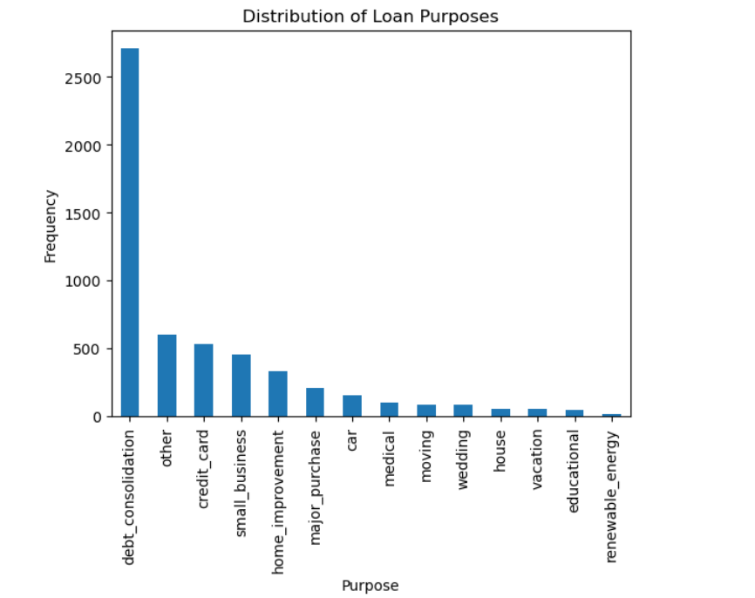
Univariate Analysis
Observation
Majority of the loans taken for debt consolidation
Conclusion
The bank needs to have a thorough background verification for applicants where the loan purpose is for debt consolidation

Slide 4
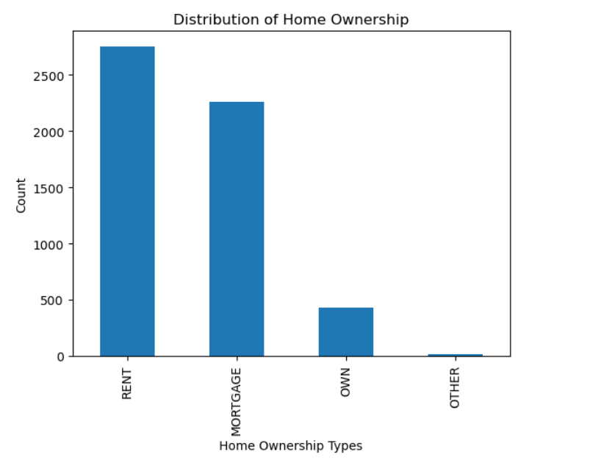
Univariate Analysis
Observation
People with own house are less likely to default
Conclusion
The bank can confidently give loans to applicants having their own home and do more checks for applicants staying in a rented home or mortgage

Slide 5
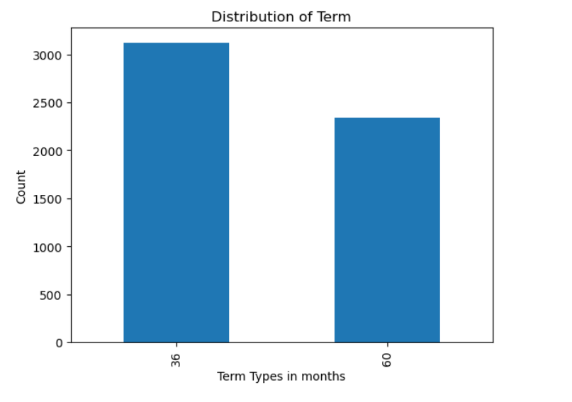
Univariate Analysis
Observation
3 year loans have more default than 5 year ones
Conclusion
The bank can do some extra background checks for short duration loan applications

Slide 6
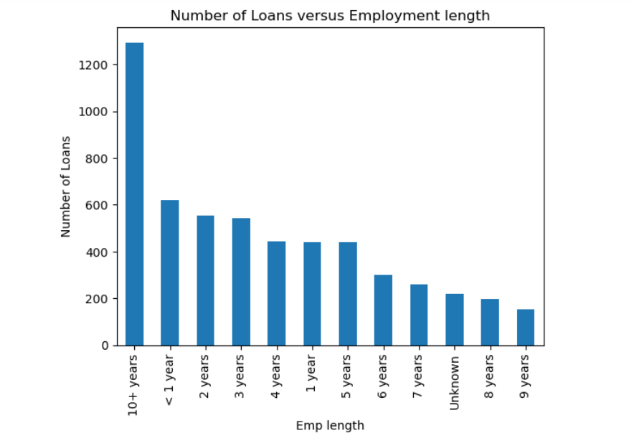
Univariate Analysis
Observation
Majority of the defaulted loans have been taken by people with 10+ years of employment.
It is followed with uniform distribution of people with < 1 year, 2 years and 3 years respectively
Conclusion
The bank can do some extra background checks for people with 10+,<1, 2 and 3 years experienced applicants

Slide 7
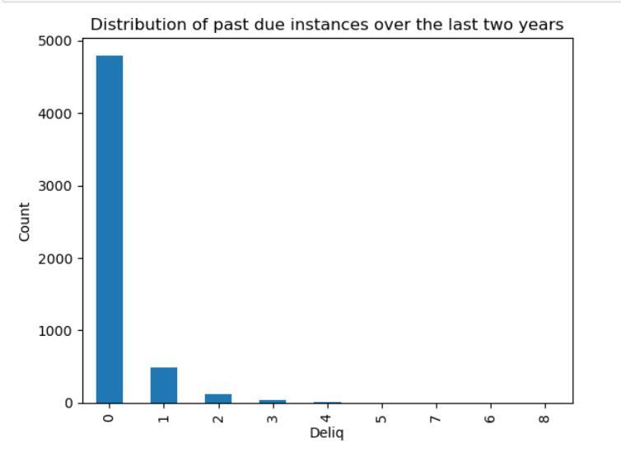
Univariate Analysis
Observation
Delinquency is not related to customers who have default
Conclusion
The bank need not consider no of delinquency count as a major factor for loan approval

Slide 8
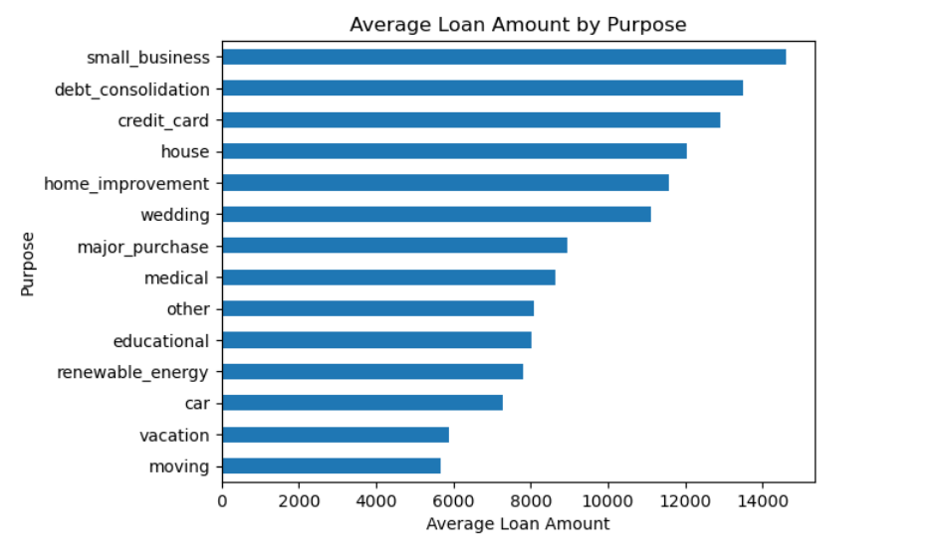
Univariate Analysis
Observation
Delinquency is not related to customers who have default
Conclusion
The bank need not consider no of delinquency count as a major factor for loan approval

Slide 9
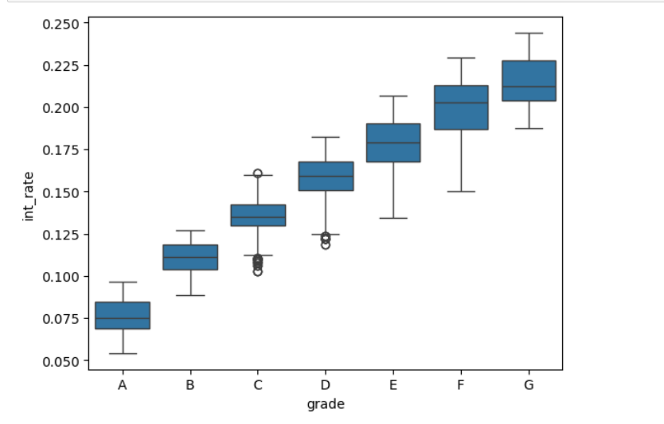
Bivariate Analysis
Observation
Grade A loans have lowest interest rates and grade G loans have highest interest rates
Conclusion
This trend is expected as Grade A applicants are of lowest risk and hence the interest rate is low

Slide 10
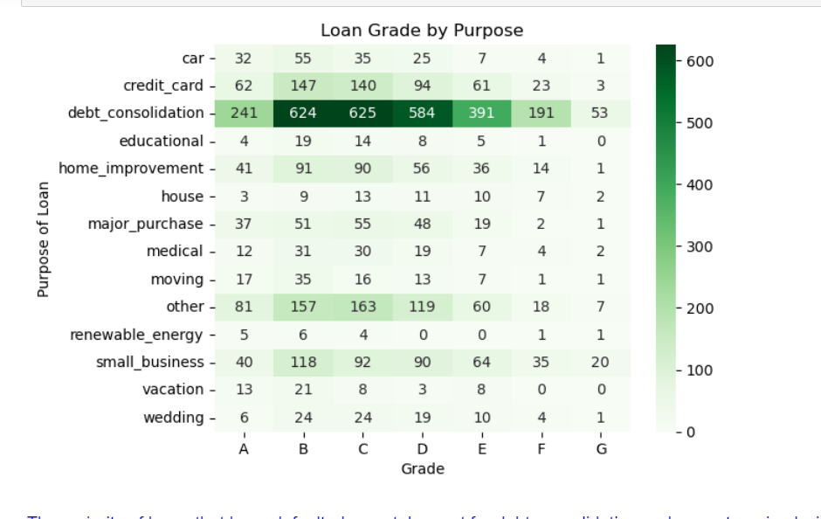
Bivariate Analysis
Observation
The majority of loans that have defaulted were taken out for debt consolidation and are categorized within the B, C, D, and E credit grades
Conclusion
The bank consider putting more checks on applicants with debt consolidation as loan purpose and belonging to B,C,D and E credit grades

Slide 11
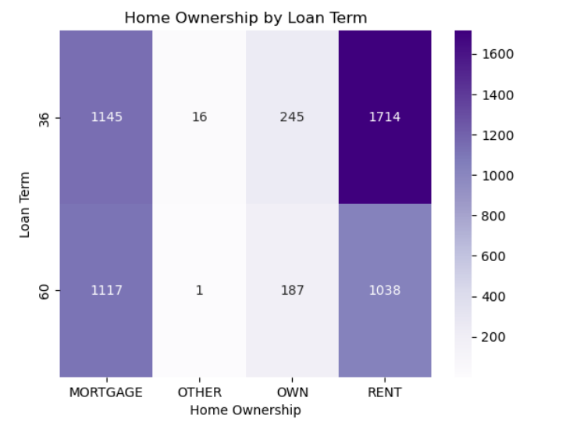
Bivariate Analysis
Observation
Renters tend to default more on shorter-term loans, while mortgage show a similar default rate across both short and long-term loans.
Conclusion
The bank consider putting more checks on applicants with rented house and looking for short term loan

Slide 12
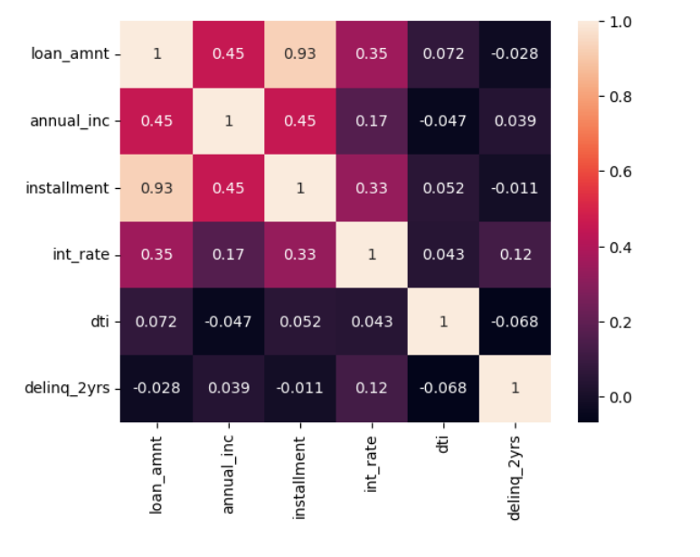
Multivariate Analysis
Observation
Annual Income & Loan Amount (0.45): There is a moderate positive correlation here. This indicates that borrowers with higher annual incomes tend to take out larger loan amounts, which could be due to their ability to afford larger repayments
Conclusion
The bank should not assume that higher loan amount can result in default loan

Slide 13
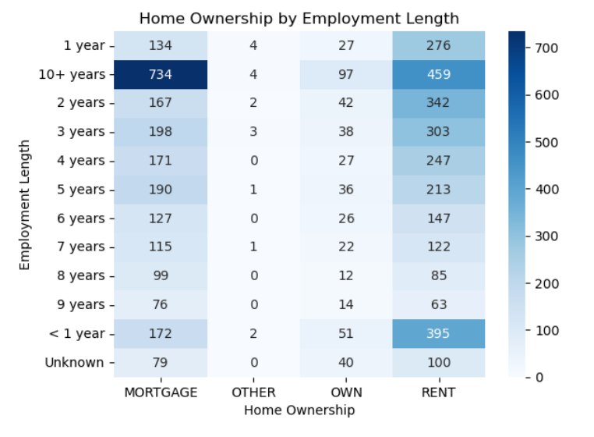
Bivariate Analysis
Observation
Individuals with an employment length of over 10 years predominantly live in rented homes or have mortgages, and they tend to have a higher default rate.
Conclusion
The bank should not assume experience in employment as the sole reason for loan application

