Slide 1
Fully Adaptive Decentralized MA-ABE: Simplified, Optimized, ASP Supported
Pratish Datta
NTT Research
Junichi Tomida
NTT Research
Nikhil Vanjani
Carnegie Mellon University
To appear at Asiacrypt 2025
Notes:
Section 0: 12:00 min.
Section 1: 29:00 min (17:00 min).
Section 2: 34:00 min (4:30 min).
Section 3: 59:00 min (25:00 min).
CMU crypto seminar times:
Section 0: 20:00 min (including discussion on ASP slide and questions)
Section 1: 37:00 min (based on estimate of 17:00 min)
Section 2: 42:00 min (based on estimate of 5:00 min)
Section 3: finished SD assumption slides by 50:00min. Skimmed over hybrids by 57:00 min. Finished talk by 62:00 min.

Slide 2






Attribute-based Encryption (ABE) [SW05, GPSW06]
Decrypt?
CS, Professor
✅
CMU
pk, msk
CS, Student
❌
msg
CS ^ Professor
ECE, Professor
❌
ECE, Student
❌
Notes:
Attribute-Based Encryption (ABE) [SW05,GPSW06] provides fine-grained access control over encrypted data by associating decryption privileges directly with user credentials (attributes).
In this scenario, consider that CMU holds the public key and master secret key of the system.
Anyone can encrypt a message in the system with respect to a ciphertext-policy, such as CS ^ Professor.
ABE enables authorized users possessing appropriate attributes to decrypt the message. For example, consider that there are four users who obtain keys for their respective attributes as shown.
Then, the first user can decrypt the ciphertext whereas others cannot.
Moreover, security should against colluduing users. For example, if users 2 and 3 collude, then, even though their joint attributes satisfy the policy, they should not be able to decrypt the ciphertext.
0:20

Slide 3


Centralized trust
CMU
pk, msk
Notes:
Now ABE as a primitive has seen a lot of success in both theoretical and applied cryptography.
But perhaps the biggest downside of ABE is the users of the system trust a central authority possessing a master secret key to issue attribute-based decryption key.This is a critical barrier to large-scale, real-world deployment. For instance, if someone steals the keys of the central authority, then no security is left in the system.
1:33

Slide 4




Decentralized Multi-Authority ABE [Cha07, LW11]
CS
Decrypt?
global params
pk, msk
Professor
CS, Professor
$$GID_{1}$$
✅
pk, msk
ECE
CS, Student
❌
$$GID_{2}$$
pk, msk
msg
ECE, Professor
❌
Student
$$GID_{3}$$
CS ^ Professor
pk, msk
ECE, Student
$$GID_{4}$$
❌
Notes:
Chase [Cha07] introduced the concept of Multi-Authority Attribute-Based Encryption (MA-ABE), which enables multiple independent authorities to concurrently manage disjoint sets of attributes.
Here, global setup algorithm is run once at the beginning to generate global public parameters. Using global params, each authority, such as CS, Profesor, ECE, Student can generate their authority keys. For sake of simplicity here, let’s assume that each authority controls one attribute each.
Encryption now requires public keys of all the attributes appearing in the policy.
Each authority issues secret keys to users for attributes under its individual control, without requiring coordination or interaction with other authorities. This is enabled by associating Global identifiers, or GIDs with each user.
Consequently, a user with GID1 holding attributes from multiple authorities for attributes CS and Professor can decrypt the ciphertext by seamlessly combining keys obtained from the relevant attribute authorities.
2:00

Slide 5
Ma-ABE security
CS
Decrypt?
global params
pk, msk
Professor
CS, Professor
$$GID_{1}$$
pk, msk
ECE
CS, Student
$$GID_{2}$$
pk, msk
❌
msg
ECE, Professor
Student
$$GID_{3}$$
CS ^ Professor
pk, msk
ECE, Student
$$GID_{4}$$
Notes:
Similar to standard ABE, Multi-Authority ABE naturally demands collusion resistance against unauthorized users
3:25

Slide 6
MA-ABE security
CS
Decrypt?
global params
pk, msk
Professor
CS, Professor
$$GID_{1}$$
pk, msk
ECE
CS, Student
$$GID_{2}$$
pk, msk
msg
ECE, Professor
Student
$$GID_{3}$$
CS ^ Professor
pk, msk
❌
ECE, Student
$$GID_{4}$$
Notes:
however, MA-ABE introduces an additional challenge: the possibility that some attribute authorities themselves may become corrupted and collude with malicious users. For example, the collusion of authorities Professor, ECE, Student and users with GID3 and 4 should still not be able to decrypt the ciphertext.
Addressing this critical security aspect, prior works have formalized various corruption models such as no corruption, static corruption, adaptive corruption.
3:35

Slide 7








Full Adaptive Security
global params
$$b∈\{0,1\}$$
$$AuthSetup(u) / KGen(u, GID) / Corrupt(u)$$
$$Enc(msg_{0}, msg_{1}, policy)$$
$${msg}_{b}$$
Admissibility:
For each GID,
issued keys + corrupt authorities do NOT satisfy the challenge
ciphertext-policy
$$policy$$
$$AuthSetup(u) / KGen(u, GID) / Corrupt(u)$$
$$b′$$
Adv wins if $b=b’$
Notes:
In this work, we consider full adaptive corruption security. Intuitively, this means the following. At the beginning of the game, the adversary obtains global params from the challenger.
After this, adversary can make following kinds of queries in arbitrary order: Authority Setup, Key Gen, Corruption and obtain respective responses immediately.
Then, it can make a challenge encryption query consisting of two messages msg0 and msg1 along with a challenge ciphertext-policy, and obtain a ciphertext encrypting msg_b, where b is the challenge bit.
After this, adversary can repeat queries like before, and eventually output a guess bit b’. Adv wins if b=b’, subject to the admissibility criteria:…
4:00

Slide 8
State-of-the-art in MA-ABE
(A ^ B) v (A ^ C)
Policy
Class
Decentralized?
Security
Attribute
reuse?
Proof Technique
[LW11a]
✅
static
corruption
❌
Simple (Dual System)
boolean span program (BSP)
[DKW23]
✅
full adaptive
❌
Complex (Dual System with dual sub-systems)
[CCG+23]
✅
full adaptive
✅
Notes:
Lewko and Waters proposed the first truly decentralized MA-ABE scheme and used dual system encryption techniques to prove security. But, they could only support static corruption of authorities. Given the inherently decentralized and dynamic nature of MA-ABE, such assumption seems overly restrictive and unrealistic.
Supporting adaptive corruptions remained a long-standing open-problem and after more than a decade, Datta, Komargodski and Waters made progress on this question and introduced the first fully adaptive MA-ABE scheme in 2023. Subsequent work of Chen et al showed how to support attribute-reuse in the policy. However, the proof technique in these works is quite complex and uses dual system with dual sub-systems. This results in an inefficient scheme compared to Lewko-Waters.

Slide 9
Central Questions
Can we design a fully adaptive decentralized
MA-ABE for BSP without two subsystems?
Can we design a decentralized MA-ABE
for an arithmetic model of computation?
1
2
Notes:
Thus, the central questions that we study in this work are as follows:
…
All works on MA-ABE so far are studied in a Boolean model of computation. A second question we ask is can we design a decentralized MA-ABE for an arithmetic model of computation?

Slide 10
Our Contributions
Fully Adaptive Decentralized MA-ABE for BSP
with Simpler Proof and Improved Efficiency
1
Lewko–Waters [LW11a] scheme with new security proof !!
✅ Conceptually simpler and tighter security analysis
✅ Efficiency gain in both computational and communication costs
Notes:
Our contributions are as follows.
First, we present a fully adaptive decentralized MA-ABE for BSP with simpler proof and improved efficiency.
In particular, we show that the celebrated construction of Lewko and Waters is in fact full adaptive secure, meaning it can handle adaptive corruptions. Towards this, we provide a new security proof, which is conceptually simpler than prior state-of-the-art and is a tighter security analysis.
A byproduct of this advancement is that our scheme achieves significant efficiency gains in both computation and communication costs.

Slide 11
Our Contributions
Decentralized MA-ABE for Arithmetic Span Program (ASP)
2
Construction and proof build upon our framework for BSP
✅ adaptive corruption of arbitrarily many user secret keys
🫤 adaptive corruption of authorities with restrictions
Fundamental barriers
Notes:
Our second contribution is the first decentralized MA-ABE scheme for Arithmetic Span Programs (ASPs).
The construction and proof build upon our framework for BSP.
We are able to support adaptive corruption of arbitrarily many user secret keys.
While we can handle adaptive corruption of authorities, this comes with some restrictions which arise due to what we perceive to be fundamental barriers for supporting ASP in the multi-authority setting.
8:00

Slide 12
Communication costs*
Scheme | Policy class | Attribute reuse? | |msk_{u}| | |pk_{u}| | |sk_{u, GID}| | |ct|
DKW23 | BSP | ❌ | 18 |Z_{q}| | 6 |G₁| | 6 |G₂| | 12n |G₁|
CCG+23 | BSP | ✅ | 18 |Z_{q}| | 6 |G₁| | 6 |G₂| | 12n |G₁|
This work | BSP | ❌ | 12 |Z_{q}| | 6 |G₁| | 2 |G₂| | 8n |G₁|
This work | BSP | ✅ | 12 |Z_{q}| | 6 |G₁| | 2 |G₂| | 8n |G₁|
This work | ASP | ❌ | 24 |Z_{q}| | 12 |G₁| | 2 |G₂| | 14n |G₁|
Size reduction
user secret key: 3x
ciphertext : 1.5x
* All instantiations from SXDH assumption on prime-order asymmetric pairing groups.
Notation. n: number of rows of BSP/ASP matrix

Slide 13
Computation costs*
Scheme | Policy class | Attribute reuse? | # exponetiations |  |  |  | # pairings
 |  |  | Auth Setup | KGen | Enc | Dec | Enc | Dec
DKW23 | BSP | ❌ | (18)₁ | (18)₂ | (6n+12ln+6l−3)₁ + (3)_{T} | (|S|)_{T} | 3 | 12 |S|
CCG+23 | BSP | ✅ | (18)₁ | (18)₂ | (18n)₁ + (6)_{T} | (|S|)_{T} | 3 | 12 |S|
This work | BSP | ❌ | (12)₁ | (7)₂ | (14n)₁ + (1)_{T} | (3 |S|)₁ + (|S|)_{T} | 0 | 6 |S|
This work | BSP | ✅ | (12)₁ | (7)₂ | (14n)₁ + (1)_{T} | (3 |S|)₁ + (|S|)_{T} | 0 | 6 |S|
This work | ASP | ❌ | (24)₁ | (7)₂ | (26n)₁ + (1)_{T} | (9 |S|)₁ + (|S|)_{T} | 0 | 6 |S|
2x fewer pairings
Time reduction
KGen: 2.6x
Enc : 1.3x
Dec : 1.7x
* All instantiations from SXDH assumption on prime-order asymmetric pairing groups.
Notation. n: number of rows of BSP/ASP matrix, l: number of columns, S: set of decryption attributes

Slide 14

1
Lewko-Waters MA-ABE for BSP
Limitations in supporting adaptive authority corruption
2
Our MA-ABE for BSP
3
Security Analysis
Notes:
Section 0: 12:00 min.
Section 1: 29:00 min (17:00 min).
Section 2: 34:00 min (4:30 min).
Section 3: 59:00 min (25:00 min).

Slide 15
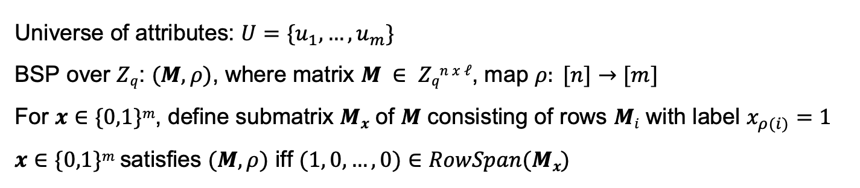
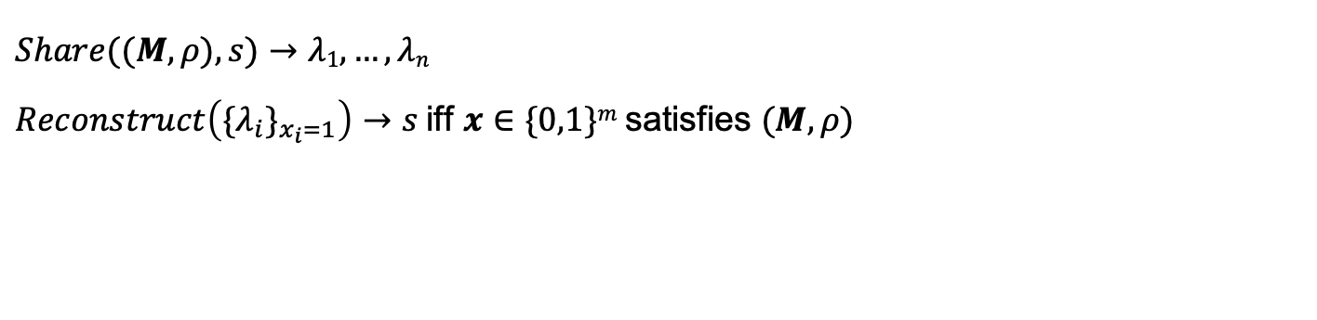
Boolean Span Program (BSP)
Universe of attributes: $U=\{u_{1}, …,u_{m}\}$ BSP over $Zq$: $(M, ρ)$, where matrix $M ∈ Zqn x ℓ$, map $ρ: [n]→[m]$ For $x∈\{0,1\}m$, define submatrix $Mx$ of $M$ consisting of rows $Mi$ with label $x_{ρ(i)}=1$ $x∈\{0,1\}m$satisfies $(M, ρ)$ iff $(1, 0, …, 0)∈RowSpan(Mx)$
Linear Secret Sharing Schemes (LSSS)
$$Share((M, ρ), s)→λ1, …, λn$$ $Reconstruct\left({\{λ}_{i}\}_{x_{i}=1}\right)→s$iff $x∈\{0,1\}m$satisfies $(M, ρ)$

Slide 16
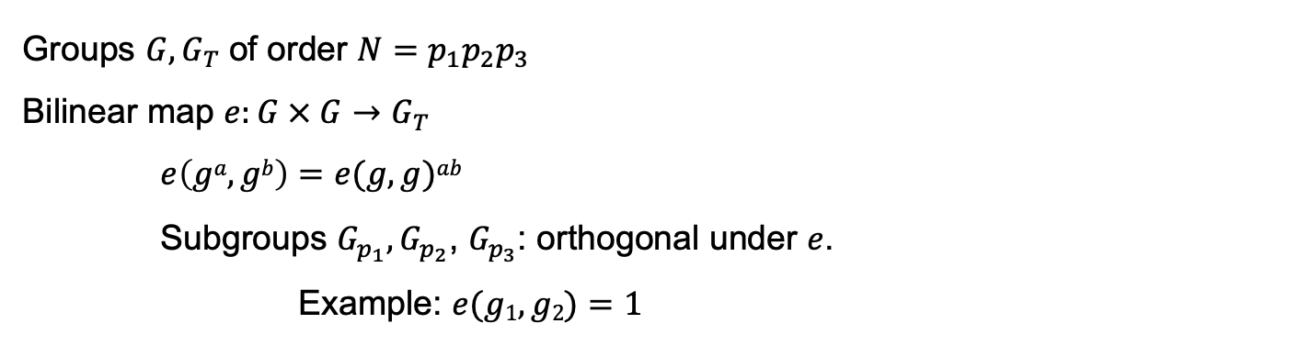
Composite-order pairing groups
Groups $G, G_{T}$of order $N=p_{1}p_{2}p_{3}$ Bilinear map $e:G × G→G_{T}$ $e\left(ga, gb\right)=e(g, g)ab$ Subgroups $G_{p_{1}},G_{p_{2}}$, $G_{p_{3}}$: orthogonal under $e$. Example: $e(g1, g2)=1$

Slide 17






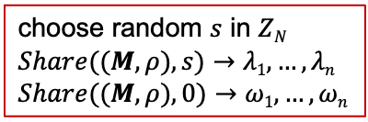

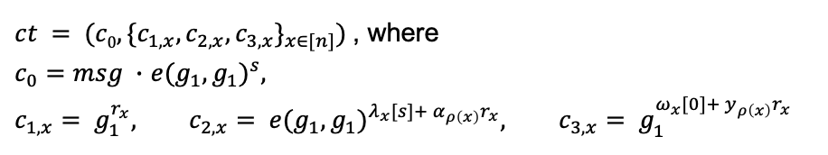
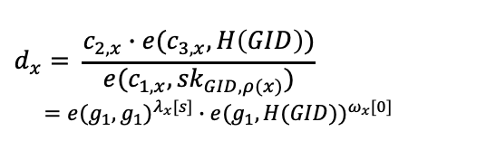




Lewko-Waters MA-ABE for BSP construction
$$msku=(αu, yu), pku=(e(g_{1}, g_{1})^{α_{u}}, g_{1}^{y_{u}})$$
$$GlobalSetup(1κ)$$
$$Dec(ct,\{sk_{GID,ρ(x)}\}_{ρ(x)∈S})$$
$$gp = (N=p1p2p3, G, G_{T}, e, g1, H: \{0,1\}^{∗}→G)$$
$$d_{x}= \frac{c_{2,x}∙e(c_{3,x}, H\left(GID\right))}{e(c_{1,x}, {sk}_{GID,ρ(x)})} \\ =e(g_{1}, g_{1})^{λ_{x}[s]}∙e(g_{1}, H(GID))^{ω_{x}[0]}$$
$$AuthSetup(gp, u)$$
choose random $αu, yu$in $ZN$
$$KGen(msk_{u}, GID)$$
$$Reconstruct$$
$$sk_{GID,u}=g_{1}^{α_{u}}H(GID)^{y_{u}}$$
$$d=e(g_{1}, g_{1})^{s}∙e(g_{1}, H(GID))^{0}$$
$$Enc((M∈Z_{N}^{n ×l}, ρ), msg∈G_{T})$$
choose random $s$ in $ZN$
$$Share((M, ρ), s)→λ1, …, λn$$
$$Share((M, ρ), 0)→ω1, …,ωn$$
$$msg=\frac{c_{0}}{d}$$
$ct = (c0, \{c_{1,x},c_{2,x}, c_{3,x}\}_{x∈[n]})$ , where
$c_{0}=msg ∙$ $e(g_{1}, g_{1})^{s}$,
$$c_{1,x}= g_{1}^{r_{x}}, c_{2,x}= e(g_{1}, g_{1})^{λ_{x}[s]+ α_{ρ\left(x\right)}r_{x}}, c_{3,x}= g_{1}^{ω_{x}[0]+ y_{ρ\left(x\right)}r_{x}}$$

Slide 18



Security Intuition
$$Dec(ct,\{sk_{GID,ρ(x)}\}_{ρ(x)∈S})$$
AND
$$λ_{A}+λ_{B}=s$$
$$ω_{A}+ω_{B}=0$$
$$d_{x}= \frac{c_{2,x}∙e(c_{3,x}, H\left(GID\right))}{e(c_{1,x}, {sk}_{GID,ρ(x)})} \\ =e(g_{1}, g_{1})^{λ_{x}[s]}∙e(g_{1}, H(GID))^{ω_{x}[0]}$$
A
B
GID’
GID
$$Reconstruct$$
$$e(g_{1}, g_{1})^{λ_{A}}∙e(g_{1}, H(GID))^{ω_{A}}$$
$$e(g_{1}, g_{1})^{λ_{B}}∙e(g_{1}, H(GID′))^{ω_{B}}$$
$$d=e(g_{1}, g_{1})^{s}∙e(g_{1}, H(GID))^{0}$$
Incompatible!
$$msg=\frac{c_{0}}{d}$$

Slide 19
Proof Technique: Dual System Encryption [W’09]
 | Normal user secret key | Semi-functional user secret key
Normal ciphertext | ✅ | ✅
Semi-functional ciphertext | ✅ | ❌

Slide 20
Proof Technique: Dual System Encryption [W’09]
 | Normal user secret key | Semi-functional user secret key
Normal ciphertext | ✅ | ✅
Semi-functional ciphertext | ✅ | ❌
Ciphertext
User secret keys
Last step: ciphertext encrypts random message

Slide 21
Limitation: Static Authority Corruption
Penultimate step: ciphertext, all user secret keys: semi-functional
Last step: ciphertext encrypts random message
Target-group-based computational assumption (DBDH variant)
Reduction embeds challenge in public keys of honest authorities

Slide 22
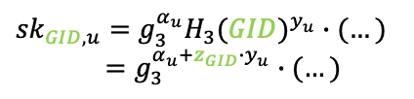
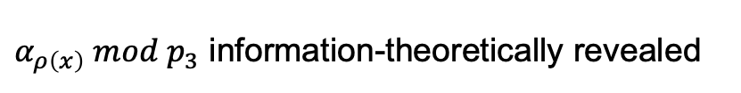



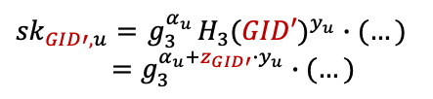
Towards Adaptive Authority Corruption
Penultimate step: ciphertext, all user secret keys: semi-functional
Last step: ciphertext encrypts random message
Make this transition information-theoretic
Want
Idea
Break correlation between $c_{0}$ and $c_{2,x}$ and use entropy of $s$ $mod p_{3}$
$c_{0}=msg ∙$ $e(g_{3}, g_{3})^{s}∙(…)$
$$c_{2,x}= e(g_{3}, g_{3})^{λ_{x}[s]+ α_{ρ\left(x\right)}r_{x}}∙(…)$$
How
Use entropy of $α_{ρ\left(x\right)}$ $mod p_{3}$ to modify $c_{2,x}$
$${sk}_{GID,u}=g_{3}^{α_{u}}H_{3}(GID)^{y_{u}}∙(…)$$
$$=g_{3}^{α_{u}+z_{GID}∙y_{u}}∙(…)$$
$α_{ρ\left(x\right)} mod p_{3}$ information-theoretically revealed
Problem
$${sk}_{GID′,u}={ g}_{3}^{α_{u}}H_{3}(GID′)^{y_{u}}∙(…)$$
$$=g_{3}^{α_{u}+z_{GID′}∙y_{u}}∙(…)$$

Slide 23

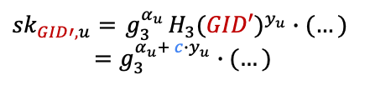
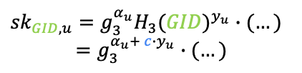
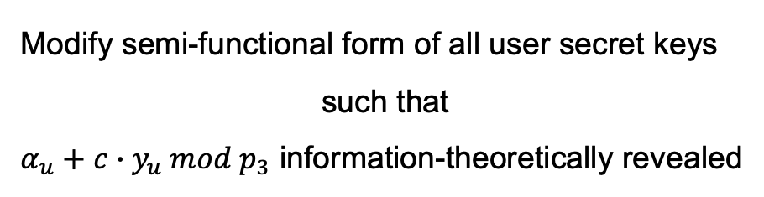
Towards Adaptive Authority Corruption
Penultimate step: ciphertext, all user secret keys: semi-functional
Last step: ciphertext encrypts random message
Make this transition information-theoretic
Want
Modify semi-functional form of all user secret keys
such that
$α_{u}+c∙y_{u} mod p_{3}$ information-theoretically revealed
Our Main Idea
$${sk}_{GID,u}=g_{3}^{α_{u}}H_{3}(GID)^{y_{u}}∙(…)$$
$$=g_{3}^{α_{u}+ c∙y_{u}}∙(…)$$
$${sk}_{GID′,u}={ g}_{3}^{α_{u}}H_{3}(GID′)^{y_{u}}∙(…)$$
$$=g_{3}^{α_{u}+ c∙y_{u}}∙(…)$$

Slide 24
1
Lewko-Waters MA-ABE for BSP
Limitations in supporting adaptive authority corruption
2
Our MA-ABE for BSP
3
Security Analysis
Notes:
Section 0: 12:00 min.
Section 1: 29:00 min (17:00 min).
Section 2: 34:00 min (4:30 min).
Section 3: 59:00 min (25 min).

Slide 25
Our MA-ABE for BSP construction: step 0 [LW11]
$$msku=(αu, yu), pku=(e(g_{1}, g_{1})^{α_{u}}, g_{1}^{y_{u}})$$
$$GlobalSetup(1κ)$$
$$Dec(ct,\{sk_{GID,ρ(x)}\}_{ρ(x)∈S})$$
$$gp = (N=p1p2p3, G, GT, e, g1, H: \{0,1\}^{∗}→G)$$
$$d_{x}= \frac{c_{2,x}∙e(c_{3,x}, H\left(GID\right))}{e(c_{1,x}, {sk}_{GID,ρ(x)})} \\ =e(g_{1}, g_{1})^{λ_{x}[s]}∙e(g_{1}, H(GID))^{ω_{x}[0]}$$
$$AuthSetup(gp, u)$$
choose random $αu, yu$in $ZN$
$$KGen(msk_{u}, GID)$$
$$Reconstruct$$
$$sk_{GID,u}=g_{1}^{α_{u}}H(GID)^{y_{u}}$$
$$d=e(g_{1}, g_{1})^{s}∙e(g_{1}, H(GID))^{0}$$
$$Enc((M∈Z_{N}^{n ×l}, ρ), msg∈G_{T})$$
choose random $s$ in $ZN$
$$Share((M, ρ), s)→λ1, …, λn$$
$$Share((M, ρ), 0)→ω1, …,ωn$$
$$msg=\frac{c_{0}}{d}$$
$ct = (c0, \{c_{1,x},c_{2,x}, c_{3,x}\}_{x∈[n]})$ , where
$c_{0}=msg ∙$ $e(g_{1}, g_{1})^{s}$,
$$c_{1,x}= g_{1}^{r_{x}}, c_{2,x}= e(g_{1}, g_{1})^{λ_{x}[s]+ α_{ρ\left(x\right)}r_{x}}, c_{3,x}= g_{1}^{ω_{x}[0]+ y_{ρ\left(x\right)}r_{x}}$$

Slide 26



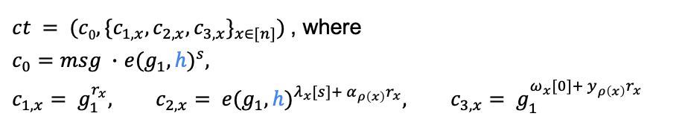
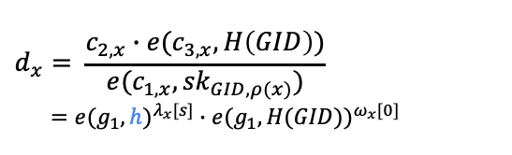
Our MA-ABE for BSP construction: step 1
$$msku=(αu, yu), pku=(e(g_{1}, h)^{α_{u}}, g_{1}^{y_{u}})$$
$$GlobalSetup(1κ)$$
$$Dec(ct,\{sk_{GID,ρ(x)}\}_{ρ(x)∈S})$$
$$gp = (N=p1p2p3, G, GT, e, g1, h, H: \{0,1\}^{∗}→G)$$
$$d_{x}= \frac{c_{2,x}∙e(c_{3,x}, H\left(GID\right))}{e(c_{1,x}, {sk}_{GID,ρ(x)})} \\ =e(g_{1}, h)^{λ_{x}[s]}∙e(g_{1}, H(GID))^{ω_{x}[0]}$$
$$AuthSetup(gp, u)$$
choose random $αu, yu$in $ZN$
$$KGen(msk_{u}, GID)$$
$$Reconstruct$$
$$sk_{GID,u}=h^{α_{u}}H(GID)^{y_{u}}$$
$$d=e(g_{1}, h)^{s}∙e(g_{1}, H(GID))^{0}$$
$$Enc((M∈Z_{N}^{n ×l}, ρ), msg∈G_{T})$$
choose random $s$ in $ZN$
$$Share((M, ρ), s)→λ1, …, λn$$
$$Share((M, ρ), 0)→ω1, …,ωn$$
$$msg=\frac{c_{0}}{d}$$
$ct = (c0, \{c_{1,x},c_{2,x}, c_{3,x}\}_{x∈[n]})$ , where
$c_{0}=msg ∙$ $e(g_{1}, h)^{s}$,
$$c_{1,x}= g_{1}^{r_{x}}, c_{2,x}= e(g_{1}, h)^{λ_{x}[s]+ α_{ρ\left(x\right)}r_{x}}, c_{3,x}= g_{1}^{ω_{x}[0]+ y_{ρ\left(x\right)}r_{x}}$$
Notes:
Since h belongs to G, it gives us more entropy

Slide 27



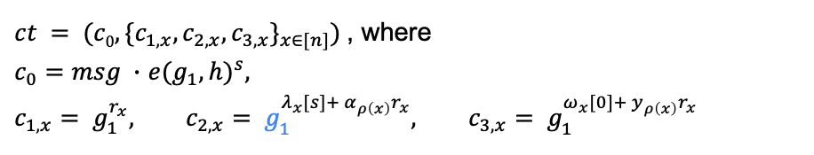
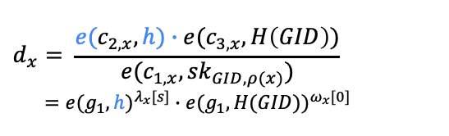
Our MA-ABE for BSP construction: step final
$$msku=(αu, yu), pku=(g_{1}^{α_{u}}, g_{1}^{y_{u}})$$
$$GlobalSetup(1κ)$$
$$Dec(ct,\{sk_{GID,ρ(x)}\}_{ρ(x)∈S})$$
$$gp = (N=p1p2p3, G, GT, e, g1, h, H: \{0,1\}^{∗}→G)$$
$$d_{x}= \frac{{e(c}_{2,x},h)∙e(c_{3,x}, H\left(GID\right))}{e(c_{1,x}, {sk}_{GID,ρ(x)})} \\ =e(g_{1}, h)^{λ_{x}[s]}∙e(g_{1}, H(GID))^{ω_{x}[0]}$$
$$AuthSetup(gp, u)$$
choose random $αu, yu$in $ZN$
$$KGen(msk_{u}, GID)$$
$$Reconstruct$$
$$sk_{GID,u}=h^{α_{u}}H(GID)^{y_{u}}$$
$$d=e(g_{1}, h)^{s}∙e(g_{1}, H(GID))^{0}$$
$$Enc((M∈Z_{N}^{n ×l}, ρ), msg∈G_{T})$$
choose random $s$ in $ZN$
$$Share((M, ρ), s)→λ1, …, λn$$
$$Share((M, ρ), 0)→ω1, …,ωn$$
$$msg=\frac{c_{0}}{d}$$
$ct = (c0, \{c_{1,x},c_{2,x}, c_{3,x}\}_{x∈[n]})$ , where
$c_{0}=msg ∙$ $e(g_{1}, h)^{s}$,
$$c_{1,x}= g_{1}^{r_{x}}, c_{2,x}= g_{1}^{λ_{x}[s]+ α_{ρ\left(x\right)}r_{x}}, c_{3,x}= g_{1}^{ω_{x}[0]+ y_{ρ\left(x\right)}r_{x}}$$
Notes:
since the only step in [LW11a] that relies on a target-group-based computational assumption is the final transition – which our proof replaces with information-theoretic transition – we no longer need to embed the secret shares of s in the target group

Slide 28
1
Lewko-Waters MA-ABE for BSP
Limitations in supporting adaptive authority corruption
2
Our MA-ABE for BSP
3
Security Analysis
Notes:
Section 0: 12:00 min.
Section 1: 29:00 min (17:00 min).
Section 2: 34:00 min (4:30 min).
Section 3: 59:00 min (25 min).

Slide 29

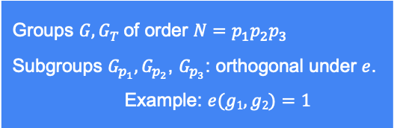
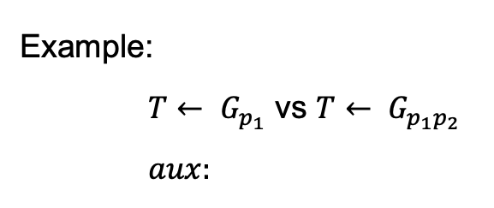
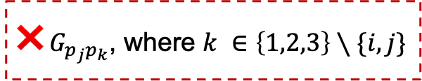

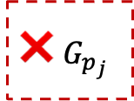


Subgroup Decision (SD) Assumption
Given $aux$, distinguish $T← G_{p_{i}}$ from $T← G_{p_{i}p_{j}}$, where $i,j ∈\{1,2,3\}$ and $i≠j$
Groups $G, G_{T}$of order $N=p_{1}p_{2}p_{3}$ Subgroups $G_{p_{1}},G_{p_{2}}$, $G_{p_{3}}$: orthogonal under $e$. Example: $e(g1, g2)=1$
❌ $G_{p_{j}}$
❌$G_{p_{j}p_{k}}$, where $k ∈\left\{1,2,3\right\}∖\{i,j\}$
Example:
$T← G_{p_{1}}$ vs $T← G_{p_{1}p_{2}}$
$aux:$
$$g_{1}$$
$$g_{3}$$
$$X_{1}X_{2}$$
$$X_{2}X_{3}$$

Slide 30

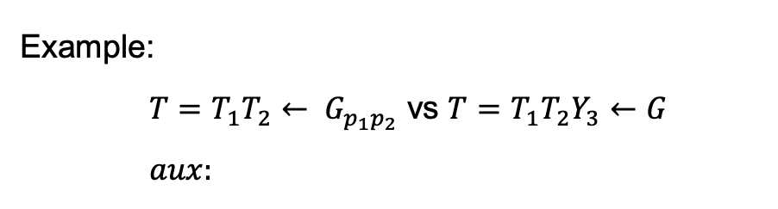
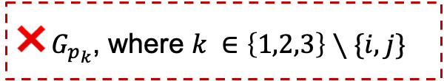


Subgroup Decision (SD) Assumption
Given $aux$, distinguish $T← G_{p_{i}p_{j}}$ from $T←G$, where $i,j ∈\{1,2,3\}$ and $i≠j$
Groups $G, G_{T}$of order $N=p_{1}p_{2}p_{3}$ Subgroups $G_{p_{1}},G_{p_{2}}$, $G_{p_{3}}$: orthogonal under $e$. Example: $e(g1, g2)=1$
❌$G_{p_{k}}$, where $k ∈\left\{1,2,3\right\}∖\{i,j\}$
Example:
$T=T_{1}T_{2}← G_{p_{1}p_{2}}$ vs $T=T_{1}T_{2}Y_{3}←G$
$aux:$
$$g_{1}$$
$$g_{2}$$
$$X_{1}X_{3}$$
$$Z_{2}Z_{3}$$

Slide 31





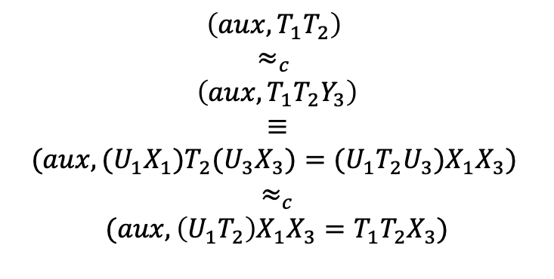


Our new Subgroup Decision (SD) Assumption
Given $aux$, distinguish $T=T_{1}T_{2}← G_{p_{1}p_{2}}$from$T=T_{1}T_{2}X_{3}←G$
$aux:$
$$g_{1}$$
$$g_{2}$$
$$X_{1}X_{3}$$
$$Z_{2}Z_{3}$$
Groups $G, G_{T}$of order $N=p_{1}p_{2}p_{3}$ Subgroups $G_{p_{1}},G_{p_{2}}$, $G_{p_{3}}$: orthogonal under $e$. Example: $e(g1, g2)=1$
Proof:
$$\left(aux, T_{1}T_{2}\right)$$
$$≈_{c}$$
$$\left(aux, T_{1}T_{2}Y_{3}\right)$$
$≡$
$$(aux, {{(U}_{1}X}_{1})T_{2}{(U_{3}X}_{3})=(U_{1}T_{2}U_{3})X_{1}X_{3})$$
$$≈_{c}$$
$$(aux, {\left(U_{1}T_{2}\right)X_{1}X_{3}=T}_{1}T_{2}X_{3})$$
$$SD$$
$$SD$$

Slide 32





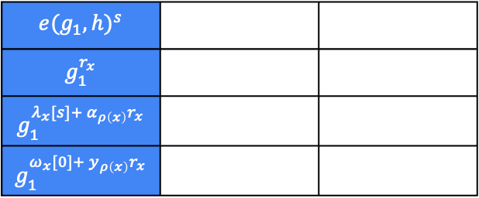



Hybrids
$Hyb0$ :
$$c0$$
$$e(g_{1}, h)^{s}$$
$$g_{1}^{r_{x}}$$
$$g_{1}^{λ_{x}[s]+ α_{ρ\left(x\right)}r_{x}}$$
$$g_{1}^{ω_{x}[0]+ y_{ρ\left(x\right)}r_{x}}$$
$$h^{α_{u}}$$
$$∙$$
$$c_{1,x}$$
$$H(GID)^{y_{u}}=h^{{z_{GID}∙y}_{u}}$$
$$c_{2,x}$$
$$sk_{GID,u}$$
$$c_{3,x}$$

Slide 33

Hybrids
$Hyb0$ :
$$c0$$
$$e(g_{1}, h)^{s}$$
$$g_{1}^{r_{x}}$$
$$g_{1}^{λ_{x}[s]+ α_{ρ\left(x\right)}r_{x}}$$
$$g_{1}^{ω_{x}[0]+ y_{ρ\left(x\right)}r_{x}}$$
$$H(GID)^{y_{u}}=h^{{z_{GID}∙y}_{u}}$$
$$c_{1,x}$$
$$sk_{GID,u}$$
$$c_{2,x}$$
$$c_{3,x}$$

Slide 34
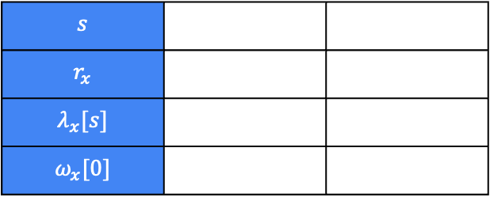

Hybrids
$Hyb0$ :
$$c0$$
$$s$$
$$r_{x}$$
$$λ_{x}[s]$$
$$ω_{x}[0]$$
$${z_{GID}∙y}_{u}$$
$$c_{1,x}$$
$$sk_{GID,u}$$
$$c_{2,x}$$
$$c_{3,x}$$

Slide 35








Hybrids
$$0→1→2→3→4→5→6→7$$
$Hyb0$ :
$$c0$$
$$s$$
$$r_{x}$$
$$λ_{x}[s]$$
$$ω_{x}[0]$$
$${z_{GID}∙y}_{u}$$
$$c_{1,x}$$
$$sk_{GID,u}$$
$$c_{2,x}$$
$$c_{3,x}$$
$Hyb1$ :
✅
$${z_{GID, 1}∙y}_{u}$$
$$sk_{GID,u}$$
$${SD: G →G}_{p_{1}}$$
❌ $G_{p_{2}}$
❌ $G_{p_{3}}$
❌$G_{p_{2}p_{3}}$
$Hyb_{0} ≈_{c} Hyb_{1}$ if:

Slide 36




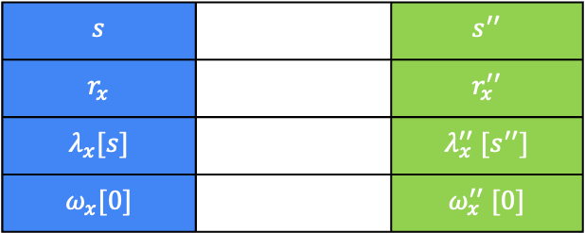








Hybrids
$$0→1→2→3→4→5→6→7$$
$Hyb1$ :
$$c0$$
$$s$$
$$r_{x}$$
$$λ_{x}[s]$$
$$ω_{x}[0]$$
$${z_{GID, 1}∙y}_{u}$$
$$c_{1,x}$$
$$sk_{GID,u}$$
$$c_{2,x}$$
$$c_{3,x}$$
$Hyb2$ :
$$c0$$
$$s$$ |  | $$s^{′′}$$
$$r_{x}$$ |  | $$r_{x}^{′′}$$
$$λ_{x}[s]$$ |  | $$λ_{x}^{′′} [s^{′′}]$$
$$ω_{x}[0]$$ |  | $$ω_{x}^{′′} [0]$$
✅
$$c_{1,x}$$
$$c_{2,x}$$
$$c_{3,x}$$
${SD: G}_{p_{1}}→ G_{p_{1}p_{3}}$
❌ $G_{p_{3}}$
❌$G_{p_{2}p_{3}}$
$Hyb_{1} ≈_{c} Hyb_{2}$ if:

Slide 37





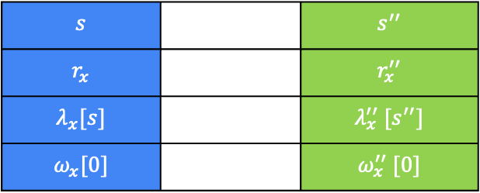
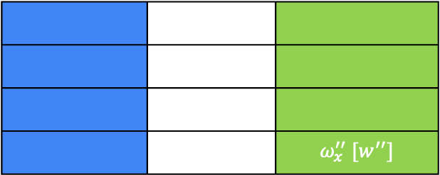
Hybrids
$$0→1→2→3→4→5→6→7$$
$Hyb2$ :
$$c0$$
$$s$$ |  | $$s^{′′}$$
$$r_{x}$$ |  | $$r_{x}^{′′}$$
$$λ_{x}[s]$$ |  | $$λ_{x}^{′′} [s^{′′}]$$
$$ω_{x}[0]$$ |  | $$ω_{x}^{′′} [0]$$
$${h_{GID, 1}∙y}_{u}$$
$$c_{1,x}$$
$$sk_{GID,u}$$
$$c_{2,x}$$
$$c_{3,x}$$
$Hyb3$ :
$$c0$$
 |  | $$ω_{x}^{′′} [w^{′′}]$$
✅
✅
✅
$$c_{1,x}$$
✅
✅
$$c_{2,x}$$
✅
✅
$$c_{3,x}$$
✅
$Hyb_{2} ≡Hyb_{3}$ since corrupts rows unauthorized to decrypt and
$y_{ρ\left(x\right)} mod p_{3}$ information-theoretically hidden

Slide 38
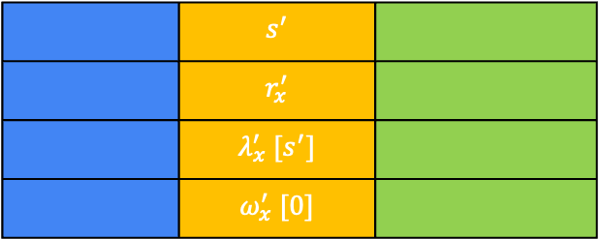





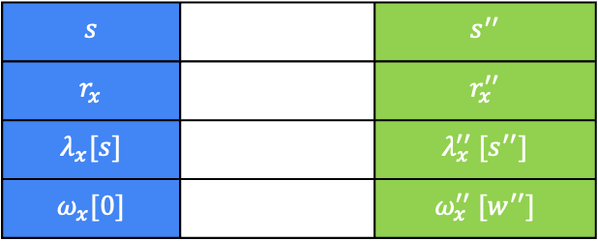

Hybrids
$$0→1→2→3→4→5→6→7$$
$Hyb3$ :
$$c0$$
$$s$$ |  | $$s^{′′}$$
$$r_{x}$$ |  | $$r_{x}^{′′}$$
$$λ_{x}[s]$$ |  | $$λ_{x}^{′′} [s^{′′}]$$
$$ω_{x}[0]$$ |  | $$ω_{x}^{′′} [w^{′′}]$$
$${h_{GID, 1}∙y}_{u}$$
$$c_{1,x}$$
$$sk_{GID,u}$$
$$c_{2,x}$$
$$c_{3,x}$$
$Hyb4$ :
$$c0$$
 | $$s^{′}$$
 | $$r_{x}^{′}$$
 | $$λ_{x}^{′} [s^{′}]$$
 | $$ω_{x}^{′} [0]$$
✅
✅
✅
$$c_{1,x}$$
✅
✅
$$c_{2,x}$$
✅
✅
$$c_{3,x}$$
✅
✅
${SD: G}_{p_{1}}→ G_{p_{1}p_{2}}$
❌ $G_{p_{2}}$
❌$G_{p_{2}p_{3}}$
$Hyb_{3} ≈_{c} Hyb_{4}$ if:

Slide 39












Hybrids
$$0→1→2→3→4→5→6→7$$
$Hyb0$ :
$$c0$$
$$s$$
$$r_{x}$$
$$λ_{x}[s]$$
$$ω_{x}[0]$$
$${z_{GID}∙y}_{u}$$
$$c_{1,x}$$
$$sk_{GID,u}$$
$$c_{2,x}$$
$$c_{3,x}$$
$Hyb_{4}$ :
$$c0$$
$$s$$ | $$s^{′}$$ | $$s^{′′}$$
$$r_{x}$$ | $$r_{x}^{′}$$ | $$r_{x}^{′′}$$
$$λ_{x}[s]$$ | $$λ_{x}^{′} [s^{′}]$$ | $$λ_{x}^{′′} [s^{′′}]$$
$$ω_{x}[0]$$ | $$ω_{x}^{′} [0]$$ | $$ω_{x}^{′′} [w^{′′}]$$
$${h_{GID, 1}∙y}_{u}$$
$$c_{1,x}$$
$$sk_{GID,u}$$
$$c_{2,x}$$
$$c_{3,x}$$
${SD: G}_{p_{1}}→ G_{p_{1}p_{2}}$
❌ $G_{p_{2}}$, ❌$G_{p_{2}p_{3}}$
$${SD: G →G}_{p_{1}}$$
❌ $G_{p_{2}}$, ❌ $G_{p_{3}}$, ❌$G_{p_{2}p_{3}}$
$Hyb_{0} ≈_{c} Hyb_{4}$ if:
${SD: G}_{p_{1}}→ G_{p_{1}p_{3}}$
❌ $G_{p_{3}},$❌$G_{p_{2}p_{3}}$

Slide 40







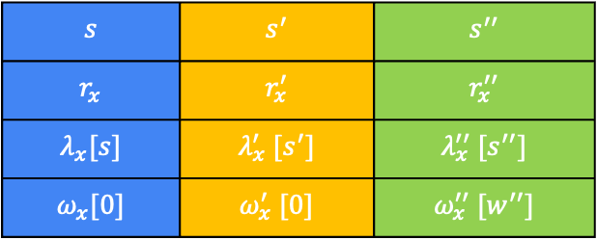
Hybrids
$$0→1→2→3→4→5→6→7$$
$Hyb4$ :
$$c0$$
$$s$$ | $$s^{′}$$ | $$s^{′′}$$
$$r_{x}$$ | $$r_{x}^{′}$$ | $$r_{x}^{′′}$$
$$λ_{x}[s]$$ | $$λ_{x}^{′} [s^{′}]$$ | $$λ_{x}^{′′} [s^{′′}]$$
$$ω_{x}[0]$$ | $$ω_{x}^{′} [0]$$ | $$ω_{x}^{′′} [w^{′′}]$$
$${h_{GID, 1}∙y}_{u}$$
$$c_{1,x}$$
$$sk_{GID,u}$$
$$c_{2,x}$$
$$c_{3,x}$$
$Hyb5$ :
$${h_{GID, 1}∙y}_{u}$$ |  | $${c∙y}_{u}$$
✅
${SD: G}_{p_{1}}→ G_{p_{1}p_{2}}$
❌ $G_{p_{2}}$
❌$G_{p_{2}p_{3}}$
$$SD:G_{p_{1}p_{2}}→G$$
❌ $G_{p_{3}}$
$Hyb_{4} ≈_{c} Hyb_{5}$ if:

Slide 41
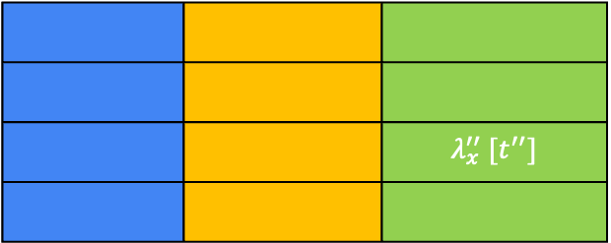




Hybrids
$$0→1→2→3→4→5→6→7$$
$Hyb5$ :
$$c0$$
$$s$$ | $$s^{′}$$ | $$s^{′′}$$
$$r_{x}$$ | $$r_{x}^{′}$$ | $$r_{x}^{′′}$$
$$λ_{x}[s]$$ | $$λ_{x}^{′} [s^{′}]$$ | $$λ_{x}^{′′} [s^{′′}]$$
$$ω_{x}[0]$$ | $$ω_{x}^{′} [0]$$ | $$ω_{x}^{′′} [w^{′′}]$$
$${h_{GID, 1}∙y}_{u}$$ |  | $${c∙y}_{u}$$
$$c_{1,x}$$
$$sk_{GID,u}$$
$$c_{2,x}$$
$$c_{3,x}$$
$Hyb6$ :
$$c0$$
 |  | $$λ_{x}^{′′} [t^{′′}]$$
✅
✅
✅
✅
$$c_{1,x}$$
✅
✅
✅
$$c_{2,x}$$
✅
✅
$$c_{3,x}$$
✅
✅
✅
$Hyb_{5} ≡Hyb_{6}$ since corrupts rows unauthorized to decrypt and the structure of user secret keys

Slide 42
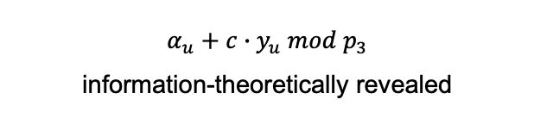

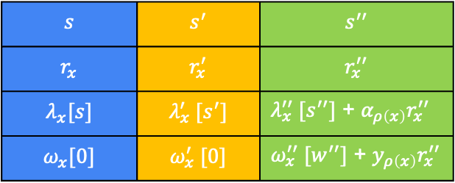
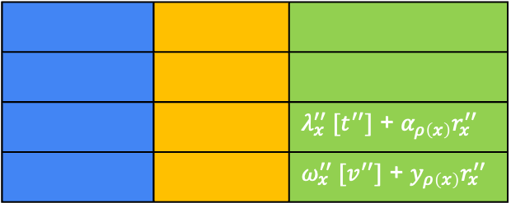
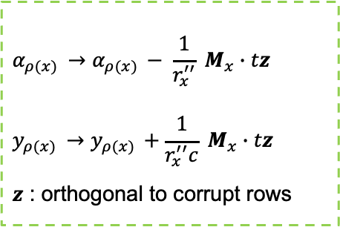
Hybrids
$$0→1→2→3→4→5→6→7$$
$$α_{u}$$
$$+$$
$Hyb5$ :
$$c0$$
$$s$$ | $$s^{′}$$ | $$s^{′′}$$
$$r_{x}$$ | $$r_{x}^{′}$$ | $$r_{x}^{′′}$$
$$λ_{x}[s]$$ | $$λ_{x}^{′} [s^{′}]$$ | $λ_{x}^{′′} [s^{′′}]$ + $α_{ρ\left(x\right)}r_{x}^{′′}$
$$ω_{x}[0]$$ | $$ω_{x}^{′} [0]$$ | $ω_{x}^{′′} [w^{′′}]$ + $y_{ρ\left(x\right)}r_{x}^{′′}$
$${h_{GID, 1}∙y}_{u}$$ |  | $${c∙y}_{u}$$
$$c_{1,x}$$
$$sk_{GID,u}$$
$$c_{2,x}$$
$α_{u}+c∙y_{u} mod p_{3}$
information-theoretically revealed
$$c_{3,x}$$
$Hyb6$ :
$$c0$$
 |  | $λ_{x}^{′′} [t^{′′}]$ + $α_{ρ\left(x\right)}r_{x}^{′′}$
 |  | $ω_{x}^{′′} [v^{′′}]$ + $y_{ρ\left(x\right)}r_{x}^{′′}$
✅
✅
✅
$$α_{ρ(x) }→α_{ρ(x) }− \frac{1}{r_{x}^{′′}} M_{x}∙tz$$
$$y_{ρ(x) }→y_{ρ(x) }+\frac{1}{r_{x}^{′′}c} M_{x}∙tz$$
$z$ : orthogonal to corrupt rows
$$c_{1,x}$$
✅
✅
✅
$$c_{2,x}$$
✅
✅
$$c_{3,x}$$
✅
✅
$Hyb_{5} ≡Hyb_{6}$ since corrupts rows unauthorized to decrypt and the structure of user secret keys

Slide 43





Hybrids
$$0→1→2→3→4→5→6→7$$
$Hyb6$ :
$$c0$$
$$s$$ | $$s^{′}$$ | $$s^{′′}$$
$$r_{x}$$ | $$r_{x}^{′}$$ | $$r_{x}^{′′}$$
$$λ_{x}[s]$$ | $$λ_{x}^{′} [s^{′}]$$ | $$λ_{x}^{′′} [t^{′′}]$$
$$ω_{x}[0]$$ | $$ω_{x}^{′} [0]$$ | $$ω_{x}^{′′} [w^{′′}]$$
$${h_{GID, 1}∙y}_{u}$$ |  | $${c∙y}_{u}$$
$$c_{1,x}$$
$$sk_{GID,u}$$
$$c_{2,x}$$
$$c_{3,x}$$
$Hyb7$ :
$c0$ encodes uniform random message
$Hyb_{6} ≡Hyb_{7}$ using entropy of $s^{′′} mod p_{3}$ since it is information-theoretically hidden

Slide 44
Also in the paper
MA-ABE for BSP
Inner hybrids of security proof
Asymmetric prime-order bilinear group construction
Extension to attribute-reuse
MA-ABE for ASP

Slide 45
Open Questions
MA-ABE for ASP with full adaptive security
Large-universe MA-ABE from standard assumptions
Thank You!
nvanjani@cmu.edu
Eprint: soon
To appear at Asiacrypt 2025
Notes:
Section 0: 12:00 min.
Section 1: 29:00 min (17:00 min).
Section 2: 34:00 min (4:30 min).
Section 3: 59:00 min (25 min).

Slide 47
Roadmap
Lewko-Waters MA-ABE for BSP construction
Limitations in supporting adaptive authority corruption
Our MA-ABE for BSP construction
Security Analysis
Our MA-ABE for ASP construction
Notes:
20mins for section 3.

Slide 48
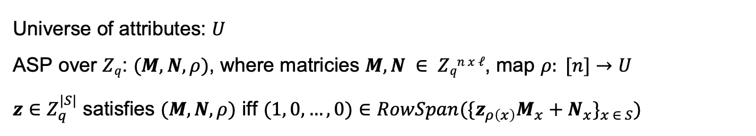
Arithmetic Span Program (ASP)
Universe of attributes: $U$ ASP over $Zq$: $(M,N, ρ)$, where matricies $M, N ∈ Zqn x ℓ$, map $ρ: [n]→U$ $z∈Z_{q}^{|S|}$ satisfies $(M, N, ρ)$ iff $(1, 0, …, 0)∈RowSpan(\{z_{ρ\left(x\right)}M_{x}+N_{x}\}_{x ∈ S})$

Slide 49

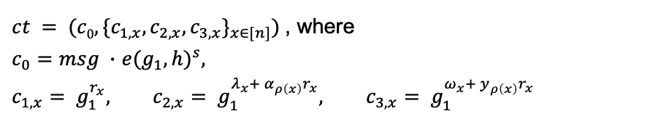

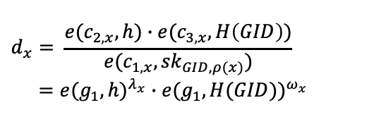
Our MA-ABE for ASP construction
$$msku=(αu, yu), pku=(g_{1}^{α_{u}}, g_{1}^{y_{u}})$$
$$GlobalSetup(1κ)$$
$$Dec(ct,\{sk_{GID,ρ(x)}\}_{ρ(x)∈S})$$
$$gp = (N=p1p2p3, G, GT, e, g1, h, H: \{0,1\}^{∗}→G)$$
$$d_{x}= \frac{{e(c}_{2,x},h)∙e(c_{3,x}, H\left(GID\right))}{e(c_{1,x}, {sk}_{GID,ρ(x)})} \\ =e(g_{1}, h)^{λ_{x}}∙e(g_{1}, H(GID))^{ω_{x}}$$
$$AuthSetup(gp, u)$$
choose random $αu, yu$in $ZN$
$$KGen(msk_{u}, GID)$$
$$Reconstruct$$
$$sk_{GID,u}=h^{α_{u}}H(GID)^{y_{u}}$$
$$d=e(g_{1}, h)^{s}∙e(g_{1}, H(GID))^{0}$$
$$Enc((M, ρ), msg∈G_{T})$$
choose random $s$ in $ZN$
$$Share((M, ρ), s)→λ1, …, λn$$
$$Share((M, ρ), 0)→ω1, …,ωn$$
$$msg=\frac{c_{0}}{d}$$
$ct = (c0, \{c_{1,x},c_{2,x}, c_{3,x}\}_{x∈[n]})$ , where
$c_{0}=msg ∙$ $e(g_{1}, h)^{s}$,
$$c_{1,x}= g_{1}^{r_{x}}, c_{2,x}= g_{1}^{λ_{x}+ α_{ρ\left(x\right)}r_{x}}, c_{3,x}= g_{1}^{ω_{x}+ y_{ρ\left(x\right)}r_{x}}$$
Notes:
since the only step in [LW11a] that relies on a target-group-based computational assumption is the final transition – which our proof replaces with information-theoretic transition – we no longer need to embed the secret shares of s in the target group

Slide 50





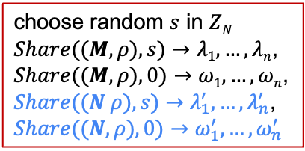


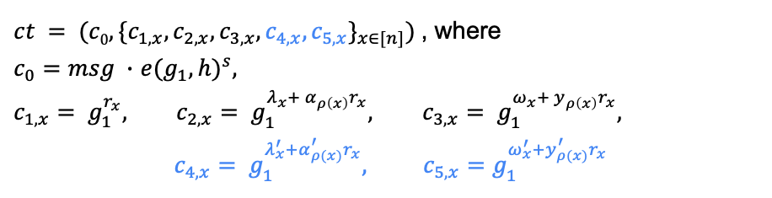

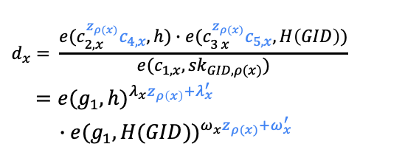
Our MA-ABE for ASP construction
$$msku=({α_{u}, y_{u},α}_{u}^{′}, y_{u}^{′}), pku=(g_{1}^{α_{u}}, g_{1}^{y_{u}}, g_{1}^{α_{u}^{′}}, g_{1}^{y_{u}^{′}})$$
$$GlobalSetup(1κ)$$
$$Dec(ct,\{z_{ρ\left(x\right)}, sk_{GID,ρ(x)}\}_{ρ(x)∈S})$$
$$gp = (N=p1p2p3, G, GT, e, g1, h, H: \{0,1\}^{∗}→G)$$
$$d_{x}= \frac{e(c_{2, x}^{z_{ρ(x)}}c_{4,x},h)∙e(c_{3 x}^{z_{ρ(x)}}c_{5,x}, H\left(GID\right))}{e(c_{1,x}, {sk}_{GID,ρ(x)})}$$
$$=e(g_{1}, h)^{λ_{x}z_{ρ\left(x\right)}+λ_{x}^{′}}$$
$$∙e(g_{1}, H(GID))^{ω_{x}z_{ρ(x)}+ω_{x}^{′}}$$
$$AuthSetup(gp, u)$$
choose random ${α_{u}, y_{u},α}_{u}^{′}, y_{u}^{′}$in $ZN$
$$KGen(msk_{u}, GID, z_{u})$$
choose random $s$ in $ZN$
$Share((M, ρ), s)→λ1, …, λn$,
$Share((M, ρ), 0)→ω1, …,ωn$,
$Share((N ρ), s)→λ_{1}^{′}, …,λ_{n}^{′}$,
$$Share((N, ρ), 0)→ω_{1}^{′}, …,ω_{n}^{′}$$
$$sk_{GID,u}=h^{α_{u}z_{u}+α_{u}^{′}}H(GID)^{y_{u}z_{u}+y_{u}^{′}}$$
$$Reconstruct$$
$$Enc((M, N, ρ), msg∈G_{T})$$
$$d=e(g_{1}, h)^{s}∙e(g_{1}, H(GID))^{0}$$
$ct = (c0, \{c_{1,x},c_{2,x}, c_{3,x},c_{4,x}, c_{5,x}\}_{x∈[n]})$ , where
$c_{0}=msg ∙$ $e(g_{1}, h)^{s}$,
$$c_{1,x}= g_{1}^{r_{x}}, c_{2,x}= g_{1}^{λ_{x}+ α_{ρ\left(x\right)}r_{x}}, c_{3,x}= g_{1}^{ω_{x}+ y_{ρ\left(x\right)}r_{x}},$$
$c_{4,x}= g_{1}^{λ_{x}^{′}+α_{ρ(x)}^{′}r_{x}}, c_{5,x}=g_{1}^{ω_{x}^{′}+y_{ρ(x)}^{′}r_{x}}$
$$msg=\frac{c_{0}}{d}$$
Notes:
since the only step in [LW11a] that relies on a target-group-based computational assumption is the final transition – which our proof replaces with information-theoretic transition – we no longer need to embed the secret shares of s in the target group

Slide 51
State-of-the-art in MA-ABE
Policy
Class
Decentralized?
Security
Attribute
reuse?
Proof Technique
[LW11a]
✅
static
corruption
❌
Simple (Dual System)
boolean span program (BSP)
[DKW23]
✅
full adaptive
❌
Complex (Dual System with dual sub-systems)
[CCG+23]
✅
full adaptive
✅
poly-depth monotone boolean circuits
[GGL24]
✅
bounded collusion
?
?
[CLW25]
✅
?
?
Notes:
Lewko and Waters proposed the first truly decentralized MA-ABE scheme and used dual system encryption techniques to prove security. But, they could only support static corruption of authorities. Given the inherently decentralized and dynamic nature of MA-ABE, such assumption seems overly restrictive and unrealistic.
Supporting adaptive corruptions remained a long-standing open-problem and after more than a decade, Datta, Komargodski and Waters made progress on this question and introduced the first fully adaptive MA-ABE scheme in 2023. Subsequent work of Chen et al showed how to support attribute-reuse in the policy. However, the proof technique in these works is quite complex and uses dual system with dual sub-systems. This results in an inefficient scheme compared to Lewko-Waters.

Slide 52
Our Contributions
Decentralized MA-ABE for Arithmetic Span Program (ASP)
2
Construction and proof build upon our framework for BSP
✅ adaptive corruption of arbitrarily many user secret keys
no authority appearing in ciphertext-policy is corrupted
OR
decryption requires keys from all authorities appearing in a ciphertext
AND
no authority appearing in ciphertext-policy is corrupted
OR
for each GID queried, there exists an honest authority appearing in
ciphertext-policy who did not issue any secret key
❌

Slide 53
Comparison
Policy
Class
Decentralized?
Security
Attribute
reuse?
Proof Technique
[LW11a]
✅
static
corruption
❌
Simple (Dual System)
boolean span program (BSP)
[DKW23]
✅
full adaptive
❌
Complex (Dual System with dual sub-systems)
[CCG+23]
✅
full adaptive
✅
This work
✅
full adaptive
✅
Simple (Dual System)
arithmetic span program (ASP)
This work
✅
full adaptive
❌
Simple (Dual System)

Slide 54

Hybrids
$Hyb0$ :
$$c0$$
$$e(g_{1}, h)^{s}$$
$$g_{1}^{r_{x}}$$
$$g_{1}^{λ_{x}[s]+ α_{ρ\left(x\right)}r_{x}}$$
$$g_{1}^{ω_{x}[0]+ y_{ρ\left(x\right)}r_{x}}$$
$$h^{α_{u}}$$
$$∙$$
$$c_{1,x}$$
$$H(GID)^{y_{u}}$$
$$c_{2,x}$$
$$sk_{GID,u}$$
$$c_{3,x}$$

Slide 55


Hybrids
$Hyb0$ :
$$c0$$
$$e(g_{1}, h)^{s}$$
$$g_{1}^{r_{x}}$$
$$g_{1}^{λ_{x}[s]+ α_{ρ\left(x\right)}r_{x}}$$
$$g_{1}^{ω_{x}[0]+ y_{ρ\left(x\right)}r_{x}}$$
$$H(GID)^{y_{u}}$$
$$c_{1,x}$$
$$sk_{GID,u}$$
$$c_{2,x}$$
$$c_{3,x}$$
$Hyb1$ :
✅
$$H_{1}(GID)^{y_{u}}$$
$$sk_{GID,u}$$
$${SD: G →G}_{p_{1}}$$
❌ $G_{p_{2}}$
❌ $G_{p_{3}}$
❌$G_{p_{2}p_{3}}$
$Hyb_{0} ≈_{c} Hyb_{1}$ if:

Slide 56
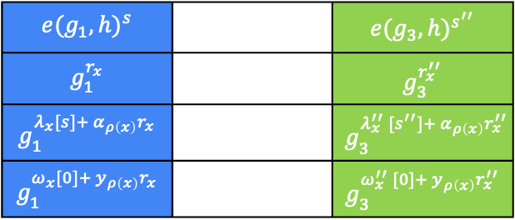

Hybrids
$Hyb1$ :
$$c0$$
$$e(g_{1}, h)^{s}$$
$$g_{1}^{r_{x}}$$
$$g_{1}^{λ_{x}[s]+ α_{ρ\left(x\right)}r_{x}}$$
$$g_{1}^{ω_{x}[0]+ y_{ρ\left(x\right)}r_{x}}$$
$$H_{1}(GID)^{y_{u}}$$
$$c_{1,x}$$
$$sk_{GID,u}$$
$$c_{2,x}$$
$$c_{3,x}$$
$Hyb2$ :
$$c0$$
$$e(g_{1}, h)^{s}$$ |  | $$e(g_{3}, h)^{s^{′′}}$$
$$g_{1}^{r_{x}}$$ |  | $$g_{3}^{r_{x}^{′′}}$$
$$g_{1}^{λ_{x}[s]+ α_{ρ\left(x\right)}r_{x}}$$ |  | $$g_{3}^{λ_{x}^{′′} [s^{′′}]+ α_{ρ\left(x\right)}r_{x}^{′′}}$$
$$g_{1}^{ω_{x}[0]+ y_{ρ\left(x\right)}r_{x}}$$ |  | $$g_{3}^{ω_{x}^{′′} [0]+ y_{ρ\left(x\right)}r_{x}^{′′}}$$
✅
$$c_{1,x}$$
$$c_{2,x}$$
$$c_{3,x}$$
${SD: G}_{p_{1}}→ G_{p_{1}p_{3}}$
❌ $G_{p_{3}}$
❌$G_{p_{2}p_{3}}$
$Hyb_{1} ≈_{c} Hyb_{2}$ if:

Slide 57
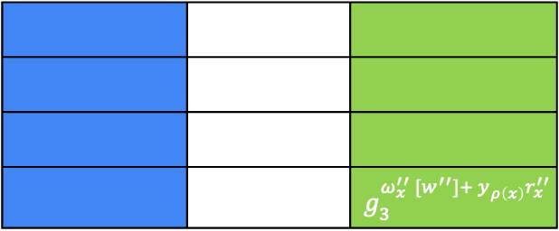
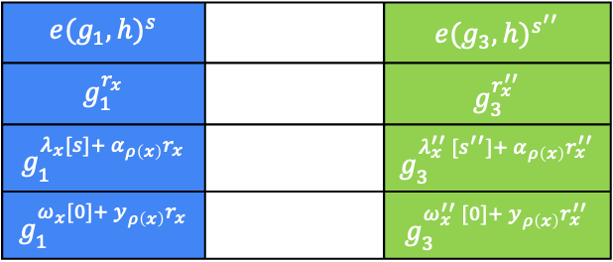
Hybrids
$Hyb2$ :
$$c0$$
$$e(g_{1}, h)^{s}$$ |  | $$e(g_{3}, h)^{s^{′′}}$$
$$g_{1}^{r_{x}}$$ |  | $$g_{3}^{r_{x}^{′′}}$$
$$g_{1}^{λ_{x}[s]+ α_{ρ\left(x\right)}r_{x}}$$ |  | $$g_{3}^{λ_{x}^{′′} [s^{′′}]+ α_{ρ\left(x\right)}r_{x}^{′′}}$$
$$g_{1}^{ω_{x}[0]+ y_{ρ\left(x\right)}r_{x}}$$ |  | $$g_{3}^{ω_{x}^{′′} [0]+ y_{ρ\left(x\right)}r_{x}^{′′}}$$
$$H_{1}(GID)^{y_{u}}$$
$$c_{1,x}$$
$$sk_{GID,u}$$
$$c_{2,x}$$
$$c_{3,x}$$
$Hyb3$ :
$$c0$$
 |  | $$g_{3}^{ω_{x}^{′′} [w^{′′}]+ y_{ρ\left(x\right)}r_{x}^{′′}}$$
✅
✅
✅
$$c_{1,x}$$
✅
✅
$$c_{2,x}$$
✅
✅
$$c_{3,x}$$
✅
$Hyb_{2} ≡Hyb_{3}$ since corrupts rows unauthorized to decrypt

Slide 58
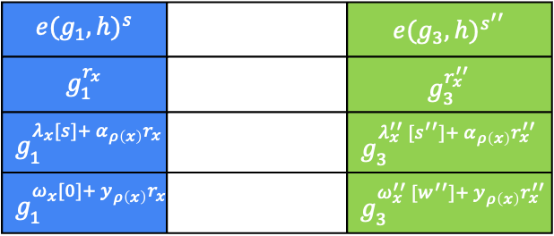
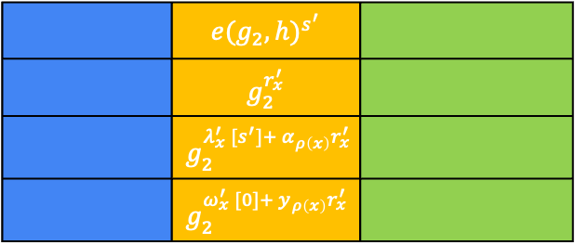
Hybrids
$Hyb3$ :
$$c0$$
$$e(g_{1}, h)^{s}$$ |  | $$e(g_{3}, h)^{s^{′′}}$$
$$g_{1}^{r_{x}}$$ |  | $$g_{3}^{r_{x}^{′′}}$$
$$g_{1}^{λ_{x}[s]+ α_{ρ\left(x\right)}r_{x}}$$ |  | $$g_{3}^{λ_{x}^{′′} [s^{′′}]+ α_{ρ\left(x\right)}r_{x}^{′′}}$$
$$g_{1}^{ω_{x}[0]+ y_{ρ\left(x\right)}r_{x}}$$ |  | $$g_{3}^{ω_{x}^{′′} [w^{′′}]+ y_{ρ\left(x\right)}r_{x}^{′′}}$$
$$H_{1}(GID)^{y_{u}}$$
$$c_{1,x}$$
$$sk_{GID,u}$$
$$c_{2,x}$$
$$c_{3,x}$$
$Hyb4$ :
$$c0$$
 | $$e(g_{2}, h)^{s^{′}}$$
 | $$g_{2}^{r_{x}^{′}}$$
 | $$g_{2}^{λ_{x}^{′} [s^{′}]+ α_{ρ\left(x\right)}r_{x}^{′}}$$
 | $$g_{2}^{ω_{x}^{′} [0]+ y_{ρ\left(x\right)}r_{x}^{′}}$$
✅
✅
✅
$$c_{1,x}$$
✅
✅
$$c_{2,x}$$
✅
✅
$$c_{3,x}$$
✅
✅
${SD: G}_{p_{1}}→ G_{p_{1}p_{2}}$
❌ $G_{p_{2}}$
❌$G_{p_{2}p_{3}}$
$Hyb_{3} ≈_{c} Hyb_{4}$ if:

Slide 59
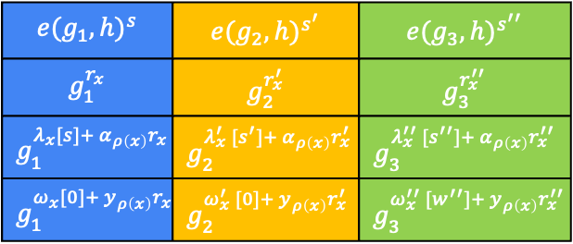

Hybrids
$Hyb4$ :
$$c0$$
$$e(g_{1}, h)^{s}$$ | $$e(g_{2}, h)^{s^{′}}$$ | $$e(g_{3}, h)^{s^{′′}}$$
$$g_{1}^{r_{x}}$$ | $$g_{2}^{r_{x}^{′}}$$ | $$g_{3}^{r_{x}^{′′}}$$
$$g_{1}^{λ_{x}[s]+ α_{ρ\left(x\right)}r_{x}}$$ | $$g_{2}^{λ_{x}^{′} [s^{′}]+ α_{ρ\left(x\right)}r_{x}^{′}}$$ | $$g_{3}^{λ_{x}^{′′} [s^{′′}]+ α_{ρ\left(x\right)}r_{x}^{′′}}$$
$$g_{1}^{ω_{x}[0]+ y_{ρ\left(x\right)}r_{x}}$$ | $$g_{2}^{ω_{x}^{′} [0]+ y_{ρ\left(x\right)}r_{x}^{′}}$$ | $$g_{3}^{ω_{x}^{′′} [w^{′′}]+ y_{ρ\left(x\right)}r_{x}^{′′}}$$
$$H_{1}(GID)^{y_{u}}$$
$$c_{1,x}$$
$$sk_{GID,u}$$
$$c_{2,x}$$
$$c_{3,x}$$
$Hyb5$ :
$$H_{1}(GID)^{y_{u}}$$ |  | $$H_{3}(GID)^{y_{u}}= g_{3}^{c∙y_{u}}$$
✅
${SD: G}_{p_{1}}→ G_{p_{1}p_{2}}$
❌ $G_{p_{2}}$
❌$G_{p_{2}p_{3}}$
$$SD:G_{p_{1}p_{2}}→G$$
❌ $G_{p_{3}}$
$Hyb_{4} ≈_{c} Hyb_{5}$ if:

Slide 60


Hybrids
$Hyb5$ :
$$c0$$
$$e(g_{1}, h)^{s}$$ | $$e(g_{2}, h)^{s^{′}}$$ | $$e(g_{3}, h)^{s^{′′}}$$
$$g_{1}^{r_{x}}$$ | $$g_{2}^{r_{x}^{′}}$$ | $$g_{3}^{r_{x}^{′′}}$$
$$g_{1}^{λ_{x}[s]+ α_{ρ\left(x\right)}r_{x}}$$ | $$g_{2}^{λ_{x}^{′} [s^{′}]+ α_{ρ\left(x\right)}r_{x}^{′}}$$ | $$g_{3}^{λ_{x}^{′′} [s^{′′}]+ α_{ρ\left(x\right)}r_{x}^{′′}}$$
$$g_{1}^{ω_{x}[0]+ y_{ρ\left(x\right)}r_{x}}$$ | $$g_{2}^{ω_{x}^{′} [0]+ y_{ρ\left(x\right)}r_{x}^{′}}$$ | $$g_{3}^{ω_{x}^{′′} [w^{′′}]+ y_{ρ\left(x\right)}r_{x}^{′′}}$$
$$H_{1}(GID)^{y_{u}}$$ |  | $$H_{3}(GID)^{y_{u}}= g_{3}^{c∙y_{u}}$$
$$c_{1,x}$$
$$sk_{GID,u}$$
$$c_{2,x}$$
$$c_{3,x}$$
$Hyb6$ :
$$c0$$
 |  | $$g_{3}^{λ_{x}^{′′} [t^{′′}]+ α_{ρ\left(x\right)}r_{x}^{′′}}$$
✅
✅
✅
✅
$$c_{1,x}$$
✅
✅
✅
$$c_{2,x}$$
✅
✅
$$c_{3,x}$$
✅
✅
✅
$Hyb_{5} ≡Hyb_{6}$ since corrupts rows unauthorized to decrypt and the structure of user secret keys

Slide 61



Hybrids
$$h^{α_{u}}$$
$$∙$$
$Hyb5$ :
$$c0$$
$$e(g_{1}, h)^{s}$$ | $$e(g_{2}, h)^{s^{′}}$$ | $$e(g_{3}, h)^{s^{′′}}$$
$$g_{1}^{r_{x}}$$ | $$g_{2}^{r_{x}^{′}}$$ | $$g_{3}^{r_{x}^{′′}}$$
$$g_{1}^{λ_{x}[s]+ α_{ρ\left(x\right)}r_{x}}$$ | $$g_{2}^{λ_{x}^{′} [s^{′}]+ α_{ρ\left(x\right)}r_{x}^{′}}$$ | $$g_{3}^{λ_{x}^{′′} [s^{′′}]+ α_{ρ\left(x\right)}r_{x}^{′′}}$$
$$g_{1}^{ω_{x}[0]+ y_{ρ\left(x\right)}r_{x}}$$ | $$g_{2}^{ω_{x}^{′} [0]+ y_{ρ\left(x\right)}r_{x}^{′}}$$ | $$g_{3}^{ω_{x}^{′′} [w^{′′}]+ y_{ρ\left(x\right)}r_{x}^{′′}}$$
$$H_{1}(GID)^{y_{u}}$$ |  | $$H_{3}(GID)^{y_{u}}= g_{3}^{c∙y_{u}}$$
$$c_{1,x}$$
$$sk_{GID,u}$$
$$c_{2,x}$$
$α_{u}+c∙y_{u} mod p_{3}$
information-theoretically revealed
$$c_{3,x}$$
$Hyb6$ :
$$c0$$
 |  | $$g_{3}^{λ_{x}^{′′} [t^{′′}]+ α_{ρ\left(x\right)}r_{x}^{′′}}$$
 |  | $$g_{3}^{ω_{x}^{′′} [v^{′′}]+ y_{ρ\left(x\right)}r_{x}^{′′}}$$
✅
✅
✅
$$α_{ρ(x) }→α_{ρ(x) }− \frac{1}{r_{x}^{′′}} M_{x}∙tz$$
$$y_{ρ(x) }→y_{ρ(x) }+\frac{1}{r_{x}^{′′}c} M_{x}∙tz$$
$z$ : orthogonal to corrupt rows
$$c_{1,x}$$
✅
✅
✅
$$c_{2,x}$$
✅
✅
$$c_{3,x}$$
✅
✅
$Hyb_{5} ≡Hyb_{6}$ since corrupts rows unauthorized to decrypt and the structure of user secret keys

Slide 62

Hybrids
$Hyb6$ :
$$c0$$
$$e(g_{1}, h)^{s}$$ | $$e(g_{2}, h)^{s^{′}}$$ | $$e(g_{3}, h)^{s^{′′}}$$
$$g_{1}^{r_{x}}$$ | $$g_{2}^{r_{x}^{′}}$$ | $$g_{3}^{r_{x}^{′′}}$$
$$g_{1}^{λ_{x}[s]+ α_{ρ\left(x\right)}r_{x}}$$ | $$g_{2}^{λ_{x}^{′} [s^{′}]+ α_{ρ\left(x\right)}r_{x}^{′}}$$ | $$g_{3}^{λ_{x}^{′′} [t^{′′}]+ α_{ρ\left(x\right)}r_{x}^{′′}}$$
$$g_{1}^{ω_{x}[0]+ y_{ρ\left(x\right)}r_{x}}$$ | $$g_{2}^{ω_{x}^{′} [0]+ y_{ρ\left(x\right)}r_{x}^{′}}$$ | $$g_{3}^{ω_{x}^{′′} [w^{′′}]+ y_{ρ\left(x\right)}r_{x}^{′′}}$$
$$H_{1}(GID)^{y_{u}}$$ |  | $$H_{3}(GID)^{y_{u}}= g_{3}^{c∙y_{u}}$$
$$c_{1,x}$$
$$sk_{GID,u}$$
$$c_{2,x}$$
$$c_{3,x}$$
$Hyb7$ :
$c0$ encodes uniform random message
$Hyb_{6} ≡Hyb_{7}$ using entropy of $s^{′′} mod p_{3}$ since it is information-theoretically hidden

