Slide 1
Multi-Client Inner Product Encryption:
Function-hiding instantiations without random oracles
Elaine Shi, Nikhil Vanjani
Carnegie Mellon University
https://eprint.iacr.org/2023/615

Slide 2


Motivating Application: Medical Research
x₁
x_{n}
f(x₁, …, x_{n})
Notes:
Let me introduce multi-client functional encryption with a motivating example.
Suppose that there is a medical research organization that has a partnership with n hospitals.
The organization wants to perform some computation on patient data that it obtains from the hospital.
Go slow.
And suppose that this data is streaming, meaning all the hospitals provide some data for time steps t.
For example, the data from hospital could be about daily number of cases of a disease,
The function that the org wants to compute could be about making predictions of spread of the disease via a linear regression model.
In all such scenarios, if we do not care about the privacy of patient data, then, the hospitals can simply share the patient data x_1 to x_n with the org in every time step.
And then, the org can compute the function f that it wants to on the data.
But, typically hospitals can’t give out the patient data in plain as this data could be sensistive.
So, what can we do then?

Slide 3

Motivating Application: Medical Research
How to decrypt to a function of messages instead of all messages?
x₁
x_{n}
f(x₁, …, x_{n})
Notes:
One solution could be that all the hospitals encrypt the data and then send to the organization.
Here, x1 in grey box denotes that x1 is encrypted.
The organization then wants to perform computations on the encrypted data and more importantly, it should only learn the decryption of the final output.
So, how can we implement this idea?
We know that traditional encryption has all-or-nothing nature of decryption, that is either you have the decryption key and you can decrypt everything or you don't have it and you can learn nothing. But, here we want a way to provide fine-grained access control to encrypted data.

Slide 4


Functional Encryption
allows fine-grained access control over the encrypted message
f
f
f
x
f(x)
Notes:
And functional encryption captures this idea essentially.
It allows…
Here, functional keys can be derived from a master key.
Functional key can later be used to decrypt a ct encrypting a message x to reveal only f(x) and no more about x. In other words, the functional key acts like a partial decryption key that allows one to learn partial information about the plaintexts in a controlled manner instead of allowing to learn the complete plaintexts.

Slide 5
Multi-Client Functional Encryption (MCFE)
allows fine-grained access control over the encrypted messages from multiple clients
f
f
f
time step t:
x
f(x)
f(x₁, …, x_{n})
x₁
x_{n}
Notes:
If the setting involves multiple clients, then, multi-client functional encryption provides a way to generalize to this setting.
Now, there are n ciphertexts instead of one.
Consequently, the functional key allows to learn f(x1, …, xn).
Here, all ciphertexts also have time steps associated with them.
The role of time step is to restrict what the decrypter can learn.
decryption works only for CTs corresponding to same time step.
If the decrypter mixes CTs from different timesteps, the output should be some garbage random value. This ensures that ciphertexts are used only as intended.

Slide 6


Multi-Client Functional Encryption (MCFE)
Setup
Notes:
A trusted authority runs the Setup algorithm.
This algorithm outputs a master secret key to the trusted authority and n encryptions keys ek_1 to ek_n, one to each client, in this case, one to each hospital.

Slide 7
Multi-Client Functional Encryption (MCFE)
x₁
x_{n}
time step t
Notes:
Now all the client’s have their encryption keys.
Suppose that they want to encrypt messages x_1 to x_n for some time step t.

Slide 8
Multi-Client Functional Encryption (MCFE)
Encrypt
Encrypt
x₁
x_{n}
time step t
x₁
x_{n}
Notes:
Then, each hospital can locally encrypt their messages under their respective encryption keys to obtain the ciphertexts.
Then, they can send these ciphertexts to the medical research organization.

Slide 9
Multi-Client Functional Encryption (MCFE)
time step t:
x₁
x_{n}
Notes:
At this stage the organization has the n ciphertexts for time step t.

Slide 10
Multi-Client Functional Encryption (MCFE)
f
time step t:
x₁
x_{n}
Notes:
Now suppose that the organization wants to evaluate a function f on these ciphertexts.

Slide 11
Multi-Client Functional Encryption (MCFE)
KeyGen
f
f
time step t:
x₁
x_{n}
Notes:
Then, it can send f to the trusted authority.
The authority can use its master key to come up with a restricted functional key for the function f via a keygen algorithm. It sends the functional key to the organization.

Slide 12
Multi-Client Functional Encryption (MCFE)
time step t:
f
x₁
x_{n}
Notes:
Now the organization has all the ciphertexts and the functional secret key.
It’s ready to perform the decryption as follows.

Slide 13
Multi-Client Functional Encryption (MCFE)
Decrypt
time step t:
f
x₁
x_{n}
f(x₁, …, x_{n})
Notes:
Equipped with the functional secret key, it can locally run a decryption algorithm on all the ciphertexts in a time step t that will output the function evaluation f(x_1 to x_n). This way, the research organization can learn the function that it needs without breaching the privacy of the sensitive patient data.
Those who are familiar with fully homomorphic encryption could ask how is MCFE different from FHE? The key difference is that
in MCFE, the evaluation on ciphertexts results in the plaintext f(x1, …, xn).
Whereas in FHE, the evaluation on ciphertexts results in an encryption of f(x_1, to x_n).
So, I hope by this point of time I have motivated you that multi-client functional encryption is an interesting cryptographic primitive to study.

Slide 14
Function hiding security of MCFE
x₁
hides x₁
f
hides f
Decrypter learns only f(x₁, …, x_{n})
Notes:
In this work, we study the function-hiding security of MCFE. A scheme is function-hiding if ct for x1 hides x1 and more importantly functional key for f hides f. Further, the decrypter learns only f(x1, …, xn) and no more info about x1, …, xn and f.

Slide 15
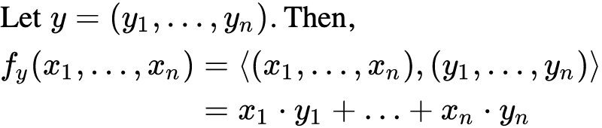
Multi-Client Inner Product Encryption (MCIPE)
Notes:
In this work, we study function-hiding MCFE for the special class of inner product functions. We call MCFE for inner products in short to be MCIPE.
The inner product function f is associated with a vector y which is vector comprising of y_1 to y_n.
The function then is just the inner product of x1, …, xn and y1, …, yn which is the same as sum of inner products xi yi of each client i.

Slide 16
Function-hiding MCIPE Applications:
Delegating computation to untrusted server
Example: Non-Interactive Anonymous Routing [SW21]
n senders
1
2
3
4
n
Single, untrusted router
permutation π
n receivers
1
2
3
4
n
Notes:
you may ask why is function-hiding security interesting?
Well, it can be useful when one needs to delegate computation to an untrusted server.
More specifically, when decryption inherently needs to be performed by some untrusted server, function-hiding security is meaningful.
For instance, in the case of non-interactive anonymous routing.
Let me explain with an illustration.
There are n senders who want to anonymously communicate with n receivers. This mapping from senders to receivers can be thought of as a permutation pi. And there is a single untrusted router to facilitate this task. So, it needs to route all the messages without knowing the underlying routing permutation pi.
Shi and Wu showed how this can be done via function-hiding MCFE for selection function which is a special case of inner product function. All the senders send their destinations to the trusted authority which computes the functional key based on this routing info and sends the functional key to the untrusted server. Now clearly this functional key should not reveal the function permutation pi to the untrusted router and hence, function-hiding security is meaningful.

Slide 17
Function-hiding MCIPE: What do we know?
[AGT21b] construction from bilinear maps:
selective security
random oracle model
Notes:
So, what do we know about function-hiding MCIPE?
Agrawal, Goyal and Tomida constructed it from bilinear maps which is a standard assumption in cryptography.
however, in order to have provable security, their result suffers from two significant caveats.
first, instead of proving full security, they have to make a significant relaxation, by imposing a strong constraint on the adversary's capabilities. this notion is called selective security. we won’t go into its details, and you only have to know that this is placing a strong restriction on the adversary's capabilities.
second, their proof uses the so-called random oracle model. random oracles are what cryptographers like to use as a heuristic when they do not know how to prove things, and in fact random oracles do not really exist.

Slide 18
Can we get fully secure function-hiding MCIPE
from any standard assumption
in the plain model?
Notes:
say plain model is a model without random oracles.

Slide 19
Our Results
Fully secure
function-hiding MCIPE
from bilinear maps
in the plain model
Notes:
first construction

Slide 20


Proving Security
Our Construction
Warmup
Notes:
The roadmap for the rest of the talk will be as follows.
To build some intuition, we will first do some warmup exercise.
And then, I will talk about our construction.
Lastly, I will briefly talk about how to prove security.

Slide 21
Proving Security
Our Construction
Warmup
Naive scheme
[AGT21b] Scheme
Notes:
For the warmup, we will first see a naive scheme that is insecure. Then I will briefly talk about how Agrawal et. al. makes the naiive scheme secure.

Slide 22

Function-hiding Inner Product Encryption (IPE)
Setup
x₁
x₁
Encrypt
y₁
y₁
KeyGen
x₁
y₁
Decrypt
x₁*y₁
Notes:
Consider inner product encryption or just IPE for short.
It is a special case of MCIPE when there is only one client.
For instance, in the medical research example, think now that only one hospital is partnering up with the research org.
Setup outputs just a master key now and this key also acts as the encryption key.
Encryption is same as before, except there is no notion of time steps here.
Keygen is also same as before, except it works for unary function instead of n-ary function.
Further, the decrypt algorithm now operates only on a single ciphertext instead of n and simply outputs inner product of x and y. Function-hiding requirement is same as before, that is ct should hide x1 and functional key should hide y1.

Slide 23
Warmup: use n instances of function-hiding IPE
1
n
x₁
x_{n}
y₁
y_{n}
functional key for y=(y₁,…, y_{n})
Notes:
As some of you maybe hearing about MCIPE for the first time, let’s start with a warm-up where we will just use n instances of IPE to construct MCFE for n clients.
The following is an insecure scheme and I want you to think why that is.
Setup algorithm simply consists of running IPE Setup n times, once for each client. each client obtains a key for an instance of IPE instance and the master key is just union of all these keys.
Equipped with the keys, the clients can locally compute the ciphertexts.
Now suppose you want to compute functional key for y=(y1, …, yn).
As each yi corresponds to i-th client, we can simply use the corresponding master key to compute functional key for y_i.
Then, the functional key for y is just the union of all the keys.

Slide 24
Warmup: use n instances of function-hiding IPE
x₁
x_{n}
y₁
y_{n}
d₁ = x₁*y₁
d_{n} = x_{n}*y_{n}
＜ x, y ＞
Hope: If IPE is function-hiding secure, then, so should be the resulting MCIPE scheme
Notes:
Suppose the organization has obtained all these ciphertexts and functional keys.
Let’s look at how can it decrypt.
It can decrypt each instance to obtain d1=x1y1, d2=x2y2 and so on.
Then, it can simply sum up all the values to obtain the desired outcome.
Hope then is..

Slide 25
Warmup: use n instances of function-hiding IPE
Problems:
Reveals every users’ inner product
Allows mix-n-match of CTs across time steps
Allows mix-n-match of functional SKs
[AGT21b] solution:
Coordinate randomness via random oracles
Notes:
This scheme has the following problems.
it reveals every users’ inner product as we just saw in the decryption algorithm. this is bad as it is leaks more info than intended.
it allows for some mix-n-match attacks on CTs across different time steps as we did not use time steps anywhere.
lastly, it also allows for mix-n-match of functional keys as it is just a union of functional keys.
Agrawal et. al.’s solution is to additionally use some coordinate randomness to prevent all the above attacks. This randomness is computed using hash functions that need to be modeled as random oracles for their security proof.

Slide 26

Alternate way to coordinate randomness?
How to prove security?
Notes:
the question then is: is there an alt way to coordinate randomness? answering this requires two ideas. i will talk about them one by one. once we have the candidate construction, it turns out that proving the resulting construction secure is non-trivial, and i'll briefly touch upon the proof techniques.

Slide 27
Proving Security
Our Construction
Correlated PRF
Our Construction
Warmup

Slide 28
Correlated Pseudorandom Functions (CPRF)
n
Setup
K₁, …, K_{n}
Can be constructed
from PRFs! [BIK+17, ABG19]
K_{i}, t
Evaluate
K_{i}(t)
Properties:
Sum of evaluations on same input t is 0
K₁(t) + … + K_{n}(t) = 0
if you use different inputs t’s, sum is junk
Notes:
CPRF consists of two algorithms Setup and Evaluate. Setup… Evaluate…
There are two interesting properties of CPRF. First, … Second…

Slide 29
Strawman MCIPE Construction
(x₁, K₁(t))
(x_{n}, K_{n}(t))
(y₁, z)
(y_{n}, z)
z is shared by all clients
z is fresh random for each query
Notes:
we expand the vectors that we encrypt by one more slot.
Now, client 1 encrypts the vector containing x1 and K1(t), where t is the time step. And so on for all other clients.
Similarly, the vectors for keys also have one more slot.
They key for y1 corresponds to (y1, z) and so on for all the n clients. Here, note that z is…

Slide 30
Strawman MCIPE Construction
(x₁, K₁(t))
(x_{n}, K_{n}(t))
(y₁, z)
(y_{n}, z)
d₁= x₁*y₁ + K₁(t)*z
d_{n} = x_{n}*y_{n} + K_{n}(t)*z
d₁ + … + d_{n} = (x₁*y₁ + … + x_{n}*y_{n}) + (K₁(t)+ … + K_{n}(t))*z
d₁ + … + d_{n} = (x₁*y₁ + … + x_{n}*y_{n})
masking terms cancel out
Notes:
with these vectors, the partial decryptions look as follows.
sum up partial decs.
masking cancel out.
solves 3 problems as follows:
doesn’t reveal every user’s inner product because of masking terms
mix-n-match of ct would result in garbage value on decryption as masking terms won’t cancel out because of CPRF
mix-n-match of sk would result in garbage value on decryption as masking terms won’t cancel out because z won’t be common for all n terms anymore.

Slide 31
Strawman MCIPE Construction
(x₁, K₁(t))
(x_{n}, K_{n}(t))
(y₁, z)
(y_{n}, z)
d₁= x₁*y₁ + K₁(t)*z
d_{n} = x_{n}*y_{n} + K_{n}(t)*z
Security: need to argue K_{i}(t)*z looks random for all honest clients
Problem: does not look random due to DDH-style attack
function-hiding IPE known only from bilinear maps
Notes:
For security, …
At this point, I would like to mention that something about the building block function-hiding IPE that we are using here. It is only known from bilinear maps.
When instantiating the IPE, we run into a problem. These terms do not look random due to DDH-style attack.

Slide 32
Our MCIPE Construction
(x₁, K₁(t)+a₁*r₁, r₁)
(x_{n}, K_{n}(t)+a_{n}*r_{n}, r_{n})
(y₁, z, -z*a₁)
(y_{n}, z, -z*a_{n})
Solution: Encrypt K_{i}(t)!
Note: IPE scheme for inner-product in the exponent
x₁ K₁(t)+a₁*r₁ r₁
(g , g , g )
El-Gamal style encryption
Notes:
encrypt Ki(t) !
So, client 1 encrypts the vector (x1, K1(t)+a1*r1, r1).
Let me explain why this is a valid encryption intuitively.
Note…
So, Imagine this vector in the exponent of some generator g.
So, we have g^(K1(t)+a1*r1), g^r1
El-Gamal style encryption…
Finally, to preserve correctness, the keys correspond to the following vectors.

Slide 33

Our MCIPE Construction
(x₁, K₁(t)+a₁*r₁, r₁)
(x_{n}, K_{n}(t)+a_{n}*r_{n}, r_{n})
(y₁, z, -z*a₁)
(y_{n}, z, -z*a_{n})
d₁= x₁*y₁ + z*K₁(t) + (a₁*r₁)*z + r₁*(-z*a₁)
d₁= x₁*y₁ + z*K₁(t)
Correctness still holds!
Notes:
more specifically, on client1’s decryption, we get the first two values as before. Additionally, we get terms (a1*r1)*z and r1*(-z*a1). These terms cancel out as a1, r1, z are all scalars here.

Slide 34
Proving Security
Our Construction
Warmup

Slide 35
Proving security
Selective security
All KeyGen queries before any Encrypt query
Full security
Any sequence of KeyGen and Encrypt queries
Notes:
Proving security is non-trivial for this scheme and we first prove selective security and then use the insights gained from it to prove full security.
I don’t have the time today to go into the details of the security game, but intuitively the difference between the two is as follows.
Full security allows for any sequence of keygen and encryption queries by the adversary.
Selective security restricts the adversary’s capabilities in that it must submit all keygen queries before any encryption query.

Slide 36
Proving security
Selective security
Key Insight: Embed x₁*y₁ in the CT₁
Identically distributed step: Use K₁(t) and z to come up with random masking terms for x₁*y₁ and so on…
Full security
Notes:
As the adversary sends keygen queries y before any encryption query,
one of the key insights is that we can embed inner product x1*y*1 in client1’s ct.
The resulting sequence of hybrids that we obtain has a main identically distributed step. the second insight is that we enable this step by using K1(t) and z to come up with random masking terms for x1*y1 and so on for all clients.

Slide 37
Proving security
Selective security
Key Insight: Embed x₁*y₁ in the CT₁
Identically distributed step: Use K₁(t) and z to come up with random masking terms for x₁*y₁ and so on…
Full security
Key Insight: Open up the blackbox of IPE and use randomness of the functional key for new hybrid sequence
Notes:
For proving full security, we can’t embed the inner product x1*y1 in ciphertext as before as the keygen queries can be submitted after encryption queries. So, we come up with a new sequence of hybrids. In this new sequence, unfortunately the above terms are not directly usable for the main identically distributed step.
Our key insight then is to open up the black box of IPE…

Slide 38
Also in the paper
Formal security definitions and proofs
How to remove the “All-or-Nothing” Admissibility Rule
All-or-Nothing Encryption (AoNE)
New Construction: Adaptive secure AoNE with succinct CT size
Notes:
This complete the technical portion of the talk. I did not have the time today to present the following details to you and I encourage you to check our paper for them.
The paper contains the formal security definitions and proof details.
The scheme I presented today satisfies full security with a restriction called “all-or-nothing” admissibility rule. In the paper we show how to use AoNE to remove this.
To this end, we provide a new adaptively secure AoNE construction with succinct cipertext size which wasn’t known before.

Slide 39
Summary
Fully secure function-hiding MCIPE from function-hiding IPE and Correlated PRFs in the plain model
Nice features:
Simpler scheme than before, including function-revealing schemes
CT size is succinct
First function-revealing MCIPE from non-lattice standard assumptions in the plain model with succinct CT size
Notes:
In summary, I presented to you today the first full-secure function-hiding MCIPE scheme from function-hiding IPE and Correlated PRFs in the plain model. It enjoys some nice features that I want to highlight. …

Slide 40
Open Questions
Handle adaptive corruptions without complexity leveraging?
Function-hiding Dynamic Decentralized Functional Encryption from standard assumptions in the plain model?
Notes:
I will leave you with a couple of open questions.
First, we studied function-hiding security in presence of static corruption of clients. How to handle adaptive corruptions in function-hiding security is a open problem. This is not only for the multi-client setting, but also for the weaker multi-input setting that does not contain any time steps t.
Second, recall that the setup and keygen steps in MCFE are performed by a trusted authority. This is not ideal for practical scenarios. The notion of DDFE decentralizes MCFE adn gets rid of the trusted authority. How to construct such a scheme with function-hiding security in the plain model is an open problem.

Slide 41
Thank You!
https://eprint.iacr.org/2023/615
nvanjani@cmu.edu

Slide 44
Extra slides start here

Slide 46
Related Works

Slide 47
Other related work on MCFE
(without function hiding)
Summation:
From DDH [SCR+11]
Arbitrary functions:
From indistinguishability obfuscation [GGG+14]
Inner Products (linear functions):
from DDH, or DCR, or LWE [CDG+18, AGT21b, …]
Quadratic functions:
from bilinear maps [AGT22]
Notes:
== essentially flash this slide, don’t go into each bullet one by one ===
Let me quickly tell you about other related works on MCFE. They all satisfy a weaker notion of security that is not function-hiding.
Shi et al. were the first to consider MCFE and constructed it for summation function. Later, Goldwasser et al. constructed it for arbitrary functions from indistinguishability obfuscation. Subsequently, there have been a lot of constructions from various standard assumptions for simpler class of functions such as inner products and quadratic functions.
Ignore:
Let me now tell you about what functionalities f can multi-client functional encryption support.
The holy grail is to be able to construct it for arbitrary functions from standard assumptions.
MCFE was introduced by Shi et al. for the simple case of summation and they constructed it from the standard DDH assumption.
Then, In 2014, Goldwasser et al. showed how to construction it for arbitrary functions from any indistinguishability obfuscator.
Given that indistinguishability obfuscation is unlikely to become practical in the near term, a natural question is for which functions can we construct MCFE efficiently from standard assumptions.
A line of work has explored how to construct MCFE for inner product computation and we now have multiple constructions from different standard assumptions such as DDH, DCR, LWE.
Very recently, Agrawal et al. also showed how to construct MCFE for quadratic functions, but they could only prove a very weak version of security, even weaker than the selective security I mentioned earlier.
In light of this, it seems that function-hiding security is much more challenging as until now we did not even know how to construct it for the simple class of inner products.

Slide 48
Multi-Client Inner Product Encryption (MCIPE): Security
function-revealing IND:
from LWE: in plain model with succinct CT size [LT19]
from DDH, or DCR, or bilinear maps: either in random oracle model or large CT size [CDG+18, ABG19, ABM+20]
function-hiding IND:
from bilinear maps: selective security and in random oracle model with succinct CT size [AGT21b]
This work: from bilinear maps, full security and in plain model with succinct CT size

Slide 50
Security definition

Slide 51

Informal function-hiding game: Real_{b}
b∈{0,1}
Setup Phase
K ⊂ [n]
Corrupt a set of clients
i
{ }_{i∈K}
Notes:
say we use selective security as a stepping stone towards full security

Slide 52
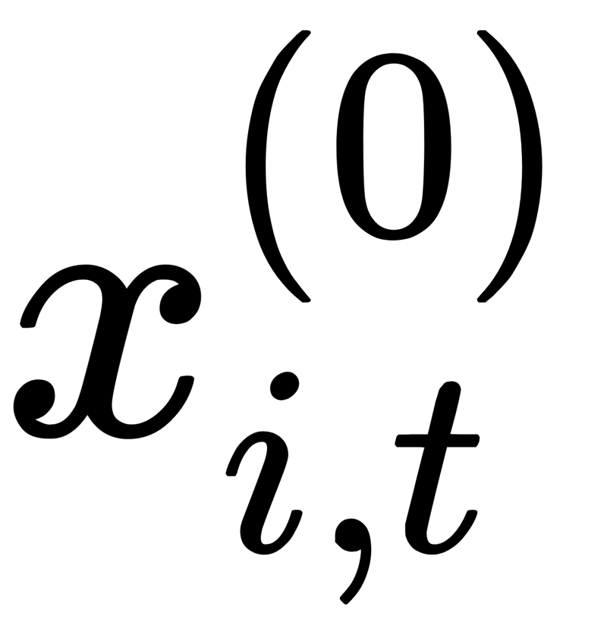
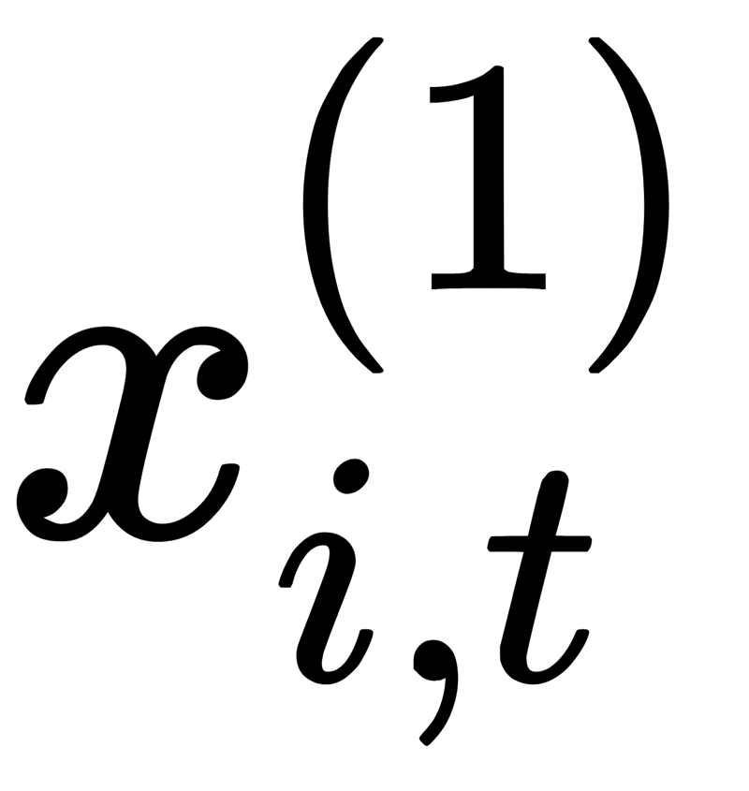
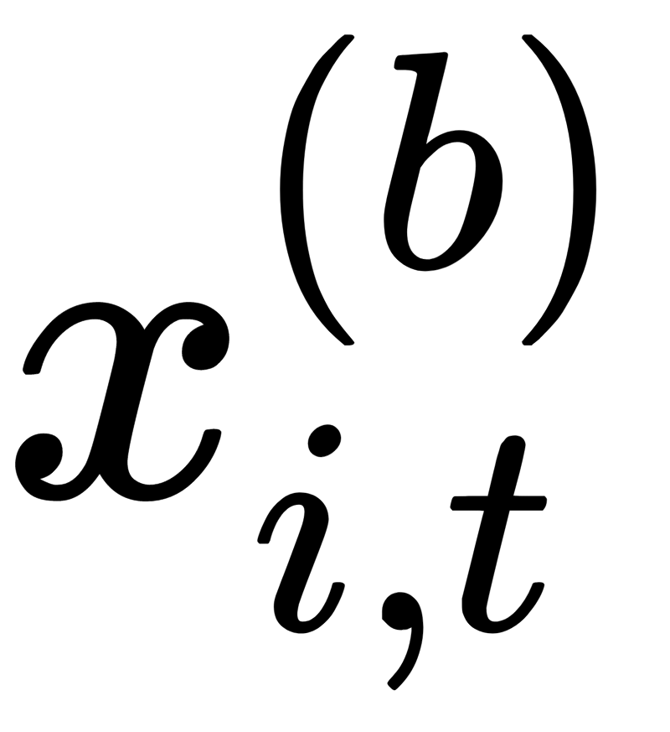
Informal function-hiding game: Real_{b}
b∈{0,1}
Query Phase
KeyGen Queries
Encrypt Queries
y⁽⁰⁾
y⁽¹⁾
y^{(b)}
t,
Notes:
say we use selective security as a stepping stone towards full security

Slide 53
Informal function-hiding security
Security requirement:
Adversary’s view in Real₀ and Real₁ are indistinguishable
Adaptive variant:
Any sequence of KeyGen and Encrypt queries
Selective variant:
All KeyGen queries before any Encrypt query
Notes:
say we use selective security as a stepping stone towards adaptive security

Slide 54
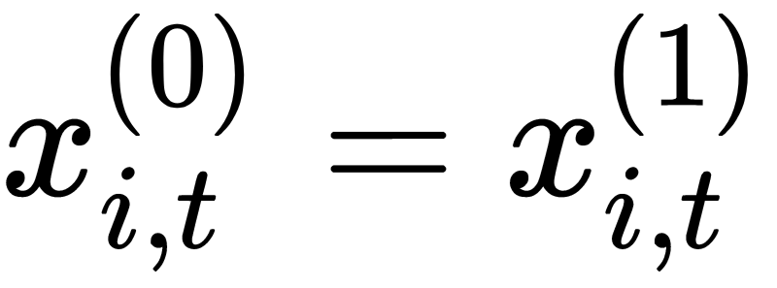
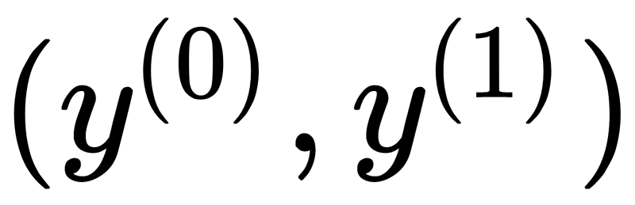
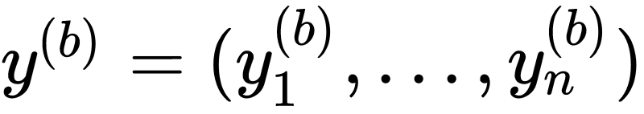
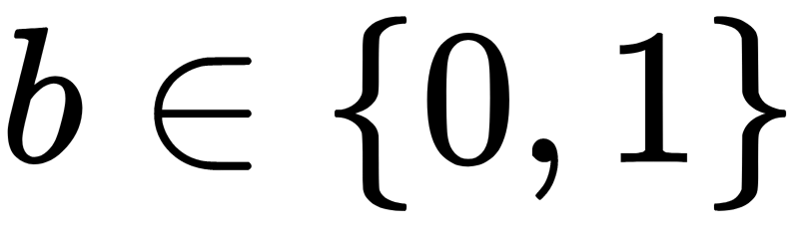
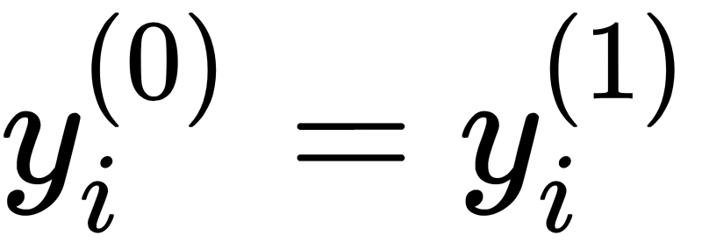
Informal function-hiding security
Admissibility Criteria:
(i) For any encryption query for a corrupt client i:
(ii) For any keygen query ,
where for :
if corrupt client i:
Notes:
need to explain this well. basically the adversary should not be able to trivially distinguish the two worlds, from the outcomes of the evaluations.

Slide 55

Informal function-hiding security
Admissibility Criteria:
(iii) For any keygen query , for all honest clients and for all time steps:
Note: for any constraint, must switch ciphertexts and keys from distribution 0 to 1 in a single shot.
Idea: Two-slot technique [Lin17]
Notes:
note here that for single user IPE, the admissibility criteria consists of just the third point and without the summation as its single client case. That is, x1 y1 = x0 y0.

Slide 56
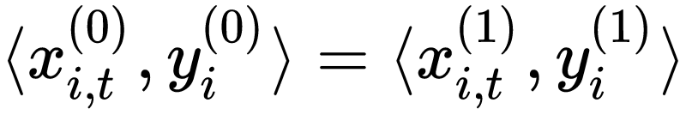
Informal function-hiding security
Admissibility Criteria:
(iii) For any keygen query , for all honest clients and for all time steps:
Hope: switch from 0 to 1 using function-hiding IPE
Key Challenge: function-hiding IPE security holds for honest client i if:
Not necessarily enforced by
MCIPE admissibility criteria!
Notes:
note here that for single user IPE, the admissibility criteria consists of just the third point and without the summation as its single client case. That is, x1 y1 = x0 y0.

Slide 57
Informal function-hiding security
Admissibility Criteria:
(iii) For any keygen query , for all honest clients and for all time steps:
Hope: switch from 0 to 1 using function-hiding IPE
Key Challenge: function-hiding IPE security holds for honest client i if:
Natural idea: massage distributions in a way that the key distributions switching from 0 to 1 are identical!
Notes:
note here that for single user IPE, the admissibility criteria consists of just the third point and without the summation as its single client case. That is, x1 y1 = x0 y0.

Slide 59
Proof Details: short

Slide 60
Function hiding security of MCFE
x1
x1
hide x1, …, xn
y1
yn
hide y1, …, yn
Decrypter learns only (x1*y1 + … + xn*yn)
Indistinguishability-based security game
KeyGen and Encrypt Queries
Selective Security:
All KeyGen queries before any Encrypt Query
Notes:
In this work, we study the function-hiding security of MCFE. A scheme is function-hiding if …

Slide 61
Proving Selective-security: Key Insights
Embed the inner product x1y1 in the CT1
Key identically distributed step: Use Ki(t) and z to come up with random masking terms
Notes:
As all keygen queries are sent before encrypt queries, the first insight for our proof is that we can embed user1’s inner product x1y1 in its ciphertext and so on for all users.
For the resulting hybrid sequence, the key step then involves showing that two distributions are identical. Our second and main insight is that we can use the terms K(i) and z to come up with random masking terms that help show that the two distributions are identical.

Slide 62
Our Selective-secure MCIPE Construction
(x1, 0, K1(t)+a1*r1, r1, 0)
(xn, 0, Kn(t)+an*rn, rn, 0)
(y1, 0, z, -z*a1, 0)
(yn, 0, z, -z*an, 0)
Notes:
To use these insights, we need some extra slots highlighted in green that contain zeros in the construction but will be changed during the security hybrids.

Slide 63
Full-secure Scheme
non-blackbox IPE
Selective-secure Scheme
Warmup

Slide 64
Full Security Proof
Challenges:
Can not embed the inner product x1y1 in the CT1
Key identically distributed step:
masking terms not available
Notes:
There are two challenges to prove full security.
First, we can no longer embed the inner product x1y1 in ct1 as y1 may not have been queried before x1. Thus, we need to come up with a new hybrid sequence to prove security.
Second, for the new hybrid sequence that we come up with, the masking terms are not available as before for the key identically distributed step, let alone proving them to be random.

Slide 65
Proving Full-security: Key Insight
As the underlying IPE is function-hiding, the
functional keys must have some randomness. Use it!
… how? Open up the blackbox of IPE
Notes:
So, our key insight for full-security is that as the underlying IPE is function-hiding, its functional keys must have some randomness. And we use this randomness by openign up the black box of IPE.

Slide 66
Our Full-secure MCIPE Construction
(x1, 0, K1(t)+a1*r1, r1)
(xn, 0, Kn(t)+an*rn, rn)
(y1, 0, z, -z*a1)
(yn, 0, z, -z*an)
Open up the black box of IPE
Notes:
More concretely, our construction is same as before, with the only difference that we open up the blackbox of IPE in our construction.

Slide 67

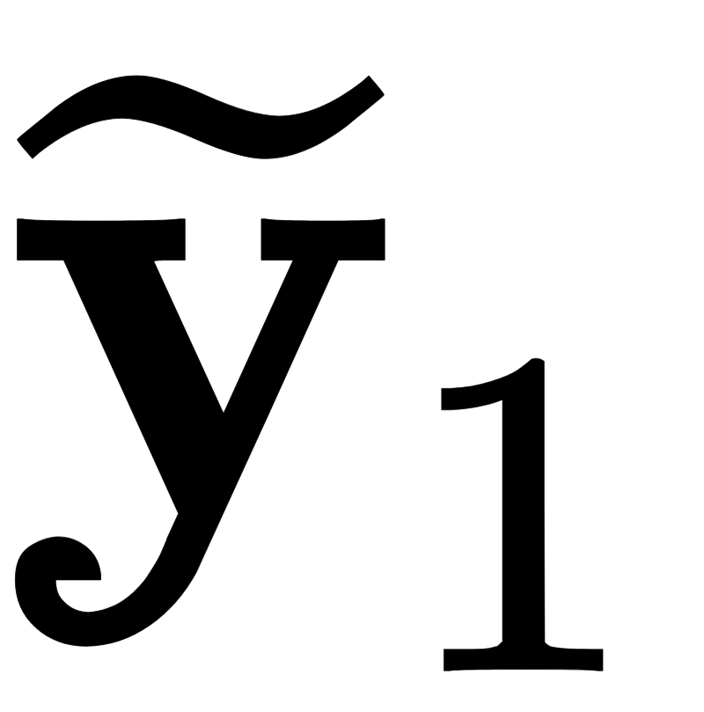
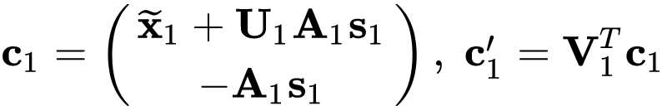
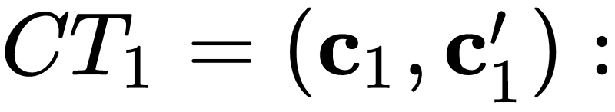
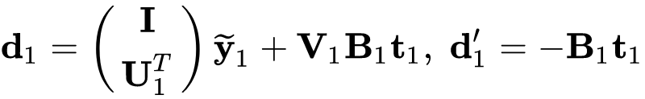
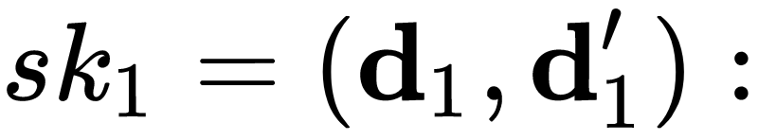
Full Security Proof
(x1, 0, K1(t)+a1*r1, r1)
(y1, 0, z, -z*a1)
Unwrapping the underling IPE…

Slide 68
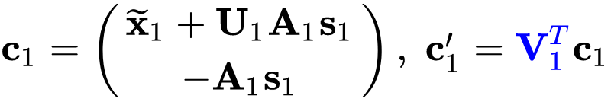
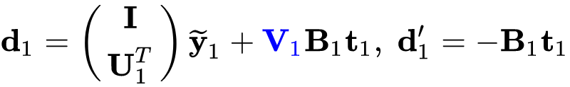

Full Security Proof
Need to be very careful
(x1, 0, K1(t)+a1*r1, r1)
(y1, 0, z, -z*a1)
Use this randomness for key identically distributed step

Slide 70
Warmup: detailed

Slide 71

Warmup: use n instances of function-hiding IPE
1
1
n
Setup
n
Notes:
As some of you maybe hearing about MCIPE for the first time, let’s start with a warm-up where we will just use n instances of IPE to construct MCFE for n clients.
The following is an insecure scheme and I want you to think why that is.
Setup algorithm simply consists of running IPE Setup n times and each client obtains a key for an instance of IPE instance and the master key is just union of all these keys.

Slide 72
Warmup: use n instances of IPE
1
1
n
x1
time step t
n
xn
Notes:
Suppose client 1 wants to encrypt x1 and so on for other clients.

Slide 73
Warmup: use n instances of IPE
x1
1
1
n
x1
Encrypt
time step t
n
xn
xn
Notes:
just use IPE key to obtain ciphertext corresponding to x1 denoted by x1 in grey box, and so on for the other clients.

Slide 74
Warmup: use n instances of IPE
1
n
time step t:
x1
xn
Notes:
now the org has n ciphertexts

Slide 75
Warmup: use n instances of IPE
1
n
time step t:
x1
xn
y1
yn
Notes:
Now suppose that the organization wants to evaluate a function y = (y1 to yn) on these ciphertexts.

Slide 76
Warmup: use n instances of IPE
1
n
time step t:
x1
xn
y1
yn
KeyGen
y1
yn
Notes:
It sends y1 to yn to trusted auth.
computes ipe keygen n times to get n keys. It sends back all n keys denoted by yi in grey box.

Slide 77
Warmup: use n instances of IPE
time step t:
x1
xn
y1
yn
Notes:
Now the org has n IPE CTs and n IPE functional keys.

Slide 78
Warmup: use n instances of IPE
time step t:
x1
xn
Decrypt
y1
yn
x1*y1
…
xn*yn
Notes:
How will it decrypt? Compute IPE decryption on each pair to obtain x1y1 x2y2 and so on till xnyn.

Slide 79
Warmup: use n instances of IPE
time step t:
x1
xn
Decrypt
y1
yn
x1*y1
+ … +
xn*yn
Hope: If IPE is function-hiding secure, then, so should be the resulting scheme
Notes:
Simply sum up.
Hope.

Slide 81
DDH attack

Slide 82
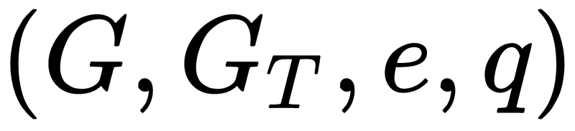
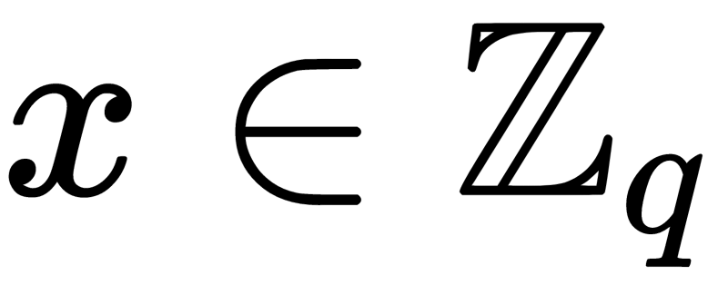
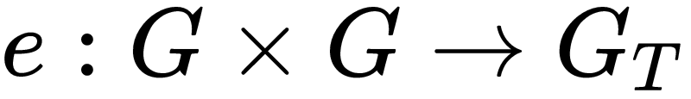
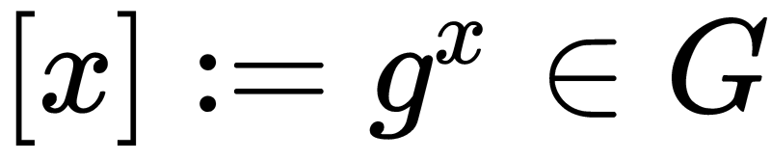
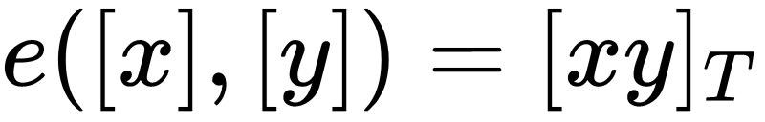
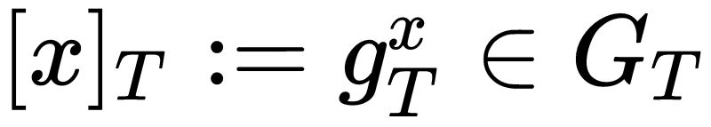
Bilinear Groups Notation
Why? Function-hiding IPE known only from bilinear maps
Notes:
DDH is easy in bilinear maps.
Our construction will be from decisional linear assumption - standard in bilinear maps.

Slide 83
Strawman MCIPE Construction
([x1, K1(t)])
([y1, z])
([xn, Kn(t)])
([yn, z])
Notation:
x
y
: ciphertext encrypting message x : functional key for y
Notes:
say at the end:
there is some problem with this construction.

Slide 84
Strawman MCIPE Construction
([x1, K1(t)])
([y1, z])
[d1]_{T}= [x1*y1 + z*K1(t)]_{T}
([xn, Kn(t)])
([yn, z])
[dn]_{T} = [xn*yn + z*Kn(t)]_{T}
Notation:
x
y
: ciphertext encrypting message x : functional key for y
Notes:
say at the end:
there is some problem with this construction.

Slide 85
Strawman MCIPE Construction
[d1]_{T}= [x1*y1 + z*K1(t)]_{T}
[dn]_{T} = [xn*yn + z*Kn(t)]_{T}
[d1]_{T} * … * [dn]_{T} = [(x1*y1 + … + xn*yn) + z*(K1(t)+ … + Kn(t))]_{T}
[d1]_{T} * … * [dn]_{T} = [x1*y1 + … + xn*yn]_{T}
Output DiscreteLog([d1]_{T} * … * [dn]_{T})
Notes:
say at the end:
there is some problem with this construction.

Slide 86
Problem with Strawman MCIPE Construction
Security: need to argue [z*Ki(t)]_{T} looks random for all honest clients… reduce to DDH assumption?
Problem:
Adversary
learns info about [z] from corrupt clients
can gain info about [Ki(t)] from honest client’s ciphertexts
can distinguish [z*Ki(t)]_{T} from random using a DDH-style attack

Slide 87
Our MCIPE Construction
([x1, K1(t)+a1*r1, r1])
([y1, z, -z*a1])
([xn, Kn(t)+an*rn, rn])
([yn, z, -z*an])
[d1]_{T}= [x1*y1 + z*K1(t) + z*(a1*r1) - (z*a1)*r1 ]_{T}
[d1]_{T}= [x1*y1 + z*K1(t)]_{T}
Notes:
encrypt Ki(t) !

Slide 88
Our MCIPE Construction
([x1, 0, K1(t)+a1*r1, r1])
([y1, 0, z, -z*a1])
([xn, 0, Kn(t)+an*rn, rn])
([yn, 0, z, -z*an])
[d1]_{T}= [x1*y1 + z*K1(t) + z*(a1*r1) - (z*a1)*r1 ]_{T}
[d1]_{T}= [x1*y1 + z*K1(t)]_{T}
Notes:
extra slots for proving security

Slide 90
Proof details: long (Hybrids)

Slide 91
Proving Selective-security: Key Insight
Natural idea: massage distributions in a way that the key distributions switching from 0 to 1 are identical!
Use randomness of Ki(t) and z to come up with masking terms for identically distributed step
Notes:
note here that for single user IPE, the admissibility criteria consists of just the third point and without the summation as its single client case. That is, x1 y1 = x0 y0.

Slide 92
Selective-security Proof Idea
(x1⁽⁰⁾, 0, K1(t)+a1*r1, r1, 0)
(y1⁽⁰⁾, 0, z, -z*a1, 0)
IPE
(x1⁽⁰⁾, x1⁽¹⁾, K1(t)+a1*r1, r1, 0)
(y1⁽⁰⁾, 0, z, -z*a1, 0)
?
(x1⁽⁰⁾, x1⁽¹⁾, K1(t)+a1*r1, r1, 0)
(0, y1⁽¹⁾, z, -z*a1, 0)
IPE
(x1⁽¹⁾, 0, K1(t)+a1*r1, r1, 0)
(y1⁽¹⁾, 0, z, -z*a1, 0)
Notes:
=== animate this ===

Slide 93
Selective-security Proof Idea
(x1⁽⁰⁾, x1⁽¹⁾, K1(t)+a1*r1, r1, 0)
(y1⁽⁰⁾, 0, z, -z*a1, 0)
?
(x1⁽⁰⁾, x1⁽¹⁾, K1(t)+a1*r1, r1, 0)
(0, y1⁽¹⁾, z, -z*a1, 0)
Notes:
encrypt Ki(t) !

Slide 94
Selective-security Proof Idea
(x1⁽⁰⁾, x1⁽¹⁾, K1(t)+a1*r1, r1, 0)
(y1⁽⁰⁾, 0, z, -z*a1, 0)
Notes:
encrypt Ki(t) !

Slide 95
Selective-security Proof Idea
(x1⁽⁰⁾, x1⁽¹⁾, K1(t)+a1*r1, r1, 0)
(y1⁽⁰⁾, 0, z, -z*a1, 0)
(x1⁽⁰⁾, x1⁽¹⁾, K1(t)+a1*r1, r1, x1⁽⁰⁾y1⁽⁰⁾+z*K1(t))
(0, 0, 0, 0, 1)
Function-hiding security of IPE
Notes:
encrypt Ki(t) !

Slide 96
Selective-security Proof Idea
(x1⁽⁰⁾, x1⁽¹⁾, K1(t)+a1*r1, r1, 0)
(y1⁽⁰⁾, 0, z, -z*a1, 0)
(x1⁽⁰⁾, x1⁽¹⁾, K1(t)+a1*r1, r1, x1⁽⁰⁾y1⁽⁰⁾+z*K1(t))
(0, 0, 0, 0, 1)
(x1⁽⁰⁾, x1⁽¹⁾, K1(t)+a1*r1, r1, x1⁽⁰⁾y1⁽⁰⁾+T1)
(0, 0, 0, 0, 1)
CPRF security +
Decisional Linear Assumption
Notes:
encrypt Ki(t) !

Slide 97
Selective-security Proof Idea
(x1⁽⁰⁾, x1⁽¹⁾, K1(t)+a1*r1, r1, 0)
(y1⁽⁰⁾, 0, z, -z*a1, 0)
(x1⁽⁰⁾, x1⁽¹⁾, K1(t)+a1*r1, r1, x1⁽⁰⁾y1⁽⁰⁾+z*K1(t))
(0, 0, 0, 0, 1)
(x1⁽⁰⁾, x1⁽¹⁾, K1(t)+a1*r1, r1, x1⁽⁰⁾y1⁽⁰⁾+T1)
(0, 0, 0, 0, 1)
(x1⁽⁰⁾, x1⁽¹⁾, K1(t)+a1*r1, r1, x1⁽¹⁾y1⁽¹⁾+T1)
(0, 0, 0, 0, 1)
Identically distributed
Need Admissibility Criteria:
Notes:
encrypt Ki(t) !

Slide 98
Selective-security Proof Idea
(x1⁽⁰⁾, x1⁽¹⁾, K1(t)+a1*r1, r1, 0)
(y1⁽⁰⁾, 0, z, -z*a1, 0)
(x1⁽⁰⁾, x1⁽¹⁾, K1(t)+a1*r1, r1, x1⁽⁰⁾y1⁽⁰⁾+z*K1(t))
(0, 0, 0, 0, 1)
(x1⁽⁰⁾, x1⁽¹⁾, K1(t)+a1*r1, r1, x1⁽⁰⁾y1⁽⁰⁾+T1)
(0, 0, 0, 0, 1)
(x1⁽⁰⁾, x1⁽¹⁾, K1(t)+a1*r1, r1, x1⁽¹⁾y1⁽¹⁾+T1)
(0, 0, 0, 0, 1)
(x1⁽⁰⁾, x1⁽¹⁾, K1(t)+a1*r1, r1, 0)
(0, y1⁽¹⁾, z, -z*a1, 0)
Notes:
encrypt Ki(t) !

Slide 99
Selective-security Proof Idea
(x1⁽⁰⁾, x1⁽¹⁾, K1(t)+a1*r1, r1, 0)
(y1⁽⁰⁾, 0, z, -z*a1, 0)
IPE
(x1⁽⁰⁾, x1⁽¹⁾, K1(t)+a1*r1, r1, x1⁽⁰⁾y1⁽⁰⁾+z*K1(t))
(0, 0, 0, 0, 1)
CPRF + Decisional Linear assumption
(x1⁽⁰⁾, x1⁽¹⁾, K1(t)+a1*r1, r1, x1⁽⁰⁾y1⁽⁰⁾+T1)
(0, 0, 0, 0, 1)
identical
(x1⁽⁰⁾, x1⁽¹⁾, K1(t)+a1*r1, r1, x1⁽¹⁾y1⁽¹⁾+T1)
(0, 0, 0, 0, 1)
(x1⁽⁰⁾, x1⁽¹⁾, K1(t)+a1*r1, r1, 0)
(0, y1⁽¹⁾, z, -z*a1, 0)
Notes:
encrypt Ki(t) !

