Slide 1
Functional Fair Exchange:
Beyond All-Or-Nothing Data Exchange
Nikhil Vanjani
Carnegie Mellon University → Babylon Labs
Notes:
Thanks for the introduction and for inviting me to give a talk at BU. I am Nikhil Vanjani, I recently finished my PhD at CMU and started as a Senior Researcher at Babylon Labs. Today I will be presenting two of my works on Functional Fair Exchange: Beyond All-or-Nothing Data Exchange and these works were done while I was at CMU.
0:30

Slide 2








Traditional Systems
Talk at 1pm?
Yes
Public-Key Encryption (PKE)
Enables privacy
Notes:
Let us start with a traditional digital system. Suppose I am messaging with Ran and I ask him should I give talk at 11am and he replies yes.
If we want to keep this conversation confidential, public key encryption can be used to do so. Here, both of us possess a public key and secret key pair and I can encrypt my message using Ran’s public key. Since only Ran possesses his decryption key, only he can decrypt this message, thus my message remains private. Likewise he can encrypt his message using my public key.
1:05

Slide 3


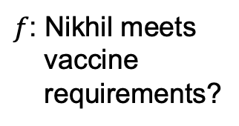

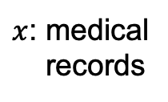
Modern Systems
$f$: Nikhil meets
vaccine
requirements?
$x$: medical
records
$$f\left(x\right)∈\{0,1\}$$
Cloud Service
$x$: sensitive data ➔ Privacy: keep it hidden from the Cloud / CMU
Public-Key Encryption (PKE)
“all-or-nothing” access to encrypted data ➔ insufficient
Functional Encryption (FE)
“fine-grained” access to encrypted data
Notes:
But modern digital systems are more complex. For instance, I can use a cloud service provider to store my digital vaccine records. When I got admission to CMU and was travelling to the US, they wanted to know if I meet the vaccination requirements. For this, they can query the cloud service provider and obtain a yes/no answer.
In this case, however, as can be seen my vaccine records are sensitive data and the bare-minimum I ask for is to keep them private, meaning keep it hidden from the Cloud and CMU. Unfortunately, public-key encryption is no good for this since it provides an `all-or-nothing’ access to encrypted data. If I encrypt the data under my keys, then I can keep it private from the cloud. But the cloud service is not usable anymore and it can’t answer CMU’s queries such as above. Functional encryption provides a pathway to address such challenges by providing `fine-grained’ access to encrypted data.
2:40

Slide 4
Focus of my research
Challenges
Making these tools expressive and efficient enough for real-world deployment
Expressivity
Efficiency
Security
Applications
“
People need not choose between utility and privacy
”
Functional Encryption (FE)
“fine-grained” access to encrypted data
Notes:
On a more abstract level, it provides a pathway so that people need not choose between utility and privacy.
While FE is a powerful cryptographic tool in this sense, there are many research challenges relating to its expressivity, efficiency, security and application that remain open today.
So, the focus of my research is making these tools expressive and efficient enough for real-world deployment.
3:20

Slide 5
Focus of my research
Making these tools expressive and efficient enough for real-world deployment
Contributions:
Theory
Applications
Decentralized Access Control
[DTV25, DTV26, DRTV26]
Anonymous Communication
[SV23,
FSSVW23]
Fair
Exchange
[VST24,
VGTS26]
Notes:
In particular, I have explored functional encryption across three application domains so far: decentralized access control, anonymous communication, and fair exchange. Access control is a natural application of FE and my work advances the theory of FE in this domain. My work on anonymous communication can be viewed at the intersection of theory and applications: we uncover it as a new application of functional encryption, but building it required new techniques that also advance the theory of functional encryption. Lastly, we show new applications of functional encryption towards realizing fair exchange on blockchains.
4:15

Slide 6
Today
Theory
Applications
Decentralized Access Control
[DTV25, DTV26, DRTV26]
Anonymous Communication
[SV23,
FSSVW23]
Fair
Exchange
[VST24,
VGTS26]
Notes:
The focus of today’s talk is going to be fair exchange
4:30

Slide 7



Functional Fair Exchange:
Beyond All-Or-Nothing Data Exchange
[VST24] Functional Adaptor Signatures: Beyond All-Or-Nothing Blockchain-based Payments. At CCS 2024.
[VGTS26] New Constructions of Functional Adaptor Signatures : Broader Functions and Improved Efficiency. At S&P (Oakland) 2026.
Joint works with Garrett Greiner (University of Utah), Sri AravindaKrishnan Thyagarajan (University of Sydney), Pratik Soni (University of Utah)
Notes:
This talk is based on two of my works at CCS 2024 and S&P 2026. These are joint works with my wonderful co-authors Garrett, Aravind, and Pratik.
4:45

Slide 8


Fair Exchange of Digital Goods
Blockchain as a TTP
money
money
data = x
data = x
Buyer
Seller
Fairness: if money sent, should receive data
Infrastructure
Costs
Compatibility
Fairness: if data sent, should receive money
[Pagnia-Gärtner’89]: impossible without a trusted third party (TTP)
Notes:
Consider a scenario of fair exchange of digital goods. Here, a seller holds some data x and a buyer is interested in paying some money to buy it.
Crucially, both of them don’t trust each other and thus require fairness from the protocol as follows.
buyer fairness means that if the money is sent, then it should receive the data.
Similarly, seller fairness requires that if the data is sent, then it should receive the money.
Pagnia and Gartner in 1989 showed that such a fair exchange is impossible without a trusted third party.
Recently, blockchains have been used as a trusted third party to overcome the impossibility and to build fair exchange protocols.
In such a case, for efficiency we also require that infrastructure costs stay low and the solutions are compatible with various blockchains.
6:00

Slide 9
Functional Fair Exchange of Digital Goods
Blockchain as a TTP
money, f
money,
f: function
x: sensitive info
data = f(x)
Buyer
Seller
Fairness: if money sent, should receive data
Infrastructure
Costs
Compatibility
Fairness: if data sent, should receive money
Privacy: buyer should learn nothing beyond f(x)
Notes:
Functional Fair Exchange generalizes this problem to the setting where the data x held by the seller is sensitive information and the buyer is interested to learn a function f evaluated on it. Here, in addition to fairness, the seller also requires data privacy which means that the buyer should learn nothing beyond f(x) about x.
6:30

Slide 10
Application: Machine Learning
Blockchain as a TTP
money, f
money,
f: function
(Eg: fine-tuning ML model)
x: sensitive info
(Eg: medical records)
data = f(x)
Data Privacy Regulations.
Eg: HIPAA
Buyer
(Researcher)
Seller
(Hospital)
Privacy: buyer should learn nothing beyond f(x)
Notes:
There are two natural kinds of application domains for considering functional fair exchange.
First, consider ML application where the function f describes fine-tuning an ML model ,data x is medical records, buyer is a researcher and seller is a hospital. This scenario is interesting since data privacy regulations such as HIPAA may prevent the hospital from selling medical records of its patients, but may allow selling specific function evaluations to advance scientific research.
7:15

Slide 11
Application: Cryptography
Blockchain as a TTP
money, f
money,
f: function
(Eg: Sign)
x: sensitive info
(Eg: signing key)
data = f(x)
Cryptographic
Privacy Requirement
Buyer
(Certificate Client)
Seller
(Certificate Issuer)
Privacy: buyer should learn nothing beyond f(x)
Notes:
Second natural style of application are cryptographic in nature. For example, f describes signing algorithm, x denotes signing key, buyer is a certificate client and seller is certificate issuer. Here, it is crucial to keep the signing key hidden for cryptographic privacy purposes.
7:45

Slide 12






Fair Exchange via Smart Contracts + PKE
1
$$ad=(K, ct)$$
money
data = x
Buyer
Seller
1
$$(k, K=g^{k}) ←EG.Setup(1λ)$$
2
$$ct ←EG.Encrypt\left(K, x\right)$$
Lock money
$$k$$
Smart Contract [K]
3
Release money
Verify $(K, k)∈R_{DL}$
$$x←EG.Decrypt(k, ct)$$
4
Notes:
Having motivated functional fair exchange, let me explain how we can build it. For this, let’s start with seeing how plain fair exchange can be obtained using smart contracts and PKE.
The seller samples El Gamal key pair little k and capital K = g^k, encrypts message x using K and sends advertisement ad=(K, ct) to the buyer. They setup a smart contract with encryption key K hardcoded in it.
Next, the buyer locks the money in to the contract.
Upon seeing this, the seller publishes key k on the smart contract. The smart contract verifies if (K, k) satisfy discrete-log relation and if so releases the money to the seller. Lastly, the buyer can observe the published key k and use it to decrypt the ciphertext and obtain message x. This completes the description of the fair exchange protocol.
9:45

Slide 13








Functional Fair Exchange via Smart Contracts + FE
1
$$ad=(ek, ct)$$
money,
f: function
(Eg: fine-tuning ML model)
x: sensitive info
(Eg: medical records)
2
$$f$$
Buyer
Seller
1
$$(ek, dk) ←FE.Setup(1λ)$$
2
$$ct ←FE.Encrypt\left(ek, x\right)$$
Lock money
3
$${dk}_{f} ←FE.KGen(dk, f)$$
$${dk}_{f}$$
Smart Contract [ek, f]
3
Release money
Verify $(ek, f,{dk}_{f})∈R_{FE}$
4
$$f(x)←FE.Decrypt({dk}_{f}, ct)$$
Notes:
Next, let’s try to build on top of this and design a functional fair exchange protocol. Our simple idea is to replace PKE with Functional Encryption.
The seller FE encrypts the message and sends advertisement as before to the buyer. They setup a smart contract with the encryption key ek and function f hard-coded in the smart contract.
Next, buyer locks in the money and sends function f to the seller.
Seller computes the function specific decryption key dk_f and publishes it to the smart contract.
The smart contract checks if the encryption key ek, function f and the functional decryption key dk_f satisfy an appropriate relation R_FE. If it does, then the contract releases the money to the seller. Lastly, the buyer can observe the published key dk_f and use to to decrypt the ciphertext and obtain f(x).
11:15

Slide 14
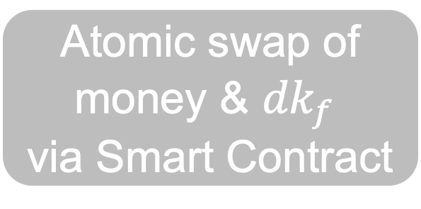
Functional Fair Exchange via Smart Contracts + FE
1
$$ad=(ek, ct)$$
money,
f: function
(Eg: fine-tuning ML model)
x: sensitive info
(Eg: medical records)
2
$$f$$
Buyer
Seller
1
$$(ek, dk) ←FE.Setup(1λ)$$
Atomic swap of
money & ${dk}_{f}$
via Smart Contract
$$ct ←FE.Encrypt\left(ek, x\right)$$
3
$${dk}_{f} ←FE.KGen(dk, f)$$
Downsides of Smart Contracts
High on-chain costs
Incompatability with Bitcoin
$$f(x)←FE.Decrypt({dk}_{f}, ct)$$
Notes:
Taking a step back, we can observe that the smart contract is essentially enabling the atomic swap of money and functional decryption key dk_f. This so far completes a conceptual explanation of how smart contracts can be used to build functional fair exchange. So, are we done?
Well, not really. It is well-known that smart contracts result in high on-chain costs and furthermore, Bitcoin’s scripting language is not powerful enough to write general-purpose smart contracts.
12:00

Slide 15
Key Challenge
Can we design Functional Fair Exchange (FFE)
protocols without using smart contracts?
Our Contributions
[VST24]: FFE via Adaptor Signatures + Functional Encryption
✅ Supports linear functions
[VGTS26]: FFE via Adaptor Signatures + Fully Homomorphic Encryption
✅ Supports arbitrary functions
Notes:
So, the key challenge that our work tries to address is: can we design functional fair exchange protocols without using smart contracts?
Our contributions are as follows: In our first work at CCS 2024, we design FFE protocols via adaptor signatures and functional encryption. Here, adaptor signatures are the key ingredient to avoid using smart contracts. Using adaptor signatures in conjunction with functional encryption is quite tricky and we show how to make it work for supporting functions f belonging the class of linear functions. In our upcoming work at Oakland 2026, we show how to broaden the scope beyond linear functions to supporting arbitrary functions by using fully homomorphic encryption instead of functional encryption.
13:00

Slide 16
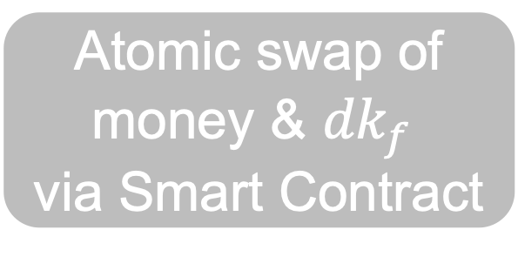
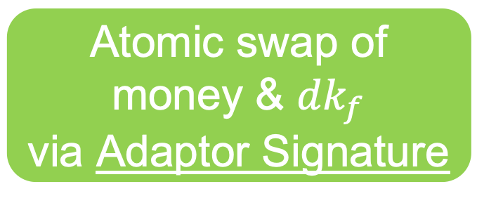
[VST24]: FFE via Adaptor Signatures + FE
1
$$ad=(ek, ct)$$
money,
f: function
(Eg: fine-tuning ML model)
x: sensitive info
(Eg: medical records)
2
$$f$$
Buyer
Seller
1
$$(ek, dk) ←FE.Setup(1λ)$$
$$ct ←FE.Encrypt\left(ek, x\right)$$
Only single signature posted to blockchain
$${dk}_{f} ←FE.KGen(dk, f)$$
Atomic swap of
money & ${dk}_{f}$
via Smart Contract
Atomic swap of
money & ${dk}_{f}$
via Adaptor Signature
3
$$f(x)←FE.Decrypt({dk}_{f}, ct)$$
Notes:
The high-level idea of our CCS24 work is that it follows the earlier smart contract template, but now uses adaptor signatures to enable the atomic swap of money and functional decryption key dk_f. Our instantiations are compatible with blockchains such as Bitcoin and our protocols result in only a single signature being posted to blockchain, which is optimial.
13:30

Slide 17

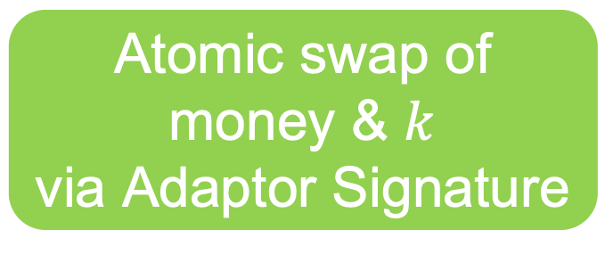
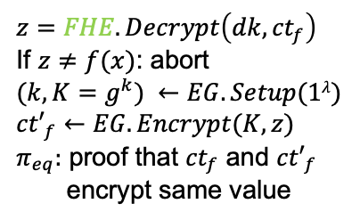





[VGTS26]: FFE via Adaptor Signatures + FHE
1
$$ad=(ek, ct)$$
money,
f: function
(Eg: fine-tuning ML model)
x: sensitive info
(Eg: medical records)
2
$${ct}_{f}, f$$
Buyer
Seller
3
${K, ct′}_{f}$, $π_{eq}$
2
$${ct}_{f} ←FHE.Eval\left(ek, f, ct\right)$$
1
$$(ek, dk) ←FHE.Setup(1λ)$$
$$ct ←FHE.Encrypt\left(ek, x\right)$$
Only single signature posted to blockchain
Atomic swap of
money & $k$
via Adaptor Signature
$$z=FHE.Decrypt\left(dk, {ct}_{f}\right)$$
If $z≠f(x)$: abort
$$(k, K=g^{k}) ←EG.Setup(1λ)$$
$${ct′}_{f}←EG.Encrypt(K, z)$$
$π_{eq}:$ proof that ${ct}_{f}$ and ${ct′}_{f}$
encrypt same value
3
$$f(x)←EG.Decrypt(k, {ct′}_{f})$$
Notes:
Second, our FHE based protocol is a little different.
First, seller sends ciphertext ct which is FHE encryption of x.
Then, the buyer can evaluate the function f on it and send back ct_f to the seller.
At this point, the seller can’t just give away decryption key dk to the buyer since it will allow the buyer to recover x fully. So, our idea is instead to decrypt ct_f to obtain message z and re-encrypt this under El Gamal encryption and send this to the buyer. Crucially, the seller also needs to give a nizk proof pi_eq proving that ct_f and ct’_f encrypt the same value.
Once this is done, it can be observed that all remains to do is an atomic swap of money and the el gamal key k. This can be done using adaptor signatures as before. At the end, the buyer uses the El Gamal key to decrypt the ciphertext ct’_f and recover f(x).
15:15

Slide 18
Functional Fair Exchange: Comparison
 | Smart contracts + FE | Adaptor Signatures + PKE | Adaptor Signatures + FE [VST24] | Adaptor Signatures + FHE [VGTS26]
Function f | arbitrary | identity | linear | arbitrary
Fairness | ✅ | ✅ | ✅ | ✅
Privacy | ✅ | ✅ | ✅ | ✅
On-chain Costs | ❌ | ✅ | ✅ | ✅
Bitcoin Compatibility | ❌ | ✅ | ✅ | ✅
Notes:
In summary, a comparison of these FFE protocols looks as follows.
Smart contract based approach support arbitrary functions but has high on-chain costs and is incompatible with blockchains such as bitcoin.
Adaptor signatures can be used in conjunction with PKE to support identity functions.
Replacing PKE with FE allows us to support linear functions.
Lastly, FHE based protocol allows us to broaden the functionality to arbitrary functions.
16:15

Slide 19

1
Warmup: Fair Exchange via AS + PKE
Functional Fair Exchange via AS + FE [VST24]
2
3
Functional Fair Exchange via AS + FHE [VGTS26]
4
Implementation & Performance
Notes:
The plan for the rest of the talk is as follows.
First, as a warm-up, we will understand adaptor signatures and how they can be used to build fair exchange protocols.
Second, we will see how to build functional fair exchange using functional encryption and understand why it can only support linear functions.
Third, I will highlight the key ideas needed for making out FHE based protocol efficient.
Lastly, I will discuss the implementation and performance of our protocols.
17:40

Slide 20

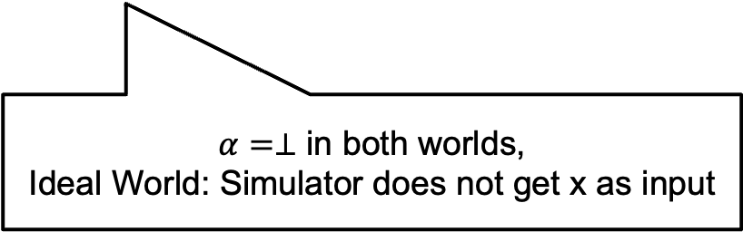


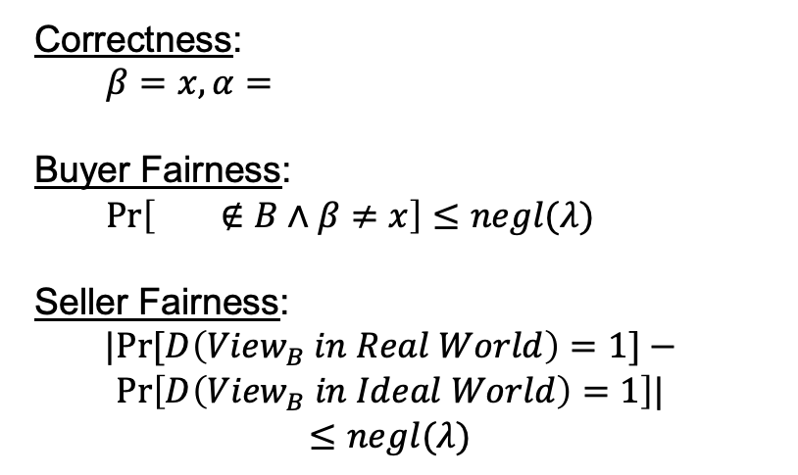


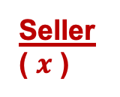

Fair Exchange [dMVVZ25]
Correctness:
$β=x, α=$
Buyer Fairness:
$\operatorname{Pr}\left[ ∉B∧β≠x\right]≤negl(λ)$
Seller Fairness:
$$|Pr⁡[D\left({View}_{B} in Real World\right)=1]−$$
$$Pr\left[D\left({View}_{B} in Ideal World\right)=1\right]|$$
$$≤negl(λ)$$
$$pp ←Setup(1^{λ})$$
Buyer
( )
Seller
( $x$ )
$$ad$$
$$ad←AdGen(pp, x)$$
$$β$$
$$α$$
$α=⊥$ in both worlds,
Ideal World: Simulator does not get x as input
Notes:
Let us start by defining Fair Exchange. There are many definitions out there and we follow the definition of dMVVZ25 since it is easy to understand.
Setup algorithm generates public parameters which are available to both buyer and seller.
Buyer has private inputs some bitcoins and seller has private input x.
Seller runs AdGen algorithm and sends advertisement to the buyer.
Then in the exchange phase, buyer, seller, and a trusted third party participate in an interactive protocol at the end of which buyer’s output is \beta, and seller’s output is \alpha. For visual simplicity, I have skipped the TTP but will highlight it in the protocols whereever it appears.
Correctness requires that if everyone is honest then beta = x and alpha = bitcoin.
Buyer fairness requires that if the buyer sent the money (aka, bitcoins don’t belong to the buyer anymore), then, \beta = x with high probability. Put another way, we require that probability that bitcoins don’t belong to the buyer and \beta \neq x is negligible.
Seller fairness requires that if the seller did not obtain money (aka, alpha = bot) then, buyer must not learn x. This is formalized via a simulation style definition where a ppt distinguisher can’t distinguish views of buyer in the real and ideal world, where the ideal world is obtained from a simulator that does not get x as input.
20:00

Slide 21
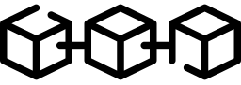
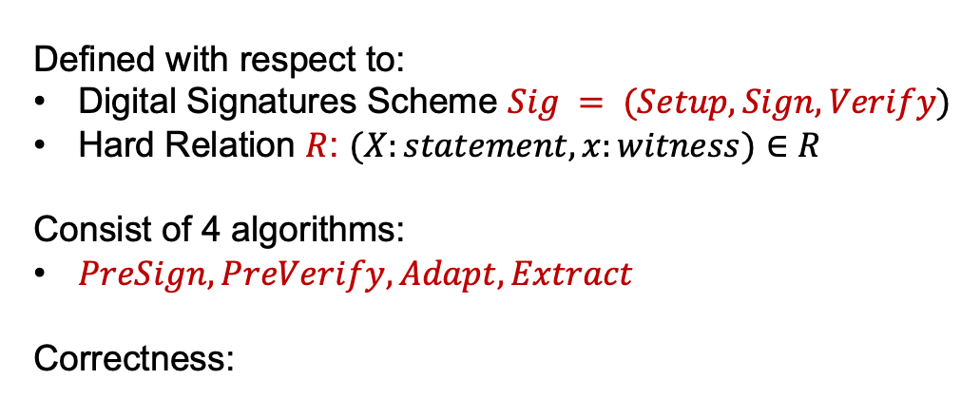




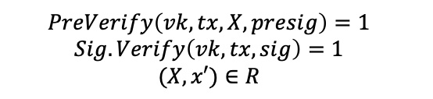

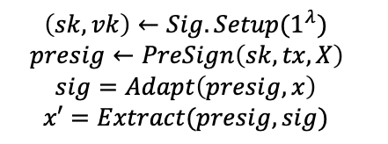


Adaptor Signature (AS)
[AEEFHMMR’21, DOY’22, GSST’24]
Buyer
(sk, )
Seller
(X, x)
Defined with respect to:
Digital Signatures Scheme $Sig = (Setup, Sign, Verify)$
Hard Relation $R$: $(X:statement, x:witness)∈R$
Consist of 4 algorithms:
$PreSign, PreVerify, Adapt, Extract$
Correctness:
$$X$$
$$PreSign$$
$$presig$$
$$PreVerify$$
$$Adapt$$
$$tx, sig$$
$$Extract$$
$$\left(sk, vk\right)←Sig.Setup(1^{λ})$$
$$presig←PreSign\left(sk, tx, X\right)$$
$$sig=Adapt\left(presig, x\right)$$
$$x′=Extract(presig, sig)$$
$$PreVerify\left(vk, tx, X, presig\right)=1$$
$$Sig.Verify\left(vk, tx, sig\right)=1$$
$$(X, x′)∈R$$
If
, then
Notes:
3.5
Adaptor Signatures are defined with respect to a digital signature scheme and a hard relation. The syntax consists of 4 algorithms: … . Let us understand these algorithms via the fair exchange application.
23:00

Slide 22
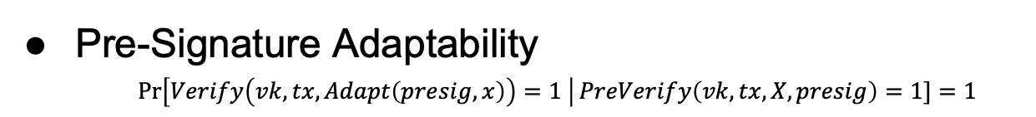
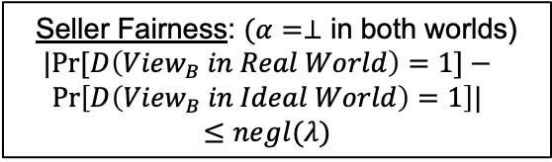

Adaptor Signature (AS): Security
Buyer
(sk, )
Seller
(X, x)
AS: Security against Malicious Seller
$$X$$
Unforgeability
Witness Extractability
Buyer Fairness:
$$\operatorname{Pr}\left[ ∉B∧β≠x\right]≤negl(λ)$$
$$PreSign$$
$$presig$$
$$PreVerify$$
$$Adapt$$
$$tx, sig$$
AS: Security against Malicious Buyer
$$Extract$$
Pre-Signature Adaptability
$\operatorname{Pr}\left[Verify\left(vk, tx, Adapt\left(presig, x\right)\right)=1 \right|PreVerify\left(vk, tx, X, presig\right)=1]=1$
Seller Fairness: $(α=⊥$ in both worlds)
$$|Pr⁡[D\left({View}_{B} in Real World\right)=1]−$$
$$Pr\left[D\left({View}_{B} in Ideal World\right)=1\right]|$$
$$≤negl(λ)$$
Notes:
26:00

Slide 23
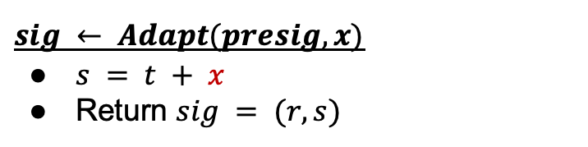
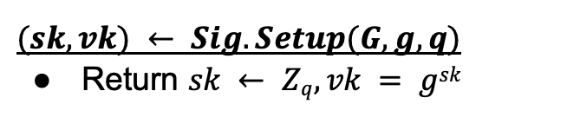
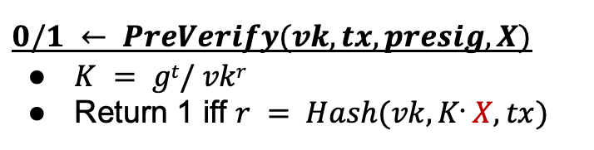
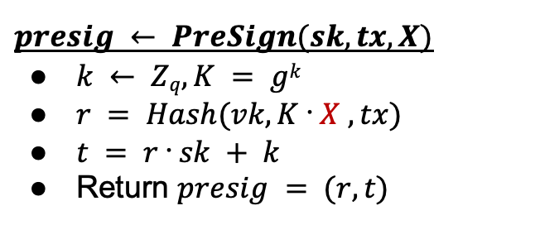
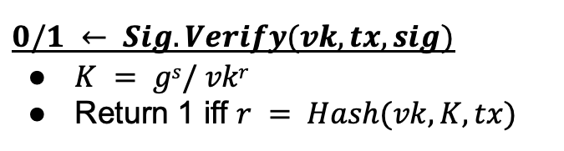
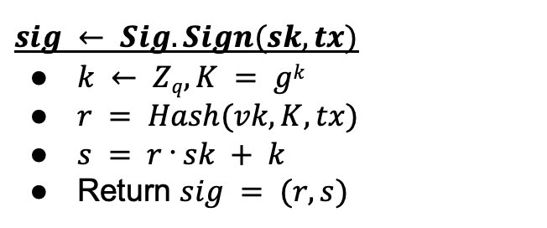
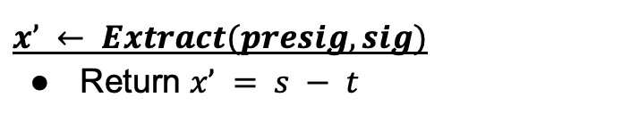
Schnorr Adaptor Signature [AEEFHMMR’21]
$$(sk, vk) ← Sig.Setup(G, g, q)$$
Return $sk ← Zq, vk = gsk$
$$presig ← PreSign(sk, tx, X)$$
$k ← Zq, K = gk$
$r = Hash(vk, K ᐧ X , tx)$
$t = r ᐧ sk + k$
Return $presig = (r, t)$
X = g^{x}
$$sig ← Sig.Sign(sk, tx)$$
$k ← Zq, K = gk$
$r = Hash(vk, K, tx)$
$s = r ᐧ sk + k$
Return $sig = (r, s)$
$$0/1 ← PreVerify(vk, tx, presig, X)$$
$K = gt/ vkr$
Return 1 iff $r = Hash(vk, Kᐧ X, tx)$
$$0/1 ← Sig.Verify(vk, tx, sig)$$
$K = gs/ vkr$
Return 1 iff $r = Hash(vk, K, tx)$
$$sig ← Adapt(presig, x)$$
$s = t + x$
Return $sig = (r, s)$
$$x’ ← Extract(presig, sig)$$
Return $x’ = s − t$
Notes:
30:00

Slide 24
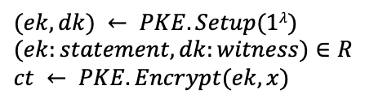
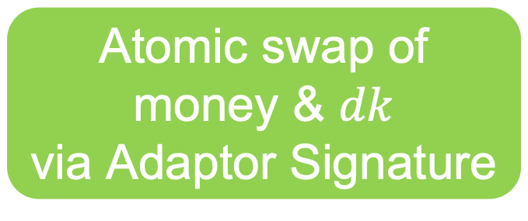



Fair Exchange via Adaptor Signatures (AS)
Buyer ( )
Seller ( $x$ )
$$(ek, dk) ← PKE.Setup(1λ)$$
$$(ek:statement, dk:witness)∈R$$
$$ct ← PKE.Encrypt(ek, x)$$
$$ad=(ek, ct)$$
Atomic swap of
money & $dk$
via Adaptor Signature
$$x = PKE.Decrypt(dk, ct)$$
Notes:
32:30

Slide 25


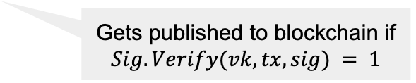




Fair Exchange via Adaptor Signatures (AS)
Buyer ( )
Seller ( $x$ )
$$(ek, dk) ← PKE.Setup(1λ)$$
$$(ek:statement, dk:witness)∈R$$
$$ct ← PKE.Encrypt(ek, x)$$
$$ad=(ek, ct)$$
$$\left(sk, vk\right)←Sig.Setup(1^{λ})$$
tx: buyer seller
$$presig$$
If $PreVerify\left(vk, tx, ek, presig\right)=0$: abort
$$tx, sig$$
$$sig=Adapt\left(presig, dk\right)$$
$$presig←PreSign\left(sk, tx, ek\right)$$
Gets published to blockchain if
$$Sig.Verify(vk, tx, sig) = 1$$
$dk ← Extract(presig, sig$)
Blockchain
$$x = PKE.Decrypt(dk, ct)$$
Notes:
33:00

Slide 26
Fair Exchange via Adaptor Signatures (AS)
Buyer ( )
Seller ( $x$ )
$$(ek, dk) ← PKE.Setup(1λ)$$
$$(ek:statement, dk:witness)∈R$$
$$ct ← PKE.Encrypt(ek, x)$$
$$ad=(ek, ct)$$
Example Instantiation: PKE = El Gamal Encryption
R = Discrete Log Relation
Sig = Schnorr Signature
AS = Schnorr Adaptor Signature
$$\left(sk, vk\right)←Sig.Setup(1^{λ})$$
tx: buyer seller
$$presig$$
If $PreVerify\left(vk, tx, ek, presig\right)=0$: abort
$$tx, sig$$
$$sig=Adapt\left(presig, dk\right)$$
$$presig←PreSign\left(sk, tx, ek\right)$$
Gets published to blockchain if
$$Sig.Verify(vk, tx, sig) = 1$$
$dk ← Extract(presig, sig$)
Blockchain
$$x = PKE.Decrypt(dk, ct)$$
Notes:
33:00

Slide 27



Buyer and Seller Fairness
Buyer
(sk, )
Seller
(x)
Buyer Fairness
$$ad=(ek, ct)$$
Unforgeability of AS
Witness Extractability of AS
$$presig$$
$$tx, sig$$
$$x$$
Seller Fairness
Pre-Signature Adaptability of AS
Semantic Security of PKE
Notes:
35:00

Slide 28



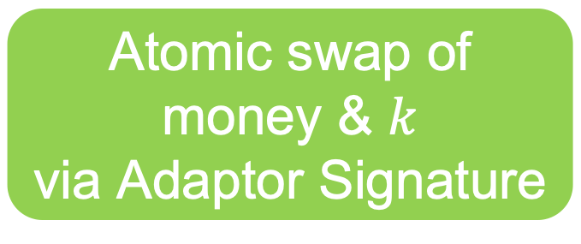


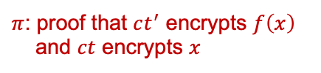
Strawman: FFE via Adaptor Signatures + PKE + NIZK
Buyer ( f, )
Seller ( x )
1
$$ad=(ek, ct)$$
1
$$(ek, dk) ←PKE.Setup(1λ)$$
$$ct ←PKE.Encrypt\left(ek, x\right)$$
2
$$f$$
3
$\left(k, K=g^{k}\right)←EG.Setup(1λ$)
$$ct^{′}←EG.Encrypt\left(K, f\left(x\right)\right)$$
3
$$K, ct^{′}, π$$
$π$: proof that $ct^{′}$ encrypts $f\left(x\right)$
and $ct$ encrypts $x$
Only single signature posted to blockchain
Atomic swap of
money & $k$
via Adaptor Signature
$$f(x)←EG.Decrypt(k, ct′)$$
Notes:
36:00

Slide 29
Strawman: FFE via Adaptor Signatures + PKE + NIZK
Main Challenge: Design Seller-optimized protocol?
Inefficient Seller: cryptographic operations depend on complexity of f
$π$: proof that $ct^{′}$ encrypts $f\left(x\right)$
and $ct$ encrypts $x$
In fine-tuning ML application,
Buyer has more compute resources than Seller
👀
Notes:
36:30

Slide 30
1
Warmup: Fair Exchange via AS + PKE
Functional Fair Exchange via AS + FE [VST24]
2
3
Functional Fair Exchange via AS + FHE [VGTS26]
4
Implementation & Performance
Notes:
37:00

Slide 31
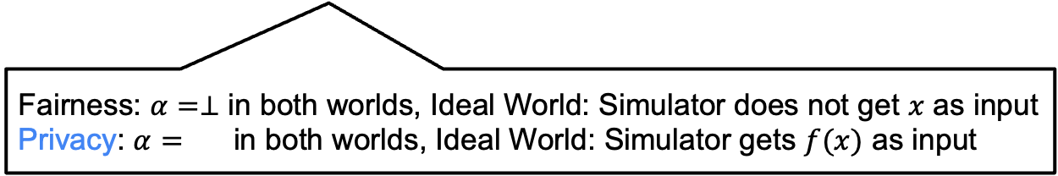
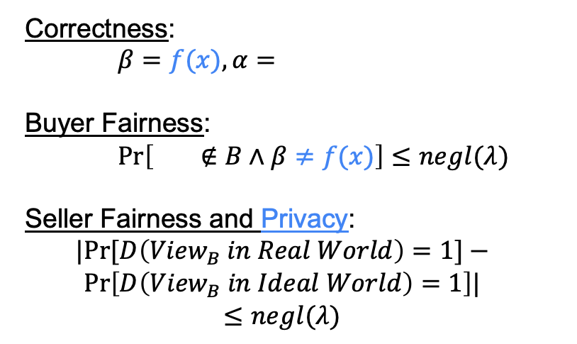
Functional Fair Exchange [VGTS26]
Correctness:
$β=f(x), α=$
Buyer Fairness:
$\operatorname{Pr}\left[ ∉B∧β≠f(x)\right]≤negl(λ)$
Seller Fairness and Privacy:
$$|Pr⁡[D\left({View}_{B} in Real World\right)=1]−$$
$$Pr\left[D\left({View}_{B} in Ideal World\right)=1\right]|$$
$$≤negl(λ)$$
$$pp ←Setup(1^{λ})$$
Buyer
(f, )
Seller
( $x$ )
$$ad$$
$$ad←AdGen(pp, x)$$
$$β$$
$$α$$
Fairness: $α=⊥$ in both worlds, Ideal World: Simulator does not get $x$ as input
Privacy: $α=$ in both worlds, Ideal World: Simulator gets $f(x)$ as input
Notes:
39:30

Slide 32
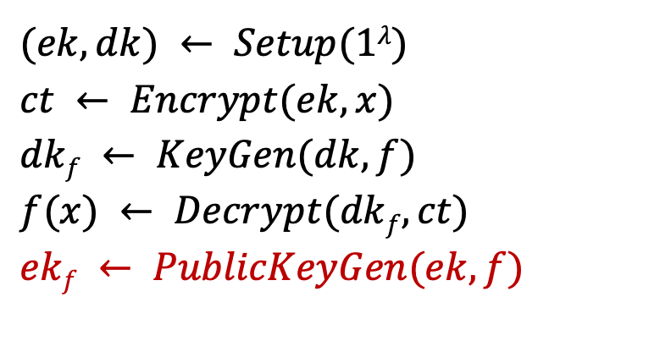

Augmenting FE with PublicKeyGen Algorithm
$$(ek, dk) ← Setup(1λ)$$
$$ct ← Encrypt(ek, x)$$
$$dkf ← KeyGen(dk, f)$$
$$f(x) ← Decrypt(dkf, ct)$$
$$ekf ← PublicKeyGen(ek, f)$$
Deterministic algorithm
Does not affect Correctness and Security definitions of FE
New Property: $R$-compliant FE
$(ekf, dkf) ∈ R$, where $R$ is a hard relation
Notes:
we augment FE with a public keygen algorithm. This is analogous to the keygen algorithm, but differs in that it takes mpk and f as input and outputs pkf.
We need it to be a deterministic algorithm. Further, this algorithm does not affect the correctness or security definitions of FE since it is a public algorithm. So, why are are we even doing this? It will be useful for our FAS construction on the next slide.
We define a new compliance property for FE. We say that an FE scheme is R-compliant if (pkf, skf) satisfy the hard relation R.
42:00

Slide 33


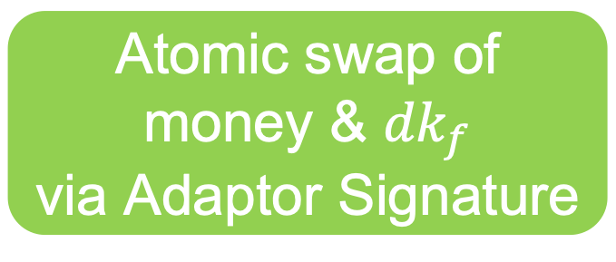


[VST24]: FFE via Adaptor Signatures + FE
Buyer ( f, )
Seller ( x )
1
$$ad=(ek, ct)$$
1
$$(ek, dk) ←FE.Setup(1λ)$$
$$ct ←FE.Encrypt\left(ek, x\right)$$
2
$$f$$
3
$${dk}_{f} ←FE.KGen(dk, f)$$
Only single signature posted to blockchain
Atomic swap of
money & ${dk}_{f}$
via Adaptor Signature
$$f(x)←FE.Decrypt({dk}_{f}, ct)$$
Notes:
43:00

Slide 34
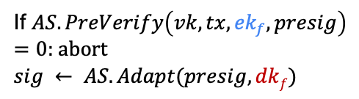



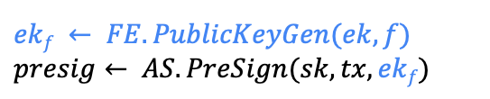

[VST24]: FFE via Adaptor Signatures + FE
Buyer ( f, )
Seller ( x )
1
$$ad=(ek, ct)$$
1
$$(ek, dk) ←FE.Setup(1λ)$$
$$ct ←FE.Encrypt\left(ek, x\right)$$
2
$$f$$
3
$${dk}_{f} ←FE.KGen(dk, f)$$
$$\left(sk, vk\right)←Sig.Setup(1^{λ})$$
tx: buyer seller
$$ekf ← FE.PublicKeyGen(ek, f)$$
$$presig← AS.PreSign(sk, tx, ekf)$$
$$tx, presig$$
2
3
$$tx, sig$$
(via blockchain)
If $AS.PreVerify\left(vk, tx, {ek}_{f}, presig\right)$
$=0$: abort
$$sig ← AS.Adapt(presig, dkf)$$
$${dk}_{f}=AS.Extract(presig, sig)$$
$$f(x)←FE.Decrypt({dk}_{f}, ct)$$
Notes:
44:00

Slide 35
[VST24]: FFE via Adaptor Signatures + FE
Theorem:
Unforgeability of AS + Witness Extractability of AS ➔ Buyer Fairness of FFE
Pre-signature Adaptability of AS + IND-sec of FE ➔Seller Fairness of FFE
Pre-signature Adaptability of AS + IND-sec of FE ➔Seller Privacy of FFE (variant)
Challenge 1: Compatibility of FE and AS
If AS is for hard relation R, then FE needs to be R-compliant
Need to choose AS that is used on blockchains
Solution:
Schnorr AS: R is Discrete Log relation
[ABDP15] FE for linear functions can be augmented with PublicKeyGen algorithm to make it R-compliant
If $AS.PreVerify\left(vk, tx, {ek}_{f}, presig\right)$
$=0$: abort
$$sig ← AS.Adapt(presig, dkf)$$
Notes:
46:00

Slide 36

Challenge 2: No known FE scheme beyond linear functions
that is R-compliant
Build Functional Fair Exchange (FFE) using FHE
Notes:
46:00

Slide 37
1
Warmup: Fair Exchange via AS + PKE
Functional Fair Exchange via AS + FE [VST24]
2
3
Functional Fair Exchange via AS + FHE [VGTS26]
4
Implementation & Performance
Notes:
46:30

Slide 38






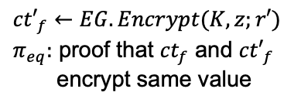
[VGTS26]: FFE via Adaptor Signatures + FHE
Buyer ( f, )
Seller ( x )
1
$$ad=(ek, ct)$$
1
$$(ek, dk) ←FHE.Setup(1λ)$$
$$ct ←FHE.Encrypt\left(ek, x;r\right)$$
2
$${ct}_{f} ←FHE.Eval\left(ek, f, ct\right)$$
2
$${ct}_{f}, f$$
3
$$z=FHE.Decrypt\left(dk, {ct}_{f}\right)$$
3
${K, ct′}_{f}$, $π_{eq}$
If $z≠f(x)$: abort
$$(k, K=g^{k}) ←EG.Setup(1λ)$$
Only single signature posted to blockchain
$${ct′}_{f}←EG.Encrypt(K, z;r′)$$
$π_{eq}:$ proof that ${ct}_{f}$ and ${ct′}_{f}$
encrypt same value
Atomic swap of
money & $k$
via Adaptor Signature
Novelty
$$f(x)←EG.Decrypt(k, {ct′}_{f})$$
Notes:
50:00

Slide 39

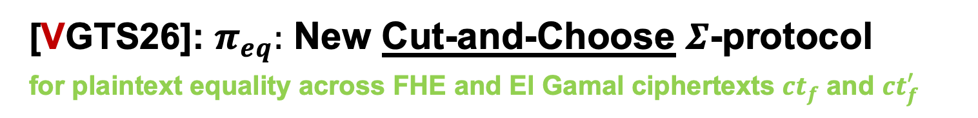


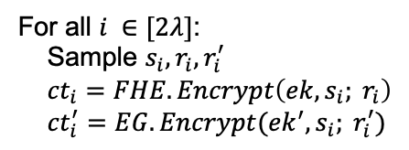
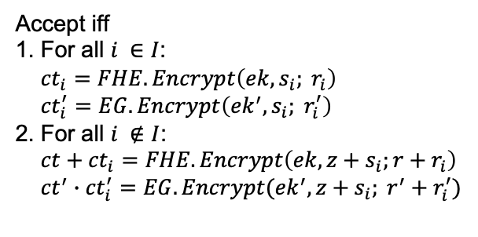


[VGTS26]: $π_{eq}:$ New Cut-and-Choose $Σ$-protocol
for plaintext equality across FHE and El Gamal ciphertexts $ct_{f}$ and $ct_{f}^{′}$
$$stmt=\left(ek, ek^{′}, ct, ct^{′}\right), wit=\left(z, r, r^{′}\right) s.t.$$
$$ct=FHE.Encrypt\left(ek, z;r\right), ct^{′}=EG.Encrypt(ek^{′}, z;r^{′})$$
Prover
Verifier
For all $i ∈[2λ]$:
Sample $s_{i}, r_{i}, r_{i}^{′}$
${ct}_{i}=FHE.Encrypt\left(ek, s_{i}; r_{i}\right)$
${ct}_{i}^{′}=EG.Encrypt({ek}^{′}, s_{i}; r_{i}^{′})$
$$\{{ct}_{i}, {ct}_{i}^{′}\}_{i ∈[2λ]}$$
$$I$$
Choose random set $I$ of size $λ$
$$\{s_{i}, r_{i}, r_{i}^{′}\}_{i ∈I},$$
$$\{{z+s}_{i}, {r+r}_{i}, r^{′}+r_{i}^{′}\}_{i ∉I}$$
Accept iff
1. For all $i ∈I$:
${ct}_{i}=FHE.Encrypt\left(ek, s_{i}; r_{i}\right)$
${ct}_{i}^{′}=EG.Encrypt\left({ek}^{′}, s_{i}; r_{i}^{′}\right)$
2. For all $i ∉I$:
$ct+{ct}_{i}=FHE.Encrypt\left(ek, z+s_{i};r+r_{i}\right)$
${ct}^{′}∙{ct}_{i}^{′}=EG.Encrypt({ek}^{′}, z+s_{i}; r^{′}+r_{i}^{′})$
Notes:
50:30

Slide 40

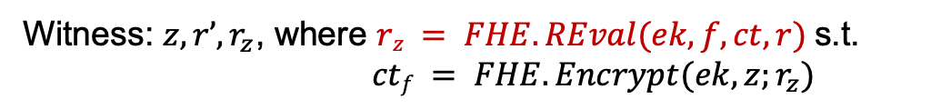
[VGTS26]: FFE via Adaptor Signatures + FHE
Buyer ( f, )
Seller ( x )
$$ct ←FHE.Encrypt\left(ek, x;r\right)$$
$${ct}_{f} ←FHE.Eval\left(ek, f, ct\right)$$
Naïve and inefficient witness computation:
Depends on complexity of $f$ !
$$z=FHE.Decrypt\left(dk, {ct}_{f}\right)$$
Witness: $z, r’,r_{z}$, where $rz = FHE.REval(ek, f, ct, r)$s.t.
$ctf = FHE.Encrypt(ek, z;r_{z})$
$${ct′}_{f}←EG.Encrypt(K, z;r′)$$
$π_{eq}:$ proof that ${ct}_{f}$ and ${ct′}_{f}$
encrypt same value
Optimized and efficient witness computation:
Depends only on output length of $f$ !
Witness: $z, r’, r_{z}$, where $rz = FHE.REval(r_{ksk}, ctf) = \left\langle rksk, ctf\right\rangle$s.t.
$FHE.KeySwitch(ksk, ctf) = FHE.Encrypt(ek, z;r_{z})$
Notes:
54:00

Slide 41
[VGTS26] FFE via Adaptor Signatures + FHE: Security
Theorem:
Unforgeability of Sig + Witness Extractability of AS + Adaptive Soundness of NIZK
➔ Buyer Fairness of FFE
Zero-Knowledge of NIZK + Semantic Security of FHE + Semantic Security of El Gamal ➔Seller Fairness of FFE
Zero-Knowledge of NIZK + Semantic Security of FHE
➔Seller Privacy of FFE

Slide 42
1
Warmup: Fair Exchange via AS + PKE
Functional Fair Exchange via AS + FE [VST24]
2
3
Functional Fair Exchange via AS + FHE [VGTS26]
4
Implementation & Performance
Notes:
54:30

Slide 43
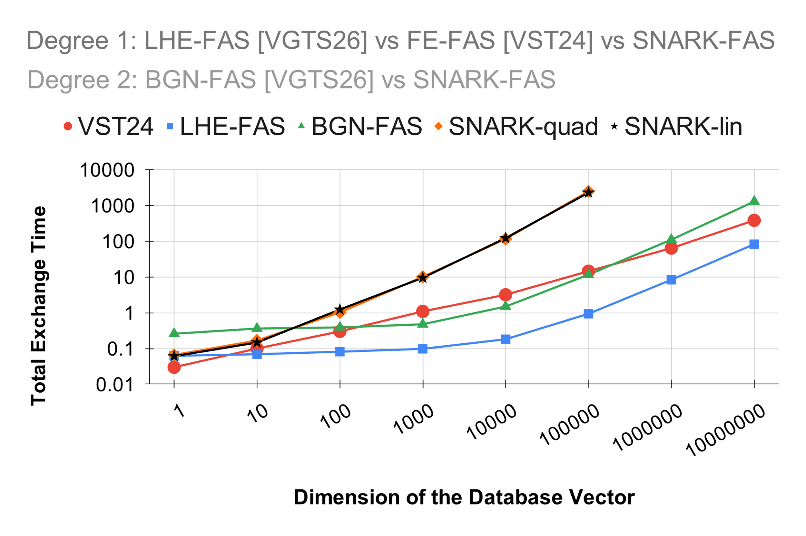
Implementation and Performance
Aside:
FAS ➔ FFE
Notes:
55:30

Slide 44
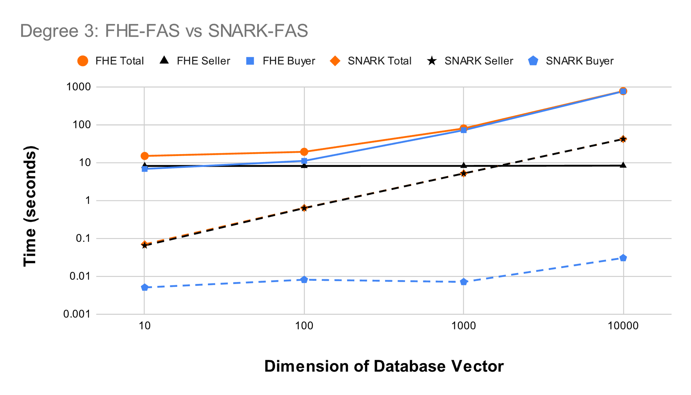
Implementation and Performance
Aside:
FAS ➔ FFE
Notes:
56:30

Slide 45
Summary
Functional Fair Exchange definition
FFE via AS + PKE + NIZK: buyer optimized
FFE via AS + FE: seller optimized
FFE via AS + FHE: seller optimized
Also in papers
Functional Adaptor Signatures (FAS) definition
  FAS ➔ FFE
FE-based instantiations: groups, lattices
HE-based instantiations: El Gamal, BGN, TFHE
Proofs
Notes:
57:00

Slide 46
Open Questions
Computation vs communication tradeoffs
Multi-seller setting
Dual notion (buyer: x, seller: f)
Enabling more use cases on Bitcoin
(i.e., without using Smart Contracts)
Notes:
58:00

Slide 47
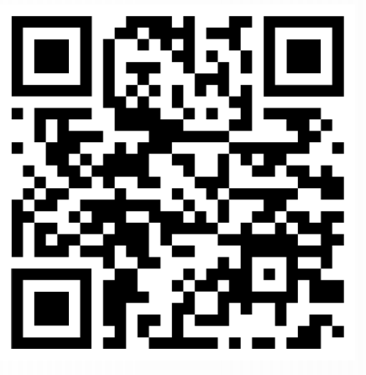
Thank You!
nikhilvanjani61@gmail.com
[VST24] Paper: https://eprint.iacr.org/2024/1523
[VST24] Code: https://github.com/nikhilvanjani/fas-impl
[VGTS26] Paper: coming soon
[VGTS26] Code: https://github.com/nikhilvanjani/fas-from-he-impl
Notes:
58:00

Slide 49
Extra Slides
Notes:
Section 0: 12:00 min.
Section 1: 29:00 min (17:00 min).
Section 2: 34:00 min (4:30 min).
Section 3: 59:00 min (25 min).

Slide 50
Intro
Notes:
Section 0: 12:00 min.
Section 1: 29:00 min (17:00 min).
Section 2: 34:00 min (4:30 min).
Section 3: 59:00 min (25 min).

Slide 51



Modern Systems
$$x$$
$$f$$
$$f(x)$$
Cloud Service

Slide 52


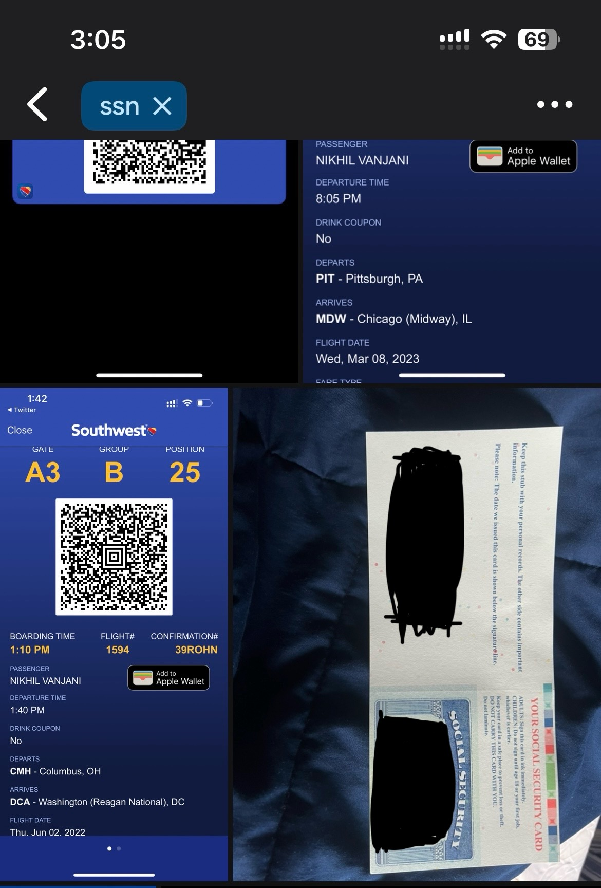
Modern Systems
ssn
Google Photos
Homomorphic Encryption

Slide 53





Beginning - 1975
Feeling sick
Get medical test
Alice
Doctor
Alice’s report
f
Alice’s sample
Alice’s Diagnosis
Alice’s report
Request data
Lab
Researcher

Slide 54

2000
Public Key Encryption
Feeling sick
Get medical test
Alice
Doctor
Alice’s report
f
Alice’s sample
Alice’s Diagnosis
Alice’s report
Request data
Lab
Researcher

Slide 55

2025
Public Key Encryption
Feeling sick
Get medical test
Alice
Doctor
Cloud Storage
f
Alice’s report
Test sample
Alice’s Diagnosis
Cloud Compute
Request data
Lab
Researcher

Slide 56

2025
Public Key Encryption
“all-or-nothing” access
Cloud Storage
f
❌ Centralized trust
Cloud Compute
❌ No privacy
❌ Not compliant with privacy regulations, e.g., HIPAA

Slide 57
Functional Encryption
“fine-grained” access
Cloud Storage via ABE
f
✅ Decentralized access control
Cloud Compute on encrypted data
✅ Meaningful privacy
✅ Compliant with privacy regulations, e.g., HIPAA

Slide 58
Fair Exchange
Notes:
Section 0: 12:00 min.
Section 1: 29:00 min (17:00 min).
Section 2: 34:00 min (4:30 min).
Section 3: 59:00 min (25 min).

Slide 59

1
Warmup: Fair Exchange via Adaptor Signatures
2
Constructions of Functional Fair Exchange
NIZK
FE
FHE
3
Implementation and Performance
Notes:
3.25
The roadmap for the rest of the talk is as follows.

Slide 60
1
Warmup: Fair Exchange via Adaptor Signatures
2
Constructions of Functional Fair Exchange
NIZK
FE
FHE
3
Implementation and Performance
Notes:
3.25
The roadmap for the rest of the talk is as follows.

Slide 61




Strawman: NIZK + EG + Schnorr AS
Buyer ( f, )
Seller ( x )
$$\left(sk, vk\right)←Sig.Setup(1^{λ})$$
$$ad$$
1
2
$$presig$$
3
$$tx, sig$$
(via blockchain)
4
Notes:
7
For the strawman construction, I will describe the AdGen, FPreSign, Adapt and FExt algorithms. The remaining algorithms Setup, AdVerifty and FPreVerify follow in a natural way from these and I will skip their description.

Slide 62


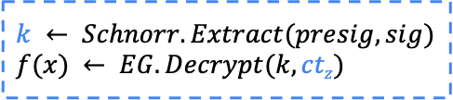



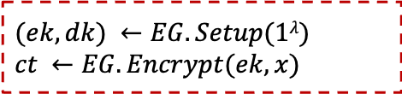

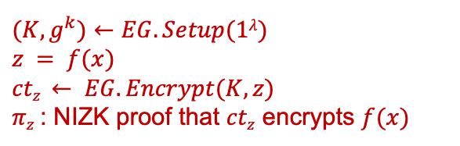
Strawman: NIZK + EG + Schnorr AS
Buyer ( f, )
Seller ( x )
$$\left(sk, vk\right)←Sig.Setup(1^{λ})$$
$$ad = (ek, ct)$$
1
$$(ek, dk) ←EG.Setup(1λ)$$
$$ct ←EG.Encrypt(ek, x)$$
2
tx: buyer seller
$$f$$
$$(K, g^{k})←EG.Setup(1λ)$$
$$z = f(x)$$
$$ctz ← EG.Encrypt(K, z)$$
$πz$: NIZK proof that $ctz$ encrypts $f(x)$
$$K, ctz , πz$$
$$presig ← Schnorr.PreSign(sk, tx, K)$$
$$tx, presig$$
3
$$sig ← Schnorr.Adapt(presig, k)$$
$$tx, sig$$
(via blockchain)
4
$$k ← Schnorr.Extract(presig, sig)$$
$$f(x) ← EG.Decrypt(k, ctz)$$
Notes:
8.5
The seller sends ad = (ct, \pi), where ct is a PKE encryption of x and a NIZK proof \pi that ct encrypts x.
For FPreSign, the buyer sends f to the seller. The seller samples SKE key k, computes f(x) and encrypts it under k to obtain ct_f. Further, it computes a NIZK proof \pi_f that ct_f encrypts f(x). Seller sends ct_f, pi_f to the buyer.
Observe that the buyer can learn f(x) if it can obtain the key k. So, the idea is to use a standard adaptor signature scheme that enables extracting SKE key k.
Towards this, it must be the case that in the Adapt phase, the seller uses k to adapt the pre-signature into a full signature.
And to enable this, the buyer must pre-sign with respect to an appropriate statement capital K which it obtains from the seller.
One natural choice is that the seller sets K=g^k, thus (K, k) satisfy the discrete log relation. So, we can use the Schnorr Adaptor Signature scheme which is defined with respect to the discrete log relation. This completes the description of the strawman construction. While this protocol is correct and can be shown to be secure, it is quite inefficient.

Slide 63
Strawman: NIZK + Schnorr Adaptor Signature
Protocol optimized for buyer, not seller
Typical Application
Buyer: Research Lab
f: fine-tuning ML model
Seller: Hospital
x: medical records dataset
More compute resources
Less compute resources
Seller optimized protocols using FE [VST24], FHE [VGTS24]
Notes:
9.25
The main source of inefficiency is that the seller computes a NIZK proof for every FPreSign interaction.
While the proof size can be reduced using ZK-SNARKs,
the proving time still grows super-linearly in the size of witness x.
So, the baseline efficiency goals for FPreSign should be that the seller computation is linear in size of x, while its communication is linear in size of f(x).
Towards achieving this goal, our idea to avoid using NIZKs FPreSign and we accomplish this by using functional encryption instead of public-key encryption.

Slide 64
1
Warmup: Fair Exchange via Adaptor Signatures
2
Constructions of Functional Fair Exchange
NIZK
FE
FHE
3
Implementation and Performance
Notes:
3.25
The roadmap for the rest of the talk is as follows.

Slide 65
Summary
Functional Adaptor Signature definition
SNARK-based FAS
FE-based FAS
FHE-based FAS
Also in papers
Functional Fair Exchange definition
FE-based instantiations: groups, lattices
HE-based instantiations: El Gamal, BGN, TFHE
Proofs
Notes:
14.5
This completes the technical part of the talk and I will leave you with two open questions.
Can we build more efficient FAS instantiations for larger witnesses?
Can we build FAS for broader class of functions beyond linear functions? While FE for broader classes are known, those constructions are not compliant with adaptor signatures used on blockchains.
With this, I thank you for your time. You can find our paper and implementation at these links.

Slide 66
Fair Exchange
2
Notes:
Section 0: 12:00 min.
Section 1: 29:00 min (17:00 min).
Section 2: 34:00 min (4:30 min).
Section 3: 59:00 min (25 min).

Slide 67
Functional Fair Exchange (FFE) of Digital Goods
 | Smart contracts | Adaptor Signatures | Functional Adaptor Signatures ([VST24])
Function f | arbitrary | identity | [VST24]: linear, [VGTS24]: arbitrary
Fairness | ✅ | ✅ | ✅
Privacy | ✅ | ✅ | ✅
Infrastructure Costs | ❌ | ✅ | ✅
Infrastructure Compatibility | ❌ | ✅ | ✅
Notes:
2.25
Smart contracts can be used for enabling such functional sales, but they suffer from three main limitations. They can’t guarantee privacy of the sensitive information x as defined above, have huge on-chain costs and are not compatible with blockchains such as bitcoin. On the other hand, adaptor signatures is a novel cryptographic primitive that can be used to address these shortcomings of smart contracts. But their main downside is that they can only be used to sell all of x and can’t enable functional sales such as f(x). In this work, we introduce functional adaptor signatures that can be used to solve all of these challenges.

Slide 68
1
Warmup: Fair Exchange via Adaptor Signatures
2
Functional Fair Exchange via Functional Adaptor Signatures
3
Constructions of Functional Adaptor Signatures
4
Implementation and Performance
Notes:
3.25
The roadmap for the rest of the talk is as follows.

Slide 69
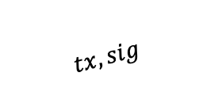






Fair Exchange via Adaptor Signatures (AS)
Buyer
Seller
$$\left(sk, vk\right)←Sig.Setup(1^{λ})$$
$$(X:statement, x:witness)∈R$$
$$X$$
tx: buyer seller
$$presig←PreSign\left(sk, tx, X\right)$$
$$presig$$
If $PreVerify\left(vk, tx, X, presig\right)=0$: abort
$$sig=Adapt\left(presig, x\right)$$
$$tx, sig$$
$$x’ ← Extract(presig, sig)$$
Gets published to blockchain if
$$Sig.Verify(vk, tx, sig) = 1$$
Blockchain
Notes:
If this seems unbelievable, please ask. I am happy to give a quick example to help build intuition.

Slide 70
Adaptor Signature Security
Buyer
Seller
Security against Malicious Seller
$$X$$
Unforgeability
Witness Extractability
$$presig$$
$$tx, sig$$
$$x$$
Security against Malicious Buyer
Pre-Signature Adaptability
Notes:
6
Let me briefly touch about FAS security. We define FAS security properties against malicious seller and buyer. Against malicious seller, we need unforgeability and witness extractability. Against malicious buyer, we need pre-signature adaptability and witness privacy.
The first three properties are similar to those considered in standard adaptor signatures and I won’t go into their details today.
I will talk a bit about witness privacy, which is the new security property of FAS.

Slide 71
1
Warmup: Fair Exchange via Adaptor Signatures
2
Functional Fair Exchange via Functional Adaptor Signatures
3
Constructions of Functional Adaptor Signatures
4
Implementation and Performance
Notes:
3.25
The roadmap for the rest of the talk is as follows.

Slide 72
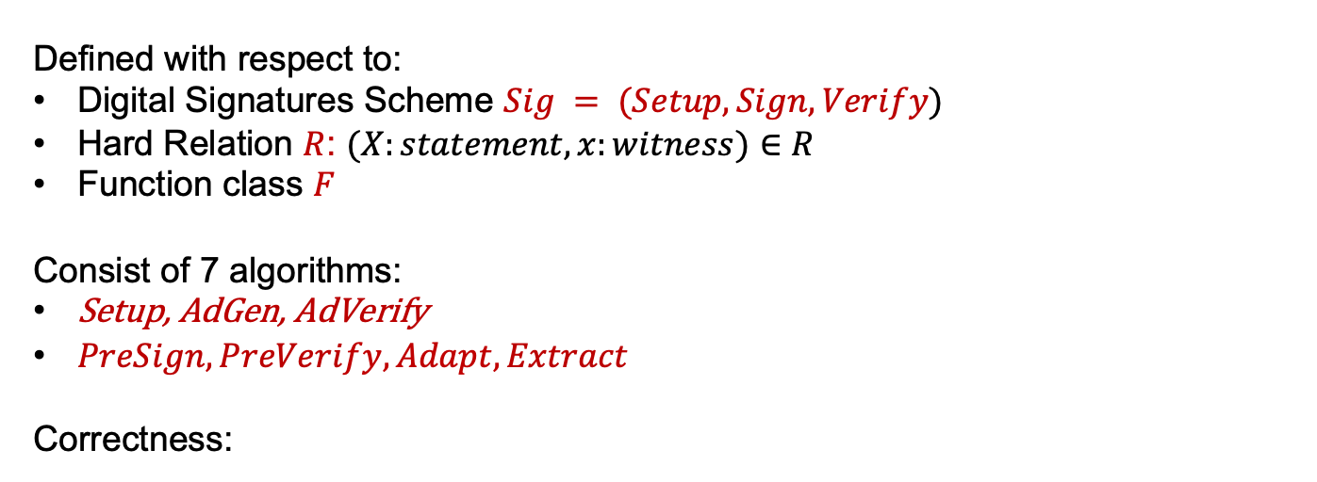
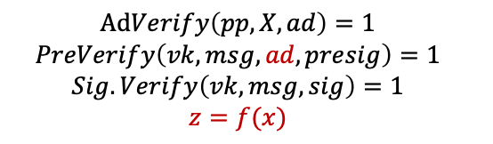
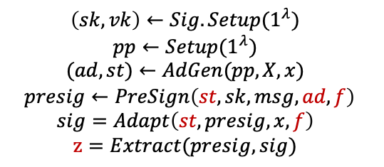
Functional Adaptor Signature (AS) [VST24]
Defined with respect to:
Digital Signatures Scheme $Sig = (Setup, Sign, Verify)$
Hard Relation $R$: $(X:statement, x:witness)∈R$
Function class $F$
Consist of 7 algorithms:
Setup, AdGen, AdVerify
$PreSign, PreVerify, Adapt, Extract$
Correctness:
$$\left(sk, vk\right)←Sig.Setup(1^{λ})$$
$$pp←Setup(1^{λ})$$
$$(ad, st)←AdGen(pp, X, x)$$
$$presig←PreSign\left(st, sk, msg, ad, f\right)$$
$$sig=Adapt\left(st,presig, x, f\right)$$
$$z=Extract(presig, sig)$$
$$AdVerify\left(pp, X, ad\right)=1$$
$$PreVerify\left(vk, msg, ad, presig\right)=1$$
$$Sig.Verify\left(vk, msg, sig\right)=1$$
$$z=f(x)$$
If
, then
Notes:
3.5
Adaptor Signatures are defined with respect to a digital signature scheme and a hard relation. The syntax consists of 4 algorithms: … . Let us understand these algorithms via the fair exchange application.

Slide 73









Functional Fair Exchange via FAS
Buyer
Seller
$$(pp, ad, sk, vk)$$
$$(pp, X, x, st, vk)$$
Trusted Third Party
$$pp ← Setup(1λ)$$
$$(sk, vk) ← Sig.Setup(1λ)$$
$$(X: statement, x: witness) ∈ R$$
$$vk$$
$$(ad, st) ← AdGen(pp, X, x)$$
$$ad$$
(via website)
If $AdVerify(pp, X, ad)=0$: abort
Notes:
4.5
A trusted third party runs the Setup algorithm and outputs the public parameters pp to both seller and buyer.
The buyer samples its signing and verification keys and sends vk to the seller. The seller sample a statement capital X and a witness x satisfying the relation R and sends the statement capital X to the buyer.
Suppose now the buyer wants to buys a function f \in F. Then, the buyer creates a transaction tx for this purpose.
The main protocol begins after this point that I will describe on the next slide. For sake of simplicity going forward, we will assume the inputs of the buyer are (pp, X, sk, vk, tx, f) and those of the seller are (pp, X, x, vk) as described here.

Slide 74





Functional Fair Exchange via FAS
Buyer
$$(pp, ad, sk, vk)$$
Seller
$$(pp, X, x, st, vk)$$
f ∈ F
tx: buyer seller
$$presig←PreSign\left(st, sk, tx, ad, f\right)$$
If $PreVerify\left(vk, msg, ad, presig\right)=0$: abort
$$sig=Adapt\left(st,presig, x, f\right)$$
$$tx, sig$$
(via blockchain)
$$f(x)=Extract(presig, sig)$$
Notes:
5.5
The seller runs the AdGen algorithm and sends the ad to the buyer. This does not need a secure private channel between the two and seller can do this by publishing ad on a website. The buyer verifies the ad via the AdVerify algorithm.
If the ad verification passes, then, it engages in an interactive protocol with the buyer to run FPreSign and compute the presignature. The seller verifies the presignature via FPreVerify algorithm.
If the presignature verification passes, the seller uses the witness x and function f to adapt the presignature into a full-signature and publishes the transaction and signature on the blockchain to get the payment from the buyer.
Once the buyer sees the transaction on the blockchain, it runs the functional extract algorithm on presignature and signature to extract f(x) from them.

Slide 75




Functional Adaptor Signature Security
Security against Malicious Seller
Buyer
Seller
Unforgeability
Witness Extractability
$$ad$$
$$presig$$
Security against Malicious Buyer
$$tx, sig$$
$$f(x)$$
Pre-Signature Adaptability
Witness Privacy
NEW
Notes:
6
Let me briefly touch about FAS security. We define FAS security properties against malicious seller and buyer. Against malicious seller, we need unforgeability and witness extractability. Against malicious buyer, we need pre-signature adaptability and witness privacy.
The first three properties are similar to those considered in standard adaptor signatures and I won’t go into their details today.
I will talk a bit about witness privacy, which is the new security property of FAS.

Slide 76
FAS Security: Witness Privacy
Three Notions
Inspired by privacy notions studied in
Zero-Knowledge Proofs
Witness Indistinguishability
Witness Hiding
Zero-Knowledge
Strongest
Notes:
6.5
Witness privacy captures the leakage a malicious buyer learns about x beyond f(x). Inspired by privacy notions studied in functional encryption and zero-knowledge proofs literature, we define three notions of witness privacy, namely witness indistinguishability, witness hiding and zero-knowledge. Zero-knowledge is the strongest among the three and we build constructions satisfying it.

Slide 77
1
Warmup: Fair Exchange via Adaptor Signatures
2
Functional Fair Exchange via Functional Adaptor Signatures
3
Constructions of Functional Adaptor Signatures
4
Implementation and Performance
Notes:
3.25
The roadmap for the rest of the talk is as follows.

Slide 78
Strawman: NIZK + Schnorr Adaptor Signature
Buyer
(pp, X, sk, vk, tx, f)
Seller
(pp, X, x, vk)
ad
1
ad ← AdGen(pp, X, x)
2
presig ← FPreSign(sk, tx, X, ad, f)
sig
3
sig ← Adapt(presig, x, f)
4
f(x) ← FExtract(presig, sig)
Notes:
7
For the strawman construction, I will describe the AdGen, FPreSign, Adapt and FExt algorithms. The remaining algorithms Setup, AdVerifty and FPreVerify follow in a natural way from these and I will skip their description.

Slide 79
[VST24] FAS Scheme: FE + Adaptor Signature (AS)
Buyer
(pp, X, sk, vk, tx, f)
Seller
(pp, X, x, vk)
ad = (mpk, ct)
1
(mpk, msk) ← FE.Setup(1^{λ})
ct ← FE.Encrypt(mpk, x)
2
pk_{f} ← FE.PublicKeyGen(mpk, f)
presig ← AS.PreSign(sk, tx, pk_{f})
f, tx, presig
3
sk_{f} ← FE.KeyGen(msk, f)
sig ← AS.Adapt(presig, sk_{f})
tx, sig
(via blockchain)
4
sk_{f} ← AS.Extract(presig, sig)
f(x) ← FE.Decrypt(sk_{f}, ct)
Notes:
11.5
Having described FE, let’s see how to use it. Now, seller computes ct as an FE encryption of x and sends the ad to the buyer.
The idea for using FE is as follows. Observe that the buyer can learn f(x) if it can obtain functional decryption key sk_f. So, the idea is to use a standard adaptor signature scheme that enables extracting the functional key sk_f.
Towards this, it must be the case that in the Adapt phase, the seller uses sk_f to adapt the pre-signature into a full signature.
And to enable this, the buyer computes pk_f via the PublicKeyGen algorithm and pre-signs with respect to the adaptor statement pk_f.

Slide 80
[VST24] FAS Scheme: FE + Adaptor Signature (AS)
Buyer
Seller
Theorem 1: If the FE scheme is IND secure,
then the FAS construction satisfies WI.
(pp, X, sk, vk, tx, f)
(pp, X, x, vk)
ad = (mpk, ct, 𝜋)
1
(mpk, msk) ← FE.Setup(1^{λ})
ct ← FE.Encrypt(mpk, x)
𝜋: NIZK proof that ct encrypts x
Challenge 1: Compatibility of FE and AS
If AS is for hard relation R, then FE needs to be R-compliant
Need to choose AS that is used on blockchains
2
pk_{f} ← FE.PublicKeyGen(mpk, f)
presig ← AS.PreSign(sk, tx, pk_{f})
Solution:
Schnorr AS: R is Discrete Log relation
[ABDP15] FE for linear functions can be augmented with PublicKeyGen algorithm to make it R-compliant
f, presig
sig
3
sk_{f} ← FE.KeyGen(msk, f)
sig ← AS.Adapt(presig, sk_{f})
4
sk_{f} ← AS.Extract(presig, sig)
f(x) ← FE.Decrypt(sk_{f}, ct)
Notes:
12.25
In the paper, we show the following theorem for this construction. If the FE scheme is indistinguishability secure and the NZIK scheme used in AdGen is zero-knowledge, then the FAS construction satisfies witness indistinguishability witness privacy.
For instantiations, the main challenge here is the compatibility of FE and AS. If AS is for hard relation R, then FE needs to be R-complaint. Further, we are restricted to choosing an adaptor signature scheme that is used on blockchains.
Towards this, our solution is to use Schnorr Adaptor Signature which is for the discrete log relation and show that the IPFE construction by Abdalla et al. can be augmented with an appropriate PublicKeyGen algorithm to make it R-compliant.

Slide 81
[VST24] FAS Scheme: FE + Adaptor Signature (AS)
Buyer
Seller
Question: If the FE scheme is SIM secure,
then does the FAS construction satisfy ZK?
(pp, X, sk, vk, tx, f)
(pp, X, x, vk)
ad = (mpk, ct, 𝜋)
1
(mpk, msk) ← FE.Setup(1^{λ})
ct ← FE.Encrypt(mpk, x)
𝜋: NIZK proof that ct encrypts x
Challenge 2: Simulation secure FE can’t be R-compliant
2
Theorem 2: If the FE scheme is IND secure,
then a variant of this FAS construction satisfies ZK.
Idea: Makes non-black-box use of [ALMT20] compiler that
upgrades IND secure FE to SIM secure FE for linear functions
pk_{f} ← FE.PublicKeyGen(mpk, f)
presig ← AS.PreSign(sk, tx, pk_{f})
f, presig
sig
3
sk_{f} ← FE.KeyGen(msk, f)
sig ← AS.Adapt(presig, sk_{f})
4
sk_{f} ← AS.Extract(presig, sig)
f(x) ← FE.Decrypt(sk_{f}, ct)
Notes:
13
A natural question then is, if the FE scheme used is simulation secure, then is the FAS construction zero-knowledge?
The main challenge here is that simulation secure FE can’t be R-compliant.
So, what we show is in fact that if the FE scheme is indistinguishability secure, then a variant of this FAS construction satisfies zero-knowledge. The main idea here is to make non-black-box use of the [ALMT20] IPFE compiler that upgrades indistinguishability secure IPFE to simulation secure IPFE. I encourage you to look at the paper for more details.

Slide 82
Challenge 3: No known FE scheme beyond linear functions
that is R-compliant
Build FAS using FHE

Slide 83

[VGTS24] FAS Scheme: FHE + Adaptor Signature (AS)
Buyer
(pp, X, sk, vk, tx, f)
Seller
(pp, X, x, vk)
ad = (mpk, ct)
1
(mpk, msk) ← FHE.Setup(1^{λ})
ct = FHE.Encrypt(mpk, x; r)
2
z ← FHE.Decrypt(msk, ct_{f})
If z$≠$ f(x): abort
Sample El Gamal keys (k, K = g^{k})
ct_{z} = EG.Encrypt(K, z; r’)
𝜋_{z} : NIZK proof that ct_{f} and ct_{z} encrypt z
ct_{f} = FHE.Eval(mpk, ct, f)
f, ct_{f}
ct_{z} , 𝜋_{z}, K
presig ← AS.PreSign(sk, tx, K)
f, presig
sig
3
sig ← AS.Adapt(presig, k)
4
k ← Schnorr.Extract(presig, sig)
f(x) ← EG.Decrypt(k, ct_{z})
Notes:
11.5
Having described FE, let’s see how to use it. Now, seller computes ct as an FE encryption of x and sends the ad to the buyer.
The idea for using FE is as follows. Observe that the buyer can learn f(x) if it can obtain functional decryption key sk_f. So, the idea is to use a standard adaptor signature scheme that enables extracting the functional key sk_f.
Towards this, it must be the case that in the Adapt phase, the seller uses sk_f to adapt the pre-signature into a full signature.
And to enable this, the buyer computes pk_f via the PublicKeyGen algorithm and pre-signs with respect to the adaptor statement pk_f.

Slide 84
[VGTS24] FAS Scheme: FHE + Adaptor Signature (AS)
Buyer
(pp, X, sk, vk, tx, f)
Seller
(pp, X, x, vk)
ct = FHE.Encrypt(mpk, x; r)
ct_{z} = EG.Encrypt(K, z; r’)
𝜋_{z} : NIZK proof that ct_{f} and ct_{z} encrypt z
ct_{f} = FHE.Eval(mpk, ct, f)
Efficient! Depends only on output length of f !
Witness: z, r’, r_{z}, where r_{z} = FHE.REval(r_{ksk}, ct_{f}) = < r_{ksk}, ct_{f} > s.t.
FHE.KeySwitch(ksk, ct_{f}) = FHE.Encrypt(mpk, z; r_{z})

Slide 85
1
Warmup: Fair Exchange via Adaptor Signatures
2
Functional Fair Exchange via Functional Adaptor Signatures
3
Constructions of Functional Adaptor Signatures
4
Implementation and Performance
Notes:
3.25
The roadmap for the rest of the talk is as follows.

Slide 86
FAS Security
Notes:
Section 0: 12:00 min.
Section 1: 29:00 min (17:00 min).
Section 2: 34:00 min (4:30 min).
Section 3: 59:00 min (25 min).

Slide 87
FAS Security: Witness Privacy
Three Notions
Witness Indistinguishability
Witness Hiding
Zero-Knowledge:
there exists an efficient simulator that can simulate the buyer’s view only using f(x)
Buyer can’t distinguish its real-world view from that against the simulator
Notes:
6.5
Zero-knowledge is a simulation style definition. Informally, it says that there exists an efficient simulator that can simulate the buyer’s view only using f(x). Further, the buyer can’t distinguish its interaction in the real-world from that with this simulator, thus formalizing the idea that beyond f(x), the buyer learns zero-knowledge about x in the real-world.

Slide 88
Schnorr AS
Notes:
Section 0: 12:00 min.
Section 1: 29:00 min (17:00 min).
Section 2: 34:00 min (4:30 min).
Section 3: 59:00 min (25 min).

Slide 89
Schnorr Adaptor Signature [AEEFHMMR’21]
Defined with respect to:
Schnorr Signatures Scheme Sig = (Setup, Sign, Verify)
Discrete Log Relation R_{DL}:
(X, x) ∈ R_{DL} iff X = g^{x}
Notes:
3.5
Functional Adaptor Signatures are a generalization of Adaptor Signatures. FAS is defined with respect to a digital signature scheme, a hard relation and a function class. The syntax consists of 7 algorithms: … . Let us understand these algorithms via the functional sale application.

Slide 90
Recall: Schnorr Signature [Sch89]
(sk, vk) ← Sig.Setup(G, g, q)
Return sk ← Z_{q}, vk = g^{sk}
sig ← Sig.Sign(sk, tx)
k ← Z_{q}, K = g^{k}
r = Hash(vk, K, tx)
s = r ᐧ sk + k
Return sig = (r, s)
0/1 ← Sig.Verify(vk, tx, sig)
K = g^{s}/ vk^{r}
Return 1 iff r = Hash(vk, K, tx)
Notes:
3.5
Functional Adaptor Signatures are a generalization of Adaptor Signatures. FAS is defined with respect to a digital signature scheme, a hard relation and a function class. The syntax consists of 7 algorithms: … . Let us understand these algorithms via the functional sale application.

Slide 91
Schnorr Adaptor Signature [AEEFHMMR’21]
(sk, vk) ← Sig.Setup(G, g, q)
Return sk ← Z_{q}, vk = g^{sk}
presig ← PreSign(sk, tx, X)
k ← Z_{q}, K = g^{k}
r = Hash(vk, K ᐧ X , tx)
t = r ᐧ sk + k
Return presig = (r, t)
X = g^{x}
sig ← Sig.Sign(sk, tx)
k ← Z_{q}, K = g^{k}
r = Hash(vk, K, tx)
s = r ᐧ sk + k
Return sig = (r, s)
0/1 ← PreVerify(vk, tx, presig, X)
K = g^{t}/ vk^{r}
Return 1 iff r = Hash(vk, Kᐧ X, tx)
0/1 ← Sig.Verify(vk, tx, sig)
K = g^{s}/ vk^{r}
Return 1 iff r = Hash(vk, K, tx)
sig ← Adapt(presig, x)
s = t + x
Return sig = (r, s)
x’ ← Extract(presig, sig)
Return x’ = s - t
Notes:
3.5
Functional Adaptor Signatures are a generalization of Adaptor Signatures. FAS is defined with respect to a digital signature scheme, a hard relation and a function class. The syntax consists of 7 algorithms: … . Let us understand these algorithms via the functional sale application.

Slide 92
Schnorr Adaptor Signature: Correctness
For every tx ∈ {0,1}*, for every (X, x) ∈ R, if
(sk, vk) ← Sig.Setup(1^{λ})
presig ← PreSign(sk, tx, X)
sig ← Adapt(presig, x)
x’ ← Extract(presig, sig)
Then, all of the following hold with probability 1:
PreVerify(vk, tx, presig, X) = 1
Verify(vk, tx, sig) = 1
(X, x’) ∈ R
vk = g^{sk}
presig = (r, t), where
  r = Hash(vk, K ᐧ X , tx)
  t = r ᐧ sk + k
sig = (r, s), where
  s = t + x
x’ = t - s
Notes:
3.5
Functional Adaptor Signatures are a generalization of Adaptor Signatures. FAS is defined with respect to a digital signature scheme, a hard relation and a function class. The syntax consists of 7 algorithms: … . Let us understand these algorithms via the functional sale application.

Slide 93
Schnorr Adaptor Signature: Security
Seller: fairness
✔ baked-in the fair sale protocol via Adaptor Signature
Buyer: fairness
Defined via Witness Extractability of Adaptor Signatures
Buyer: Authenticity
✔ baked-in the Schnorr Adaptor Signature scheme since Discrete Log is a unique witness relation
Notes:
3.5
Functional Adaptor Signatures are a generalization of Adaptor Signatures. FAS is defined with respect to a digital signature scheme, a hard relation and a function class. The syntax consists of 7 algorithms: … . Let us understand these algorithms via the functional sale application.

Slide 95
FE Syntax
Notes:
Section 0: 12:00 min.
Section 1: 29:00 min (17:00 min).
Section 2: 34:00 min (4:30 min).
Section 3: 59:00 min (25 min).

Slide 96




What is Functional Encryption (FE)?
Setup
Notes:
A trusted authority runs the Setup algorithm.
This algorithm outputs a master secret key to the trusted authority and n encryptions keys ek_1 to ek_n, one to each client, in this case, one to each hospital.

Slide 97

What is Functional Encryption (FE)?
Encrypt
x
x
Notes:
Then, each hospital can locally encrypt their messages under their respective encryption keys to obtain the ciphertexts.
Then, they can send these ciphertexts to the medical research organization.

Slide 98

What is Functional Encryption (FE)?
x
x
x
x
Notes:
At this stage the organization has the n ciphertexts for time step t.

Slide 99

What is Functional Encryption (FE)?
KeyGen
x
f
x
f
x
x
Notes:
At this stage the organization has the n ciphertexts for time step t.

Slide 100
What is Functional Encryption (FE)?
Decrypt
x
f
x
x
f(x)
x
Notes:
At this stage the organization has the n ciphertexts for time step t.

