Slide 1
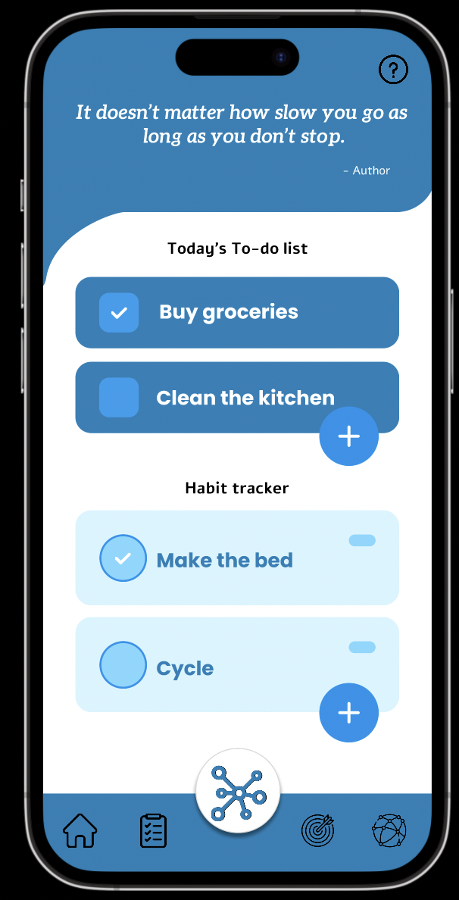
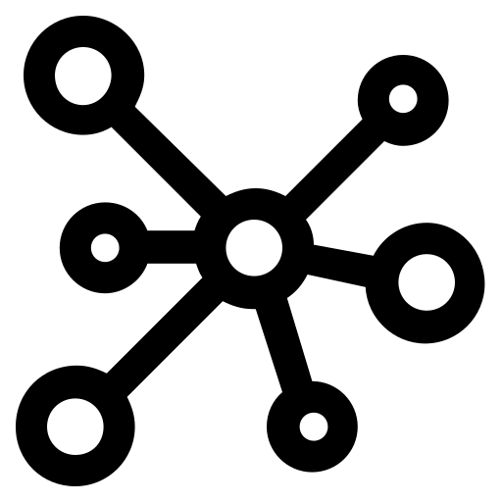
Project Unity
.
Members:
Dheeptha
Nishitha
Vamsi
Nikhil

Slide 2
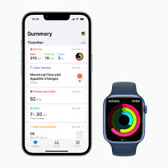


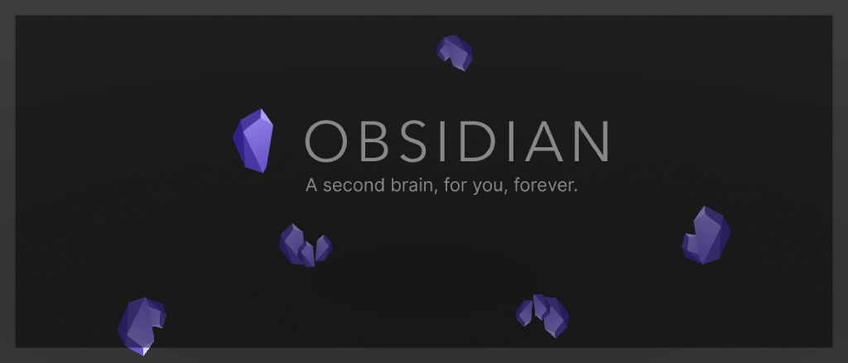
Current landscape
Do you recognize these apps? Remember 1st January, new year resolutions :P

Slide 3
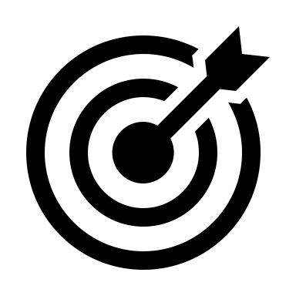


Problem
Currently, there is need for a Unified app catering to personal development, note-taking and habit tracking.
Below we have the results from a Survey on Enterprise Apps usage(900 people) (Link)
Notable insights:
Context switch
43% switch from one app to another all the time.
Information disperse
41% turn to several apps per day.
User needs
67% want everything in a single window.
Impacts concentration
Chance of falling into addictive apps
Opportunity area.

Slide 4

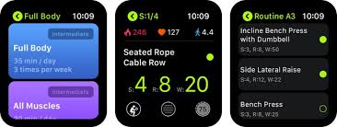
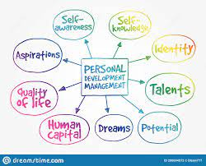
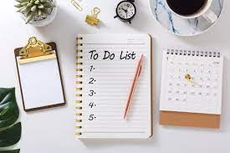
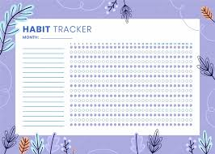
How do we solve it? Our offerings
Note taking Mind-map model Health data To-do list Habit tracker

Slide 5
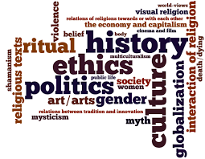
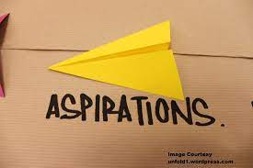
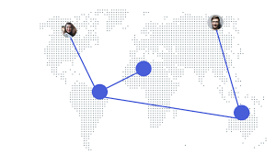
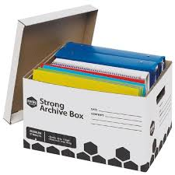
Mind-map model
Enlisting your personal belief system, for orthogonal domains
Short term and long-term aspirations/vision from Personal/Professional perspective
Domain specific mentor list, their contact links
Archive of favorite books, YouTube videos and blog articles.

Slide 6
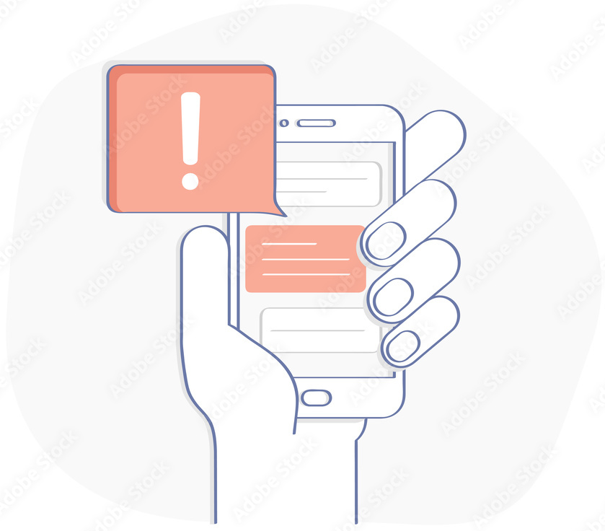
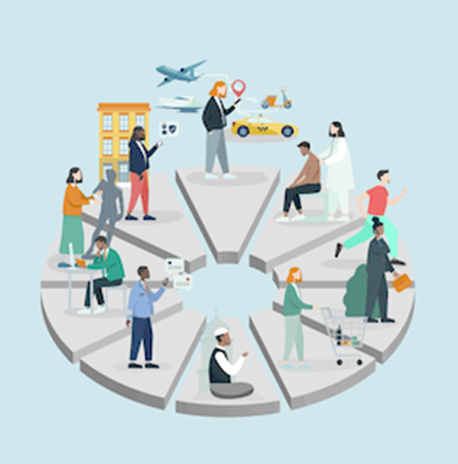
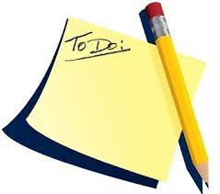
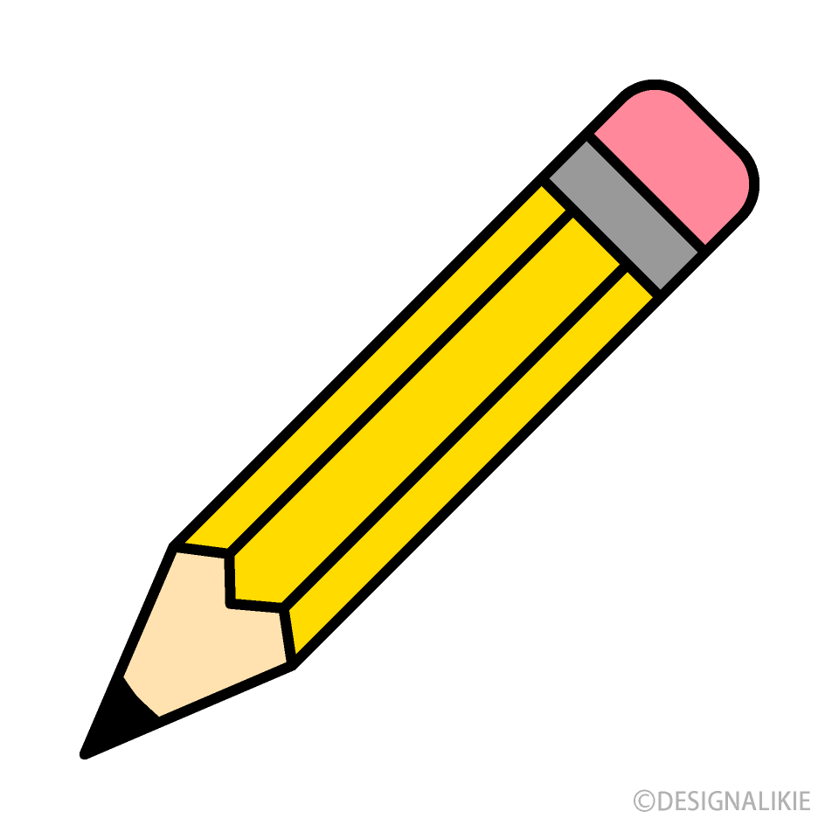
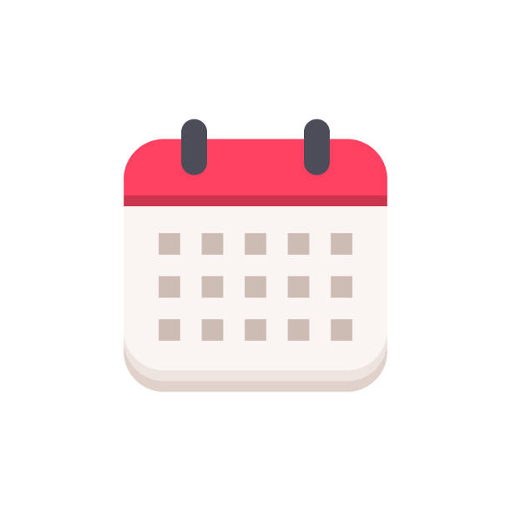
Note Taking and To-do List
User can place reminders for future events.
Gives out suggestions based on the reservations
Creating a to-do list for day to day tasks.
Keeps track of completion of the tasks based on timeline and send periodic reminders
User can take notes digitally, embed images.
The notes are integrated into the calendar.

Slide 7

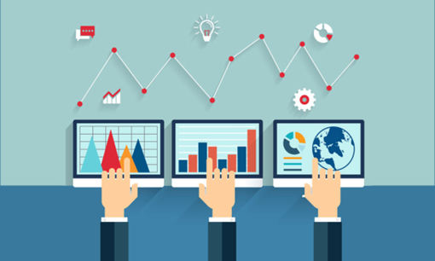
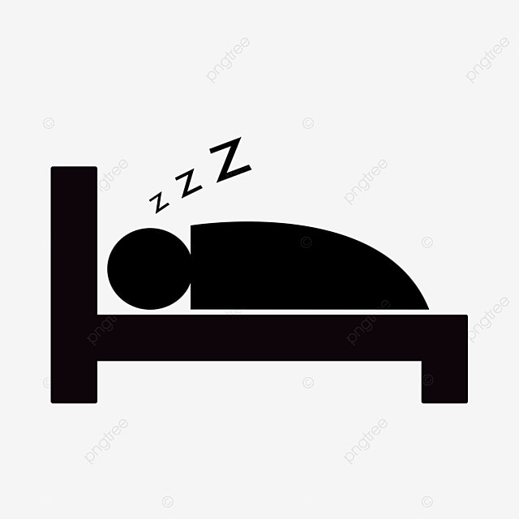
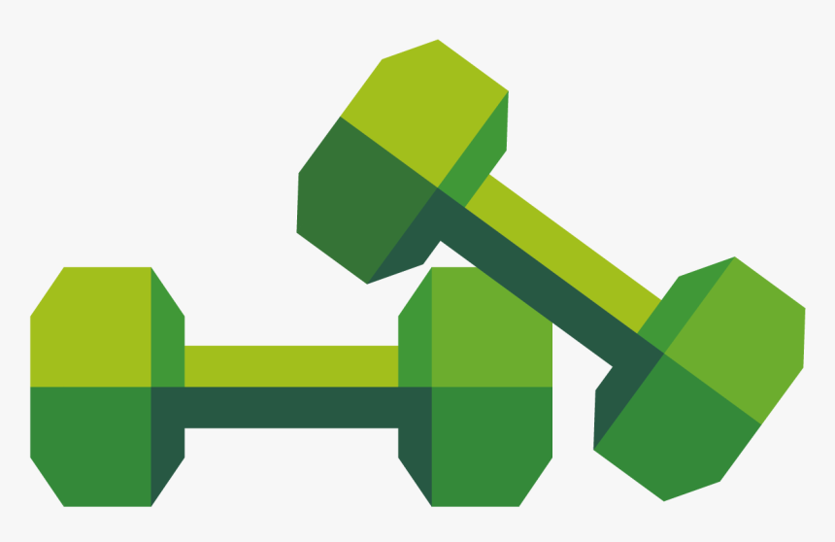
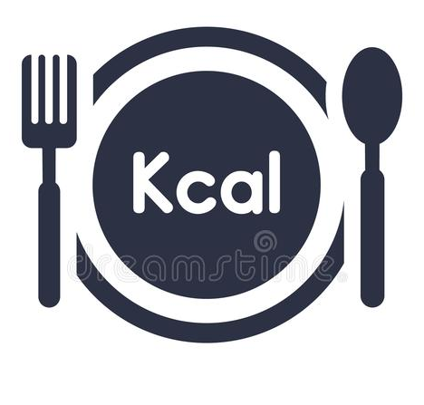
Health data & Habit tracking
Automatic reminders to maintain daily habits like drinking water every hour.
Customizable by the user
Tracks sleep data on a daily basis and gives feed back.
Gives out suggestion to improve sleep cycle.
User can setup custom workout goals and can keep track of the complete progress.
User can even setup long-term goals for multiple years.
Keeps track of calorie intake and calories burnt during workout.

