Slide 1

PHISHING
AWARENESS
TRAINING
RECOGNIZE • VERIFY • STAY SAFE
Cyber Security Awareness Session

Slide 2

What is Phishing?
THE BASIC IDEA
Phishing is a cyber attack where an attacker pretends to be someone you trust to trick you into sharing sensitive information.
Fake trust → Real loss
Targets: passwords, OTPs, bank details, college / work logins.
02 / 08

Slide 3

Types of Phishing
FOUR COMMON FORMS
Email phishing — fake mails with bad links
1
Smishing — fraud SMS / WhatsApp messages
2
Vishing — scam phone calls
3
Fake websites — cloned login pages
4
03 / 08

Slide 4
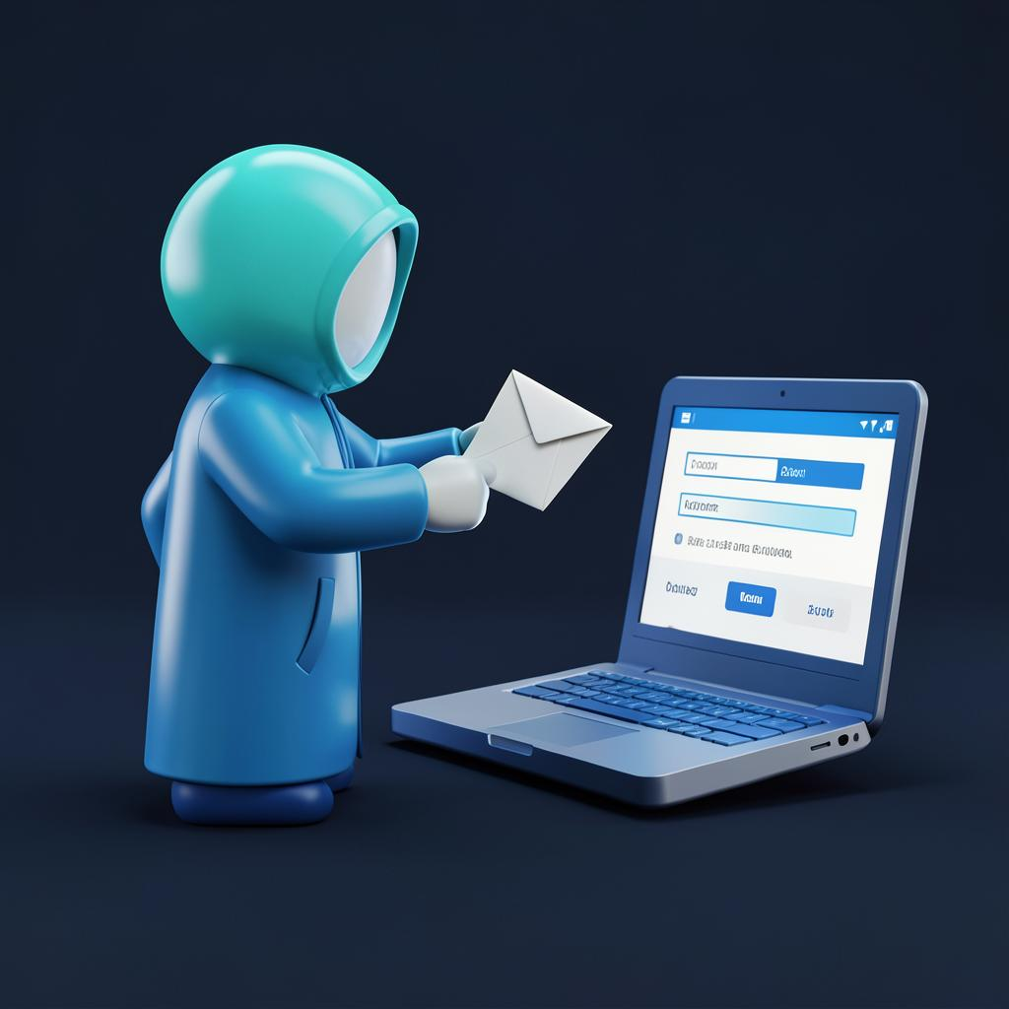
How Phishing Works
THE ATTACK CHAIN
1. Attacker
▼
2. Fake Message
▼
3. Victim
▼
4. Fake Website
▼
5. Data Theft
04 / 08

Slide 5
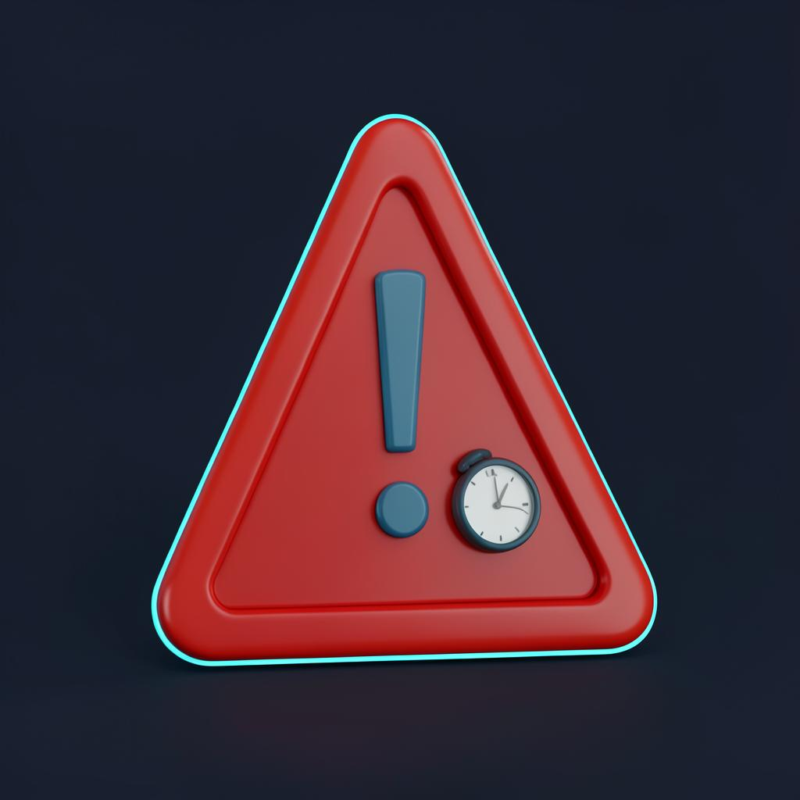
Warning Signs
SPOT THESE RED FLAGS
Urgent or threatening language
1
Suspicious or shortened links
2
Unknown / mismatched sender
3
Requests for passwords or OTP
4
Unexpected attachments
5
05 / 08

Slide 6

How to Stay Safe
SIMPLE DAILY HABITS
Verify the sender before acting
1
Check the full URL carefully
2
Never share OTP or passwords
3
Turn on multi-factor authentication
4
Report suspicious messages
5
06 / 08

Slide 7

Quick Quiz
PICK THE RIGHT ANSWER
1. A mail asks for your OTP to "verify" your account. You should:
a) Send it b) Ignore & report c) Reply for details
Answer: b — no genuine service ever asks for your OTP.
2. Which link is safest?
a) pay-sbi-verify.xyz b) sbi.co.in c) sbi-login.secure-net.ru
Answer: b — the real domain, not a look-alike.
3. Best protection if a password leaks?
a) MFA b) Longer username c) Antivirus only
Answer: a — multi-factor authentication blocks the login.
07 / 08

Slide 8
Conclusion
REMEMBER THREE WORDS
STOP
THINK
VERIFY
“Your awareness is your first line of defense.”
Thank you — Questions welcome
08 / 08

