Slide 1
K-Means clustering
Nikhil kumar verma
a17018

Slide 2
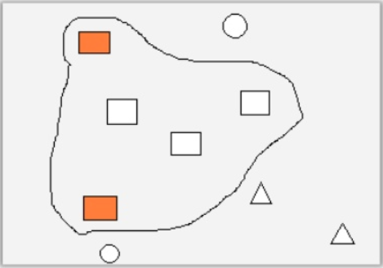
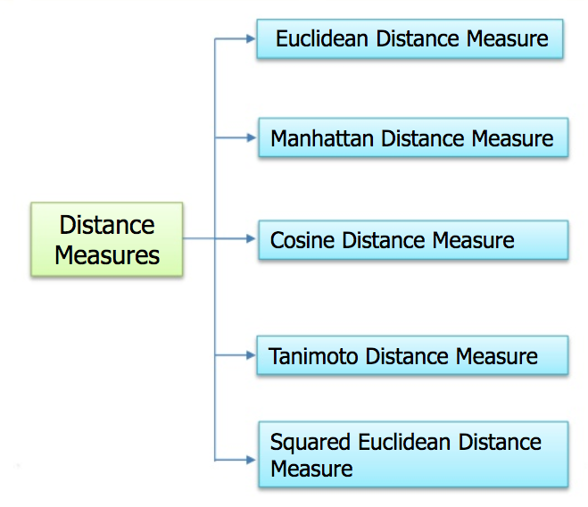
SIMILARITY / DISSIMILARITY MEASUREMENT
To achieve Clustering, a similarity/dissimilarity measure must be determined so as to
cluster the data points based either on:
1.Similarity in the data or
2.Dissimilarity in the data
The measure reflects the degree of closeness or separation of the target objects
and should correspond to the characteristics that are believed to distinguish the clusters embedded in the data.
Similarity can also be measured in terms of the placing of data points.
By finding the distance between the data points, the distance/difference of the point to the cluster can be found.

Slide 3
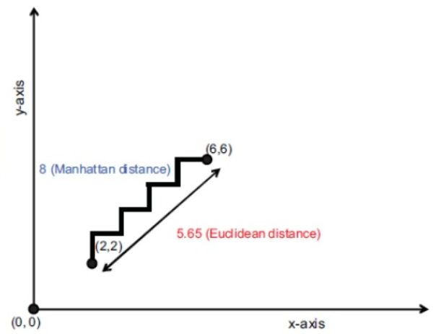


Difference between Euclidean and Manhattan distance
From this image we can say that, The Euclidean distance measure gives 5.65 as the distance between (2,2) and (6,6) whereas the Manhattan distance is 8.0
Mathematically, Euclidean distance between two n-dimensional vectors (a1,a2,...,an) and (b1,b2,...,bn) is:
Manhattan distance between two n-dimensional vectors:

Slide 4
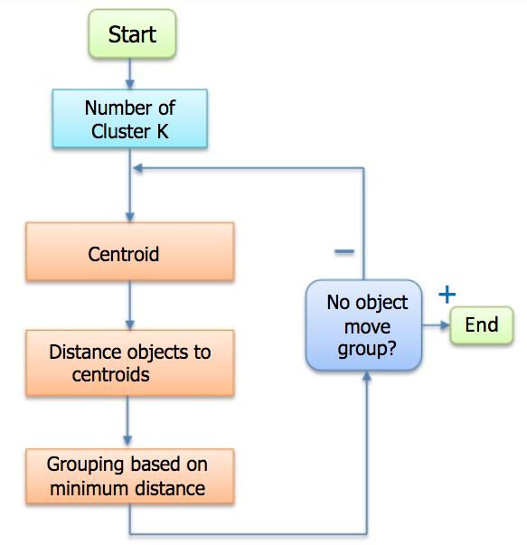
K-means clustering
The process by which objects are classified into a number of groups so that they are as much dissimilar as possible from one group to another group, but as much similar as possible within each group.
The objects in group 1 should be as similar as possible.
But there should be much difference between an object in group1and group 2.
The attributes of the objects are allowed to determine which objects should be grouped together.
PROCESS FLOW OF K-MEANS
Iterate until stable (cluster centers converge):
Determine the centroid coordinate.
Determine the distance of each object to the centroids.
Group the object based on minimum distance (find the closest centroid).

Slide 5
Iris dataset in python
This data sets consists of 3 different types of irises’ (Setosa, Versicolour, and Virginica) petal and sepal length, stored in a 150x4 numpy.ndarray
The rows being the samples and the columns being: Sepal Length, Sepal Width, Petal Length and Petal Width.
Github link : https://github.com/nikhilvrm13/K-Means-Clustering-of-Iris-dataset

