Slide 1

Auto CPU Scheduling Analyzer
Operating Systems course project · Review
Measures your machine, simulates 7 scheduling algorithms, recommends the best one
Notes:
Introduce the project: a tool that needs no typed input. It reads live processes and machine properties, simulates every major CPU scheduling algorithm on that data and recommends the best one.

Slide 2
Why scheduler demos fall short
Typical simulators
This project
You type every arrival and burst time
One algorithm at a time
No verdict on which is best
Context switching assumed free
Arrival, burst, priority read from live processes
All 7 algorithms on the same workload
Weighted score picks the winner
Real context-switch time measured
Notes:
The usual lab programs ask the student to type a table of numbers. Our program removes that step and also answers the question every student is asked: which algorithm is best.

Slide 3




Project objectives
Zero input
Compare all
No typed burst or arrival times. Everything is measured.
FCFS, SJF, SRTF, Priority, Round Robin and MLFQ side by side.
Recommend
Live dashboard
A scored verdict for the processes running right now.
Website with charts and Gantt timelines, plus a CLI.
Notes:
Four goals: no input, compare every algorithm, give a recommendation, and present it in a live website.

Slide 4
Algorithms compared
Algorithm | Picks next | Preemptive | Weakness
FCFS | Earliest arrival | No | Convoy effect
SJF | Shortest burst | No | Long jobs starve
SRTF | Least time remaining | Yes | Many switches
Priority (NP) | Best priority number | No | Starvation
Priority (P) | Best priority number | Yes | Starvation, switches
Round Robin | Next in queue, fixed slice | Yes | Longer turnaround
MLFQ | Highest non-empty queue | Yes | Complex to tune
Notes:
Quick revision of each algorithm: what it picks, whether it can preempt, and its main weakness. These weaknesses are exactly what the metrics in the tool expose.

Slide 5
System architecture
1
System probe
2
Process sampler
3
Workload builder
Clock speed, cores, RAM, disk, network, context-switch time
Two CPU-time snapshots, one second apart, for every process
Arrival, burst, priority and type from real data
4
Simulation engine
5
Scorer
6
Dashboard + CLI
7 schedulers on one workload in 1 ms ticks
Normalise metrics, apply adaptive weights, rank
Website with Gantt charts, or terminal report
Notes:
Pipeline in six stages, numbered in order. The first three gather real data, the fourth simulates, the fifth scores, the last presents.

Slide 6
Real data replaces typed input
Arrival time
Process creation time (oldest = 0 ms)
Burst time
CPU time consumed, log-scaled to 5-100 ms
Priority
OS nice value, minus 3 if I/O-bound
CPU work
CPU seconds × measured clock speed (Mcycles)
Time quantum
80th percentile of the burst times
Switch cost
Measured thread context-switch time
Notes:
Left column is what a scheduler needs. Right column is where our program gets it. Burst is log-scaled because lifetime CPU time ranges from milliseconds to hours. The quantum uses the textbook rule that about 80 percent of bursts should finish inside one slice.

Slide 7
Simulation engine
FCFS
SJF
How it runs
1 ms ticks; the policy picks who runs next
Measured switch cost is added to the clock
CPU idles until the next arrival
Identical workload for every algorithm
SRTF
Priority (NP)
Priority (P)
Round Robin
MLFQ
Auto quantum
Notes:
Each policy is a small class that answers one question: which ready process runs for the next millisecond. The engine charges the measured context-switch time whenever the CPU changes process, so switch-heavy algorithms are penalised fairly.

Slide 8
Scoring the winner
Each metric is normalised: 0 = best algorithm, 1 = worst
Weighted penalties are subtracted from 100
Weights adapt to the workload: many I/O-bound jobs raise response time, uneven bursts raise waiting and starvation
Notes:
The score is 100 minus the weighted sum of normalised penalties. Weights are not fixed: if more than 40 percent of processes are I/O-bound, response time gains weight; if burst times vary a lot, waiting time and worst-case wait gain weight.

Slide 9


Implementation
Engine
API
Dashboard
os_scheduler_analyzer.py
server.py
static/index.html
Python and psutil: probe, workload builder, 7 schedulers, scoring
Standard-library HTTP server with a JSON endpoint /api/analyze
Plain HTML, CSS and JavaScript. No libraries, works offline
pip install -r requirements.txt → python server.py → localhost:8000
Notes:
Three files do all the work. Only one external package is needed, psutil. The web server uses only the Python standard library.

Slide 10
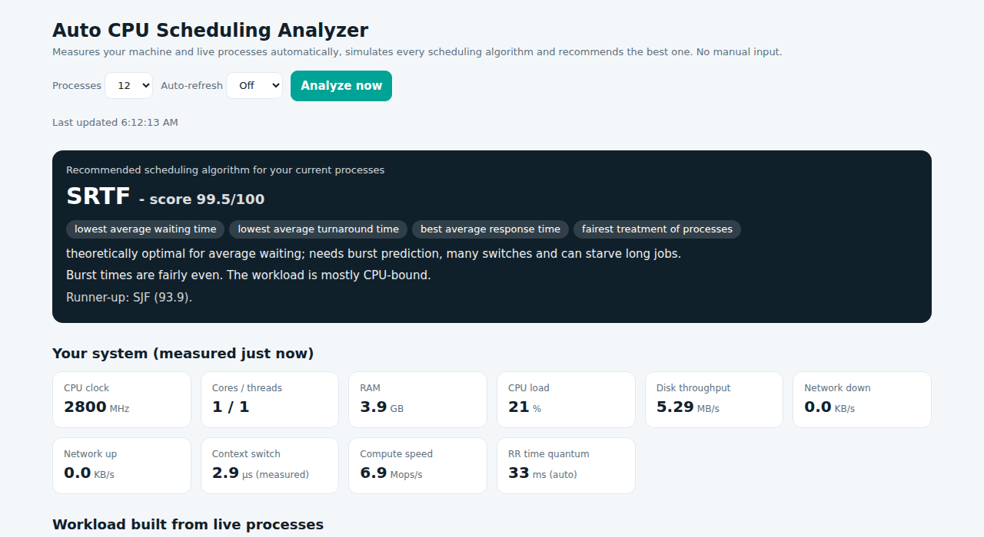
The web dashboard
Winner banner with reasons
Live system measurements
Ranking, score and metric charts
Gantt chart for all 7 algorithms
Auto-refresh to watch it change
Screenshot from a sample run
Notes:
Live demo here: run python server.py, open the page, click Analyze now, then change the workload (open or close apps) and analyze again to show that the winner can change.

Slide 11
Sample result
99.5
SRTF score out of 100
-58%
waiting time vs FCFS (37 ms against 89 ms)
Sample run on the development machine. Your laptop will produce its own numbers.
Notes:
Numbers come from one real run. FCFS and non-preemptive priority score lowest because short jobs wait behind long ones. SRTF and SJF win on this CPU-bound, uneven workload.

Slide 12



The best algorithm depends on the load
Uneven CPU jobs
Interactive mix
Critical tasks
SJF and SRTF win: short jobs finish first, waiting time drops.
MLFQ and Round Robin rise: quick response matters more.
Priority scheduling runs urgent work first. Watch for starvation.
That is why the tool measures the workload instead of assuming one.
Notes:
Change the running apps and re-run the analysis: the recommendation can change. This is the main message of the project.

Slide 13
Limitations and future work
Limitations
Future work
Jobs are single bursts, not CPU and I/O cycles
Single-CPU model
No aging in priority scheduling
Burst times scaled for readability
Burst prediction by exponential averaging
Aging and an MLFQ priority boost
Multi-core simulation
Linux CFS as an eighth algorithm
Notes:
Be upfront about limitations: it is a simulation on a snapshot of real data. The future-work list shows how it could grow into a more realistic scheduler study.

Slide 14

References
Silberschatz, Galvin, Gagne. Operating System Concepts. Wiley.
Tanenbaum, Bos. Modern Operating Systems. Pearson.
psutil documentation: psutil.readthedocs.io
Linux kernel documentation: CFS scheduler design, kernel.org
Notes:
Textbook chapters on CPU scheduling were used for the algorithm definitions and the quantum rule of thumb.

Slide 15
Conclusion
No input
7 algorithms
1 verdict
Every scheduling input is measured from the machine
Compared fairly on one real workload
A scored recommendation with reasons
Thank you. Questions?
Notes:
Close with the three takeaways, then invite questions. Offer a live demo if time allows.

