Slide 1
PACE CONNECT Team 2
NIKHITA PATIL
SONAL SAHU
MABLE MACWAN
DRASHTI PATEL
AKSHAY MEHTA
SHARDUL VIRKAR

Slide 2

INTRODUCTION
PACE Connect is an app for new or current Pace students.
It will allow students to find accommodation availability around the campus, connect with Pace alumni to know more about courses or facilities at Pace, buy or sell items , get notifications about events happening in Pace.

Slide 3
SPRINTS
Frontend and Backend implementation and testing of Sign up module
Sprint1
Frontend and Backend Implementation and testing of Forgot Password
Sprint 2
Frontend and Backend Implementation and testing of Post Query to forum
Sprint 3
Frontend and Backend and testing of Edit/Delete Query, Integration and regression testing
Sprint 4

Slide 4
SPRINTS
SPRINT 1
Frontend, Backend and testing of Sign up
SPRINT 2
Frontend, Backend and testing of Forgot Password
SPRINT 3
Frontend, Backend and testing of Post Query
SPRINT 4
Frontend, Backend and testing of Edit/Delete Query, Integration and regression testing
Sprint 1
As a new user , I want to sign up for an account so that I can create a profile to access Pace Connect app for posting queries on the discussion forum.
Implementation of frontend and backend completed.
Testing completed using testcases for signup module.

Slide 5
SPRINT 1 - STATUS
Created Sign Up User interface
Submission of Sign Up data to backend
Testing of Sign Up page frontend
Testing of Sign Up Page on submission

Slide 6
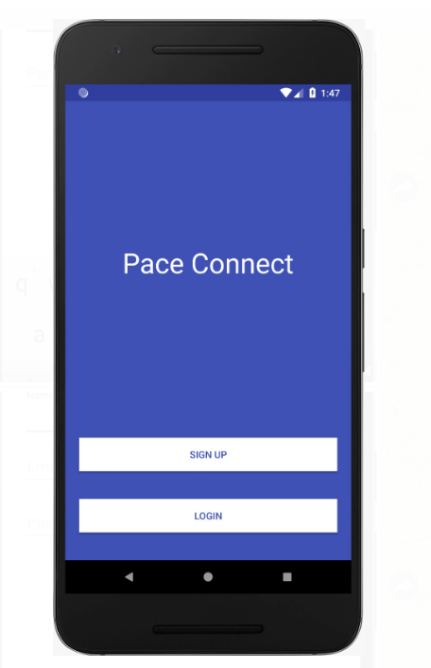
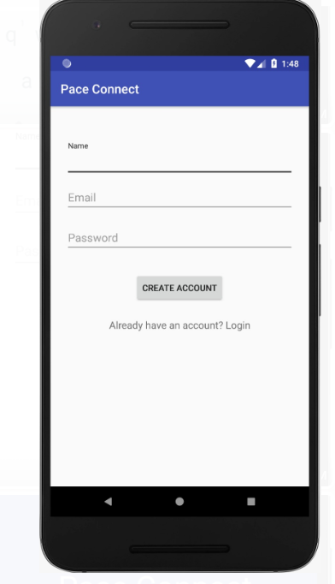
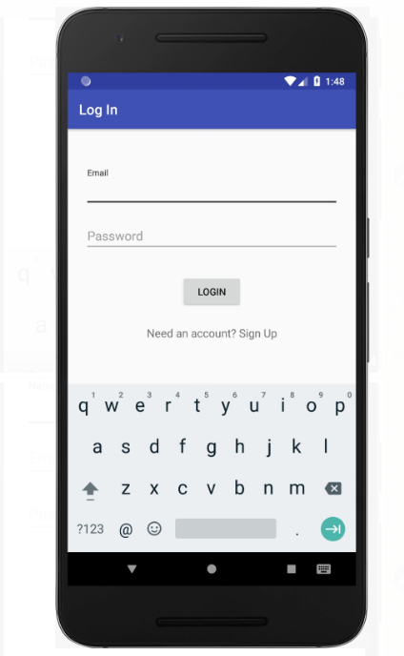
IMPLEMENTATION

Slide 7
TESTCASES – SIGN UP
Step | Test Steps | Test Data | Expected Result | Actual Result | Status (Pass/Fail) | Notes
1 | Open the Pace Connect App |  | User should be able to view Login and Sign Up buttons | User was able to see the Login and Sign up buttons | Pass
2 | User clicks on Sign Up button |  | User should navigate to Sign up page with text fields –Name, Email and Password and Create Account button | User navigated to Sign Up page with text fields Name, Email and Password and Create Account button | Pass
3 | Provide valid Name | Name= John Dave | Name can be entered | Name was entered correctly | Pass
4 | Provide valid email address | Email= abc.xyz@gmail.com | Credential can be entered | Validated email address | Pass
5 | Provide invalid email address | Email=abc@gmail | Entered invalid email | Email Id invalid error message | Pass
6 | Provide valid password | Password: 12345$ | Credential can be entered | Validated password | Pass
7 | Click on Create Account button |  | New User created | User logged in | Pass

Slide 8
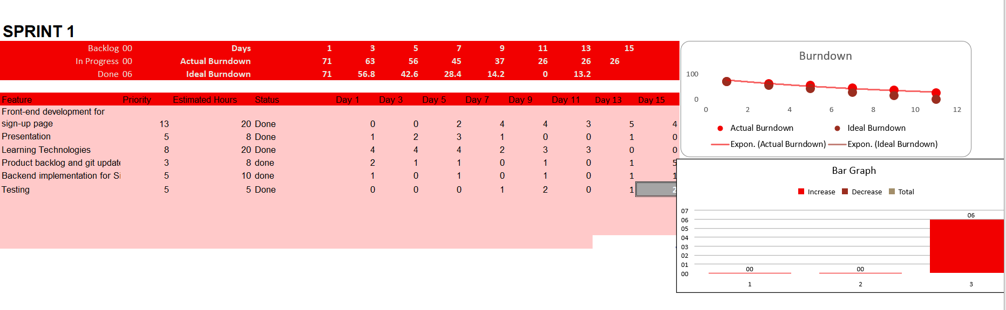
BURNDOWN CHART

Slide 9
PRODUCT BACKLOG
Story Id | Story | Estimation | Priority | Status
1 | As a new user , I want to sign up for an account so that I can create a profile to access Pace Connect app for posting queries on the discussion forum. | 8 | High | Completed
2 | As a registered user, I want to log in with Pace Connect app so that I can access Pace Connect app for creating or replying to queries on the discussion forum. | 8 | High | Completed
3 | As a registered user, I want to securely reset my password so that I can change my password if I forgot/misplaced my previous password. | 5 | Medium | Not Started
4 | As a registered user, I want to post a query, so that I can get replies from other students regarding accommodation availability, job openings, course enquiries etc. | 13 | High | In Progress
5 | As a registered user, I want to reply on the existing query so that I can provide required information by replying to the queries posted on the forum. | 8 | Medium | In Progress
6 | As a registered user, I want to edit or delete a query posted on the forum so that I can modify my existing post created by him to add/delete details to the post. | 8 | Medium | Not Started
 | Total | 50

Slide 10
JIRA AND CODE LINK
https://paceconnect.atlassian.net/secure/RapidBoard.jspa?rapidView=1&projectKey=PC&view=planning&selectedIssue=PC-6&selectedEpic=PC-1
https://github.com/AkshayMehta78/Pace-connect

Slide 11
FUTURE IMPLEMENTATIONS
Forgot password frontend/backend testing
As a registered user, I want to securely reset my password so that I can change my password if I forgot/misplaced my previous password.
Post query on forum/testing
As a registered user, I want to post a query, so that I can get replies from other students regarding accommodation availability, job openings, course enquiries etc.
Reply query on forum/testing
As a registered user, I want to reply on the existing query so that I can provide required information by replying to the queries posted on the forum.
Edit/delete on forum/testing
As a registered user, I want to edit or delete a query posted on the forum so that I can modify my existing post created by him to add/delete details to the post.
Integration and regression testing

Slide 12
THANK YOU

