Slide 1
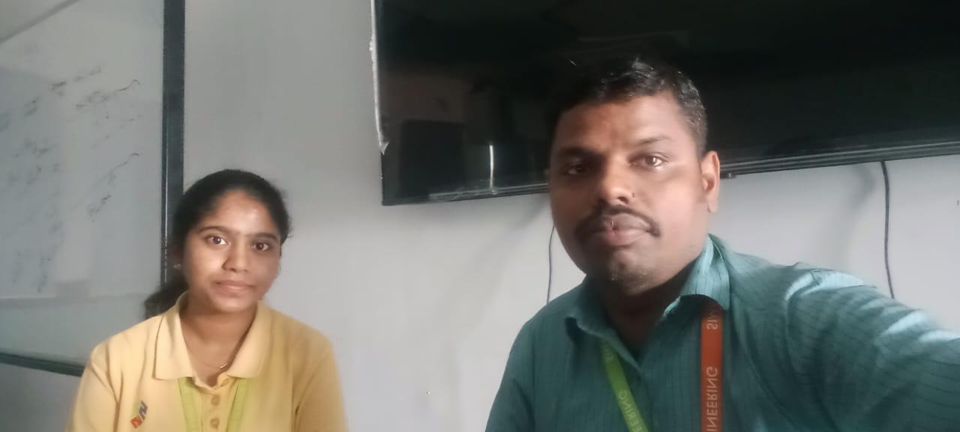
Slot B | Total Marks | Marks Obtained | Class Average Mark
Model Exam A Slot | N/A | N/A
Test 1 ( A Slot) | N/A | N/A
Test 2 ( B Slot) | N/A | N/A
Test 3 ( C Slot)
Test 4 ( A Slot)
Test 5 ( A Slot)
Sai Nikitha .A (192225110)

Slide 2
Dear Parents,
She has consistently demonstrated strong performance in her academics. She is having a minimum attendance percentage to appear for the end-of-semester examination and try to improve the same for all courses in the future. She registered for leetcode, worked for 20 days, solved 50 easy questions, and made no progress in leetcode after that. She is very interested in dancing, swimming so she is looking for some events and competitions related to her interest.
SUBJECT SLOT A: S A, ATTENDANCE: 88%
SUBJECT SLOT B: CA, ATTENDANCE: 85%
SUBJECT SLOT C: R PROGRAMMING. ATTENDANCE: 88%
SLOT - I: PROJECT ATTENDANCE: 100% ( PICO-submitted)
Sincerely,Dr. Narenthirakumar.

Slide 3
MENTEE RESPONSE
PARENT’S RESPONSE
I will obey mentor instruction
She will obey mentor institutions

