Slide 1
Time Off Request
EMPLOYEE:
DATE:
STATUS:
Meghan Harris
4/1/22
PENDING

Slide 2

Time Off Request
EMPLOYEE:
DATE:
STATUS:
Meghan Harris
4/1/22

Slide 3


Flights to Nashville, TN

Slide 4

BOOKED

Slide 5
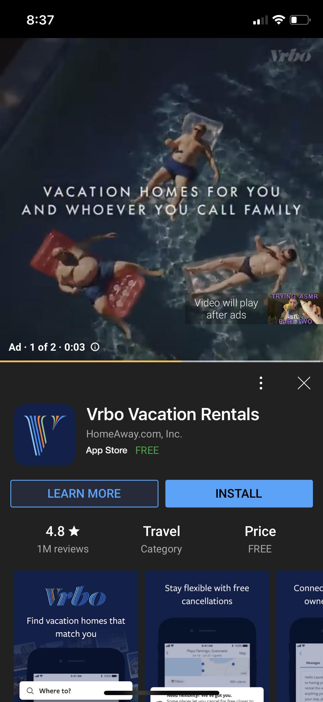

Slide 9
Why do super targeted ads work on me?

Slide 10
Why do super targeted ads work on me?
All
News
Images
Videos
Shopping
About 201,000,000 results (0.66 seconds)

Slide 11
Why do super targeted ads work on me?
All
News
Images
Videos
Shopping
About 201,000,000 results (0.66 seconds)

Slide 12
60%
of consumers say they are likely to become repeat buyers after a personalized shopping experience*.
*Newman 2021

Slide 13
70%
70%
of consumers prefer brands know more about them*.
*State of Personalization, 2020

Slide 14
40%
Companies that excel at personalization generate
more revenue from those activities than average players*.
*Arora, 2021

Slide 15
there are severe consequences for companies that are not implementing correct recommendations to consumers.
INSIGHT

Slide 16
consumers are expecting personalized recommendations.
INSIGHT

Slide 17
BUSINESS PROBLEM
Notes:
Gathering slide

Slide 18
the consumer journey stops entirely if a specific property they are looking at is booked.
BUSINESS PROBLEM
Notes:
Gathering slide

Slide 19
not able to identify members who are most likely to travel in the next season.
BUSINESS PROBLEM
Notes:
Gathering slide

Slide 20
BUSINESS PROBLEM
APPROACH
Notes:
Gathering slide

Slide 21
customers who can’t find bookings they want

Slide 22
members who are willing to travel

Slide 23
customers who can’t find bookings they want
members who are willing to travel

Slide 24
customers who can’t find bookings they want
Target members via recommendation engine
members who are willing to travel

Slide 25
ANALYTICAL APPROACH
Notes:
Gathering slide

Slide 26
customers who can’t find bookings they want
Target members via recommendation engine
members who are willing to travel

Slide 27
members who are willing to travel

Slide 28
ANALYTICAL APPROACH
1
Build a propensity to travel model to accurately predict members who will travel in the next season.

Slide 29
customers who can’t find bookings they want
Target members via recommendation engine
members who are willing to travel

Slide 30
ANALYTICAL APPROACH
1
Build a propensity to travel model to accurately predict members who will travel in the next season.
2
Build a recommendation engine on inputted variables to recommend resorts available based on search history.

Slide 31
ANALYTICAL APPROACH
PROCESS
Notes:
Gathering slide

Slide 32
HIGH LEVEL ANALYTICAL APPROACH PROCESS
1
DATA PREP
2
MODELING
3
RANKING RESORT MATCHES
FILTERING
4
VALIDATION
5
Notes:
Gathering slide

Slide 33
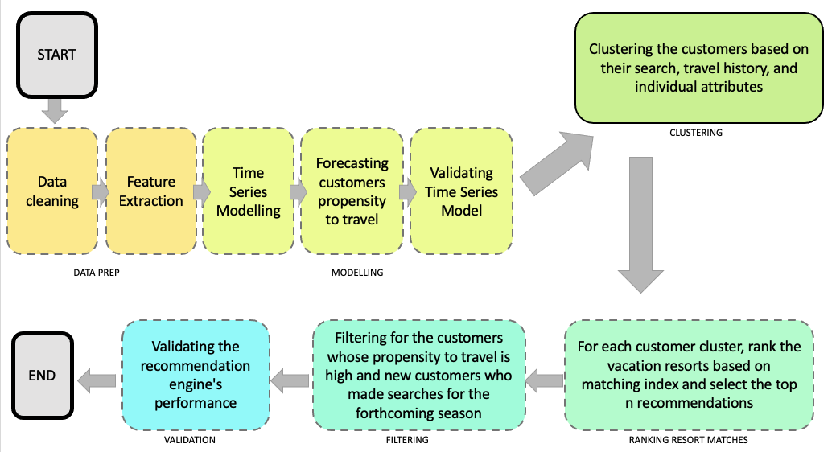
Notes:
Gathering slide

Slide 34
DATA PREP
Notes:
Gathering slide

Slide 35
MODELING
Notes:
Gathering slide

Slide 36
RANKING RESORT MATCHES
Notes:
Gathering slide

Slide 37
FILTERING
Notes:
Gathering slide

Slide 38
VALIDATION
Notes:
Gathering slide

Slide 39
EXPLORATORY DATA ANALYSIS
Notes:
Nikitha

Slide 40
EXPLORATORY DATA ANALYSIS OBJECTIVE
1
3
Opportunity to better understand relationships between different variables.
Gives a better understanding of data set.
2
Helps detects outliers/anomalies in data.

Slide 41
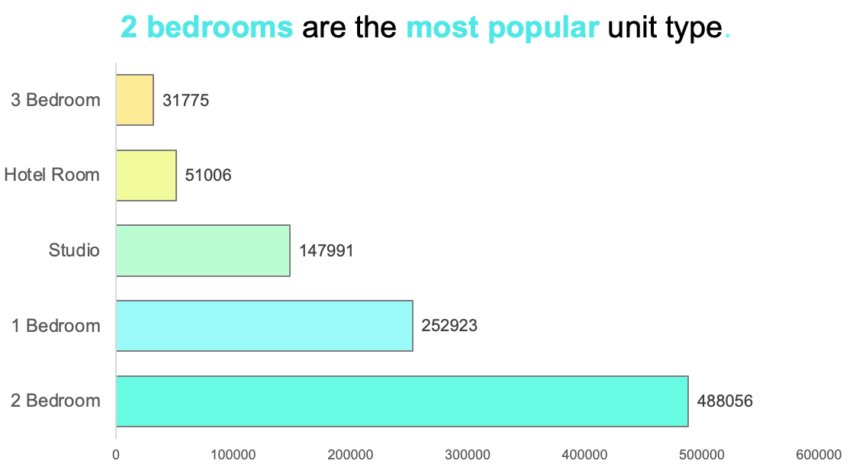

Slide 42
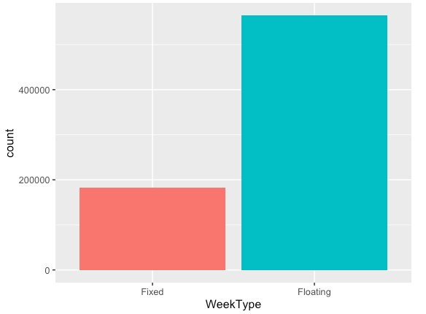
There's significantly more customers who have floating time shares.

Slide 43
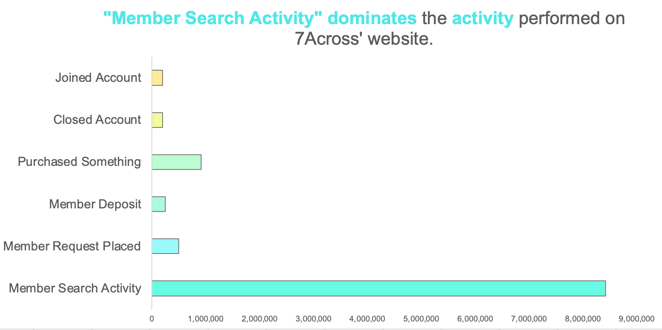

Slide 44
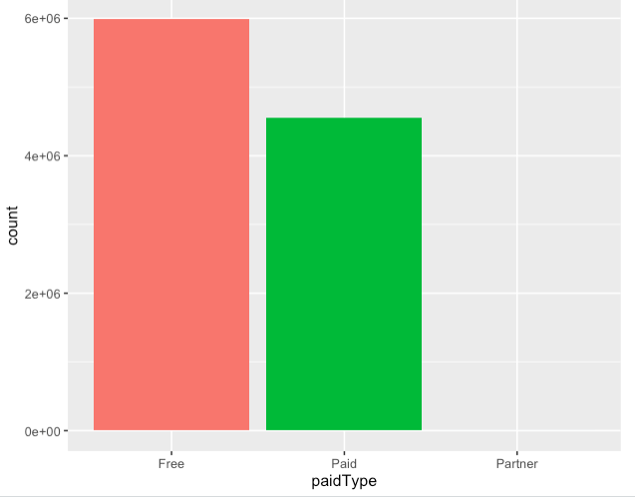
Free members have more activity than paid.

Slide 45
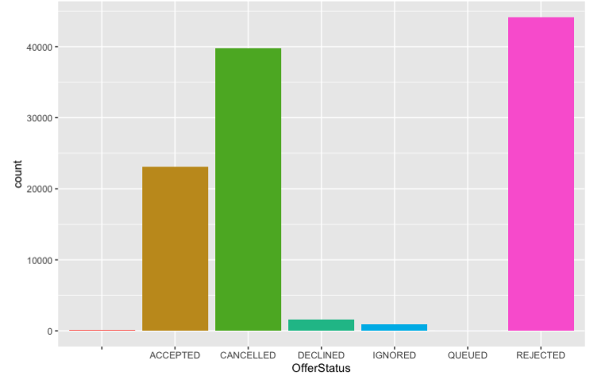
Most users either reject or cancel the offers made.

Slide 46
INSIGHTS FROM EXPLORATORY DATA ANALYSIS
1
2 Bedroom is the most popular unit type.
2
There’s significantly more customers who have floating time shares.
3
“Member Activity Search” dominates activity performed on 7Across’ website.
Free members have more activity than paid.
4
Most users either reject or cancel the offers made.
5
Notes:
Gathering slide

Slide 47
MODELING
Notes:
PRANAV

Slide 48
IMPORTANT VARIABLES
MODELING
Notes:
Gathering slide

Slide 49
1. Membership Days
2. Days to Expiry
3. Days since Deposit
4. No bookings in the past 12 months
5. Number of searches in 12 months
most important
least important
Notes:
Gathering slide

Slide 50
Who is more likely to book based on length of membership in days?
1. Membership Days
2. Days to Expiry
3. Days since Deposit
4. No bookings in the past 12 months
5. Number of searches in 12 months
What number of days left to expiry leads to higher booking?
Is there a certain timeframe day-wise from initial deposit that leads to a higher propensity to travel?
Does the number of bookings indicate a higher propensity to travel?
Does the number of searches indicate a higher propensity to travel?
Notes:
Gathering slide

Slide 51
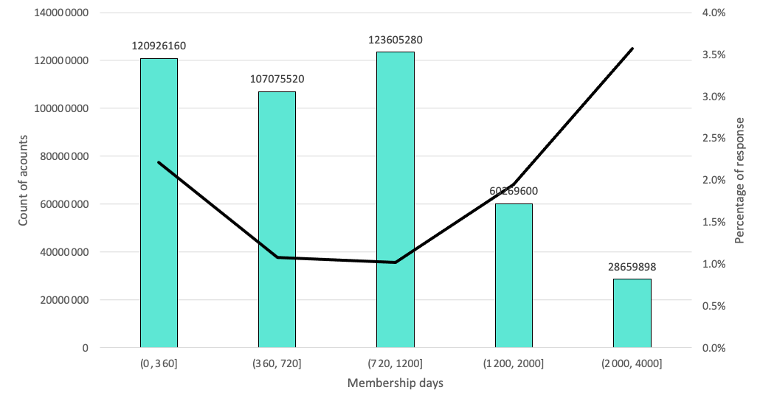
Who is more likely to book based on length of membership in days?
Membership Days
Notes:
Gathering slide

Slide 52
Who is more likely to book based on length of membership in days?
Membership Days
Notes:
Gathering slide

Slide 53
Who is more likely to book based on length of membership in days?
Membership Days
Members who have been a part of 7Across longer have the highest propensity to travel.
Notes:
Gathering slide

Slide 54
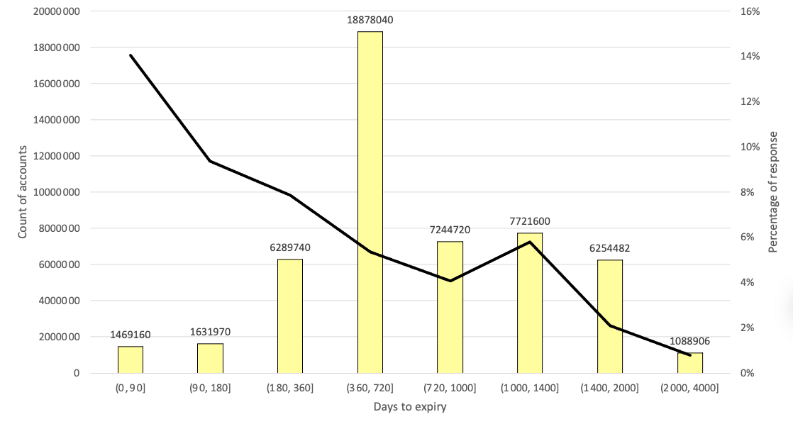
What number of days left to expiry leads to higher booking?
Days to Expiry
Notes:
Gathering slide

Slide 55
What number of days left to expiry leads to higher booking?
Days to Expiry
Most number of days to expiry
Notes:
Gathering slide

Slide 56
What number of days left to expiry leads to higher booking?
Days to Expiry
Highest propensity to travel
Notes:
Gathering slide

Slide 57
What number of days left to expiry leads to higher booking?
Days to Expiry
The closer the expiry date, the highest propensity to travel is
Notes:
Gathering slide

Slide 58
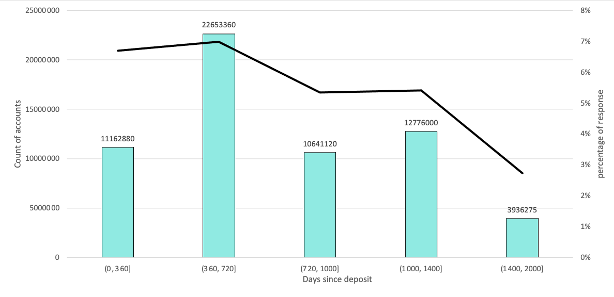
Is there a certain timeframe day-wise from initial deposit that leads to a higher propensity to travel?
Days since Deposit
Notes:
Gathering slide

Slide 59
Is there a certain timeframe day-wise from initial deposit that leads to a higher propensity to travel?
Days since Deposit
Highest propensity to travel and highest amount
Notes:
Gathering slide

Slide 60
Is there a certain timeframe day-wise from initial deposit that leads to a higher propensity to travel?
Days since Deposit
Most members book 360-720 days after their initial deposit and have the highest propensity to travel. However, the later the deposit, the lower the propensity to travel.
Notes:
Gathering slide

Slide 61
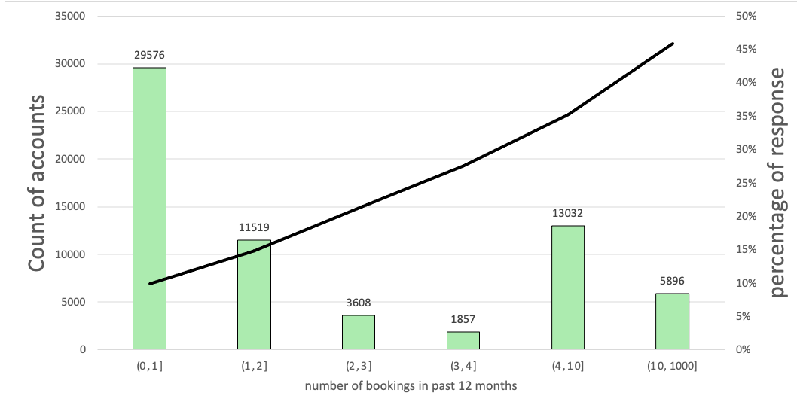
Amount of Bookings in the past 12 months
Does the number of bookings indicate a higher propensity to travel?
Notes:
Gathering slide

Slide 62
Amount of Bookings in the past 12 months
Does the number of bookings indicate a higher propensity to travel?
Most number of members
Notes:
Gathering slide

Slide 63
Amount of Bookings in the past 12 months
Does the number of bookings indicate a higher propensity to travel?
Highest propensity to travel
Notes:
Gathering slide

Slide 64
Amount of Bookings in the past 12 months
Does the number of bookings indicate a higher propensity to travel?
The more a member books, the higher the propensity to travel
Notes:
Gathering slide

Slide 65
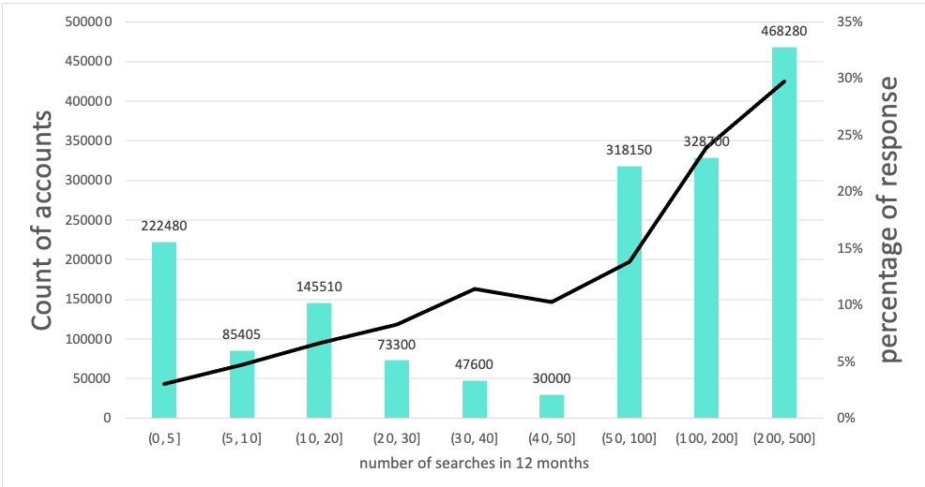
Number of Searches in the past 12 months
Does the number of searches indicate a higher propensity to travel?
Notes:
Gathering slide

Slide 66
Number of Searches in the past 12 months
Does the number of searches indicate a higher propensity to travel?
Highest propensity to travel and highest amount
Notes:
Gathering slide

Slide 67
Number of Searches in the past 12 months
Does the number of searches indicate a higher propensity to travel?
The more a member searches, the higher the propensity to travel
Notes:
Gathering slide

Slide 68
Who is more likely to book based on length of membership in days?
Members who have been a part of 7Across longer have the highest propensity to travel.
What number of days left to expiry leads to higher booking?
The closer the expiry date, the highest propensity to travel is
Is there a certain timeframe day-wise from initial deposit that leads to a higher propensity to travel?
Most members book 360-720 days after their initial deposit and have the highest propensity to travel. However, the later the deposit, the lower the propensity to travel.
Does the number of bookings indicate a higher propensity to travel?
The more a member books, the higher the propensity to travel
Does the number of searches indicate a higher propensity to travel?
The more a member searches, the higher the propensity to travel
Notes:
Gathering slide

Slide 69
MODELING
METHODOLOGY
Notes:
Gathering slide

Slide 70
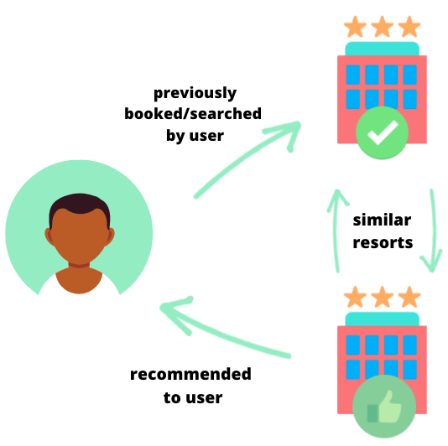
Notes:
Content-based filtering

Slide 71
MODELING
CONSIDERATIONS
Notes:
Gathering slide

Slide 72
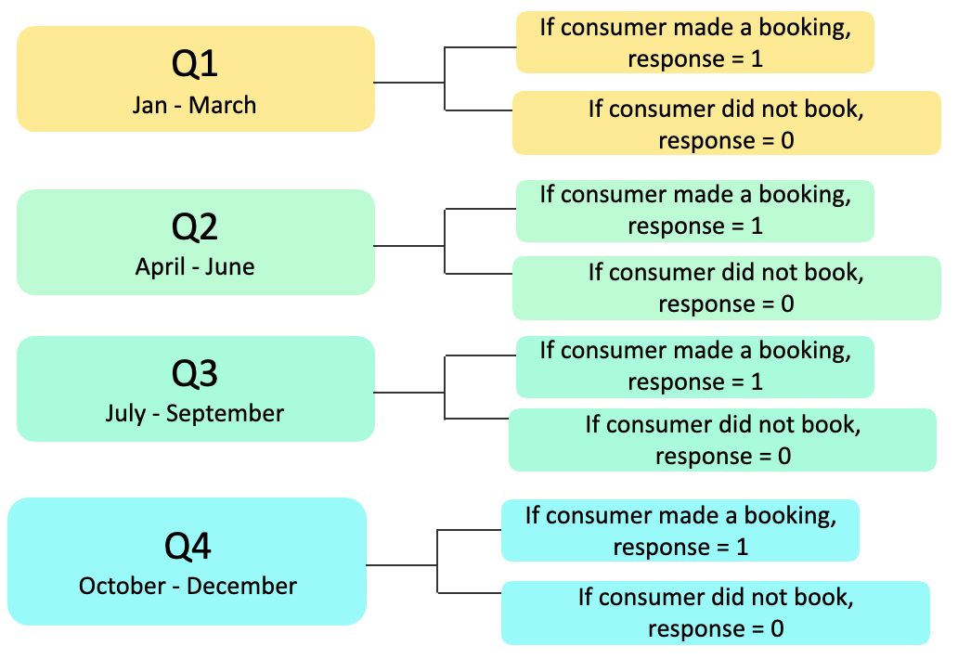
MODEL CONSIDERATIONS
1
Separating data based on season booking date.

Slide 73
MODEL CONSIDERATIONS
1
Separating data based on season booking date.
2
Important variables and their interactions

Slide 74

The Propensity to Travel model will…
Notes:
Gathering slide

Slide 75


Identify who 7Across does not want to target.
Notes:
Gathering slide

Slide 76

Identify who 7Across needs to target.
Notes:
Gathering slide

Slide 77

Output from Propensity to Travel model
Resort
Availability
Customer
Searches
Bookings
Credit
Availability
Visited Resorts
Ownership
Cancellations
Top 10 User-Based Resorts
Notes:
Gathering slide

Slide 78
Output from Propensity to Travel model
Resort
Availability
Customer
Searches
Bookings
feeds into
Credit
Availability
Visited Resorts
Ownership
Cancellations
Top 10 User-Based Resorts
Notes:
Gathering slide

Slide 79
Output from Propensity to Travel model
Recommendation model
Resort
Availability
Customer
Searches
Bookings
feeds into
Credit
Availability
Visited Resorts
Ownership
Cancellations
Top 10 User-Based Resorts
Notes:
Gathering slide

Slide 80
Output from Propensity to Travel model
Recommendation model
Resort
Availability
Customer
Searches
Bookings
feeds into
Credit
Availability
Visited Resorts
Ownership
Cancellations
that outputs
Top 10 User-Based Resorts
Notes:
Gathering slide

Slide 81

Output from Propensity to Travel model
Recommendation model
Resort
Availability
Customer
Searches
Bookings
feeds into
Credit
Availability
Visited Resorts
Ownership
Cancellations
that outputs
Top 10 User-Based Resorts
Notes:
Gathering slide

Slide 82
MODELING
ASSESSMENT
Notes:
CV

Slide 83
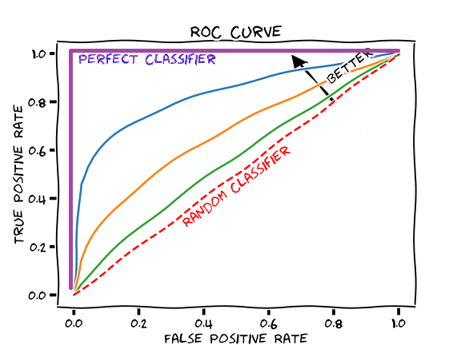
Accuracy is not the best metric to validate model, as the data response variable is highly skewed.
ROC is a better metric.
ROC: tells how much the model is capable of distinguishing between classes on a scale from 0-1 (1=perfect classifier).

Slide 84
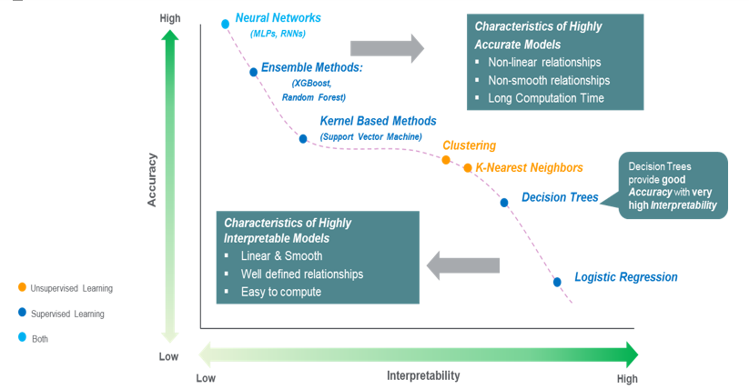
Notes:
Source: https://towardsdatascience.com/the-balance-accuracy-vs-interpretability-1b3861408062

Slide 85
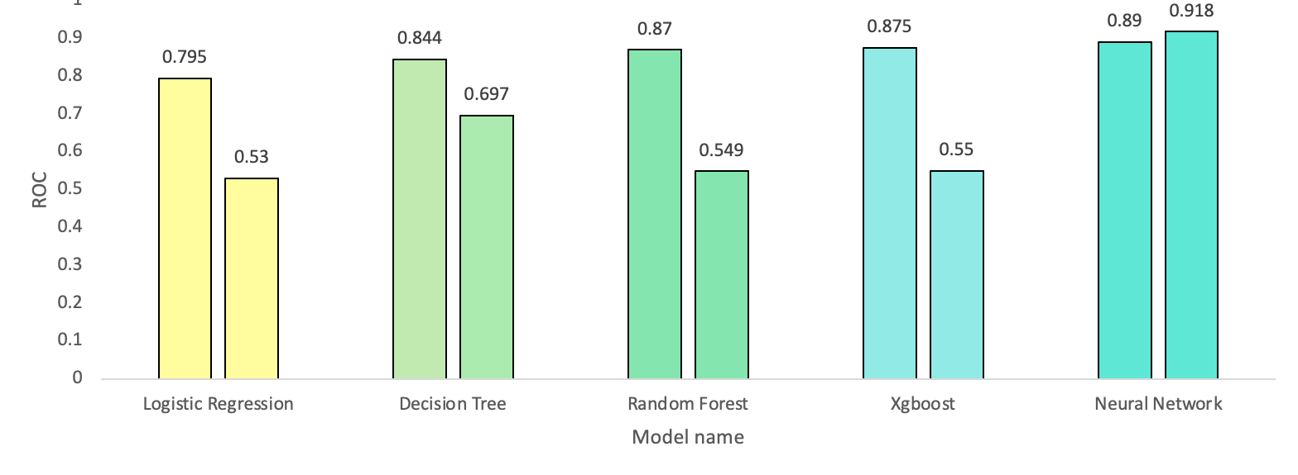
The Neural Network models performs the best.
Before
Before
Before
Before
Before
Notes:
Gathering slide

Slide 86
The Neural Network models performs the best.
Before
Before
Before
Before
Before
Notes:
Gathering slide

Slide 87
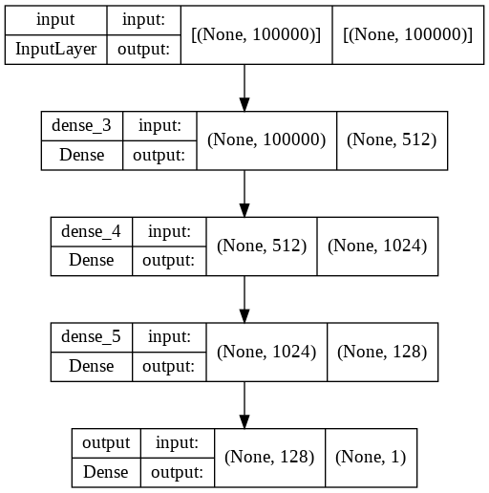
Model ROC : 0.89
Although it is a black box model (where the interpretability is low), the consistent and superior performance makes it the best model.
Architecture of Neural Network model:

Slide 88
Content-based filtering was used to build the recommendation model.
Bookings
Searches
Requests
2 Most Preferred Resorts
Top 5 Similar resorts for the best preferred resort
Recommendations for the member
Top 5 Similar resorts for the 2nd best preferred resort

Slide 89
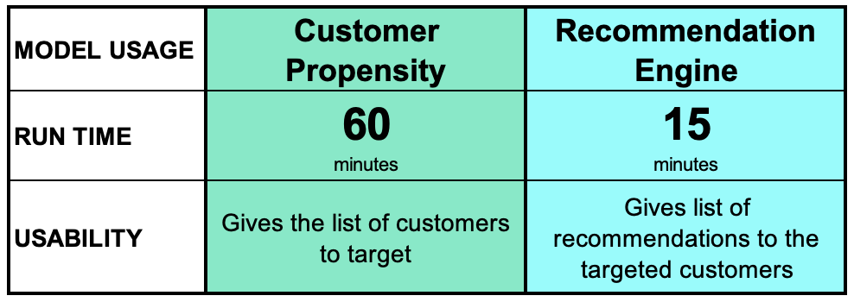
7Across’ Applied Business Performance:
Notes:
Business-applied performance: 60 minutes to run

Slide 90
TYING IT ALL TOGETHER.
Notes:
PRANAV

Slide 91
ANALYTICAL APPROACH
1
Build a propensity to travel model to accurately predict members who will travel in the next season.
2
Build a recommendation engine on inputted variables to recommend resorts available based on search history.

Slide 92
ANALYTICAL APPROACH
1
Build a propensity to travel model to accurately predict members who will travel in the next season.
2
Build a recommendation engine on inputted variables to recommend resorts available based on search history.

Slide 93
ANALYTICAL APPROACH
1
Build a propensity to travel model to accurately predict members who will travel in the next season.
2
Build a recommendation engine on inputted variables to recommend resorts available based on search history.

Slide 94
Thank You!

