Slide 1

DATABASE CREATION AND MAINTAINANCE
PRESENTING BY :
B.KIRAN KUMAR
210101120121
GUIDED BY :
Mrs. ALIVA PANDA

Slide 2
TOPIC : DATA DEFINITION IN SQL, TABLE, KEY AND FOREIGN KEYS
CONTENTS :
Data definition in SQL Data definition commands in DBMS
SQL Table
Operations in Table
Keys
Types of keys
Foreign key

Slide 3
Data Definition in SQL :
Data :
Data is a raw material or static value or fact.
It is the creation, modification and removal of definitions that define the organization of data in a database.
Ex: Country name is INDIA that is a data.
Database :
Database is a simple collection of interrelated data.
Database store all data and useful information.
Ex: you have excel sheet about list of all country with their code it’s the simple type of database. Excel is one type of database but it is not effectiveness because searching is complicated.
DBMS : DBMS is a management system that provides you permit to manage all your data and database.

Slide 4
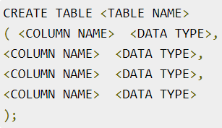
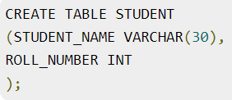
Data Definition Commands in DBMS
Data definition commands are used to create, modify and remove database objects such as schemas, tables, views, indexes etc.
Common Data Definition commands −
1. Create :
The main use of create command is to create a new table in database. It has a predefined syntax in which we specify the columns and their respective data types.
Example
Create a student table with columns student name and roll number.
syntax

Slide 5
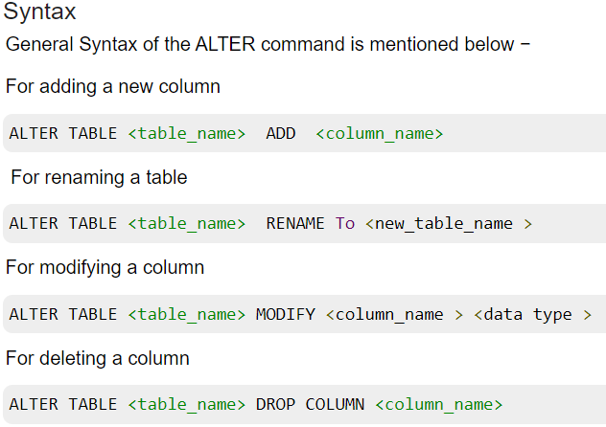
2. Alter :
An existing database object can be modified using the alter command. Alter command can do following changes to any table-
Add new columns.
Add new integrity constraints.
Modify existing columns.
Drop integrity constraints.
3. Rename :
The rename command renames an object
Syntax
Rename <old name> to <new name>

Slide 6

4. Drop :
This command can delete an index, table or view. Basically, any component from a relational database management system can be removed using the Drop command. Once the object is dropped, it cannot be re used. The general syntax of drop command is as follows −
Syntax :
5. Truncate :
Using the truncate command, all the records in a database are deleted, but the database structure is maintained.
syntax
TRUNCATE TABLE <table name>
6. Comment :
This command is used to add comments to the data dictionary.
syntax
Single line comments: use ‘ --‘ before any text.
Multiline comments: /* comments in between */

Slide 7
SQL Table
SQL Table is a collection of data which is organized in terms of rows and columns. In DBMS, the table is known as relation and row as a tuple.
Table is a simple form of data storage. A table is also considered as a convenient representation of relations.
Operation on Table
Create table
Drop table
Delete table
Rename table
1.SQL Create Table :
SQL create table is used to create a table in the database. To define the table, you should define the name of the table and also define its columns and column's data type.

Slide 8
2. Drop table :
A SQL drop table is used to delete a table definition and all the data from a table. When this command is executed, all the information available in the table is lost forever, so you have to very careful while using this command.
3. SQL DELETE table :
In SQL, DELETE statement is used to delete rows from a table. We can use WHERE condition to delete a specific row from a table. If you want to delete all the records from the table, then you don't need to use the WHERE clause.
4. SQL RENAME TABLE :
In some situations, database administrators and users want to change the name of the table in the SQL database because they want to give a more relevant name to the table.
Any database user can easily change the name by using the RENAME TABLE and ALTER TABLE statement in Structured Query Language.
The RENAME TABLE and ALTER TABLE syntax help in changing the name of the table.

Slide 9
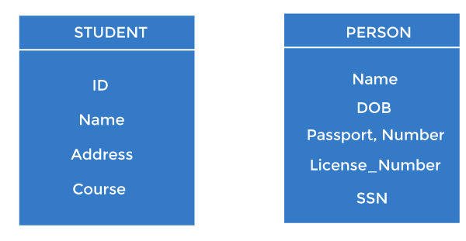
Keys :
Keys play an important role in the relational database.
It is used to uniquely identify any record or row of data from the table. It is also used to establish and identify relationships between tables.
For example, ID is used as a key in the Student table because it is unique for each student. In the PERSON table, passport_number, license_number, SSN are keys since they are unique for each person.

Slide 10
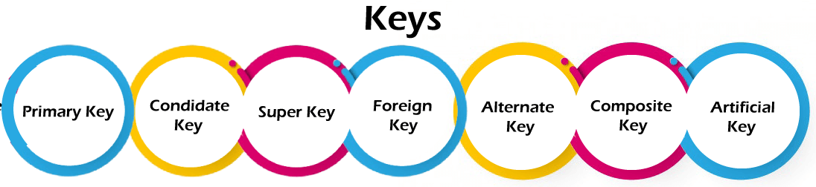
Types of keys:

Slide 11
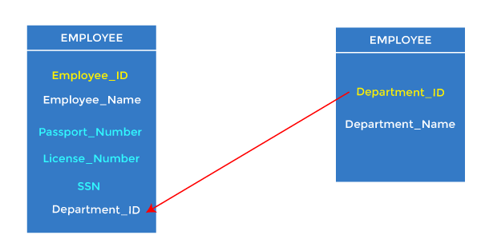
Foreign key :
Foreign keys are the column of the table used to point to the primary key of another table.
Every employee works in a specific department in a company, and employee and department are two different entities. So we can't store the department's information in the employee table. That's why we link these two tables through the primary key of one table.
We add the primary key of the DEPARTMENT table, Department_Id, as a new attribute in the EMPLOYEE table.
In the EMPLOYEE table, Department_Id is the foreign key, and both the tables are related.

Slide 12


