Slide 1
Motion Planning and Control of an Autonomous Car for Pedestrian Avoidance
ME47035 Robot Motion Planning and control (Final Project)
Group 13
Nikhil H N 5049628
Shantanu S 5032814
Varun K 4980611
Weiming C 5015006

Slide 2
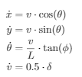
Description of the Model
Model Parameters and assumtions
3 DOF kinematic bicycle model with lateral Dynamics.
No Ackerman steering.
Limited steering and Throttle Input possible.
States of the Model
Global X position of the car
Global Y position of the car
Orientation θ of the car
Throttle delta of the car
The Non linear equation for motion are

Slide 3
Description of the Model
Motion Planning
A Model Predictive Control is used for path planning.
The constraints of the motion are included in the design.
The steering angle is constrained between –0.5 and 0.5 rad.
The throttle input is constrained between –1 and +1 (full acc/full braking).
The path planning is done online as the environment is dynamics with moving pedestrian.
Predicted horizon of 10 steps.

Slide 4
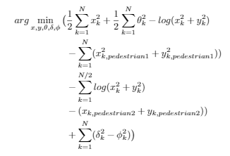
Model and planning
Motion Planning
The cost function is defined as
It consist of the following factors
Positive for deviation from the lane
Positive for deviation from the straight position
Negative for distance between car and pedestrian.

Slide 5
Model and planning
Planned Scenario and Obstacle
A straight 40 m wide road.
The car should reach the goal with the desired heading
2 Pedestrians cross the road at different locations with the speed of 2 km/h.
If there are no pedestrians the car drives in the center of the road.

Slide 6
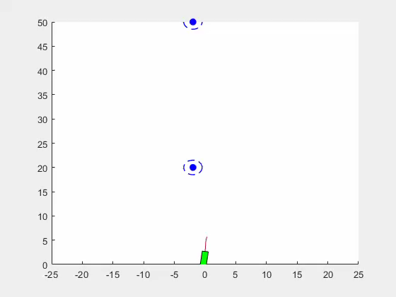
Results

Slide 7
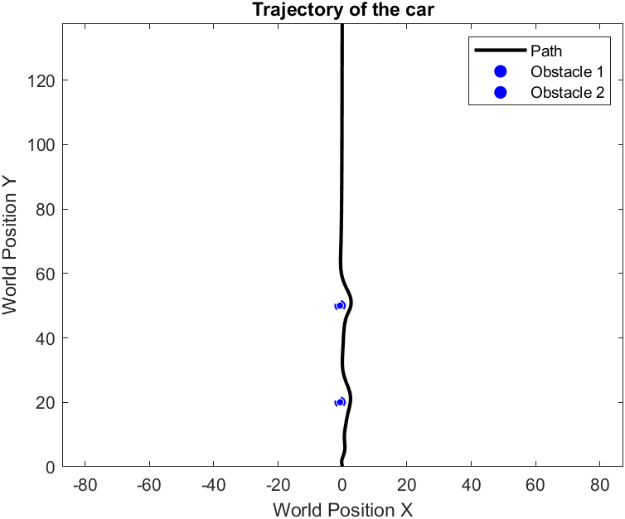
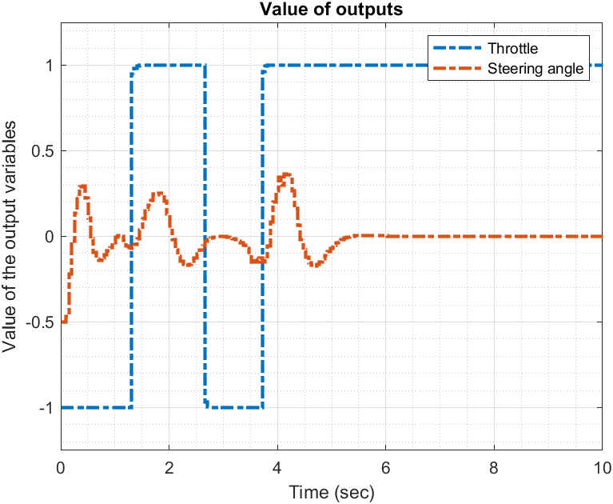
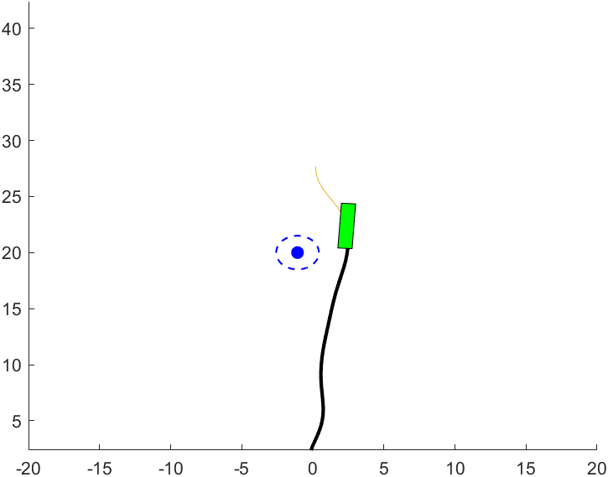
Car Avoiding the obstacle

Slide 8
Further Discussions
Implementation
The Implementation of the MPC application is solving it in real time.
We can use simple linear model with a linear solver or a bicycle model with a non linear solver to get the solution in real time depending on the computing power
A path planning for obstacle avoidance by a simple car model with 2 inputs and 3 DOF is achieved.

Slide 9
Further Discussions
Limitation
The Bicycle model has lot of assumtion regarding the dynamics of the car and therefore can only be implimented with a high safety factor for the path chosen.
Planar model of the car will increase the complication of the problem but will give more accurate prediction regarding the path of the car.

Slide 10
Further Discussions
Possible Improvements
Complication of model, including the model of the steering, suspension and the tire dynamics to icrease the fedality of the model.
Some comfort features like limit to the rate of steering and the rate of acceleration to avoid the jerky ride.
More kind of small path planning manuvers such as Parking, Lane merging or overtaking can be included.

