Slide 1
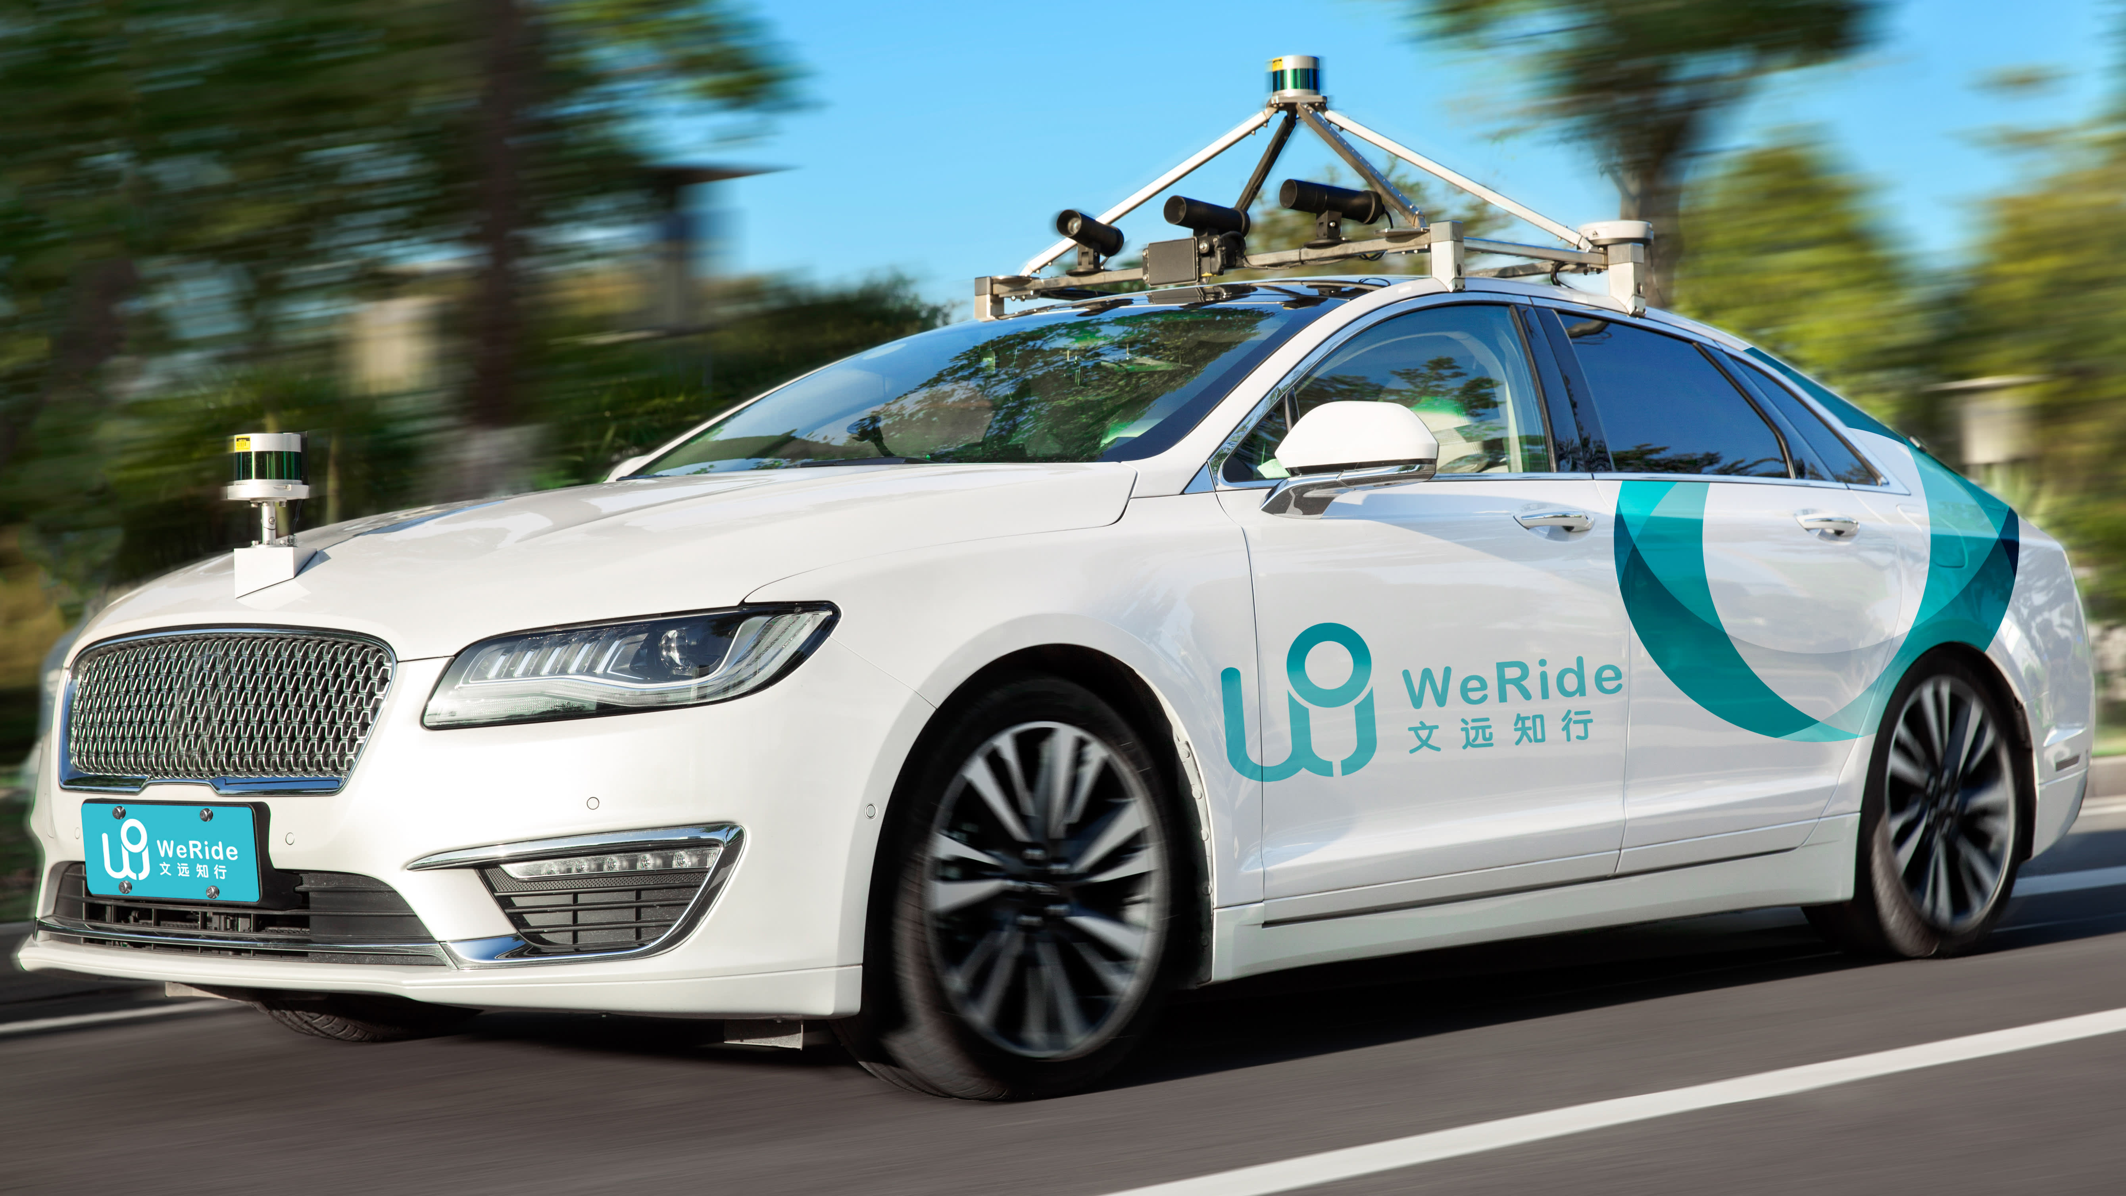
Motion Planning and Control of an Autonomous Car for Pedestrian Avoidance using MPC
ME47035
Robot Motion Planning and Control
Final Project 2020-2021
Group 13
Nikhil H N 5049628
Shantanu S 5032814
Varun K 4980611
Weiming C 5015006
Image Source

Slide 2
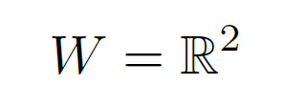
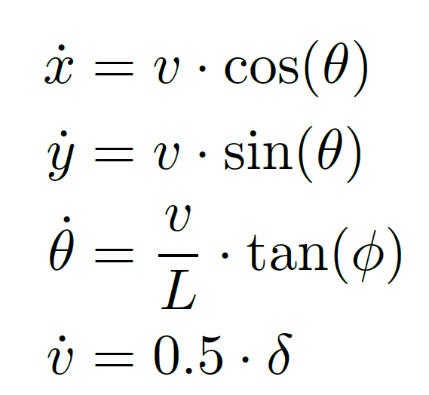
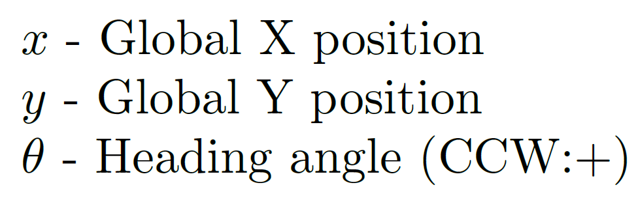
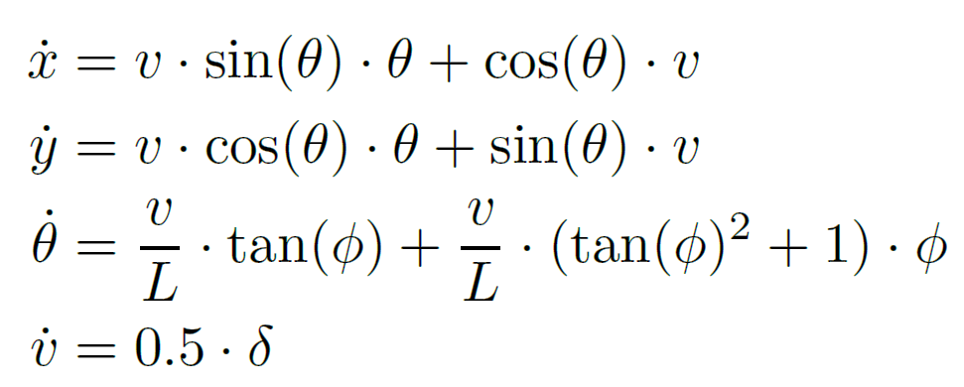

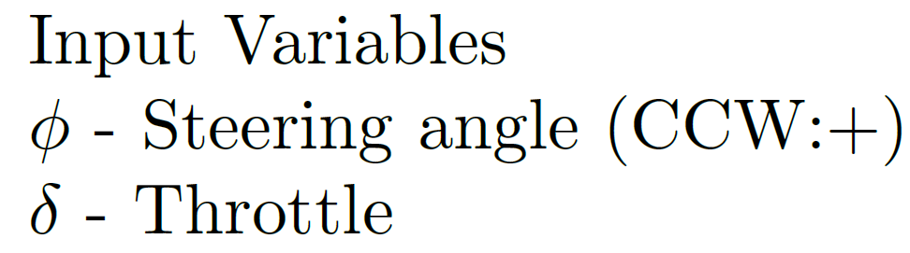
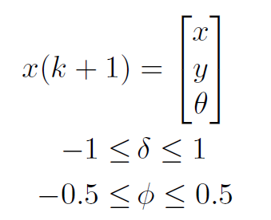
Project Description and Planner
Description
Challenge: Path planning and obstacle avoidance of a car.
“Model Predictive Control (MPC)”
Car – Classical Bicycle Model (3DOF).
Workspace:
Configuration Space:
Moves on the center lane – maintain trajectory.
Two moving pedestrians – avoid obstacles.
After obstacle avoidance, the car returns to original trajectory – zero error.
Model Predictive Control Algorithm with constraints and a cost function. Prediction Horizon: 10 steps.
Non-linear equations for motion | Analytical Jacobian equations for motion prediction
Here, v represents the velocity of the car and L represents the car length.
Planner
Cost Function:
Positive for deviation from lane
and straight position
Weighted errors between car position and pedestrian position
Throttle Error
Steering Error
State Constraints
Given Constraints:
Throttle Constraint
Steering Constraint

Slide 3
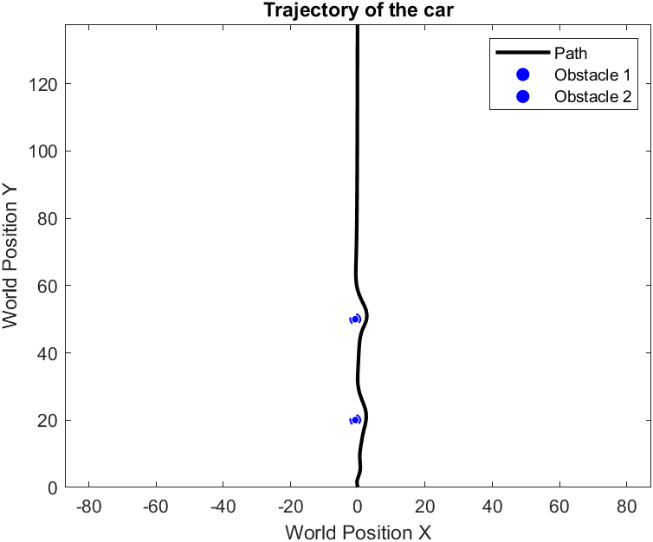
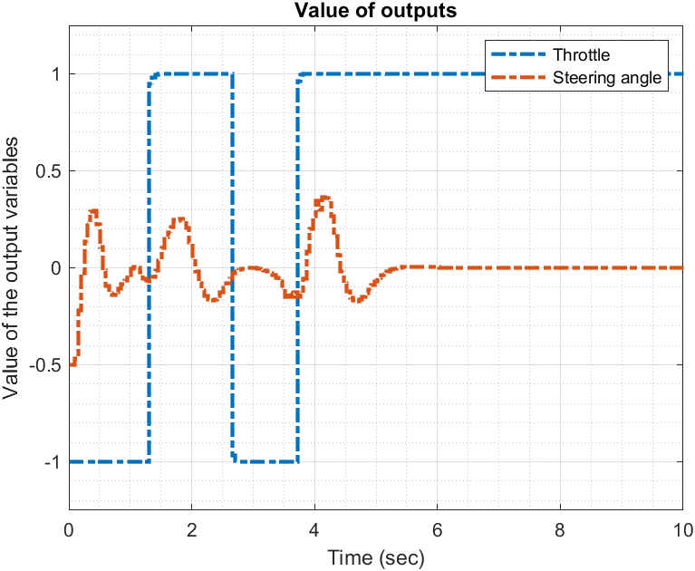
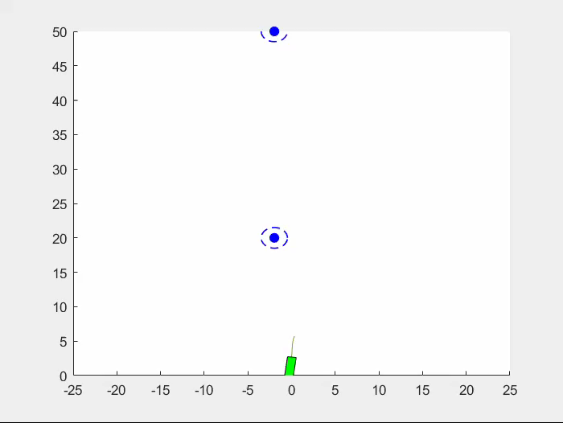
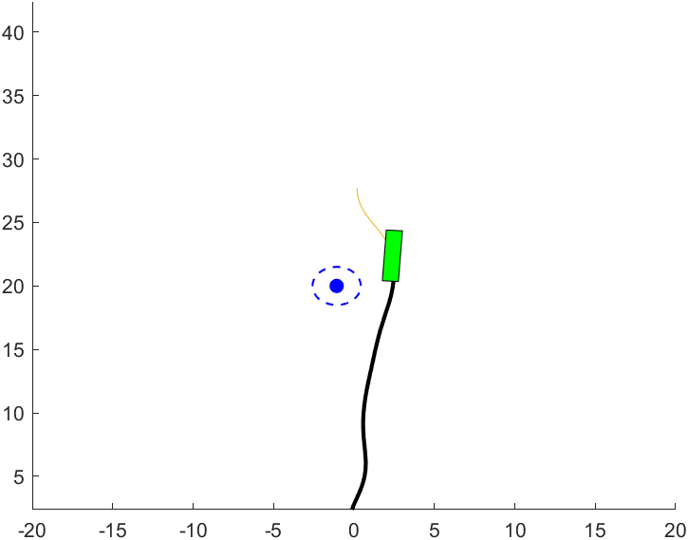
Results
Straight 40m road
Car avoids pedestrian
Pedestrian speed: 2 km/h

Slide 4
Discussion
MPC - locally optimal solution for the given cost function and constraints if the problem is convex.
Implementation of the MPC application - online. Solution is complete as goal is reached.
A path planning with obstacle avoidance by a simple car model with 2 inputs and 3 DOF is achieved.
The Bicycle model is simple and has lot of assumptions regarding the dynamics of the car and therefore can only be implemented with a high safety factor for the path chosen.
Car heading not accurately simulated. Planar model of the car to accurately simulate car heading.
Complex model can be considered, by modeling steering, suspension and tire dynamics to increase the feudality.
Some additional constraints - limit rate of steering, rate of acceleration to avoid jerky ride.
Usage of RRT/RRT* for path planning and MPC for obstacle avoidance – MPC is local.
Additionally, small path planning maneuvers such as parking, lane merging or overtaking can also be included.
Implementation:
Limitations:
Recommendation:

