Slide 1

Group presentation for CS5331 Final Project
Harry
Zaman

Slide 2
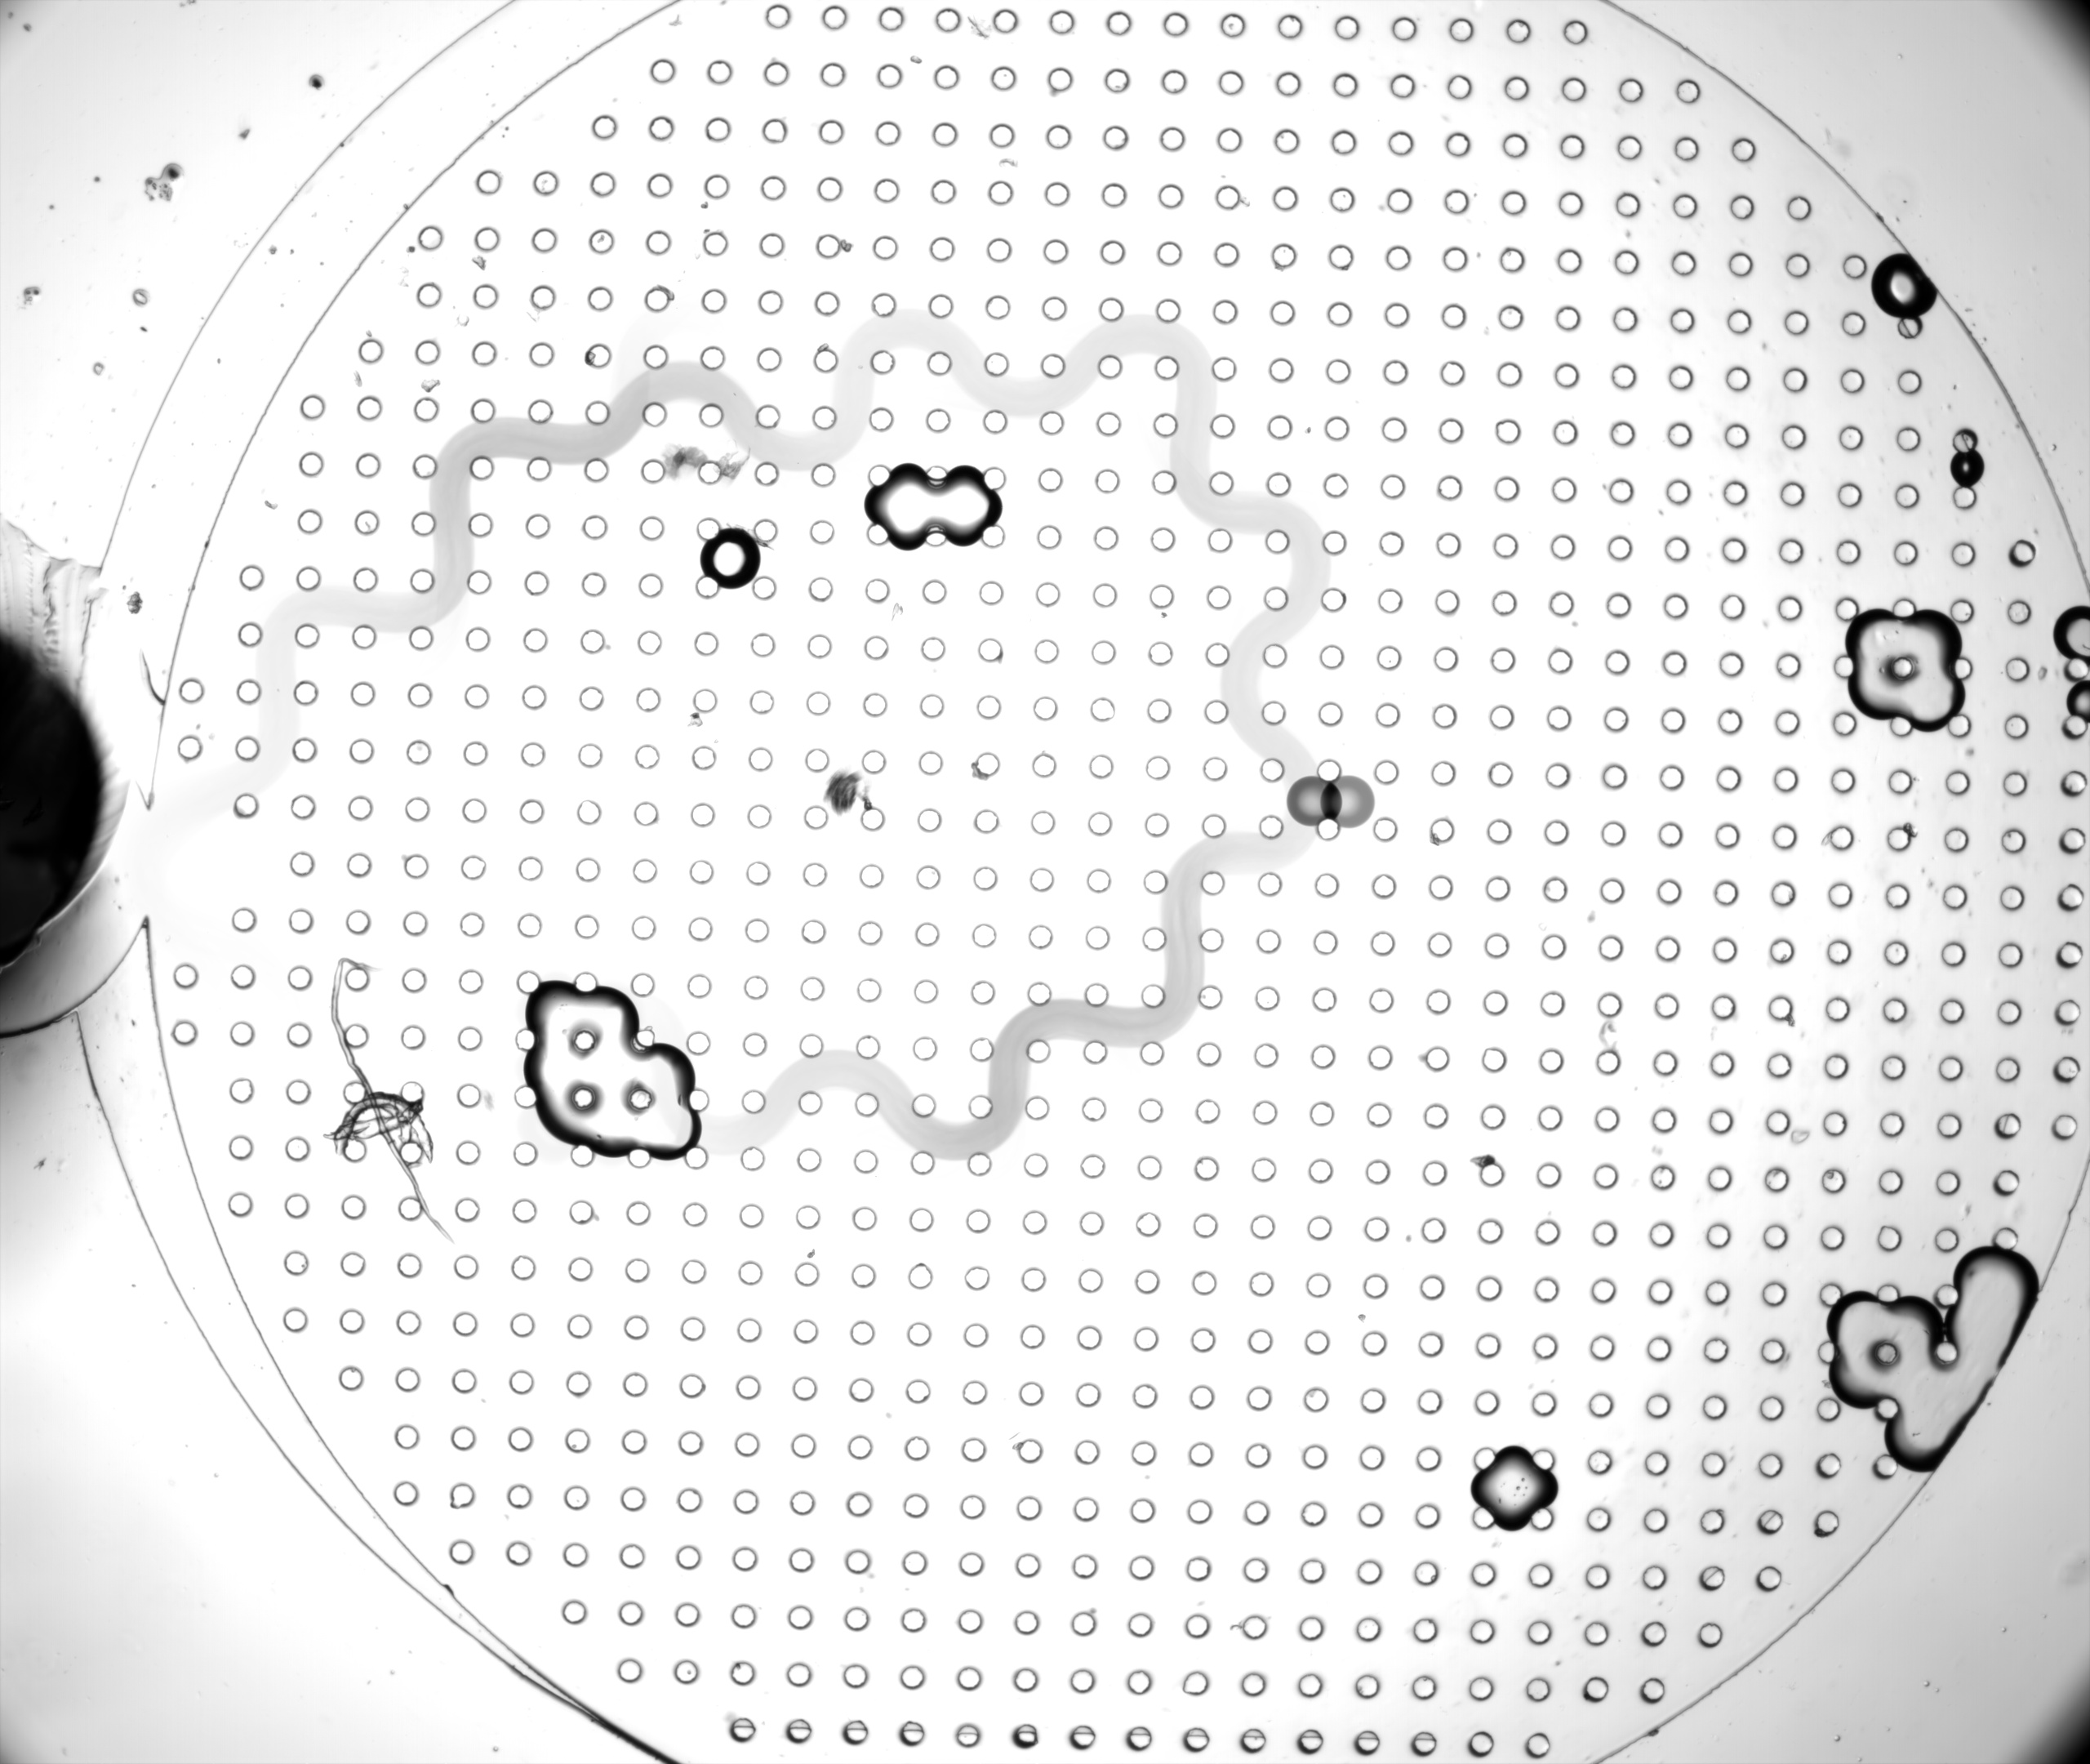
Mean image
Taking the mean of the frames in the video.

Slide 3
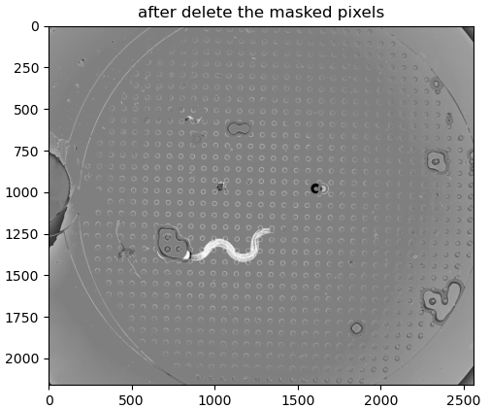
subtracted image
blurred background is subtracted from actual image

Slide 4
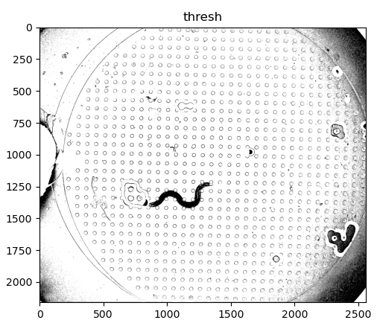
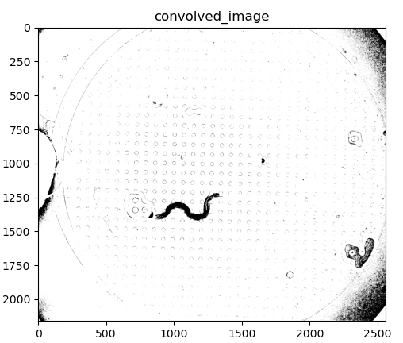
Separate the background
OTSU
2x2 averaging kernel

Slide 5
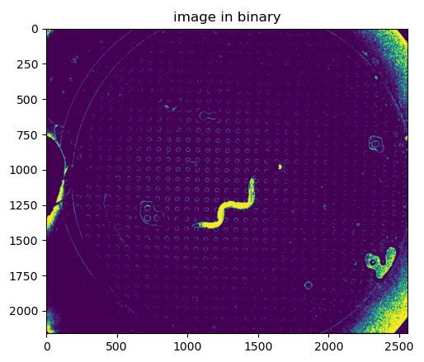
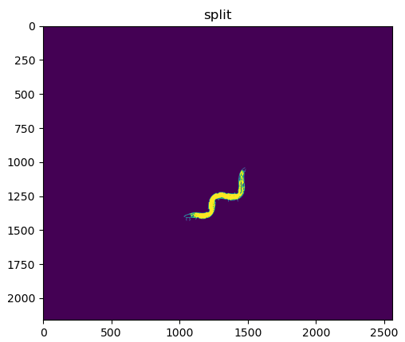
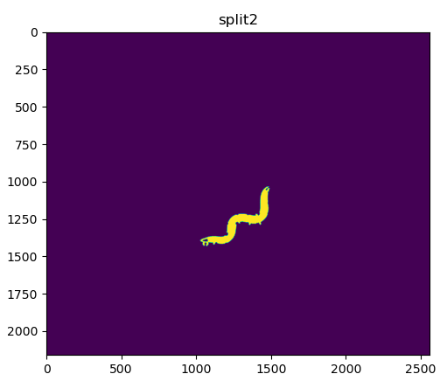
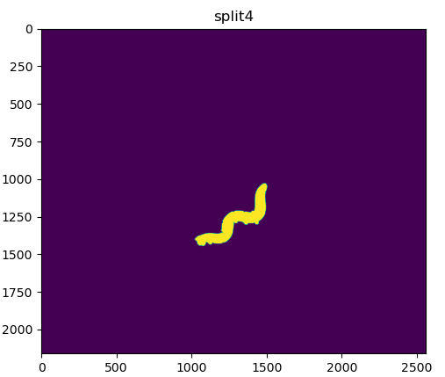
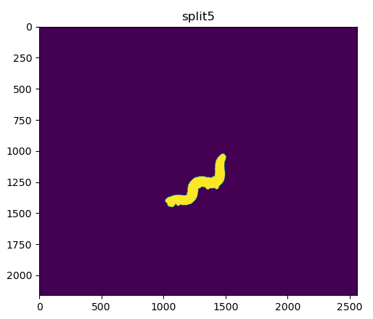
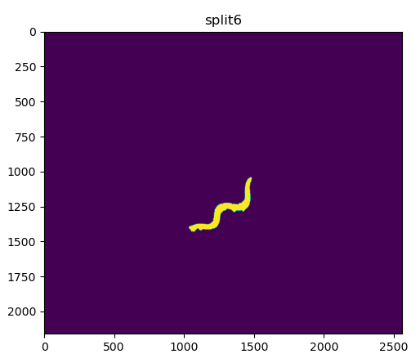
Closing and opening
Starting from a point on the worm we start closing then opening
Growing➔
thinning➔

Slide 6
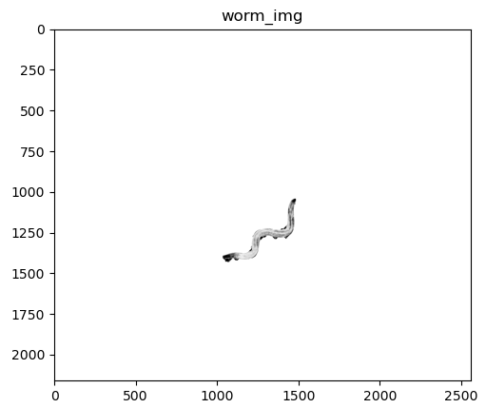
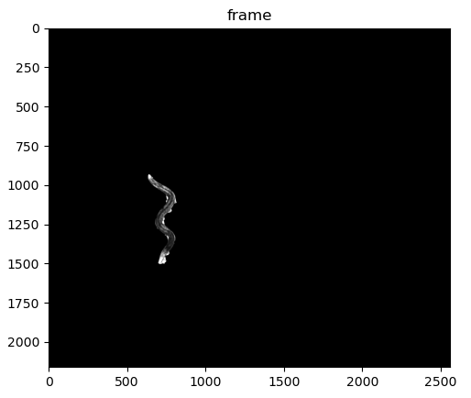
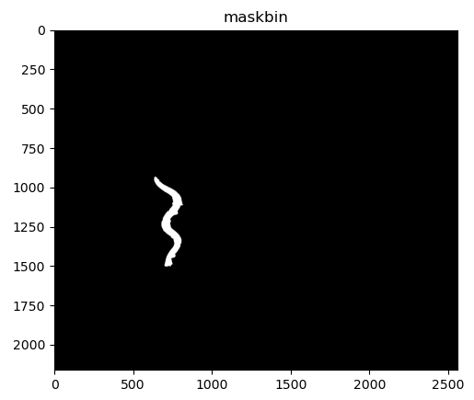
Binarized worm
After rotation from the head to tail angle, we take the binarized worm

Slide 7

Centerline detection and straight position estimation
X | Y | Estimated X
0 | 10 | 0
1 | 12 | 3
2 | 15 | 6
3 | 10 | 8

Slide 8
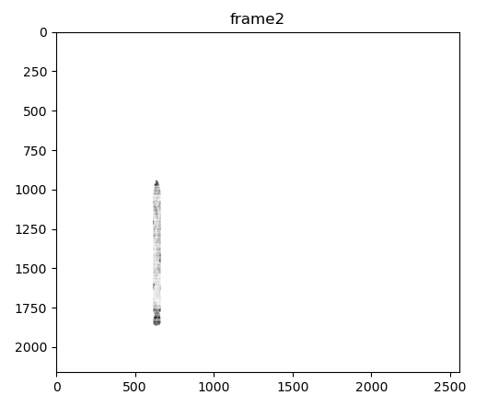
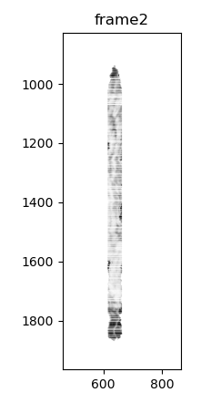
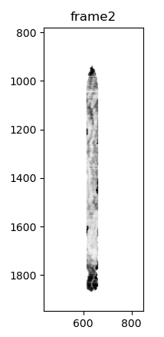
Finally

Slide 9
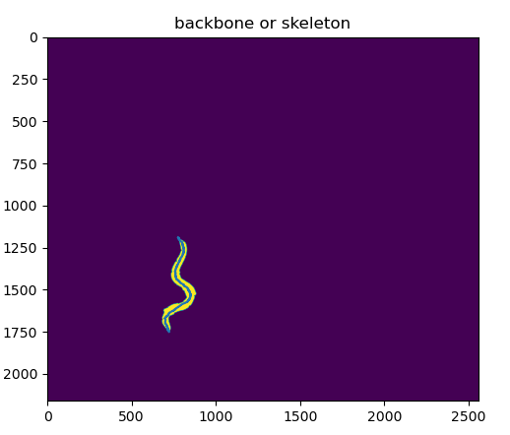
Additional slide added after presentation
Skeleton is plotted here

